Slide 1

Project Data Analysis
Hossam
Magda
Naeila

Slide 2

CLEAN Data with paython
CLEAN Data with EXCEL
dash Board for Data
the final project

Slide 3
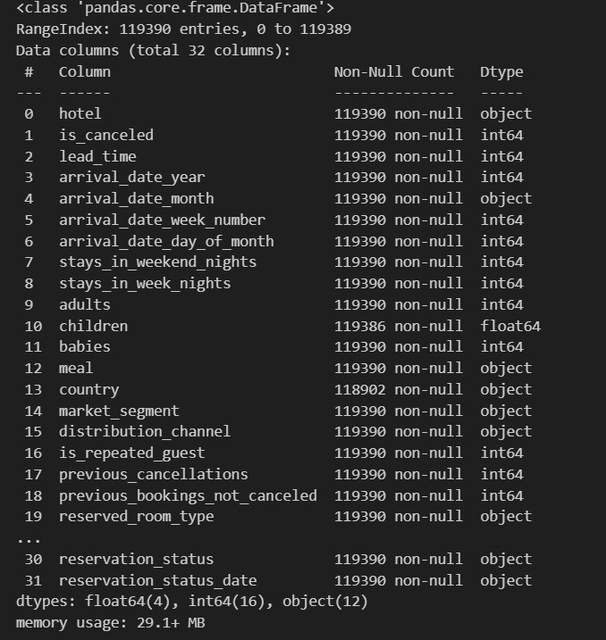
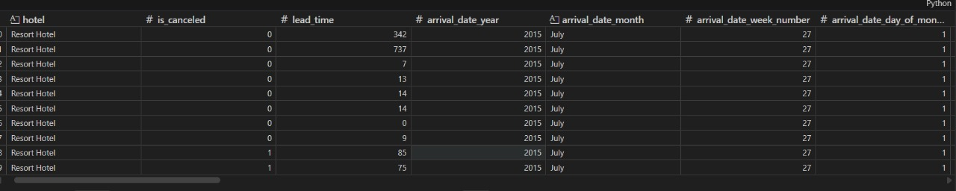
Step 1: Initial data exploration

Slide 4
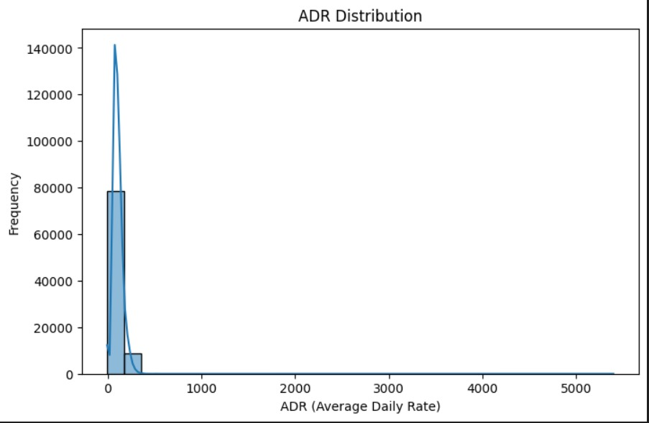
Step 2 Descriptive statistics analysis

Slide 5
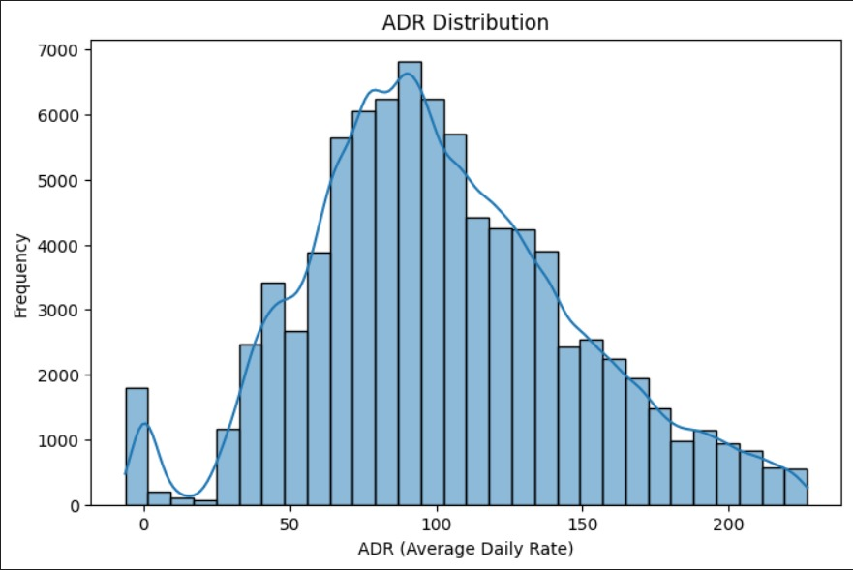
Step 3 Data cleaning Steps

Slide 6
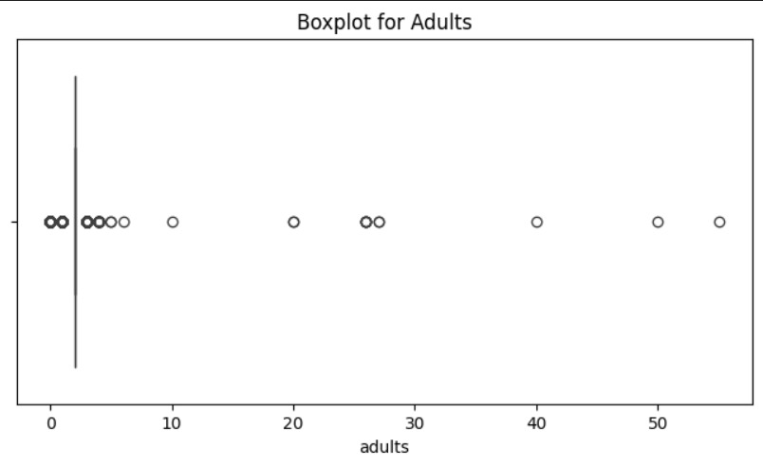
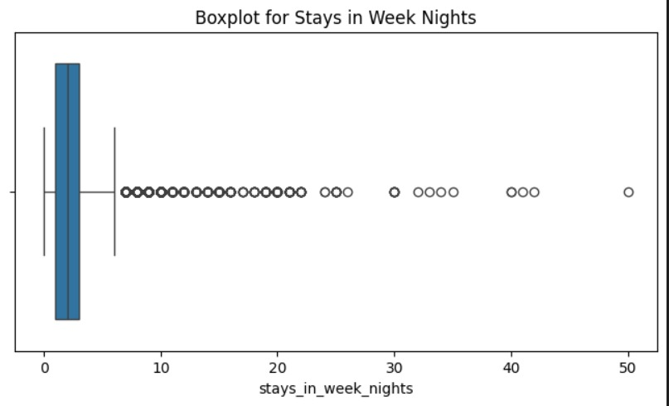
Step 4 data visualisation and outlier

Slide 7
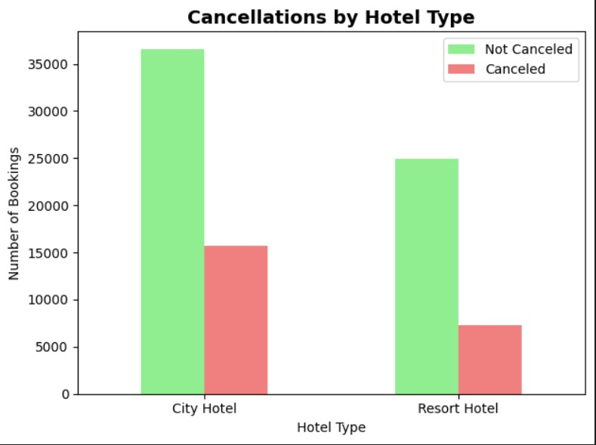
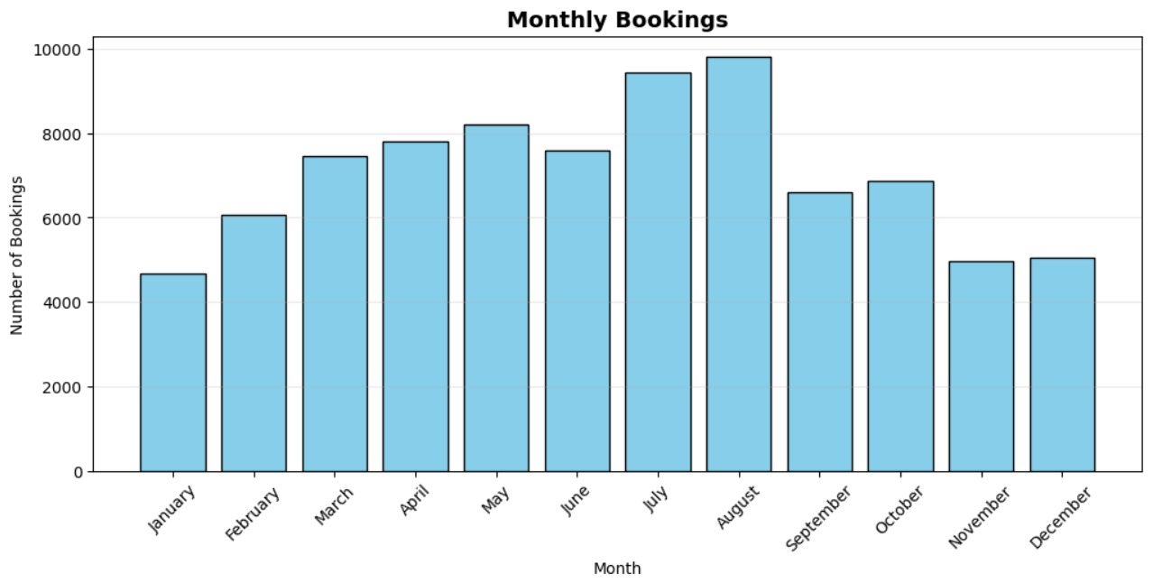
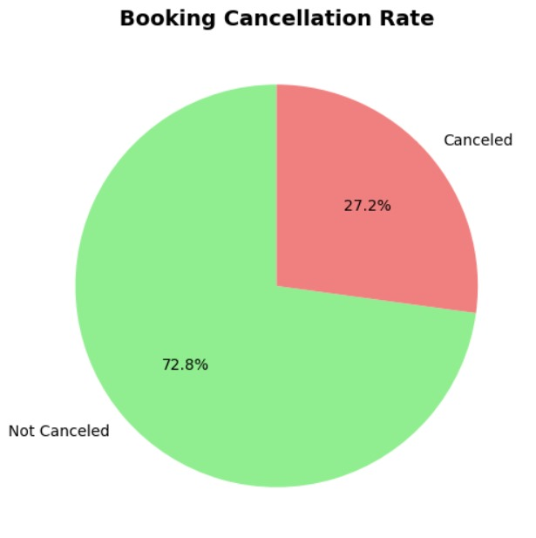
Step 5 overall metric calculation

Slide 8
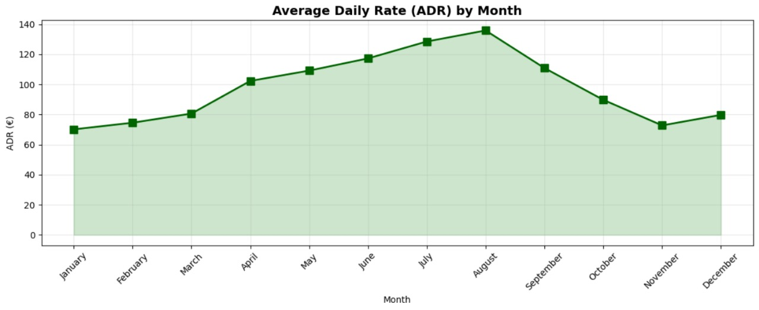
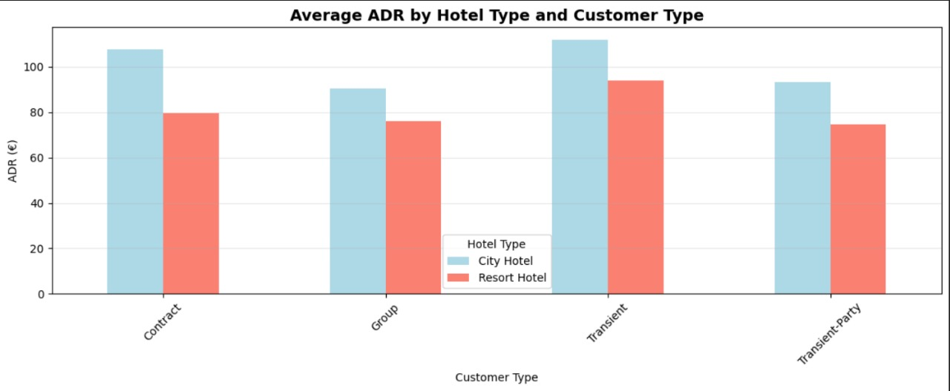
Overall metric calculation

Slide 9
CLEAN data with EXCEL step 1 data cleaning and preparation step 2 data inspection step 3 handling missing values
Step 4 Removing duplication

Slide 10
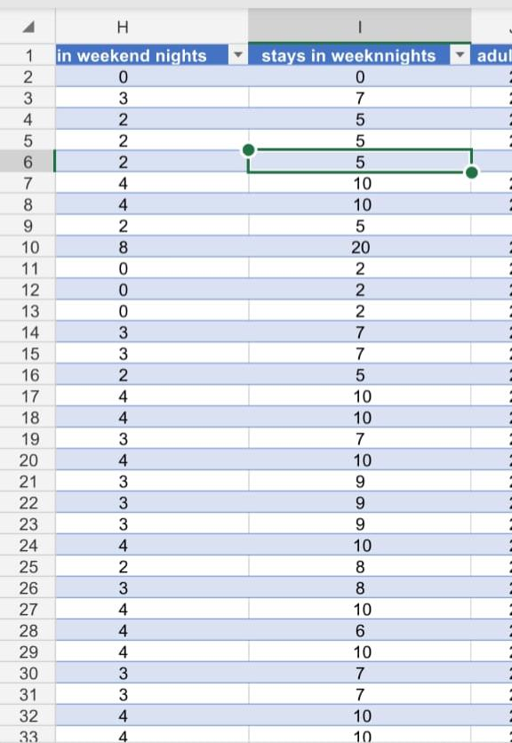
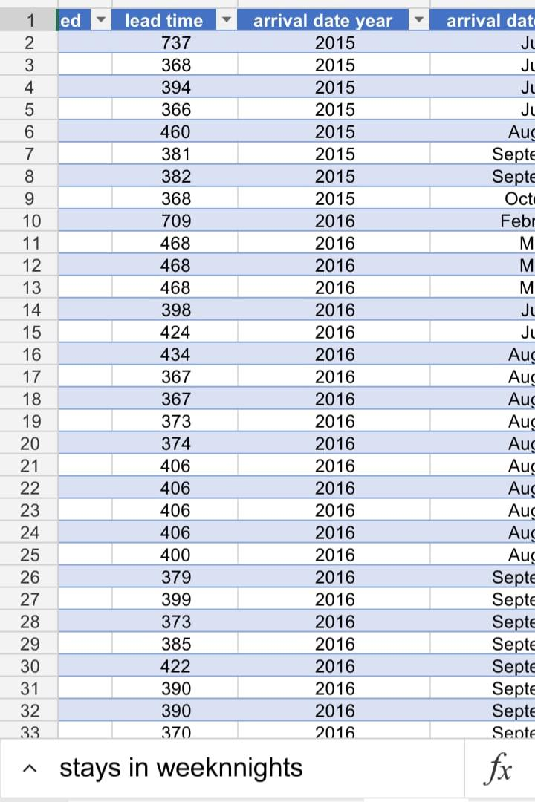

Slide 11
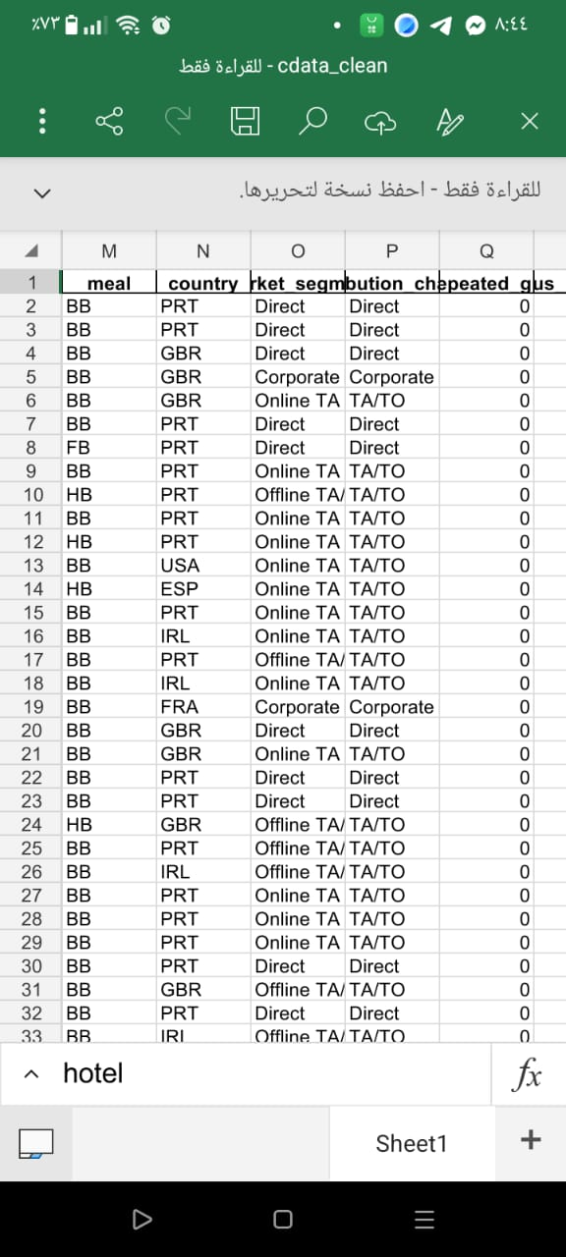
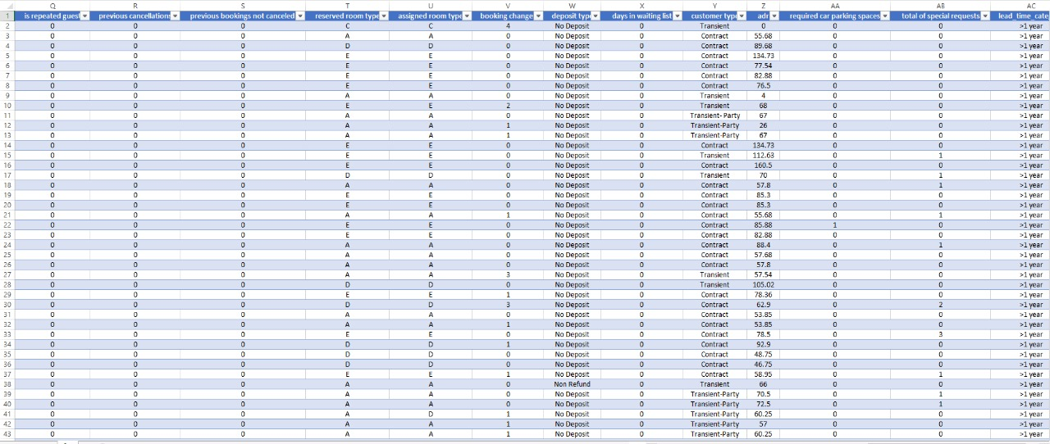
Data Before and after CLEAN

Slide 12
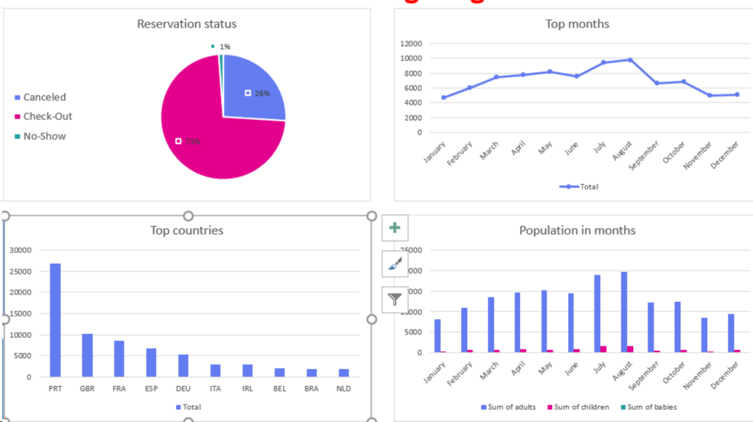

Slide 13
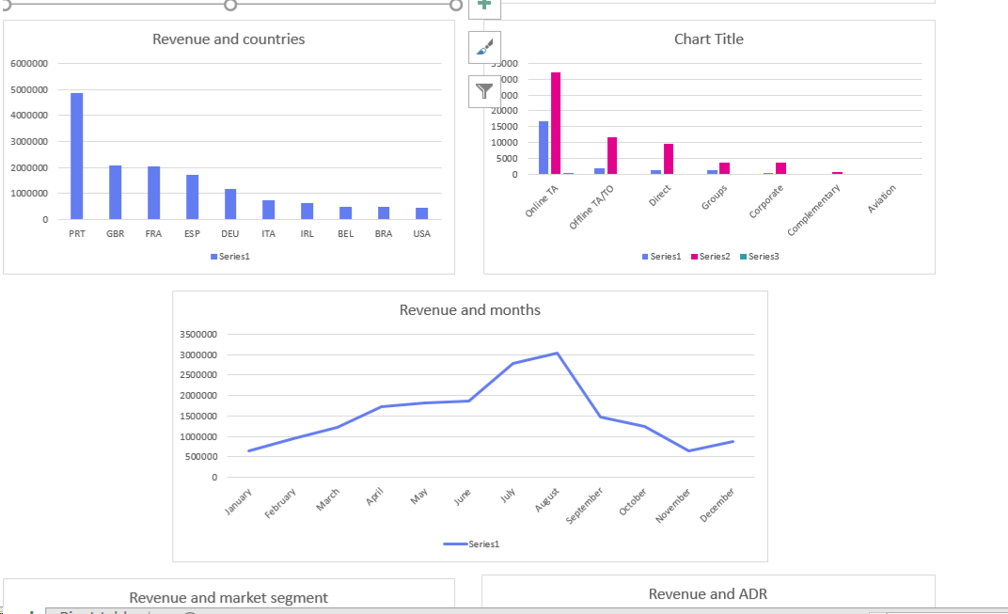
Dash Board for Data

Slide 14
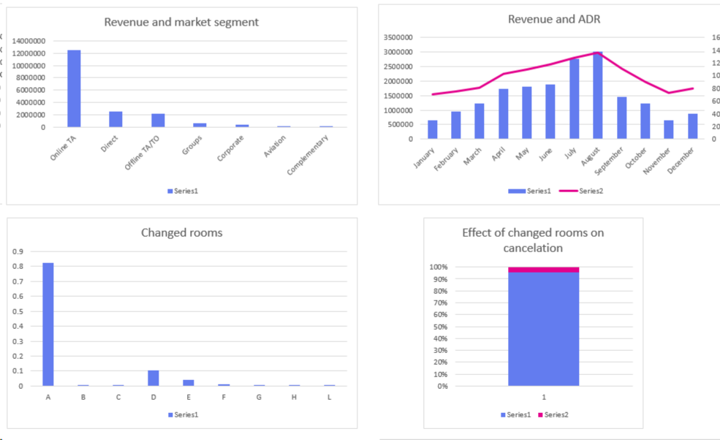

Slide 15
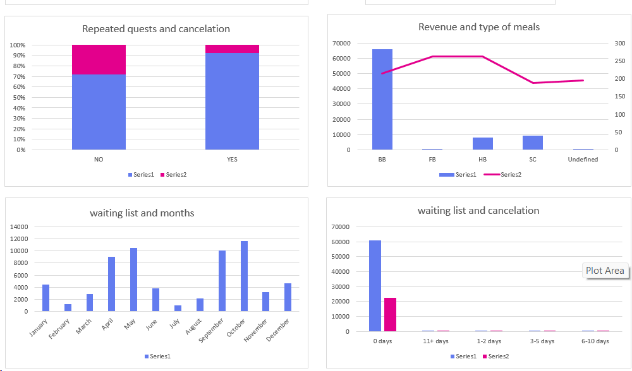

Slide 16
1. Hotel Type · Share: City Hotel accounts for ~66% of bookings, Resort Hotel ~34%. · Insight: City Hotels are more popular for short-term stays
.2. Arrival Month · Peak season: August and July. · Low season: Winter months. ·
Insight: Clear seasonality → Off-season promotions can boost occupancy.3. Meal Plan · Share: Bed & Breakfast (BB) represents ~77% of all meal plans. · Insight: Guests prefer basic meal options → Opportunity to upsell Half Board or Full Board packages.Would you like me to help with a deeper analysis, visualize this data (e.g., in a chart), or assist with anything else related to this
Insights from categorical
4. Market SegmentOnline TA: ~47%, Direct: ~20%.Insight:Heavy reliance on Online Travel Agents → Higher cancellation risk. Encourage direct bookings for better control and higher profit.
5. Distribution ChannelTA/TO is the dominant channel (~82%). Insight: Traditional travel agents dominate → Strengthening direct channels can increase profitability
.6. Deposit TypeNo Deposit: ~87% of bookings.Insight:No-deposit bookings have higher cancellation rates → Promote advance payments or partial deposits.
7. Customer TypeTransient guests: ~75%, Repeated guests: ~3%.Insight:Guest loyalty is very low. Loyalty programs are needed.2) Insights from Numerical Features8. Cancellation RateOverall cancellation rate: ~37%.Insight:High cancellation rate → Apply stricter policies or incentives for confirmed bookings.9. Lead TimeMedian: 69 days, Maximum: 737 days.Longer lead times are associated with higher cancellations.Insight: Offer flexible policies for long-lead bookings to reduce cancellations.

Slide 17
13. Previous Cancellations & Booking ChangesMost guests have no previous cancellations.Average booking changes:~0.22. Insight: Guests are generally stable. Only specific groups require cancellation-risk monitoring.14. Special RequestsMedian: 0, Max: 5. Insight: Most guests don't request extra services → Upselling amenities can increase revenue.15. Waiting List DaysMedian: 0, Max: 391 days.Insight:Waiting lists are rarely used → Focus more on optimizing room allocation.16. Repeated Guests
Insights from categorical

Slide 18

Thank you

