Slide 1
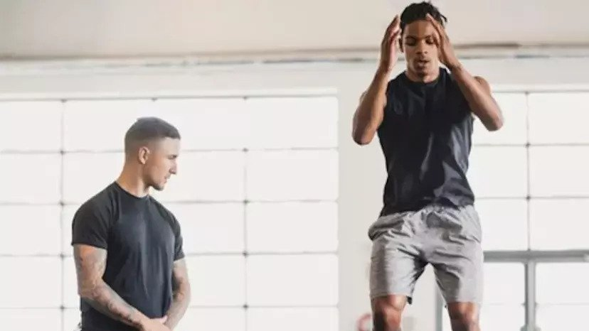

Online coaching Web app "Captainy "
Open Source Track Intake 42
24/7/2022

Slide 2
Team members
Sarah Abd Eldaym
Hossam Adel
Amira Emad
Shrouk Mamdoh
Team Leader : Sarah Abd Eldaym Team Supervisor : Eng. Noha Salah

Slide 3
Outline
Introduction
Why Captainy?
Tools & Technologies
System Architecture
Project Demo

Slide 4
Introduction
people get so busy in life that they forget to take care of their bodies, and finding a good professional coach for your specific fitness needs is a hassle.
Captainy is here to help you find your perfect coach in just few clicks
Reach your goal safely in a short time with a specialist coach

Slide 5
Why captainy
Everyone is different when it comes to fitness.
Captainy displays the best matches personal trainer in your area.
Captainy is the most convenient way to connect with a local personal trainer. Whether client is looking to simply get healthier or get into a specific fitness activity.

Slide 6
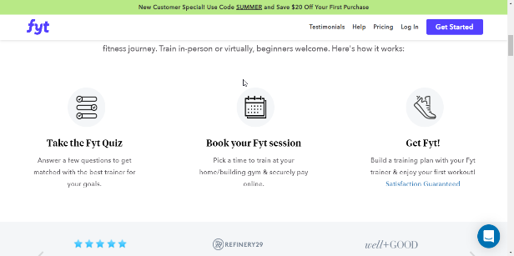
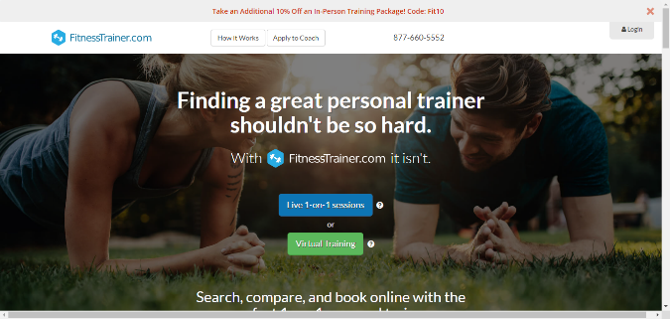
competitors
The idea has not yet been implemented in Egypt
But it is implemented outside Egypt in different forms Like:

Slide 7


Customer Analysis
Coaches
Trainees

Slide 8

Tools & technology
PHP Laravel
ReactJS
Bootstrap
MySQL
HTML
CSS
GitHub
VS Code
PhpMyAdmin

Slide 9
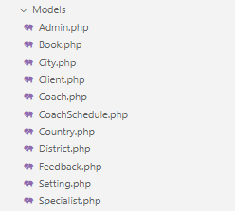
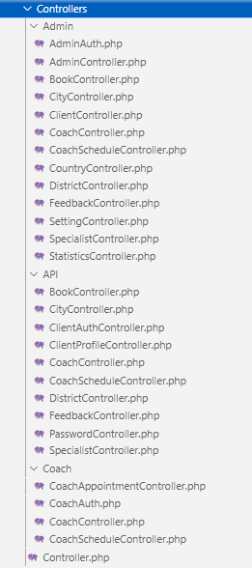
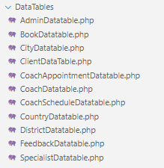
System architecture
Model
Controller
Views

Slide 10
demo

Slide 11
Thank you

