Slide 1
CS305
System Modeling and Simulation
Prof. Dr. Khaled Mahar
khmahar@aast.edu
Lecture 12

Slide 2
Chapter 6 Queueing Models
Banks, Carson, Nelson & Nicol
Discrete-Event System Simulation

Slide 3
Purpose
Queueing models provide the analyst with a powerful tool for designing and evaluating the performance of queueing systems.
To study and analyze the performance of queueing models:
For relatively simple systems, solve the model mathematically.
For realistic models of complex systems, simulation is usually required.
Typical measures of system performance:
Server utilization, length of waiting lines, and delays of customers

Slide 4
Outline
The Queuing Model and Definitions
Application of Queuing Theory
Queuing System Notation
Little’s Law (conservation Equation)
Stationary Analysis of M/M/1 Queueing System

Slide 5
The Queuing Model
Queuing System
Queue
Server
Use Queuing models to
Describe the behavior of queuing systems
Evaluate system performance
A Queue System is characterized by
Queue (Buffer): with a finite or infinite size
Server: with a given processing speed
Events: Arrival (birth) or Departure (death) with given rates

Slide 6
Queuing theory definitions
(Bose) “the basic phenomenon of queueing arises whenever a shared facility needs to be accessed for service by a large number of jobs or customers.”
(Wolff) “The primary tool for studying these problems [of congestions] is known as queueing theory.”
(Kleinrock) “We study the phenomena of standing, waiting, and serving, and we call this study Queueing Theory." "Any system in which arrivals place demands upon a finite capacity resource may be termed a queueing system.”
(Mathworld) “The study of the waiting times, lengths, and other properties of queues.”
http://www2.uwindsor.ca/~hlynka/queue.html

Slide 7
Characteristics of queuing systems
Arrival Process
The distribution that determines how the tasks arrives in the system.
Service Process
The distribution that determines the task processing time
Number of Servers
Total number of servers available to process the tasks

Slide 8
Kendall Notation A/B/m(/K/N/X)
To specify a queue, we use the Kendall Notation.
The First three parameters are typically used, unless specified
A: Arrival Distribution
B: Service Distribution
m: Number of servers
K: System Capacity (infinite if not specified)
N: Population Size (infinite if not specified)
X: Service Discipline (FCFS/FIFO)

Slide 9
Kendall Notation of Queueing System
Arrival Process
M: Markovian
D: Deterministic
Er: Erlang
G: General
Service Process
M: Markovian
D: Deterministic
Er: Erlang
G: General
A/B/m/K/N/X
Number of servers m=1,2,…
Service Discipline
FIFO, LIFO, Round Robin, …
Storage Capacity
K= 1,2,…
(if ∞ then it is omitted)
Number of customers (population)
N= 1,2,…
M: stands for "Markovian", implying exponential distribution for service times or inter-arrival times.
Notes:
D: Deterministic (e.g. fixed constant)
G: General (anything)

Slide 10
Kendall Notation Examples
M/M/1 Queue
Poisson arrivals (exponential inter-arrival), and exponential service, 1 server, infinite capacity and population, FCFS (FIFO)
the simplest ‘realistic’ queue
M/M/m Queue
Same, but m servers
M/D/1 Queue
Poisson arrivals and CONSTANT service times, 1 server, infinite capacity and population, FIFO.
G/G/3/20/1500/SPF
General arrival and service distributions, 3 servers, 17 queues (20-3), 1500 total jobs, Shortest Packet First

Slide 11
The Conservation Equation (The Little’s Law)
The long-term average number of customers in a stable system, is equal to the long-term average arrival rate, multiplied by the long-term average time a customer spends in the system.
Little’s Law is an important tool for verifying queueing simulations due to its simplicity and generality. It may be used to discover modeling errors or coding bugs.

Slide 12
The Conservation Equation
Conservation equation (a.k.a. Little’s law)
Holds for almost all queueing systems (regardless of the number of servers, the queue discipline, or other special circumstances).
G/G/1/N/K example (cont.): On average, one arrival every 4 time units and each arrival spends 4.6 time units in the system. Hence, at an arbitrary point in time, there is (1/4)(4.6) = 1.15 customers present on average.
Average # in system
Average System time
Arrival rate

Slide 13
The Queuing Times
Queuing System
Queue
Server
Queuing Time
Service Time
System Time
(the time a customer spends in the system)

Slide 14
Generality of Little’s Law
Mean number tasks in system = mean arrival rate x mean system time
Little’s Law is a pretty general result
It does not depend on the arrival process distribution
It does not depend on the service process distribution
It does not depend on the number of servers and buffers in the system.
Applies to any system in equilibrium, as long as nothing in black box is creating or destroying tasks
Queueing
System
λ
Aggregate Arrival rate

Slide 15
Performance Measures of Interest
Some Primary performance measures of queueing systems:
π_{j}: steady-state probability of having j customers in system,
λ: arrival rate,
μ: service rate of one server,
ρ: server utilization,
L: long-run time-average number of customers in system,
L_{Q}: long-run time-average number of customers in queue,
w : long-run average time spent in system per customer,
w_{Q}: long-run average time spent in queue per customer.

Slide 16
M/M/1 Queue
Poisson Arrivals, exponentially distributed service times, 1 server and infinite buffer

Slide 17
Birth-Death Chain
λ₀
λ₁
λ_{i-1}
λ_{i}
0
1
i
μ₁
μ_{i}
μ_{i+1}
and

Slide 18
Recall the Birth-Death Chain Example
λ₀
λ₁
λ₂
λ_{j-2}
λ_{j-1}
λ_{j}
0
1
2
j-1
j
μ₁
μ₂
μ₃
μ_{j-1}
μ_{j}
μ_{j+1}
At steady state, we obtain
In general
Making the sum equal to 1
Solution exists if

Slide 19
M/M/1 Queue: Steady State
λ
λ
λ
λ
λ
λ
0
1
2
j-1
j
μ
μ
μ
μ
μ
μ
Using the birth-death result λ_{j}=λ and μ_{j}=μ, we obtain
Therefore
Goal: Find a closed form expression for the probability of the number of jobs in the queue (π_{i}) given only λ and µ

Slide 20


Solving for π₀ and π_{j}
Utilization
$$ρ=\frac{λ}{μ}<1$$
Probability that the system is idle
Note that:
Notes:
Sum of geometric series

Slide 21
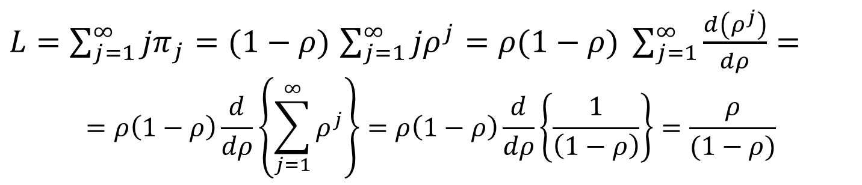
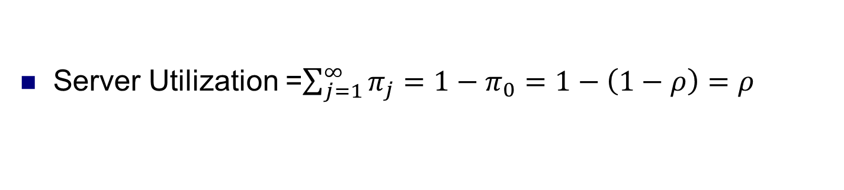
M/M/1 Performance Metrics
Server Utilization =$\sum_{j=1}^{∞}{π_{j}=1−π_{0}=1−\left(1−ρ\right)=ρ}$
Throughput = µ$\sum_{j=1}^{∞}{π_{j}=μ\left(1−π_{0}\right)=μρ=μ\frac{λ}{μ}=λ}$
Long-run average number of customers in system L:
$L=\sum_{j=1}^{∞}{{jπ}_{j}}=(1−ρ)$ $\sum_{j=1}^{∞}{{jρ}^{j}=ρ(1−ρ) \sum_{j=1}^{∞}{\frac{d\left(ρ^{j}\right)}{dρ}=}}$
$$=ρ\left(1−ρ\right)\frac{d}{dρ}\left\{\sum_{j=1}^{∞}{ρ^{j}}\right\}=ρ\left(1−ρ\right)\frac{d}{dρ}\left\{\frac{1}{\left(1−ρ\right)}\right\}=\frac{ρ}{(1−ρ)}$$
Notes:
Throughput: rate of output

Slide 22
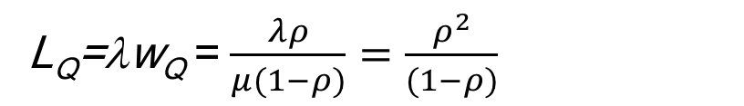
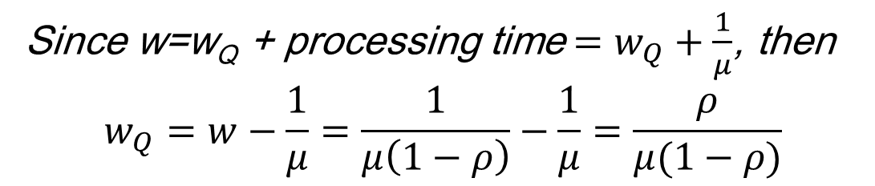
M/M/1 Performance Metrics
Long-run average time spent in system per customer W
Long-run average time spent in queue per customer W_{Q}
Since w=w_{Q} + processing time$=w_{Q}+\frac{1}{μ}$, then
$$w_{Q}=w−\frac{1}{μ}=\frac{1}{μ\left(1−ρ\right)}−\frac{1}{μ}=\frac{ρ}{μ(1−ρ)}$$
Long-run average number of customers in queue L_{Q}
L_{Q}=λw_{Q} =$\frac{λρ}{μ(1−ρ)}=\frac{ρ^{2}}{(1−ρ)}$

Slide 23
M/M/1 Performance Metrics Summary
Server Utilization =ρ
Throughput = λ
Average No. of customers in system L= $\frac{ρ}{(1−ρ)}$
Average time spent in system per customer w = $\frac{1}{μ(1−ρ)}$
Average time spent in queue per customer w_{Q} = $\frac{ρ}{μ(1−ρ)}$
Average number of customers in queue L_{Q}$=\frac{ρ^{2}}{(1−ρ)}$

Slide 24
Example
On a network gateway, measurements show that the packets arrive at a mean rate of 375 packets per second (pps) and the gateway takes about 2 millisecs to forward them. Assuming an M/M/1 model.
What is the gateway’s utilization?
What is the probability of 10 packets in the gateway?
What is mean number of packets in the gateway?
what is the average time spent in gateway per packet?
what is the average number of packets in the buffer?

Slide 25
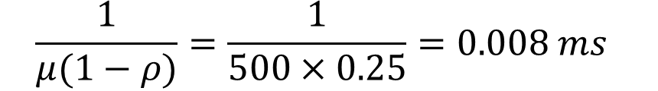
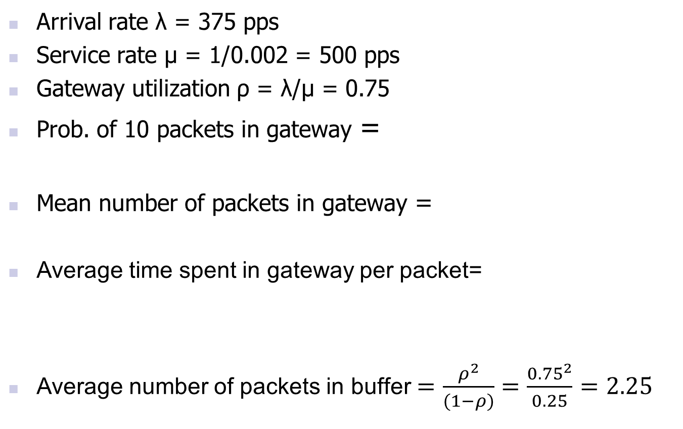
Example
Arrival rate λ = 375 pps
Service rate μ = 1/0.002 = 500 pps
Gateway utilization ρ = λ/μ = 0.75
Prob. of 10 packets in gateway =
Mean number of packets in gateway =
Average time spent in gateway per packet=
Average number of packets in buffer$=\frac{ρ^{2}}{(1−ρ)}=\frac{{0.75}^{2}}{0.25}=2.25$
$$\frac{1}{μ(1−ρ)}=\frac{1}{500×0.25}=0.008 ms$$

