Slide 1
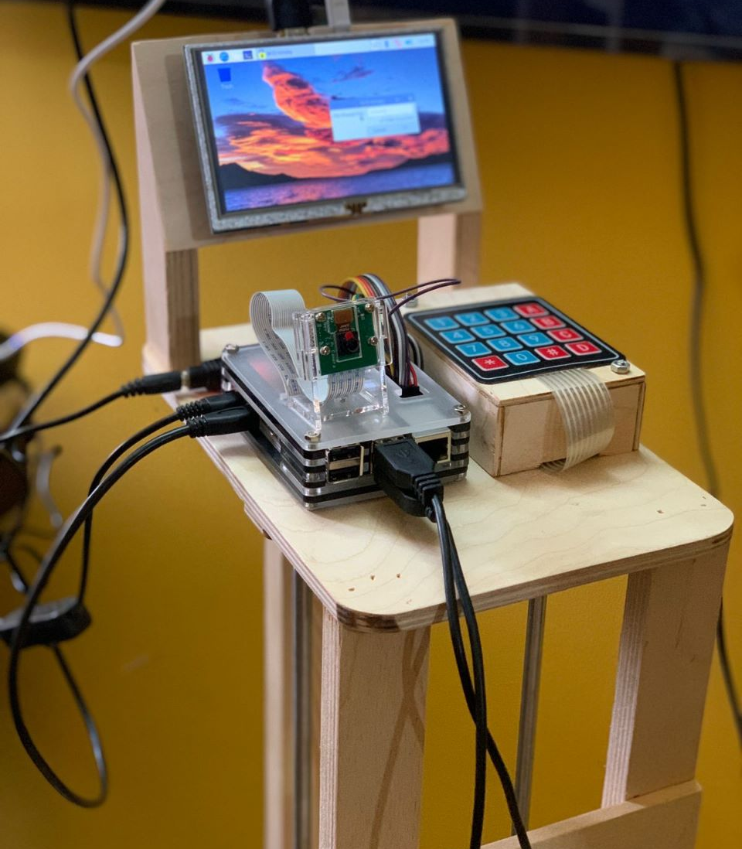
Welcome To Our Project
“The smart elevator”

Slide 2

Agenda
What is smart elevator ? #01
Why smart elevator? #02
Components #03
User usage #04
Challenges #05
Project potential #06
Team members #07

Slide 3
1.What is the smart elevator?
Traditional elevator systems have limited security measures, resulting in unauthorized access, theft, or harm to passengers.
Smart elevators with face recognition and speech recognition techniques offer enhanced security by allowing only authorized individuals to access the elevator.
Smart elevators are designed to transform the simple act of traveling between floors.

Slide 4




2.Why smart elevator?
Efficiency #01 Reduce waiting time
Energy savings #02 the most efficient way to move people through a building
,
Safety #03 safety features
Saving time #04 Save professors and doctors time,

Slide 5
3.Our Components
3.2 Hardware:
3.1 Technologies:
3.2.1 RPI board
3.2.5 mic
3.1.1 Face recognition
3.2.2 Keypad
3.2.6 servo motor
3.1.2 Speech recognition
3.2.3 LCD
3.2.7 camera
3.2.4 DC gear motor w/encoder

Slide 6
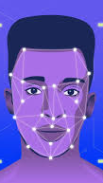
3.1.1 Face recognition.
Facial recognition is a category of biometric security. The technology is mostly used for security and law enforcement, though there is increasing interest in other areas of use.
Facial recognition is a way of identifying or confirming an individual’s identity using their face. Facial recognition systems can be used to identify people in photos, or in real-time (videos).
We Used python ,Open Cv and face_recognition library we will build an algorithm that recognize the user’s face and authenticate their identity
Face recognition steps:
Step 1: Face detection
Step 2: Face analysis Step 3: Converting the image to data
Step 4: Finding a match

Slide 7
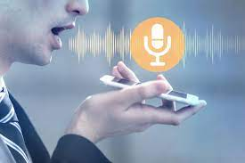
3.1.2 Speech recognition.
Speech recognition AI is the process of converting spoken language into text. This technology uses machine learning and neural networks to process audio data and convert it into words that can be used in businesses.
Speech recognition steps:
Step 1: Recording the user speech
Step 2 :Transforming Audio Frequencies
Step 3: Extracting Features from Speech
Step 4: Recognizing Spoken Words

Slide 8
3.2Hardware
Raspberry pi board #01 our complete personal computer which will run the whole project.
DC w encoder #04 which will control our elevator movement.
Keypad #02 used for entrance the default password
Camera #05 which will capture the face in face recognition step
Servo motor #03 responsible for open and close elevator gate.
LCD #07 (Liquid Crystal Display)
Used to show user inputting
Microphone #06 used for recording user speech

Slide 9
4. User usage
First step:
User stands in front of elevator and Using either camera or keypad
Second step:
If he get the access the elevator gate will open
Third step :
Using the mic In the elevator for Entering the Floor Number (Destination)
Final step:
And finally get to her/his destination

Slide 10

5.Challenges.
Privacy concerns.
some people may be uncomfortable with their face, or their fingerprint being stored.
Technical issues.
Face recognition and speech recognition may not always work reliably, leading to frustration and delays.
Security issues. If the system is hacked, sensitive information could be used for nefarious purposes.

Slide 11
6.Project potential
01
Using finger counter technology for inputting the Floor Number (Destination)
02
spread the idea
03
Automatically select the destination for the user depending on previous experiences

