Slide 1
Egypt-Guide
Guiding you ,Helping you ,Showing you !

Slide 2
Egypt the worldwide tourist country
A lot of tourists visit Egypt each year .
They came for The monuments of Pharaonic
civilization.
The most beautiful landscapes and beaches .

Slide 3
Egypt-Guide
You come for Recreation we will help you
You come for watching the great Egyptian ancient civilization we will help too
Out website will lead you in Egypt

Slide 4
Egypt-Guide
Our website has all what tourists need and help them to know easily all touristic monuments ,The most famous beaches and hotels in Egypt. We Designed this website because most of the tourists do not know all touristic monuments and to attract them to visit Egypt again.

Slide 5
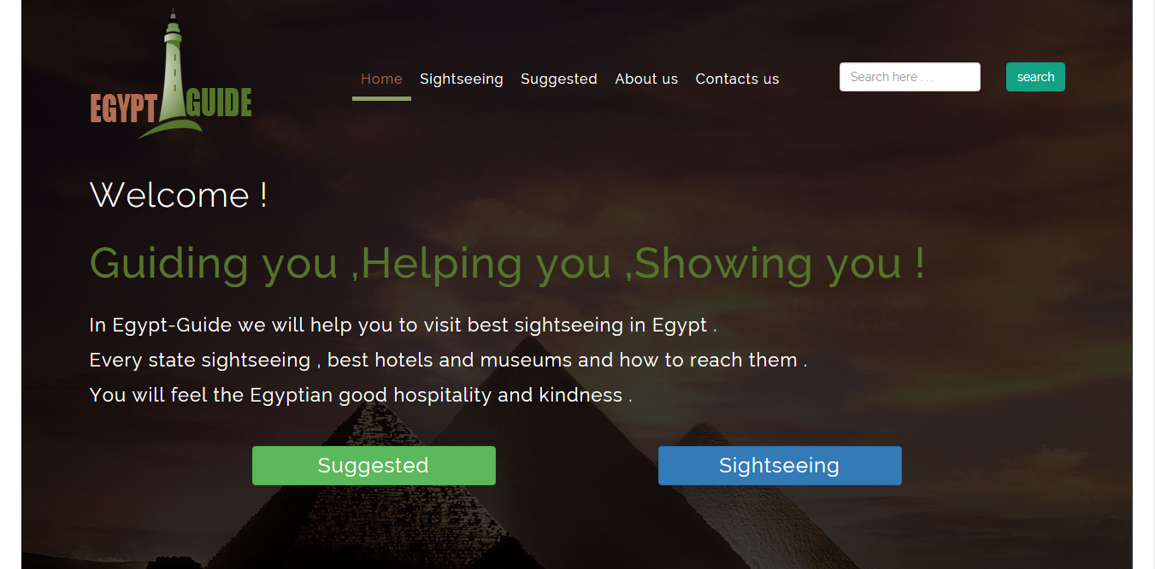
The home page

Slide 6
The home page
In the home page :
In the top of page you will find navigation bar it have all the section of the website such as
(sightseeing , suggested places , about us , contact us)
And Button to search to any place we want to go.
The body of the page has some information about The importance of the site.

Slide 7
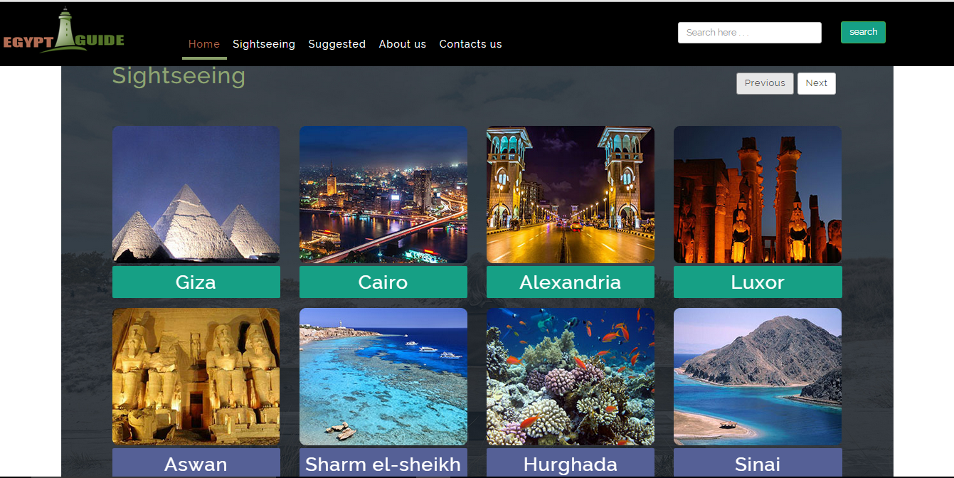
The sightseeing page

Slide 8
The sightseeing page
In this page you will find all the tourism governorates in Egypt such as( Cairo , Giza , Luxor , Aswan , ………………..)
By clicking on any governorate we will show all the tourist places
And the best hotel their and some information about any place and photo of it .
You will be very pleased if you visit this places . after visit the places in any governorate we will know that “Egypt is the first and most means of publicizing the tourism countries in the world”.

Slide 9
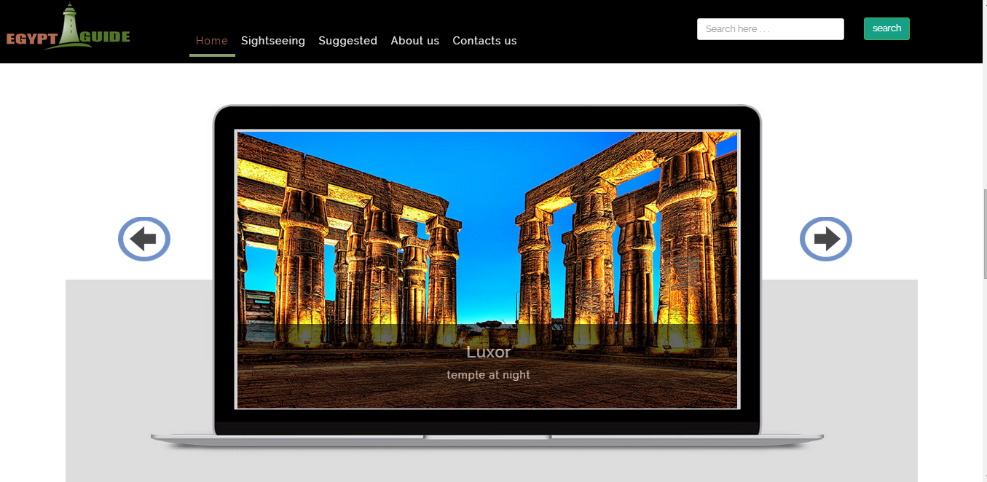
The suggested places page

Slide 10
The suggested places page
in this page
You will find the most places that most of the tourists visit it .
We suggest to visit this places and we sure you will be happy and pleased to visit it . All places in suggested places have photo about it and some information about it .

Slide 11
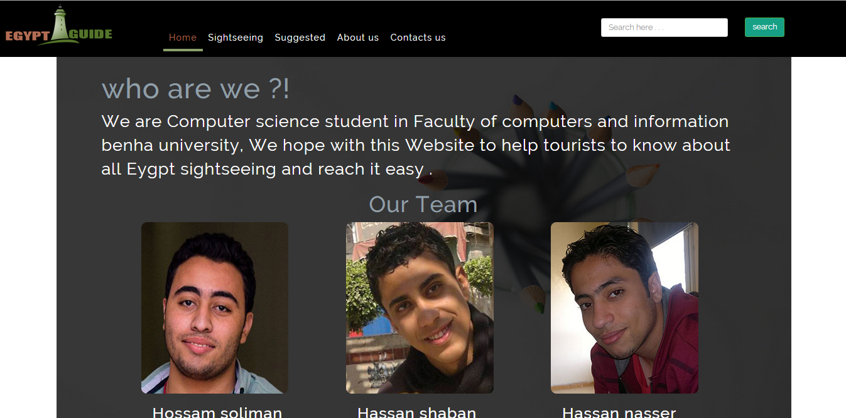
About us page

Slide 12
About us page
in this page
You will find information about the website designers.
“We are Computer science student in Faculty of computers and information Benha university, We hope with this Website to help tourists to know about all Eygptian sightseeing and reach it easy “.
This page has three photo about us .

Slide 13
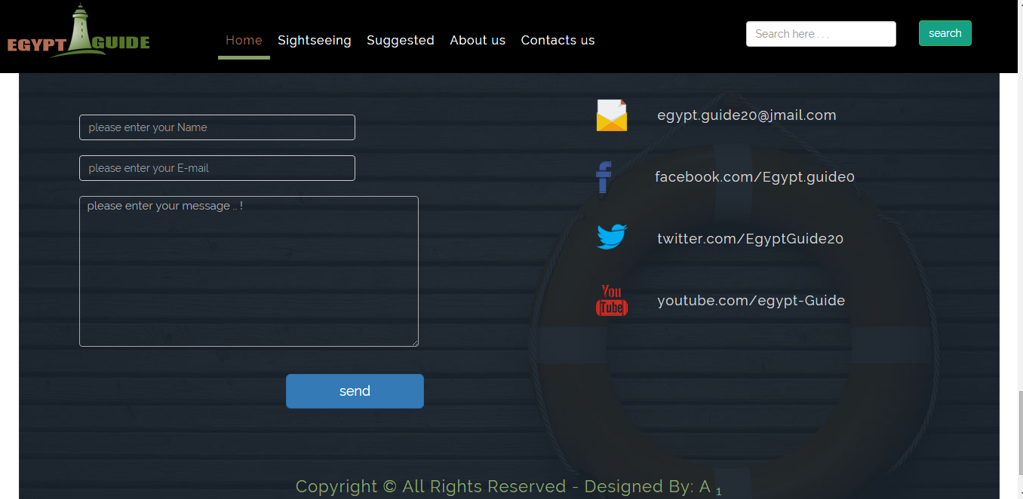
Contact us page

Slide 14
Contact us page
in this page
you can contact with us by sending your name , E-mail and message
To tell us about any Suggestions or to know any thing about the website.
You can follow us by facebook and twitter and send message to our E-mail and make subscribe us in youtube .
And All rights reserved.

