Slide 1
“ You will never forget “
Team names:
Hossam hassan mahmoud Hossam said soliman
Hassan Nasser mohamed Hassan shaban farhat

Slide 2


Agenda
“ You will never Forget ”
Minder
Phone Book

Slide 3
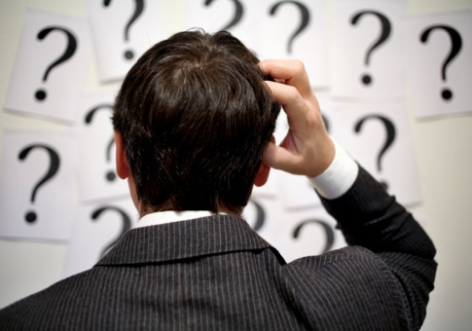
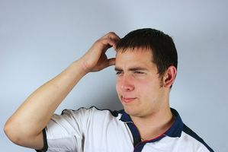
A lot of people have problem with remembering things .

Slide 4

But now :
__________________________
“ You will never forget ”

Slide 5
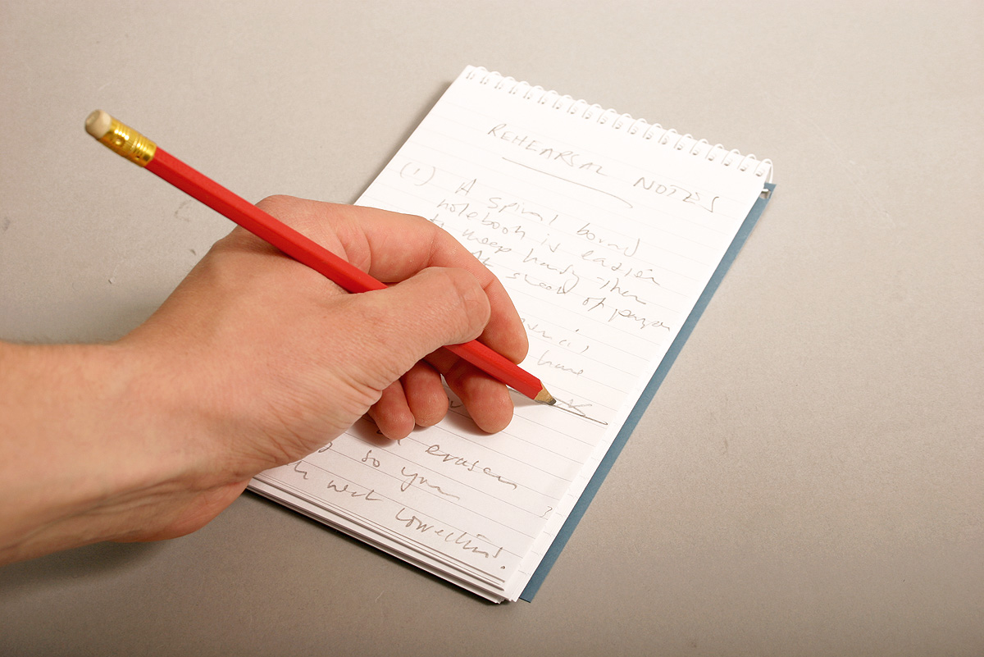
Minder ________________________________________________

Slide 6
Minder ________________________________________________
And they had only to write it down but it had a lot of problem :
They can lose the paper which they wrote down the note in
They can forget date they want do some action in

Slide 7
Minder ______________________________
You shouldn’t worry any more any thing u want to note to be able to remember later available now you won’t Forget any Date
or any contact of your Relative or friends any
more with our Program .
“ You will never forget ”

Slide 8
Minder
_______________________________________
You can now remember any thing you want By
adding new note and you should enter the
time and date you Want get Alert in it .

Slide 9

Phone Book _____________________________________

Slide 10
Phone Book _____________________________________
You can use it for :
Show All your Saved contacts .
save your friend or your relatives contacts and
it allow you to search.
Search For number By Name .
Delete numbers .

Slide 11
Thank You
Developed By:
Hossam hassan Hossam soliman
Hassan Nasser Hassan shaban

Slide 12


________________________________
Thank You
________________________________

