Slide 1


You Will Never Forget
Hossam saeed soliman
Hassan Nasser Mohamed
Hassan shaban farhat

Slide 2
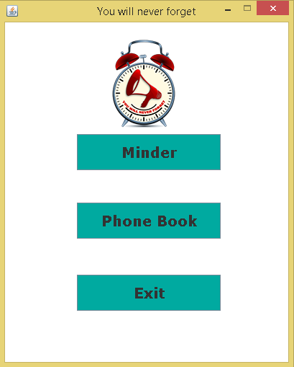
features :-
Minder .
Phone Book .

Slide 3

Minder usage
We use minder with saving our important notes and dates on it with time to give us warning when it becomes matching the time which we enter

Slide 4
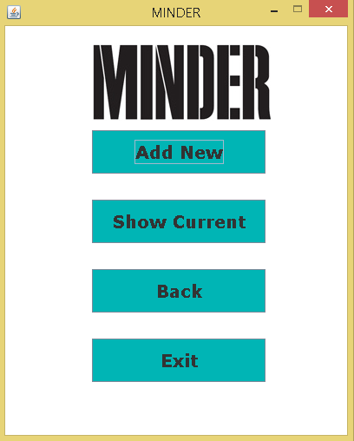
MINDER features !?
Add new
Show all

Slide 5
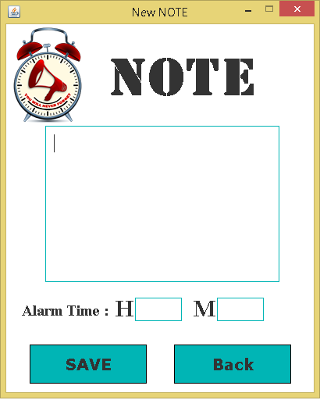
Add new note !
in this option we can add new note with new time in local time in HH:mm format .

Slide 6
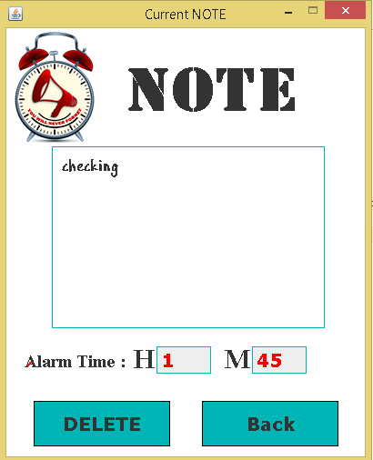
Show current note !
in this option we can show the last note which has been stored in the minder . We can delete it too from show current note feature.

Slide 7

Phone book

Slide 8

usage of phone book
We use phone book to remember all phone numbers in our life and help us to Easy accessible .
The phone book in computer Helps programmers and computer users as all work that they do in computer

Slide 9
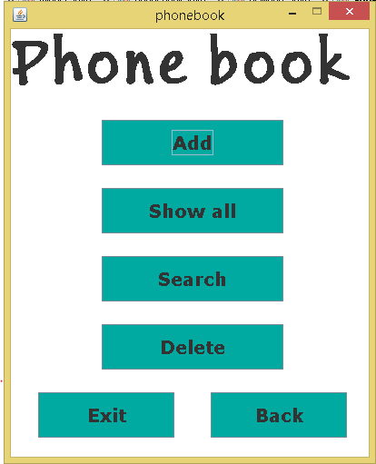
Options in phone book
Add new
Show all
Search
delete

Slide 10
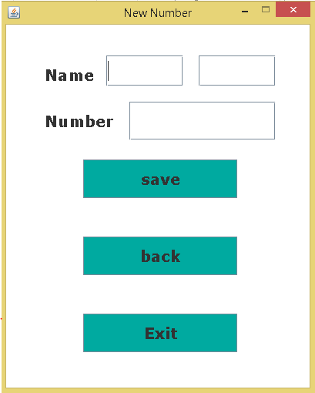
Add new number
in this option we can add new name and his number and save the name

Slide 11
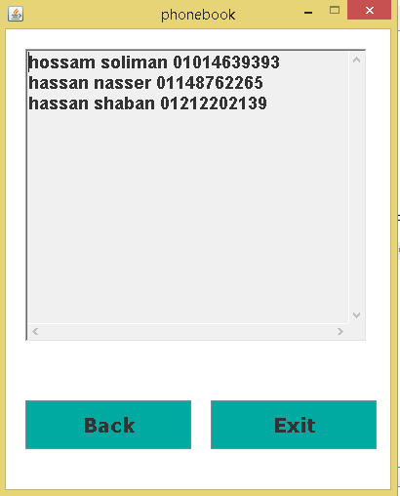
Show all
in this option we can show all number we store in program which we save it before .

Slide 12
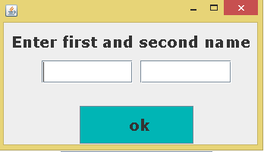
search
in this option we can search from our list any number we want

Slide 13
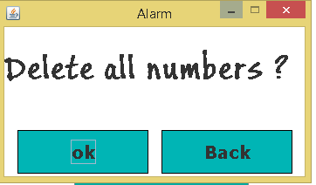
delete
in this option we can delete the list

Slide 14


