Slide 1

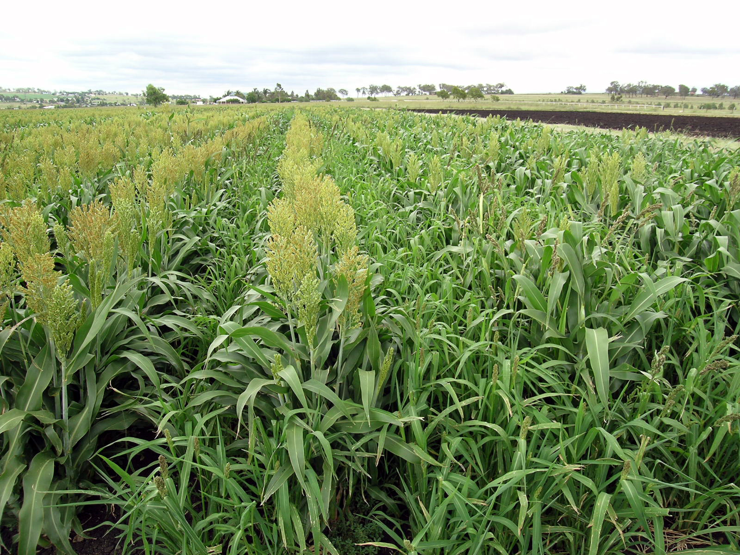
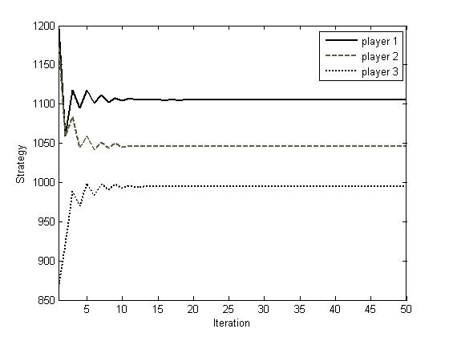
Cooperative Coevolutionary Invasive Weed Optimization and its Application to Nash Equilibrium Search in Electricity Markets H. Hajimirsadeghi, A. Ghazanfari, A. Rahimi Kian, C. Lucas Control and Intelligent Processing Center of Excellence University of Tehran, Iran
Philosophy
Motivation
Why Weeds?
The most robust and troublous
plant in agriculture.
After thousands of tillage and
hand-weeding we still have weeds.
After 50 years of herbicides we
still have weeds.
Why Coevolutionary Computing:
Task decomposition
Parallel computation
Simulation of multiagent systems
IWO improves search capability in Coevolutionary Algorithms
Coevolutionary framework prepares a suitable basin for parallel computation and simulation of multiagent systems (like markets)
Invasive Weed Optimization Algorithm
0- Function to be Minimized
1- Initialization
f5
2- Function Evaluation
f6
f4
f2
f3
f1
f5
1 *
2 *
0 *
f6
f5
1 *
2 *
0 *
f6
Cooperative Coevolutionary Algorithm
1 *
f4
f2
f3
1 *
f4
f2
f3
3 *
f1
2 *
3- Reproduction
3 *
f1
2 *
4- Spatial Dispersal
General Cooperative Coevolutionray Algorithm
1 *
0 *
f6
For population , all populations Initialize population ; For population , all populations Evaluate population with collaborators; For until a terminating criterion is met For population , all populations Evolutionary process to make next generation; Evaluate next generation with collaborators; Next
1 *
f5
f4
2 *
f3
f1
f2
6- Next Population
3 *
2 *
5- Competitive Exclusion
Results of CCIWO for Function Optimization
Best Solution found until now
Name | Function | Initial range | Modality
Sphere |  | [-100, 100] | unimodal
Rosenbrock |  | [-2.12, 2.12] | unimodal
Rastrigin |  | [-5.12, 5.12] | multimodal
Ackley |  | [-32, 32] | multimodal
Griewank |  | [-600, 600] | multimodal
 |  | …
variable
Fcn. value
…
…
Fcn. value
variable
x11 | f11
x12 | f12
x1N | f1N
Function Evaluation
fn1 | xn1
fn2 | xn2
fnN | xnN
…
…
…
…
Function | Mean value |  |  | Number of Function Evaluation
 | CCGA | LCGA | CCIWO | CCGA | LCGA | CCIWO
Sphere | 1e-08 | 1e-12 | 4e-13 | 600000 | 600000 | 326203
Rosenbrock | 70 | 90 | 0.27 | 600000 | 600000 | 323635
Rastrigin | 0.5 | 0.12 | 4e-10 | 600000 | 600000 | 324578
Ackley | 0.8 | 8 | 3e-07 | 600000 | 600000 | 316616
Griewank | 0.02 | 2 | 2e-12 | 600000 | 600000 | 323789
IWO Operators
Cooperative Coevolutionary
Invasive Weed Optimization
(CCIWO)
IWO Operators
New Population
New Population
Transmission-Constrained Electricity Markets
Nash Equilibrium (NE)
Results of NE Search with CCIWO
Three Bus Cournot Model with Linear
Demand Function

