Slide 1
Ant Colony Optimization with a Genetic Restart Approach toward Global Optimization
03/09/2008
Hossein Hajimirsadeghi, Mahdy Nabaee, Babak Nadjar-araabi
Control and Intelligent Processing Center of Excellence
School of Electrical and Computer engineering
University of Tehran, Tehran, IRAN

Slide 2
Outline
Multiplicative Squares
Ant Colony Optimization
Local Search algorithms
Genetic Algorithms
Methodology
Results
Conclusion
2

Slide 3


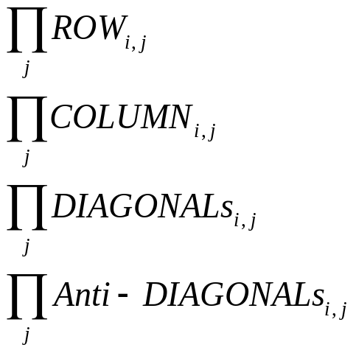

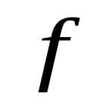


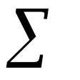
Multiplicative Squares
Numbers 1 to
:
MAX-MS: Max { }
MIN-MS: Min { }
Kurchan: Min (Max {} – Min {})
For each i
3

Slide 4
Multiplicative Squares (3*3 example)
Rows: 5*1*8 = 40, 3*9*4 = 108, 7*2*6 = 84
Columns: 5*3*7 = 105, 1*9*2 = 18, 8*4*6 = 192
Diagonals: 5*9*6 = 270, 1*4*7 = 28, 8*3*2 = 48
Anti-diagonals: 8*9*7 = 504, 1*3*6 = 18, 5*4*2 = 40
MAX-MS/MIN-MS: SF=40+108+84+105+18+192+270+28+48+504+18+40= 1455
Kurchan MS: SF= 504-18 = 486
5 | 1 | 8
3 | 9 | 4
7 | 2 | 6
4

Slide 5
Why Multiplicative Squares?
NP-hard Combinatorial Problem
Ill-conditioned
  1 16
Complicated
  precision of 20+ digits for dimensions greater than 10
  12961354134332523412…???
  Local Optima
1 | 9 | 3 | 16 |  |  | 16 | 9 | 3 | 1
11 | 5 | 13 | 6 |  |  | 11 | 5 | 13 | 6
2 | 15 | 4 | 10 |  |  | 2 | 15 | 4 | 10
14 | 7 | 12 | 8 |  |  | 14 | 7 | 12 | 8
(a) |  |  |  |  |  | (b)
SF= 134355
SF=66045
5

Slide 6
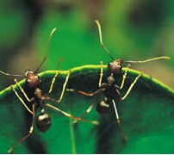
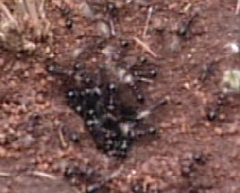
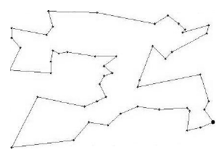
Introduction (ACO)
Ant Colony Optimization (Marco Dorigo, 1992):
  bio-inspired
  population-based
  meta-heuristic
  Evolutionary
  Combinatorial Optimization problems.
Used to solve
Traveling Salesman Problem
(TSP).
http://iridia.ulb.ac.be/~mdorigo/ACO/ACO.html
Fig.1 TSP with 50 cities
6

Slide 7

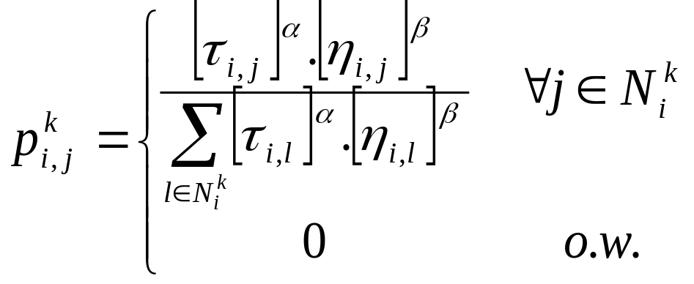

Ant System
TSP
7

Slide 8
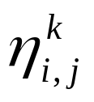
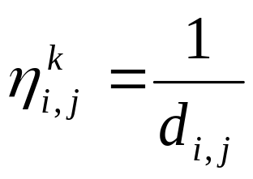
Ant System
: Heuristic Function
(attractiveness)
(visibility)
8

Slide 9
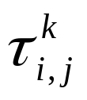
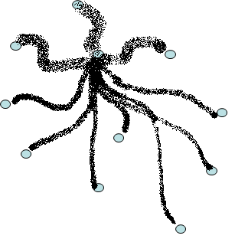
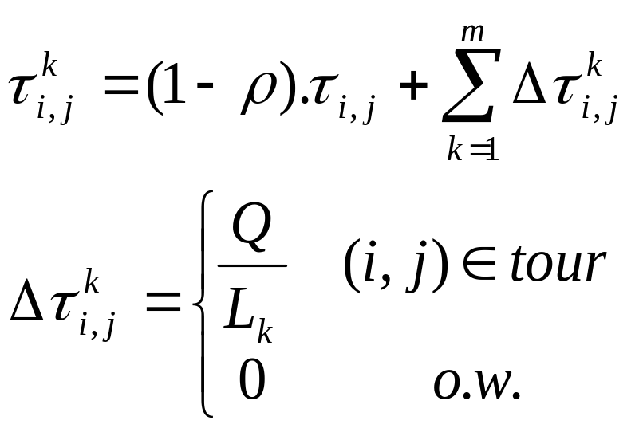
Ant System
: Pheromone Trails
9

Slide 10
Ant System Extensions
ASrank
AS-elite
MMAS
Ant-Q
ACS
ACO-LBT
P-B ACO
Omicron ACO (OA)
…
10

Slide 11
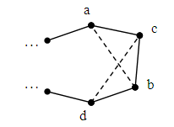
Local Search Algorithms
Hill Climbing
2-opt and 3-opt
K-opt
Lin-Kernighan
Fig. 3. With 2-opt algorithm dashed lines convert to solid lines: (a,b) (a,c) and (c,d) (b,d).
11

Slide 12
Genetic Algorithms
Encoding
Selection
Mutation
GA Operators
Binary Encoding
Permutation Encoding
Real Encoding
Tree Encoding
Cross Over
Elitism
Selection
Cross Over
Mutation
Elitism
Fig.4. Genetic Operators
12

Slide 13
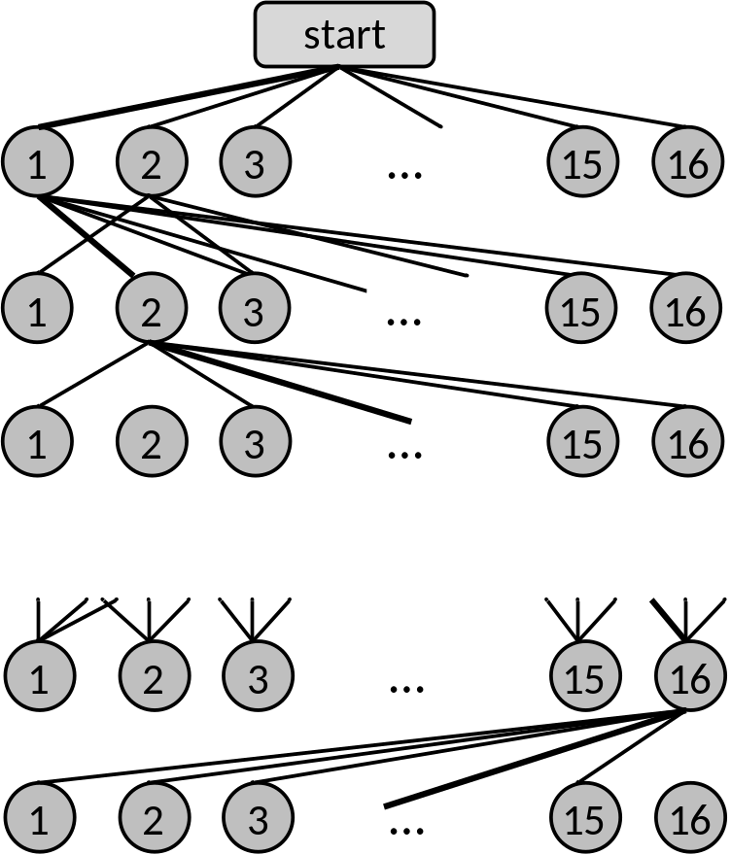
Proposed Method
Fig. 4. Graph representation for the MAX MS (4*4) problem, using ACO. Heavy lines show a feasible path for the problem.
Indices are selected
to 1 are put
according to the
indices
1 | 8 | 10 | 6
4 |  | 9 | 11
3 | 2 | 14 | 12
5 |  | 13 | 7
15
Index 6
16
Index 13
13

Slide 14
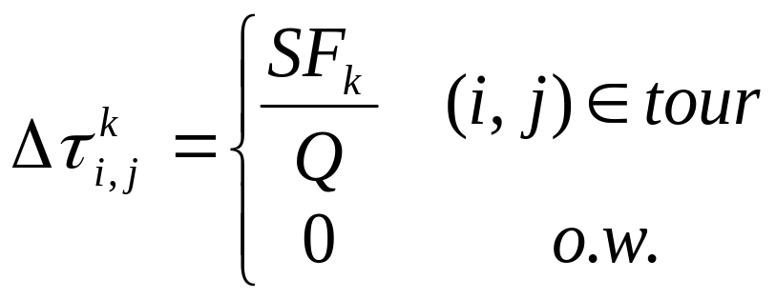



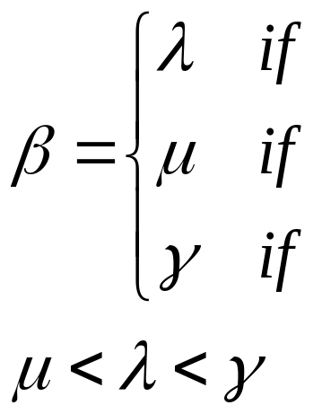
ACO Terms for MAX-MS
Trails:
Heuristic Function:
(a) |  |  |  |  |  | (b)
Fig. 5. Heuristic function is illustrated for two sample conditions. The current position of the ant is displayed by .
14

Slide 15
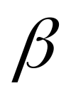
ACO Terms for MAX-MS
Max and min trail like MAX-MIN Ant System (MMAS).
iteration-best and global-best deposit pheromone
Eating ants like Ant Colony System (ACS).
Adaptive (decreasing with iterations)
15

Slide 16
Local Search
2 opt for each iteration
Fig.6. 2-opt
16

Slide 17
Genetic Restart Approach
Cross-over
Mutation
Fig. 7. An example of two cut cross over with 3 children.
Parent 1 | 1 | 3 | 4 | 2 | 5
Parent 2 | 4 | 5 | 1 | 2 | 3
Child 1 | 3 | 4 | 5 | 1 | 2
Child 2 | 5 | 1 | 2 | 3 | 4
Child 3 | 5 | 3 | 4 | 1 | 2
Fig. 8. An example of a two cut mutation.
Parent 1 | 1 | 3 | 4 | 2 | 5
Parent 2 | 4 | 5 | 1 | 2 | 3
Child of parent 1 | 1 | 4 | 3 | 2 | 5
Child of parent 2 | 2 | 5 | 1 | 4 | 3
17

Slide 18
Results
TABLE 1 Experiment results
(a) MS7
Method | Best | Avg. | Std. Dev. | Std. Dev % | Best err.% | Avg. err.%
Adaptive heuristic | 836927418654 | 836545183884.3 | 310273380.3 | 0.037 | 0 | 0.046
Fixed heuristic | 836864383934 | 836387896300.2 | 282729277 | 0.034 | 0.0075 | 0.064
No GA restart | 836590536598 | 835890051299.2 | 472719981.5 | 0.057 | 0.0403 | 0.124
(b) MS8
Method | Best | Avg. | Std. Dev. | Std. Dev % | Best err.% | Avg. err.%
Adaptive heuristic | 402702517088866 | 402397450057731 | 410397887424.8 | 0.102 | 0 | 0.076
Fixed heuristic | 402693316462602 | 396228893243407 | 12487304223038.1 | 3.15 | 0.0023 | 1.608
No GA restart | 402672245516278 | 379411679729931 | 27191910644358.2 | 7.17 | 0.0075 | 5.784
18

Slide 19
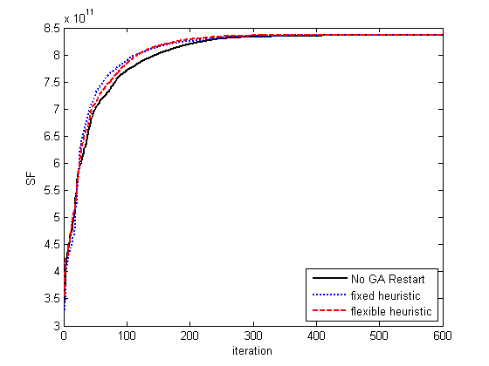
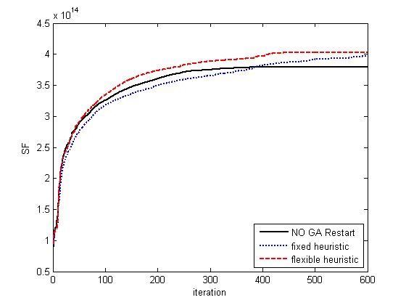
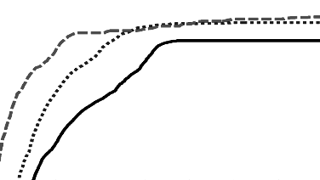
Results
Zoom on iteration = 300 to 600
a
b
Fig. 9. Evaluation of introduced algorithms.
(a) Comparison between the proposed strategies on MS7. (b) Comparison between the proposed strategies on MS8.
19

Slide 20
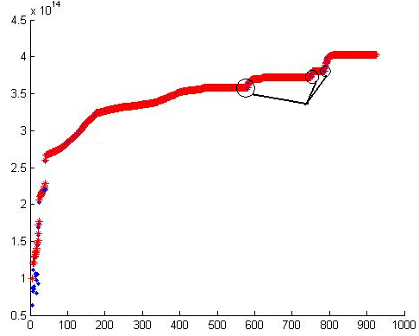
Performance of the Genetic Restart Approach
TABLE 2 Genetic Semi-Random-Restart Performance
Method | Avg. number of successive genetic restart (MS7) | Avg. number of successive genetic restart (MS8)
Fixed heuristic | 1.6 | 2.4
Flexible heuristic | 1.3 | 2.3
SF
Survivor semi-random-restart
Fig. 10. Successful operation of the posed restart algorithm to evade local optimums.
20

Slide 21
Conclusion
Novel algorithm to solve MAX-MS
  Adaptive
  Genetic Restart Algorithm
Can be used for NP-hard combinatorial problems for global optimization
21

Slide 22
03/09/2008
Thanks for Your Attention

