Slide 1
Multiple Instance Real Boosting with Aggregation Functions
Hossein Hajimirsadeghi and Greg Mori
School of Computing Science
Simon Fraser University
International Conference on Pattern Recognition
November 14, 2012

Slide 2
Multiple Instance Learning
Traditional supervised learning gets Instance/label pairs
Multiple Instance Learning (MIL) gets bag of instances/label pairs
A kind of weak learning to handle ambiguity in training data
Standard Definitions:
Positive Bag: At least one of the instances is positive
Negative Bag: All the instances are negative

Slide 3
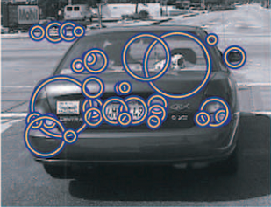
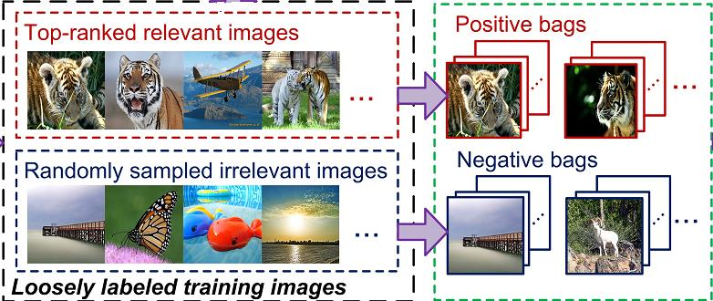
Applications of MIL
Image Categorization
[e.g., chen et al., IEEE-TPAMI 2006]
Content-Based Image Retrieval
[e.g., Li et al., ICCV11]
Notes:
Image Categorization: image is a bag that contains instances corresponding to
blocks, regions, or patches
Content-Basd Image Retrieval: In addition to using blocks or segments to represent images, there is another ambiguity in what images are truly relevant. For example, usually, there is a coarse categorization to find the top-ranked relevant images (for the purpose of training) but we cannot fully rely on the resulting images.
Text Categorization: Instead of the whole document, each document is represented by multiple passages.
Object Tracking: For example, a bag of windows centered around the estimated object location is considered as a positive bag.

Slide 4
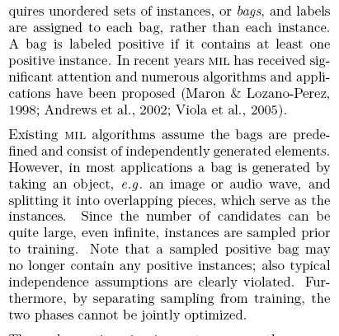

Applications of MIL
Text Categorization
[e.g., Andrews et al., NIPS02]
Object Tracking
[e.g., Babenko et al., IEEE-TPAMI 2011]
Notes:
Text Categorization: Instead of the whole document, each document is represented by multiple passages.
Object Tracking: For example, a bag of windows centered around the estimated object location is considered as a positive bag.

Slide 5
Problem & Objective
The information “At least one of the instances is positive” is very weak and ambiguous.
There are examples of MIL datasets where most instances in the positive bags are positive.
We aim to mine through different levels of ambiguity in the data:
For example: a few instances are positive, some instances are positive, many instances are positive, most instances are positive, …

Slide 6
Approach
Using the ideas in Boosting:
Finding a bag-level classifier by maximizing the expected log-likelihood of the training bags
Finding an instance-level strong classifier as a combination of weak classifiers like RealBoost Algorithm (Friedman et al. 2000), modified by the information from the bag-level classifier
Using aggregation functions with different degrees of or-ness:
Aggregate the probability of instances to define probability of a bag be positive

Slide 7
Ordered Weighted Averaging (OWA)
OWA is an aggregation function:
Yager et al. IEEE-TSMC, 1988

Slide 8
OWA: Example
Sort the values:
0.9, 0.6, 0.5, 0.1
Compute the weighted sum:
Ex: uniform aggregation (mean):

Slide 9
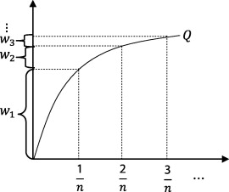
OWA: Linguistic Quantifiers
Regular Increasing Monotonic (RIM) Quantifiers
All, Many, Half, Some, At Least One, …

Slide 10
OWA: RIM Quantifiers
RIM Quantifier : All
1
Q
1
Ex:
Notes:
This quantifier is equivalent to min.
For example, all of the arguments should have high values to have the result be high. In our case, all the probabilities of the instances should be high to have a high bag probability.

Slide 11
OWA: RIM Quantifiers
RIM Quantifier : At Least One
1
Q
1
Ex:
Notes:
This quantifier is equivalent to Max.
If any of the arguments has high value the result be high. In our case, an instance with high probability makes the whole bag have high probability.

Slide 12
OWA: RIM Quantifiers
RIM Quantifier : At Least Some
1
Q
Gives higher weights to the largest arguments
So, some high values are enough to make the result high
1

Slide 13
OWA: RIM Quantifiers
RIM Quantifier : Many
1
Q
Gives lower weights to the largest arguments
So, many arguments should have high values to make the result high
1
Notes:
Many of the arguments should have high value to make the result high

Slide 14
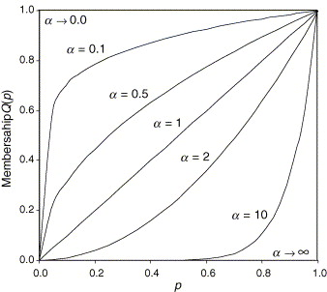
OWA: Linguistic Quantifiers
Linguistic Quantifier |  | Degree of orness
At least one of them (Max function) |  | 0.999
Few of them | 0.1 | 0.909
Some of them | 0.5 | 0.667
Half of them | 1 | 0.5
Many of them | 2 | 0.333
Most of them | 10 | 0.091
All of them (Min Function) |  | 0.001
Notes:
Different values of \alpha makes Q(p) convex or concave. Low values of \alpha gives high weights to larger arguments in aggregation. However, high values of \alpha gives high weights to smaller arguments and low values to larger arguments
For example, with \alpha = 0.1, even if few of the arguments (i.e. a_1 … a_n) have large values the result of aggregation will be a large value. However, with \alpha = 10 most of the arguments should have large values to make the result be a large value.

Slide 15
MIRealBoost
Training
Bags
Bag
Classifier
Instance
Classifier
Instance
Probabilities
Bag
Probabilities
Notes:
You can also see the pseudo-code in the paper.

Slide 16
MIRealBoost
MIL training input:
Objective to find the bag classifier:

Slide 17
MIRealBoost: Learning Bag Classifier
Objective: Maximize the Expected Binomial Log-Likelihood:
?
Proved:
Notes:
For proof, it is only required to take the derivatives w.r.t. p(X) and set to zero

Slide 18
MIRealBoost: Estimate Bag Prob.
Aggregate
Estimate probability of each instance
?
Aggregation functions:
Noisy-OR
OWA
Notes:
The probability of a bag be positive is obtained by aggregation of the probability of the instances.
So, if we could estimate probability of the instances we would find the bag probability.

Slide 19
MIRealBoost: Estimate Instance Prob.
Estimate Instance Probabilities by training the standard RealBoost classifier:
Then:

Slide 20
MIRealBoost: Learning Instance Classifier
RealBoost classifier :
Proved:
?
Notes:
RealBoost classifier minimizes the stage-wise expected exponential cost
F_m(x) is the strong classifier in the m-th step. f_m(x) is the weak classifier in the m_th step.
PDF stands for probability density function. See the notes in the next slide.

Slide 21
MIRealBoost: Estimate Weak Classifiers
Notes:
The weighted conditional probability density functions for the positive and negative classes, i.e. Pw(x|y=1) and Pw(x|y=-1), are fit by approximatng the class probability functions using weighted training instances. In our work, these PDFs are estimated by kernel smoothing density functions computed from the weighted voting of training examples
Note that each classifier is a stump (i.e., built from only one feature). So, the density functions are 1-dimensional.

Slide 22
MIRealBoost: Estimate Weak Classifiers
?
We do not know true instance labels.
Estimate the instance label by the bag label,
weighted by the bag confidence
Notes:
With the pseudo labels and weighs, it can be observed that if a bag is correctly classified, then the weights of all the instances in that bag decreases. However, if a bag is not classified correctly, the weights of all the instance of that bag increases. So, all the instances inside the bag compete to contribute to prediction of the true bag label.

Slide 23
MIRealBoost Algorithm
For each feature k=1:K, compute the weak classifier
Compute the experimental log likelihood
Compute the instance probabilities
Aggregate the instance probabilities to find bag probabilities
Notes:
You can also see the pseudo-code in the paper.

Slide 24
Experiments
Popular MIL datasets:
Image categorization: Elephant, Fox, and Tiger
Drug activity prediction: Musk1 and Musk2
Notes:
In the image datasets, each bag represents an image and the instances inside the bag represent 230-D feature vectors of different segmented blobs of the image. The image datasets contain 100 positive and 100 negative bags. In the MUSK datasets, each bag describes a molecule, and the instances inside the bag represent 166-D feature vectors of the low-energy configurations of the molecule. Musk1 has 47 positive bags and 45 negative bags with about 5 instances per bag. Musk2 has 39 positive bags and 63 negative bags with variable number of instances in a bag, ranging from 1 to 1044 (average 64 instances per bag)

Slide 25
Results
MIRealBoost classification accuracy with Different Aggregation functions
agg | Elephant | Fox | Tiger | Musk1 | Musk2
NOR | 83 | 63 | 72 | 85 | 74
Max | 77 | 58 | 68 | 85 | 74
Few | 75 | 58 | 70 | 83 | 72
Some | 75 | 57 | 73 | 85 | 75
Half | 72 | 54 | 70 | 90 | 77
Many | 67 | 52 | 67 | 91 | 75
Most | 54 | 50 | 51 | 83 | 69
All | 50 | 50 | 50 | 84 | 69
Notes:
Best results are marked in bold face
For the image datasets NOR has the overall best performance. However, for Musk1 and Musk2 the Many and Half OWA operators outperform the others.
The reason might be that in an image usually one of the segments is the true segment (positive instance). However, in the Musk datasets, more than one configuration of a molecule might be positive.
It has been previously reported in (Gehler and Chapelle, AISTATS07) that Musk1 dataset contains less ambiguity in positive bags, i.e. there are many positive instances in each bag.

Slide 26
Results
Comparison with MILBoost Algorithm
Method | Elephant | Fox | Tiger | Musk1 | Musk2
MIRealBoost | 83 | 63 | 73 | 91 | 77
MILBoost | 73 | 58 | 56 | 71 | 61
MILBoost results are reported from Leistner et al. ECCV10
Notes:
MIRealBoost always outperforms MILBoost

Slide 27
Results
Comparison between state-of-the-art MIL methods
Method | Elephant | Fox | Tiger | Musk1 | Musk2
MIRealBoost | 83 | 63 | 73 | 91 | 77
MIForest | 84 | 64 | 82 | 85 | 82
MI-Kernel | 84 | 60 | 84 | 88 | 89
MI-SVM | 81 | 59 | 84 | 78 | 84
mi-SVM | 82 | 58 | 79 | 87 | 84
MILES | 81 | 62 | 80 | 88 | 83
AW-SVM | 82 | 64 | 83 | 86 | 84
AL-SVM | 79 | 63 | 78 | 86 | 83
EM-DD | 78 | 56 | 72 | 85 | 85
MIGraph | 85 | 61 | 82 | 90 | 90
miGraph | 87 | 62 | 86 | 90 | 90
Notes:
Best results are marked in bold face.
The accuracy of all methods except MIGraph and miGraph have been reported from Leistner et al. ECCV10
For MIGraph and miGraph, the results have been reported from Zhou et al. ICML09
It can be observed that the performance of the methods varies depending on the dataset. However, MIRealBoost is comparable to the best methods in most cases (Elephant, Fox, and Musk1)
miGraph and MIGraph are not comparable with others because they consider the correlations between instances.

Slide 28
Conclusion
Proposed MIRealBoost algorithm
Modeling different levels of ambiguity in data
Using OWA aggregation functions which can realize a wide range of orness in aggregation
Experimental results showed:
encoding degree of ambiguity can improve the accuracy
MIRealBoost outperforms MILBoost and comparable with state-of-the art methds
Notes:
For the first item:
MIRealBoost has general advantages of boosting algorithms like simple programming, few parameters for tunning, and ability of feature selection.

Slide 29
Thanks!
supported by grants from the Natural Sciences and Engineering Research Council of Canada (NSERC).

Slide 30
MIRealBoost: Learning Instance Classifier
Implementation details:
Each weak classifier is a stump (i.e., built from only one feature).
At each step, the best feature is selected as the feature which leads to the bag probabilities, which maximize the empirical log-likelihood of the bags.
Notes:
The algorithm sequentially selects the weak classifiers, which maximize the empirical log-likelihood (1), from the pool of all weak classifiers in a stage-wise greedy approach

