Slide 1
A Hybrid IWO/PSO Algorithm for Fast and Global Optimization
05/19/2009
Hossein Hajimirsadeghi
Control and Intelligent Processing Center of Excellence,
School of ECE, University of Tehran,
P. O. Box 14395-515, Tehran, Iran
Email: h.hajimirasdeghi@ece.ut.ac.ir

Slide 2
Outline
Biomimicry for Decision Making and Control
Domains of Intelligence in Biological Systems
The Proposed Optimization Algorithm
  IWO
  PSO
  IWO/PSO
Evaluating Performance of IWO/PSO for Optimization
IWO/PSO for Adaptive Control
Concluding Remarks
2
Notes:
fdsfdsfa

Slide 3
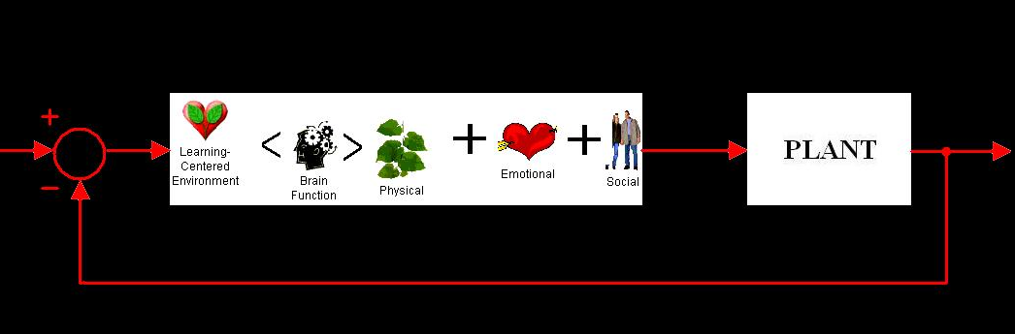
Biomimicry
Biological Organisms
Living in complex uncertain environments
Robust and Fault Tolerant
Adaptive
Multi-agent Systems
Self Organized
Automated
Efficient and Optimized
Stable
Far sighted
Control and Decision Making
Complex systems with uncertainties
Robust and Fault Tolerant Controllers
Adaptive Controllers
Multi-agent Systems
Autonomous robots, automation in Process Control
Efficient embodiment and sensor/actuator design and positioning
Multimodal non-differentiable Optimization
Stable systems
Long-term scheduling and decision making
Sociology
social networks
Cues in Advertising
Smart environments
Politics
Consensus among the members in parties
Influence on elections
Economics
Energy conservation
Evolutionary game theory
Restructuring
Art
Swarm Intelligence in the movies
Aesthetic representation of information
Engineering
Soft Computing
Automated Fabrication
Bioinspired robotics
3

Slide 4
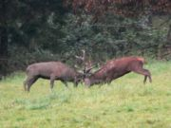

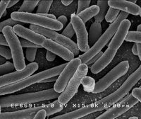
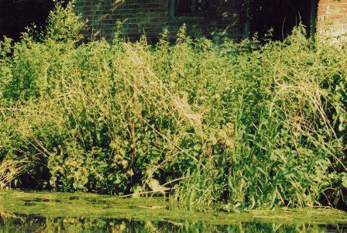
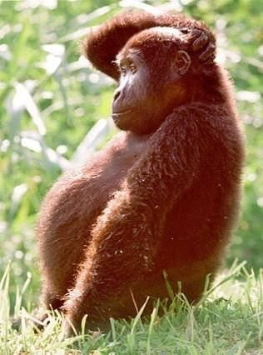
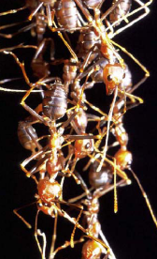
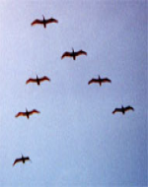

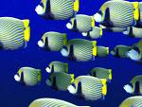
Some Domains of Intelligence in Biological Systems (Computational Perspective)
Competition
Evolution
Reproduction
Learning
Swarming
Communication
4

Slide 5
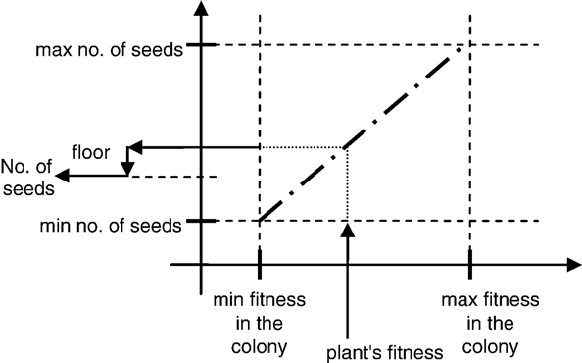
Invasive Weed Optimization
Why weeds?
  The most robust and troublous plant in agriculture
  The weeds always win
Biomimicry of Weed Colonizing:
  Initializing a population
  Fitness Evaluation
  Reproduction
  Spatial dispersal
  Competitive exclusion
1 *
0 *
f6
f5
2 *
f3
1 *
f4
f2
f1
3 *
2 *
5

Slide 6
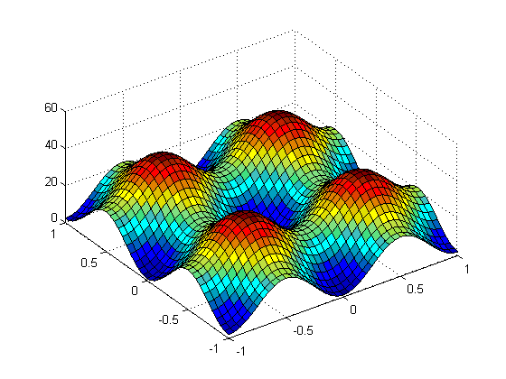
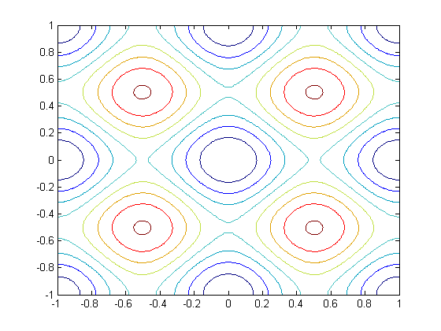

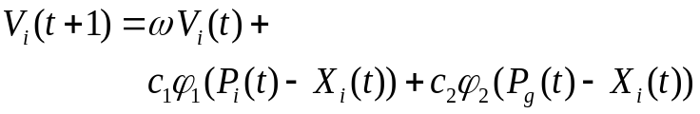

Particle Swarm Optimization
Birds flocking and Fish schooling
How can they exhibit such an efficient
coordinated collective behavior?
PSO tries to mimic foraging trend and
collaborative communication in swarms
PSO Algorithm:
  Consider a population of solutions (particles)
  Evaluating the particles
  Particle best solution
  Global best solution
  Update particles’ velocities:
  Move particles:
local maximum
f5
f4
f1
f3
f2
f6
local minimum
Global minimum
6

Slide 7
IWO/PSO
IWO/PSO Algorithm
  Initializing a population
  Evaluating the solutions
  Reproducing the seeds
  Plant best solution
  Global best solution
  Determine seeds velocities for dispersion
  Spatial dispersal
  Competitive exclusion
1 *
2 *
f5
f3
f1
f4
f6
3 *
f2
2 *
7

Slide 8
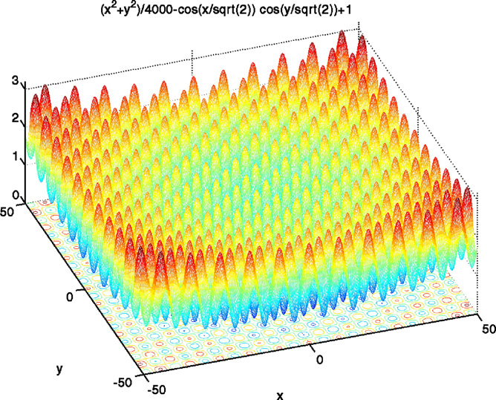
Comparative Study (Griewank Function)
8

Slide 9
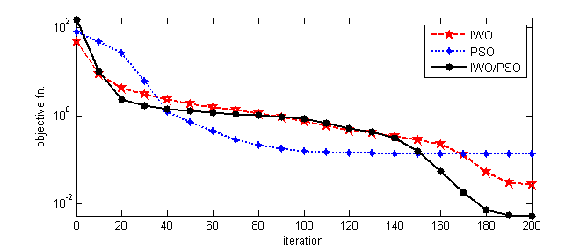
Comparative Study
Results of the Griewank Function Optimization for Comparison with 5 EAs
Comparison Criteria | Algorithm | dim 10 | dim 20
% success¹ | IWO/PSO | 100 | 100
 | IWO² | 95 | 95
 | PSO³ | 30 | 80
 | GAs (Evolver) ³ | 50 | 30
 | MAs³ | 90 | 100
 | SFL³ | 50 | 70
Comparison Criteria | Algorithm | dim 10 | dim 20
Mean Solution | IWO/PSO | 0.006 | 0.0087
 | IWO | 0.0163 | 0.0494
 | PSO | 0.093 | 0.081
 | GAs (Evolver) | 0.06 | 0.097
 | MAs | 0.014 | 0.013
 | SFL | 0.08 | 0.06
¹Success criterion is to reach a target value of 0.05 or less.
²A. R. Mehrabian and C. Lucas, “A novel numerical optimization algorithm inspired from weed colonization,” Ecological Informatics, vol. 1, pp. 355–366, 2006.
³E. Elbeltagia, T. Hegazyb, and D. Grierson, “Comparison among five evolutionary-based optimization algorithms,” Advanced Engineering
Informatics, vol. 19, pp. 43–53, 2005.
Optimization process of the Griewank10
for IWO, PSO, and IWO/PSO
9

Slide 10
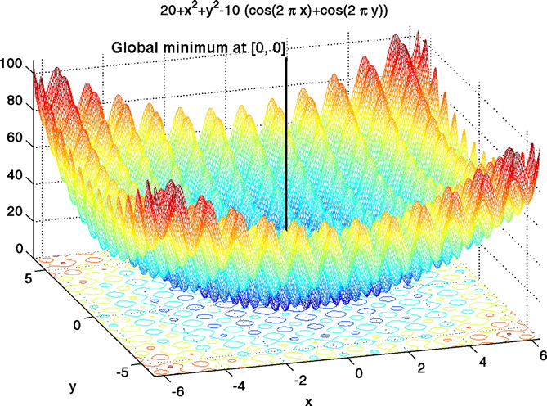
Comparative Study (Rastrigin Function)
10

Slide 11
Comparative Study
Simulation Results of Rastrigin30 Function Optimization for comparison
with SPSO, and OPSO
Method | Mean error | Standard deviation | Median error | Eval. Num. | Success¹ %
Standard type PSO (SPSO²) | 99.5 | 27 | 98.2 | 20000 | 55
OPSO² | 46.5 | 13.1 | 44.8 | 20000 | 100
IWO/PSO | 31.55 | 8.59 | 31.19 | 19189 | 100
¹Success criterion is to reach a target value of 50 or less.
²M. Meissner, M. Schmuker, and G. Schneider, “Optimized Particle Swarm Optimization (OPSO)
and its application to artificial neural network training,” BMC Bioinformatics, vol. 7, no. 125, 2006.
Simulation results of Rastrigin30 Function Optimization for comparison
with FPSO
Algorithm | Mean | Std | Eval. Num.
FPSO² | 28.26 | 8.31 | 98105
IWO/PSO | 23.52 | 5.69 | 98682
² Z. Cui1, J. Zeng, and G. Sun, “A Fast Particle Swarm Optimization,” Int. J. of Innovative
Computing, Information and Control, vol. 4, no. 6, pp. 1365–1380, 2006
11
Notes:
fdsfdsfa

Slide 12
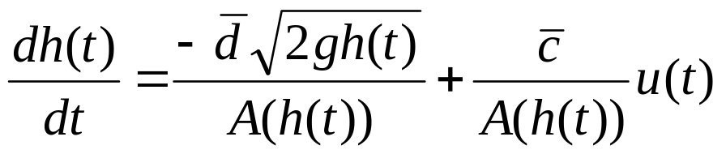
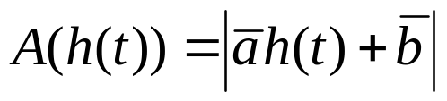
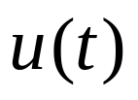
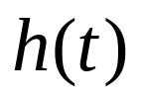


IWO/PSO for Adaptive Control
Liquid Level Control for a Surge Tank
Unknown tank cross-sectional area
: input
: liquid level
: desired level
12

Slide 13

IWO/PSO for Adaptive Control
Pick best
model
IWO/PSO Algorithm
Multiple model
Identification
strategy
Plant
Parameters
Population of Models
Reference Model
Best Model
Cost= Sum of squares
of N=100 past values
for each model
Certainty Equivalence Control Law
Controller
Plant
Indirect adaptive control¹ for liquid level control of surge tank with IWO/PSO algorithm
¹for more detailed investigation in indirect adaptive control with population based evolutionary algorithms,
one might see: W. Lennon and K. Passino, “Genetic adaptive identification and control,” Eng. Applicat. Artif. Intell., vol. 12, pp. 185-200, Apr. 1999.
13
Notes:
fdsfdsfa

Slide 14
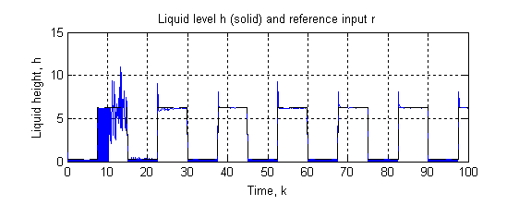
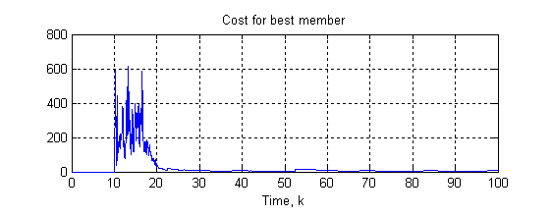
IWO/PSO for Adaptive Control
IWO/PSO for adaptive control of a surge tank
14

Slide 15
Concluding Remarks
Biomimicry for Decision Making and Control
  Organism evolved and learned to solve technical problems
  Transfer of ideas
  Biomimicry for Computational Intelligence
IWO/PSO Algorithm
  Swarming, Collaborative Communication, Colonization, Competition in an Evolutionary framework
  Fast convergence and high ability for Global search
    non-differentiable objective functions with a multitude number of local optima
  Online Optimization for adaptive control
Stability and Convergence Analysis?
15

Slide 16
05/19/2009
Thanks for Your Adaptive Attention Control!

