Slide 1
Conceptual Imitation Learning Based on Functional Effects of Action
28/04/2011
Hossein Hajimirsadeghi
School of Electrical and Computer Engineering,
University of Tehran, Iran

Slide 2
Outline
Introduction
  Imitation Learning
  Concepts
  Conceptual Imitation Learning
  Problem Statement
Hidden Markov Models
  Definition & Main Problems
The Proposed Algorithm
Experiments
Conclusions
2
Notes:
fdsfdsfa

Slide 3
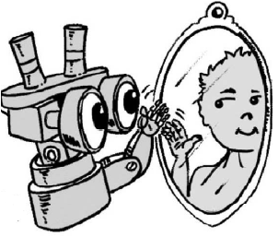
What is Imitation Learning?
Imitation Learning is A Type of Social Learning
  Transmitting skills and knowledge from an agent to another agent
Why is it Beneficial?:
  In General:
    Safety Increase
    Speed Increase
    Energy Consumption Decrease
  In Robotics:
    User-friendly and simple means of programming
3
Notes:
fdsfdsfa

Slide 4
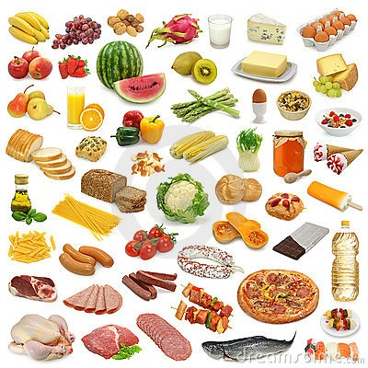

Concept
What is a Concept?
  A representation of world in agent’s mind (General)
  A unit of knowledge or meaning made out of some other units which share some characteristics (Zentall et al., 2002)
    Example: A Specific Food
    Example: General Food Concept
4
Notes:
fdsfdsfa

Slide 5
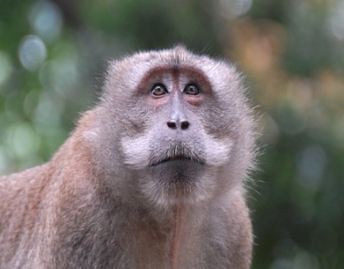
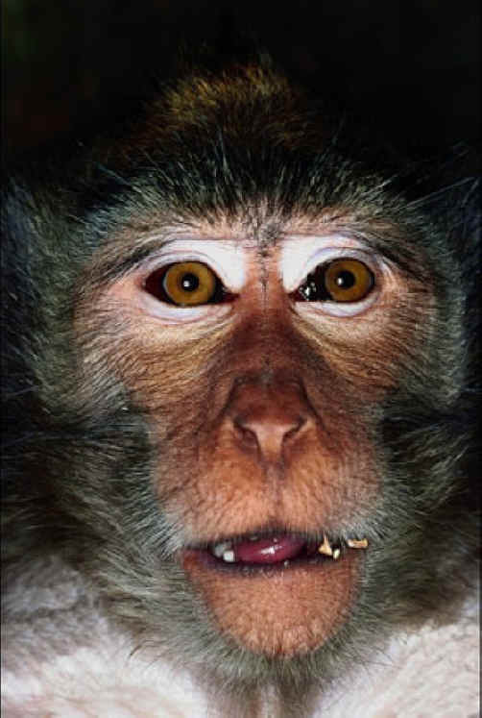


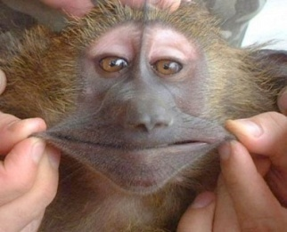
Concept Representations
Exemplar
Prototype
5
Notes:
fdsfdsfa

Slide 6
Types of Concepts
Perceptual Concepts
Relational Concepts
Associative Concepts
Perceptual Similarity
Perception & Functional
Similarity
Functional Similarity
A Concept
A Concept
Perceptual Space
Needs an external information
6
Notes:
fdsfdsfa

Slide 7
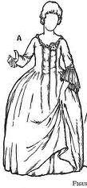
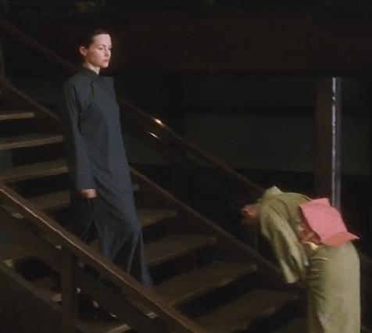
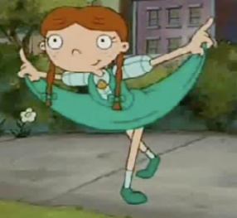




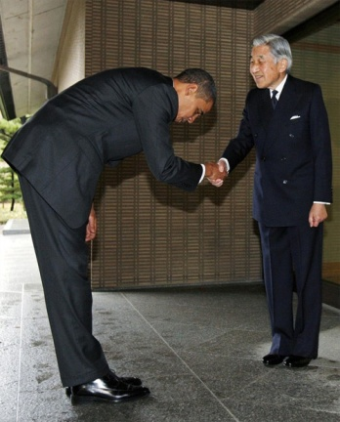
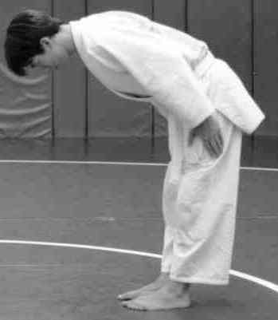

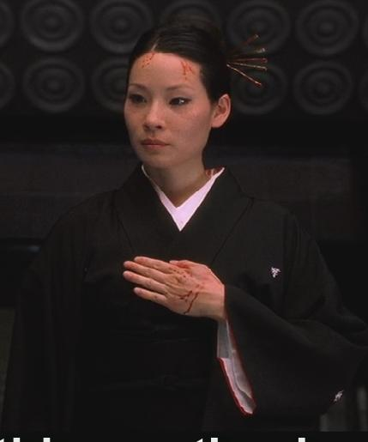
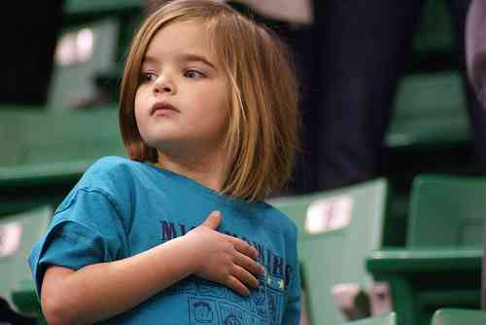





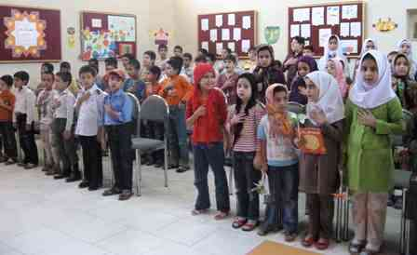
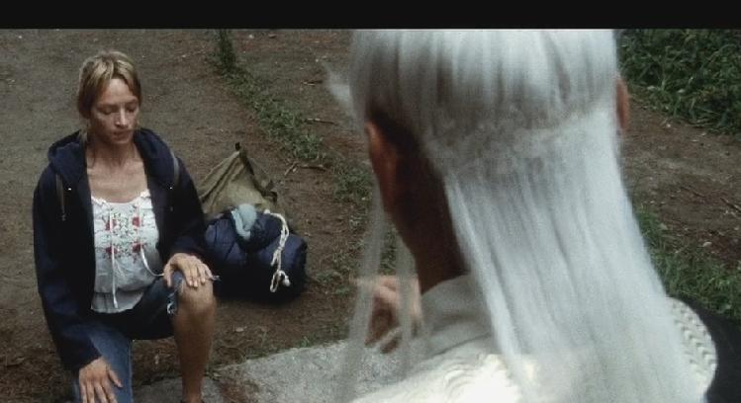
A Real Example of Relational Concepts
Concept of
Respect
2
Notes:
fdsfdsfa

Slide 8
Conceptual Imitation Learning
Low Level Imitation
  Mimicking
True Imitation
  Understanding
  Generalization
  Recognition
  Generation
Needs Conceptualization & Abstraction
8
Notes:
fdsfdsfa

Slide 9
State-of-the-Art Works on Imitation and Conceptual Abstraction
Perceptual Concepts
Samejima et al. (2002)
Cadone & Nakamura (2006)
Inamura et al. (2004)
Calinon & Billard (2004)
Calinon et al. (2005)
Billard et al. (2006)
Takano & Nakamura (2006)
Lee et al. (2008)
Kulic et al. (2008, 2009)
Relational Concepts
Mobahi et al. (2005, 2007)
Hajimirsadeghi et al. (2010)
Using modular
controllers and predictors
Integration of Recognition and Regeneration
Using Associative Neural
Networks
Stochastic Modeling with
Hidden Markov Models
Autonomous & Incremental Concept Learning & Acquisition
Only for Single Observations
Deterministic Modeling
Learning Concept through Interaction with the Teacher
One-to-one relation between concepts and actions
9
Notes:
fdsfdsfa

Slide 10
Our Proposed Model
Relational Concepts
Functional Similarity is Identified by the Effects
Suitable for Sequence of Observations
Stochastic Modeling with
Hidden Markov Models
Integration of Recognition and Regeneration
Autonomous & Incremental Concept Learning & Acquisition
Each Concept is Represented by All Perceptual Variants of an Action
10
Notes:
fdsfdsfa

Slide 11
Problem Statement
Proposing an Incremental and Gradual Learning Algorithm for Autonomous Acquisition, Generalization, Recognition, and Regeneration of Relational Concepts through perception of Spatio-Temporal demonstrations and Identifying their Functional Effects.
Main Ideas:
  Using Prototypes (Start From Exemplar, End with Prototypes)
  A Prototype Abstracts Perceptually Similar Demonstrations.
  A Concept Emerges as a Set of Prototypes which Have Similar Functionalities.
  Functional Similarity between Demonstrations is Understood by Recognizing their Functional Effects (External Information).
11
Notes:
fdsfdsfa

Slide 12




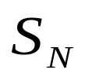
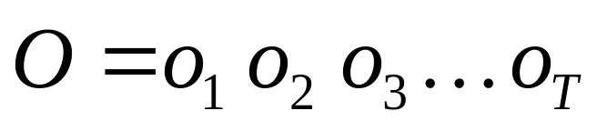
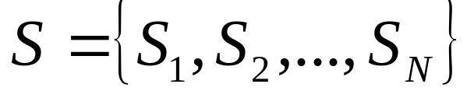


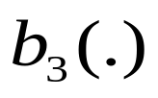
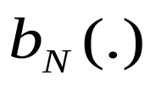


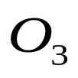

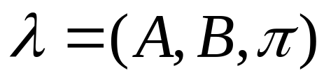
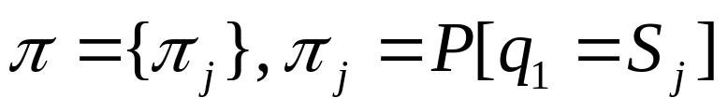
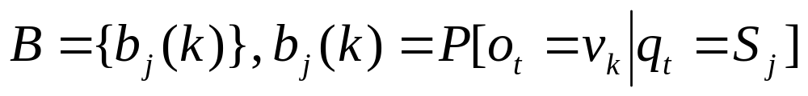
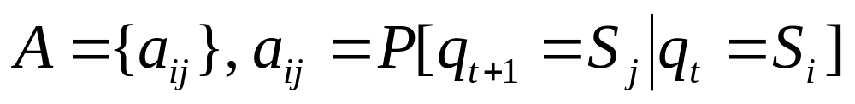
Hidden Markov Models
12
Notes:
fdsfdsfa

Slide 13




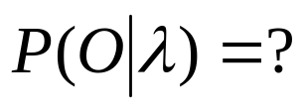

Main Problems for HMMs
Training
  Given or
Evaluation
  Given and
Sequence Generation
  Give
Solution: Baum-Welch Algorithm (Re-estimation Formulas)
HMMs can be used for Both Recognition and Generation
Solution: Forward Algorithm
Conceptual
Imitation
Learning
Solution: Estimation of State Duration
+ Greedy Selection of Consecutive States and Observations
+ Curve Fitting
13
Notes:
fdsfdsfa

Slide 14
The Proposed Algorithm
Some Definitions:
  An exemplar is an HMM trained by only one demonstration
  A prototype is an HMM made out of unifying perceptually the same exemplars
  Exemplars are stored in the Working Memory (WM)
  Prototypes are stored in the Long-term Memory (LTM)
  A concept is a set of HMM exemplars and prototypes, sharing the same functional effects.
Exemplar
Prototype
Concept 1
Concept 2
Concept 3
.
.
.
WM
Concepts
LTM
14
Notes:
fdsfdsfa

Slide 15


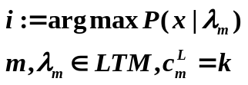



A New Action is Demonstrated
x := Sense()
Effect
The effect of demonstrated action is recognized
The effect has an
equivalent sensory-motor
concept in the memory
Yes
No
:= the equivalent
sensory-motor
concept in the
memory
There is at least one prototype for concept
Make new exemplar with x
Make new concept with this exemplar
No
Yes
Find the most probable prototype of concept
Yes
No
is the minimum log likelihood of the sequences previously encoded into the HMM prototype
Make new exemplar with x for the concept
…
15
Notes:
fdsfdsfa

Slide 16
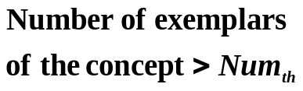
…
No
Yes
Cluster exemplars and prototypes of the concept
Being Sufficiently Cohered
Including Sufficient Number of Elements
Prototyping criteria are satisfied
Yes
No
Make new prototypes for the concept
16
Notes:
fdsfdsfa

Slide 17



After Learning (Recall Phase)
1. An Action is Demonstrated
Prototypes & Exemplars
Concepts
Actions
2. The New
Demonstration is
Perceived (Perception Sequence)
C1
Action 1
4. Most Probable Concept is retrived
5. The action is Executed
3. Probability of Observation is
Computed Against
All the Prototypes
C2
Action 2
C3
Action 3
17
Notes:
fdsfdsfa

Slide 18



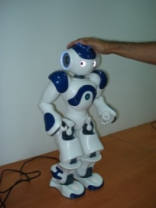

Experiment: Conceptual Hand Gesture Imitation Based on their Emotional Effects
There are a teacher, a humanoid robot, and a human agent
  The teacher demonstrates a gesture
  The human agent makes an emotional response (effect of the teacher’s action)
  The robot perceive the demonstrations and recognize the emotional response
# | Concept | Human Agent’s Response | Action 1 | Action 2 | Action 3
1 | Anger | Angry Face | Striking from Left | Striking from Right | -
2 | Unhappiness | Unhappy Face | Hitting the Head | Hitting the Chest | -
3 | Happiness | Happy Face | Throwing Fist Up & Down | - | -
4 | Love | Caressing the Robot’s Tactile Sensor | Air Kiss | Sketching Heart Sign | Caressing the Face
5 | Disgust | Disgusted Face | Cut-Throat Gesture | - | -
18

Slide 19
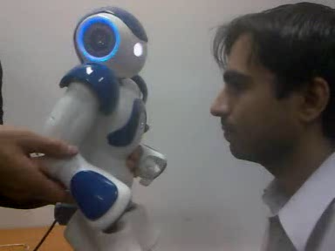
Experiment: Conceptual Hand Gesture Imitation Based on their Emotional Effects
Kinesthetic Teaching for Making Demonstrations
For Facial Expression Recognition, we used Eigen Face Algorithm (Turk 91)
  Principal Component Analysis
  1-Nearest Neighbor
19

Slide 20
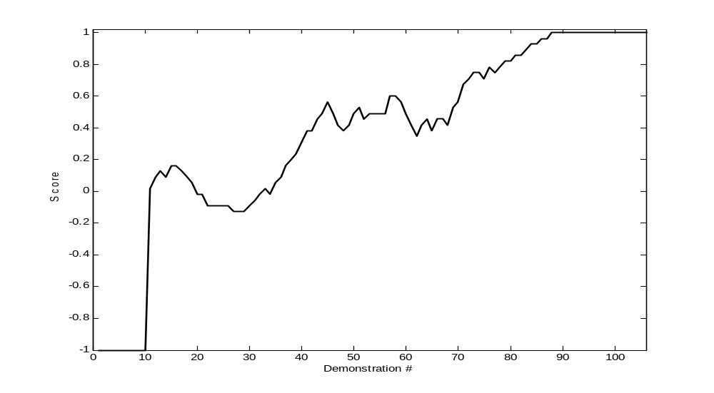
Results
Perception Sequences are incrementally entered to the learning algorithm
K-fold Cross Validation with k=5
Scoring Mechanism:
  +1(Hit)
  -1(Miss)
20

Slide 21
Results
Number of Generated Prototype For Each Experiment
Experiment# | Anger | Unhappiness | Happiness | Love | Disgust | Sum
1 | 2 | 2 | 1 | 3 | 2 | 10
2 | 2 | 2 | 1 | 3 | 1 | 9
3 | 2 | 2 | 2 | 3 | 2 | 11
4 | 2 | 2 | 2 | 3 | 2 | 11
5 | 2 | 2 | 2 | 3 | 1 | 10
21

Slide 22
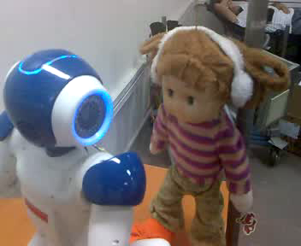
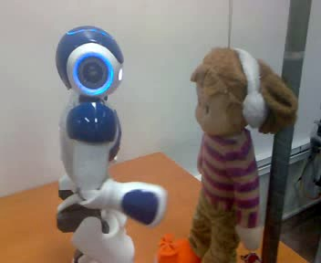
Results
Robot Gesture Reproduction
22

Slide 23
Conclusion
An Incremental and Gradual Learning Algorithm for Autonomous Acquisition, Generalization, Recognition, and Regeneration of Relational Concepts through perception of Spatio-Temporal demonstrations and their Functional Effects
Outcome: An Agent is Trained Who can make Functional Effects in the Environment
23
Notes:
fdsfdsfa

Slide 24
Conclusions
Consequences of Imitation Learning by Relational Concepts:
  Recognition of Novel Demonstrations of the Learned Concepts
  No Need of Motor Learning for Previously Learned Concepts
  If Motor Programs are Learned for the Perceptual Variants of A Concept,
    Flexibility of Choice between the alternatives
  Less Concepts
    Smaller Representation of World
    Simpler Interaction with World
    Smaller Memory
    Simpler Search
  Ease of Knowledge Transfer
    from an Agent to Another Agent
    from a Situation to Another Situation
24
Notes:
fdsfdsfa

Slide 25
28/04/2011
Thanks for Your Attention

Slide 26
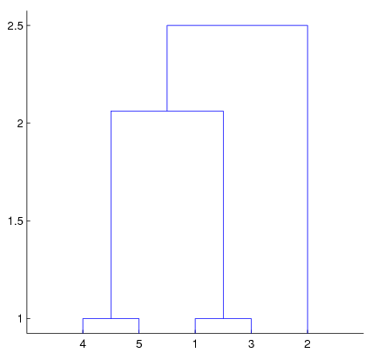
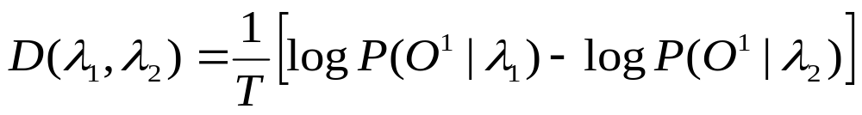
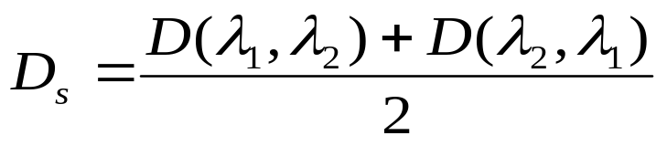

Clustering
Clustering All HMM Exemplars and Prototypes of A Concept
Pseudo-Distance Definition (Rabiner 1989)
Agglomerative Hierarchical Clustering
18

Slide 27
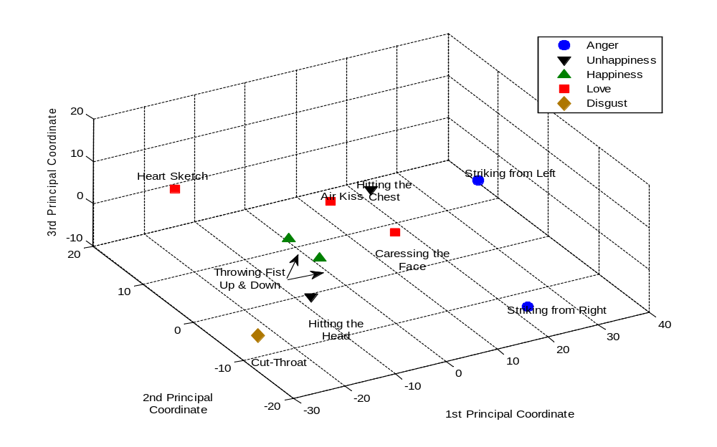
Results
Proto-Symbol Space of HMM Prototypes (Using Multidimensional Scaling Method)
23

Slide 28
What is Imitation Learning?
Imitation Learning is A Type of Social Learning
  Transmitting skills and knowledge from an agent to another agent
Why is it Beneficial?:
  In General:
    Safety Increase
    Speed Increase
    Energy Consumption Decrease
  In Robotics:
    User-friendly means of programming
    Better regeneration of human-like movements
    understanding mechanisms for developmental organization of perception-action integration in animals.
3
Notes:
fdsfdsfa

Slide 29
Conceptual Imitation Learning
Low Level Imitation
  Mimicking
True Imitation
  Understanding
  Recognition
  Generalization
  Generation
Importance of Conceptual Imitation Learning
  Recognition of Novel Demonstrations
  No Need of Motor Learning for Previously Learned Concepts
  Less Memory, Easy Search
  Ease of Knowledge Transfer from Agent to Agent
  For Concepts with Functional Abstraction:
    Less Concept, Smaller Representation of World, Simpler Interaction with World
    Motor Learning for Only one of the Perceptual Variants
      Else: Flexibility of Choice between the alternatives
    Ease of Knowledge Transfer from a Situation to Another Situation
Needs Conceptualization & Abstraction
8
Notes:
fdsfdsfa

Slide 30
Importance of HMMs for Conceptual Imitation Learning
Simultaneous Modeling of the Statistical Variations in
  Dynamics of Observation Sequence &
  Amplitude of Observations
A Unified Mathematical Model for Both
  Recognition
  Generation
14

Slide 31

Clustering
Clustering All HMM Exemplars and Prototypes of A Concept
Pseudo-Distance Definition (Rabiner 1989)
Agglomerative Hierarchical Clustering
Conditions For Cluster Selection:
  Falling Behind the Threshold Distance
  Surpassing Minimum Number of Elements
19

Slide 32
Clustering
Prototypes and Exemplars
Concepts
Actions
C1
Action 1
Prototyping the Selected Clusters and save in the LTM
Also Save the value of for the new prototypes
LTM
20

Slide 33
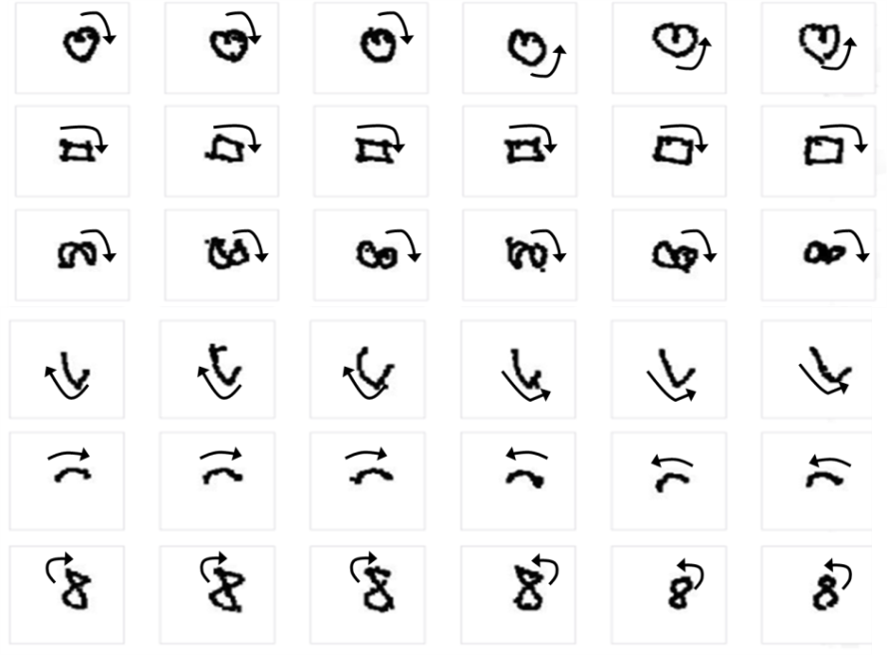
Experiment: Human-Robot Interaction Task
Conceptual Hand Gesture Imitation
43
The concepts are Relational
Demonstrations are incrementally entered to the proposed algorithm
23
20
42
42
40
19

Slide 34
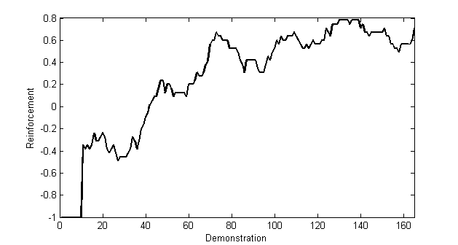
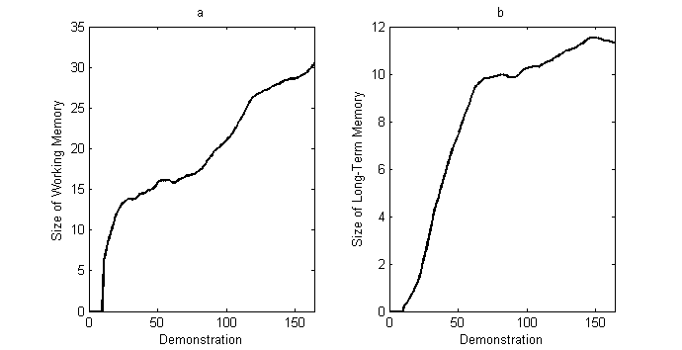
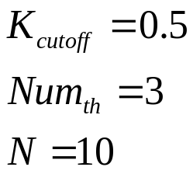
Results
Perception Sequence is a 2-D Signal of Changes in the Hand Path of Demonstrator
K-fold Cross Validation with k=5
Reinforcement Signals:
  +1(reward)
  -1(punishment)
Parameter Settings:
21

Slide 35
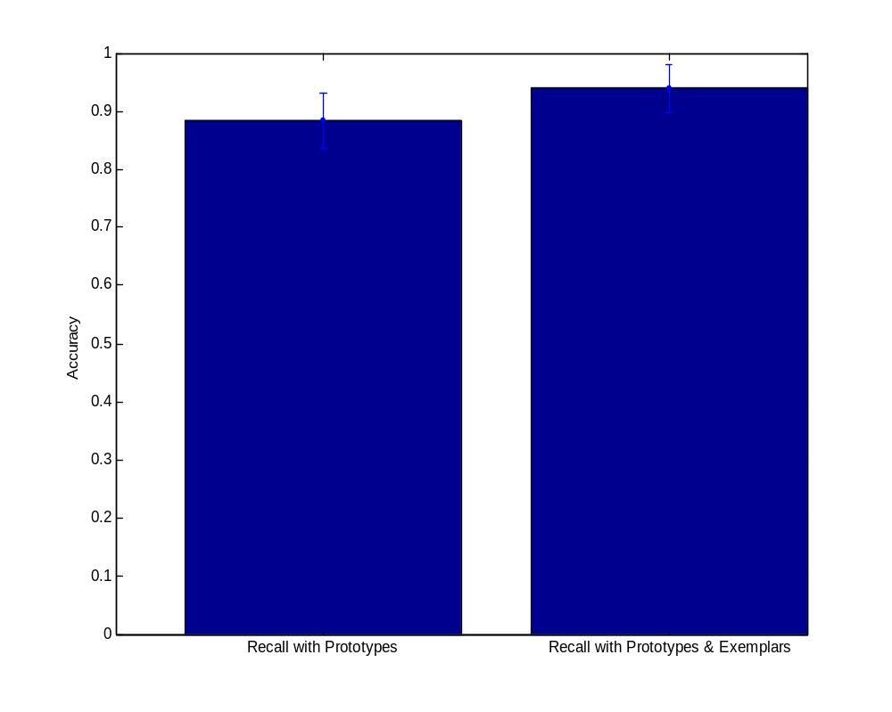
Results
Recognition Accuracy After Learning
  Use Only Prototypes
  Use Prototypes and Exemplars
26

Slide 36
Conclusion
An Incremental and Gradual Learning Algorithm for Autonomous Acquisition, Generalization, Recognition, and Regeneration of Relational Concepts through perception of Spatio-Temporal demonstrations of the Teacher
  Using Prototypes to Represent Concepts
  A Prototype Abstracts Perceptually Similar Demonstrations of a Concept
  A Concept Comprises a Set of Perceptual Prototypes which Have Similar Functionalities.
  Functional Similarity between Demonstrations is understood by Interaction with the Teachers (External Information).
28
Notes:
fdsfdsfa

Slide 37
Conclusions
Future Works:
  Using HMMs for Multimodal Integration of Heterogeneous Perceptions
    Representation and Recognition of Multimodal Concepts
  Concept Recognition with Incomplete Observation Sequences
  Conceptual Imitation Learning Based on Functional Effects of Action
    E.g., emotional effects of action
  Multi-Resolution Representation of Concepts by Hierarchical Organization of Prototypes
30
Notes:
fdsfdsfa

