Slide 1
Automatic Artifact Identification in Image Communication using Watermarking and Classification Algorithms
Shabnam Sodagari, Hossein Hajimirsadeghi, Alireza Nasiri Avanaki
Control and Intelligent Processing Center of Excellence, School of ECE, University of Tehran,
P. O. Box 14395-515, Tehran, Iran
Emails: shabnam@ieee.org, h.hajimirasdeghi@ece.ut.ac.ir, avanaki@ut.ac.ir

Slide 2
Introduction
In Communication of Images through networks and channels:
Quality Degradation by noise
Relevant noise types : AWGN, Salt and Pepper, Packet Loss, JPEG
For each noise type, there exists a solution to conceal its effects.
Problem: Identify the noise type, which has affected the image at the receiver

Slide 3
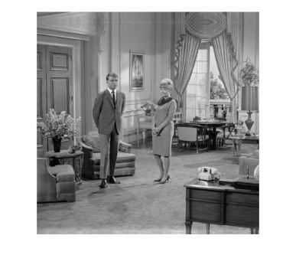

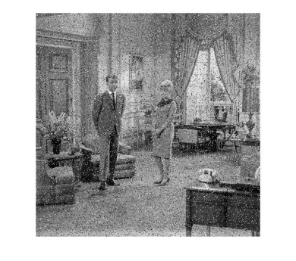
Process
Histogram Calculation
Robustness ?
Invisibility?
Watermarking
…
Communication Line
Original Image
Watermarked Image
Retrieving Watermarked Histogram
Which
Technique?
EUREKA!!
Noise is Identified
Which Features?
…
…
Machine Learning
Communication Line
Removing the Noise
Noisy Image
Histogram Calculation

Slide 4
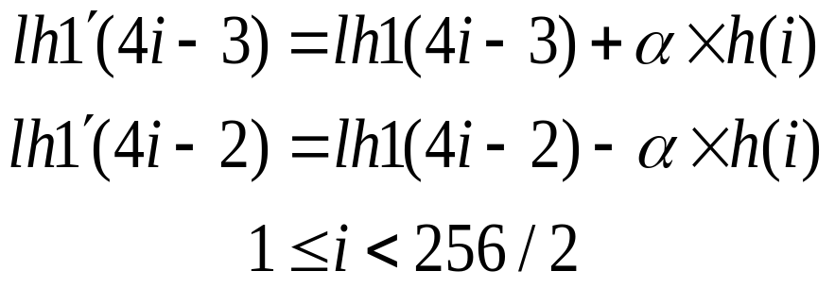
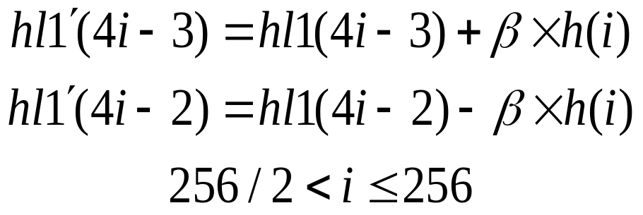


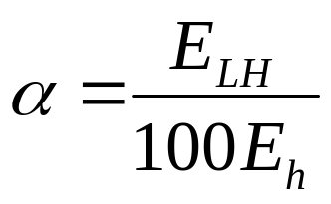
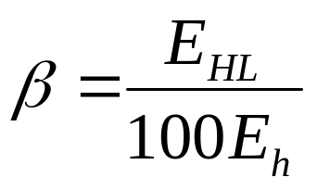
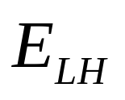
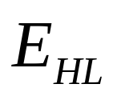
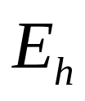
The applied data hiding scheme
1- Histogram with 256 bins is calculated
2- DWT is calculated
3- Histogram is embedded in DWT Coefficients
Invisibility
and
,
and
the energies of horizontal and vertical detail coefficients and the histogram respectively.

Slide 5


Invisibility of our Watermarking Scheme
original image
watermarked image

Slide 6
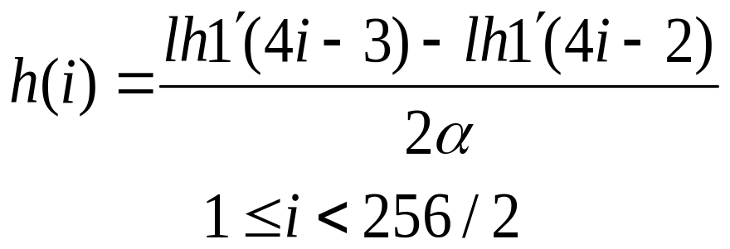
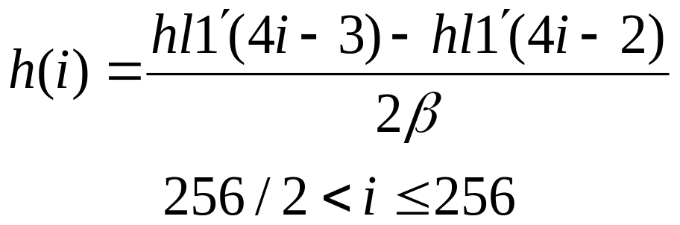
Extraction of the Intact Embedded Histogram at the Receiver
Robustness
variations in neighboring wavelet
coefficients are not considerable

Slide 7
Classification
Feature Extraction from Histogram:
  2nd to 7th moments of the Histogram
Classification Algorithms:
Validation
MLP ANN
SVM
KNN
Bayesian
Linear Discreminant
MMD
2nd and 3rd moments
PCA
3 Combined Features

Slide 8
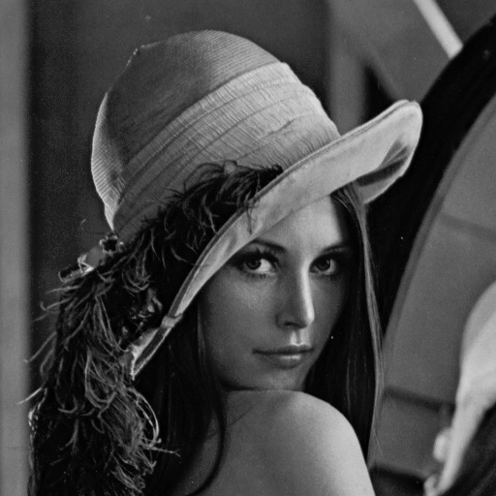
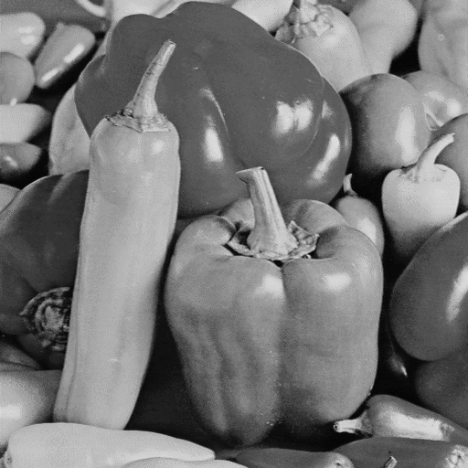
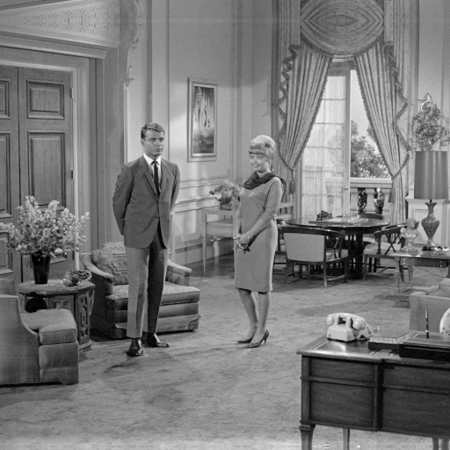
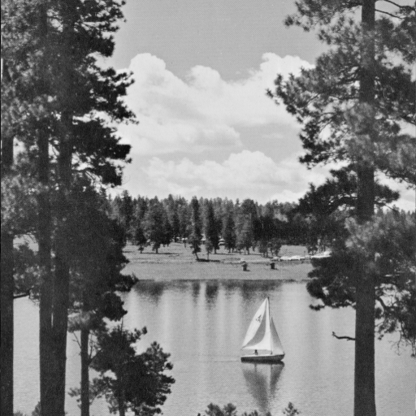
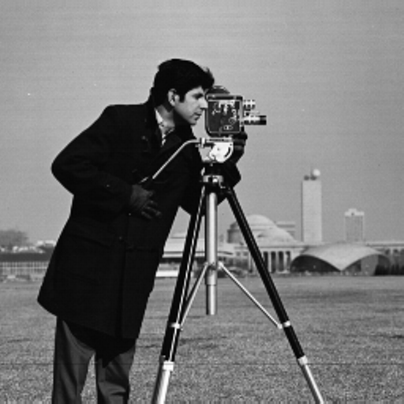
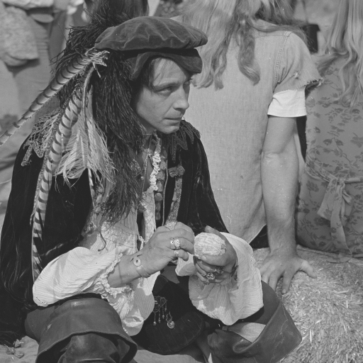
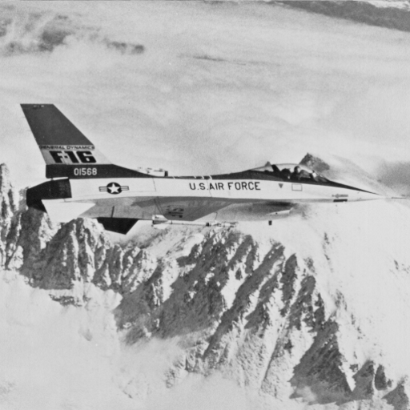
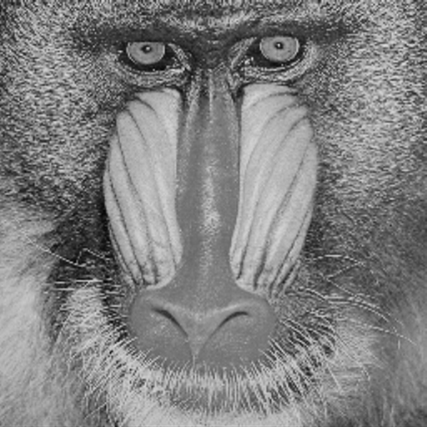
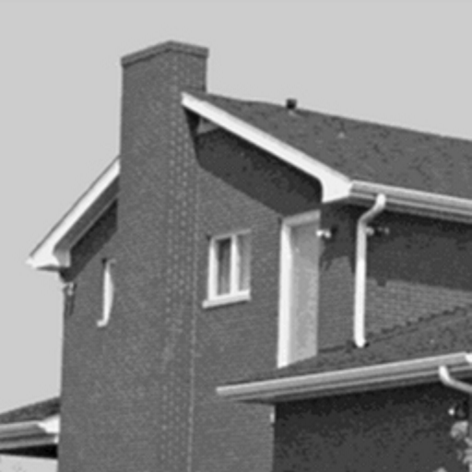
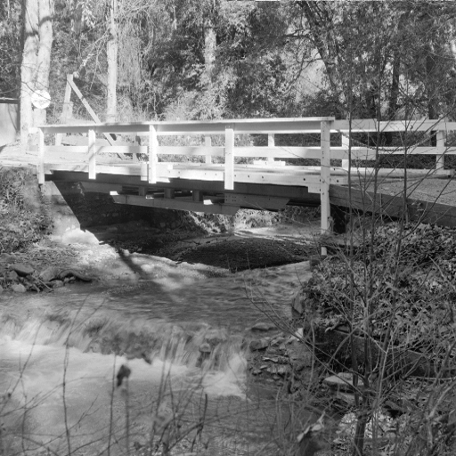
Simulation
Salt & Pepper (density range of 1%-70%)
AWGN (quality factors 35-90)
Packet Loss (loss probabilities of 2%-70%)
JPEG (PSNR’s ranging from 8-29 dB)
Noise Types
TRAIN
TEST

Slide 9


Results
Classifier | Accuracy
MLP | 0.864
SVM | 0.840
KNN | 0.829
Bayesian (kNN) | 0.826
Bayesian (Gaussian) | 0.824
Linear ( ) | 0.802
Bayesian (Parzen) | 0.772
Linear ( ) | 0.768
MMD | 0.528

Slide 10
Conclusions
Automatic Identification of dominant Noise
  Roust Watermarking Method
  Histogram Statistics as Feature Vectors
  Accuracy of 0.86 using MLP ANN with 2nd and 3rd moments of histogram as features
Future Work:
  Similar works for color images and video communication
  Identification of all noise categories when more than 1 noise type affect the image
  Using a rough estimate of the histogram of each block

Slide 11
Thanks for Your Attention

