Slide 1
Experimental Report
4.2.2026

Slide 2
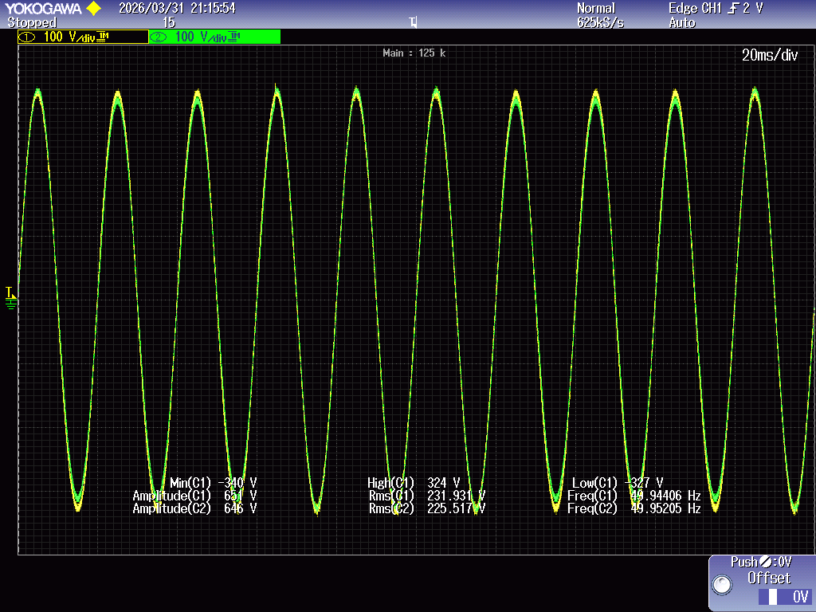
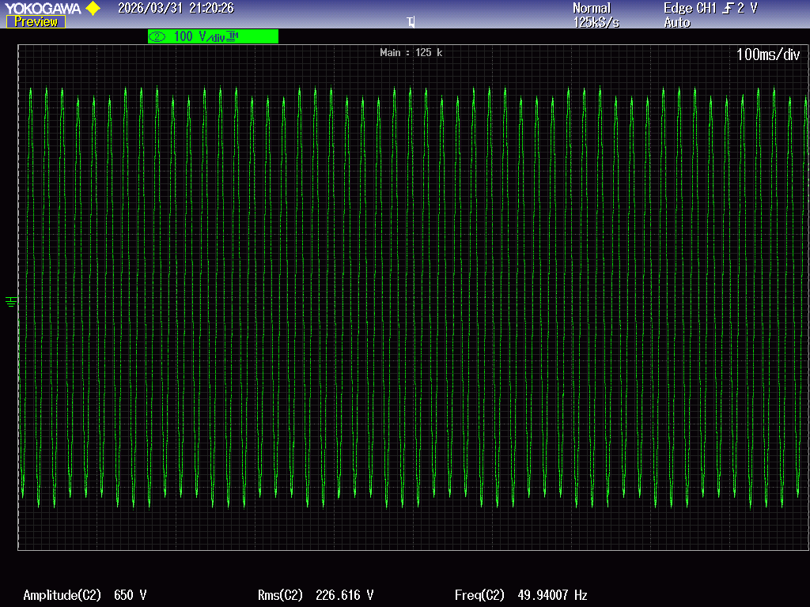
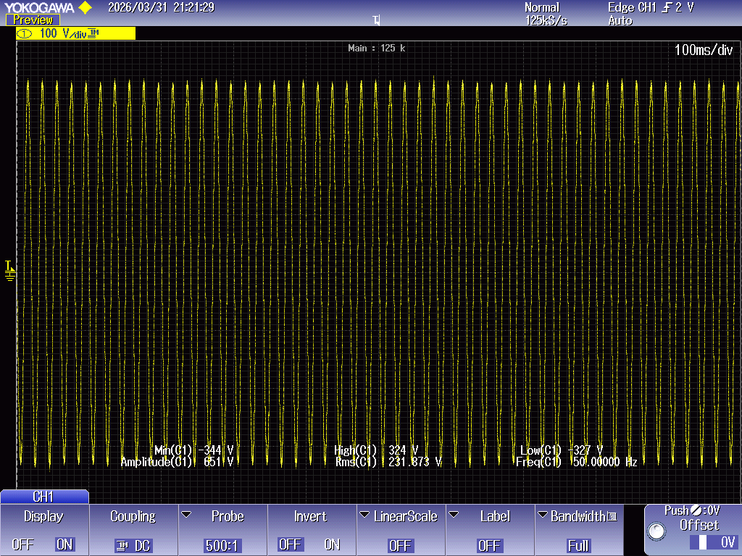
Experimental Investigation of Voltage Flicker at 8 Hz Modulation (230V - 219V)
Figure 1 Voltage waveform comparison: Grid voltage with flicker vs. DVR output
Figure 2 Grid voltage with Flicker
Figure 3 DVR output
Channel 1: After Inject Voltage
Channel 2: Grid With Flicker

Slide 3
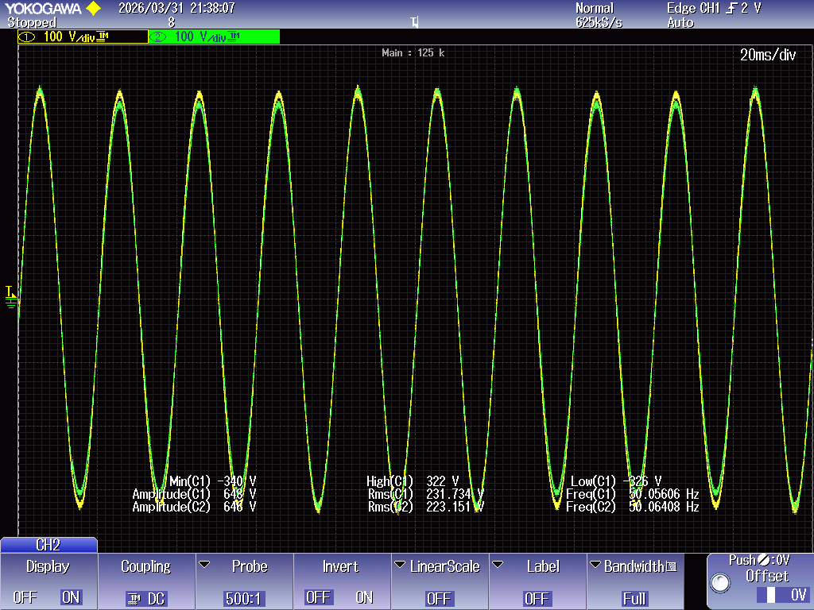
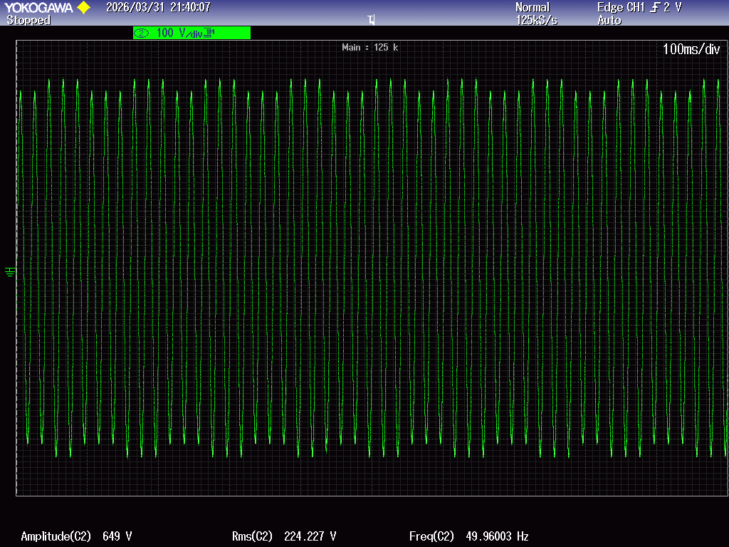
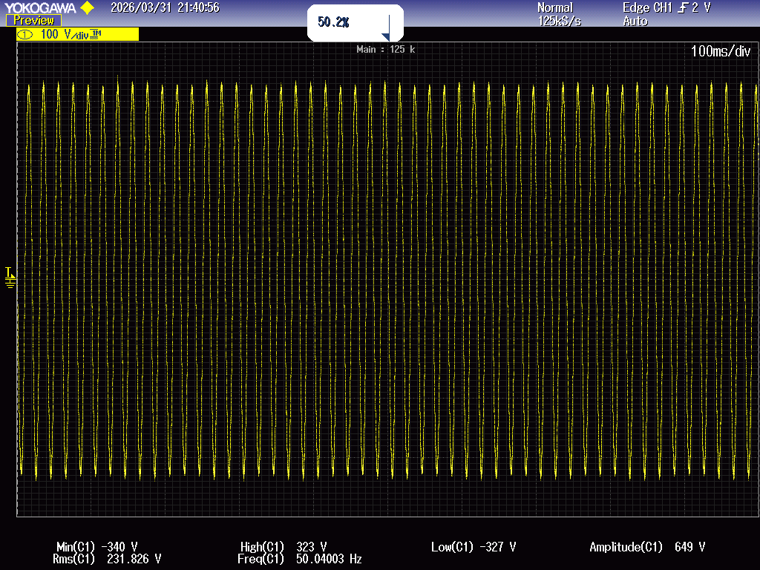
Experimental Investigation of Voltage Flicker at 8 Hz Modulation (230V - 215V)
Figure 1 Voltage waveform comparison: Grid voltage with flicker vs. DVR output
Figure 2 Grid voltage with Flicker
Figure 3 DVR output
Channel 1: After Inject Voltage
Channel 2: Grid With Flicker

Slide 4
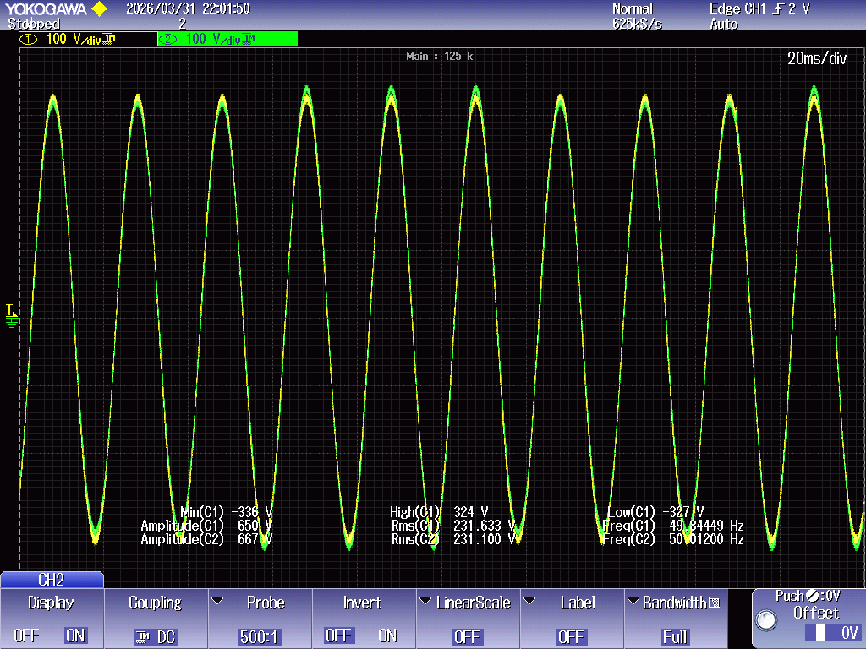
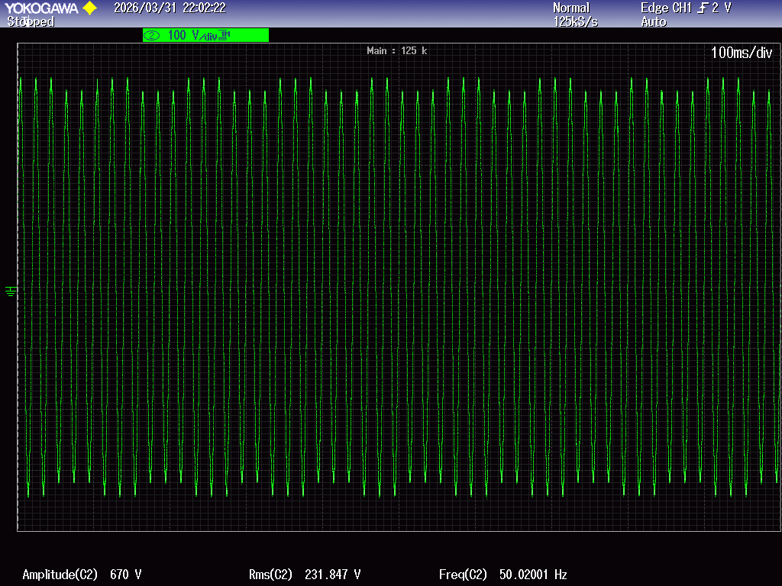
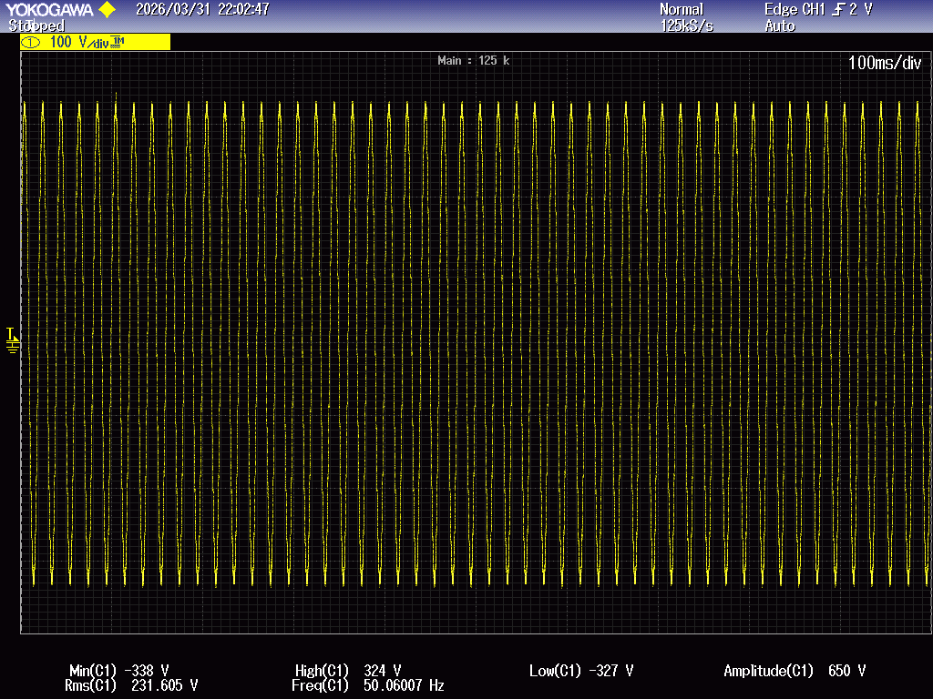
Experimental Investigation of Voltage Flicker at 8 Hz Modulation (237.5V – 222.5V)
Figure 1 Voltage waveform comparison: Grid voltage with flicker vs. DVR output
Figure 2 Grid voltage with Flicker
Figure 3 DVR output
Channel 1: After Inject Voltage
Channel 2: Grid With Flicker

