Slide 1

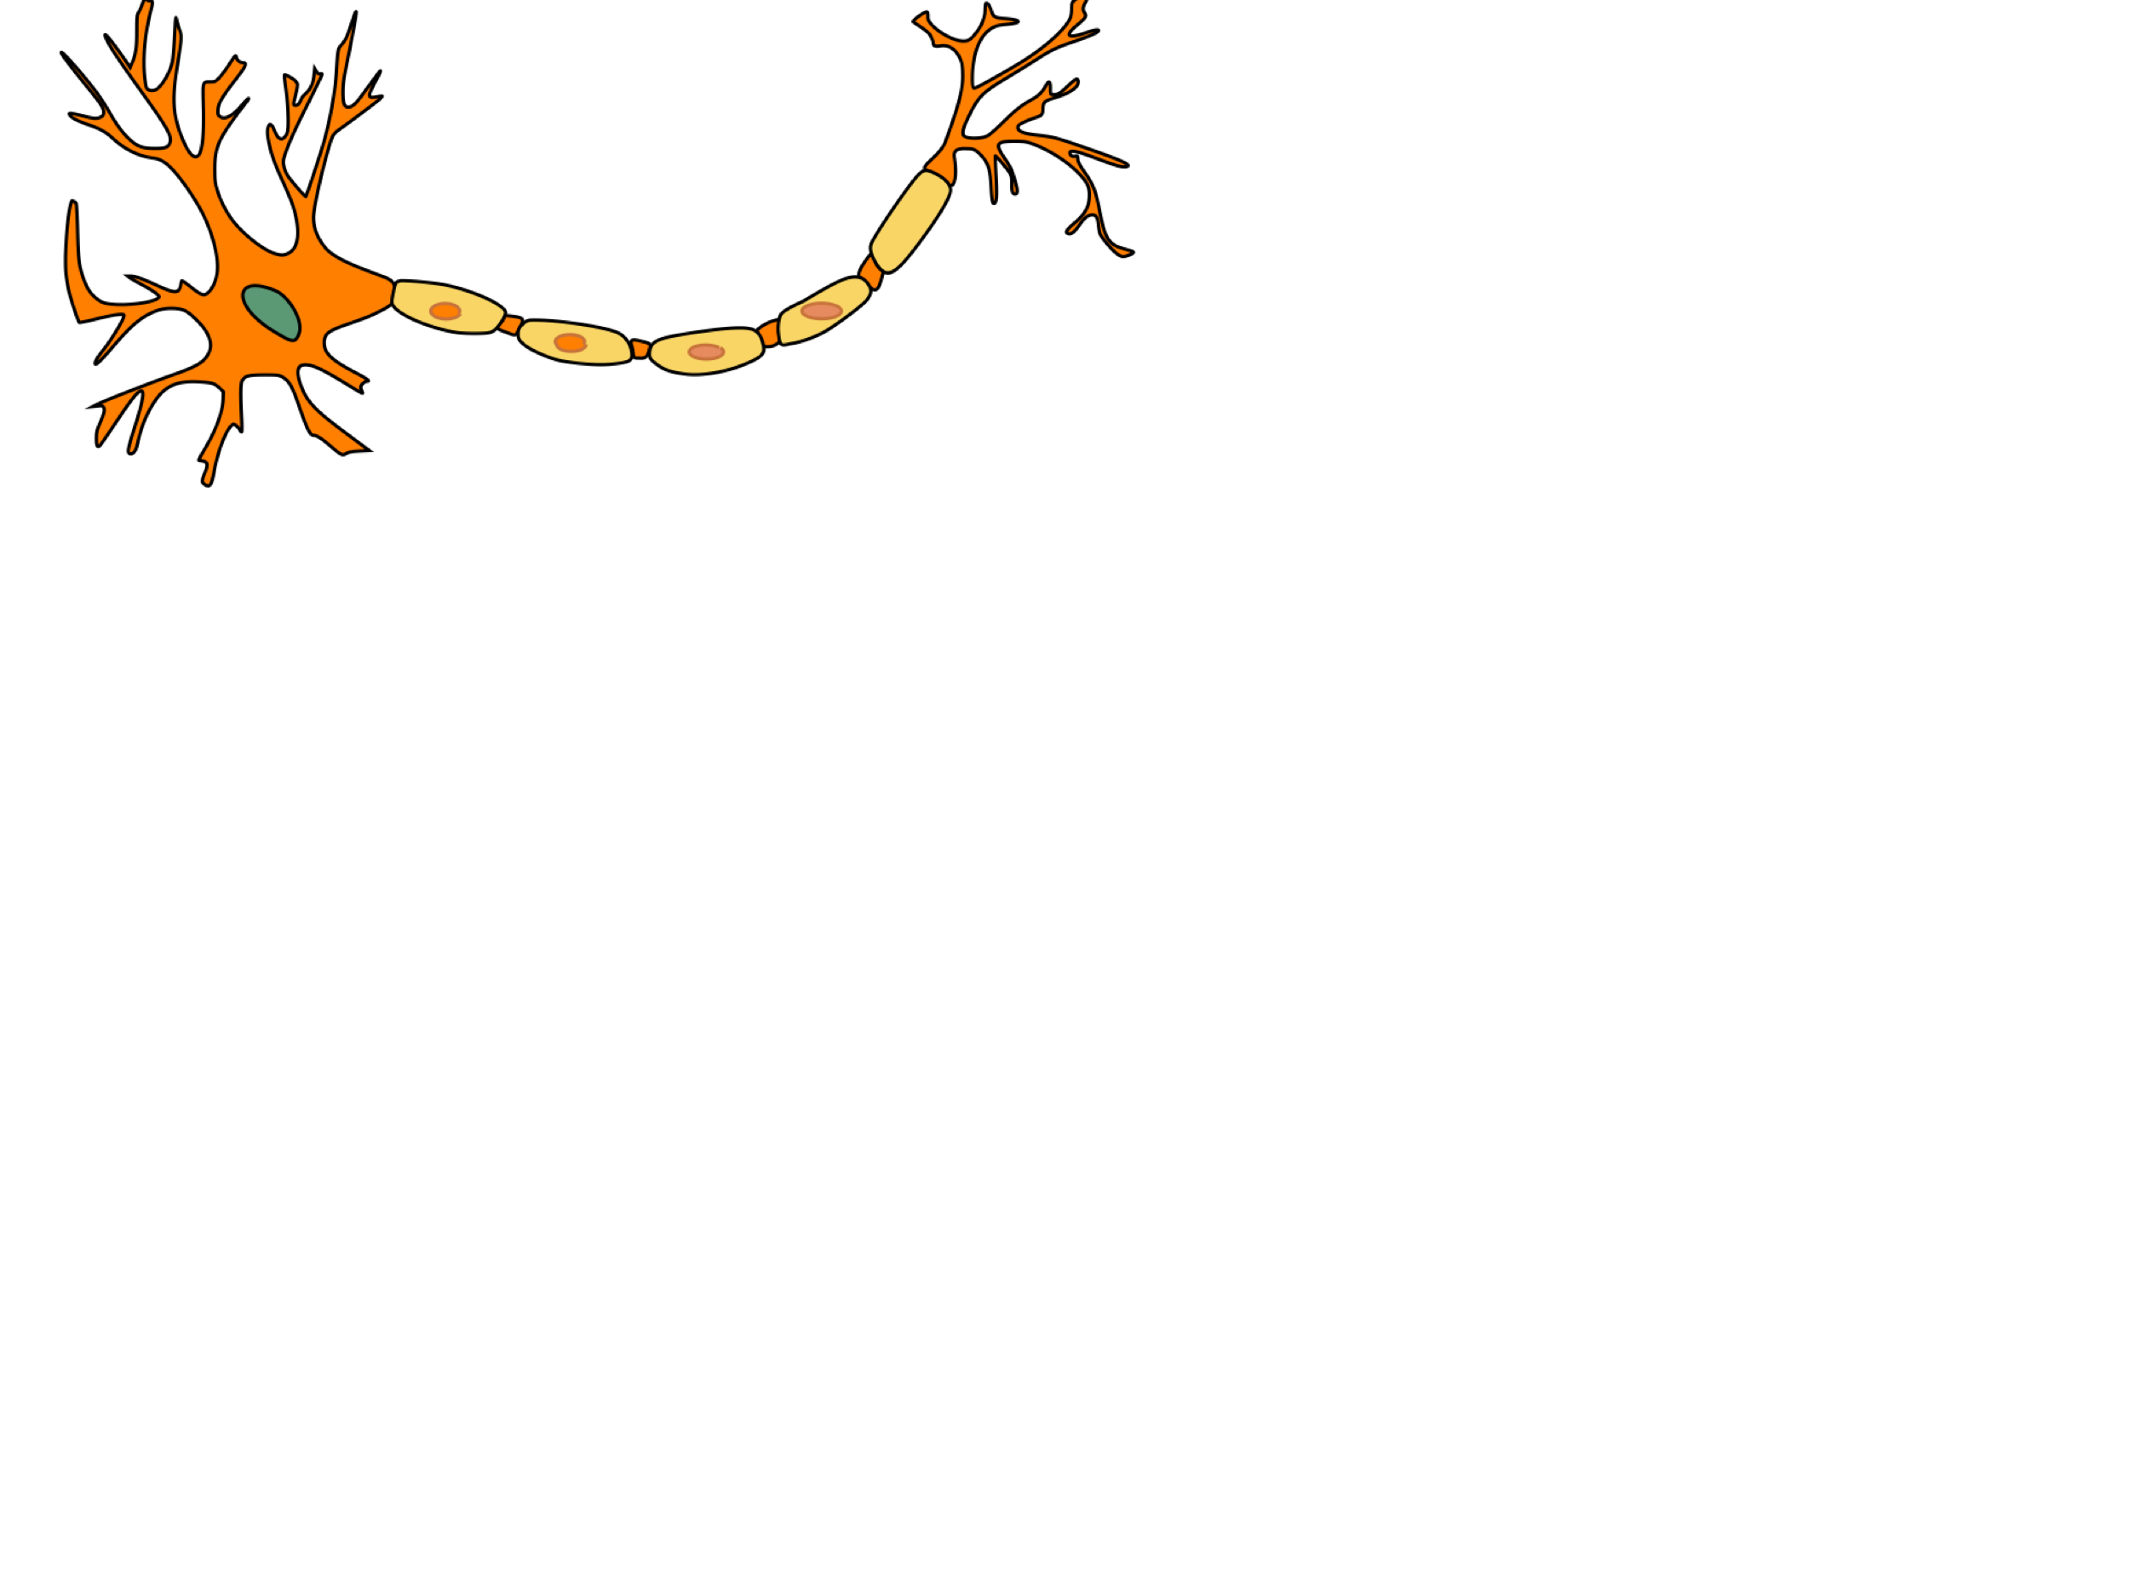
Project Logic Brain : a Binary Neural Networks acceleration
Presented by:
Alexandre Riviello
Nathan Heraief
Mohammad Hossein Askari

Slide 2
1. Introduction
Context:
The basic audio recognition Tensorflow models are based off a paper written by Sainath et al. in 2015.
A group of researchers at the University of Waterloo decided to reimplement these models in PyTorch to be consistent with the other researchers in their department.
Their implementation includes the preprocessing of the audio inputs and the CNN models that are found in the Tensorflow library.
https://www.isca-speech.org/archive/interspeech_2015/papers/i15_1478.pdf
https://arxiv.org/pdf/1710.06554.pdf

Slide 3
2. Presentation Plan
Structure:
Project overview
Memory management
Neural core
Controller unit
Improvements

Slide 4
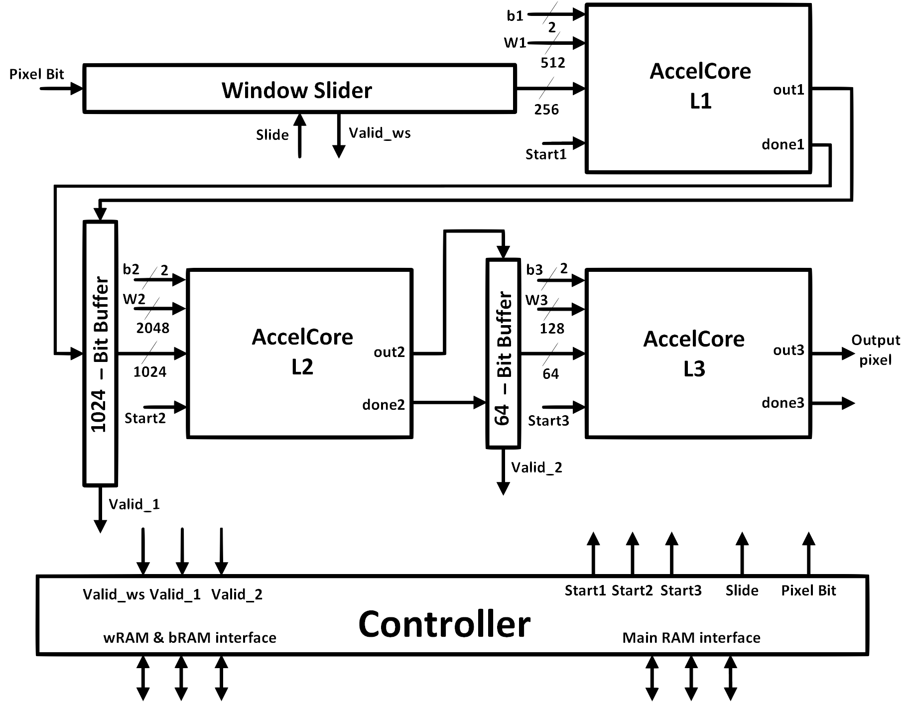
3. Project Overview
Context:

Slide 5
4. Memory Management
Description of our Memory handle process:

Slide 6
4. Memory Management
Simulation, and results

Slide 7
5. Neural core
Simulation, and results

Slide 8
6. Controller Unit
Explanation of the Python code for the preprocessing (part 3)

Slide 9
5. Improvements
Explanation of the Python code for the preprocessing (part 4)

Slide 10
6. Conclusion
Explanation of the Python code for the preprocessing (part 4)

Slide 11
7. References
Explanation of the Python code for the preprocessing (part 4)

