Slide 1


In The Name of God
Programming Languages : Kotlin
Teacher : Dr. Morteza Keshtkaran
Provided by : Hossein Dehghanipour
Fall 2019

Slide 2
Introduction
The syntax is pretty much similar to Java
Kotlin is based on JVM
Better performance and small runtime
No Static Declaration − Kotlin does not have usual static handling modifier like Java

Slide 3
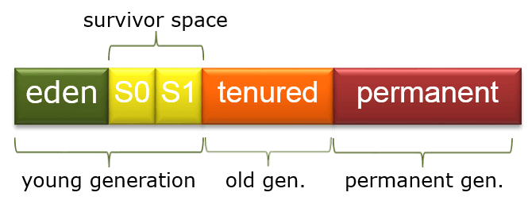
Garbage Collector :
Garbage Collection (5)
Kotlin is run in JVM so it uses the same garbage collector as Java or any other JVM based language. Oracle’s HotSpot is by far the most common GC .
Java garbage collection is an automatic process. The programmer does not need to explicitly mark objects to be deleted. The garbage collection implementation lives in the JVM. Each JVM can implement garbage collection however it pleases.
All of HotSpot’s garbage collectors implement a generational garbage collection strategy that categorizes objects by age. The rationale behind generational garbage collection is that most objects are short-lived and will be ready for garbage collection soon after creation.

Slide 4
HotSpot GC :
HotSpot has four garbage collectors:
Serial: All garbage collection events are conducted serially in one thread. Compaction is executed after each garbage collection.
Parallel: Multiple threads are used for minor garbage collection. A single thread is used for major garbage collection and Old Generation compaction. Alternatively, the Parallel Old variant uses multiple threads for major garbage collection and Old Generation compaction.
CMS (Concurrent Mark Sweep): Multiple threads are used for minor garbage collection using the same algorithm as Parallel. Major garbage collection is multi-threaded, like Parallel Old, but CMS runs concurrently alongside application processes to minimize “stop the world” events (i.e. when the garbage collector running stops the application). No compaction is performed.
G1 (Garbage First): The newest garbage collector is intended as a replacement for CMS. It is parallel and concurrent like CMS, but it works quite differently under the hood compared to the older garbage collectors.

Slide 5
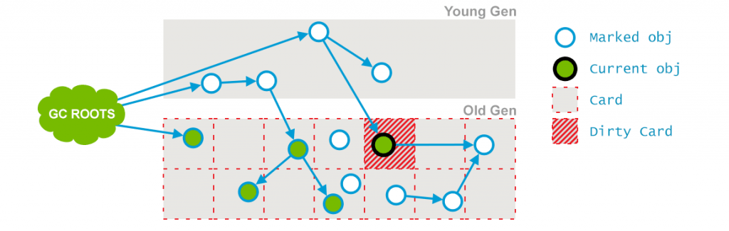
Kotlin In Android : GC
Android uses the most common type of garbage collection, known as tracing garbage collection with the CMS algorithm. CMS stands for Concurrent Mark-Sweep.

Slide 6






IDEs :
Eclipse , Intellij , Android Studio , TryKotlin , Vim , Sublime Text

Slide 7
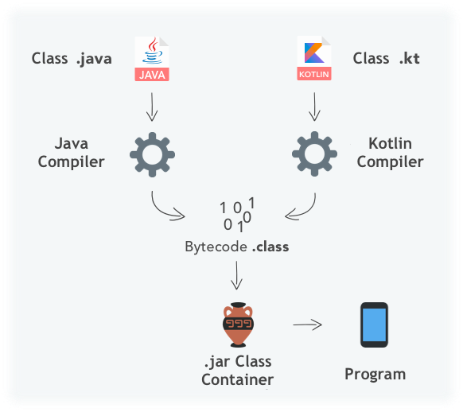
Compiling Process
Kotlin compiler creates a byte code and that byte code can run on the JVM, which is exactly equal to the byte code generated by the Java .class file
You can also use all Java libraries in Kotlin.

Slide 8

Variables

Slide 9
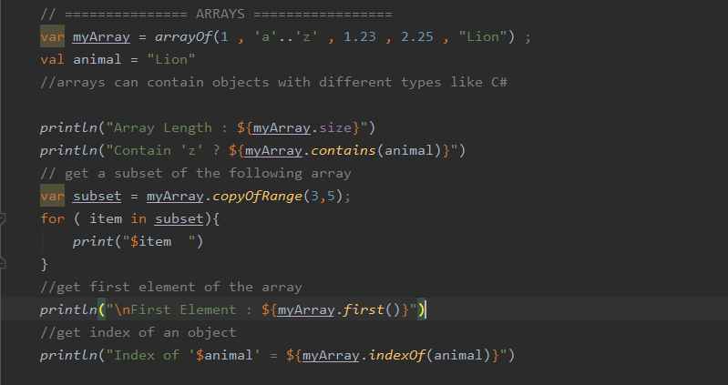
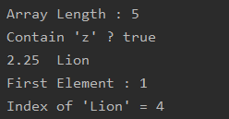
Arrays : Not Type Specified

Slide 10
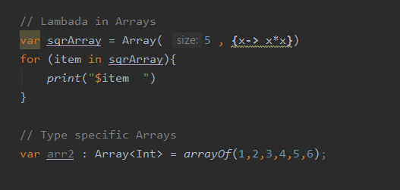

Arrays -> Type Specification + lambda

Slide 11
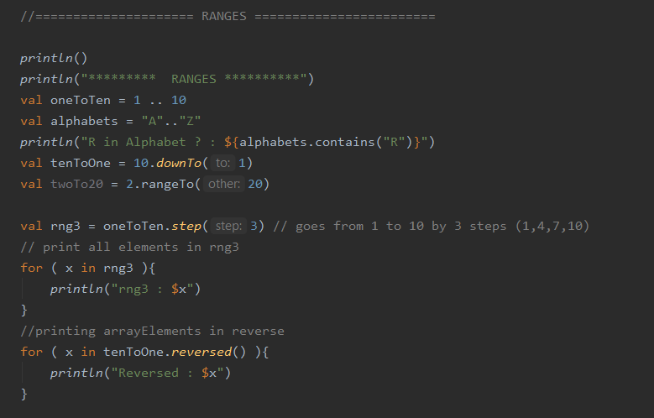
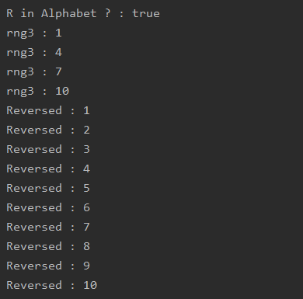
Ranges

Slide 12
Control Flow
If/Else
When/Else

Slide 13
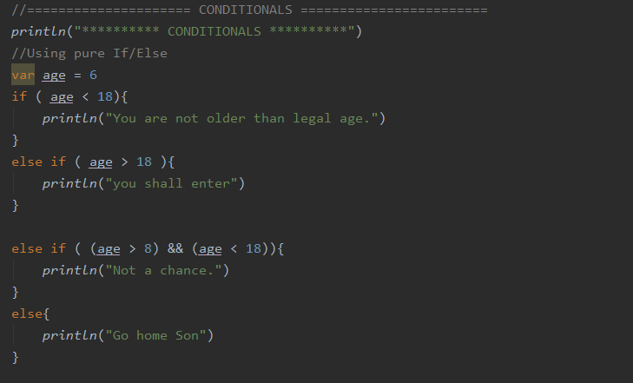

IF/Else

Slide 14
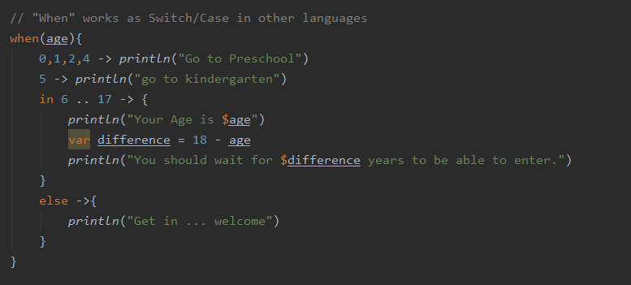

When

Slide 15
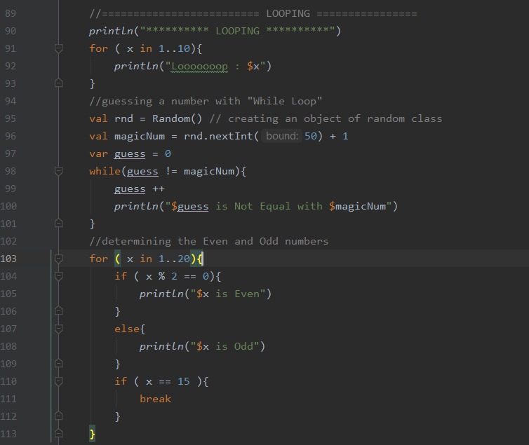
Loops

Slide 16
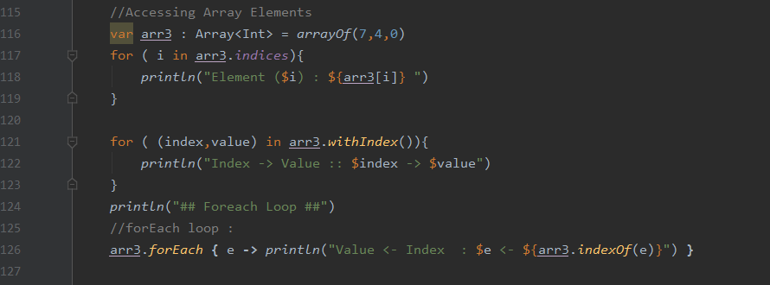
Accessing Array Elements

Slide 17
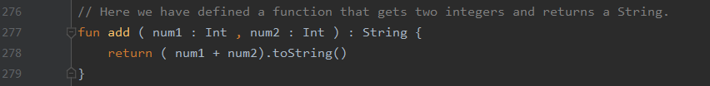


Functions -> نحوه ی تعریف تابع(6)

Slide 18
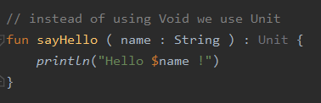


Slide 19
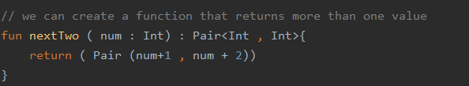
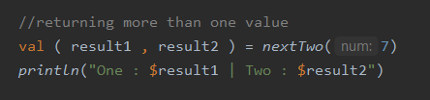

Functions (II)

Slide 20
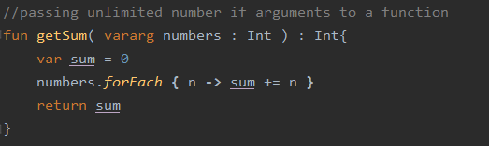
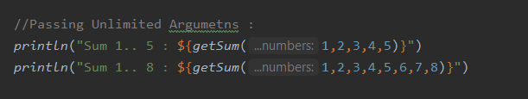

(9)Variable number of parameters

Slide 21
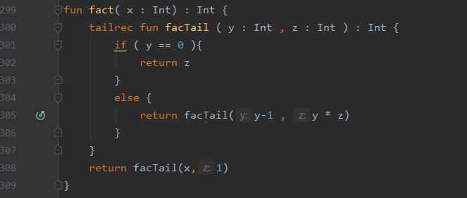
Tail Recursive Functions :

Slide 22
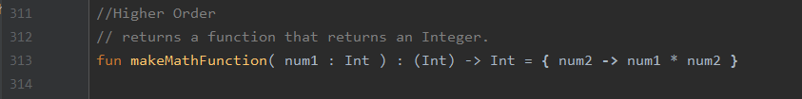
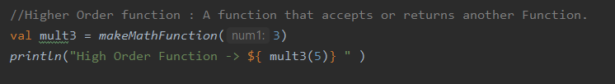

Higher Order Functions

Slide 23

Lambda

Slide 24
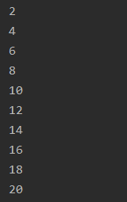
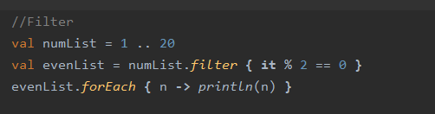
Filter

Slide 25

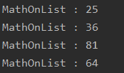
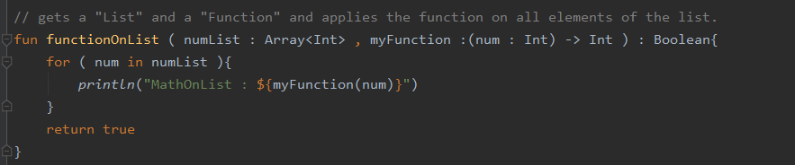
What is a Higher Order Function ?
Higher Order function : A function that accepts or returns another Function.
ارسال تابع به عنوان پارامتر تابع دیگر (11)

Slide 26
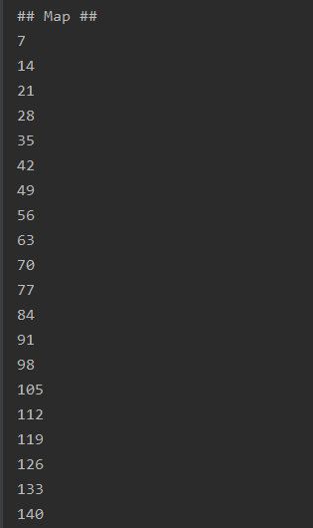
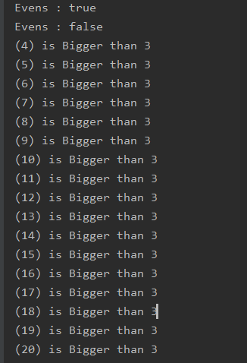

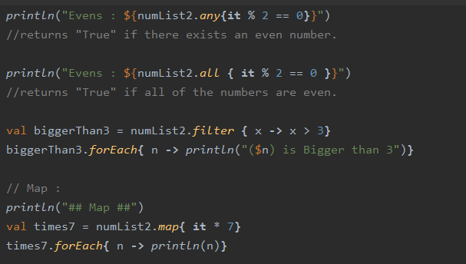
Collection Methods

Slide 27
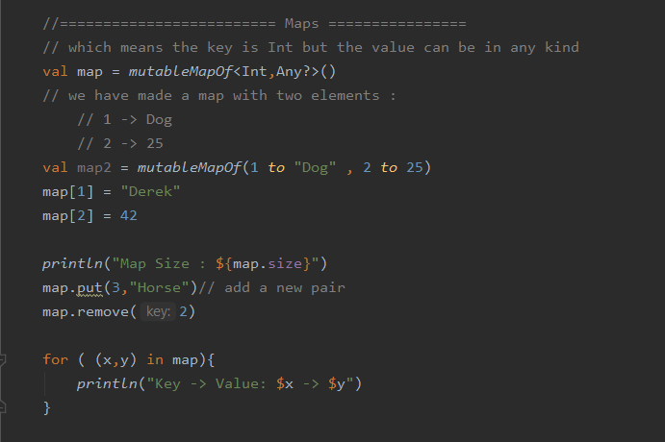

Maps ( Data Structure)
Associative Array (Dictionary) .(3)

Slide 28
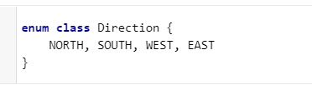
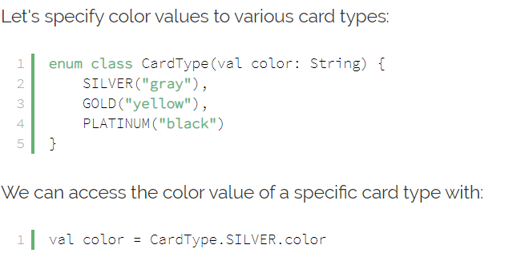
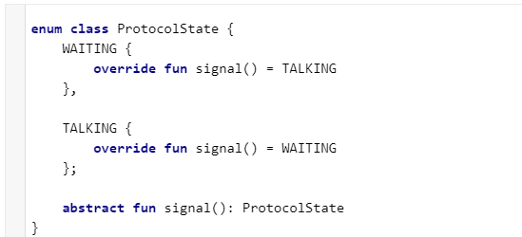
Enumerations :
Reference : https://kotlinlang.org/
Reference : https://www.baeldung.com/kotlin-enum
Reference : https://kotlinlang.org/
.Enums(2)
بررسی محدودیت در انجام عملیات بر روی آن

Slide 29
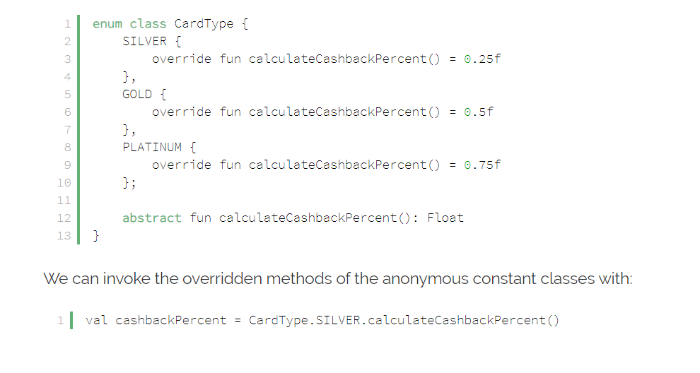
Reference : https://www.baeldung.com/kotlin-enum

Slide 30
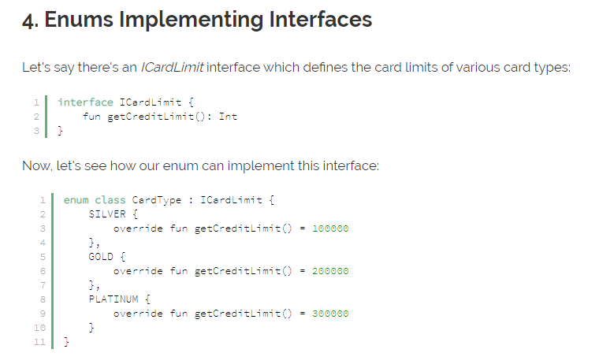
Reference : https://www.baeldung.com/kotlin-enum

Slide 31
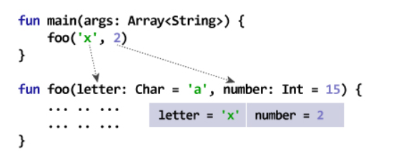
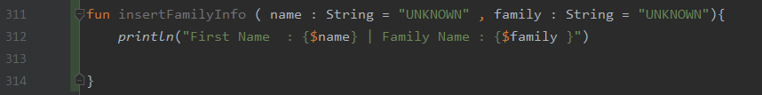
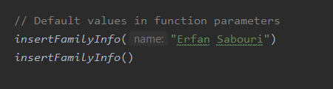
Default Values :
Reference : www.programiz.com
#Default Value(5)

Slide 32
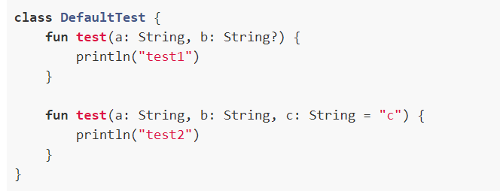

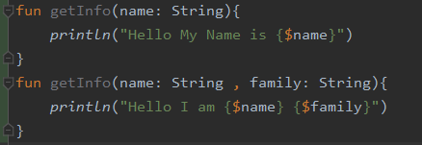
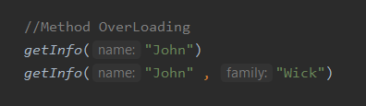
Method Over-Loading: #12

Slide 33
Argument Passing :
Call – by – value -> Supports
Call – by – value – result - > Doesn’t Support
Call – by – result -> Doesn’t Support
Call – by – reference -> Doesn’t Support
Call – by – name -> Doesn’t Support

Slide 34
Static Or Dynamic Scoping ? #1
Kotlin Only Supports static scoping.

Slide 35
Coroutine :
The most interesting thing is that a thread can stop executing a coroutine at some specific “suspension points”, and go do some other work. It can resume executing the coroutine later on, or another thread could even take over.

Slide 36
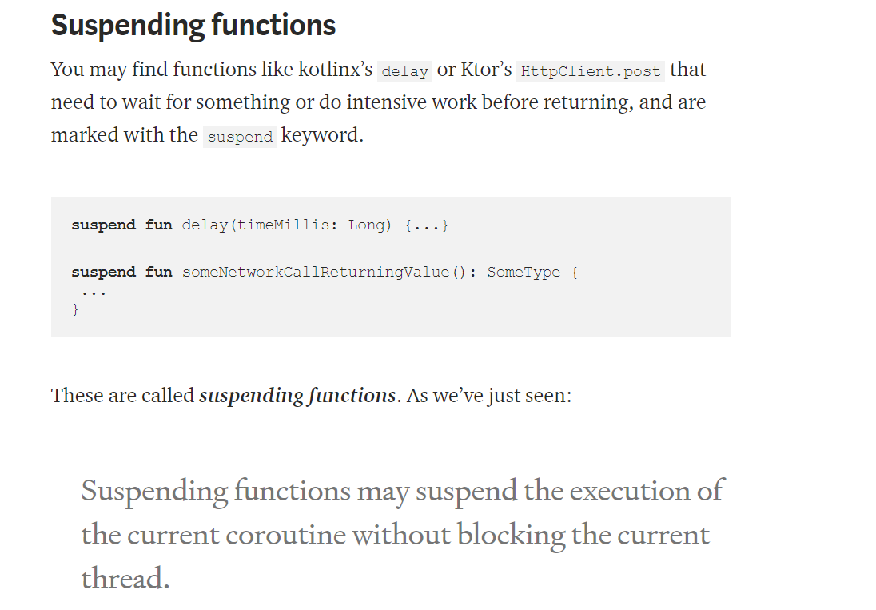
Reference : https://proandroiddev.com/how-to-make-sense-of-kotlin-coroutines-b666c7151b93

Slide 37
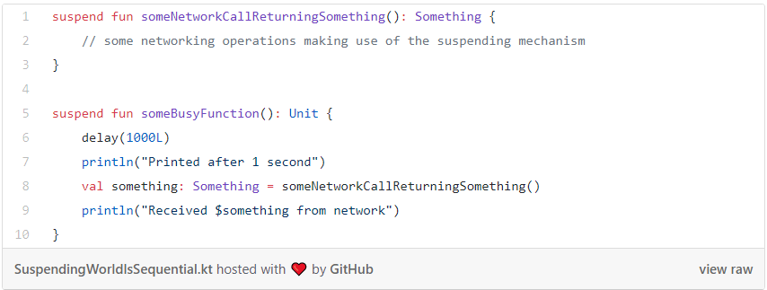

Slide 38
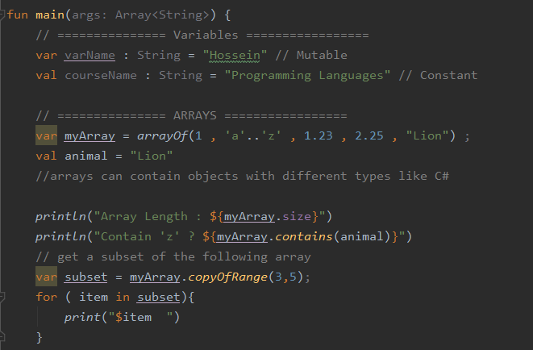
Positional Parameters :

Slide 39
Unions -> Does not support Unions

Slide 40
References :
YouTube/Derek Banas
www.TutorialsPoints.com
www.proandroiddev.com
www.programiz.com
www.kotlinlang.org
www.baeldung.com

Slide 41

Thanks for watching !
You can upload the source code and presentation at :
https://github.com/hosseindehghanipour1998
Any Questions or Suggestions :
Hossein.dehghanipour1998@gmail.com

