Slide 1
Analog systems
Continuous

Slide 2
Voltage
Time
Notes:
physical quantities called signals. Electrical signals such as voltages and currents are the most common. Electronic devices called transistors predominate in the circuitry that implement, represent, and manipulate these signals.

Slide 3
digital systems
Discrete
Notes:
Thus, a digital system is a system that manipulates discrete elements of information represented internally in binary form.

Slide 4
Electricity
Number system

Slide 5
base-?

Slide 6
base-10

Slide 7
Voltage
[9,10)
[8,9)
[7,8)
[6,7)
[5,6)
[4,5)
[3,4)
[2,3)
[1,2)
[0,1)
Time

Slide 8
Voltage
[0,1) | [1,2) | [2,3) | [3,4) | [4,5) | [5,6) | [6,7) | [7,8) | [9,10) | [10,11) | [11,12) | [12,13) | [13,14) | [14,15) | [15,16)
Time

Slide 9
Voltage
[9,10)
[8,9)
[7,8)
[6,7)
[5,6)
[4,5)
[3,4)
[2,3)
[1,2)
[0,1)
[0,1) | [1,2) | [2,3) | [3,4) | [4,5) | [5,6) | [6,7) | [7,8) | [9,10) | [10,11) | [11,12) | [12,13) | [13,14) | [14,15) | [15,16)
Time

Slide 10
Voltage
[9,10)
[8,9)
[7,8)
[6,7)
[5,6)
[4,5)
[3,4)
[2,3)
[1,2)
[0,1)
░ | ░ | 5 | ░ | 2 | 2 | ░ | 9 | ░ | ░ | ░ | 7 | ░ | ░ | ░
Time
Value

Slide 11
granularity

Slide 12
Voltage
[9,10)
[8,9)
[7,8)
[6,7)
[5,6)
[4,5)
[3,4)
[2,3)
[1,2)
[0,1)
░ | ░ | ░ | 6 | 5 | ░ | ░ | ░ | 2 | 2 | 2 | 3 | ░ | ░ | 9
Time
Value

Slide 13
Voltage
[9,∞)
[6,9)
[3,6)
[0,3)
░ | ░ | 2 | 1 | 0 | 0 | ░ | 3 | 3 | 3 | 3 | ░ | 2 | 1 | ░
Time
Value

Slide 14
Voltage
[5,∞)
[0,5)
░ | 1 | 1 | ░ | 0 | 0 | 1 | 1 | 1 | 1 | 1 | 1 | 1 | 0 | 0
Time
Value

Slide 15
reliability
Robust to Noise
Fundamentally Hardware | Engineering Problem

Slide 16
Ternary computer
https://en.wikipedia.org/wiki/Ternary_computer
Balanced Trinary {−1,0,1}
Entirely from Wood!
Thomas Fowler 1840
More History and Etymology → https://en.wikipedia.org/wiki/Computer

Slide 17
decimal computer
https://en.wikipedia.org/wiki/Decimal_computer
They are not actually base-10! We’ll cover them later.

Slide 18
True vs. false

Slide 19

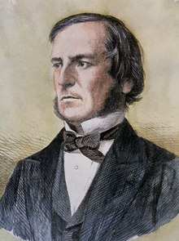
George Boole (/buːl/)
Mathematician
Philosopher
Logician
The Laws of Thought (1854)
Boolean Algebra!
Notes:
The cost of circuits that implement binary logic in all of today’s digital devices and computers is an important factor addressed by designers—be they computer engineers, electrical engineers, or computer scientists.
Finding simpler and cheaper, but equivalent, realizations of a circuit can reap huge payoffs in reducing the overall cost of the design. Mathematical methods that simplify circuits rely primarily on Boolean algebra.

Slide 20
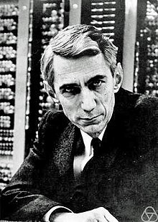
Claude Elwood Shannon
Mathematician
Electrical Engineer
Cryptographer
M.Sc. Thesis (1937)
A Symbolic Analysis of Relay and Switching Circuits
Switching Algebra!
Notes:
He is also well known for founding digital circuit design theory in 1937, when—as a 21-year-old master's degree student at the Massachusetts Institute of Technology (MIT)—he wrote his thesis demonstrating that electrical applications of Boolean algebra could construct any logical numerical relationship

Slide 21
binary computer

Slide 22
+5V | 1
+2V | ░
+0.8V | 0
0V
Positive logic
https://www.electronics-tutorials.ws/logic/logic_1.html

Slide 23
Voltage
HIGH
[2,5]
[0.8,2)
[0,0.8)
0 | 1 | ░ | ░ | 1 | 1 | 1 | 1 | 0 | 0 | 0 | 0 | 1 | 1 | 0
noise
LOW
Time
Value

Slide 24

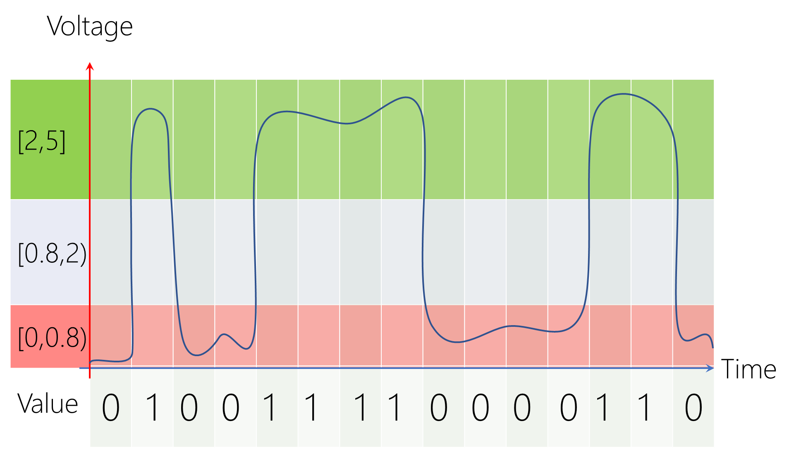
+5V
+5V
0
1
00
Δt
Δt
0V
0V
Earth (Ground)
Earth (Ground)

Slide 25
+5V | 0
+2V | ░
+0.8V | 1
0V
negative logic
https://www.electronics-tutorials.ws/logic/logic_1.html

Slide 26
Voltage
HIGH
[2,5]
[0.8,2)
[0,0.8)
1 | 0 | ░ | ░ | 0 | 0 | 0 | 0 | 1 | 1 | 1 | 1 | 0 | 0 | 1
noise
LOW
Time
Value

Slide 27
+5V
+5V
1
0
00
Δt
Δt
0V
0V
Earth (Ground)
Earth (Ground)

Slide 28
design computer
Positive Logic
Button-Up Approach
Notes:
The cost of circuits that implement binary logic in all of today’s digital devices and computers is an important factor addressed by designers—be they computer engineers, electrical engineers, or computer scientists.
Finding simpler and cheaper, but equivalent, realizations of a circuit can reap huge payoffs in reducing the overall cost of the design. Mathematical methods that simplify circuits rely primarily on Boolean algebra.

Slide 29
design computer
Positive Logic
Button-Up Approach
Finding simpler, but equivalent, computers reduces the overall cost!
Rely primarily on mathematical methods in Boolean algebra!
Notes:
The cost of circuits that implement binary logic in all of today’s digital devices and computers is an important factor addressed by designers—be they computer engineers, electrical engineers, or computer scientists.
Finding simpler and cheaper, but equivalent, realizations of a circuit can reap huge payoffs in reducing the overall cost of the design. Mathematical methods that simplify circuits rely primarily on Boolean algebra.

Slide 30
build computer
Electrical and Computer Engineering

Slide 31
Logic gates

Slide 32
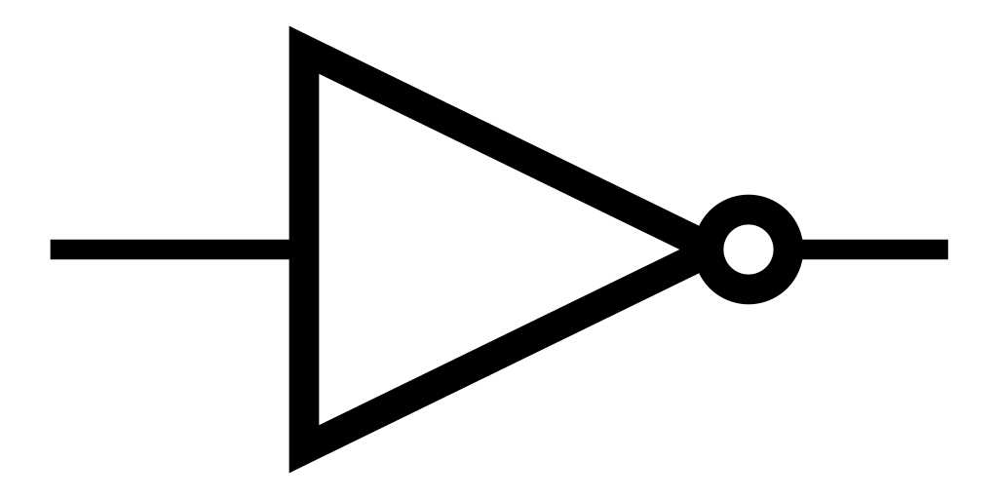

Slide 33
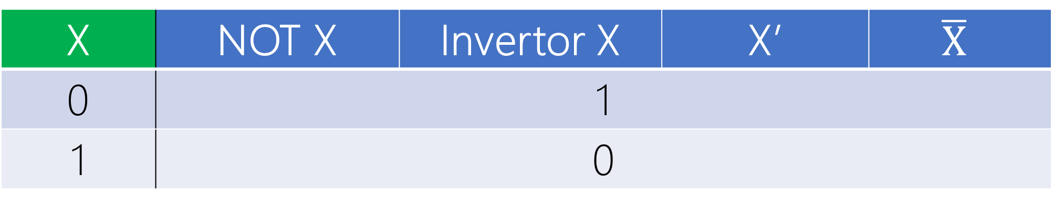
Inversion Bubble
X
F = X’
X | NOT X | Invertor X | X’ | $$\overline{X}$$
0 | 1
1 | 0
Boolean Expression/Function: F = X’
> inverse of X gives F <

Slide 34
W | Z | Y | X
X’
Y’
Z’
W’
F₁ = X’
F₂ = Y’
F₃ = Z’
F₄ = W’
1’s Complement

Slide 35
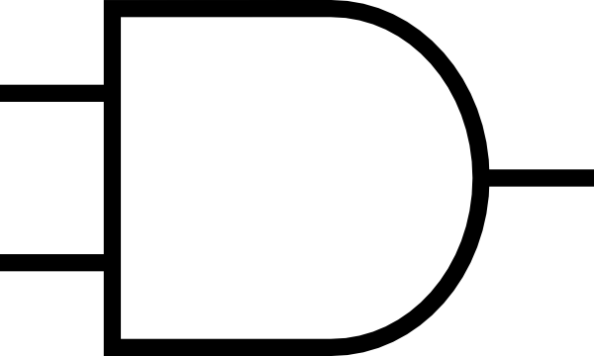

Slide 36
X
F = YX
Y
Y | X | X AND Y | Y . X | Y * X
0 | 0 | 0
0 | 1 | 0
1 | 0 | 0
1 | 1 | 1

Slide 37
X
F =YX=XY
Commutative
Y
X | Y | Y AND X | X . Y | X * Y
0 | 0 | 0
0 | 1 | 0
1 | 0 | 0
1 | 1 | 1

Slide 38
X
F = 0
0
F = X0 = 0
Y | X | YX
0 | 1 | 0
0 | 0 | 0

Slide 39
0
F = 0
Y
F = 0Y = 0
Y | X | YX
0 | 0 | 0
1 | 0 | 0

Slide 40
X
F = X
1
F = X1 = 1111X1111 = X
Y | X | YX
1 | 0 | 0
1 | 1 | 1

Slide 41
X
F = X
X
F = XX = X
X | X | XX
0 | 0 | 0
1 | 1 | 1

Slide 42
X
F = X
F = XX = X
X | X | XX
0 | 0 | 0
1 | 1 | 1

Slide 43
X
F = 0
X
F = XX’ = 0
X’ | X | X’X
1 | 0 | 0
0 | 1 | 0

Slide 44
X
F = 0
Inversion Bubble
F = XX’ = 0
X’ | X | X’X
1 | 0 | 0
0 | 1 | 0

Slide 45
X
F = 0
X’
F = XX’ = 0
X’ | X | X’X
1 | 0 | 0
0 | 1 | 0

Slide 46
3-Input and

