Slide 1
Universality

Slide 2
Universal SET
Is it possible to implement ALL the possible Boolean functions using NOT, AND, OR, NAND, NOR? Yes!

Slide 3
Universal SET
What if we are not given some!
What if some are very costly! E.g., NOT
Can we reduce this set? E.g., building NOT by NAND/ NOR

Slide 4
Set | Universal set
{NOT, AND, OR, NAND, NOR} | Yes! (a Full Set)
{NOT, AND, OR} | Yes, (a Full Set) NAND = NOT-AND NOR = NOT-OR
{NOT, AND} | If we could design OR
{NOT, OR} | If we could design AND
{NOT} | If we could design AND, OR
{AND} | If we could design NOT, OR
{OR} | If we could design NOT, AND
{NAND} | If we could design NOT, AND, OR
{NOR} | If we could design NOT, AND, OR

Slide 5
Set | Universal set
{NOT, AND, OR, NAND, NOR} | Yes! (a Full Set)
{NOT, AND, OR} | Yes, (a Full Set) NAND = AND-NOT NOR = OR-NOT
{NOT, AND} | If we could design OR (a Complete Set)
{NOT, OR} | If we could design AND (a Complete Set)
{NOT} | If we could design AND, OR
{AND} | If we could design NOT, OR
{OR} | If we could design NOT, AND
{NAND} | If we could design NOT, AND, OR
{NOR} | If we could design NOT, AND, OR

Slide 6
Universal SET
{NOT, AND}

Slide 7
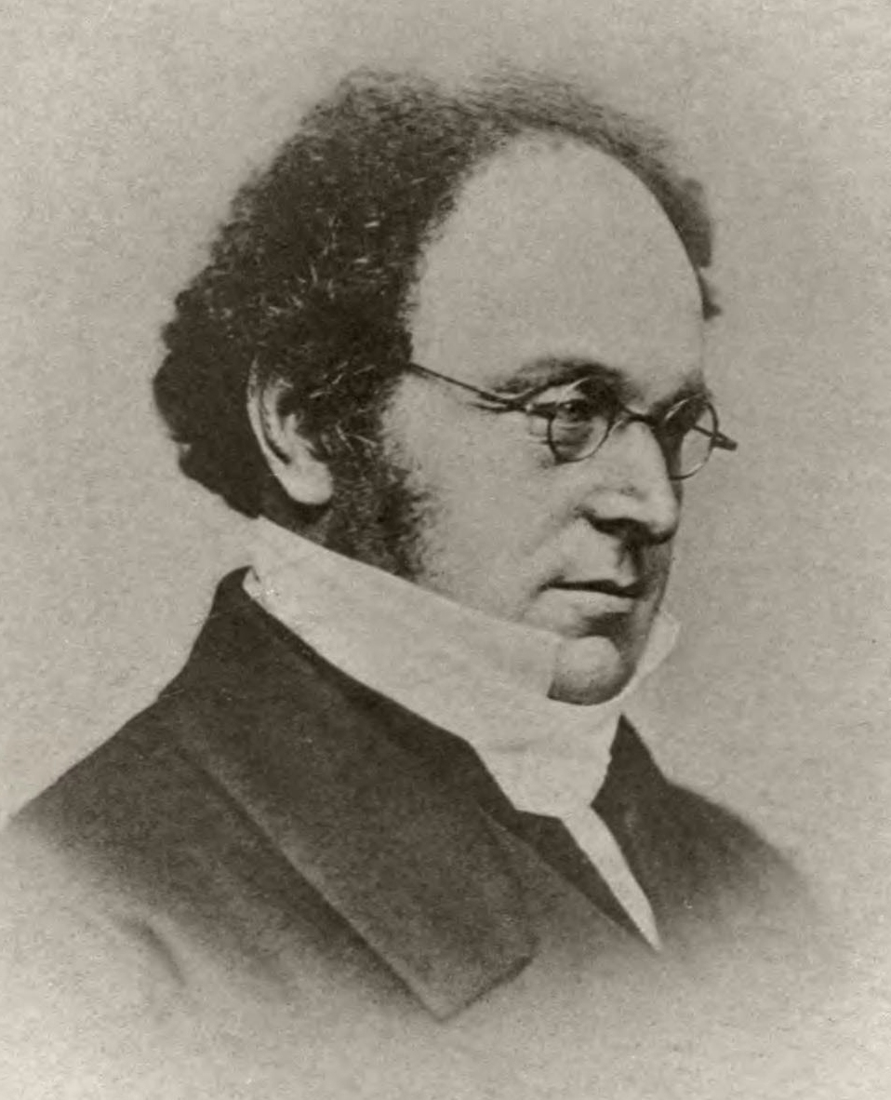
Augustus De Morgan
(1806–1871)
Mathematician
Logician
De Morgan's laws
► (Y+X)’= Y’X’

Slide 8


X’
X
Y’X’=(Y+X)’
Y+X
Y’
Y

Slide 9
X
Y+X
Y
OR

Slide 10
Set | Universal set
{NOT, AND, OR, NAND, NOR} | Yes! (a Full Set)
{NOT, AND, OR} | Yes, (a Full Set) NAND = AND-NOT NOR = OR-NOT
{NOT, AND} | If we could design OR (a Complete Set)
{NOT, OR} | If we could design AND (a Complete Set)
{NOT} | If we could design AND, OR
{AND} | If we could design NOT, OR
{OR} | If we could design NOT, AND
{NAND} | If we could design NOT, AND, OR
{NOR} | If we could design NOT, AND, OR

Slide 11
Universal SET
{NOT, OR}

Slide 12
Augustus De Morgan
(1806–1871)
Mathematician
Logician
De Morgan's laws
► Y’+X’ = (YX)’

Slide 13

X’
X
Y’+X’=(YX)’
YX
Y’
Y

Slide 14
X
YX
Y
AND

Slide 15
Set | Universal set
{NOT, AND, OR, NAND, NOR} | Yes! (a Full Set)
{NOT, AND, OR} | Yes, (a Full Set) NAND = AND-NOT NOR = OR-NOT
{NOT, AND} | If we could design OR (a Complete Set)
{NOT, OR} | If we could design AND (a Complete Set)
{NOT} | If we could design AND, OR
{AND} | If we could design NOT, OR
{OR} | If we could design NOT, AND
{NAND} | If we could design NOT, AND, OR
{NOR} | If we could design NOT, AND, OR

Slide 16
Universal GATE
{NAND}

Slide 17
NOT ► (XX)’ = (X↑X) = X’
X
X’

Slide 18
AND►NOT (NAND) = ((Y↑X))’=YX
X
(Y↑X)
Y
(Y↑X)’= YX

Slide 19
OR ► DE Morgan's law
(Y+X)’ = Y’X’
((Y+X)’)’ = (Y’X’)’
Y + X = (Y’X’)’
Y + X = Y’ ↑ X’

Slide 20
OR: DE Morgan's law
X’
X
(Y’X’)’ =
Y+X =
Y’ ↑ X’
Y
Y’

Slide 21
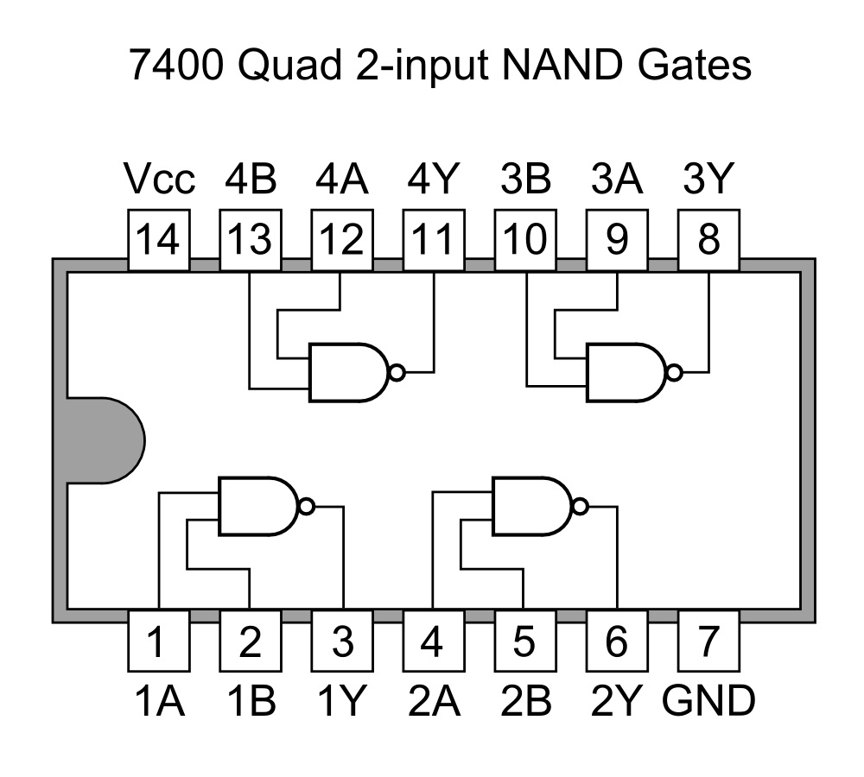
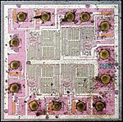
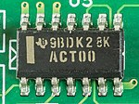
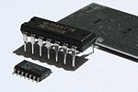
https://commons.wikimedia.org/wiki/7400_series_overview

Slide 22
X’
Y’
Y+X
X
X
X’
Y
Y
Y’

Slide 23
Set | Universal set
{NOT, AND, OR, NAND, NOR} | Yes! (a Full Set)
{NOT, AND, OR} | Yes, (a Full Set) NAND = AND-NOT NOR = OR-NOT
{NOT, AND} | If we could design OR (a Complete Set)
{NOT, OR} | If we could design AND (a Complete Set)
{NOT} | If we could design AND, OR
{AND} | If we could design NOT, OR
{OR} | If we could design NOT, AND
{NAND} | If we could design NOT, AND, OR
{NOR} | If we could design NOT, AND, OR

Slide 24
Universal GATE
{NOR}

Slide 25
NOT ► (X+X)’ = (XX) = X’
OR ► NOT (NOR)
AND ► De Morgan's law
(Y’+X’)’ = YX = (Y’↓X’)

Slide 26
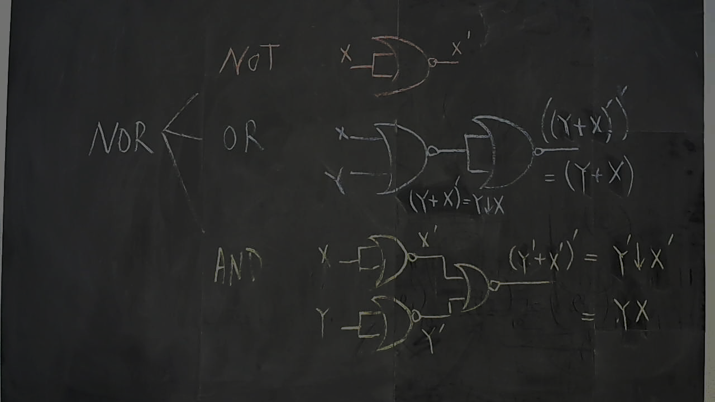

Slide 27
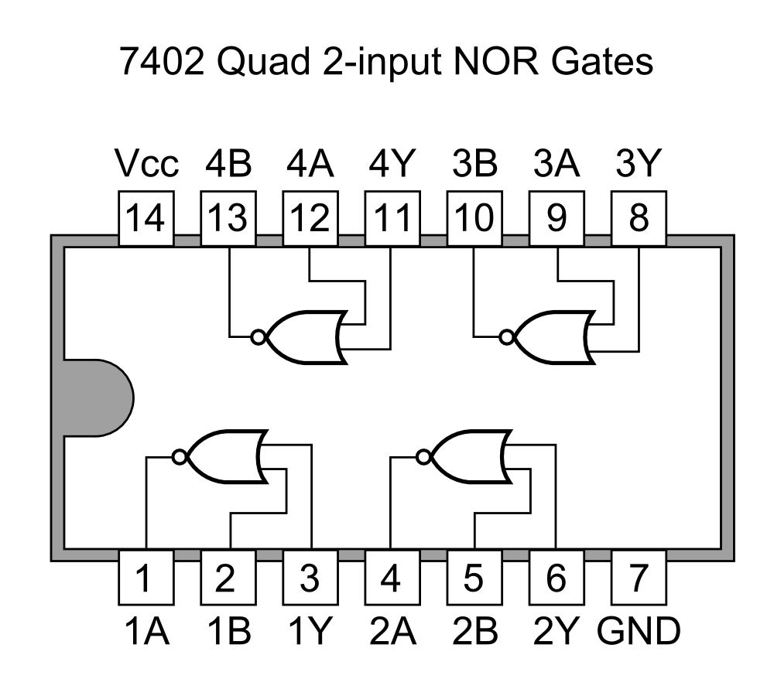
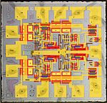
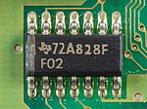
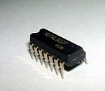
https://commons.wikimedia.org/wiki/7400_series_overview

Slide 28
YX
Y’
X’
X’
X
X
Y’
Y
Y

Slide 29
Design
a design algorithm for any digital units (logic circuits), given truth table

Slide 30
minterm
aka. Standard Product

Slide 31
X’ vs. x
1 binary variable appear either:
in its normal form X, or
in its complement form X’

Slide 32
m₀ | X’
m₁ | X

Slide 33
YX vs. YX’ vs. Y’x vs. Y’X’
2 binary variables appear either in one of these forms:

Slide 34
m₀ | Y’X’
m₁ | Y’X
m₂ | YX’
m₃ | YX

Slide 35
ZYX vs. ZYX’ vs. …
3 binary variables appear either in one of these forms: how many?

Slide 36
ZYX vs. ZYX’ vs. …
3 binary variables appear either in one of these forms: how many?
Each variable can take 2 forms (normal and complement)
We have 3 variables, 2×2×2 = 2³ = 8

Slide 37
m₀ | Z’Y’X’
m₁ | Z’Y’X
m₂ | Z’YX’
m₃ | Z’YX
m₄ | ZY’X’
m₅ | ZY’X
m₆ | ZYX’
m₇ | ZYX

Slide 38
A_{n}…A₂A₁A₀ vs. A_{n}…A₂A₁A’₀ …
n binary variables appear either in one of these forms: how many?
Each variable can take 2 forms (normal and complement)
We have n variables, 2×2×2× … ×2 = 2^{n}

Slide 39
m₀ | A’_{n}…A’₂A’₁A’₀
m₁ | A’_{n}…A’₂A’₁A₀
m₂ | A’_{n}…A’₂A₁A’₀
… | …
… | …
m₂^{n}₋₃ | A_{n}…A₂A’₁A₀
m₂^{n}₋₂ | A_{n}…A₂A₁A’₀
m₂^{n}₋₁ | A_{n}…A₂A₁A₀

Slide 40
Truth table
en.wikipedia.org/wiki/Truth_table

Slide 41
X | F = F(X) = ?
0 | ?
1 | ?

Slide 42
X | F = F(X) = 1
0 | 1
1 | 1

Slide 43
X | F = F(X) = 0
0 | 0
1 | 0

Slide 44
X | F = F(X) = X’
0 | 1
1 | 0

Slide 45
m₀ | X’
m₁ | X

Slide 46
X | F = F(X) = X’ = m₀
0 | 1
1 | 0

Slide 47
X | F = F(X) = X’ = m₀
0 | 1
1 | 0

Slide 48
X
F = X’=m₀

Slide 49
X | F = F(X) = X
0 | 0
1 | 1

Slide 50
X | F = F(X) = X = m₁
0 | 0
1 | 1

Slide 51
X | F = F(X) = X = m₁
0 | 0
1 | 1

Slide 52
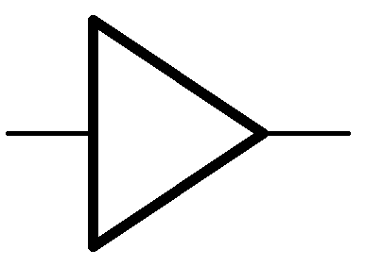
X
F = X=m₁
Digital Buffer
X’
X
X

Slide 53
Truth table ↔ minterm

Slide 54
Y | X | F = F(Y,X) = ?
0 | 0 | ?
0 | 1 | ?
1 | 0 | ?
1 | 1 | ?

Slide 55
Y | X | F = F(Y,X) = 0
0 | 0 | 0
0 | 1 | 0
1 | 0 | 0
1 | 1 | 0

Slide 56
Y | X | F = F(Y,X) = 1
0 | 0 | 1
0 | 1 | 1
1 | 0 | 1
1 | 1 | 1

Slide 57
Y | X | F = F(Y,X) = YX
0 | 0 | 0
0 | 1 | 0
1 | 0 | 0
1 | 1 | 1

Slide 58
X
F = YX
Y

Slide 59
m₀ | Y’X’
m₁ | Y’X
m₂ | YX’
m₃ | YX

Slide 60
Y | X | F = F(Y,X) = YX =m₃
0 | 0 | 0
0 | 1 | 0
1 | 0 | 0
1 | 1 | 1

Slide 61
Y | X | F = F(Y,X) = YX =m₃
0 | 0 | 0
0 | 1 | 0
1 | 0 | 0
1 | 1 | 1

Slide 62
Y | X | F = F(Y,X) = YX’ =m₂
0 | 0 | 0
0 | 1 | 0
1 | 0 | 1
1 | 1 | 0

Slide 63
Y | X | F = F(Y,X) = YX’ =m₂
0 | 0 | 0
0 | 1 | 0
1 | 0 | 1
1 | 1 | 0

Slide 64
X
F = YX’
Y

Slide 65
Y | X | F = F(Y,X) = Y’X =m₁
0 | 0 | 0
0 | 1 | 1
1 | 0 | 0
1 | 1 | 0

Slide 66
Y | X | F = F(Y,X) = Y’X =m₁
0 | 0 | 0
0 | 1 | 1
1 | 0 | 0
1 | 1 | 0

Slide 67
X
F = Y’X
Y

Slide 68
Y | X | F = F(Y,X) = Y’X’ =m₀
0 | 0 | 1
0 | 1 | 0
1 | 0 | 0
1 | 1 | 0

Slide 69
Y | X | F = F(Y,X) = Y’X’ =m₀
0 | 0 | 1
0 | 1 | 0
1 | 0 | 0
1 | 1 | 0

Slide 70
X
F = Y’X’
Y

Slide 71
Y | X | F = F(Y,X) = ?
0 | 0 | 1
0 | 1 | 1
1 | 0 | 0
1 | 1 | 0

Slide 72
Y | X | F = F(Y,X) = Y’X’
0 | 0 | 1
0 | 1 | 1
1 | 0 | 0
1 | 1 | 0

Slide 73
Y | X | F = F(Y,X) = Y’X’+Y’X
0 | 0 | 1
0 | 1 | 1
1 | 0 | 0
1 | 1 | 0

Slide 74
Y | X | F = F(Y,X) = m₀+m₁
0 | 0 | 1
0 | 1 | 1
1 | 0 | 0
1 | 1 | 0

Slide 75
Y | X | F = F(Y,X) = ∑m(0,1)
0 | 0 | 1
0 | 1 | 1
1 | 0 | 0
1 | 1 | 0

Slide 76
Y
X
Y’X’
Y’X’+Y’X
Y’X

Slide 77
Y
X
Y’X’
Y’X’+Y’X
Y’X

Slide 78
Y | X | F = F(Y,X) = ?
0 | 0 | 0
0 | 1 | 1
1 | 0 | 1
1 | 1 | 0

Slide 79
Y | X | F = F(Y,X) = Y’X
0 | 0 | 0
0 | 1 | 1
1 | 0 | 1
1 | 1 | 0

Slide 80
Y | X | F = F(Y,X) = m₁+m₂
0 | 0 | 0
0 | 1 | 1
1 | 0 | 1
1 | 1 | 0

Slide 81
Y | X | F = F(Y,X) = ∑m(1,2)
0 | 0 | 0
0 | 1 | 1
1 | 0 | 1
1 | 1 | 0

Slide 82
Y
Y
X
X
Y’X
Y’X+YX’
YX’

Slide 83
Exclusive-OR (XOR)
X
Y+X
Y
Y | X | F = F(Y,X) = Y’X+YX’ = m₁+m₂
0 | 0 | 0
0 | 1 | 1
1 | 0 | 1
1 | 1 | 0

Slide 84
Y | X | F = F(Y,X) = ?
0 | 0 | 1
0 | 1 | 0
1 | 0 | 0
1 | 1 | 1

Slide 85
Y | X | F = F(Y,X) = Y’X’
0 | 0 | 1
0 | 1 | 0
1 | 0 | 0
1 | 1 | 1

Slide 86
Y | X | F = F(Y,X) = Y’X’+YX
0 | 0 | 1
0 | 1 | 0
1 | 0 | 0
1 | 1 | 1

Slide 87
Y | X | F = F(Y,X) = m₀+m₃
0 | 0 | 1
0 | 1 | 0
1 | 0 | 0
1 | 1 | 1

Slide 88
Y | X | F = F(Y,X) = ∑m(0,3)
0 | 0 | 1
0 | 1 | 0
1 | 0 | 0
1 | 1 | 1

Slide 89
Y
Y
X
X
Y’X’
Y’X’+YX
YX

Slide 90
NOT Exclusive-OR (XNOR)
X
Y X
Y
Y | X | F = F(Y,X) = Y’X’+YX = m₀+m₃
0 | 0 | 1
0 | 1 | 0
1 | 0 | 0
1 | 1 | 1

Slide 91
Y | X | F = F(Y,X) = ?
0 | 0 | 1
0 | 1 | 1
1 | 0 | 0
1 | 1 | 1

Slide 92
Y | X | F = F(Y,X) = Y’X’
0 | 0 | 1
0 | 1 | 1
1 | 0 | 0
1 | 1 | 1

Slide 93
Y | X | F = F(Y,X) = Y’X’+Y’X
0 | 0 | 1
0 | 1 | 1
1 | 0 | 0
1 | 1 | 1

Slide 94
Y | X | F = F(Y,X) = Y’X’+Y’X+YX
0 | 0 | 1
0 | 1 | 1
1 | 0 | 0
1 | 1 | 1

Slide 95
Y | X | F=F(Y,X)=m₀+m₁+m₃ =∑m(0,1,3)
0 | 0 | 1
0 | 1 | 1
1 | 0 | 0
1 | 1 | 1

Slide 96
Y
Y
X
X
Y’X’
Y’X
Y’X’+Y’X+YX
YX

Slide 97
SUM OF PRODUCTS
(SOP)

Slide 98
Y
Y
X
X
Y’X’
Y’X
Y’X’+Y’X+YX
YX

Slide 99
2 LEVELS
AND → OR

Slide 100
Y
Y
X
X
Y’X’
Y’X
Y’X’+Y’X+YX
YX

Slide 101
Given 3 inputs, design a circuit to determine if there is even number of 1

Slide 102
Z | Y | X | F(Z,Y,X)=?
0 | 0 | 0 | ?
0 | 0 | 1 | ?
0 | 1 | 0 | ?
0 | 1 | 1 | ?
1 | 0 | 0 | ?
1 | 0 | 1 | ?
1 | 1 | 0 | ?
1 | 1 | 1 | ?

Slide 103
Z | Y | X | F(Z,Y,X)=?
0 | 0 | 0 | 1
0 | 0 | 1 | 0
0 | 1 | 0 | 0
0 | 1 | 1 | 1
1 | 0 | 0 | 0
1 | 0 | 1 | 1
1 | 1 | 0 | 1
1 | 1 | 1 | 0

Slide 104
Z | Y | X | F(Z,Y,X)=Z’Y’X’
0 | 0 | 0 | 1
0 | 0 | 1 | 0
0 | 1 | 0 | 0
0 | 1 | 1 | 1
1 | 0 | 0 | 0
1 | 0 | 1 | 1
1 | 1 | 0 | 1
1 | 1 | 1 | 0

Slide 105
Z | Y | X | F(Z,Y,X)=Z’Y’X’+Z’YX
0 | 0 | 0 | 1
0 | 0 | 1 | 0
0 | 1 | 0 | 0
0 | 1 | 1 | 1
1 | 0 | 0 | 0
1 | 0 | 1 | 1
1 | 1 | 0 | 1
1 | 1 | 1 | 0

Slide 106
Z | Y | X | F(Z,Y,X)=Z’Y’X’+Z’YX+ZY’X
0 | 0 | 0 | 1
0 | 0 | 1 | 0
0 | 1 | 0 | 0
0 | 1 | 1 | 1
1 | 0 | 0 | 0
1 | 0 | 1 | 1
1 | 1 | 0 | 1
1 | 1 | 1 | 0

Slide 107
Z | Y | X | F(Z,Y,X)=Z’Y’X’+Z’YX+ZY’X+ZYX’
0 | 0 | 0 | 1
0 | 0 | 1 | 0
0 | 1 | 0 | 0
0 | 1 | 1 | 1
1 | 0 | 0 | 0
1 | 0 | 1 | 1
1 | 1 | 0 | 1
1 | 1 | 1 | 0

Slide 108
Z | Y | X | F(Z,Y,X)=m₀+m₃+m₅+m₆
0 | 0 | 0 | 1
0 | 0 | 1 | 0
0 | 1 | 0 | 0
0 | 1 | 1 | 1
1 | 0 | 0 | 0
1 | 0 | 1 | 1
1 | 1 | 0 | 1
1 | 1 | 1 | 0

Slide 109
Z | Y | X | F(Z,Y,X)=m₀+m₃+m₅+m₆=∑m(0,3,5,6)
0 | 0 | 0 | 1
0 | 0 | 1 | 0
0 | 1 | 0 | 0
0 | 1 | 1 | 1
1 | 0 | 0 | 0
1 | 0 | 1 | 1
1 | 1 | 0 | 1
1 | 1 | 1 | 0

Slide 110
Y
Y
X
Z
X
Z’Y’X’+Z’YX+ZY’X+ZYX’

Slide 111
SUM OF PRODUCTS (SOP)
2 LEVELS AND-OR

Slide 112
Y
Y
X
Z
X
Z’Y’X’+Z’YX+ZY’X+ZYX’

Slide 113
Y
Y
X
Z
X
Z’Y’X’+Z’YX+ZY’X+ZYX’

