Slide 1
Design
an algorithm for designing any digital units (logic circuits), given truth table

Slide 2
minterm
aka. Standard Product

Slide 3
Truth table
en.wikipedia.org/wiki/Truth_table

Slide 4
SUM OF PRODUCTS (SOP)
2 LEVELS AND-OR
with product meaning the ANDing
with sum meaning the ORing

Slide 5
Z | Y | X | F(Z,Y,X)=m₀+m₃+m₅+m₆=∑m(0,3,5,6)
0 | 0 | 0 | 1
0 | 0 | 1 | 0
0 | 1 | 0 | 0
0 | 1 | 1 | 1
1 | 0 | 0 | 0
1 | 0 | 1 | 1
1 | 1 | 0 | 1
1 | 1 | 1 | 0

Slide 6



Y
Y
X
Z
X
F=Z’Y’X’+Z’YX+ZY’X+ZYX’

Slide 7
Y
Y
X
Z
X
F=Z’Y’X’+Z’YX+ZY’X+ZYX’

Slide 8
Multiple Boolean functions
F₁, F₂, …

Slide 9
Z | Y | X | F₁(Z,Y,X)=∑m(0,3,5,6)
0 | 0 | 0 | 1
0 | 0 | 1 | 0
0 | 1 | 0 | 0
0 | 1 | 1 | 1
1 | 0 | 0 | 0
1 | 0 | 1 | 1
1 | 1 | 0 | 1
1 | 1 | 1 | 0

Slide 10
Y
Y
X
Z
X
F₁=Z’Y’X’+Z’YX+ZY’X+ZYX’

Slide 11
Z | Y | X | F₂(Z,Y,X)=∑m(4,5)
0 | 0 | 0 | 0
0 | 0 | 1 | 0
0 | 1 | 0 | 0
0 | 1 | 1 | 0
1 | 0 | 0 | 1
1 | 0 | 1 | 1
1 | 1 | 0 | 0
1 | 1 | 1 | 0

Slide 12
Y
Y
X
Z
X
F₂=ZY’X’+ZY’X

Slide 13
Z | Y | X | F₁(Z,Y,X)=∑m(0,3,5,6) | F₂(Z,Y,X)=∑m(4,5)
0 | 0 | 0 | 1 | 0
0 | 0 | 1 | 0 | 0
0 | 1 | 0 | 0 | 0
0 | 1 | 1 | 1 | 0
1 | 0 | 0 | 0 | 1
1 | 0 | 1 | 1 | 1
1 | 1 | 0 | 1 | 0
1 | 1 | 1 | 0 | 0

Slide 14
Z
Y
X
F₁=Z’Y’X’+Z’YX+ZY’X+ZYX’
F₂=ZY’X’+ZY’X
Re-use minterms

Slide 15
Show the remainder (MOD)
number % 3 = ?

Slide 16
What is the range of numbers?

Slide 17
What is the range of numbers?
[0, 15]₁₀

Slide 18
How many input binary variables?
[0, 15]₁₀ = [0,1111]₂ = [0000,1111]₂

Slide 19
W | Z | Y | X
0 | 0 | 0 | 0
0 | 0 | 0 | 1
0 | 0 | 1 | 0
0 | 0 | 1 | 1
0 | 1 | 0 | 0
0 | 1 | 0 | 1
0 | 1 | 1 | 0
0 | 1 | 1 | 1
1 | 0 | 0 | 0
1 | 0 | 0 | 1
1 | 0 | 1 | 0
1 | 0 | 1 | 1
1 | 1 | 0 | 0
1 | 1 | 0 | 1
1 | 1 | 1 | 0
1 | 1 | 1 | 1

Slide 20
What is the range of output?

Slide 21
What is the range of output?
The remainder of any number divided by 3 is 0, 1, 2

Slide 22
What is the range of output?
[0, 2]₁₀

Slide 23
How many Boolean function?
[0, 2]₁₀ = [0, 10]₂ = [00, 10]₂

Slide 24
W | Z | Y | X | F₁ | F₂
0 | 0 | 0 | 0
0 | 0 | 0 | 1
0 | 0 | 1 | 0
0 | 0 | 1 | 1
0 | 1 | 0 | 0
0 | 1 | 0 | 1
0 | 1 | 1 | 0
0 | 1 | 1 | 1
1 | 0 | 0 | 0
1 | 0 | 0 | 1
1 | 0 | 1 | 0
1 | 0 | 1 | 1
1 | 1 | 0 | 0
1 | 1 | 0 | 1
1 | 1 | 1 | 0
1 | 1 | 1 | 1

Slide 25
W | Z | Y | X | F₁ | F₂
0 | 0 | 0 | 0 | 0 | 0
0 | 0 | 0 | 1
0 | 0 | 1 | 0
0 | 0 | 1 | 1
0 | 1 | 0 | 0
0 | 1 | 0 | 1
0 | 1 | 1 | 0
0 | 1 | 1 | 1
1 | 0 | 0 | 0
1 | 0 | 0 | 1
1 | 0 | 1 | 0
1 | 0 | 1 | 1
1 | 1 | 0 | 0
1 | 1 | 0 | 1
1 | 1 | 1 | 0
1 | 1 | 1 | 1

Slide 26
W | Z | Y | X | F₁ | F₂
0 | 0 | 0 | 0 | 0 | 0
0 | 0 | 0 | 1 | 0 | 1
0 | 0 | 1 | 0
0 | 0 | 1 | 1
0 | 1 | 0 | 0
0 | 1 | 0 | 1
0 | 1 | 1 | 0
0 | 1 | 1 | 1
1 | 0 | 0 | 0
1 | 0 | 0 | 1
1 | 0 | 1 | 0
1 | 0 | 1 | 1
1 | 1 | 0 | 0
1 | 1 | 0 | 1
1 | 1 | 1 | 0
1 | 1 | 1 | 1

Slide 27
W | Z | Y | X | F₁ | F₂
0 | 0 | 0 | 0 | 0 | 0
0 | 0 | 0 | 1 | 0 | 1
0 | 0 | 1 | 0 | 1 | 0
0 | 0 | 1 | 1
0 | 1 | 0 | 0
0 | 1 | 0 | 1
0 | 1 | 1 | 0
0 | 1 | 1 | 1
1 | 0 | 0 | 0
1 | 0 | 0 | 1
1 | 0 | 1 | 0
1 | 0 | 1 | 1
1 | 1 | 0 | 0
1 | 1 | 0 | 1
1 | 1 | 1 | 0
1 | 1 | 1 | 1

Slide 28
W | Z | Y | X | F₁ | F₂
0 | 0 | 0 | 0 | 0 | 0
0 | 0 | 0 | 1 | 0 | 1
0 | 0 | 1 | 0 | 1 | 0
0 | 0 | 1 | 1 | 0 | 0
0 | 1 | 0 | 0
0 | 1 | 0 | 1
0 | 1 | 1 | 0
0 | 1 | 1 | 1
1 | 0 | 0 | 0
1 | 0 | 0 | 1
1 | 0 | 1 | 0
1 | 0 | 1 | 1
1 | 1 | 0 | 0
1 | 1 | 0 | 1
1 | 1 | 1 | 0
1 | 1 | 1 | 1

Slide 29
W | Z | Y | X | F₁ | F₂
0 | 0 | 0 | 0 | 0 | 0
0 | 0 | 0 | 1 | 0 | 1
0 | 0 | 1 | 0 | 1 | 0
0 | 0 | 1 | 1 | 0 | 0
0 | 1 | 0 | 0 | 0 | 1
0 | 1 | 0 | 1 | 1 | 0
0 | 1 | 1 | 0 | 0 | 0
0 | 1 | 1 | 1 | 0 | 1
1 | 0 | 0 | 0 | 1 | 0
1 | 0 | 0 | 1 | 0 | 0
1 | 0 | 1 | 0 | 0 | 1
1 | 0 | 1 | 1 | 1 | 0
1 | 1 | 0 | 0 | 0 | 0
1 | 1 | 0 | 1 | 0 | 1
1 | 1 | 1 | 0 | 1 | 0
1 | 1 | 1 | 1 | 0 | 0

Slide 30
minterms

Slide 31
W | Z | Y | X | F₁=m₂+m₅+m₈+m₁₁+m₁₄ | F₂
0 | 0 | 0 | 0 | 0 | 0
0 | 0 | 0 | 1 | 0 | 1
0 | 0 | 1 | 0 | 1 | 0
0 | 0 | 1 | 1 | 0 | 0
0 | 1 | 0 | 0 | 0 | 1
0 | 1 | 0 | 1 | 1 | 0
0 | 1 | 1 | 0 | 0 | 0
0 | 1 | 1 | 1 | 0 | 1
1 | 0 | 0 | 0 | 1 | 0
1 | 0 | 0 | 1 | 0 | 0
1 | 0 | 1 | 0 | 0 | 1
1 | 0 | 1 | 1 | 1 | 0
1 | 1 | 0 | 0 | 0 | 0
1 | 1 | 0 | 1 | 0 | 1
1 | 1 | 1 | 0 | 1 | 0
1 | 1 | 1 | 1 | 0 | 0

Slide 32
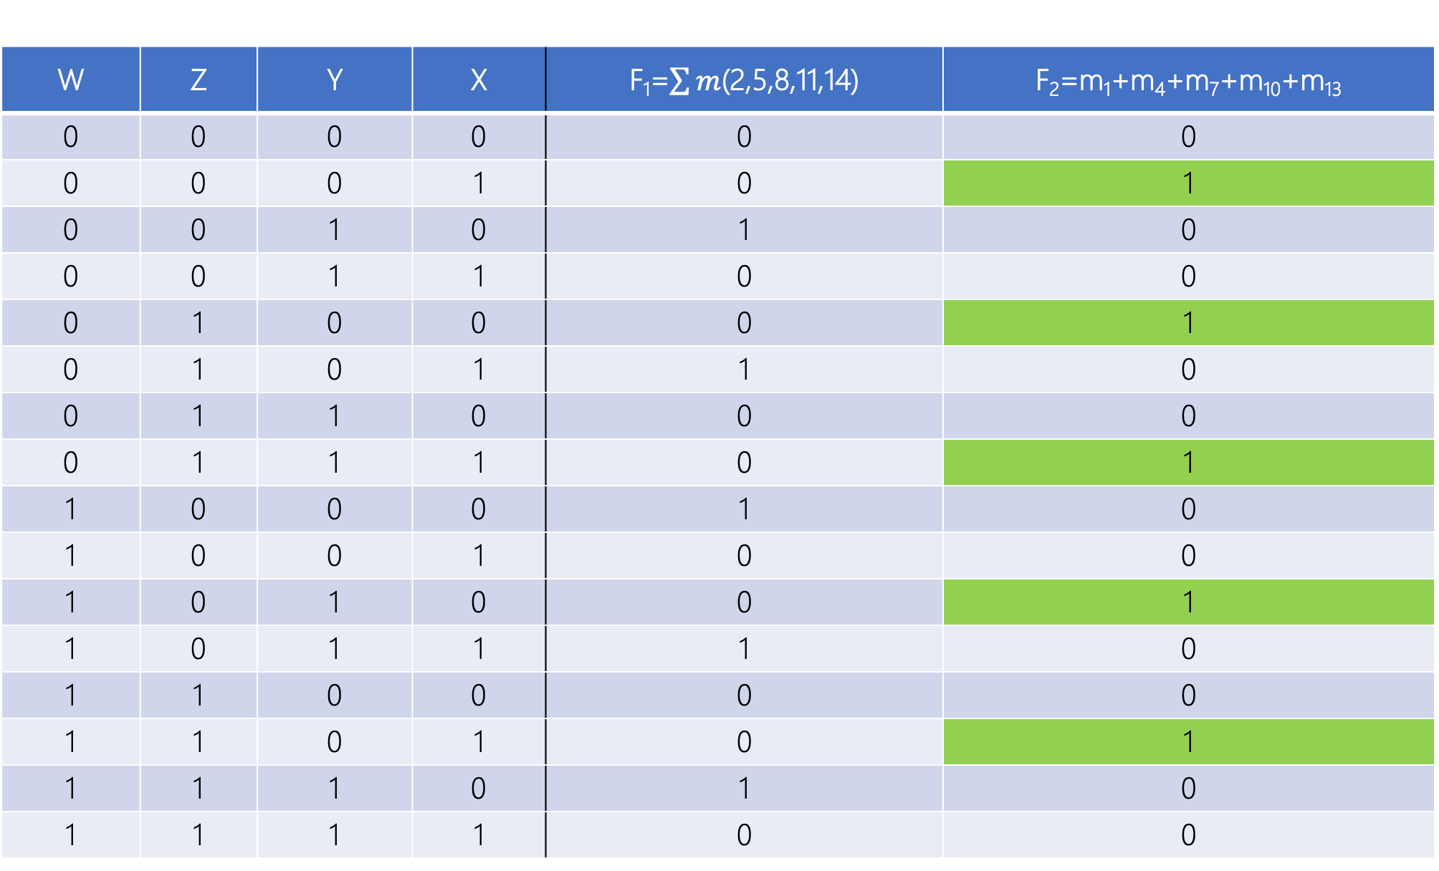
W | Z | Y | X | F₁=$\sum{m}$(2,5,8,11,14) | F₂=m₁+m₄+m₇+m₁₀+m₁₃
0 | 0 | 0 | 0 | 0 | 0
0 | 0 | 0 | 1 | 0 | 1
0 | 0 | 1 | 0 | 1 | 0
0 | 0 | 1 | 1 | 0 | 0
0 | 1 | 0 | 0 | 0 | 1
0 | 1 | 0 | 1 | 1 | 0
0 | 1 | 1 | 0 | 0 | 0
0 | 1 | 1 | 1 | 0 | 1
1 | 0 | 0 | 0 | 1 | 0
1 | 0 | 0 | 1 | 0 | 0
1 | 0 | 1 | 0 | 0 | 1
1 | 0 | 1 | 1 | 1 | 0
1 | 1 | 0 | 0 | 0 | 0
1 | 1 | 0 | 1 | 0 | 1
1 | 1 | 1 | 0 | 1 | 0
1 | 1 | 1 | 1 | 0 | 0

Slide 33
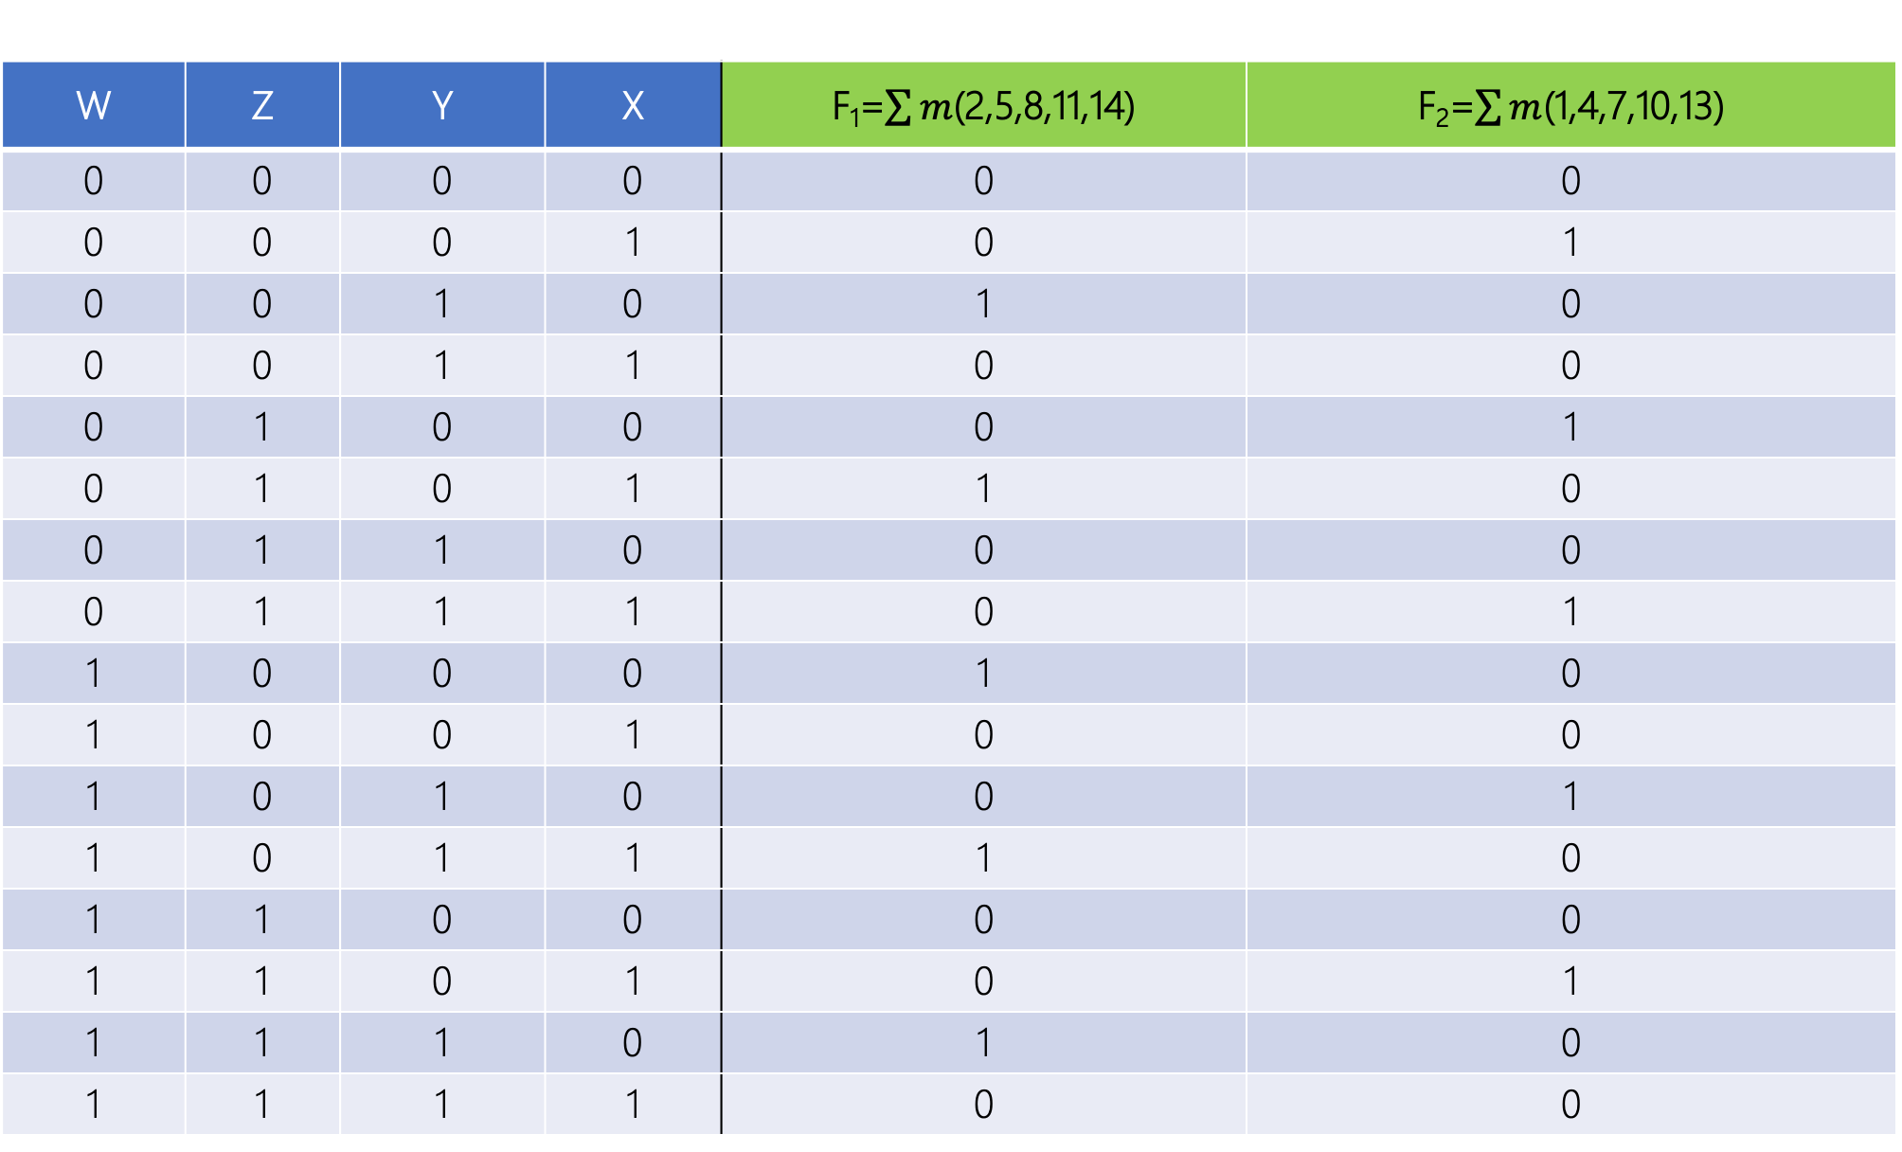
W | Z | Y | X | F₁=$\sum{m}$(2,5,8,11,14) | F₂=$\sum{m}$(1,4,7,10,13)
0 | 0 | 0 | 0 | 0 | 0
0 | 0 | 0 | 1 | 0 | 1
0 | 0 | 1 | 0 | 1 | 0
0 | 0 | 1 | 1 | 0 | 0
0 | 1 | 0 | 0 | 0 | 1
0 | 1 | 0 | 1 | 1 | 0
0 | 1 | 1 | 0 | 0 | 0
0 | 1 | 1 | 1 | 0 | 1
1 | 0 | 0 | 0 | 1 | 0
1 | 0 | 0 | 1 | 0 | 0
1 | 0 | 1 | 0 | 0 | 1
1 | 0 | 1 | 1 | 1 | 0
1 | 1 | 0 | 0 | 0 | 0
1 | 1 | 0 | 1 | 0 | 1
1 | 1 | 1 | 0 | 1 | 0
1 | 1 | 1 | 1 | 0 | 0

Slide 34
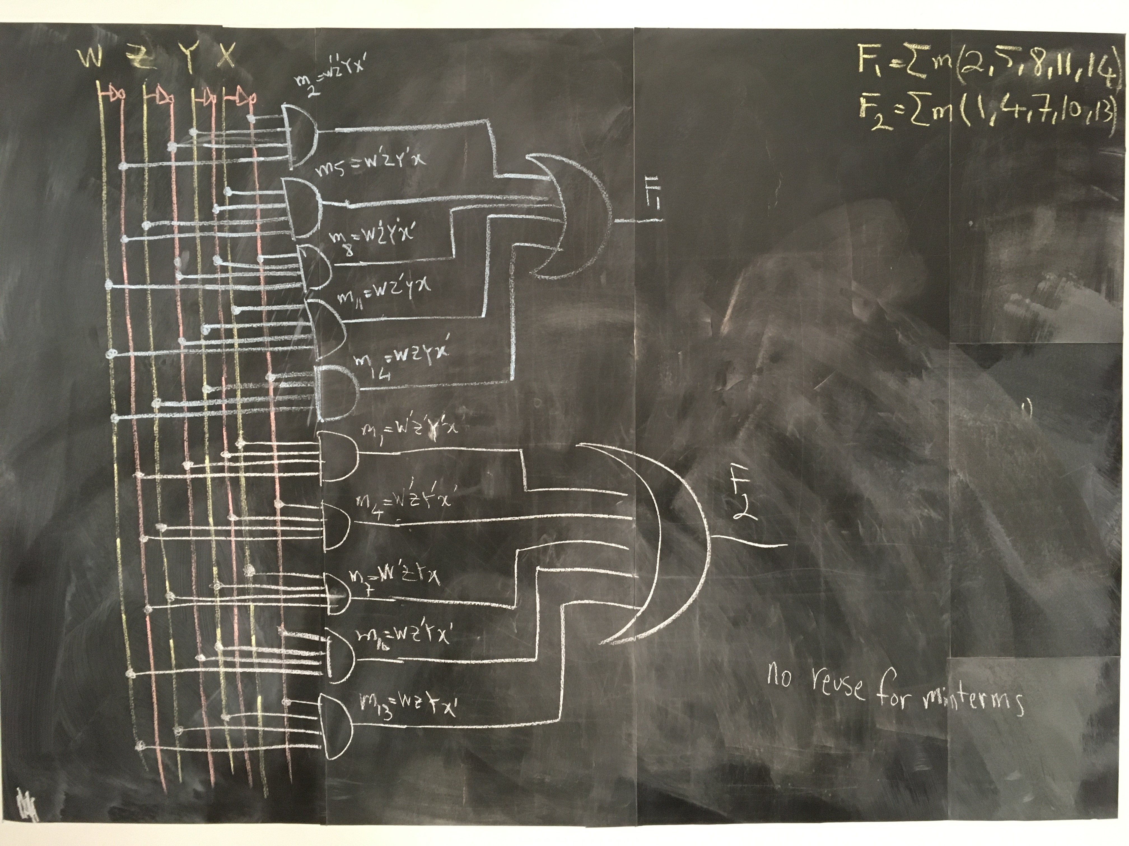

Slide 35
Universality

Slide 36
Universal GATE
{NAND}

Slide 37
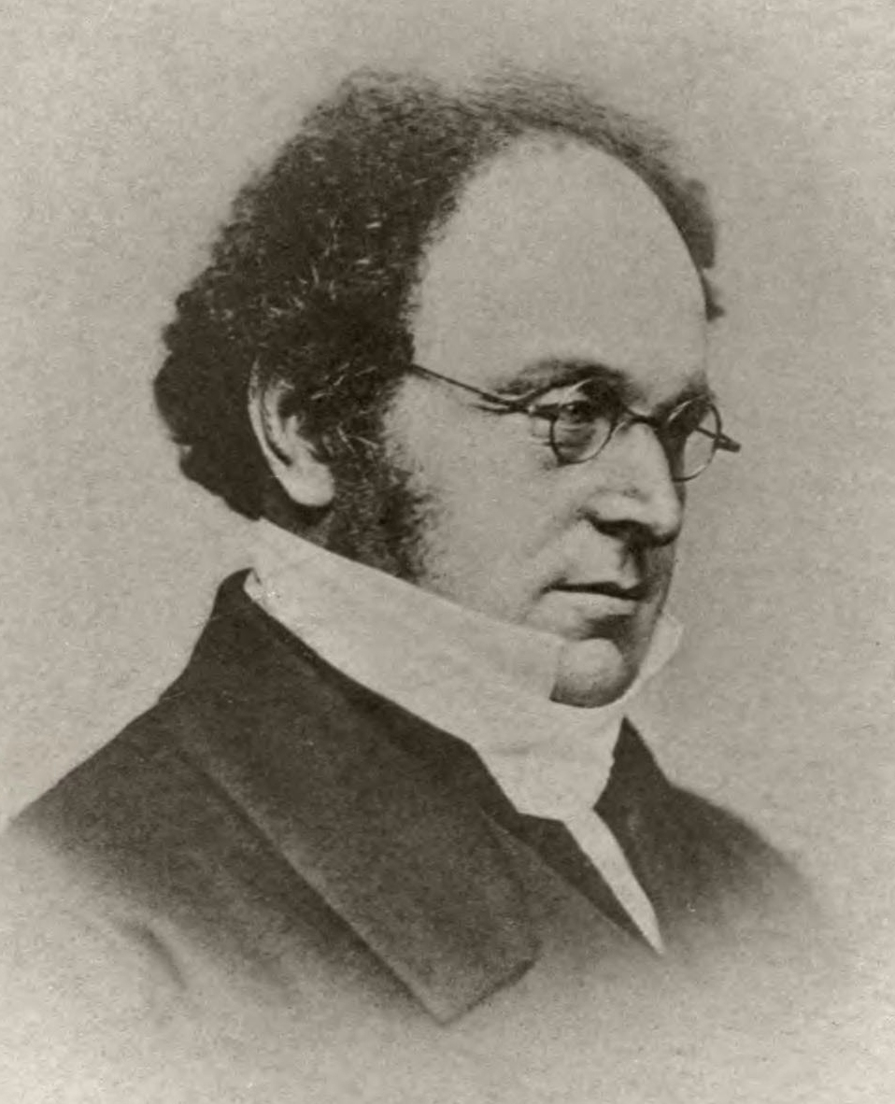
Augustus De Morgan
(1806–1871)
Mathematician
Logician
De Morgan's laws
► (Y+X)’= Y’X’

Slide 38
Augustus De Morgan
(1806–1871)
Mathematician
Logician
De Morgan's laws
► ((Y+X)’)’= (Y’X’)’

Slide 39
Augustus De Morgan
(1806–1871)
Mathematician
Logician
De Morgan's laws
► Y+X = (Y’X’)’

Slide 40
Augustus De Morgan
(1806–1871)
Mathematician
Logician
De Morgan's laws
► Y+X = Y’ ↑ X’

Slide 41
Z
Y
X
F₁=Z’Y’X’+Z’YX+ZY’X+ZYX’
F₂=ZY’X’+ZY’X

Slide 42
Z
Y
X
F₁=Z’Y’X’+Z’YX+ZY’X+ZYX’

Slide 43
Z
Y
X
F₁=Z’Y’X’+Z’YX+ZY’X+ZYX’
F₁= ((F₁)’)’

Slide 44
Z
Y
X
F₁=Z’Y’X’+Z’YX+ZY’X+ZYX’
F₁= ((F₁)’)’
F1= ((m₀+m₃+m₅+m₆)’)’

Slide 45
Z
Y
X
F₁=Z’Y’X’+Z’YX+ZY’X+ZYX’
F₁= ((F₁)’)’
F1= ((m₀+m₃+m₅+m₆)’)’
F1= (m’₀ m’₃ m’₅ m’₆)’

Slide 46
Z
Y
X
F₁=Z’Y’X’+Z’YX+ZY’X+ZYX’
F₁= ((F₁)’)’
F1= ((m₀+m₃+m₅+m₆)’)’
F1= (m’₀ m’₃ m’₅ m’₆)’
F1= ((Z’Y’X’)’ (Z’YX)’ (ZY’X)’ (ZYX’))’

Slide 47
Z
Y
X
F₁=Z’Y’X’+Z’YX+ZY’X+ZYX’
F₁= ((F₁)’)’
F1= ((m₀+m₃+m₅+m₆)’)’
F1= (m’₀ m’₃ m’₅ m’₆)’
F1= ((Z’Y’X’)’ (Z’YX)’ (ZY’X)’ (ZYX’))’
F₁= ((Z’↑Y’↑X’) (Z’↑Y↑X) (Z↑Y’↑X) (Z↑Y↑X’))’

Slide 48
Z
Y
X
F₁=Z’Y’X’+Z’YX+ZY’X+ZYX’
F₁= ((F₁)’)’
F1= ((m₀+m₃+m₅+m₆)’)’
F1= (m’₀ m’₃ m’₅ m’₆)’
F1= ((Z’Y’X’)’ (Z’YX)’ (ZY’X)’ (ZYX’))’
F₁= ((Z’↑Y’↑X’) (Z’↑Y↑X) (Z↑Y’↑X) (Z↑Y↑X’))’
F₁= ((Z’↑Y’↑X’)↑(Z’↑Y↑X)↑(Z↑Y’↑X)↑(Z↑Y↑X’))

Slide 49
Z
Y
X
F₁= ((F₁)’)’
F1= ((m₀+m₃+m₅+m₆)’)’
F1= (m’₀ m’₃ m’₅ m’₆)’
F1= ((Z’Y’X’)’ (Z’YX)’ (ZY’X)’ (ZYX’))’
F₁= ((Z’↑Y’↑X’) (Z’↑Y↑X) (Z↑Y’↑X) (Z↑Y↑X’))’
F₁= ((Z’↑Y’↑X’)↑(Z’↑Y↑X)↑(Z↑Y’↑X)↑(Z↑Y↑X’))

Slide 50
Z
Y
X
F₂=ZY’X’+ZY’X

Slide 51
Z
Y
X
F₂= m₄+m₅
F₂= ((F₂)’)’

Slide 52
Z
Y
X
F₂= m₄+m₅
F₂= ((F₂)’)’
F₂= ((m₄+m₅)’)’

Slide 53
Z
Y
X
F₂= m₄+m₅
F₂= ((F₂)’)’
F₂= ((m₄+m₅)’)’
F₂= (m’₄m’₅)’

Slide 54
Z
Y
X
F₂= m₄+m₅
F₂= ((F₂)’)’
F₂= ((m₄+m₅)’)’
F₂= (m’₄m’₅)’
F₂= ((ZY’X’)’ (ZY’X)’)’

Slide 55
Z
Y
X
F₂= m₄+m₅
F₂= ((F₂)’)’
F₂= ((m₄+m₅)’)’
F₂= (m’₄m’₅)’
F₂= ((ZY’X’)’ (ZY’X)’)’
F₂= ((Z↑Y’↑X’) (Z↑Y’↑X))’

Slide 56
Z
Y
X
F₂= m₄+m₅
F₂= ((F₂)’)’
F₂= ((m₄+m₅)’)’
F₂= (m’₄m’₅)’
F₂= ((ZY’X’)’ (ZY’X)’)’
F₂= ((Z↑Y’↑X’) (Z↑Y’↑X))’
F₂= ((Z↑Y’↑X’)↑(Z↑Y’↑X))

Slide 57
Z
Y
X
F₂= ((Z↑Y’↑X’)↑(Z↑Y’↑X))

Slide 58
Z
Y
X
F₁= ((Z’↑Y’↑X’)↑(Z’↑Y↑X)↑(Z↑Y’↑X)↑(Z↑Y↑X’))
F₂= ((Z↑Y’↑X’)↑(Z↑Y’↑X))

Slide 59
Z
Y
X
F₁= ((Z’↑Y’↑X’)↑(Z’↑Y↑X)↑(Z↑Y’↑X)↑(Z↑Y↑X’))
NOT by NAND?
F₂= ((Z↑Y’↑X’)↑(Z↑Y’↑X))

Slide 60
Z
Y
X
F₁= ((Z’↑Y’↑X’)↑(Z’↑Y↑X)↑(Z↑Y’↑X)↑(Z↑Y↑X’))
NOT by NAND?
F₂= ((Z↑Y’↑X’)↑(Z↑Y’↑X))

Slide 61
Universal GATE {NAND}
F=(F’)’=(SoP’)’

Slide 62
Design II
a new algorithm for designing any logic circuits, given truth table

Slide 63
MAXTERM
aka. Standard Sum

Slide 64
X’ vs. x
1 binary variable appear either:
in its normal form X, or
in its complement form X’

Slide 65
M₀=m’₀ | (X’)=(X’)’=X
M₁=m’₁ | X’

Slide 66
Y+X vs. Y+X’ vs. Y’+x vs. Y’+X’
2 binary variables appear either in one of these forms:

Slide 67
M₀=m’₀ | (Y’X’)’ = y+x
M₁=m’₁ | (Y’X)’ = y+X’
M₂=m’₂ | (YX’)’ = y’+x
M₃=m’₃ | (YX)’ = y’+X’

Slide 68
Z+Y+X vs. Z+Y+X’ vs. …
3 binary variables appear either in one of these forms: how many?

Slide 69
Z+Y+X vs. Z+Y+X’ vs. …
3 binary variables appear either in one of these forms: how many?
Each variable can take 2 forms (normal and complement)
We have 3 variables, 2×2×2 = 2³ = 8

Slide 70
M₀=m’₀ | (Z’Y’X’)’=Z+y+X
M₁=m’₁ | (Z’Y’X)’=Z+Y+X’
M₂=m’₂ | (Z’YX’)’=Z+Y’+X
M₃=m’₃ | (Z’YX)’=Z+Y’+X’
M₄=m’₄ | (ZY’X’)’=Z’+Y+X
M₅=m’₅ | (ZY’X)’=Z’+Y+X’
M₆=m’₆ | (ZYX’)’=Z’+Y’+X
M₇=m’₇ | (ZYX)’=Z’+Y’+X’

Slide 71
A_{n}+…A₂+A₁+A₀ vs. A_{n}+…A₂+A₁+A’₀ …
n binary variables appear either in one of these forms: how many?
Each variable can take 2 forms (normal and complement)
We have n variables, 2×2×2× … ×2 = 2^{n}

Slide 72
M₀=m’₀ | A_{n}+A₂+A₁+A₀
M₁=m’₁ | A_{n}+…A₂+A₁+A’₀
M₂=m’₂ | A_{n}+…A₂+A’₁+A₀
… | …
… | …
M₂^{n}₋₃=m’₂^{n}₋₃ | A’_{n}+…A’₂+A₁+A’₀
M₂^{n}₋₂=m’₂^{n}₋₂ | A’_{n}+…A’₂+A’₁+A₀
M₂^{n}₋₁=m’₂^{n}₋₁ | A’_{n}+…A’₂+A’₁+A’₀

Slide 73
Truth table
en.wikipedia.org/wiki/Truth_table

Slide 74
Truth table ↔ MAXTERM

Slide 75
Y | X | F=m₀+m₁
0 | 0 | 1
0 | 1 | 1
1 | 0 | 0
1 | 1 | 0

Slide 76
Y
X
Y’X’
F_{sop}=Y’X’+Y’X
Y’X

Slide 77
Y | X | F=m₀+m₁ | F’=m₂+m₃
0 | 0 | 1 | 0
0 | 1 | 1 | 0
1 | 0 | 0 | 1
1 | 1 | 0 | 1

Slide 78
Y | X | F=m₀+m₁ | F’=m₂+m₃ | (F’)’=(m₂+m₃)’
0 | 0 | 1 | 0 | 1
0 | 1 | 1 | 0 | 1
1 | 0 | 0 | 1 | 0
1 | 1 | 0 | 1 | 0

Slide 79
Y | X | F=(F’)’=(m₂+m₃)’=m’₂m’₃
0 | 0 | 1
0 | 1 | 1
1 | 0 | 0
1 | 1 | 0

Slide 80
Y | X | F=(F’)’=m’₂m’₃=M₂M₃
0 | 0 | 1
0 | 1 | 1
1 | 0 | 0
1 | 1 | 0

Slide 81
Y | X | F=(F’)’=m’₂m’₃=M₂M₃
0 | 0 | 1
0 | 1 | 1
1 | 0 | 0
1 | 1 | 0

Slide 82
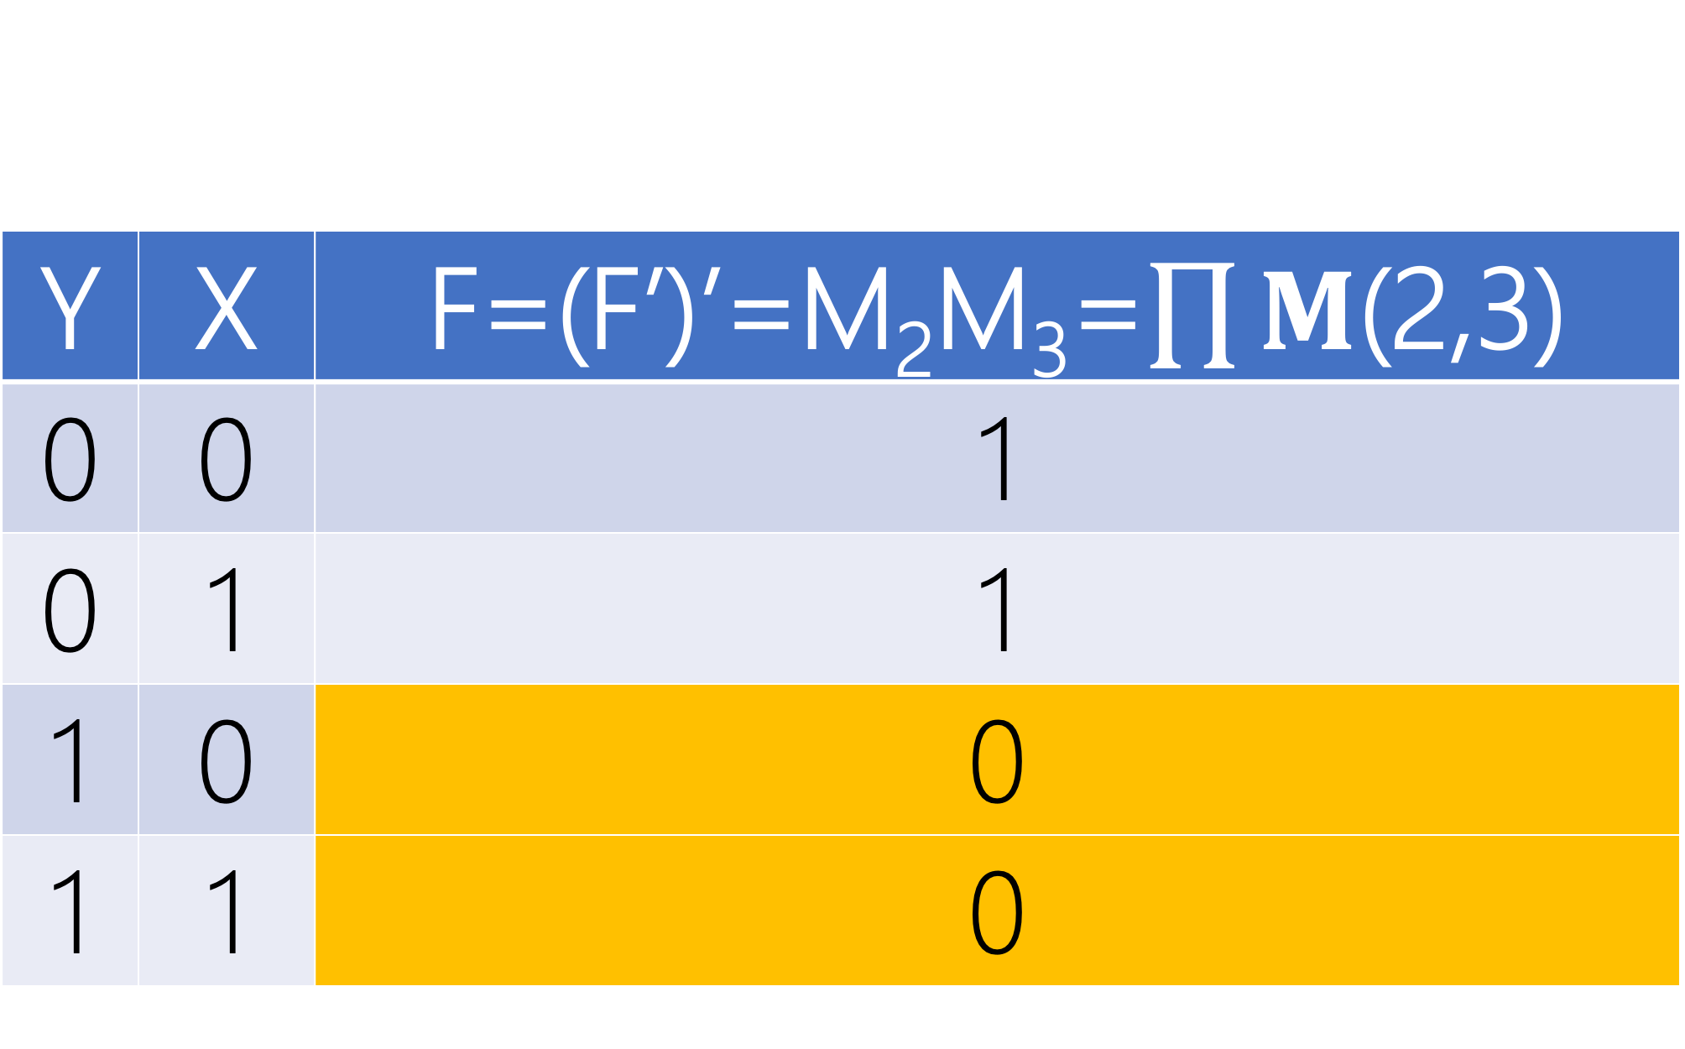
Y | X | F=(F’)’=M₂M₃=$\prod{M}$(2,3)
0 | 0 | 1
0 | 1 | 1
1 | 0 | 0
1 | 1 | 0

Slide 83
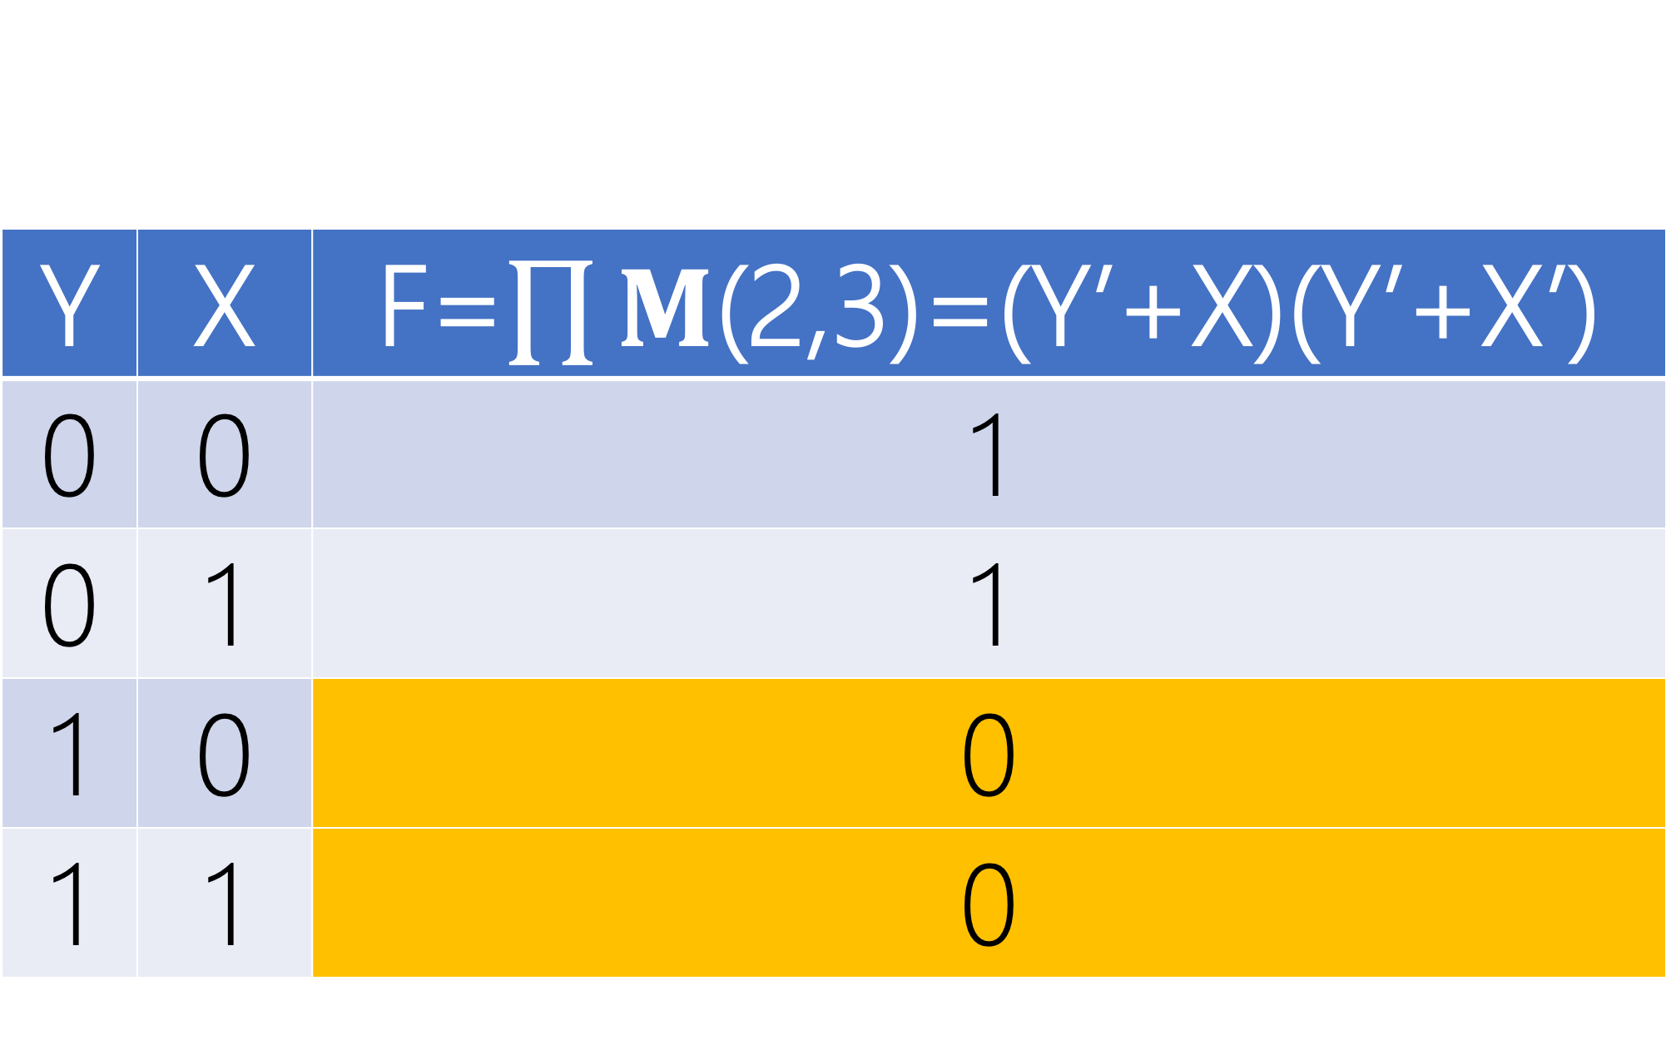
Y | X | F=$\prod{M}$(2,3)=(Y’+X)(Y’+X’)
0 | 0 | 1
0 | 1 | 1
1 | 0 | 0
1 | 1 | 0

Slide 84
Y
X
Y’+X
F=(Y’+X)(Y’+X’)
Y’+X’

Slide 85
PRODUCT OF SUMS
(POS)

Slide 86
Y
X
Y’+X
F=(Y’+X)(Y’+X’)
Y’+X’

Slide 87
Y
X
Y’+X
F=(Y’+X)(Y’+X’)
Y’+X’

Slide 88
2 LEVELS
OR → AND

Slide 89
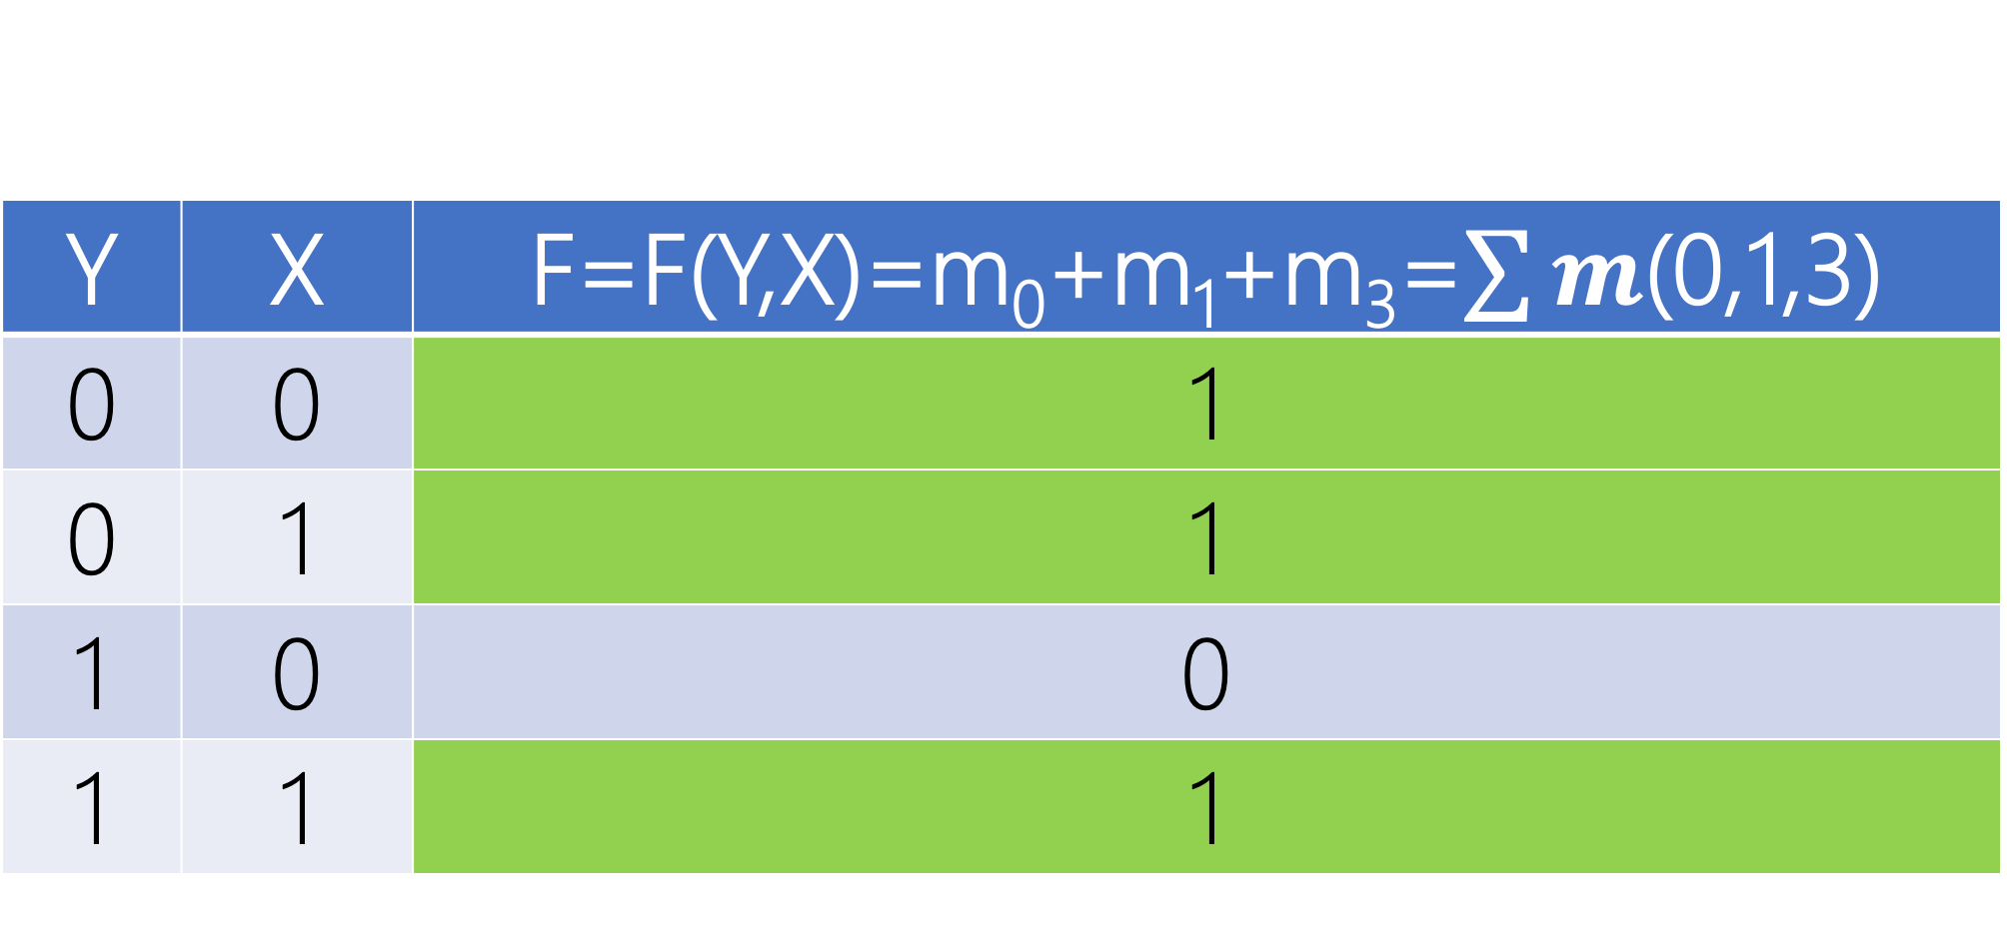
Y | X | F=F(Y,X)=m₀+m₁+m₃=$\sum{m}$(0,1,3)
0 | 0 | 1
0 | 1 | 1
1 | 0 | 0
1 | 1 | 1

Slide 90
Y
Y
X
X
Y’X’
Y’X
F_{sop}=Y’X’+Y’X+YX
YX

Slide 91
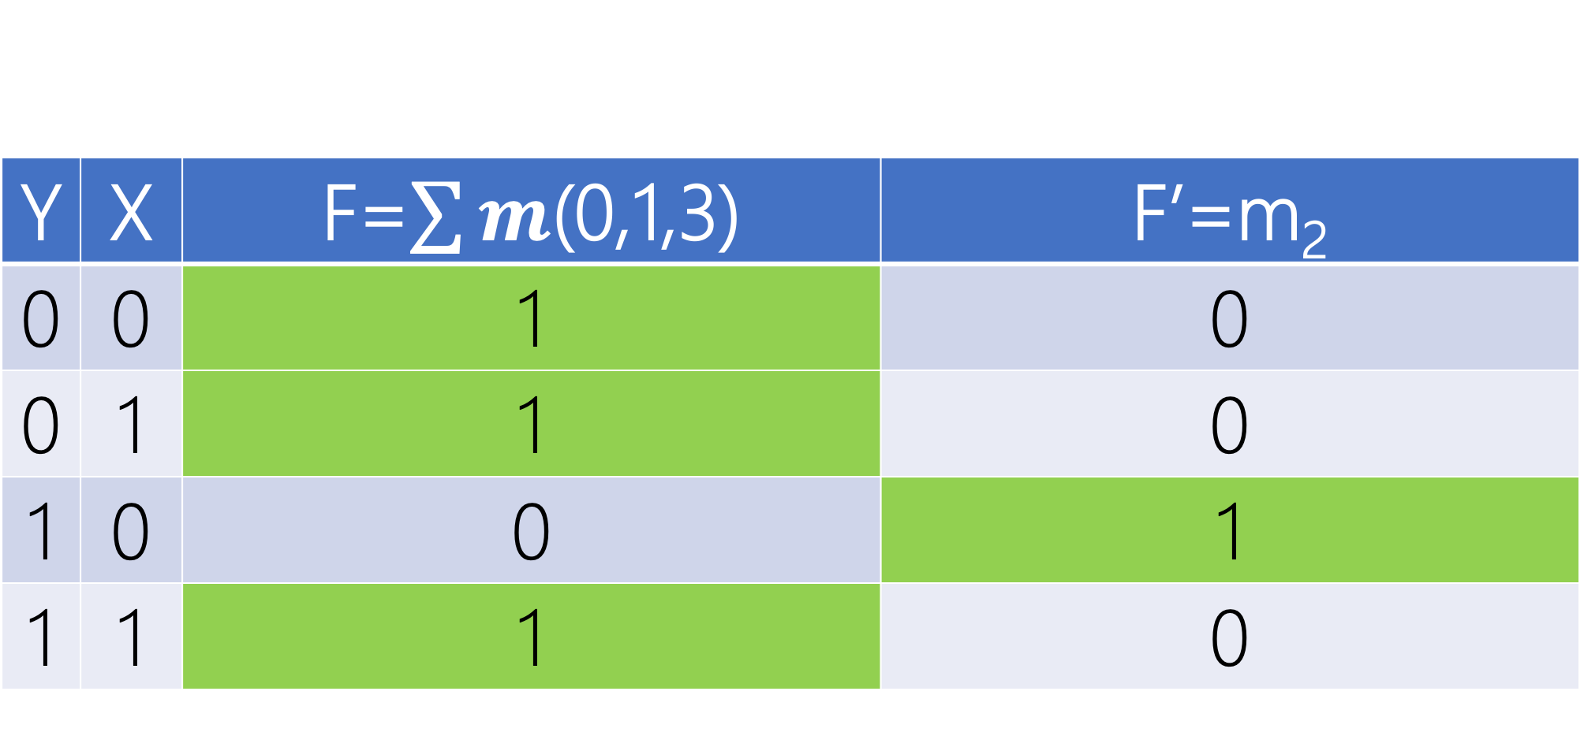
Y | X | F=$\sum{m}$(0,1,3) | F’=m₂
0 | 0 | 1 | 0
0 | 1 | 1 | 0
1 | 0 | 0 | 1
1 | 1 | 1 | 0

Slide 92
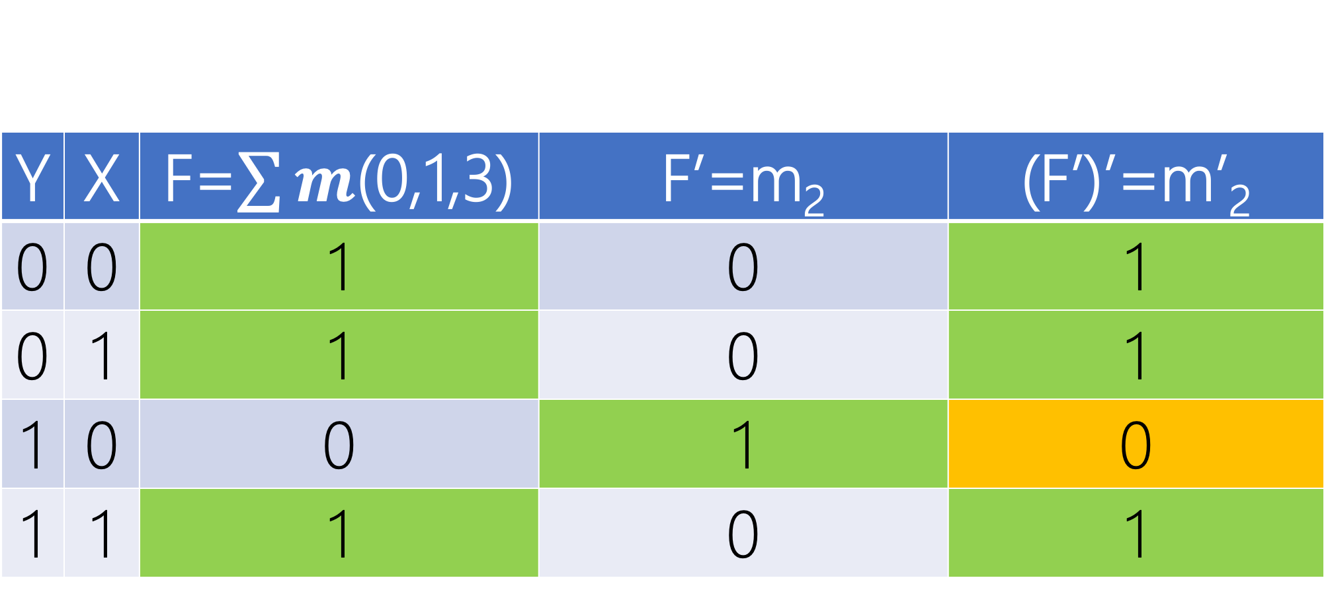
Y | X | F=$\sum{m}$(0,1,3) | F’=m₂ | (F’)’=m’₂
0 | 0 | 1 | 0 | 1
0 | 1 | 1 | 0 | 1
1 | 0 | 0 | 1 | 0
1 | 1 | 1 | 0 | 1

Slide 93
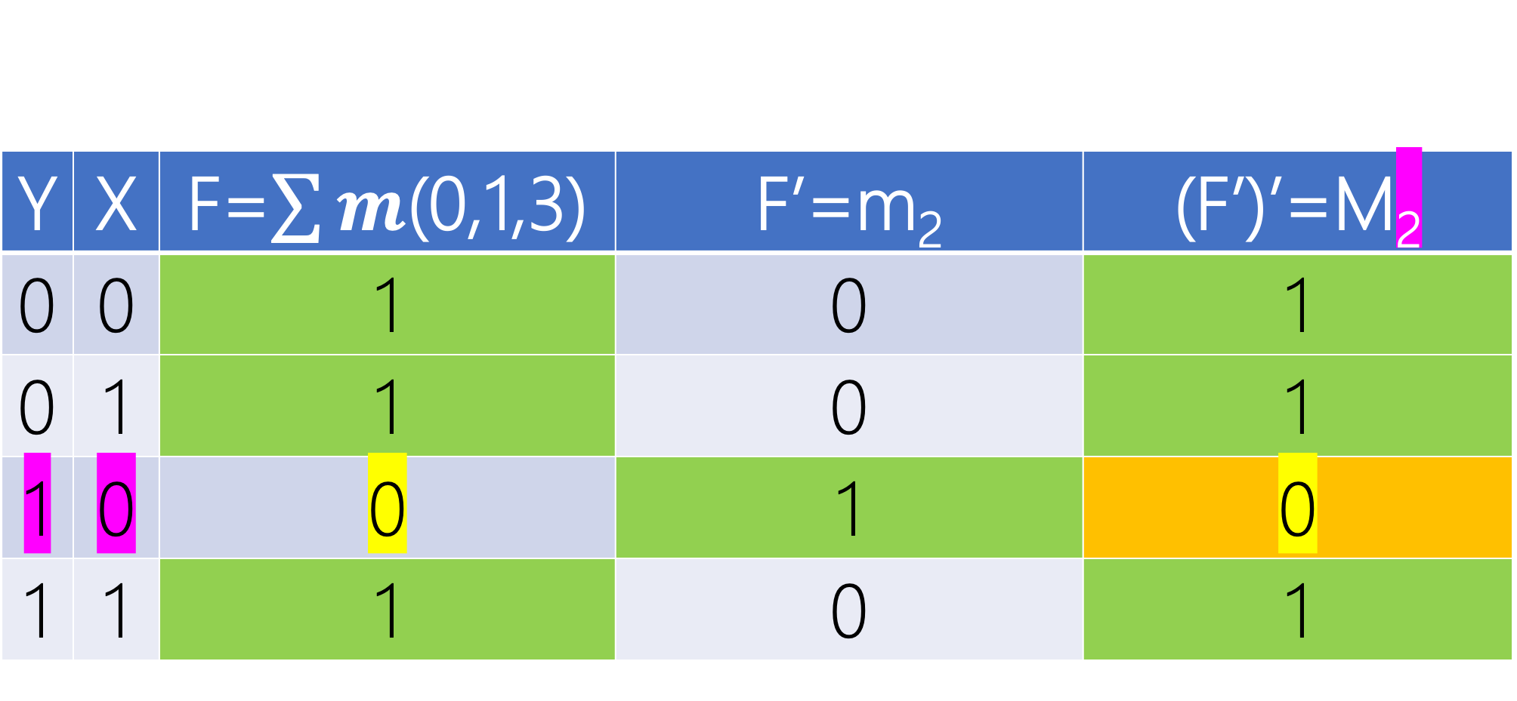
Y | X | F=$\sum{m}$(0,1,3) | F’=m₂ | (F’)’=M₂
0 | 0 | 1 | 0 | 1
0 | 1 | 1 | 0 | 1
1 | 0 | 0 | 1 | 0
1 | 1 | 1 | 0 | 1

Slide 94
Y
Y
X
X
Y’+X
F_{pos}=M₂=m’₂=(YX’)’=(Y’+X)

Slide 95
Y
Y
X
X
Y’+X
1
F_{pos}=M₂=m’₂=(YX’)’=(Y’+X)(1)

Slide 96
DESIGN I vs. II
SoP vs. PoS
Lecture Assignment

Slide 97
Given 3 inputs, design a circuit to determine if there is even number of 1

Slide 98
Y
Y
X
Z
X
Z’Y’X’+Z’YX+ZY’X+ZYX’

Slide 99
Z | Y | X | F(Z,Y,X)=?
0 | 0 | 0 | ?
0 | 0 | 1 | ?
0 | 1 | 0 | ?
0 | 1 | 1 | ?
1 | 0 | 0 | ?
1 | 0 | 1 | ?
1 | 1 | 0 | ?
1 | 1 | 1 | ?

Slide 100
Z | Y | X | F(Z,Y,X)=?
0 | 0 | 0 | 1
0 | 0 | 1 | 0
0 | 1 | 0 | 0
0 | 1 | 1 | 1
1 | 0 | 0 | 0
1 | 0 | 1 | 1
1 | 1 | 0 | 1
1 | 1 | 1 | 0

Slide 101
Z | Y | X | F(Z,Y,X)=M₁
0 | 0 | 0 | 1
0 | 0 | 1 | 0
0 | 1 | 0 | 0
0 | 1 | 1 | 1
1 | 0 | 0 | 0
1 | 0 | 1 | 1
1 | 1 | 0 | 1
1 | 1 | 1 | 0

Slide 102
Z | Y | X | F(Z,Y,X)=M₁M₂
0 | 0 | 0 | 1
0 | 0 | 1 | 0
0 | 1 | 0 | 0
0 | 1 | 1 | 1
1 | 0 | 0 | 0
1 | 0 | 1 | 1
1 | 1 | 0 | 1
1 | 1 | 1 | 0

Slide 103
Z | Y | X | F(Z,Y,X)=M₁M₂M₄
0 | 0 | 0 | 1
0 | 0 | 1 | 0
0 | 1 | 0 | 0
0 | 1 | 1 | 1
1 | 0 | 0 | 0
1 | 0 | 1 | 1
1 | 1 | 0 | 1
1 | 1 | 1 | 0

Slide 104
Z | Y | X | F(Z,Y,X)=M₁M₂M₄M₇
0 | 0 | 0 | 1
0 | 0 | 1 | 0
0 | 1 | 0 | 0
0 | 1 | 1 | 1
1 | 0 | 0 | 0
1 | 0 | 1 | 1
1 | 1 | 0 | 1
1 | 1 | 1 | 0

Slide 105
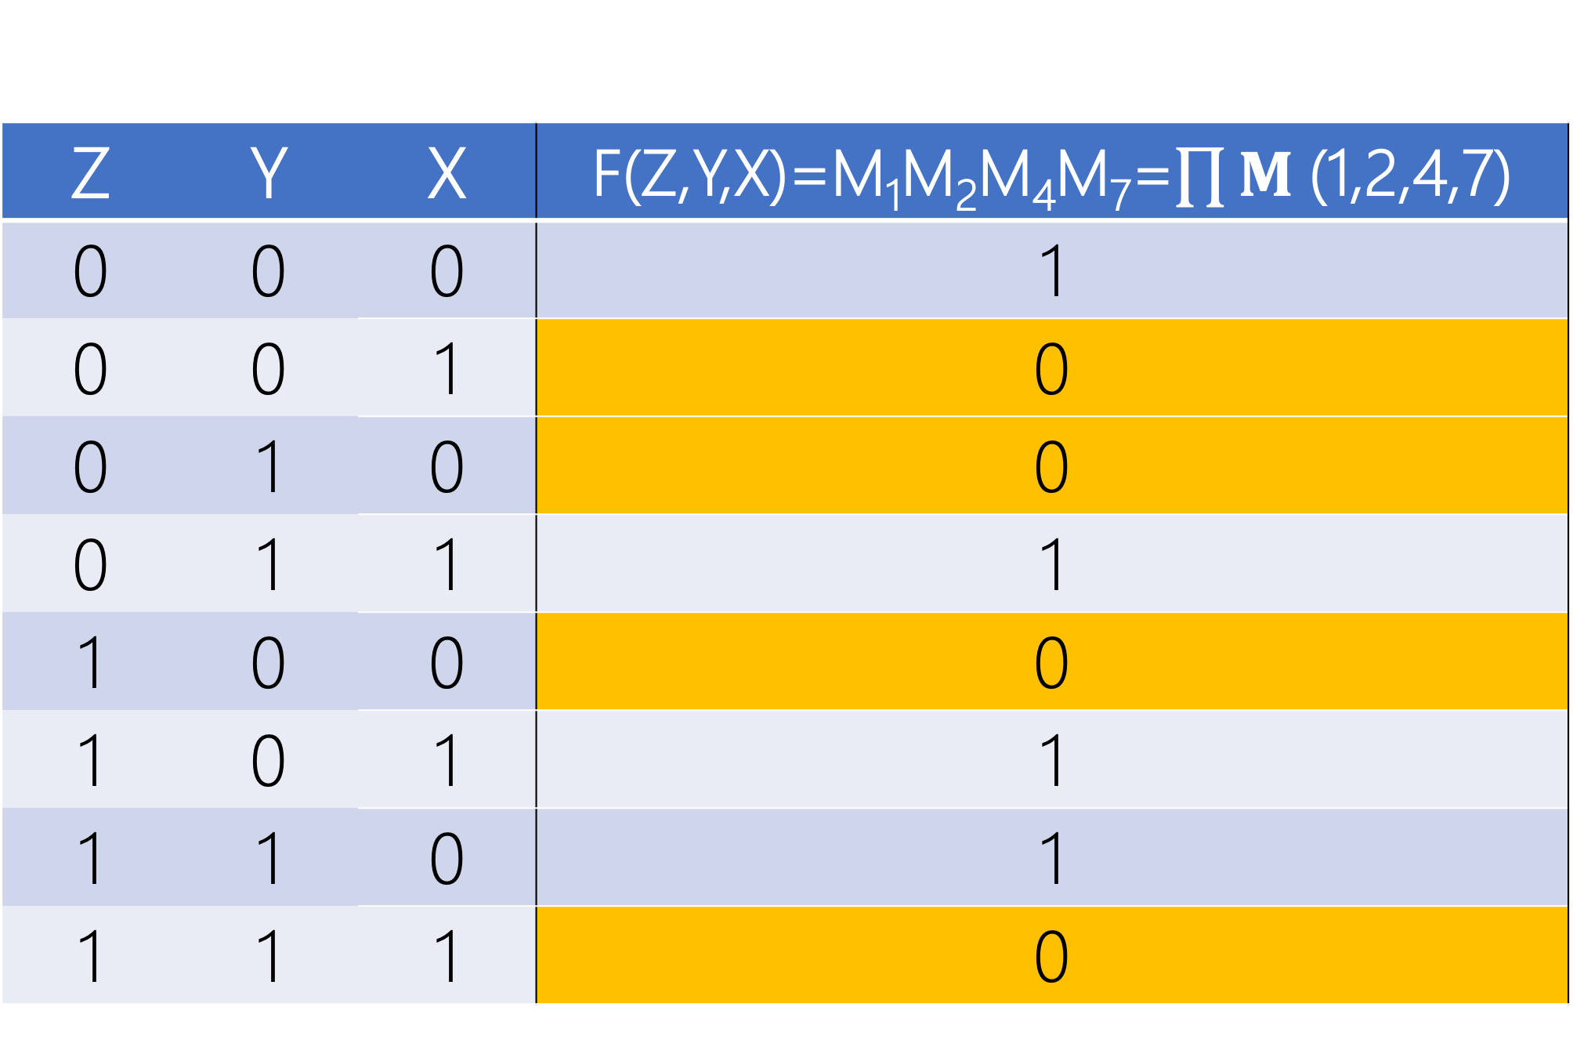
Z | Y | X | F(Z,Y,X)=M₁M₂M₄M₇=$\prod{M}$(1,2,4,7)
0 | 0 | 0 | 1
0 | 0 | 1 | 0
0 | 1 | 0 | 0
0 | 1 | 1 | 1
1 | 0 | 0 | 0
1 | 0 | 1 | 1
1 | 1 | 0 | 1
1 | 1 | 1 | 0

Slide 106
Y
Y
X
Z
X
M₁=Z+Y+X’
M₂=Z+Y’+X’
M₄=Z’+Y+X
M₇=Z’+Y’+X’
F=(Z+Y+X’)(Z+Y’+X’)(Z’+Y+X)(Z’+Y’+X’)

Slide 107
Universal GATE
{NOR}
Lecture Assignment

Slide 108
RECAP
Any Boolean Function F:
- Sum (OR) of Products (ANDs)
- Sum of minterms for Entries with 1
- ANDs-OR
- NAND via (F’)’
- Product (AND) of Sums (ORs)
- Product of MAXTERMS (NOT minterms) for Entries with 0
- ORs-AND
- NOR via (F’)’

