Slide 1
Minimization
aka. Simplification

Slide 2
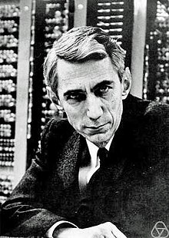
Claude Elwood Shannon
Mathematician
Electrical Engineer
Cryptographer
M.Sc. Thesis (1937)
A Symbolic Analysis of Relay and Switching Circuits
Switching Algebra!
2-valued Boolean algebra
Notes:
He is also well known for founding digital circuit design theory in 1937, when—as a 21-year-old master's degree student at the Massachusetts Institute of Technology (MIT)—he wrote his thesis demonstrating that electrical applications of Boolean algebra could construct any logical numerical relationship

Slide 3
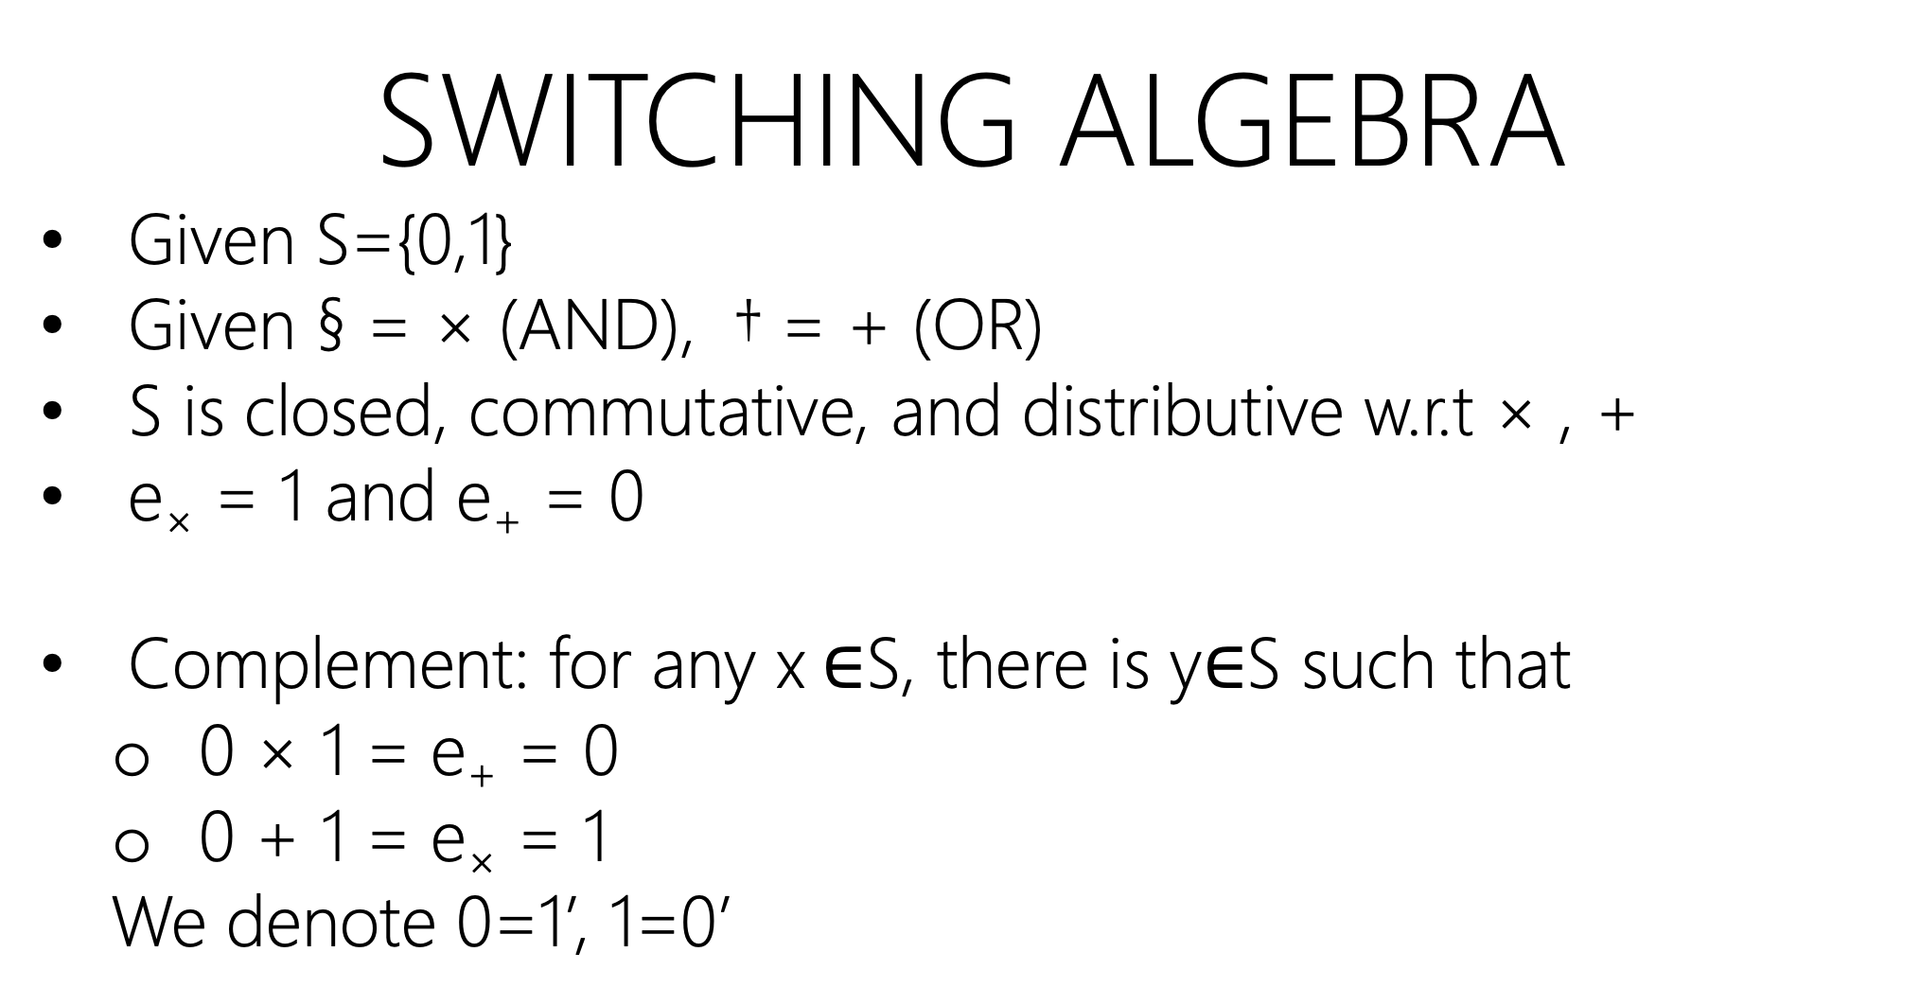
Switching algebra
Given S={0,1}
Given § = × (AND), † = + (OR)
S is closed, commutative, and distributive w.r.t × , +
e× = 1 and e₊ = 0
Complement: for any x $∈$S, there is y$∈$S such that
0 × 1 = e₊ = 0
0 + 1 = e× = 1
We denote 0=1’, 1=0’

Slide 4
Switching algebra
Is-A
Boolean algebra
It satisfies all conditions of Boolean algebra!
Prove → Book: 2.3 axiomatic definition of Boolean algebra

Slide 5
Another sample of algebra in CS:
Relational Algebra (SQL)
Is relational algebra a Boolean algebra? Check this when you take
COMP-3150: Database Management Systems!

Slide 6
Basic Theorems
Prove by postulates

Slide 7
X + X = X
X+ X + X + … + X = X

Slide 8
X + X = X
X+ X + X + … + X = X
X + X =
= (X + X) 1 using identity e×=1

Slide 9
X + X = X
X+ X + X + … + X = X
X + X =
= (X + X) 1 using identity e×=1
= (X + X) (X+X’) using complement property

Slide 10
X + X = X
X+ X + X + … + X = X
X + X =
= (X + X) 1 using identity e×=1
= (X + X) (X+X’) using complement property
= X + (XX’) using distributive property of + over ×

Slide 11
X + X = X
X+ X + X + … + X = X
X + X =
= (X + X) 1 using identity e×=1
= (X + X) (X+X’) using complement property
= X + (XX’) using distributive property of + over ×
= X + 0 using complement property

Slide 12
X + X = X
X+ X + X + … + X = X
X + X =
= (X + X) 1 using identity e×=1
= (X + X) (X+X’) using complement property
= X + (XX’) using distributive property of + over ×
= X + 0 using complement property
= X using identity property of e₊=0

Slide 13
X + 1 = 1
X+ Y + Z + … + 1 = 1

Slide 14
X + 1 = 1
X+ Y + Z + … + 1 = 1
X + 1 =
= (X + 1) 1 using identity e×=1

Slide 15
X + 1 = 1
X+ Y + Z + … + 1 = 1
X + 1 =
= (X + 1) 1 using identity e×=1
= (X + 1) (X+X’) using complement property

Slide 16
X + 1 = 1
X+ Y + Z + … + 1 = 1
X + 1 =
= (X + 1) 1 using identity e×=1
= (X + 1) (X+X’) using complement property
= X + (1X’) using distributive property of + over ×

Slide 17
X + 1 = 1
X+ Y + Z + … + 1 = 1
X + 1 =
= (X + 1) 1 using identity e×=1
= (X + 1) (X+X’) using complement property
= X + (1X’) using distributive property of + over ×
= X + X’ using identity e×=1

Slide 18
X + 1 = 1
X+ Y + Z + … + 1 = 1
X + 1 =
= (X + 1) 1 using identity e×=1
= (X + 1) (X+X’) using complement property
= X + (1X’) using distributive property of + over ×
= X + X’ using identity e×=1
= 1 using complement property

Slide 19
X + xy = x
X + xY + xZW + … + xwAD = x
Absorption

Slide 20
X + xy = x
X + xY + xZW + … + xwAD = x
X + xy =
= X1+XY using identity e×=1
= x(1 + Y) using distributive property of × over +
= X1 using previous theorem x+1=1
= X using identity e×=1
Absorption

Slide 21

duality
Dual(F) = OR $⇄$ AND, 1 $⇄$ 0
Dual(F) may or may not equal to F!

Slide 22

duality
X+1 $⇄$ X0
X+X’ $⇄$ XX’
(X+Y)’ $⇄$ (XY)’

Slide 23
duality
A postulate or a proved theorem for F
Also a postulate or a proved theorem for Dual(F)

Slide 24

duality
{X+1=1} $⇄$ {X0 = 0}
{X+X’=1} $⇄$ {XX’=0}k
{(X+Y)’=X’Y’} $⇄$ {(XY)’=X’+Y’}

Slide 25
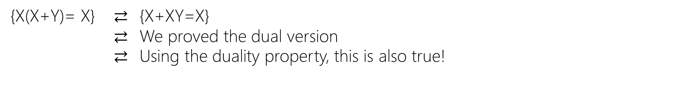
X(x+y) = x
X(x+Y)(x+Z) … (x+w) = x
{X(x+y)= X} $⇄$ {X+XY=X}
$⇄$ We proved the dual version
$⇄$ Using the duality property, this is also true!
Absorption

Slide 26
Basic Theorems
prove by truth table
For equality proof, F₁=F₂, for all possibility in the input variables (all rows), both side of equation must have equal value for same input variables.
For inequality proof, F₁≠F₂, find at least one possibility (a row) that have different values.

Slide 27
Minimization
Boolean Algebra (algebraically)
aka. Algebraic Manipulation

Slide 28
F = zy’x’+ zYX + Zyx’ + zy’X
4 × 3-input-and
1 × 4-input-OR

Slide 29
F = zy’x’+ zYX + Zyx’ + zy’X

Slide 30
F = z (y’x’ + yx + yx’ + y’x)

Slide 31
F = z (y’x’ + yx + yx’ + y’x)

Slide 32
F = z (y’(x’+X) + yx + yx’)

Slide 33
F = z (y’(x’+X) + yx + yx’)

Slide 34
F = z (y’ 1 + yx + yx’)

Slide 35
F = z (y’ 1 + yx + yx’)

Slide 36
F = z (y’ + yx + yx’)

Slide 37
F = z (y’ + yx + yx’)

Slide 38
F = z (y’ + y (x+X’))

Slide 39
F = z (y’ + y (x+X’))

Slide 40
F = z (y’ + y1)

Slide 41
F = z (y’+y)

Slide 42
F = z (y’+y)

Slide 43
F = z1

Slide 44
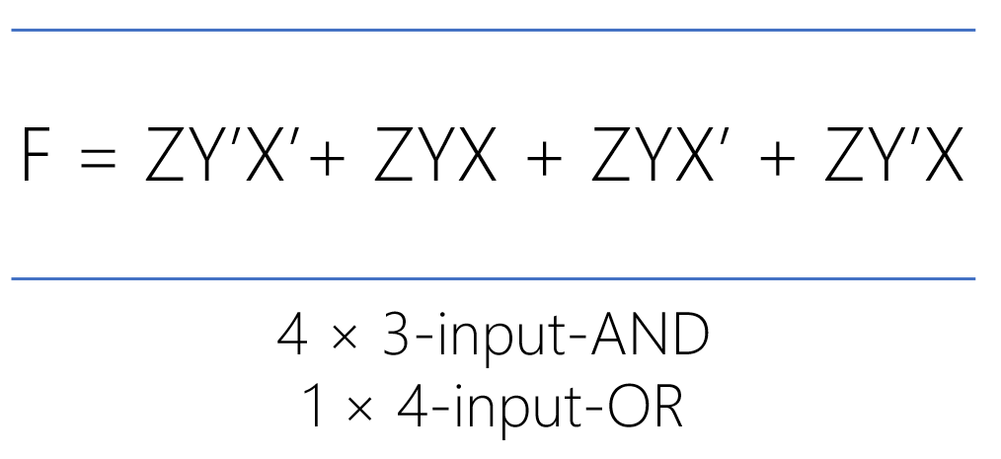
F = z
0 gates!

Slide 45
F = zy’x’ + zyx+ zyx’ + zy’x

Slide 46
F = zy’ (x’+X) + zyx + zyx’

Slide 47
F = zy’ (x’+X) + zyx + zyx’

Slide 48
F = zy’ (x’+X) + zy (x+X’)

Slide 49
F = zy’ (x’+X) + zy (x+X’)

Slide 50
F = zy’1 + zy1

Slide 51
F = zy’ + zy

Slide 52
F = z (y’+Y)

Slide 53
F = z1

Slide 54
F = z
0 gates!

Slide 55
F = zy’x’ + zyx’ + Z’y’x
3 × 3-input-and
1 × 3-input-OR

Slide 56
F = zy’x’ + zyx’ + Z’y’x

Slide 57
F = zx’(y’+Y) + Z’y’x

Slide 58
F = zx’ (y’+Y) + Z’y’x

Slide 59
F = zx’1+ Z’y’x

Slide 60
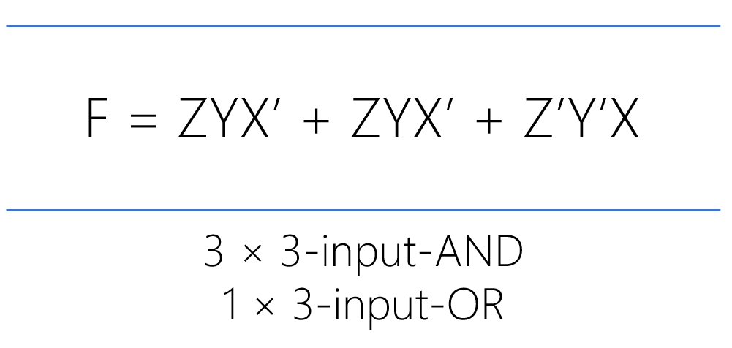
F = zx’+ Z’y’x
1 × 2-input-and
1 × 3-input-and
1 × 2-input-OR

Slide 61
Minimization
Boolean Algebra (algebraically)
Needs to be smart. It is hard due to guesswork (which rules to apply?)
If the number of variables (ABCDEF…) and/or number of minterms (MAXTERMS) grows
No Algorithm
Is the result minimal?!

Slide 62
Minimization
II) Map (Karnaugh map, K-map)
aka. Graphical Manipulation

Slide 63
Minimization
II) Map (Karnaugh map, K-map)
aka. Graphical Manipulation
Algorithm; Straightforward, up to six variables
Result is always minimal

Slide 64
Truth table
Y | X | F
0 | 0 | ?
0 | 1 | ?
1 | 0 | ?
1 | 1 | ?

Slide 65
Boolean function
Algebraic Expression
F_{sop} = Σ minterms
F_{pos} = ∏ MAXTERMs

Slide 66
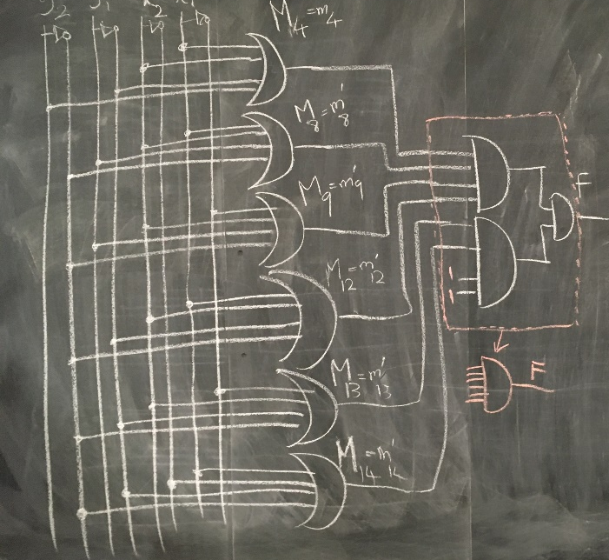
Logic circuit

Slide 67

Maurice Karnaugh
Physicist
Mathematician
Inventor
Bell Labs (1954)
"The Map Method for Synthesis of
Combinational Logic Circuits”

Slide 68
KARNAUGH MAP
/ˈkɑːrnɔː/

Slide 69
1-Variable KARNAUGH MAP

Slide 70
X | F
0 | m₀
1 | m₁
X
0 | 1
m₀ | m₁

Slide 71
2-Variable KARNAUGH MAP

Slide 72
Y | X | F
0 | 0 | m₀
0 | 1 | m₁
1 | 0 | m₂
1 | 1 | m₃
 |  | X
 |  | 0 | 1
Y | 0 | m₀ | m₁
 | 1 | m₂ | m₃

Slide 73
Y | X | F
0 | 0 | m₀
0 | 1 | m₁
1 | 0 | m₂
1 | 1 | m₃
 |  | X
 |  | 0 | 1
Y | 0 | m₀ | m₁
 | 1 | m₂ | m₃

Slide 74
Y | X | F
0 | 0 | 1
0 | 1 | 0
1 | 0 | 0
1 | 1 | 0
F(Y,X) = m₀ = Y’X’
 |  | X
 |  | 0 | 1
Y | 0 | 1 | 0
 | 1 | 0 | 0
F(Y,X) = Y’X’

Slide 75
Y | X | F
0 | 0 | 0
0 | 1 | 1
1 | 0 | 0
1 | 1 | 0
F(Y,X) = m₁ = Y’X
 |  | X
 |  | 0 | 1
Y | 0 | 0 | 1
 | 1 | 0 | 0
F(Y,X) = Y’X

Slide 76
Y | X | F
0 | 0 | 0
0 | 1 | 0
1 | 0 | 1
1 | 1 | 0
F(Y,X) = m₂ = YX’
 |  | X
 |  | 0 | 1
Y | 0 | 0 | 0
 | 1 | 1 | 0
F(Y,X) = YX’

Slide 77
Y | X | F
0 | 0 | 0
0 | 1 | 0
1 | 0 | 0
1 | 1 | 1
F(Y,X) = m₃ = YX
 |  | X
 |  | 0 | 1
Y | 0 | 0 | 0
 | 1 | 0 | 1
F(Y,X) = YX

Slide 78
Y | X | F
0 | 0 | 1
0 | 1 | 1
1 | 0 | 0
1 | 1 | 0
F(Y,X) = m₀ + m₁ F(Y,X) = Y’X’ + Y’X F(Y,X) = Y’(X’ + X) F(Y,X) = Y’
 |  | X
 |  | 0 | 1
Y | 0 | 1 | 1
 | 1 | 0 | 0
F(Y,X) = Y’

Slide 79
Y | X | F
0 | 0 | 0
0 | 1 | 0
1 | 0 | 1
1 | 1 | 1
F(Y,X) = m₂ + m₃ F(Y,X) = YX’ + YX F(Y,X) = Y(X’ + X) F(Y,X) = Y
 |  | X
 |  | 0 | 1
Y | 0 | 0 | 0
 | 1 | 1 | 1
F(Y,X) = Y

Slide 80
Y | X | F
0 | 0 | 0
0 | 1 | 1
1 | 0 | 0
1 | 1 | 1
F(Y,X) = m₁ + m₃ F(Y,X) = Y’X + YX F(Y,X) = X(Y’ + Y) F(Y,X) = X
 |  | X
 |  | 0 | 1
Y | 0 | 0 | 1
 | 1 | 0 | 1
F(Y,X) = X

Slide 81
Y | X | F
0 | 0 | 1
0 | 1 | 0
1 | 0 | 1
1 | 1 | 0
F(Y,X) = m₀ + m₂ F(Y,X) = Y’X’ + YX’ F(Y,X) = X’(Y’ + Y) F(Y,X) = X’
 |  | X
 |  | 0 | 1
Y | 0 | 1 | 0
 | 1 | 1 | 0
F(Y,X) = X’

Slide 82
Y | X | F
0 | 0 | 1
0 | 1 | 1
1 | 0 | 1
1 | 1 | 0
F(Y,X) = m₀ + m₁ + m₂ F(Y,X) = Y’X’ + Y’X + YX’ F(Y,X) = Y’(X’ + X) + YX’ F(Y,X) = Y’ + YX’
 |  | X
 |  | 0 | 1
Y | 0 | 1 | 1
 | 1 | 1 | 0
F(Y,X) = Y’ + YX’

Slide 83
Y | X | F
0 | 0 | 1
0 | 1 | 1
1 | 0 | 1
1 | 1 | 0
F(Y,X) = m₀ + m₁ + m₂ F(Y,X) = Y’X’ + Y’X + YX’ F(Y,X) = X’(Y’ + Y) + Y’X F(Y,X) = X’ + Y’X
 |  | X
 |  | 0 | 1
Y | 0 | 1 | 1
 | 1 | 1 | 0
F(Y,X) = X’ + Y’X

Slide 84
Y | X | F
0 | 0 | 1
0 | 1 | 1
1 | 0 | 1
1 | 1 | 0
F(Y,X) = m₀ + m₁ + m₂ F(Y,X) = Y’X’ + Y’X + YX’ F(Y,X) = Y’X’ + Y’X’ + Y’X + YX’ F(Y,X) = Y’(X’ + X) + Y’X’ + YX’ F(Y,X) = Y’ + Y’X’ + YX’ F(Y,X) = Y’ + X’(Y’ + Y) F(Y,X) = Y’ + X’
 |  | X
 |  | 0 | 1
Y | 0 | 1 | 1
 | 1 | 1 | 0
F(Y,X) = Y’ + X’

Slide 85
Y | X | F
0 | 0 | 1
0 | 1 | 1
1 | 0 | 1
1 | 1 | 1
F(Y,X) = m₀ + m₁ + m₂ + m₃ F(Y,X) = Y’X’ + Y’X + YX’ + YX F(Y,X) = Y’(X’ + X) + Y(X’ + X) F(Y,X) = Y’ + Y F(Y,X) = 1
 |  | X
 |  | 0 | 1
Y | 0 | 1 | 1
 | 1 | 1 | 1
F(Y,X) = m₀+m₁+m₂+m₃
F(Y,X) = 1

Slide 86
Y | X | F
0 | 0 | 0
0 | 1 | 1
1 | 0 | 1
1 | 1 | 0
F(Y,X) = m₁ + m₂ F(Y,X) = Y’X + YX’
 |  | X
 |  | 0 | 1
Y | 0 | 0 | 1
 | 1 | 1 | 0
F(Y,X) = m₁ + m₂ F(Y,X) = Y’X + YX’

Slide 87
Y | X | F
0 | 0 | 1
0 | 1 | 0
1 | 0 | 0
1 | 1 | 1
F(Y,X) = m₀ + m₂ F(Y,X) = Y’X’ + YX
 |  | X
 |  | 0 | 1
Y | 0 | 1 | 0
 | 1 | 0 | 1
F(Y,X) = m₀ + m₂ F(Y,X) = Y’X’ + YX

Slide 88
3-Variable KARNAUGH MAP

Slide 89
 |  | X
 |  | 0 | 1
Y | 0 | m₀ | m₁
 | 1 | m₂ | m₃
 |  | X
 |  | 0 | 1
Y | 0 | m₀ | m₁
 | 1 | m₂ | m₃
Z | Y | X | F
0 | 0 | 0 | m₀
0 | 0 | 1 | m₁
0 | 1 | 0 | m₂
0 | 1 | 1 | m₃
1 | 0 | 0 | m₄
1 | 0 | 1 | m₅
1 | 1 | 0 | m₆
1 | 1 | 1 | m₇
 |  | YX
 |  | 00 | 01 | 11 | 10
Z | 0 | m₀ | m₁ | m₃ | m₂
 | 1 | m₄ | m₅ | m₇ | m₆

Slide 90
 |  | X
 |  | 0 | 1
Y | 0 | m₀ | m₁
 | 1 | m₂ | m₃
 |  | X
 |  | 0 | 1
Y | 0 | m₀ | m₁
 | 1 | m₂ | m₃
Z | Y | X | F
0 | 0 | 0 | m₀
0 | 0 | 1 | m₁
0 | 1 | 0 | m₂
0 | 1 | 1 | m₃
1 | 0 | 0 | m₄
1 | 0 | 1 | m₅
1 | 1 | 0 | m₆
1 | 1 | 1 | m₇
 |  | YX
 |  | 00 | 01 | 11 | 10
Z | 0 | m₀ | m₁ | m₃ | m₂
 | 1 | m₄ | m₅ | m₇ | m₆

Slide 91
Z | Y | X | F
0 | 0 | 0 | m₀
0 | 0 | 1 | m₁
0 | 1 | 0 | m₂
0 | 1 | 1 | m₃
1 | 0 | 0 | m₄
1 | 0 | 1 | m₅
1 | 1 | 0 | m₆
1 | 1 | 1 | m₇
 |  | YX
 |  | 00 | 01 | 11 | 10
Z | 0 | m₀ | m₁ | m₃ | m₂
 | 1 | m₄ | m₅ | m₇ | m₆
Y

Slide 92
Z | Y | X | F
0 | 0 | 0 | m₀
0 | 0 | 1 | m₁
0 | 1 | 0 | m₂
0 | 1 | 1 | m₃
1 | 0 | 0 | m₄
1 | 0 | 1 | m₅
1 | 1 | 0 | m₆
1 | 1 | 1 | m₇
 |  | YX
 |  | 00 | 01 | 11 | 10
Z | 0 | m₀ | m₁ | m₃ | m₂
 | 1 | m₄ | m₅ | m₇ | m₆
Y'

Slide 93
Z | Y | X | F
0 | 0 | 0 | m₀
0 | 0 | 1 | m₁
0 | 1 | 0 | m₂
0 | 1 | 1 | m₃
1 | 0 | 0 | m₄
1 | 0 | 1 | m₅
1 | 1 | 0 | m₆
1 | 1 | 1 | m₇
 |  | YX
 |  | 00 | 01 | 11 | 10
Z | 0 | m₀ | m₁ | m₃ | m₂
 | 1 | m₄ | m₅ | m₇ | m₆
X

Slide 94
Z | Y | X | F
0 | 0 | 0 | m₀
0 | 0 | 1 | m₁
0 | 1 | 0 | m₂
0 | 1 | 1 | m₃
1 | 0 | 0 | m₄
1 | 0 | 1 | m₅
1 | 1 | 0 | m₆
1 | 1 | 1 | m₇
 |  | YX
 |  | 00 | 01 | 11 | 10
Z | 0 | m₀ | m₁ | m₃ | m₂
 | 1 | m₄ | m₅ | m₇ | m₆
X’ ?

Slide 95
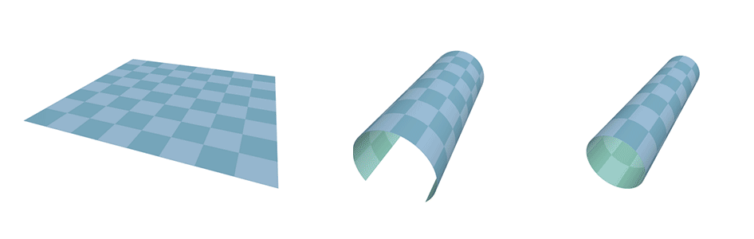
Z | Y | X | F
0 | 0 | 0 | m₀
0 | 0 | 1 | m₁
0 | 1 | 0 | m₂
0 | 1 | 1 | m₃
1 | 0 | 0 | m₄
1 | 0 | 1 | m₅
1 | 1 | 0 | m₆
1 | 1 | 1 | m₇
 |  | YX
 |  | 00 | 01 | 11 | 10
Z | 0 | m₀ | m₁ | m₃ | m₂
 | 1 | m₄ | m₅ | m₇ | m₆

Slide 96

Z | Y | X | F
0 | 0 | 0 | m₀
0 | 0 | 1 | m₁
0 | 1 | 0 | m₂
0 | 1 | 1 | m₃
1 | 0 | 0 | m₄
1 | 0 | 1 | m₅
1 | 1 | 0 | m₆
1 | 1 | 1 | m₇
 |  | YX
 |  | 00 | 01 | 11 | 10
Z | 0 | m₀ | m₁ | m₃ | m₂ | 0 | Z
 | 1 | m₄ | m₅ | m₇ | m₆ | 1
X’
X’

Slide 97
Z | Y | X | F
0 | 0 | 0 | 1
0 | 0 | 1 | 1
0 | 1 | 0 | 1
0 | 1 | 1 | 1
1 | 0 | 0 | 0
1 | 0 | 1 | 0
1 | 1 | 0 | 1
1 | 1 | 1 | 1
 |  | YX
 |  | 00 | 01 | 11 | 10
Z | 0 | 1 | 1 | 1 | 1
 | 1 | 0 | 0 | 1 | 1
F(Y,X) = ∑ m(0,1,2,3,6,7)
F(Y,X) = Z’Y’X’+Z’Y’X+Z’YX’+Z’YX+ZYX’+ZYX
F(Y,X) = ?

Slide 98
Z | Y | X | F
0 | 0 | 0 | 1
0 | 0 | 1 | 1
0 | 1 | 0 | 1
0 | 1 | 1 | 1
1 | 0 | 0 | 0
1 | 0 | 1 | 0
1 | 1 | 0 | 1
1 | 1 | 1 | 1
 |  | YX
 |  | 00 | 01 | 11 | 10
Z | 0 | 1 | 1 | 1 | 1
 | 1 | 0 | 0 | 1 | 1
F(Y,X) = ∑ m(0,1,2,3,6,7)
F(Y,X) = Z’ +
F(Y,X) = ∑ m(0,1,2,3,6,7)
F(Y,X) = Z’Y’X’+Z’Y’X+Z’YX’+Z’YX+ZYX’+ZYX
F(Y,X) = ?

Slide 99
Z | Y | X | F
0 | 0 | 0 | 1
0 | 0 | 1 | 1
0 | 1 | 0 | 1
0 | 1 | 1 | 1
1 | 0 | 0 | 0
1 | 0 | 1 | 0
1 | 1 | 0 | 1
1 | 1 | 1 | 1
 |  | YX
 |  | 00 | 01 | 11 | 10
Z | 0 | 1 | 1 | 1 | 1
 | 1 | 0 | 0 | 1 | 1
F(Y,X) = ∑ m(0,1,2,3,6,7)
F(Y,X) = Z’ + ZY
F(Y,X) = ∑ m(0,1,2,3,6,7)
F(Y,X) = Z’Y’X’+Z’Y’X+Z’YX’+Z’YX+ZYX’+ZYX
F(Y,X) = ?

Slide 100
Z | Y | X | F
0 | 0 | 0 | 1
0 | 0 | 1 | 1
0 | 1 | 0 | 1
0 | 1 | 1 | 1
1 | 0 | 0 | 0
1 | 0 | 1 | 0
1 | 1 | 0 | 1
1 | 1 | 1 | 1
 |  | YX
 |  | 00 | 01 | 11 | 10
Z | 0 | 1 | 1 | 1 | 1
 | 1 | 0 | 0 | 1 | 1
F(Y,X) = ∑ m(0,1,2,3,6,7)
F(Y,X) = Z’ + Y
F(Y,X) = ∑ m(0,1,2,3,6,7)
F(Y,X) = Z’Y’X’+Z’Y’X+Z’YX’+Z’YX+ZYX’+ZYX
F(Y,X) = ?

Slide 101
Z | Y | X | F
0 | 0 | 0 | 1
0 | 0 | 1 | 1
0 | 1 | 0 | 1
0 | 1 | 1 | 1
1 | 0 | 0 | 0
1 | 0 | 1 | 0
1 | 1 | 0 | 1
1 | 1 | 1 | 1
 |  | YX
 |  | 00 | 01 | 11 | 10
Z | 0 | 1 | 1 | 1 | 1
 | 1 | 0 | 0 | 1 | 1
F(Y,X) = Π M(4,5)
F(Y,X) = ?
F(Y,X) = Π M(4,5)
F(Y,X) = (Z’+Y+X) (Z’+Y+X’)
F(Y,X) = ?

Slide 102
Z | Y | X | F
0 | 0 | 0 | 1
0 | 0 | 1 | 1
0 | 1 | 0 | 1
0 | 1 | 1 | 1
1 | 0 | 0 | 0
1 | 0 | 1 | 0
1 | 1 | 0 | 1
1 | 1 | 1 | 1
 |  | YX
 |  | 00 | 01 | 11 | 10
Z | 0 | 0 | 0 | 0 | 0
 | 1 | 1 | 1 | 0 | 0
F’(Y,X) = ∑ m(4,5)
F’(Y,X) = ZY’
F(Y,X) = Π M(4,5)
F(Y,X) = (Z’+Y+X) (Z’+Y+X’)
F(Y,X) = ?

Slide 103
Z | Y | X | F
0 | 0 | 0 | 1
0 | 0 | 1 | 1
0 | 1 | 0 | 1
0 | 1 | 1 | 1
1 | 0 | 0 | 0
1 | 0 | 1 | 0
1 | 1 | 0 | 1
1 | 1 | 1 | 1
 |  | YX
 |  | 00 | 01 | 11 | 10
Z | 0 | 1 | 1 | 1 | 1
 | 1 | 0 | 0 | 1 | 1
F(Y,X) = Π M(4,5)
F(Y,X) = (F’)’
F(Y,X) = (ZY’)’
F(Y,X) = Z’+Y
F(Y,X) = Π M(4,5)
F(Y,X) = (Z’+Y+X) (Z’+Y+X’)
F(Y,X) = ?

Slide 104
Z | Y | X | F
0 | 0 | 0 | 1
0 | 0 | 1 | 1
0 | 1 | 0 | 1
0 | 1 | 1 | 1
1 | 0 | 0 | 0
1 | 0 | 1 | 0
1 | 1 | 0 | 1
1 | 1 | 1 | 1
 |  | YX
 |  | 00 | 01 | 11 | 10
Z | 0 | 1 | 1 | 1 | 1
 | 1 | 0 | 0 | 1 | 1
F(Y,X) = ∑ m(0,1,2,3,6,7)
F(Y,X) = Z’ + Y
 |  | YX
 |  | 00 | 01 | 11 | 10
Z | 0 | 1 | 1 | 1 | 1
 | 1 | 0 | 0 | 1 | 1
F(Y,X) = ∑ m(0,1,2,3,6,7)
F(Y,X) = Z’Y’X’+Z’Y’X+Z’YX’+Z’YX+ZYX’+ZYX
F(Y,X) = ?
F(Y,X) = Π M(4,5)
F(Y,X) = (Z’+Y+X) (Z’+Y+X’)
F(Y,X) = ?
F(Y,X) = Π M(4,5)
F(Y,X) = (F’)’
F(Y,X) = (ZY’)’
F(Y,X) = Z’+Y

Slide 105
Z | Y | X | F
0 | 0 | 0 | 1
0 | 0 | 1 | 0
0 | 1 | 0 | 1
0 | 1 | 1 | 0
1 | 0 | 0 | 1
1 | 0 | 1 | 0
1 | 1 | 0 | 1
1 | 1 | 1 | 0
 |  | YX
 |  | 00 | 01 | 11 | 10
Z | 0 | 1 | 0 | 0 | 1
 | 1 | 1 | 0 | 0 | 1
F(Y,X) = ∑ m(0,2,4, 6)
F(Y,X) = Z’Y’X’+Z’YX’+ZY’X’+ZYX’
F(Y,X) = ?

Slide 106
Z | Y | X | F
0 | 0 | 0 | 1
0 | 0 | 1 | 0
0 | 1 | 0 | 1
0 | 1 | 1 | 0
1 | 0 | 0 | 1
1 | 0 | 1 | 0
1 | 1 | 0 | 1
1 | 1 | 1 | 0
 |  | YX
 |  | 00 | 01 | 11 | 10
Z | 0 | 1 | 0 | 0 | 1
 | 1 | 1 | 0 | 0 | 1
F(Y,X) = ∑ m(0,2,4, 6)
F(Y,X) = X’
F(Y,X) = ∑ m(0,2,4, 6)
F(Y,X) = Z’Y’X’+Z’YX’+ZY’X’+ZYX’
F(Y,X) = ?

Slide 107
Z | Y | X | F
0 | 0 | 0 | 1
0 | 0 | 1 | 0
0 | 1 | 0 | 1
0 | 1 | 1 | 0
1 | 0 | 0 | 1
1 | 0 | 1 | 0
1 | 1 | 0 | 1
1 | 1 | 1 | 0
 |  | YX
 |  | 00 | 01 | 11 | 10
Z | 0 | 1 | 0 | 0 | 1
 | 1 | 1 | 0 | 0 | 1
F(Z,Y,X) = Π M(1,3,5,7)
F(Y,X) = (X)’
F(Y,X) = X’
F(Z,Y,X) = Π M(1,3,5,7)
F(Y,X) = (Z+Y+X’)(Z+Y’+X’)(Z’+Y+X’)(Z’+Y’+X’)
F(Y,X) = ?

Slide 108
4-Variable KARNAUGH MAP

