Slide 1
Logic
Circuits
Sequential
Combinational

Slide 2
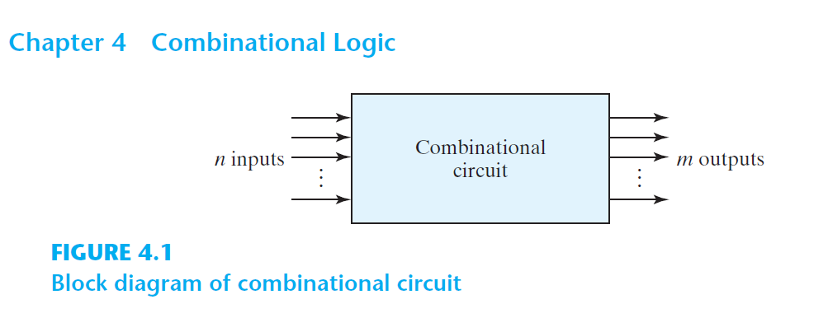

Slide 3

Feedback

Slide 4
Combinational Logic
aka. Combinational Circuit
Combination of logic gates on the present inputs → the outputs at any time!
A combinational circuit performs an operation that can be specified logically by a set of Boolean functions.

Slide 5

Voltage
Y
X
X
F
Y
Time

Slide 6
Voltage
Y
X
X
F
Y
Time
Propagation Delay (Gate Delay) ≈ Δt
https://en.wikipedia.org/wiki/Propagation_delay#Electronics

Slide 7
Voltage
Y
X
X
F
Y
Time
Propagation Delay (Gate Delay) ≈ Δt ≈ 0
https://en.wikipedia.org/wiki/Propagation_delay#Electronics

Slide 8
What we’ve done so far
Combinational Logic aka. Combinational Circuit

Slide 9
Design a combinational logic circuit:
Truth Table
Boolean Function (Algebraic Expression)
Minimization
Boolean Algebra
Karnaugh Map (K-Map)
Quine-McCluskey Algorithm
Logic Diagram

Slide 10
Arithmatic
&
Logical Op
Combinational
Logic
Data
Transmission
Coders

Slide 11
Binary Adder, Binary Subtractor, Binary Multiplier
Binary Comparator (Magnitude Comparator)
Arithmatic
&
Logical Op
Decoder, Encoder
Multiplexer (MUX, MPX), De-Multiplexer (Demux)
Data
Transmission
Coders
Binary Codes (BCD, Excess-3, Gray)

Slide 12
Binary Adder, Binary Subtractor, Binary Multiplier
Binary Comparator (Magnitude Comparator)
Arithmatic
&
Logical Op

Slide 13
Binary Adder

Slide 14
Design a logic circuit that adds two binary digits (bit).

Slide 15
Range of inputs:
2 bits

Slide 16
Input binary variables:
X and Y

Slide 17
Range of outputs?

Slide 18
 | 0 |  | 0 |  | 1 |  | 1
+ | 0 |  | 1 |  | 0 |  | 1
 | 0 |  | 1 |  | 1 |  | 0
C=1

Slide 19
 | 0 |  | 0 |  | 1 |  | 1
+ | 0 |  | 1 |  | 0 |  | 1
 | 0 |  | 1 |  | 1 |  | 0
C=0
C=0
C=0
C=1

Slide 20
 | X
+ | Y
 | S
C

Slide 21
Range of outputs?
2 bits

Slide 22
Output binary variables:
Carry and Sum

Slide 23
Y | X | F₂=C(Y,X)=YX | F₁=S(Y,X)=Y’X+YX’
0 | 0 | 0 | 0
0 | 1 | 0 | 1
1 | 0 | 0 | 1
1 | 1 | 1 | 0

Slide 24
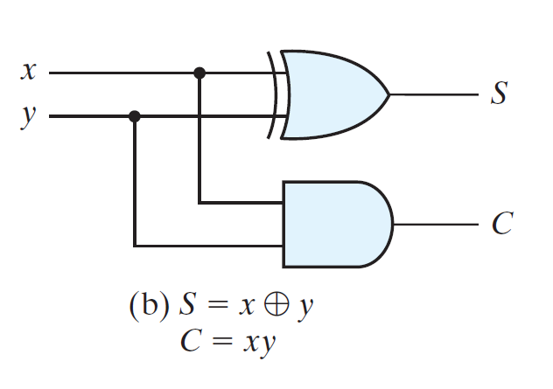

Slide 25
Half Adder: Just 2 bits: X+Y

Slide 27
Half Adder

Slide 28
Design a logic circuit that adds two binary numbers!

Slide 29
Range of inputs:
2 binary numbers in range [00,11]₂

Slide 30
Input binary variables:
X=X₂X₁ and Y=Y₂Y₁

Slide 31
Range of outputs?

Slide 32
 | 00 |  | 00 |  | 00 | … | 11
+ | 00 |  | 01 |  | 10 | … | 11
 | 00 |  | 01 |  | 10 |  | 10
C=0
C=0
C=0
C=1

Slide 33
 | X₂X₁
+ | Y₂Y₁
 | S₂S₁
C

Slide 34
Range of outputs?
Carry, S₂, S₁

Slide 35
Y₂ | Y₁ | X₂ | X₁ | F₁=C(Y₁,Y₂,X₂,X₁) | F₂=S₁(Y₁,Y₂,X₂,X₁) | F₃=S₂(Y₁,Y₂,X₂,X₁)
0 | 0 | 0 | 0 | 0 | 0 | 0
0 | 0 | 0 | 1 | 0 | 0 | 1
0 | 0 | 1 | 0 | 0 | 1 | 0
0 | 0 | 1 | 1 | 0 | 1 | 1
0 | 1 | 0 | 0 | 0 | 0 | 1
0 | 1 | 0 | 1 | 0 | 1 | 0
0 | 1 | 1 | 0 | 0 | 1 | 1
0 | 1 | 1 | 1 | 1 | 0 | 0
1 | 0 | 0 | 0 | 0 | 1 | 0
1 | 0 | 0 | 1 | 0 | 1 | 1
1 | 0 | 1 | 0 | 1 | 0 | 0
1 | 0 | 1 | 1 | 1 | 0 | 1
1 | 1 | 0 | 0 | 0 | 1 | 1
1 | 1 | 0 | 1 | 1 | 0 | 0
1 | 1 | 1 | 0 | 1 | 0 | 1
1 | 1 | 1 | 1 | 1 | 1 | 0

Slide 36
Y₂ | Y₁ | X₂ | X₁ | F₁=C(Y₁,Y₂,X₂,X₁) | F₂=S₁(Y₁,Y₂,X₂,X₁) | F₃=S₂(Y₁,Y₂,X₂,X₁)
0 | 0 | 0 | 0 | 0 | 0 | 0
0 | 0 | 0 | 1 | 0 | 0 | 1
0 | 0 | 1 | 0 | 0 | 1 | 0
0 | 0 | 1 | 1 | 0 | 1 | 1
0 | 1 | 0 | 0 | 0 | 0 | 1
0 | 1 | 0 | 1 | 0 | 1 | 0
0 | 1 | 1 | 0 | 0 | 1 | 1
0 | 1 | 1 | 1 | 1 | 0 | 0
1 | 0 | 0 | 0 | 0 | 1 | 0
1 | 0 | 0 | 1 | 0 | 1 | 1
1 | 0 | 1 | 0 | 1 | 0 | 0
1 | 0 | 1 | 1 | 1 | 0 | 1
1 | 1 | 0 | 0 | 0 | 1 | 1
1 | 1 | 0 | 1 | 1 | 0 | 0
1 | 1 | 1 | 0 | 1 | 0 | 1
1 | 1 | 1 | 1 | 1 | 1 | 0
Wait a sec!
Can we re-use the half adder?
Half adder for adding 2 bits.
How about having 2 half adders for adding 2 × 2 bits?

Slide 37
 | X₂X₁
+ | Y₂Y₁
 | S₂S₁
C

Slide 38
Half Adder
Half Adder

Slide 39
Y₂
X₂
Y₁
X₁
Half Adder
Half Adder
C
S₂
S₁

Slide 40
Y₂
X₂
Y₁
X₁
Half Adder
Half Adder
C
S₂
S₁

Slide 41
C=1
 | 0 1
+ | 0 1
 | 1 0
C=0

Slide 42
Y₂
X₂
Y₁
X₁
Half Adder
Half Adder

Slide 43
Y
X
C _{Previous}
Full Adder

Slide 44
Design a logic circuit that adds two binary digits (bit) and a carry bit.

Slide 45
C_{p} | Y | X | C=∑m(3,5,6,7) | S=∑m(1,2,4,7)
0 | 0 | 0 | 0 | 0
0 | 0 | 1 | 0 | 1
0 | 1 | 0 | 0 | 1
0 | 1 | 1 | 1 | 0
1 | 0 | 0 | 0 | 1
1 | 0 | 1 | 1 | 0
1 | 1 | 0 | 1 | 0
1 | 1 | 1 | 1 | 1

Slide 46
 |  | YX
 |  | 00 | 01 | 11 | 10
C_{p} | 0 | m₀ | m₁ | m₃ | m₂
 | 1 | m₄ | m₅ | m₇ | m₆
S=∑m(1,2,4,7)
0 | 1 | 0 | 1
1 | 0 | 1 | 0
 |  | YX
 |  | 00 | 01 | 11 | 10
C_{p} | 0 | m₀ | m₁ | m₃ | m₂
 | 1 | m₄ | m₅ | m₇ | m₆
C=∑m(3,5,6,7)
0 | 0 | 1 | 0
0 | 1 | 1 | 1

Slide 47
 |  | YX
 |  | 00 | 01 | 11 | 10
C_{p} | 0 | m₀ | m₁ | m₃ | m₂
 | 1 | m₄ | m₅ | m₇ | m₆
S=∑m(1,2,4,7)
S=C’_{p}Y’X+C’_{p}YX’+C_{p}Y’X’+C_{p}YX
0 | 1 | 0 | 1
1 | 0 | 1 | 0
m₀ | m₁ | m₃ | m₂
m₄ | m₅ | m₇ | m₆

Slide 48
 |  | YX
 |  | 00 | 01 | 11 | 10
C_{p} | 0 | m₀ | m₁ | m₃ | m₂
 | 1 | m₄ | m₅ | m₇ | m₆
S=∑m(1,2,4,7)
S=C’_{p}Y’X+C’_{p}YX’+C_{p}Y’X’+C_{p}YX
S=C’_{p}(Y’X+YX’)+C_{p}(Y’X’+YX)
0 | 1 | 0 | 1
1 | 0 | 1 | 0
m₀ | m₁ | m₃ | m₂
m₄ | m₅ | m₇ | m₆

Slide 49
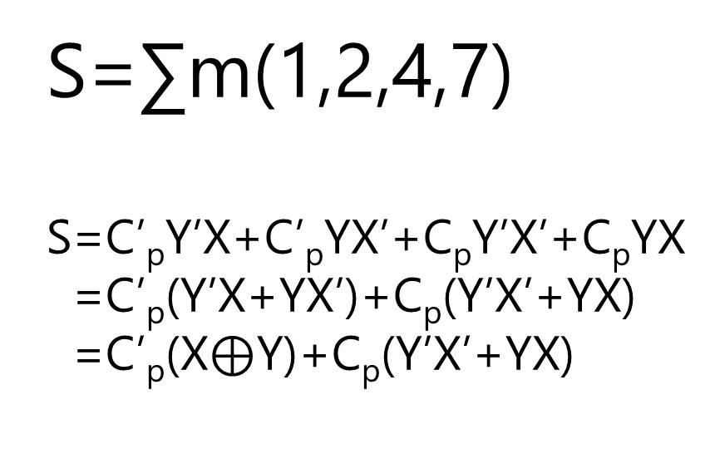
 |  | YX
 |  | 00 | 01 | 11 | 10
C_{p} | 0 | m₀ | m₁ | m₃ | m₂
 | 1 | m₄ | m₅ | m₇ | m₆
S=∑m(1,2,4,7)
S=C’_{p}Y’X+C’_{p}YX’+C_{p}Y’X’+C_{p}YX
S=C’_{p}(Y’X+YX’)+C_{p}(Y’X’+YX)
S=C’_{p}(X$⊕$Y)+C_{p}(Y’X’+YX)
0 | 1 | 0 | 1
1 | 0 | 1 | 0
m₀ | m₁ | m₃ | m₂
m₄ | m₅ | m₇ | m₆

Slide 50
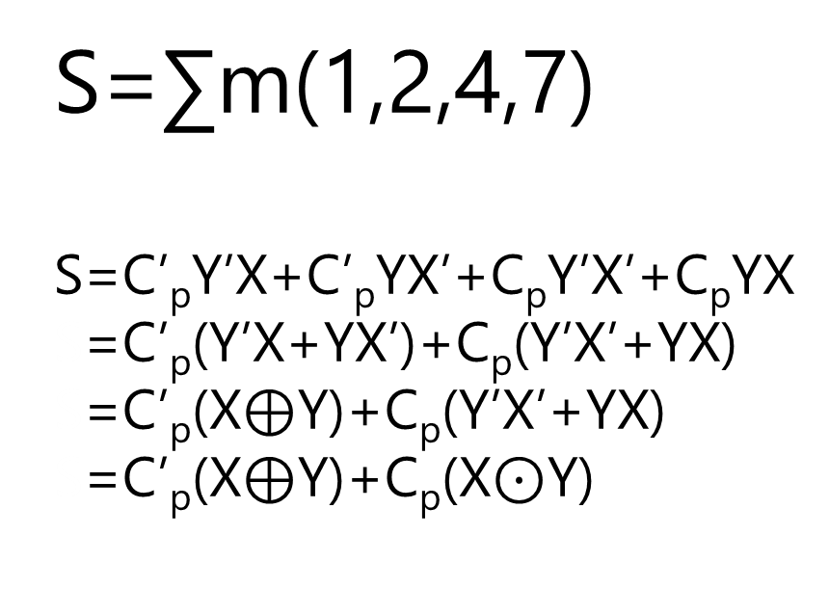
 |  | YX
 |  | 00 | 01 | 11 | 10
C_{p} | 0 | m₀ | m₁ | m₃ | m₂
 | 1 | m₄ | m₅ | m₇ | m₆
S=∑m(1,2,4,7)
S=C’_{p}Y’X+C’_{p}YX’+C_{p}Y’X’+C_{p}YX
S=C’_{p}(Y’X+YX’)+C_{p}(Y’X’+YX)
S=C’_{p}(X$⊕$Y)+C_{p}(Y’X’+YX)
S=C’_{p}(X$⊕$Y)+C_{p}(X$⊙$Y)
0 | 1 | 0 | 1
1 | 0 | 1 | 0
m₀ | m₁ | m₃ | m₂
m₄ | m₅ | m₇ | m₆

Slide 51
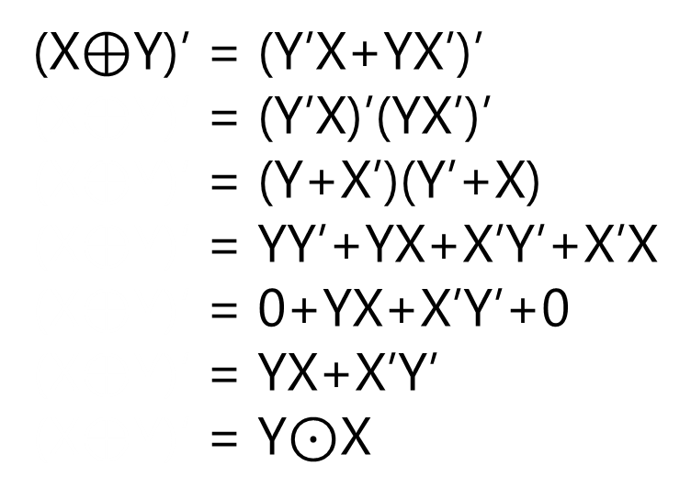
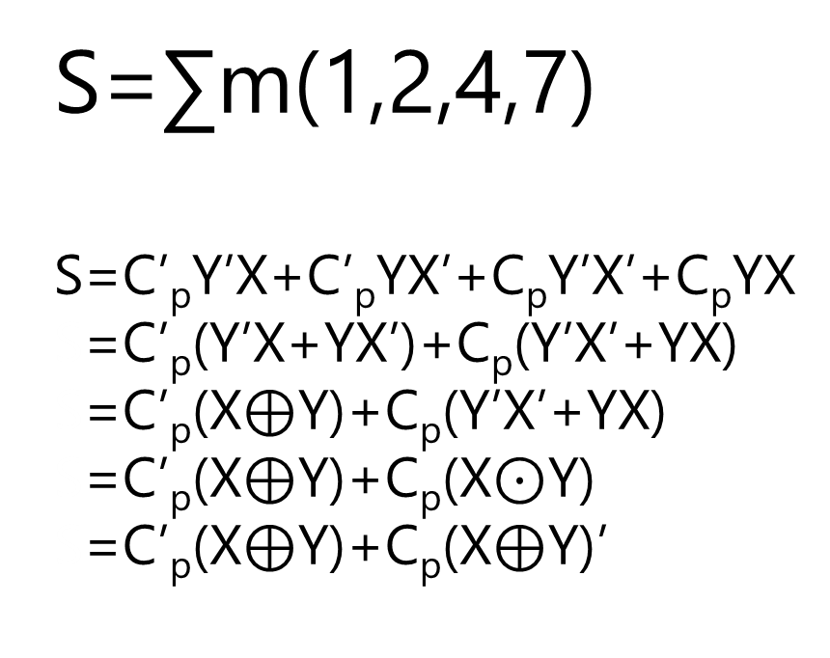
 |  | YX
 |  | 00 | 01 | 11 | 10
C_{p} | 0 | m₀ | m₁ | m₃ | m₂
 | 1 | m₄ | m₅ | m₇ | m₆
S=∑m(1,2,4,7)
S=C’_{p}Y’X+C’_{p}YX’+C_{p}Y’X’+C_{p}YX
S=C’_{p}(Y’X+YX’)+C_{p}(Y’X’+YX)
S=C’_{p}(X$⊕$Y)+C_{p}(Y’X’+YX)
S=C’_{p}(X$⊕$Y)+C_{p}(X$⊙$Y)
S=C’_{p}(X$⊕$Y)+C_{p}(X$⊕$Y)’
0 | 1 | 0 | 1
1 | 0 | 1 | 0
m₀ | m₁ | m₃ | m₂
m₄ | m₅ | m₇ | m₆
(X$⊕$Y)’ = (Y’X+YX’)’
(X$⊕$Y)’ = (Y’X)’(YX’)’
(X$⊕$Y)’ = (Y+X’)(Y’+X)
(X$⊕$Y)’ = YY’+YX+X’Y’+X’X
(X$⊕$Y)’ = 0+YX+X’Y’+0
(X$⊕$Y)’ = YX+X’Y’
(X$⊕$Y)’ = Y$⊙$X

Slide 52
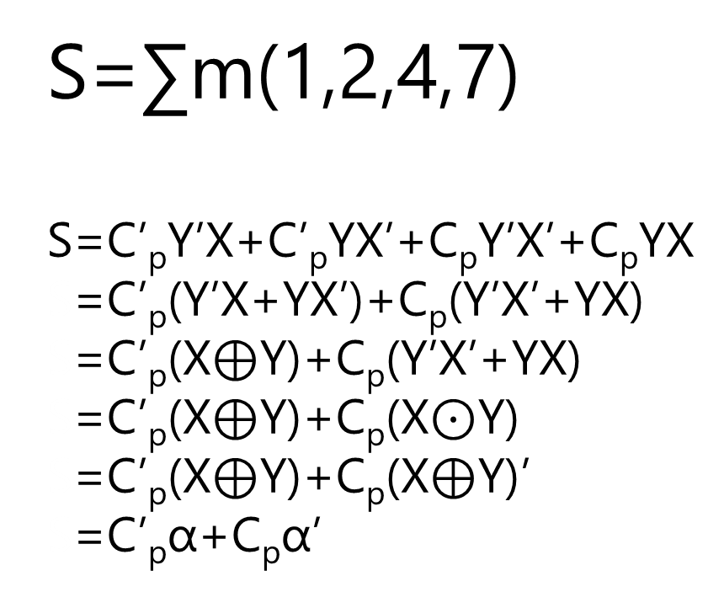
 |  | YX
 |  | 00 | 01 | 11 | 10
C_{p} | 0 | m₀ | m₁ | m₃ | m₂
 | 1 | m₄ | m₅ | m₇ | m₆
S=∑m(1,2,4,7)
S=C’_{p}Y’X+C’_{p}YX’+C_{p}Y’X’+C_{p}YX
S=C’_{p}(Y’X+YX’)+C_{p}(Y’X’+YX)
S=C’_{p}(X$⊕$Y)+C_{p}(Y’X’+YX)
S=C’_{p}(X$⊕$Y)+C_{p}(X$⊙$Y)
S=C’_{p}(X$⊕$Y)+C_{p}(X$⊕$Y)’
S=C’_{p}α+C_{p}α’
0 | 1 | 0 | 1
1 | 0 | 1 | 0
m₀ | m₁ | m₃ | m₂
m₄ | m₅ | m₇ | m₆

Slide 53
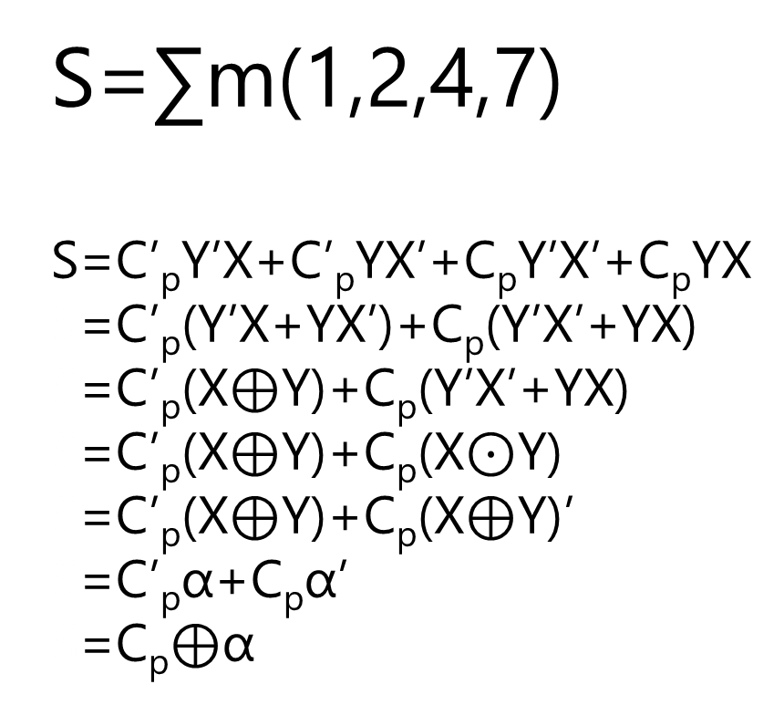
 |  | YX
 |  | 00 | 01 | 11 | 10
C_{p} | 0 | m₀ | m₁ | m₃ | m₂
 | 1 | m₄ | m₅ | m₇ | m₆
S=∑m(1,2,4,7)
S=C’_{p}Y’X+C’_{p}YX’+C_{p}Y’X’+C_{p}YX
S=C’_{p}(Y’X+YX’)+C_{p}(Y’X’+YX)
S=C’_{p}(X$⊕$Y)+C_{p}(Y’X’+YX)
S=C’_{p}(X$⊕$Y)+C_{p}(X$⊙$Y)
S=C’_{p}(X$⊕$Y)+C_{p}(X$⊕$Y)’
S=C’_{p}α+C_{p}α’
S=C_{p}$⊕$α
0 | 1 | 0 | 1
1 | 0 | 1 | 0
m₀ | m₁ | m₃ | m₂
m₄ | m₅ | m₇ | m₆

Slide 54
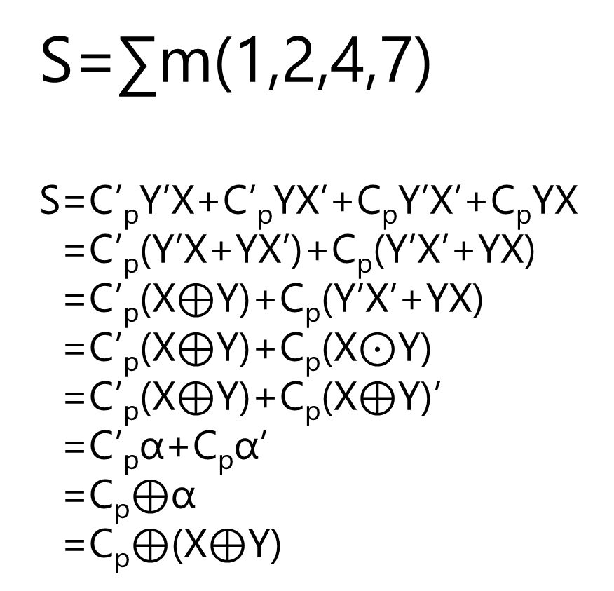
 |  | YX
 |  | 00 | 01 | 11 | 10
C_{p} | 0 | m₀ | m₁ | m₃ | m₂
 | 1 | m₄ | m₅ | m₇ | m₆
S=∑m(1,2,4,7)
S=C’_{p}Y’X+C’_{p}YX’+C_{p}Y’X’+C_{p}YX
S=C’_{p}(Y’X+YX’)+C_{p}(Y’X’+YX)
S=C’_{p}(X$⊕$Y)+C_{p}(Y’X’+YX)
S=C’_{p}(X$⊕$Y)+C_{p}(X$⊙$Y)
S=C’_{p}(X$⊕$Y)+C_{p}(X$⊕$Y)’
S=C’_{p}α+C_{p}α’
S=C_{p}$⊕$α
S=C_{p}$⊕$(X$⊕$Y)
0 | 1 | 0 | 1
1 | 0 | 1 | 0
m₀ | m₁ | m₃ | m₂
m₄ | m₅ | m₇ | m₆

Slide 55
 |  | YX
 |  | 00 | 01 | 11 | 10
C_{p} | 0 | m₀ | m₁ | m₃ | m₂
 | 1 | m₄ | m₅ | m₇ | m₆
S=∑m(1,2,4,7)
S=C_{p}⊕(X⊕Y)
⊕ is associative, we can drop ( ). But let’s keep them!
0 | 1 | 0 | 1
1 | 0 | 1 | 0
m₀ | m₁ | m₃ | m₂
m₄ | m₅ | m₇ | m₆

Slide 56
 |  | YX
 |  | 00 | 01 | 11 | 10
C_{p} | 0 | m₀ | m₁ | m₃ | m₂
 | 1 | m₄ | m₅ | m₇ | m₆
C=∑m(3,5,6,7)
C=YX+C_{p}X+C_{p}Y
0 | 0 | 1 | 0
0 | 1 | 1 | 1

Slide 57
C_{p}
Y
X
S
C

Slide 58
C_{p}
X
Y
S
C

Slide 59
C_{p}
X
Y
Full Adder
S
C

Slide 60
C_{p}
X
Y
S
C

Slide 61
C_{p}
C_{p}
X
X
Y
Y
S
S
C
C

Slide 62
C_{p}
Y
X
X
Half Adder
Y
S
C₀
S₀
C
Full Adder = Half Adder + …

Slide 63

C_{p}
Y
X
X
Half Adder
Y
S
C₀
S₀
C
Full Adder $=^{?}$ 2 Half Adder + …

Slide 64

Full Adder $∝$ 2 Half Adder

Slide 66
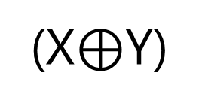
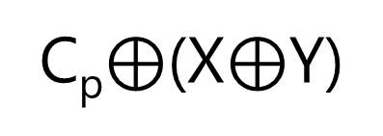
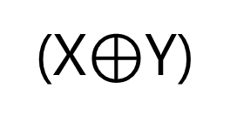
C_{p}
(X$⊕$Y)
S
C_{p}$⊕$(X$⊕$Y)
(X$⊕$Y)

Slide 67
C_{p}
(X$⊕$Y)
C_{p}$⊕$(X$⊕$Y)
(X$⊕$Y)

Slide 68
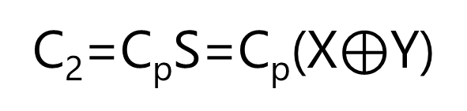
C_{p}
(X$⊕$Y)
C_{p}$⊕$(X$⊕$Y)
(X$⊕$Y)
C₂=C_{p}S=C_{p}(X$⊕$Y)
C₁=XY

Slide 69
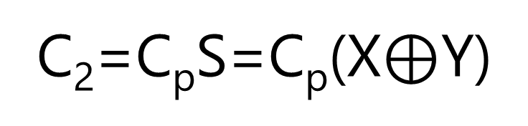
C₁=XY
C = XY + C_{p}X + C_{p}Y
C₂=C_{p}S=C_{p}(X$⊕$Y)

Slide 70
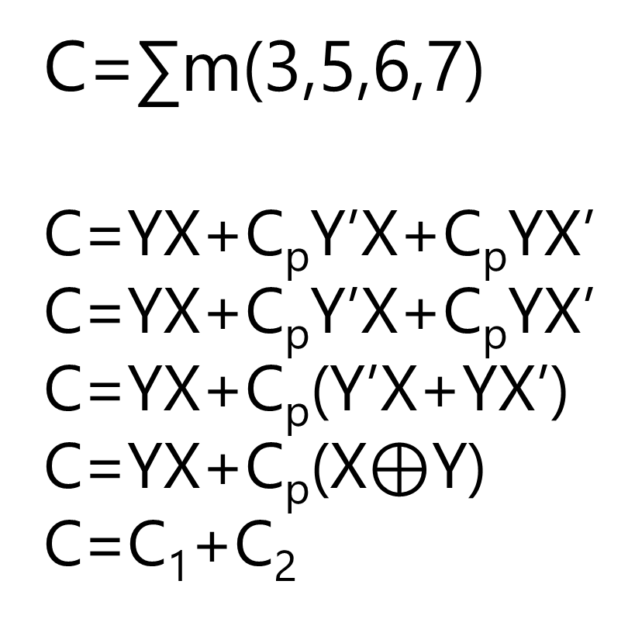
 |  | YX
 |  | 00 | 01 | 11 | 10
C_{p} | 0 | m₀ | m₁ | m₃ | m₂
 | 1 | m₄ | m₅ | m₇ | m₆
C=∑m(3,5,6,7)
C=YX+C_{p}Y’X+C_{p}YX’
C=YX+C_{p}Y’X+C_{p}YX’
C=YX+C_{p}(Y’X+YX’)
C=YX+C_{p}(X$⊕$Y)
C=C₁+C₂
0 | 0 | 1 | 0
0 | 1 | 1 | 1

Slide 71
Y
X
C_{p}
C
S

Slide 72
Y
X
C_{p}
Half Adder
Half Adder
C
S
Full Adder = 2 Half Adder + OR

Slide 73
Y
X
C_{p}
Full Adder
C
S

Slide 74
Design a logic circuit that adds two binary numbers!

Slide 75
C₃C₂C₁C₀
C₀=0
 | X₄X₃X₂X₁
+ | Y₄Y₃Y₂Y₁
 | S₄S₃S₂S₁
C4

Slide 76
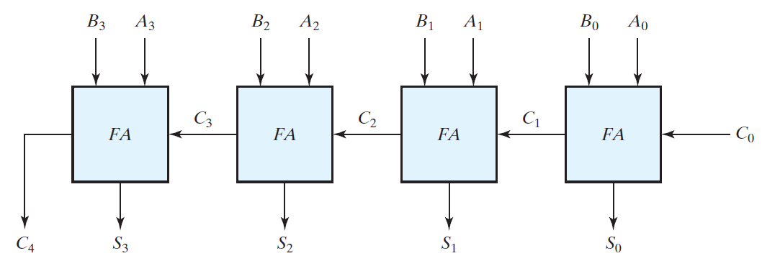
Y₄
X₄
Y₃
X₃
Y₂
X₂
Y₁
X₁
=0
S₄
S₃
S₂
S₁

Slide 77
Y₄
X₄
Y₃
X₃
Y₂
X₂
Y₁
X₁
4-bit Adder
=0
S₄
S₃
S₂
S₁

Slide 78
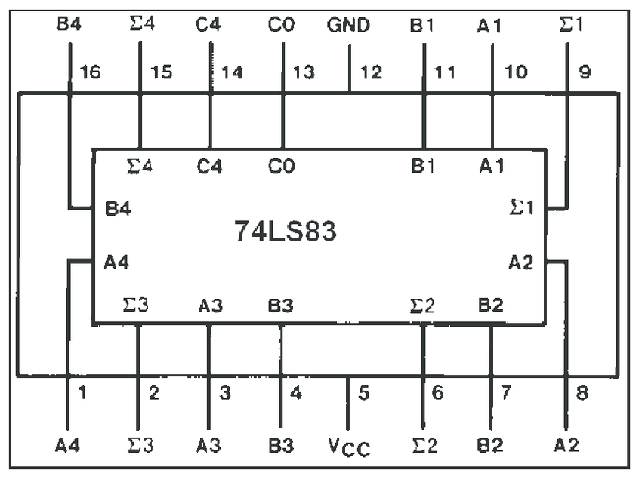
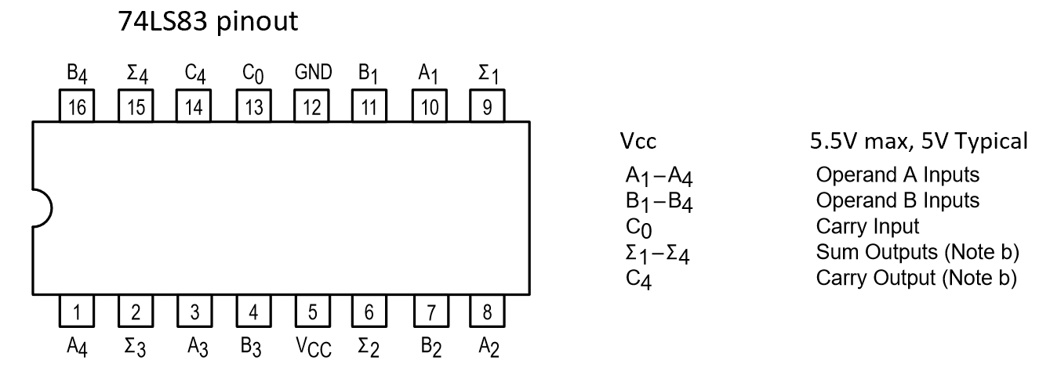

Slide 79
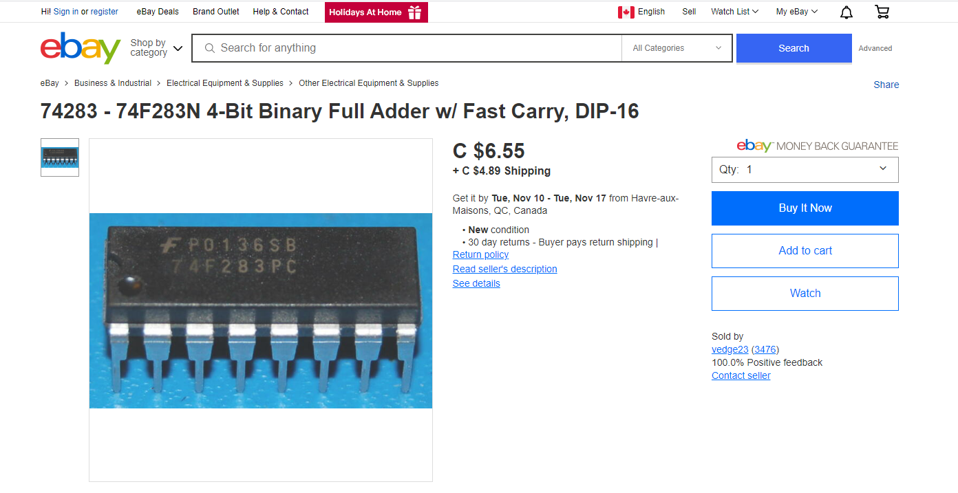

Slide 80
Carry Propagation

Slide 81
Y₄
X₄
Y₃
X₃
Y₂
X₂
Y₁
X₁
C₀
C₄
S₄
C₃
S₃
C₂
S₂
C₁
S₁
If gate delay is Δt, how long does it take to see the S=S₄S₃S₂S₁?

Slide 82
Y₄
X₄
Y₃
X₃
Y₂
X₂
Y₁
X₁
C₀
C₄
S₄
C₃
S₃
C₂
S₂
C₁
S₁
If gate delay is Δt, how long does it take to see the S=S₄S₃S₂S₁?
S₁: 2 × Δt
S₂: 2 × Δt + C₁
S₃: 2 × Δt + C₂
S₄: 2 × Δt + C₃

Slide 83
Y₄
X₄
Y₃
X₃
Y₂
X₂
Y₁
X₁
C₀
C₄
S₄
C₃
S₃
C₂
S₂
C₁
S₁
If gate delay is Δt, how long does it take to see the S=S₄S₃S₂S₁?
S₁: 2 × Δt
S₂: 2 × Δt + C₁
S₃: 2 × Δt + C₂
S₄: 2 × Δt + C₃
In parallel

Slide 84
Y₄
X₄
Y₃
X₃
Y₂
X₂
Y₁
X₁
C₀
C₄
S₄
C₃
S₃
C₂
S₂
C₁
S₁
If gate delay is Δt, how long does it take to see the S=S₄S₃S₂S₁?
S₁: 2 × Δt
S₂: 2 × Δt + C₁
S₃: 2 × Δt + C₂
S₄: 2 × Δt + C₃
In parallel

Slide 85
Y₄
X₄
Y₃
X₃
Y₂
X₂
Y₁
X₁
C₀
C₄
S₄
C₃
S₃
C₂
S₂
C₁
S₁
If gate delay is Δt, how long does it take to see the S=S_{n}…S₃S₂S₁?

Slide 86
Y₄
X₄
Y₃
X₃
Y₂
X₂
Y₁
X₁
C₀
C₄
S₄
C₃
S₃
C₂
S₂
C₁
S₁
If gate delay is Δt, how long does it take to see the C₄?

Slide 87
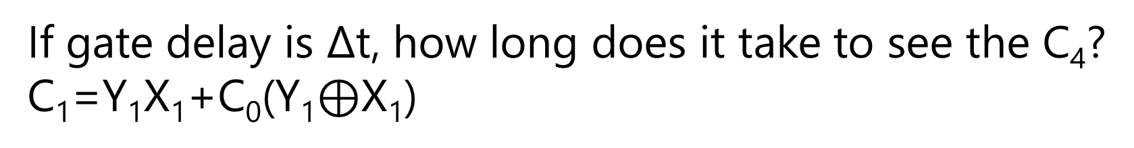
Y₄
X₄
Y₃
X₃
Y₂
X₂
Y₁
X₁
C₀
C₄
S₄
C₃
S₃
C₂
S₂
C₁
S₁
If gate delay is Δt, how long does it take to see the C₄?
C₁=Y₁X₁+C₀(Y₁$⊕$X₁)

Slide 88
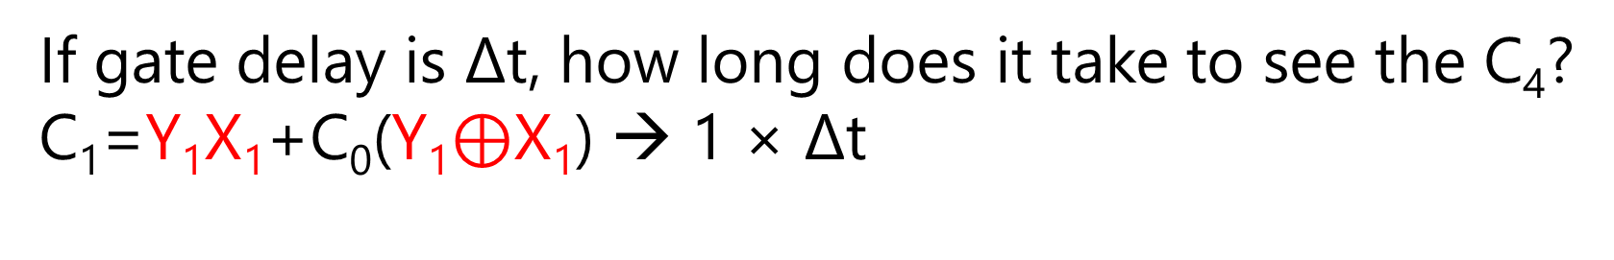
Y₄
X₄
Y₃
X₃
Y₂
X₂
Y₁
X₁
C₀
C₄
S₄
C₃
S₃
C₂
S₂
C₁
S₁
If gate delay is Δt, how long does it take to see the C₄?
C₁=Y₁X₁+C₀(Y₁$⊕$X₁) → 1 × Δt
AND and XOR can be done in parallel.

Slide 89
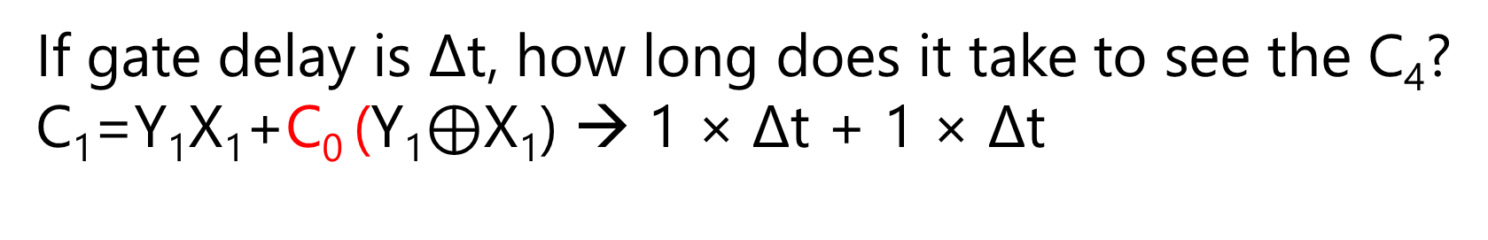
Y₄
X₄
Y₃
X₃
Y₂
X₂
Y₁
X₁
C₀
C₄
S₄
C₃
S₃
C₂
S₂
C₁
S₁
If gate delay is Δt, how long does it take to see the C₄?
C₁=Y₁X₁+C₀ (Y₁$⊕$X₁) → 1 × Δt + 1 × Δt
C₀ AND

Slide 90
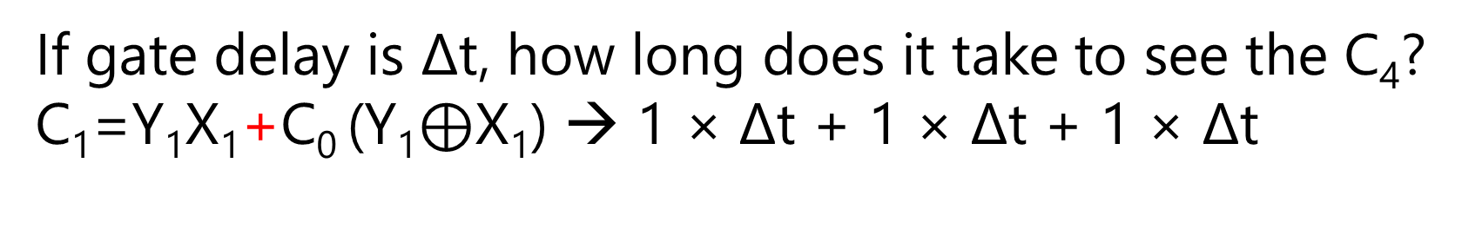
Y₄
X₄
Y₃
X₃
Y₂
X₂
Y₁
X₁
C₀
C₄
S₄
C₃
S₃
C₂
S₂
C₁
S₁
If gate delay is Δt, how long does it take to see the C₄?
C₁=Y₁X₁+C₀ (Y₁$⊕$X₁) → 1 × Δt + 1 × Δt + 1 × Δt
OR

Slide 91
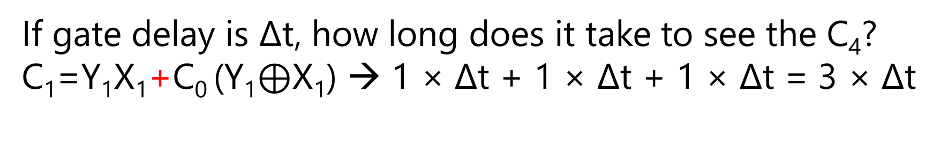
Y₄
X₄
Y₃
X₃
Y₂
X₂
Y₁
X₁
C₀
C₄
S₄
C₃
S₃
C₂
S₂
C₁
S₁
If gate delay is Δt, how long does it take to see the C₄?
C₁=Y₁X₁+C₀ (Y₁$⊕$X₁) → 1 × Δt + 1 × Δt + 1 × Δt = 3 × Δt

Slide 92
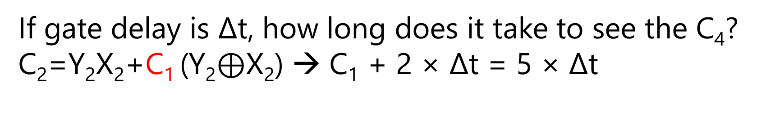
Y₄
X₄
Y₃
X₃
Y₂
X₂
Y₁
X₁
C₀
C₄
S₄
C₃
S₃
C₂
S₂
C₁
S₁
If gate delay is Δt, how long does it take to see the C₄?
C₂=Y₂X₂+C₁ (Y₂$⊕$X₂) → C₁ + 2 × Δt = 5 × Δt
C₁ AND then OR
In the meantime, in parallel, we can do the Y₂X₂ and Y₂$⊕$X₂

Slide 93

Y₄
X₄
Y₃
X₃
Y₂
X₂
Y₁
X₁
C₀
C₄
S₄
C₃
S₃
C₂
S₂
C₁
S₁
If gate delay is Δt, how long does it take to see the C₄?
C₃=Y₃X₃+C₂ (Y₃$⊕$X₃) → C₂ + 2 × Δt = 7 × Δt

Slide 94

Y₄
X₄
Y₃
X₃
Y₂
X₂
Y₁
X₁
C₀
C₄
S₄
C₃
S₃
C₂
S₂
C₁
S₁
If gate delay is Δt, how long does it take to see the C₄?
C₄=Y₄X₄+C₃ (Y₄$⊕$X₄) → C₃ + 2 × Δt = 9 × Δt

Slide 95
Y₄
X₄
Y₃
X₃
Y₂
X₂
Y₁
X₁
C₀
C₄
S₄
C₃
S₃
C₂
S₂
C₁
S₁
If gate delay is Δt, how long does it take to see the C_{n}?

Slide 96
Carry Lookahead
C_{1:n} → Constant Delay
Book Page 138-141

Slide 97
Binary Adder
Does it matter we have signed or unsigned binary numbers?
Justify your answer.

Slide 98
Binary Subtractor
Signed-2’s-Complement

Slide 99

X $−$ Y
Subtraction in Signed-2’s-Complement

Slide 100
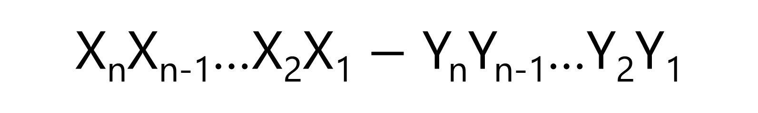
X_{n}X_{n-1}…X₂X₁ $−$ Y_{n}Y_{n-1}…Y₂Y₁
Subtraction in Signed-2’s-Complement

Slide 101
X + 2’s-comp(Y)
Subtraction in Signed-2’s-Complement

Slide 102
X + 1’s-comp(Y) + 1
Subtraction in Signed-2’s-Complement

Slide 103
bitwise
X + Y’ + 1
Subtraction in Signed-2’s-Complement

Slide 104
bitwise
X + Y’ + (C₀=1)
Subtraction in Signed-2’s-Complement

Slide 105
Y’₄
X₄
Y’₃
X₃
Y’₂
X₂
Y’₁
X₁
4-bit Adder
=1
S₄
S₃
S₂
S₁

Slide 106
Y₄
Y₃
Y₂
Y₁
Y’₄
X₄
Y’₃
X₃
Y’₂
X₂
Y’₁
X₁
4-bit Adder | Subtractor
= 0
= 1
S₄
S₃
S₂
S₁

Slide 107
Y₄
Y₃
Y₂
Y₁
Y’₄
X₄
Y’₃
X₃
Y’₂
X₂
Y’₁
X₁
4-bit Adder | Subtractor
= 0
= 1
S₄
S₃
S₂
S₁

Slide 108
Y₄
Y₃
Y₂
Y₁
Y’₄
X₄
Y’₃
X₃
Y’₂
X₂
Y’₁
X₁
4-bit Adder | Subtractor
= 0
= 1
S₄
S₃
S₂
S₁

Slide 109
A ? 0 = A
A ? 1 = A’

Slide 110

A $⨁$ 0 = A
A $⨁$ 1 = A’

Slide 111
Y₄
Y₃
Y₂
Y₁
Y’₄
X₄
Y’₃
X₃
Y’₂
X₂
Y’₁
X₁
4-bit Adder | Subtractor
M
S₄
S₃
S₂
S₁
M=0 → Adder
M=1 → Subtractor

Slide 112
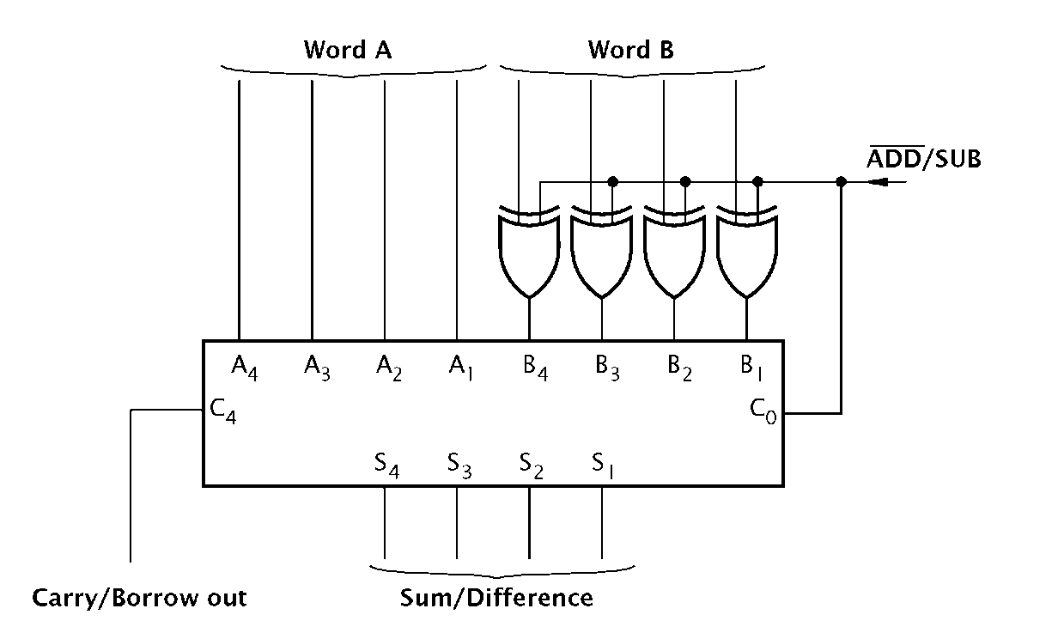

Slide 113
Binary Subtractor
Unsigned?

Slide 114
Overflow
Signed-2’s-Complement

