Slide 1
4-Variable KARNAUGH MAP

Slide 2
 |  | YX
 |  | 00 | 01 | 11 | 10
WZ | 00 | m₀ | m₁ | m₃ | m₂
 | 01 | m₄ | m₅ | m₇ | m₆
 | 11 | m₁₂ | m₁₃ | m₁₅ | m₁₄
 | 10 | m₈ | m₉ | m₁₁ | m₁₀

Slide 3
 |  | YX
 |  | 00 | 01 | 11 | 10
WZ | 00 | m₀ | m₁ | m₃ | m₂
 | 01 | m₄ | m₅ | m₇ | m₆
 | 11 | m₁₂ | m₁₃ | m₁₅ | m₁₄
 | 10 | m₈ | m₉ | m₁₁ | m₁₀

Slide 4
 |  | YX
 |  | 00 | 01 | 11 | 10
WZ | 00 | m₀ | m₁ | m₃ | m₂
 | 01 | m₄ | m₅ | m₇ | m₆
 | 11 | m₁₂ | m₁₃ | m₁₅ | m₁₄
 | 10 | m₈ | m₉ | m₁₁ | m₁₀

Slide 5
 |  | YX
 |  | 00 | 01 | 11 | 10
WZ | 00 | m₀ | m₁ | m₃ | m₂
 | 01 | m₄ | m₅ | m₇ | m₆
 | 11 | m₁₂ | m₁₃ | m₁₅ | m₁₄
 | 10 | m₈ | m₉ | m₁₁ | m₁₀
F (W,Z,Y,X) = ∑m(0, 1, 2, 4, 5, 6, 8, 9, 12, 13, 14)

Slide 6
 |  | YX
 |  | 00 | 01 | 11 | 10
WZ | 00 | 1 | 1 | 0 | 1
 | 01 | 1 | 1 | 0 | 1
 | 11 | 1 | 1 | 0 | 1
 | 10 | 1 | 1 | 0 | 0
m₀ | m₁ | m₃ | m₂
m₄ | m₅ | m₇ | m₆
m₁₂ | m₁₃ | m₁₅ | m₁₄
m₈ | m₉ | m₁₁ | m₁₀
F (W,Z,Y,X) = ∑m(0, 1, 2, 4, 5, 6, 8, 9, 12, 13, 14)

Slide 7
 |  | YX
 |  | 00 | 01 | 11 | 10
WZ | 00 | 1 | 1 | 0 | 1
 | 01 | 1 | 1 | 0 | 1
 | 11 | 1 | 1 | 0 | 1
 | 10 | 1 | 1 | 0 | 0
m₀ | m₁ | m₃ | m₂
m₄ | m₅ | m₇ | m₆
m₁₂ | m₁₃ | m₁₅ | m₁₄
m₈ | m₉ | m₁₁ | m₁₀
F (W,Z,Y,X) = ∑m(0, 1, 2, 4, 5, 6, 8, 9, 12, 13, 14)
F (W,Z,Y,X) = Y’ +

Slide 8
 |  | YX
 |  | 00 | 01 | 11 | 10
WZ | 00 | 1 | 1 | 0 | 1
 | 01 | 1 | 1 | 0 | 1
 | 11 | 1 | 1 | 0 | 1
 | 10 | 1 | 1 | 0 | 0
m₀ | m₁ | m₃ | m₂
m₄ | m₅ | m₇ | m₆
m₁₂ | m₁₃ | m₁₅ | m₁₄
m₈ | m₉ | m₁₁ | m₁₀
Warning!
W={0,1}, the value of W matters in m₁₀
Z={0,1}
Y={1}
X={0}
F (W,Z,Y,X) = ∑m(0, 1, 2, 4, 5, 6, 8, 9, 12, 13, 14)
F (W,Z,Y,X) = Y’ +

Slide 9
 |  | YX
 |  | 00 | 01 | 11 | 10
WZ | 00 | 1 | 1 | 0 | 1
 | 01 | 1 | 1 | 0 | 1
 | 11 | 1 | 1 | 0 | 1
 | 10 | 1 | 1 | 0 | 0
m₀ | m₁ | m₃ | m₂
m₄ | m₅ | m₇ | m₆
m₁₂ | m₁₃ | m₁₅ | m₁₄
m₈ | m₉ | m₁₁ | m₁₀
F (W,Z,Y,X) = ∑m(0, 1, 2, 4, 5, 6, 8, 9, 12, 13, 14)
F (W,Z,Y,X) = Y’ + W’YX’

Slide 10
 |  | YX
 |  | 00 | 01 | 11 | 10
WZ | 00 | 1 | 1 | 0 | 1
 | 01 | 1 | 1 | 0 | 1
 | 11 | 1 | 1 | 0 | 1
 | 10 | 1 | 1 | 0 | 0
m₀ | m₁ | m₃ | m₂
m₄ | m₅ | m₇ | m₆
m₁₂ | m₁₃ | m₁₅ | m₁₄
m₈ | m₉ | m₁₁ | m₁₀
F (W,Z,Y,X) = ∑m(0, 1, 2, 4, 5, 6, 8, 9, 12, 13, 14)
F (W,Z,Y,X) = Y’ + W’YX’ + WZYX’

Slide 11
 |  | YX
 |  | 00 | 01 | 11 | 10
WZ | 00 | 1 | 1 | 0 | 1
 | 01 | 1 | 1 | 0 | 1
 | 11 | 1 | 1 | 0 | 1
 | 10 | 1 | 1 | 0 | 0
m₀ | m₁ | m₃ | m₂
m₄ | m₅ | m₇ | m₆
m₁₂ | m₁₃ | m₁₅ | m₁₄
m₈ | m₉ | m₁₁ | m₁₀
F (W,Z,Y,X) = ∑m(0, 1, 2, 4, 5, 6, 8, 9, 12, 13, 14)
F (W,Z,Y,X) = Y’ + W’YX’ + ZYX’

Slide 12
 |  | YX
 |  | 00 | 01 | 11 | 10
WZ | 00 | 1 | 1 | 0 | 1
 | 01 | 1 | 1 | 0 | 1
 | 11 | 1 | 1 | 0 | 1
 | 10 | 1 | 1 | 0 | 0
m₀ | m₁ | m₃ | m₂
m₄ | m₅ | m₇ | m₆
m₁₂ | m₁₃ | m₁₅ | m₁₄
m₈ | m₉ | m₁₁ | m₁₀
F (W,Z,Y,X) = ∑m(0, 1, 2, 4, 5, 6, 8, 9, 12, 13, 14)
F (W,Z,Y,X) = Y’ + W’X’ + WYX’

Slide 13
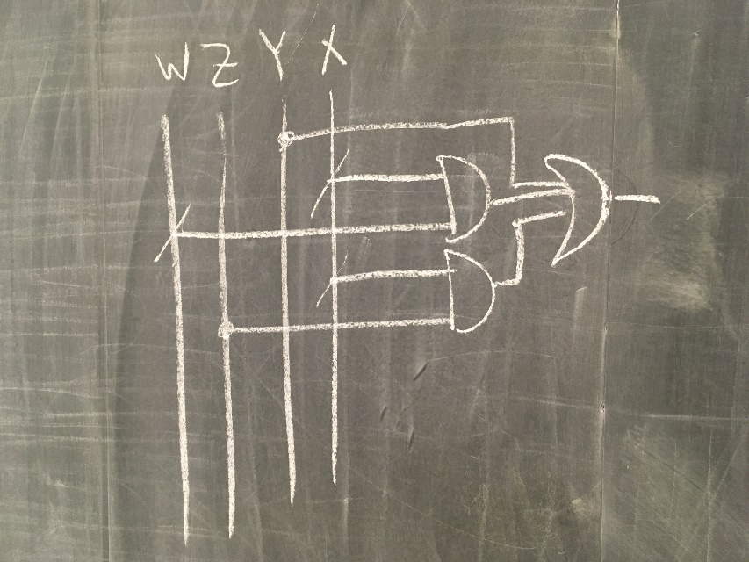
 |  | YX
 |  | 00 | 01 | 11 | 10
WZ | 00 | 1 | 1 | 0 | 1
 | 01 | 1 | 1 | 0 | 1
 | 11 | 1 | 1 | 0 | 1
 | 10 | 1 | 1 | 0 | 0
m₀ | m₁ | m₃ | m₂
m₄ | m₅ | m₇ | m₆
m₁₂ | m₁₃ | m₁₅ | m₁₄
m₈ | m₉ | m₁₁ | m₁₀
F (W,Z,Y,X) = ∑m(0, 1, 2, 4, 5, 6, 8, 9, 12, 13, 14)
F (W,Z,Y,X) = Y’ + W’X’ + ZX’

Slide 14
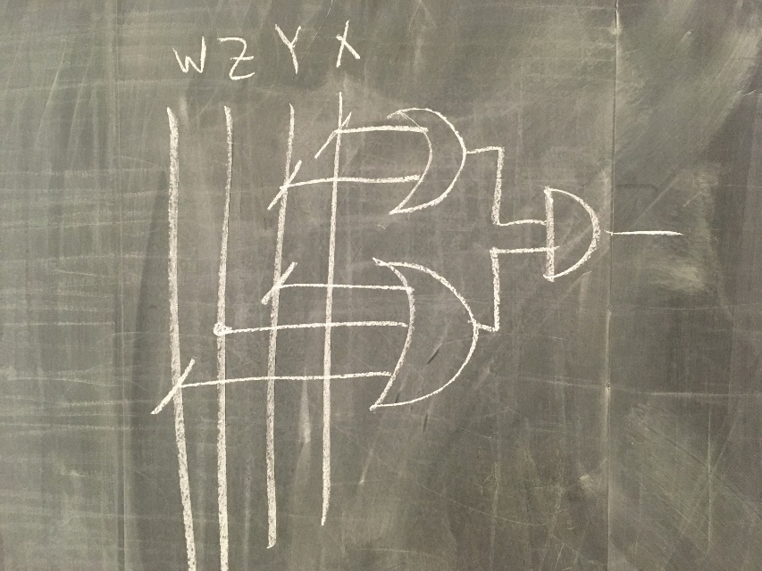
 |  | YX
 |  | 00 | 01 | 11 | 10
WZ | 00 | 1 | 1 | 0 | 1
 | 01 | 1 | 1 | 0 | 1
 | 11 | 1 | 1 | 0 | 1
 | 10 | 1 | 1 | 0 | 0
m₀ | m₁ | m₃ | m₂
m₄ | m₅ | m₇ | m₆
m₁₂ | m₁₃ | m₁₅ | m₁₄
m₈ | m₉ | m₁₁ | m₁₀
F (W,Z,Y,X) = ∏M(3, 7, 10, 11, 15)
F (W,Z,Y,X) = (YX)’(WZ’Y)’
F (W,Z,Y,X) = (Y’+X’)(W’+Z+Y’)

Slide 15
Click to Play!
https://en.wikipedia.org/wiki/Karnaugh_map#/media/File:Torus_from_rectangle.gif

Slide 16
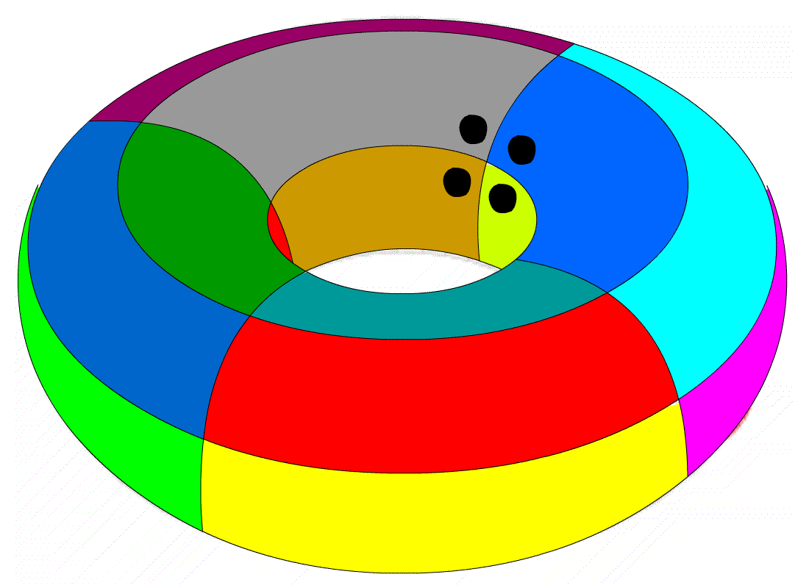
 |  | YX
 |  | 00 | 01 | 11 | 10
WZ | 00 | 1 | 0 | 0 | 1
 | 01 | 0 | 0 | 0 | 0
 | 11 | 0 | 0 | 0 | 0
 | 10 | 1 | 0 | 0 | 1
m₀ | m₁ | m₃ | m₂
m₄ | m₅ | m₇ | m₆
m₁₂ | m₁₃ | m₁₅ | m₁₄
m₈ | m₉ | m₁₁ | m₁₀
F (W,Z,Y,X) = ∑m(0, 2, 8, 10)
F (W,Z,Y,X) = Z’X’
torus

Slide 17
 |  | YX
 |  | 00 | 01 | 11 | 10
WZ | 00 | 1 | 0 | 0 | 1
 | 01 | 0 | 0 | 0 | 0
 | 11 | 0 | 0 | 0 | 0
 | 10 | 1 | 0 | 0 | 1
m₀ | m₁ | m₃ | m₂
m₄ | m₅ | m₇ | m₆
m₁₂ | m₁₃ | m₁₅ | m₁₄
m₈ | m₉ | m₁₁ | m₁₀
F (W,Z,Y,X) = ∑m(0, 2, 8, 10)
F (W,Z,Y,X) = Z’X’
F (W,Z,Y,X) = ∏M(1,3-7,9,11-15)
F (W,Z,Y,X) = (X)’(Z)’
F (W,Z,Y,X) = X’Z’
torus

Slide 18
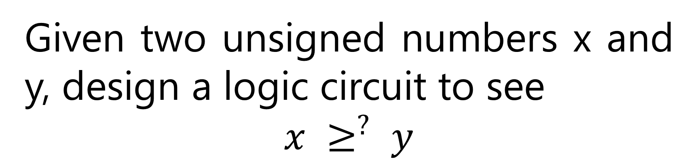
Given two unsigned numbers x and y, design a logic circuit to see
$$x ≥^{?} y$$

Slide 19
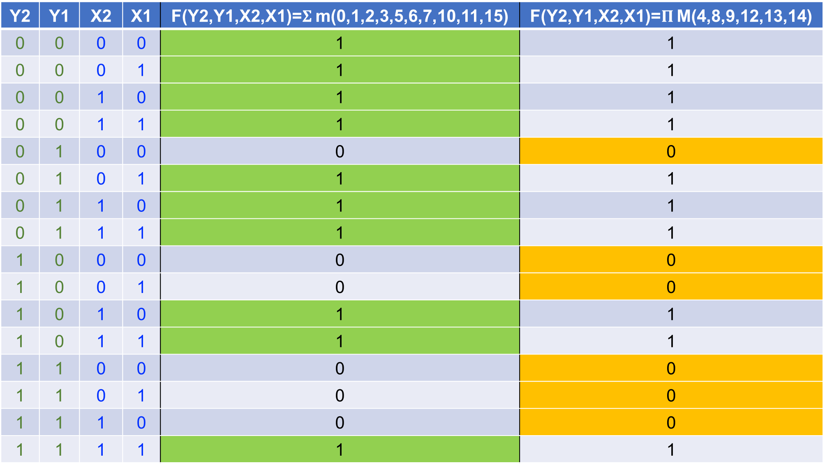
Y2 | Y1 | X2 | X1 | F(Y2,Y1,X2,X1)=$Σ$ m(0,1,2,3,5,6,7,10,11,15) | F(Y2,Y1,X2,X1)=$Π$ M(4,8,9,12,13,14)
0 | 0 | 0 | 0 | 1 | 1
0 | 0 | 0 | 1 | 1 | 1
0 | 0 | 1 | 0 | 1 | 1
0 | 0 | 1 | 1 | 1 | 1
0 | 1 | 0 | 0 | 0 | 0
0 | 1 | 0 | 1 | 1 | 1
0 | 1 | 1 | 0 | 1 | 1
0 | 1 | 1 | 1 | 1 | 1
1 | 0 | 0 | 0 | 0 | 0
1 | 0 | 0 | 1 | 0 | 0
1 | 0 | 1 | 0 | 1 | 1
1 | 0 | 1 | 1 | 1 | 1
1 | 1 | 0 | 0 | 0 | 0
1 | 1 | 0 | 1 | 0 | 0
1 | 1 | 1 | 0 | 0 | 0
1 | 1 | 1 | 1 | 1 | 1

Slide 20
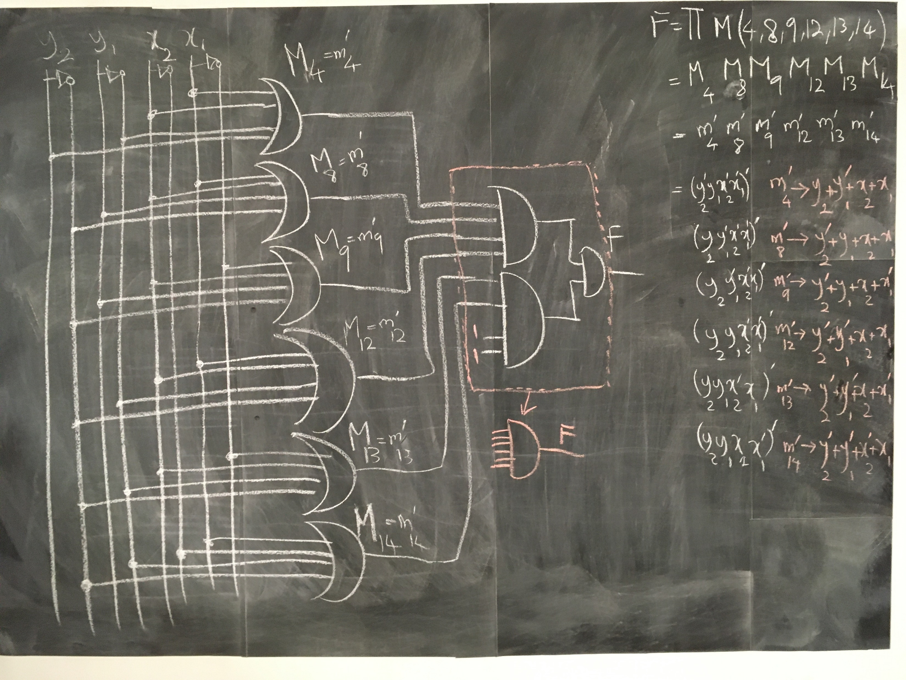

Slide 21
 |  | X₂X₁
 |  | 00 | 01 | 11 | 10
Y₂Y₁ | 00 | 1 | 1 | 1 | 1
 | 01 | 0 | 1 | 1 | 1
 | 11 | 0 | 0 | 1 | 0
 | 10 | 0 | 0 | 1 | 1
m₀ | m₁ | m₃ | m₂
m₄ | m₅ | m₇ | m₆
m₁₂ | m₁₃ | m₁₅ | m₁₄
m₈ | m₉ | m₁₁ | m₁₀
F(Y₂,Y₁,X₂,X₁)=𝚺 m(0,1,2,3,5,6,7,10,11,15)
F(Y₂,Y₁,X₂,X₁)=𝚷 M(4,8,9,12,13,14)

Slide 22
 |  | X₂X₁
 |  | 00 | 01 | 11 | 10
Y₂Y₁ | 00 | 1 | 1 | 1 | 1
 | 01 | 0 | 1 | 1 | 1
 | 11 | 0 | 0 | 1 | 0
 | 10 | 0 | 0 | 1 | 1
m₀ | m₁ | m₃ | m₂
m₄ | m₅ | m₇ | m₆
m₁₂ | m₁₃ | m₁₅ | m₁₄
m₈ | m₉ | m₁₁ | m₁₀
F(Y₂,Y₁,X₂,X₁)=𝚺 m(0,1,2,3,5,6,7,10,11,15)
F(Y2,Y1,X2,X1)=Y’₂Y’₁ +

Slide 23
 |  | X₂X₁
 |  | 00 | 01 | 11 | 10
Y₂Y₁ | 00 | 1 | 1 | 1 | 1
 | 01 | 0 | 1 | 1 | 1
 | 11 | 0 | 0 | 1 | 0
 | 10 | 0 | 0 | 1 | 1
m₀ | m₁ | m₃ | m₂
m₄ | m₅ | m₇ | m₆
m₁₂ | m₁₃ | m₁₅ | m₁₄
m₈ | m₉ | m₁₁ | m₁₀
F(Y₂,Y₁,X₂,X₁)=𝚺 m(0,1,2,3,5,6,7,10,11,15)
F(Y2,Y1,X2,X1)= Y’₂Y’₁ + X₂X₁

Slide 24
 |  | X₂X₁
 |  | 00 | 01 | 11 | 10
Y₂Y₁ | 00 | 1 | 1 | 1 | 1
 | 01 | 0 | 1 | 1 | 1
 | 11 | 0 | 0 | 1 | 0
 | 10 | 0 | 0 | 1 | 1
m₀ | m₁ | m₃ | m₂
m₄ | m₅ | m₇ | m₆
m₁₂ | m₁₃ | m₁₅ | m₁₄
m₈ | m₉ | m₁₁ | m₁₀
F(Y₂,Y₁,X₂,X₁)=𝚺 m(0,1,2,3,5,6,7,10,11,15)
F(Y2,Y1,X2,X1)= Y’₂Y’₁ + X₂X₁ + Y’₂X₁

Slide 25
 |  | X₂X₁
 |  | 00 | 01 | 11 | 10
Y₂Y₁ | 00 | 1 | 1 | 1 | 1
 | 01 | 0 | 1 | 1 | 1
 | 11 | 0 | 0 | 1 | 0
 | 10 | 0 | 0 | 1 | 1
m₀ | m₁ | m₃ | m₂
m₄ | m₅ | m₇ | m₆
m₁₂ | m₁₃ | m₁₅ | m₁₄
m₈ | m₉ | m₁₁ | m₁₀
F(Y₂,Y₁,X₂,X₁)=𝚺 m(0,1,2,3,5,6,7,10,11,15)
F(Y2,Y1,X2,X1)= Y’₂Y’₁ + X₂X₁ + Y’₂X₁ + Y’₂X₂

Slide 26
 |  | X₂X₁
 |  | 00 | 01 | 11 | 10
Y₂Y₁ | 00 | 1 | 1 | 1 | 1
 | 01 | 0 | 1 | 1 | 1
 | 11 | 0 | 0 | 1 | 0
 | 10 | 0 | 0 | 1 | 1
m₀ | m₁ | m₃ | m₂
m₄ | m₅ | m₇ | m₆
m₁₂ | m₁₃ | m₁₅ | m₁₄
m₈ | m₉ | m₁₁ | m₁₀
F(Y₂,Y₁,X₂,X₁)=𝚺 m(0,1,2,3,5,6,7,10,11,15)
F(Y2,Y1,X2,X1)= Y’₂Y’₁ + X₂X₁ + Y’₂X₁ + Y’₂X₂ + Y’₁X₂

Slide 27
 |  | YX
 |  | 00 | 01 | 11 | 10
WZ | 00 | 1 | 1 | 1 | 1
 | 01 | 0 | 1 | 1 | 1
 | 11 | 0 | 0 | 1 | 0
 | 10 | 0 | 0 | 1 | 1
m₀ | m₁ | m₃ | m₂
m₄ | m₅ | m₇ | m₆
m₁₂ | m₁₃ | m₁₅ | m₁₄
m₈ | m₉ | m₁₁ | m₁₀
Change of Variable:
X1 → X
X2 → Y
Y1 → Z
Y2 → W
F(Y₂,Y₁,X₂,X₁)=𝚷 M(4,8,9,12,13,14)

Slide 28
 |  | YX
 |  | 00 | 01 | 11 | 10
WZ | 00 | 1 | 1 | 1 | 1
 | 01 | 0 | 1 | 1 | 1
 | 11 | 0 | 0 | 1 | 0
 | 10 | 0 | 0 | 1 | 1
m₀ | m₁ | m₃ | m₂
m₄ | m₅ | m₇ | m₆
m₁₂ | m₁₃ | m₁₅ | m₁₄
m₈ | m₉ | m₁₁ | m₁₀
Change of Variable:
X1 → X
X2 → Y
Y1 → Z
Y2 → W
F(Y₂,Y₁,X₂,X₁)=𝚷 M(4,8,9,12,13,14)
F(W,Z,Y,X)=()’

Slide 29
 |  | YX
 |  | 00 | 01 | 11 | 10
WZ | 00 | 1 | 1 | 1 | 1
 | 01 | 0 | 1 | 1 | 1
 | 11 | 0 | 0 | 1 | 0
 | 10 | 0 | 0 | 1 | 1
m₀ | m₁ | m₃ | m₂
m₄ | m₅ | m₇ | m₆
m₁₂ | m₁₃ | m₁₅ | m₁₄
m₈ | m₉ | m₁₁ | m₁₀
F(Y₂,Y₁,X₂,X₁)=𝚷 M(4,8,9,12,13,14)
F(W,Z,Y,X))=(WY’ + )’

Slide 30
 |  | YX
 |  | 00 | 01 | 11 | 10
WZ | 00 | 1 | 1 | 1 | 1
 | 01 | 0 | 1 | 1 | 1
 | 11 | 0 | 0 | 1 | 0
 | 10 | 0 | 0 | 1 | 1
m₀ | m₁ | m₃ | m₂
m₄ | m₅ | m₇ | m₆
m₁₂ | m₁₃ | m₁₅ | m₁₄
m₈ | m₉ | m₁₁ | m₁₀
F(Y₂,Y₁,X₂,X₁)=𝚷 M(4,8,9,12,13,14)
F(W,Z,Y,X))=(WY’ + ZY’X’ + )’

Slide 31
 |  | YX
 |  | 00 | 01 | 11 | 10
WZ | 00 | 1 | 1 | 1 | 1
 | 01 | 0 | 1 | 1 | 1
 | 11 | 0 | 0 | 1 | 0
 | 10 | 0 | 0 | 1 | 1
m₀ | m₁ | m₃ | m₂
m₄ | m₅ | m₇ | m₆
m₁₂ | m₁₃ | m₁₅ | m₁₄
m₈ | m₉ | m₁₁ | m₁₀
F(Y₂,Y₁,X₂,X₁)=𝚷 M(4,8,9,12,13,14)
F(W,Z,Y,X))=(WY’ + ZY’X’ + WZX’)’

Slide 32
 |  | YX
 |  | 00 | 01 | 11 | 10
WZ | 00 | 1 | 1 | 1 | 1
 | 01 | 0 | 1 | 1 | 1
 | 11 | 0 | 0 | 1 | 0
 | 10 | 0 | 0 | 1 | 1
m₀ | m₁ | m₃ | m₂
m₄ | m₅ | m₇ | m₆
m₁₂ | m₁₃ | m₁₅ | m₁₄
m₈ | m₉ | m₁₁ | m₁₀
F(Y₂,Y₁,X₂,X₁)=𝚷 M(4,8,9,12,13,14)
F(W,Z,Y,X))=(WY’ + ZY’X’ + WZX’)’
F(Y2,Y1,X2,X1)=(WY’)’ (ZY’X’)’ (WZX’)’
F(Y2,Y1,X2,X1)=(W’+Y) (Z’+Y+X)’ (W’+Z’+X)

Slide 33
5-Variable KARNAUGH MAP

Slide 34
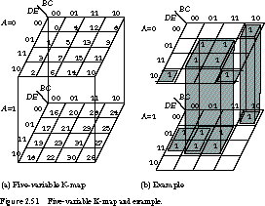

Slide 36
n-Variable KARNAUGH MAP

Slide 37
n-Variable
Quine–McCluskey Algorithm
https://en.wikipedia.org/wiki/Quine%E2%80%93McCluskey_algorithm
1878 ← 1937 ← 1952 ← 1956

Slide 38
Demo
Quine–McCluskey Algorithm
https://www.mathematik.uni-marburg.de/~thormae/lectures/ti1/code/qmc/

Slide 39
Don’t Care Conditions
In practice, in some applications the function is not specified for certain combinations of the variables.

Slide 40
Z | Y | X | F=if input is positive(2’s comp.) then 1 else 0
0 | 0 | 0 | ?
0 | 0 | 1 | ?
0 | 1 | 0 | ?
0 | 1 | 1 | ?
1 | 0 | 0 | ?
1 | 0 | 1 | ?
1 | 1 | 0 | ?
1 | 1 | 1 | ?

Slide 41
Z | Y | X | F=if input is positive(2’s comp.) then 1 else 0
0 | 0 | 0 | 0
0 | 0 | 1 | 1
0 | 1 | 0 | 1
0 | 1 | 1 | 1
1 | 0 | 0 | 0
1 | 0 | 1 | 0
1 | 1 | 0 | 0
1 | 1 | 1 | 0

Slide 42
Z | Y | X | F=∑m(1,2,3)=∏M(0,4,5,6,7)
0 | 0 | 0 | 0
0 | 0 | 1 | 1
0 | 1 | 0 | 1
0 | 1 | 1 | 1
1 | 0 | 0 | 0
1 | 0 | 1 | 0
1 | 1 | 0 | 0
1 | 1 | 1 | 0

Slide 43
 |  | YX
 |  | 00 | 01 | 11 | 10
Z | 0 | 0 | 1 | 1 | 1
 | 1 | 0 | 0 | 0 | 0
m₀ | m₁ | m₃ | m₂
m₄ | m₅ | m₇ | m₆
F (Z,Y,X) = ∑m(1, 2, 3)
F (W,Z,Y = Z’X + Z’Y
Boolean algebra → Z’(X+Y)

Slide 44
 |  | YX
 |  | 00 | 01 | 11 | 10
Z | 0 | 0 | 1 | 1 | 1
 | 1 | 0 | 0 | 0 | 0
m₀ | m₁ | m₃ | m₂
m₄ | m₅ | m₇ | m₆
F(Z,Y,X) = Π M(0,4,5,6,7)
FX.(Y,X) = (Z + Y’X’)’
F(X,Y,X) = Z’ (Y+X)

Slide 45
Z | Y | X | F=if positive(2’s comp.) then 1 if negative 0
0 | 0 | 0 | 0
0 | 0 | 1 | 1
0 | 1 | 0 | 1
0 | 1 | 1 | 1
1 | 0 | 0 | 0
1 | 0 | 1 | 0
1 | 1 | 0 | 0
1 | 1 | 1 | 0

Slide 46
Z | Y | X | F=if positive(2’s comp.) then 1 if negative 0
0 | 0 | 0 | ░
0 | 0 | 1 | 1
0 | 1 | 0 | 1
0 | 1 | 1 | 1
1 | 0 | 0 | 0
1 | 0 | 1 | 0
1 | 1 | 0 | 0
1 | 1 | 1 | 0

Slide 47
 |  | YX
 |  | 00 | 01 | 11 | 10
Z | 0 | ░ | 1 | 1 | 1
 | 1 | 0 | 0 | 0 | 0
m₀ | m₁ | m₃ | m₂
m₄ | m₅ | m₇ | m₆
F (Z,Y,X) = ∑m(1, 2, 3) + ∑d(0)
F (W,Z,Y = Z’X + Z’Y

Slide 48
 |  | YX
 |  | 00 | 01 | 11 | 10
Z | 0 | 1 | 1 | 1 | 1
 | 1 | 0 | 0 | 0 | 0
m₀ | m₁ | m₃ | m₂
m₄ | m₅ | m₇ | m₆
F (Z,Y,X) = ∑m(1, 2, 3) + ∑m(0)
F (W,Z,Y = Z’
In this case, the don’t care condition help to more simplification

Slide 49
 |  | YX
 |  | 00 | 01 | 11 | 10
Z | 0 | ░ | 1 | 1 | 1
 | 1 | 0 | 0 | 0 | 0
m₀ | m₁ | m₃ | m₂
m₄ | m₅ | m₇ | m₆
F(Z,Y,X) = Π M(4,5,6,7) + ∑D(0)
FX.(Y,X) = (Z)’
FX.(Y,X) = Z’

Slide 50
 |  | YX
 |  | 00 | 01 | 11 | 10
Z | 0 | 0 | 1 | 1 | 1
 | 1 | 0 | 0 | 0 | 0
m₀ | m₁ | m₃ | m₂
m₄ | m₅ | m₇ | m₆
F(Z,Y,X) = Π M(0,4,5,6,7) + ∑M(0)
FX.(Y,X) = (Z + Y’X’)’
F(X,Y,X) = Z’ (Y+X)
In this case, the don’t care condition does NOT help to more simplification

Slide 51
Don’t Care Conditions
Functions that have unspecified outputs for some input combinations are called incompletely specified functions.
Don’t-care conditions can be used on a map to provide further simplification of the Boolean expression.

Slide 52
Don’t Care Conditions
To distinguish the don’t-care condition from 1’s and 0’s, an X is used.
Notes:
Thus, an X inside a square in the map indicates that we don’t care
whether the value of 0 or 1 is assigned to F for the particular minterm.

Slide 53
 |  | YX
 |  | 00 | 01 | 11 | 10
Z | 0 | X | 1 | 1 | 1
 | 1 | 0 | 0 | 0 | 0
m₀ | m₁ | m₃ | m₂
m₄ | m₅ | m₇ | m₆
F (Z,Y,X) = ∑m(1, 2, 3) + ∑d(0)
F (Z,Y,X) = Π M(4,5,6,7) + ∑D(0)

