Slide 1
Logic
Circuits
Sequential
Combinational

Slide 2
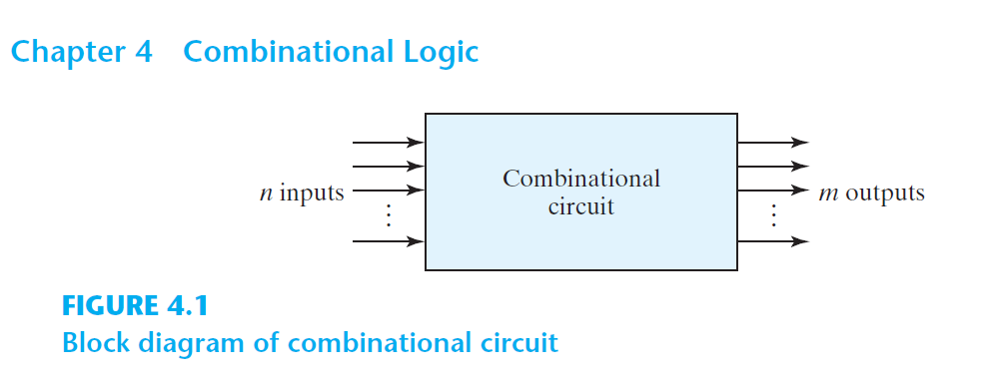

Slide 3
Combinational Logic
aka. Combinational Circuit
Combination of logic gates on the present inputs → the outputs at any time!
A combinational circuit performs an operation that can be specified logically by a set of Boolean functions.

Slide 4
Arithmatic
&
Logical Op
Combinational
Logic
Data
Transmission
Coders

Slide 5
Binary Adder, Binary Subtractor, Binary Multiplier
Binary Comparator (Magnitude Comparator)
Arithmatic
&
Logical Op
Decoder, Encoder
Multiplexer (MUX, MPX), De-Multiplexer (Demux)
Data
Transmission
Coders
Binary Codes (BCD, Excess-3, Gray)

Slide 6
Decoder, Encoder
Multiplexer (MUX, MPX), De-Multiplexer (Demux)
Data
Transmission

Slide 7
Binary Decoder
BCD Decoder
Display Decoder

Slide 8
Decoder
Decode Binary to 1-hot
1-hot: a vector of bits with a single 1 and all the others 0
[0010000000]
[0000000100]
[0010010000]

Slide 9
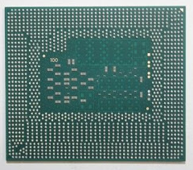
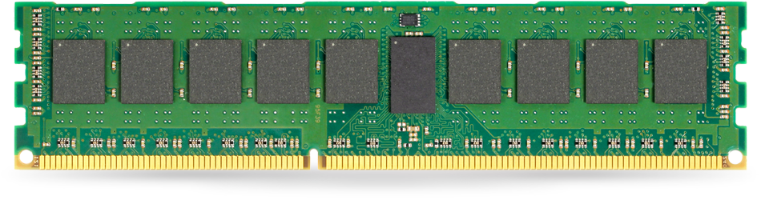

Slide 10
0
0
0
0
0
0
0
0
0
Address

Slide 11
1
0
0
0
0
0
0
0
0
Address

Slide 12
0
1
0
0
0
0
0
0
0
Address

Slide 13
0
0
1
0
0
0
0
0
0
Address

Slide 14
D₀
D₁
X

Slide 15
D₀=1
D₁=0
0

Slide 16
D₀=0
D₁=1
1

Slide 17
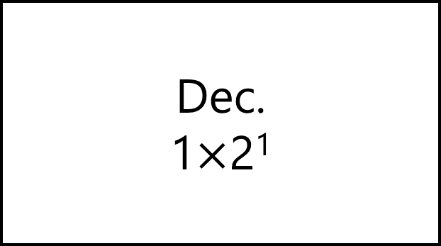
D₀
D₁
Dec.
1$×$2¹
X

Slide 18
X | D₀ | D₁
0 | 1 | 0
1 | 0 | 1

Slide 19
X | D₀=m₀ | D₁=m₁
0 | 1 | 0
1 | 0 | 1

Slide 20
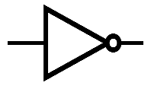
D₀
D₁
X

Slide 21
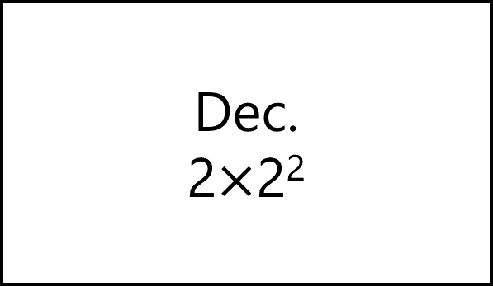
D₀
D₁
D₂
D₃
Dec.
2$×$2²
X
Y

Slide 22
D₀=1
D₁=0
D₂=0
D₃=0
Dec.
2$×$2²
0
0

Slide 23
D₀=0
D₁=1
D₂=0
D₃=0
Dec.
2$×$2²
1
0

Slide 24
D₀=0
D₁=0
D₂=1
D₃=0
Dec.
2$×$2²
0
1

Slide 25
D₀=0
D₁=0
D₂=0
D₃=1
Dec.
2$×$2²
1
1

Slide 26
Y | X | D₀=m₀ | D₁=m₁ | D₂=m₂ | D₃=m₃
0 | 0 | 1 | 0 | 0 | 0
0 | 1 | 0 | 1 | 0 | 0
1 | 0 | 0 | 0 | 1 | 0
1 | 1 | 0 | 0 | 0 | 1

Slide 27
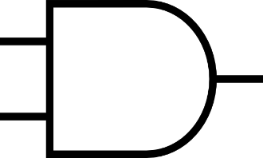
D₀
D₁
D₂
D₃
X
Y

Slide 28
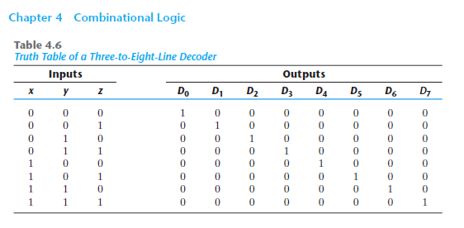

Slide 29
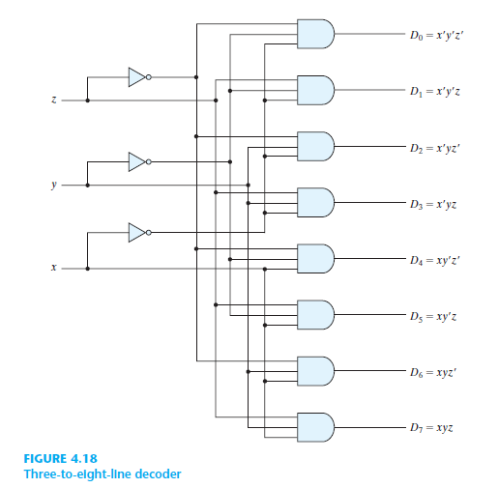

Slide 30
Decoder
Decode 4-Bit Binary to 2⁴ One-hot

Slide 31
Decoder
Decode n-Bit Binary to 2^{n} One-hot

Slide 32

Decoder
Decode 2-Bit Binary to 2² One-hot
Re-Use 1$×$2¹ Decoder

Slide 33

D₀
D₁
D₂
D₃
Dec.
2$×$4
X
Y

Slide 34
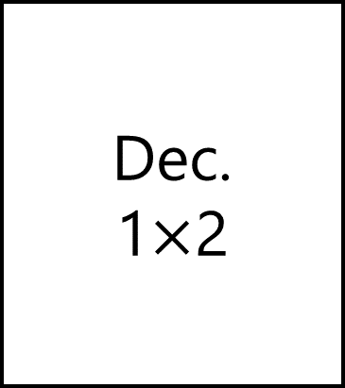

Dec.
1$×$2
D₀
D₁
D₂
D₃
D₀
X
D₁
X
Y
Dec.
1$×$2
D₀
X
D₁

Slide 35
Dec.
1$×$2
D₀=1
D₁=0
D₂=1
D₃=0
D₀
X
D₁
0
0
Dec.
1$×$2
D₀
X
D₁

Slide 36
Dec.
1$×$2
D₀=0
D₁=1
D₂=1
D₃=0
D₀
X
D₁
1
0
Dec.
1$×$2
D₀
X
D₁

Slide 37
Decoder
Enable input

Slide 38
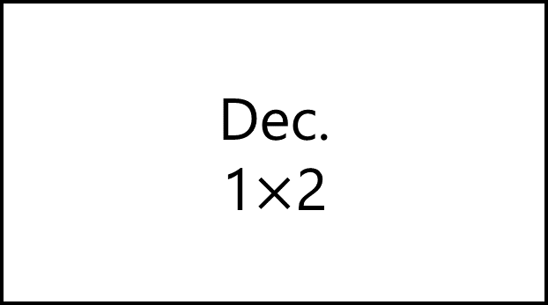
D₀
D₁
Dec.
1$×$2
X
E

Slide 39
D₀=0
D₁=0
Dec.
1$×$2
X
E=0

Slide 40
D₀
D₁
Dec.
1$×$2
X
E=1

Slide 41
E | X | D₀=m₂ | D₁=m₃
0 | 0 | 0 | 0
0 | 1 | 0 | 0
1 | 0 | 1 | 0
1 | 1 | 0 | 1

Slide 42
E | X | D₀=m₀ | D₁=m₁
1 | 0 | 1 | 0
1 | 1 | 0 | 1

Slide 43
D₀
D₁
X
E

Slide 44
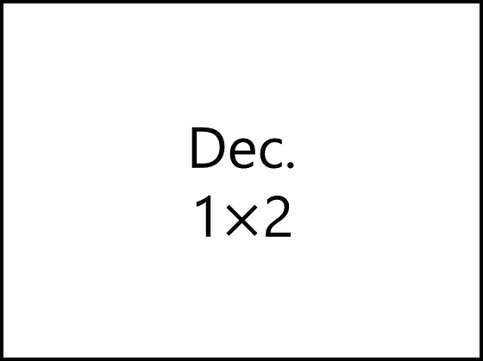
Dec.
1$×$2
D₀
D₁
X
E

Slide 45

Dec.
1$×$2
D₀
X
D₁
E

Slide 46

Dec.
1$×$2
D₀
D₁
D₂
D₃
D₀
X
D₁
E
X
Y
Dec.
1$×$2
D₀
X
D₁
E

Slide 47

Dec.
1$×$2
D₀
D₁
D₂
D₃
D₀
X
D₁
E
X
0
Dec.
1$×$2
D₀
X
D₁
E

Slide 48
Dec.
1$×$2
D₀=1
D₁=0
D₂=0
D₃=0
D₀
X
D₁
E
0
0
Dec.
1$×$2
D₀
X
D₁
E

Slide 49
Dec.
1$×$2
D₀=0
D₁=1
D₂=0
D₃=0
D₀
X
D₁
E
1
0
Dec.
1$×$2
D₀
X
D₁
E

Slide 50

Dec.
1$×$2
D₀
D₁
D₂
D₃
D₀
X
D₁
E
X
1
Dec.
1$×$2
D₀
X
D₁
E

Slide 51
Dec.
1$×$2
D₀=0
D₁=0
D₂=1
D₃=0
D₀
X
D₁
E
0
1
Dec.
1$×$2
D₀
X
D₁
E

Slide 52
Dec.
1$×$2
D₀=0
D₁=0
D₂=0
D₃=1
D₀
X
D₁
E
1
1
Dec.
1$×$2
D₀
X
D₁
E

Slide 53

Dec.
1$×$2
D₀
D₁
D₂
D₃
D₀
X
D₁
E
X
Y
Dec.
1$×$2
D₀
X
Dec.
1$×$2
D₁
D₀
E
1
X
D₁
E

Slide 54

Dec.
1$×$2
D₀=0
D₁=0
D₂=1
D₃=0
D₀
X
D₁
E
0
1
Dec.
1$×$2
D₀
X
Dec.
1$×$2
D₁
D₀
E
1
X
D₁
E

Slide 55

Decoder
Decode 3-Bit Binary to 2³ One-hot
Re-Use 2$×$2² Decoder

Slide 56


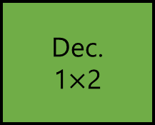
D₀
D₁
D₂
D₃
D₄
D₅
D₆
D₇
Dec.
2$×$4
D₀
X
D₁
Y
D₂
X
Y
Z
E
D₃
Dec.
1$×$2
D₀
Dec.
2$×$4
D₀
X
D₁
X
D₁
E
Y
D₂
E
D₃

Slide 57

D₀=0
D₁=0
D₂=0
D₃=0
D₄=0
D₅=0
D₆=1
D₇=0
Dec.
2$×$4
D₀
X
D₁
Y
D₂
0
1
1
E
D₃
Dec.
1$×$2
D₀
Dec.
2$×$4
D₀
X
D₁
X
D₁
E
Y
D₂
E
D₃

Slide 58

D₀
D₁
D₂
D₃
D₄
D₅
D₆
D₇
Decoder
3 $×$ 2³
Dec.
2$×$4
D₀
X
D₁
Y
D₂
X
Y
Z
E
D₃
Dec.
1$×$2
D₀
Dec.
2$×$4
D₀
X
D₁
X
D₁
E
Y
D₂
E
D₃

Slide 59

Decoder
Decode 4-Bit Binary to 2⁴ One-hot
Re-Use 1$×$2¹ Decoder
Re-Use 2$×$2² Decoder
Re-Use 3$×$2³ Decoder

Slide 60
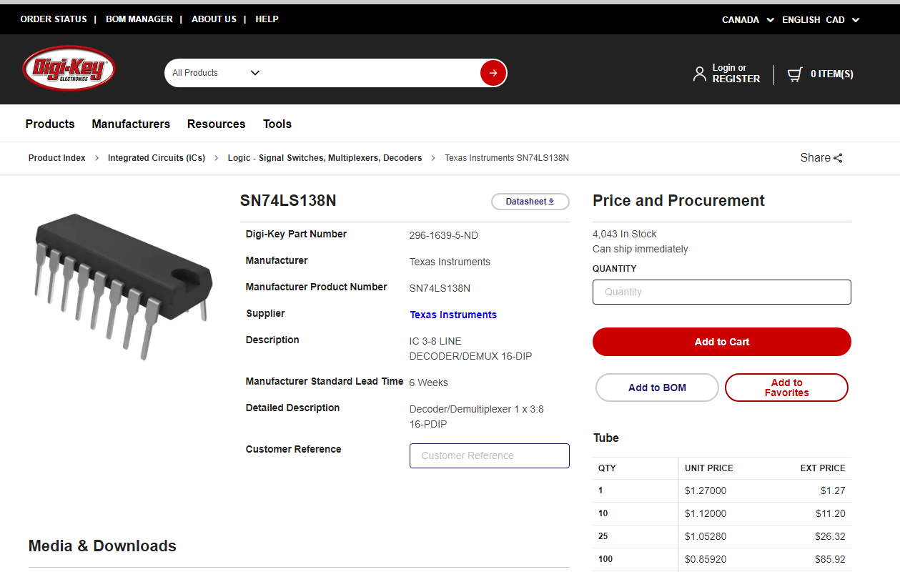
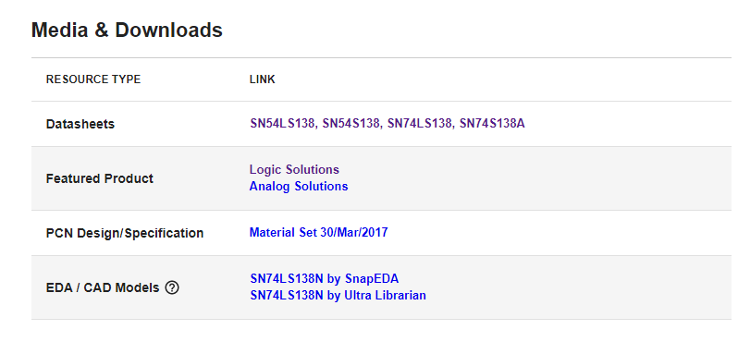
Notes:
https://www.ti.com/lit/ds/sdls014/sdls014.pdf?ts=1604890033918&ref_url=https%253A%252F%252Fwww.google.com%252F

Slide 61
Decoder
Boolean Function
F_{SoP} = ∑m(…)
F_{PoS} = ∏M(…)

Slide 62
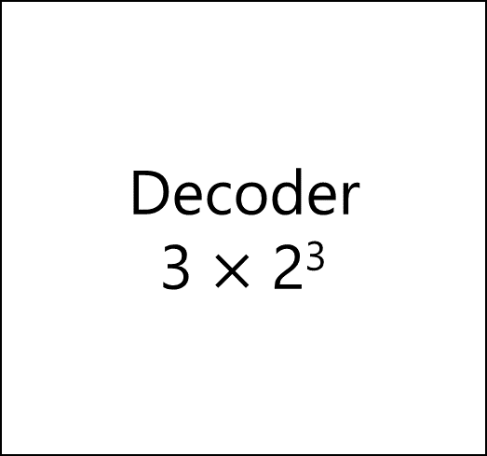
Decoder
3 $×$ 2³
D₀
D₁
D₂
D₃
D₄
D₅
D₆
D₇
m₀
m₁
m₂
m₃
m₄
m₅
m₆
m₇
X
Y
Z

Slide 63

Decoder
3 $×$ 2³
D₀
D₁
D₂
D₃
D₄
D₅
D₆
D₇
X
Y
Z
F_{SoP} = ∑m(2,4,7)

Slide 64

Decoder
3 $×$ 2³
D₀
D₁
D₂
D₃
D₄
D₅
D₆
D₇
X
Y
Z
F_{PoS} = ∏M(0,1,3,5,6)

Slide 65
Decoder
Full Adder
S = ∑m(1,2,4,7)
C = ∑m(3,5,6,7)

Slide 66
C_{p} | Y | X | C=∑m(3,5,6,7) | S=∑m(1,2,4,7)
0 | 0 | 0 | 0 | 0
0 | 0 | 1 | 0 | 1
0 | 1 | 0 | 0 | 1
0 | 1 | 1 | 1 | 0
1 | 0 | 0 | 0 | 1
1 | 0 | 1 | 1 | 0
1 | 1 | 0 | 1 | 0
1 | 1 | 1 | 1 | 1

Slide 67
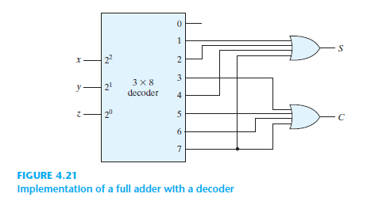
C_{p}
Y
X

Slide 68
Encoder

Slide 69
Encoder
1-hot to Binary

Slide 70
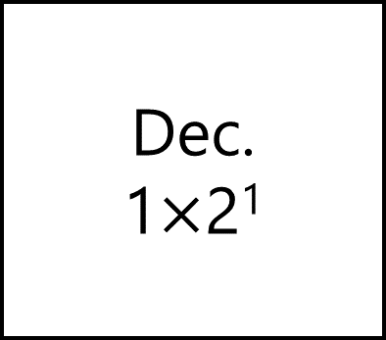
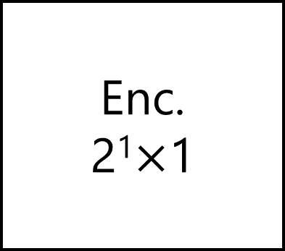
D₀
D₁
Dec.
1$×$2¹
Enc.
2¹$×$1
X
X

Slide 71
D₀
D₁
Enc.
2¹$×$1
X

Slide 72
D₁ | D₀ | F₁
0 | 0 | X
0 | 1 | 0
1 | 0 | 1
1 | 1 | X
X: Don’t Care Conditions

Slide 73
D₁ | D₀ | F₁
0 | 0 | X
0 | 1 | 0
1 | 0 | 1
1 | 1 | X
 |  | D₀
 |  | 0 | 1
D₁ | 0 | m₀ | m₁
 | 1 | m₂ | m₃
X | 0
1 | X

Slide 74
D₁ | D₀ | F₁
0 | 0 | X
0 | 1 | 0
1 | 0 | 1
1 | 1 | X
 |  | D₀
 |  | 0 | 1
D₁ | 0 | m₀ | m₁
 | 1 | m₂ | m₃
X | 0
1 | X
F₁ = D’₀

Slide 75
D₁ | D₀ | F₁
0 | 0 | X
0 | 1 | 0
1 | 0 | 1
1 | 1 | X
 |  | D₀
 |  | 0 | 1
D₁ | 0 | m₀ | m₁
 | 1 | m₂ | m₃
X | 0
1 | X
F₁ = D₁

Slide 76
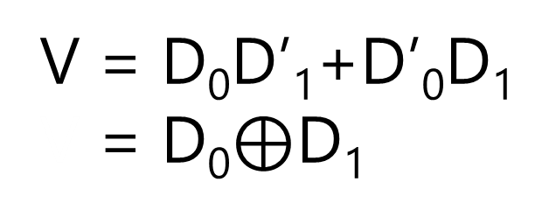
D₁ | D₀ | F₁ | V
0 | 0 | X | 0
0 | 1 | 0 | 1
1 | 0 | 1 | 1
1 | 1 | X | 0
 |  | D₀
 |  | 0 | 1
D₁ | 0 | m₀ | m₁
 | 1 | m₂ | m₃
 |  | D₀
 |  | 0 | 1
D₁ | 0 | m₀ | m₁
 | 1 | m₂ | m₃
X | 0
1 | X
0 | 1
1 | 0
F₁ = D₁
V = D₀D’₁+D’₀D₁
V = D₀$⊕$D₁

Slide 77
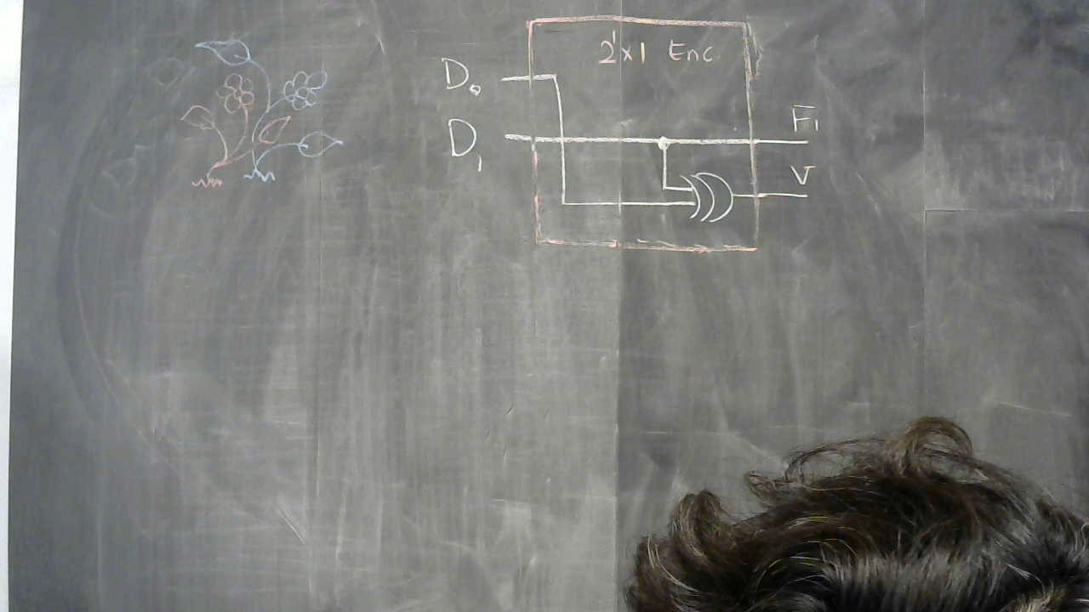

Slide 78
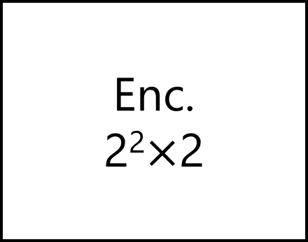
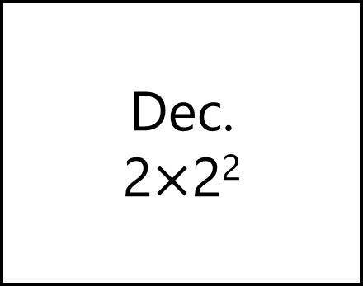
D₀
D₁
D₂
D₃
Dec.
2$×$2²
Enc.
2²$×$2
X
Y
X
Y
V

Slide 79
D₃ | D₂ | D₁ | D₀ | F₂=Y | F₁=X | F₃=V
0 | 0 | 0 | 0 | X | X | 0
0 | 0 | 0 | 1 | 0 | 0 | 1
0 | 0 | 1 | 0 | 0 | 1 | 1
0 | 0 | 1 | 1 | X | X | 0
0 | 1 | 0 | 0 | 1 | 0 | 1
0 | 1 | 0 | 1 | X | X | 0
0 | 1 | 1 | 0 | X | X | 0
0 | 1 | 1 | 1 | X | X | 0
1 | 0 | 0 | 0 | 1 | 1 | 1
1 | 0 | 0 | 1 | X | X | 0
1 | 0 | 1 | 0 | X | X | 0
1 | 0 | 1 | 1 | X | X | 0
1 | 1 | 0 | 0 | X | X | 0
1 | 1 | 0 | 1 | X | X | 0
1 | 1 | 1 | 0 | X | X | 0
1 | 1 | 1 | 1 | X | X | 0

Slide 80
 |  | D₁D₀
 |  | 00 | 01 | 11 | 10
D₃D₂ | 00 | m₀ | m₁ | m₃ | m₂
 | 01 | m₄ | m₅ | m₇ | m₆
 | 11 | m₁₂ | m₁₃ | m₁₅ | m₁₄
 | 10 | m₈ | m₉ | m₁₁ | m₁₀
X | 0 | X | 1
0 | X | X | X
X | X | X | X
1 | X | X | X
F₁ = X = D₁+D₃

Slide 81
 |  | D₁D₀
 |  | 00 | 01 | 11 | 10
D₃D₂ | 00 | m₀ | m₁ | m₃ | m₂
 | 01 | m₄ | m₅ | m₇ | m₆
 | 11 | m₁₂ | m₁₃ | m₁₅ | m₁₄
 | 10 | m₈ | m₉ | m₁₁ | m₁₀
X | 0 | X | 0
1 | X | X | X
X | X | X | X
1 | X | X | X
F₂ = Y = D₂+D₃

Slide 82
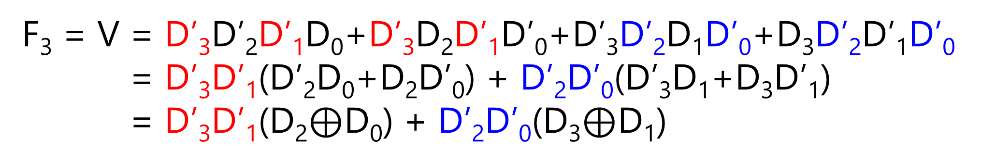
 |  | D₁D₀
 |  | 00 | 01 | 11 | 10
D₃D₂ | 00 | m₀ | m₁ | m₃ | m₂
 | 01 | m₄ | m₅ | m₇ | m₆
 | 11 | m₁₂ | m₁₃ | m₁₅ | m₁₄
 | 10 | m₈ | m₉ | m₁₁ | m₁₀
0 | 1 | 0 | 1
1 | 0 | 0 | 0
0 | 0 | 0 | 0
1 | 0 | 0 | 0
F₃ = V = D’₃D’₂D’₁D₀+D’₃D₂D’₁D’₀+D’₃D’₂D₁D’₀+D₃D’₂D’₁D’₀
F₃ = V = D’₃D’₁(D’₂D₀+D₂D’₀) + D’₂D’₀(D’₃D₁+D₃D’₁)
F₃ = V = D’₃D’₁(D₂$⊕$D₀) + D’₂D’₀(D₃$⊕$D₁)

Slide 83
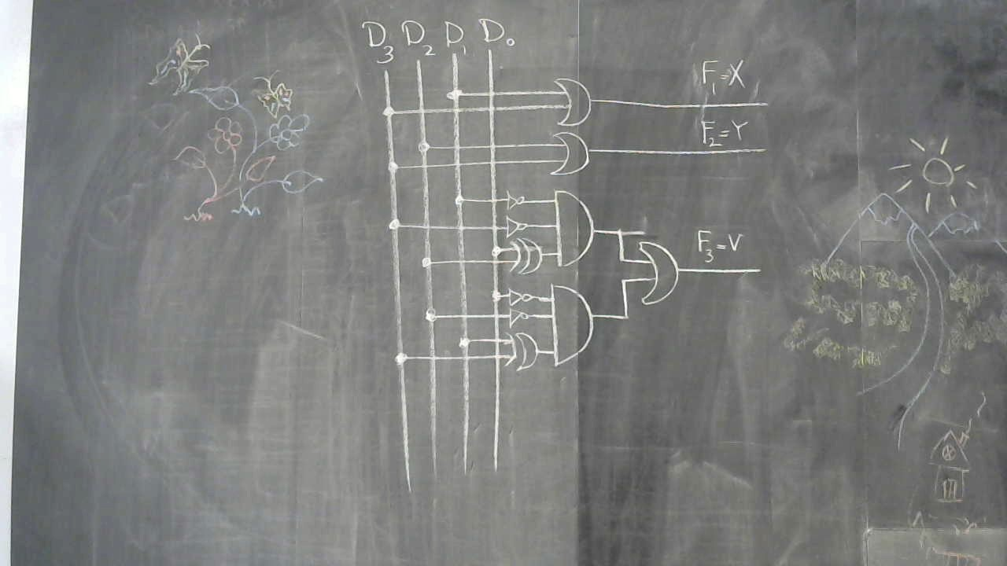

Slide 84
Priority Encoder

Slide 85
D₃ | D₂ | D₁ | D₀ | F₂=Y | F₁=X | F₃=V
0 | 0 | 0 | 0 | X | X | 0
0 | 0 | 0 | 1 | 0 | 0 | 1
0 | 0 | 1 | 0 | 0 | 1 | 1
0 | 0 | 1 | 1 | X | X | 0
0 | 1 | 0 | 0 | 1 | 0 | 1
0 | 1 | 0 | 1 | X | X | 0
0 | 1 | 1 | 0 | X | X | 0
0 | 1 | 1 | 1 | X | X | 0
1 | 0 | 0 | 0 | 1 | 1 | 1
1 | 0 | 0 | 1 | X | X | 0
1 | 0 | 1 | 0 | X | X | 0
1 | 0 | 1 | 1 | X | X | 0
1 | 1 | 0 | 0 | X | X | 0
1 | 1 | 0 | 1 | X | X | 0
1 | 1 | 1 | 0 | X | X | 0
1 | 1 | 1 | 1 | X | X | 0

Slide 86
D₃ | D₂ | D₁ | D₀ | F₂=Y | F₁=X | F₃=V
0 | 0 | 0 | 0 | X | X | 0
0 | 0 | 0 | 1 | 0 | 0 | 1
0 | 0 | 1 | 0 | 0 | 1 | 1
0 | 0 | 1 | 1 | X | X | 0
0 | 1 | 0 | 0 | 1 | 0 | 1
0 | 1 | 0 | 1 | X | X | 0
0 | 1 | 1 | 0 | X | X | 0
0 | 1 | 1 | 1 | X | X | 0
1 | 0 | 0 | 0 | 1 | 1 | 1
1 | 0 | 0 | 1 | X | X | 0
1 | 0 | 1 | 0 | X | X | 0
1 | 0 | 1 | 1 | X | X | 0
1 | 1 | 0 | 0 | X | X | 0
1 | 1 | 0 | 1 | X | X | 0
1 | 1 | 1 | 0 | X | X | 0
1 | 1 | 1 | 1 | X | X | 0

Slide 87
D₃ | D₂ | D₁ | D₀ | F₂=Y | F₁=X | F₃=V
0 | 0 | 0 | 0 | X | X | 0
0 | 0 | 0 | 1 | 0 | 0 | 1
0 | 0 | 1 | 0 | 0 | 1 | 1
0 | 0 | 1 | 1 | 0 | 1 | 1
0 | 1 | 0 | 0 | 1 | 0 | 1
0 | 1 | 0 | 1 | X | X | 0
0 | 1 | 1 | 0 | X | X | 0
0 | 1 | 1 | 1 | X | X | 0
1 | 0 | 0 | 0 | 1 | 1 | 1
1 | 0 | 0 | 1 | X | X | 0
1 | 0 | 1 | 0 | X | X | 0
1 | 0 | 1 | 1 | X | X | 0
1 | 1 | 0 | 0 | X | X | 0
1 | 1 | 0 | 1 | X | X | 0
1 | 1 | 1 | 0 | X | X | 0
1 | 1 | 1 | 1 | X | X | 0

Slide 88
D₃ | D₂ | D₁ | D₀ | F₂=Y | F₁=X | F₃=V
0 | 0 | 0 | 0 | X | X | 0
0 | 0 | 0 | 1 | 0 | 0 | 1
0 | 0 | 1 | 0 | 0 | 1 | 1
0 | 0 | 1 | 1 | 0 | 1 | 1
0 | 1 | 0 | 0 | 1 | 0 | 1
0 | 1 | 0 | 1 | X | X | 0
0 | 1 | 1 | 0 | X | X | 0
0 | 1 | 1 | 1 | X | X | 0
1 | 0 | 0 | 0 | 1 | 1 | 1
1 | 0 | 0 | 1 | X | X | 0
1 | 0 | 1 | 0 | X | X | 0
1 | 0 | 1 | 1 | X | X | 0
1 | 1 | 0 | 0 | X | X | 0
1 | 1 | 0 | 1 | X | X | 0
1 | 1 | 1 | 0 | X | X | 0
1 | 1 | 1 | 1 | X | X | 0

Slide 89
D₃ | D₂ | D₁ | D₀ | F₂=Y | F₁=X | F₃=V
0 | 0 | 0 | 0 | X | X | 0
0 | 0 | 0 | 1 | 0 | 0 | 1
0 | 0 | 1 | 0 | 0 | 1 | 1
0 | 0 | 1 | 1 | 0 | 1 | 1
0 | 1 | 0 | 0 | 1 | 0 | 1
0 | 1 | 0 | 1 | 1 | 0 | 1
0 | 1 | 1 | 0 | X | X | 0
0 | 1 | 1 | 1 | X | X | 0
1 | 0 | 0 | 0 | 1 | 1 | 1
1 | 0 | 0 | 1 | X | X | 0
1 | 0 | 1 | 0 | X | X | 0
1 | 0 | 1 | 1 | X | X | 0
1 | 1 | 0 | 0 | X | X | 0
1 | 1 | 0 | 1 | X | X | 0
1 | 1 | 1 | 0 | X | X | 0
1 | 1 | 1 | 1 | X | X | 0

Slide 90
D₃ | D₂ | D₁ | D₀ | F₂=Y | F₁=X | F₃=V
0 | 0 | 0 | 0 | X | X | 0
0 | 0 | 0 | 1 | 0 | 0 | 1
0 | 0 | 1 | 0 | 0 | 1 | 1
0 | 0 | 1 | 1 | 0 | 1 | 1
0 | 1 | 0 | 0 | 1 | 0 | 1
0 | 1 | 0 | 1 | 1 | 0 | 1
0 | 1 | 1 | 0 | 1 | 0 | 1
0 | 1 | 1 | 1 | X | X | 0
1 | 0 | 0 | 0 | 1 | 1 | 1
1 | 0 | 0 | 1 | X | X | 0
1 | 0 | 1 | 0 | X | X | 0
1 | 0 | 1 | 1 | X | X | 0
1 | 1 | 0 | 0 | X | X | 0
1 | 1 | 0 | 1 | X | X | 0
1 | 1 | 1 | 0 | X | X | 0
1 | 1 | 1 | 1 | X | X | 0

Slide 91
D₃ | D₂ | D₁ | D₀ | F₂=Y | F₁=X | F₃=V
0 | 0 | 0 | 0 | X | X | 0
0 | 0 | 0 | 1 | 0 | 0 | 1
0 | 0 | 1 | 0 | 0 | 1 | 1
0 | 0 | 1 | 1 | 0 | 1 | 1
0 | 1 | 0 | 0 | 1 | 0 | 1
0 | 1 | 0 | 1 | 1 | 0 | 1
0 | 1 | 1 | 0 | 1 | 0 | 1
0 | 1 | 1 | 1 | 1 | 0 | 1
1 | 0 | 0 | 0 | 1 | 1 | 1
1 | 0 | 0 | 1 | X | X | 0
1 | 0 | 1 | 0 | X | X | 0
1 | 0 | 1 | 1 | X | X | 0
1 | 1 | 0 | 0 | X | X | 0
1 | 1 | 0 | 1 | X | X | 0
1 | 1 | 1 | 0 | X | X | 0
1 | 1 | 1 | 1 | X | X | 0

Slide 92
D₃ | D₂ | D₁ | D₀ | F₂=Y | F₁=X | F₃=V
0 | 0 | 0 | 0 | X | X | 0
0 | 0 | 0 | 1 | 0 | 0 | 1
0 | 0 | 1 | 0 | 0 | 1 | 1
0 | 0 | 1 | 1 | 0 | 1 | 1
0 | 1 | 0 | 0 | 1 | 0 | 1
0 | 1 | 0 | 1 | 1 | 0 | 1
0 | 1 | 1 | 0 | 1 | 0 | 1
0 | 1 | 1 | 1 | 1 | 0 | 1
1 | 0 | 0 | 0 | 1 | 1 | 1
1 | 0 | 0 | 1 | 1 | 1 | 1
1 | 0 | 1 | 0 | 1 | 1 | 1
1 | 0 | 1 | 1 | 1 | 1 | 1
1 | 1 | 0 | 0 | 1 | 1 | 1
1 | 1 | 0 | 1 | 1 | 1 | 1
1 | 1 | 1 | 0 | 1 | 1 | 1
1 | 1 | 1 | 1 | 1 | 1 | 1

Slide 93
D₃ | D₂ | D₁ | D₀ | F₂=Y | F₁=X | F₃=V
0 | 0 | 0 | 0 | X | X | 0
0 | 0 | 0 | 1 | 0 | 0 | 1
0 | 0 | 1 | X | 0 | 1 | 1
0 | 0 | 1 | X | 0 | 1 | 1
0 | 1 | X | X | 1 | 0 | 1
0 | 1 | X | X | 1 | 0 | 1
0 | 1 | X | X | 1 | 0 | 1
0 | 1 | X | X | 1 | 0 | 1
1 | X | X | X | 1 | 1 | 1
1 | X | X | X | 1 | 1 | 1
1 | X | X | X | 1 | 1 | 1
1 | X | X | X | 1 | 1 | 1
1 | X | X | X | 1 | 1 | 1
1 | X | X | X | 1 | 1 | 1
1 | X | X | X | 1 | 1 | 1
1 | X | X | X | 1 | 1 | 1

Slide 94
D₃ | D₂ | D₁ | D₀ | F₂=Y | F₁=X | F₃=V
0 | 0 | 0 | 0 | X | X | 0
0 | 0 | 0 | 1 | 0 | 0 | 1
0 | 0 | 1 | X | 0 | 1 | 1
0 | 1 | X | X | 1 | 0 | 1
1 | X | X | X | 1 | 1 | 1

Slide 95
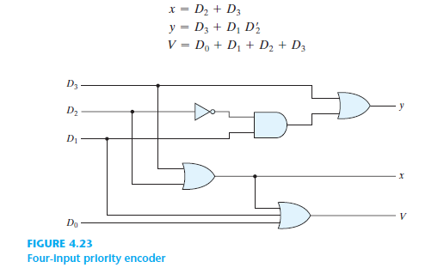

Slide 96
Priority Encoder
Applications

Slide 97
Positional Encoders

Slide 98
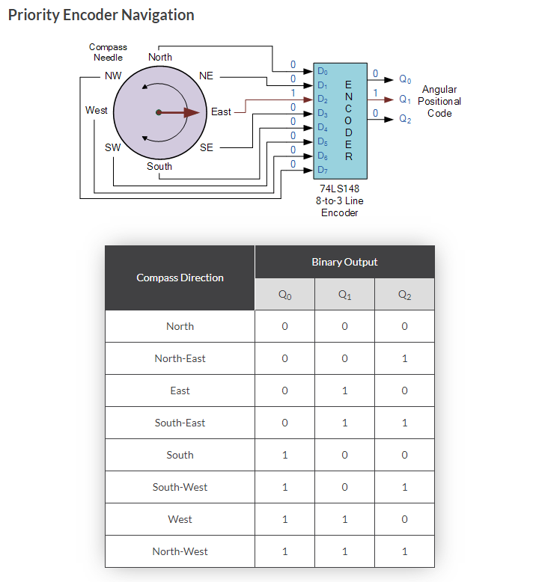
https://www.electronics-tutorials.ws/

Slide 99
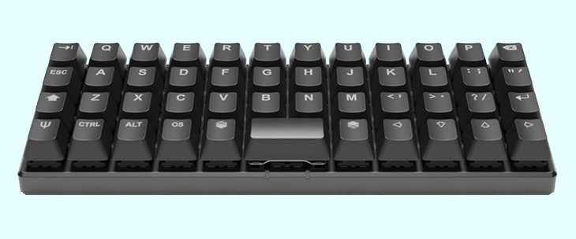
Keyboard Encoders

