Slide 1
Binary Adder, Binary Subtractor, Binary Multiplier
Binary Comparator (Magnitude Comparator)
Arithmatic
&
Logical Op
Decoder, Encoder
Multiplexer (MUX, MPX), De-Multiplexer (Demux)
Data
Transmission
Coders
Binary Codes (BCD, Excess-3, Gray)

Slide 2
Multiplexer
Shortened to MUX or MPX

Slide 3
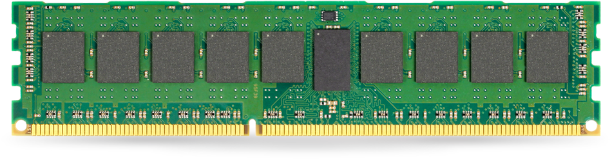
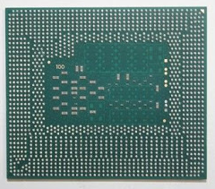
Address to Select

Slide 4
Transfer

Slide 14

Multiplexer
2¹$×$1

Slide 15

I₀
MUX
2$×$1
F
I₁
S

Slide 16
I₀
F=I₀
I₁
S=0

Slide 17
I₀
F=I₁
I₁
S=1

Slide 18
S | I₁ | I₀ | F
0 | 0 | 0 | 0
0 | 0 | 1 | 1
0 | 1 | 0 | 0
0 | 1 | 1 | 1
1 | 0 | 0 | 0
1 | 0 | 1 | 0
1 | 1 | 0 | 1
1 | 1 | 1 | 1

Slide 19
S | I₁ | I₀ | F
0 | 0 | 0 | 0
0 | 0 | 1 | 1
0 | 1 | 0 | 0
0 | 1 | 1 | 1
1 | 0 | 0 | 0
1 | 0 | 1 | 0
1 | 1 | 0 | 1
1 | 1 | 1 | 1

Slide 20
 |  | I₁I₀
 |  | 00 | 01 | 11 | 10
S | 0 | m₀ | m₁ | m₃ | m₂
 | 1 | m₄ | m₅ | m₇ | m₆
0 | 1 | 1 | 0
0 | 0 | 1 | 1
F=S’I₀+SI₁

Slide 21
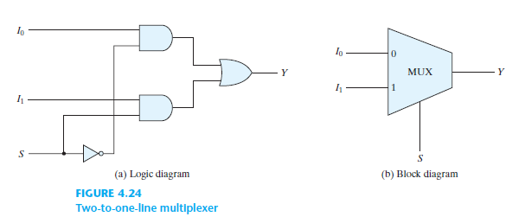

Slide 22
S | F=S’I₀+SI₁
0 | I₀
1 | I₁

Slide 23

Multiplexer
2²$×$1

Slide 24

I₀
I₁
MUX
4$×$1
F
I₂
I₃
S₁
S₀

Slide 25
I₀
I₁
MUX
4$×$1
F
I₂
I₃
0
0

Slide 26
I₀
I₁
MUX
4$×$1
F
I₂
I₃
0
1

Slide 27
I₀
I₁
MUX
4$×$1
F
I₂
I₃
1
0

Slide 28
I₀
I₁
MUX
4$×$1
F
I₂
I₃
1
1

Slide 29
S₁ | S₀ | I₃ | I₂ | I₁ | I₀ | F
0 | 0 | X | X | X | 0 | 0
0 | 0 | X | X | X | 1 | 1
0 | 1 | X | X | 0 | X | 0
0 | 1 | X | X | 1 | X | 1
1 | 0 | X | 0 | X | X | 0
1 | 0 | X | 1 | X | X | 1
1 | 1 | 0 | X | X | X | 0
1 | 1 | 1 | X | X | X | 1

Slide 30
S₁ | S₀ | F=S’₁S’₀I₀+S’₁S₀I₁+S₁S’₀I₂+S₁S₀I₃
0 | 0 | I₀
0 | 1 | I₁
1 | 0 | I₂
1 | 1 | I₃

Slide 31
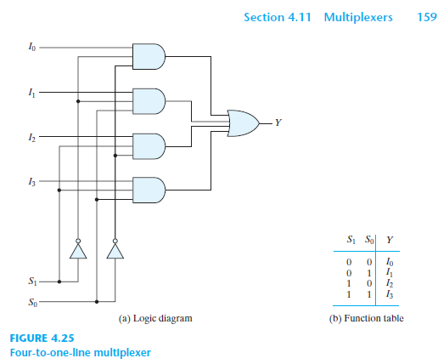

Slide 32

Multiplexer
2^{n}$×$1

Slide 33
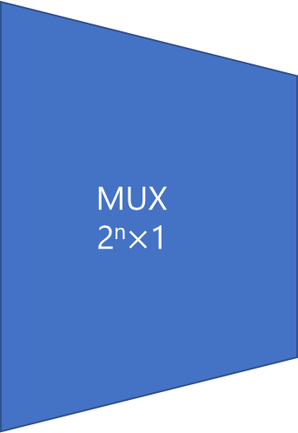
I₀
MUX
2^{n}$×$1
I₁
…
F
I₂^{n}₋₁
I₂^{n}
…
S_{n}
S_{n-1}
… S₁
S₀

Slide 34
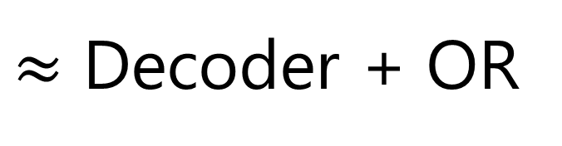
$≈$ Decoder + OR

Slide 36
Sum of Products
2 Levels
ANDs-OR

Slide 37
Multiplexer
Boolean Function
F_{SoP} = ∑m(…)
F_{PoS} = ∏M(…)

Slide 38
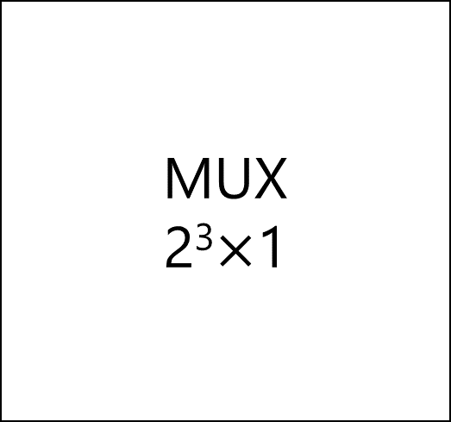
MUX
2³$×$1
I₀
I₁
I₂
I₃
I₄
I₅
I₆
I₇
F
S₂ | S₁ | S₀

Slide 39
m₀
m₁
m₂
m₃
m₄
m₅
m₆
m₇
MUX
2³$×$1
I₀
I₁
I₂
I₃
I₄
I₅
I₆
I₇
F
S₂ | S₁ | S₀
Z | Y | X

Slide 40
MUX
Full Adder
S = ∑m(1,2,4,7)
C = ∑m(3,5,6,7)

Slide 41
C_{p} | Y | X | C=∑m(3,5,6,7) | S=∑m(1,2,4,7)
0 | 0 | 0 | 0 | 0
0 | 0 | 1 | 0 | 1
0 | 1 | 0 | 0 | 1
0 | 1 | 1 | 1 | 0
1 | 0 | 0 | 0 | 1
1 | 0 | 1 | 1 | 0
1 | 1 | 0 | 1 | 0
1 | 1 | 1 | 1 | 1

Slide 42

m₀ | 0
m₁ | 1
m₂ | 1
m₃ | 0
m₄ | 1
m₅ | 0
m₆ | 0
m₇ | 1
MUX
2³$×$1
I₀
I₁
I₂
I₃
I₄
I₅
I₆
I₇
S
S₂ | S₁ | S₀
C_{p} | Y | X
S = ∑m(1,2,4,7)

Slide 43

m₀ | 0
m₁ | 0
m₂ | 0
m₃ | 1
m₄ | 0
m₅ | 1
m₆ | 1
m₇ | 1
MUX
2³$×$1
I₀
I₁
I₂
I₃
I₄
I₅
I₆
I₇
C
S₂ | S₁ | S₀
C_{p} | Y | X
C = ∑m(3,5,6,7)

Slide 44
Multiplexer
Boolean Function II
Book: Page 161

Slide 45

MUX
2²$×$1
I₀
I₁
I₂
I₃
S
S₁ | S₀
C_{p} | Y | X
S = ∑m(1,2,4,7)

Slide 46
MUX
2²$×$1
I₀
I₁
I₂
I₃
C’_{p}
S
S₁ | S₀
0 | 0 | 1
S = ∑m(1,2,4,7)

Slide 47
MUX
2²$×$1
I₀
I₁
I₂
I₃
C’_{p}
S
C’_{p}
S₁ | S₀
0 | 1 | 0
S = ∑m(1,2,4,7)

Slide 48
MUX
2²$×$1
I₀
I₁
I₂
I₃
C_{p}
C’_{p}
S
C’_{p}
S₁ | S₀
1 | 0 | 0
S = ∑m(1,2,4,7)

Slide 49
MUX
2²$×$1
I₀
I₁
I₂
I₃
C_{p}
C’_{p}
S
C’_{p}
C_{p}
S₁ | S₀
1 | 1 | 1
S = ∑m(1,2,4,7)

Slide 50
MUX
2²$×$1
I₀
I₁
I₂
I₃
C
S₁ | S₀
C_{p} | Y | X
C = ∑m(3,5,6,7)

Slide 51
MUX
2²$×$1
I₀
I₁
I₂
I₃
C
C’_{p}
S₁ | S₀
0 | 1 | 1
C = ∑m(3,5,6,7)

Slide 52
MUX
2²$×$1
I₀
I₁
I₂
I₃
C_{p}
C
C’_{p}
S₁ | S₀
1 | 0 | 1
C = ∑m(3,5,6,7)

Slide 53
MUX
2²$×$1
I₀
I₁
I₂
I₃
C_{p}
C
C_{p}
C’_{p}
S₁ | S₀
1 | 1 | 0
C = ∑m(3,5,6,7)

Slide 54
MUX
2²$×$1
I₀
I₁
I₂
I₃
C_{p}
C
C_{p}
C’_{p}+ C_{p}=1
S₁ | S₀
1 | 1 | 1
C = ∑m(3,5,6,7)

Slide 55
MUX
2²$×$1
I₀
I₁
I₂
I₃
0
C_{p}
C
C_{p}
C’_{p}+ C_{p}=1
S₁ | S₀
C_{p} | Y | X
C = ∑m(3,5,6,7)

Slide 56
MUX
2²$×$1
I₀
I₁
I₂
I₃
0
C_{p}
C
C_{p}
C’_{p}+ C_{p}=1
S₁ | S₀
C_{p} | Y | X
C = ∑m(3,5,6,7)

Slide 57
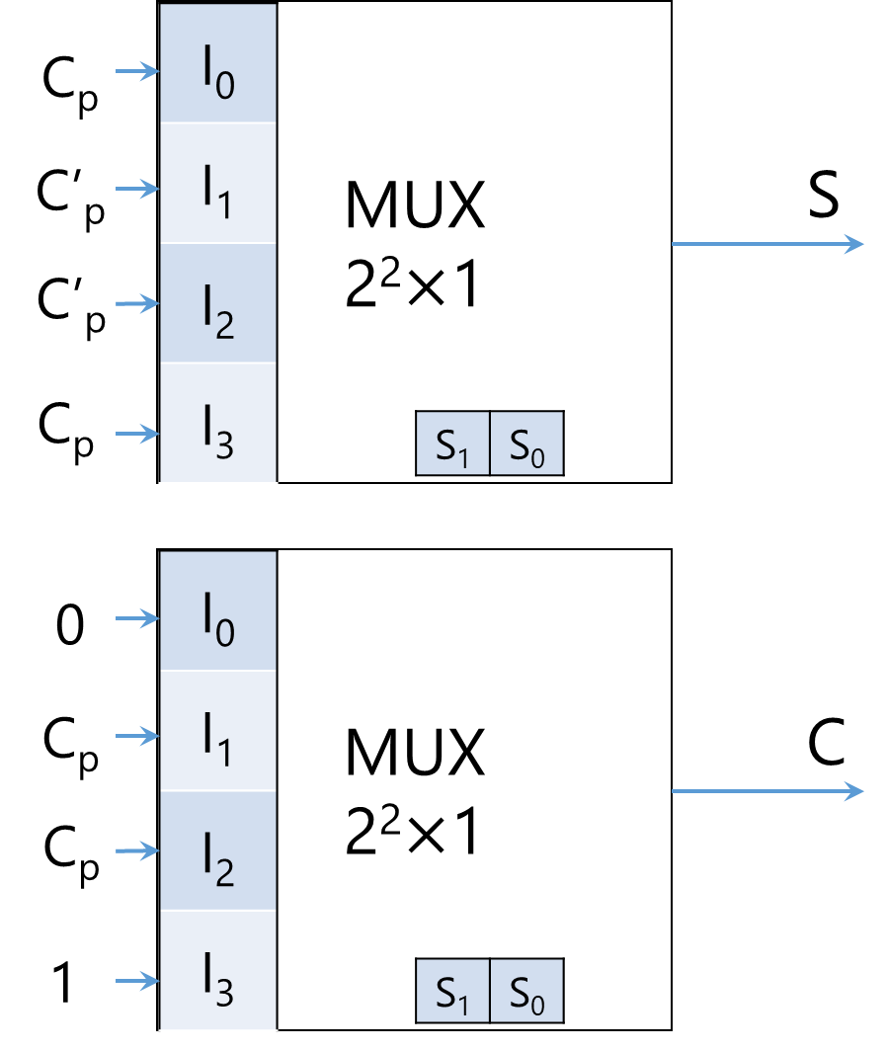
X
Y
C_{p}

Slide 58
Multiplexer
Three-State Gates + Decoders
Book: Page 162-164

Slide 59
De-multiplexer

Slide 60


O₀
I₀
O₁
I₁
MUX
4$×$1
De-MUX
1$×$4
F
O₂
I₂
O₃
I₃
S₁
S₀
S₁
S₀

Slide 61

S₁ | S₀ | F | O₀ | O₁ | O₂ | O₃
0 | 0 | 0 | 0 | 0 | 0 | 0
0 | 0 | 1 | 1 | 0 | 0 | 0
0 | 1 | 0 | 0 | 0 | 0 | 0
0 | 1 | 1 | 0 | 1 | 0 | 0
1 | 0 | 0 | 0 | 0 | 0 | 0
1 | 0 | 1 | 0 | 0 | 1 | 0
1 | 1 | 0 | 0 | 0 | 0 | 1
1 | 1 | 1 | 0 | 0 | 0 | 0
O₀
O₁
De-MUX
1$×$4
F
O₂
O₃
S₁
S₀

Slide 62
S₁ | S₀ | F | O₀ | O₁ | O₂ | O₃
0 | 0 | 0 | 0 | 0 | 0 | 0
0 | 0 | 1 | 1 | 0 | 0 | 0
0 | 1 | 0 | 0 | 0 | 0 | 0
0 | 1 | 1 | 0 | 1 | 0 | 0
1 | 0 | 0 | 0 | 0 | 0 | 0
1 | 0 | 1 | 0 | 0 | 1 | 0
1 | 1 | 0 | 0 | 0 | 0 | 1
1 | 1 | 1 | 0 | 0 | 0 | 0
O₀
O₁
De-MUX
1$×$4
F
O₂
O₃
S₁
S₀

Slide 63
S₁ | S₀ | F | O₀ | O₁ | O₂ | O₃
0 | 0 | 0 | 0 | 0 | 0 | 0
0 | 0 | 1 | 1 | 0 | 0 | 0
0 | 1 | 0 | 0 | 0 | 0 | 0
0 | 1 | 1 | 0 | 1 | 0 | 0
1 | 0 | 0 | 0 | 0 | 0 | 0
1 | 0 | 1 | 0 | 0 | 1 | 0
1 | 1 | 0 | 0 | 0 | 0 | 1
1 | 1 | 1 | 0 | 0 | 0 | 0
O₀
O₁
De-MUX
1$×$4
F
O₂
O₃
S₁
S₀

Slide 64
S₁ | S₀ | F | O₀ | O₁ | O₂ | O₃
0 | 0 | 0 | 0 | 0 | 0 | 0
0 | 0 | 1 | 1 | 0 | 0 | 0
0 | 1 | 0 | 0 | 0 | 0 | 0
0 | 1 | 1 | 0 | 1 | 0 | 0
1 | 0 | 0 | 0 | 0 | 0 | 0
1 | 0 | 1 | 0 | 0 | 1 | 0
1 | 1 | 0 | 0 | 0 | 0 | 0
1 | 1 | 1 | 0 | 0 | 0 | 1
O₀
O₁
De-MUX 1$×$4
F
O₂
O₃
S₁
S₀

Slide 65
S₁ | S₀ | O₀ | O₁ | O₂ | O₃
0 | 0 | F | 0 | 0 | 0
0 | 1 | 0 | F | 0 | 0
1 | 0 | 0 | 0 | F | 0
1 | 1 | 0 | 0 | 0 | F
O₀
O₁
De-MUX
1$×$4
F
O₂
O₃
S₁
S₀

Slide 66
S₁ | S₀ | O₀= S’₁S’₀F | O₁= S’₁S₀F | O₂= S₁S’₀F | O₃= S₁S₀F
0 | 0 | F | 0 | 0 | 0
0 | 1 | 0 | F | 0 | 0
1 | 0 | 0 | 0 | F | 0
1 | 1 | 0 | 0 | 0 | F
O₀
O₁
De-MUX 1$×$4
F
O₂
O₃
S₁
S₀

Slide 67
F
O₀
O₁
F
O₂
O₃
1-to-4 De-mux

Slide 68
De-multiplexer = Decoder w/ Enable input
How come?!

Slide 69
Binary Adder, Binary Subtractor, Binary Multiplier
Binary Comparator (Magnitude Comparator)
Arithmatic
&
Logical Op
Decoder, Encoder
Multiplexer (MUX, MPX), De-Multiplexer (Demux)
Data
Transmission
Coders
Binary Codes (BCD, Excess-3, Gray)

Slide 70
Coding

Slide 71
A → Encode →B

Slide 72
A ← Decode ← B

Slide 73
A ↔ [En][De]code ↔ B
By a convention
Math, e.g., conversion in radix numbering system
Non-math, e.g., in base-64, the value of characters
Engineering
etc

Slide 74


1-way Coding
A $→$ Encode $→$B
A $↚$ Decode $↚$ B

Slide 75
2-way Coding
A ↔ Look up Table ↔ B

Slide 76
Base-64
A ↔ Look up Table ↔ B

Slide 77
Digit | Value | → | Digit | Value | → | Digit | Value | → | Digit | Value
A | 0 |  | Q | 16 |  | g | 32 |  | w | 48
B | 1 |  | R | 17 |  | h | 33 |  | x | 49
C | 2 |  | S | 18 |  | i | 34 |  | y | 50
D | 3 |  | T | 19 |  | j | 35 |  | z | 51
E | 4 |  | U | 20 |  | k | 36 |  | 0 | 52
F | 5 |  | V | 21 |  | l | 37 |  | 1 | 53
G | 6 |  | W | 22 |  | m | 38 |  | 2 | 54
H | 7 |  | X | 23 |  | n | 39 |  | 3 | 55
I | 8 |  | Y | 24 |  | o | 40 |  | 4 | 56
J | 9 |  | Z | 25 |  | p | 41 |  | 5 | 57
K | 10 |  | a | 26 |  | q | 42 |  | 6 | 58
L | 11 |  | b | 27 |  | r | 43 |  | 7 | 59
M | 12 |  | c | 28 |  | s | 44 |  | 8 | 60
N | 13 |  | d | 29 |  | t | 45 |  | 9 | 61
O | 14 |  | e | 30 |  | u | 46 |  | + | 62
P | 15 |  | f | 31 |  | v | 47 |  | / | 63

Slide 78
Binary Codes
Assigning binary numbers to things
A ↔ Look up Table ↔ Binary Number

Slide 79
Binary Coded Decimal
BCD (8421)
Decimal ↔ Look up Table ↔ Binary Number

Slide 80
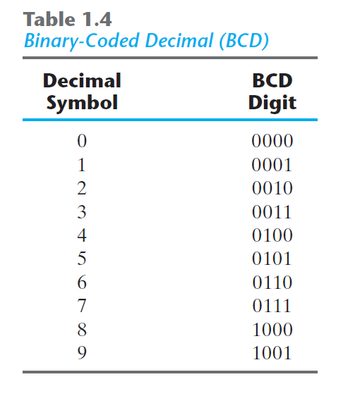

Slide 81
Decimal | BCD (Binary Code) | Binary Number
10 | 0001 0000 | 0000 1010
11 | 0001 0001 | 0000 1011
12 | 0001 0010 | 0000 1100
13 | 0001 0011 | 0000 1101
14 | 0001 0100 | 0000 1110
15 | 0001 0101 | 0000 1111
16 | 0001 0110 | 0001 0000
17 | 0001 0111 | 0001 0001
18 | 0001 1000 | 0001 0010
19 | 0001 1001 | 0001 0011
20 | 0010 0000 | 0001 0100
21 | 0010 0001 | 0001 0101
22 | 0010 0010 | 0001 0110
23 | 0010 0011 | 0001 0111
… | … | …

Slide 82
Decimal | BCD (Binary Code) | Binary Number
10 | 0001 0000 | 0000 1010
11 | 0001 0001 | 0000 1011
12 | 0001 0010 | 0000 1100
13 | 0001 0011 | 0000 1101
14 | 0001 0100 | 0000 1110
15 | 0001 0101 | 0000 1111
16 | 0001 0110 | 0001 0000
17 | 0001 0111 | 0001 0001
18 | 0001 1000 | 0001 0010
19 | 0001 1001 | 0001 0011
20 | 0010 0000 | 0001 0100
21 | 0010 0001 | 0001 0101
22 | 0010 0010 | 0001 0110
23 | 0010 0011 | 0001 0111
… | … | …

Slide 83
(185)₁₀ = (?)_{BCD} = (?)₂

Slide 84
(185)₁₀ = (0001)_{BCD} = (?)₂

Slide 85
(185)₁₀ = (0001 1000)_{BCD} = (?)₂

Slide 86
(185)₁₀ = (0001 1000 0101)_{BCD} = (?)₂

Slide 87
(185)₁₀ = (0001 1000 0101)_{BCD} = (?)₂

Slide 88
(185)₁₀ = (0001 1000 0101)_{BCD} = (?)₂
 | Remainder
185÷2 | 1
92÷2 | 0
46÷2 | 0
23÷2 | 1
11÷2 | 1
5÷2 | 1
2÷2 | 0
1÷2 | 1
0

Slide 89
(185)₁₀ = (0001 1000 0101)_{BCD} = (10111001)₂

Slide 90
Other Binary Codes
A ↔ Look up Table ↔ B

Slide 91
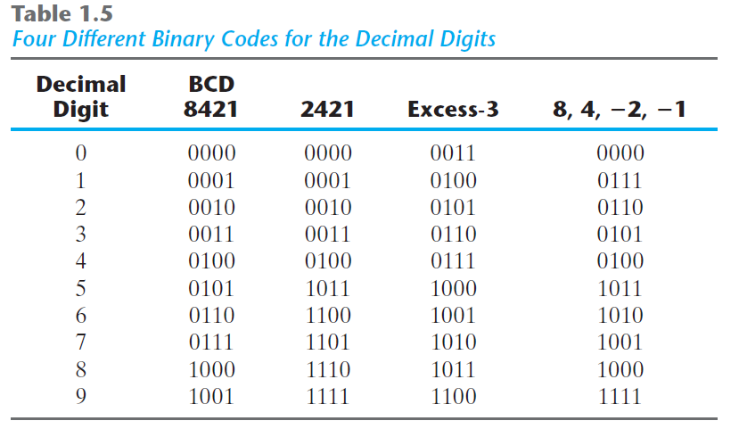

Slide 92
Other Binary Codes
Aiken (2421)
/ˈeɪkən/
https://en.wikipedia.org/wiki/Aiken_code

Slide 93
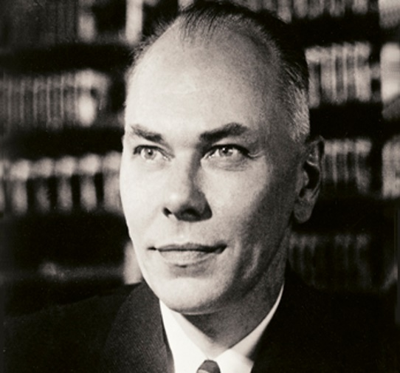
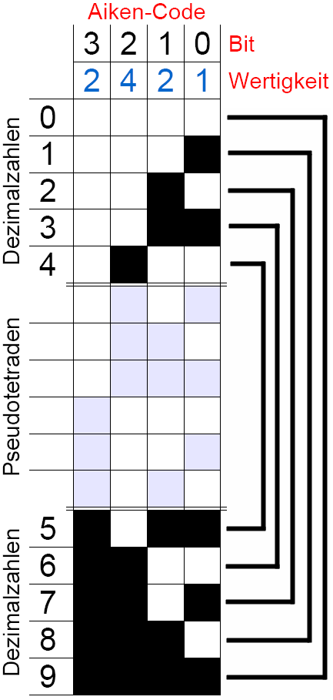
Howard Hathaway Aiken
(March 8, 1900 – March 14, 1973)
Physicist
Pioneer in computing
Original conceptual designer behind IBM's Harvard Mark I
Notes:
The Aiken code differs from the standard 8421 BCD code in that the Aiken code does not weight the fourth digit as 8 as with the standard BCD code but with 2.

Slide 94
Aiken
NOT

Slide 95
(185)₁₀ = (0001 1000 0101)_{BCD (8421)}
(185)₁₀ = (10111001)₂
(185)₁₀ = (0001 NOT(1) NOT(4))_{Aiken (2421)}

Slide 96
(185)₁₀ = (0001 1000 0101)_{BCD (8421)}
(185)₁₀ = (10111001)₂
(185)₁₀ = (0001 NOT(0001) NOT(0100))_{Aiken (2421)}

Slide 97
(185)₁₀ = (0001 1000 0101)_{BCD (8421)}
(185)₁₀ = (10111001)₂
(185)₁₀ = (0001 1110 1011)_{Aiken (2421)}

Slide 98
Other Binary Codes
Excess-3 (XS-3)
https://en.wikipedia.org/wiki/Excess-3

Slide 99
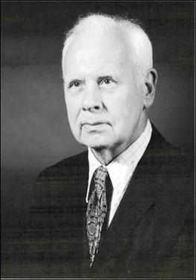
George Robert Stibitz
(April 30, 1904 – January 31, 1995)
Bell Labs researcher
One of the fathers of the modern first digital computer
+3

Slide 100
(185)₁₀ = (0001 1000 0101)_{BCD (8421)}
(185)₁₀ = (10111001)₂
(185)₁₀ = (0001 1110 1011)_{Aiken (2421)}
(185)₁₀ = ((1+3) (8+3) (5+3))_{Excess-3}

Slide 101
(185)₁₀ = (0001 1000 0101)_{BCD (8421)}
(185)₁₀ = (10111001)₂
(185)₁₀ = (0001 1110 1011)_{Aiken (2421)}
(185)₁₀ = ((4) (11) (8))_{Excess-3}

Slide 102
(185)₁₀ = (0001 1000 0101)_{BCD (8421)}
(185)₁₀ = (10111001)₂
(185)₁₀ = (0001 1110 1011)_{Aiken (2421)}
(185)₁₀ = (0100 1011 1000)_{Excess-3}

Slide 103
Other Binary Codes
84(-2)(-1)

Slide 104
Aiken
NOT

Slide 105
(185)₁₀ = (0001 1000 0101)_{BCD (8421)}
(185)₁₀ = (10111001)₂
(185)₁₀ = (0001 1110 1011)_{Aiken (2421)}
(185)₁₀ = (0100 1011 1000)_{Excess-3}
(185)₁₀ = (0111 1000 1011)₈₄₋₂₋₁

Slide 106
What’s nice about some binary codes?

Slide 107
Self-complementing
The 9’s complement of the decimal number
=
The 1’s complement (NOT) of its binary code

Slide 108
(185)₁₀ = (0001 1110 1011)_{Aiken (2421)}
(185)₁₀ = (0100 1011 1000)_{Excess-3}
(185)₁₀ = (0111 1000 1011)₈₄₋₂₋₁
9’s-comp(185)₁₀ = (814)₁₀
9’s-comp(185)10= NOT(0001 1110 1011)_{Aiken (2421)}
9’s-comp(185)10= NOT(0100 1011 1000)_{Excess-3}
9’s-comp(185)10= NOT(0111 1000 1011)₈₄₋₂₋₁

Slide 109
(185)₁₀ = (0001 1110 1011)_{Aiken (2421)}
(185)₁₀ = (0100 1011 1000)_{Excess-3}
(185)₁₀ = (0111 1000 1011)₈₄₋₂₋₁
9’s-comp(185)₁₀ = (814)₁₀
9’s-comp(185)10= (1110 0001 0100)_{Aiken (2421)}
9’s-comp(185)10= (1011 0100 0111)_{Excess-3}
9’s-comp(185)10= (1000 0111 0100)₈₄₋₂₋₁

Slide 110
Other Binary Codes
Gray

Slide 111
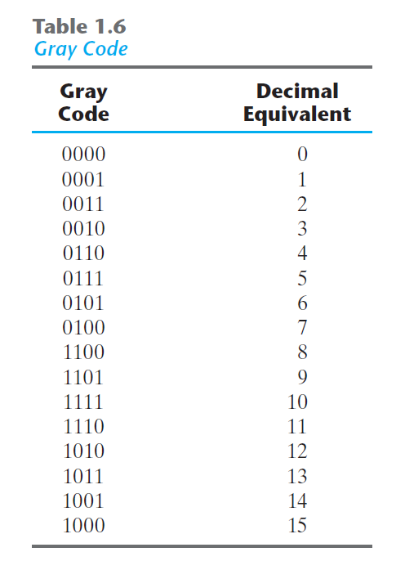

Slide 112
Gray Code
Analog → Digital

Slide 113
1-bit change

Slide 114
Gray Code
Analog → Digital
Straight binary number sequence for 7 to 8: 0111 → 1000; causes all four bits to change values.
Gray code for 7 → 8: 0100 to 1100; only the first bit changes from 0 to 1; the other three bits remain the same.

Slide 115
Gray Code
Algorithm
Step 0: Convert the decimal number to binary number.
Step 1: The MSB (Most Significant Bit) of a gray code and binary code is the same.
Step 2: The next digit of gray code is the XOR of the previous and current digit in the binary code.

Slide 116
Step 0: Convert the decimal number to binary number.
(20)₁₀ | Binary Number | 1 | 0 | 1 | 0 | 0
 | Gray Code

Slide 117
Step 1: The MSB (Most Significant Bit) of a gray code and binary code is the same.
(20)₁₀ | Binary Number | 1 | 0 | 1 | 0 | 0
 | Gray Code | 1

Slide 118
Step 2: The next digit of gray code is the XOR of the previous and current digit in the binary code.
(20)₁₀ | Binary Number | 1 | 0 | 1 | 0 | 0
 | Gray Code | 1 | 1$⊕$0=1

Slide 119
Step 2: The next digit of gray code is the XOR of the previous and current digit in the binary code.
(20)₁₀ | Binary Number | 1 | 0 | 1 | 0 | 0
 | Gray Code | 1 | 1 | 0$⊕$1=1

Slide 120
Step 2: The next digit of gray code is the XOR of the previous and current digit in the binary code.
(20)₁₀ | Binary Number | 1 | 0 | 1 | 0 | 0
 | Gray Code | 1 | 1 | 1 | 1$⊕$0=1

Slide 121
Step 2: The next digit of gray code is the XOR of the previous and current digit in the binary code.
(20)₁₀ | Binary Number | 1 | 0 | 1 | 0 | 0
 | Gray Code | 1 | 1 | 1 | 1 | 0$⊕$0=0

Slide 122
Step 2: The next digit of gray code is the XOR of the previous and current digit in the binary code.
(20)₁₀ | Binary Number | 1 | 0 | 1 | 0 | 0
 | Gray Code | 1 | 1 | 1 | 1 | 0
(21)₁₀ | Binary Number | 1 | 0 | 1 | 0 | 1
 | Gray Code | 1 | 1 | 1 | 1 | 1

Slide 123
ASCII Code
American Standard Code for Information Interchange

Slide 124
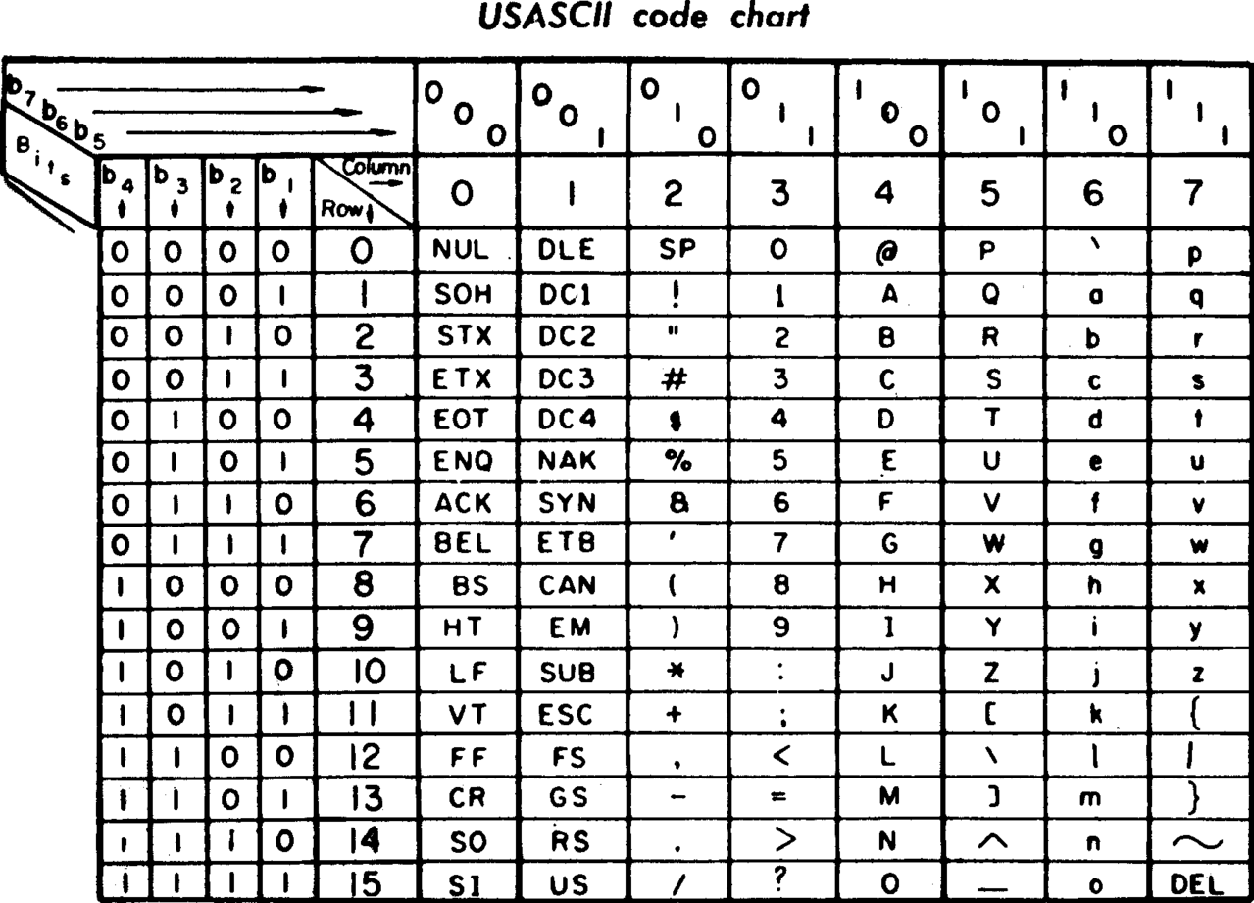

Slide 125
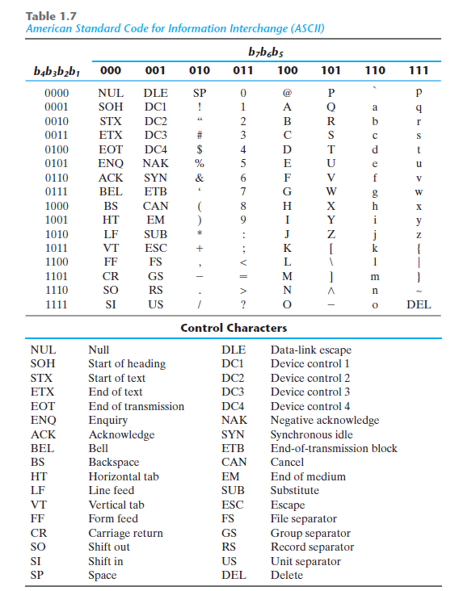
“0” = (011 0000)₂ = (48)₁₀

Slide 126
Combinational Logic
Binary Codes

Slide 127
Combinational Logic
Code Conversion

Slide 128
Aiken

Slide 129
Aiken
0001 0000
0001 0000
0001 0001
0001 0010
0001 0011
0001 0100
0001 1011
You fill it
at home
You fill it
at home
0001 0001
0001 0010
0001 0011
0001 0100
0001 0101

Slide 130





Aiken
$$↔$$
$$↔$$
$$↔$$
$$↔$$
$$↔$$
0001 0000
0001 0000
0001 0001
0001 0010
0001 0011
0001 0100
0001 1011
You fill it
at home
You fill it
at home
0001 0001
0001 0010
0001 0011
0001 0100
0001 0101

Slide 131
Combinational Logic
Code Conversion
BCD (8421) → Excess-3

Slide 132
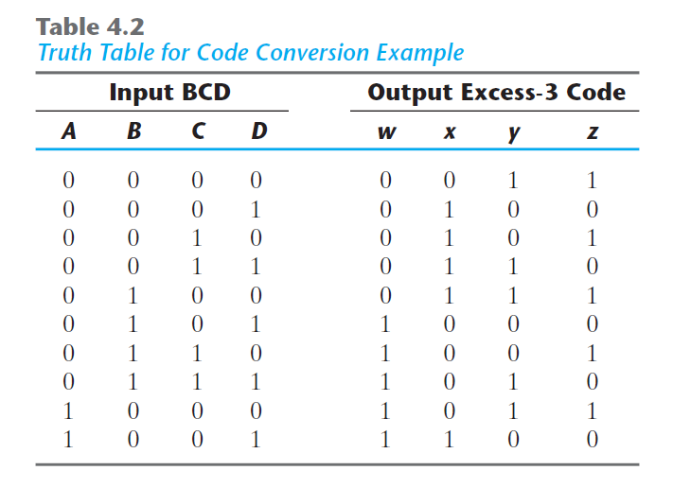

Slide 133
A | B | C | D | W | X | Y | Z
0 | 0 | 0 | 0 | 0 | 0 | 1 | 1
0 | 0 | 0 | 1 | 0 | 1 | 0 | 0
0 | 0 | 1 | 0 | 0 | 1 | 0 | 1
0 | 0 | 1 | 1 | 0 | 1 | 1 | 0
0 | 1 | 0 | 0 | 0 | 1 | 1 | 1
0 | 1 | 0 | 1 | 1 | 0 | 0 | 0
0 | 1 | 1 | 0 | 1 | 0 | 0 | 1
0 | 1 | 1 | 1 | 1 | 0 | 1 | 0
1 | 0 | 0 | 0 | 1 | 0 | 1 | 1
1 | 0 | 0 | 1 | 1 | 1 | 0 | 0
1 | 0 | 1 | 0 | X | X | X | X
1 | 0 | 1 | 1 | X | X | X | X
1 | 1 | 0 | 0 | X | X | X | X
1 | 1 | 0 | 1 | X | X | X | X
1 | 1 | 1 | 0 | X | X | X | X
1 | 1 | 1 | 1 | X | X | X | X

Slide 134
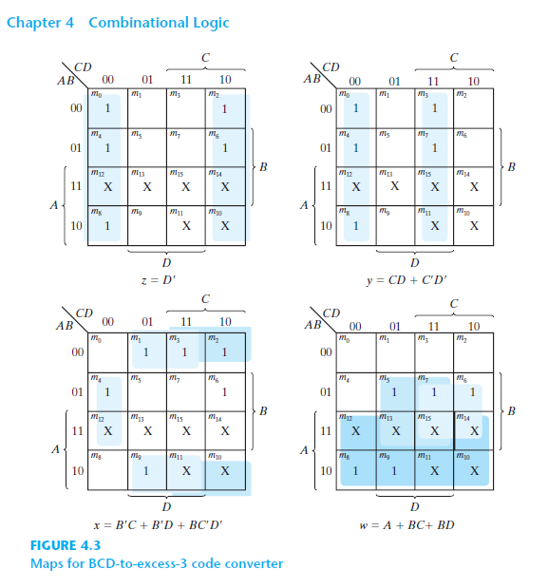

Slide 135
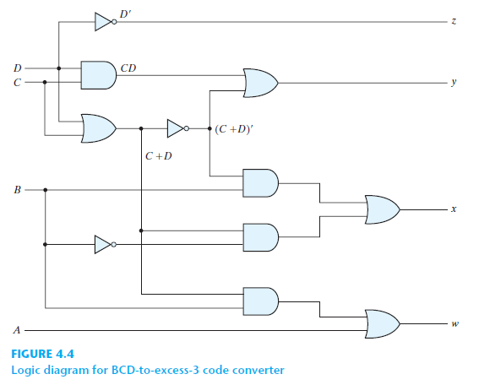

Slide 136
BCD-to-Excess-3

Slide 137
Excess-3-to-BCD
BCD-to-Aiken
Aiken-to-BCD
Aiken-to-Excess-3
…

Slide 138
Combinational Logic
Binary Code Encoder

Slide 139
Keyboard-to-Binary Code
Binary Code Encoder

Slide 140
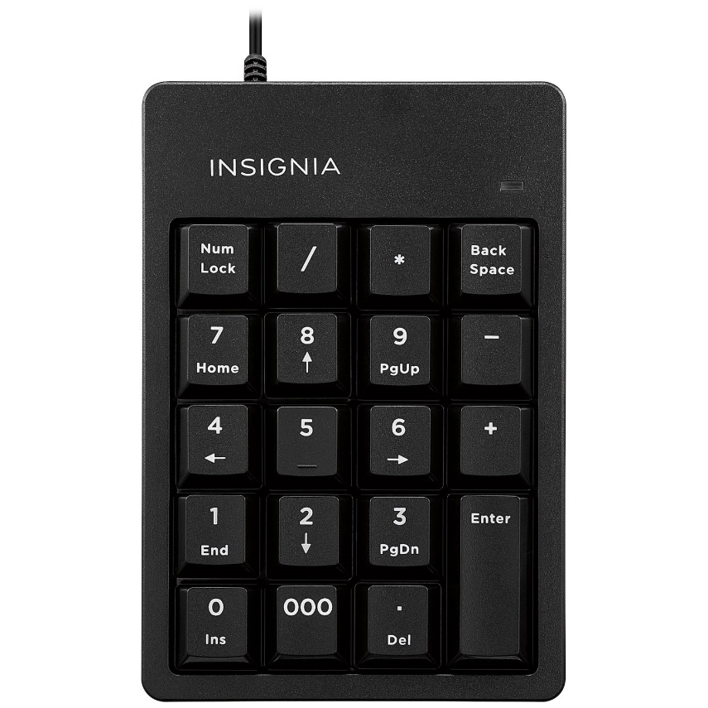


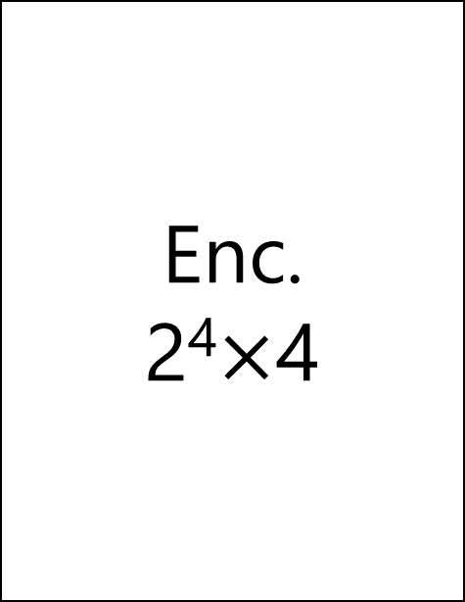
Enc.
2⁴$×$4
Binary Number
BCD
Excess-3
Aiken
Gray
…
. . .
. . .
0
0

Slide 141
Combinational Logic
Display Decoder

Slide 142
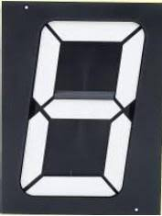
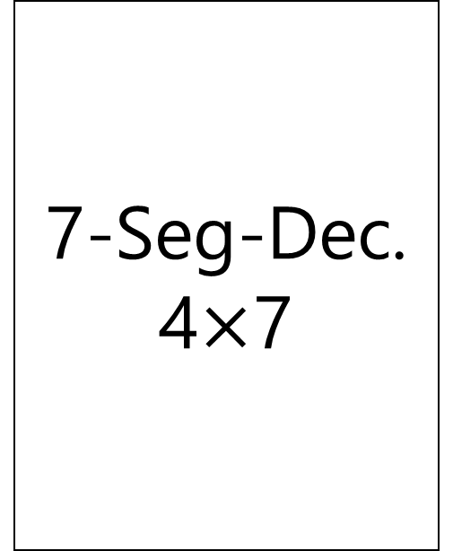
7-Seg-Dec.
4$×$7
Binary Number
BCD
Excess-3
Aiken
Gray
…
A
B
C
D

Slide 143
7-Seg-Dec.
4$×$7
Binary Number
BCD
Excess-3
Aiken
Gray
…
A
B
C
D

Slide 144
7-Seg-Dec.
4$×$7
Binary Number
BCD
Excess-3
Aiken
Gray
…
A
B
C
D

Slide 145
7-Seg-Dec.
4$×$7
Binary Number
BCD
Excess-3
Aiken
Gray
…
A
B
C
D

Slide 146
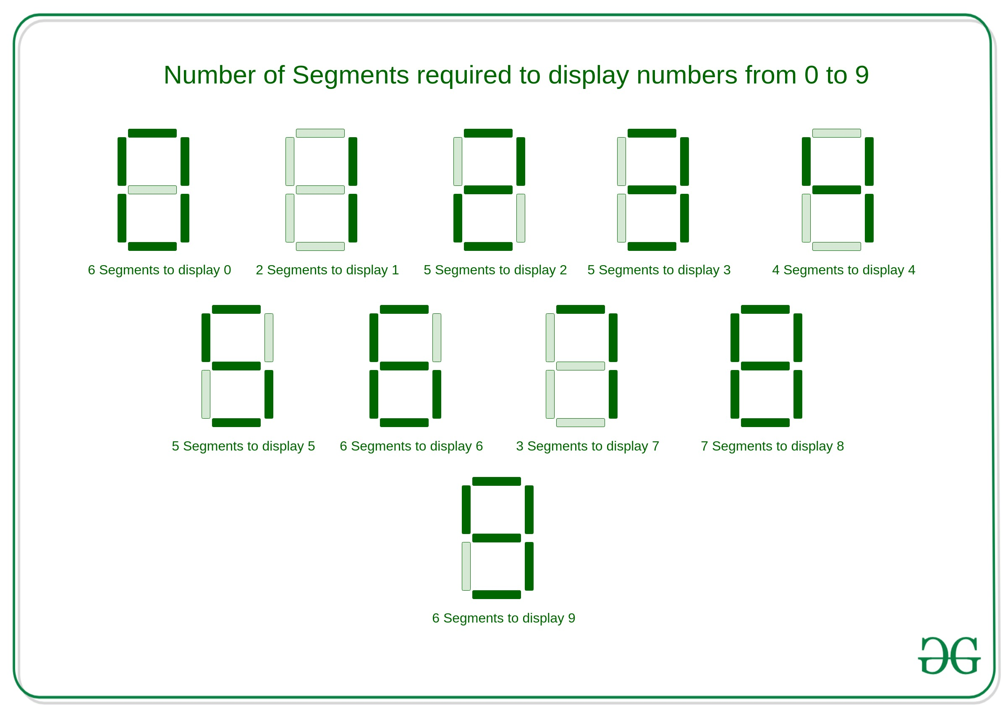
7-Seg-Dec.
4$×$7
a
Binary Number
BCD
Excess-3
Aiken
Gray
…
a
b
c
d
e
f
g
A
f
b
B
g
C
e
c
D
d

Slide 147
7-Seg-Dec.
4$×$7
Binary Number
a
0
a=1
b=1
c=1
d=1
e=1
f=1
g=0
0
f
b
g
0
e
c
0
d

Slide 148
7-Seg-Dec.
4$×$7
Binary Number
a
0
a=0
b=1
c=1
d=0
e=0
f=1
g=1
0
f
b
g
1
e
c
0
d

Slide 149
7-Seg-Dec.
4$×$7
Binary Number
a=x
b=x
c=x
d=x
e=x
f=x
g=x
1
1
1
1
From 10 to 15, don’t care conditions!

Slide 150
7-Seg-Dec.
4$×$7
Excess-3
a
0
a=1
b=1
c=1
d=1
e=1
f=1
g=0
0
f
b
g
1
e
c
1
d

Slide 151
7-Seg-Dec.
4$×$7
Excess-3
a
1
a=0
b=1
c=1
d=0
e=0
f=1
g=1
1
f
b
g
1
e
c
0
d

Slide 152
7-Seg-Dec.
4$×$7
Excess-3
a=x
b=x
c=x
d=x
e=x
f=x
g=x
0
0
0
0
0,1,2,13,14,15, don’t care conditions!

Slide 153
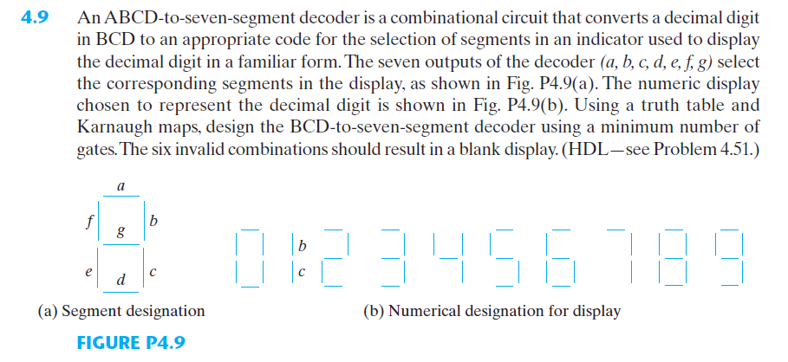

Slide 154
Combinational Logic
Binary Code Arithmetic

Slide 155
Combinational Logic
BCD Adder
Book: Page 144-146

