Slide 1


Sequential Logic

Slide 2

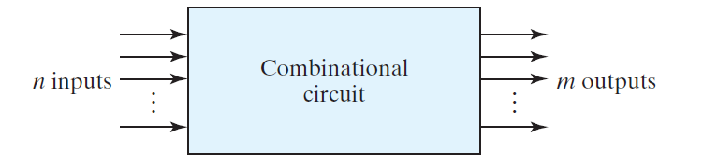
Feedback

Slide 3
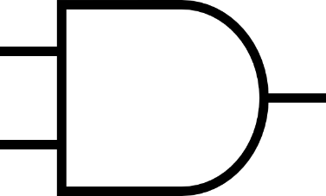
Voltage
Y
X
X
F
Y
Time

Slide 4
Voltage
Y
X
X
F(Y,X;T+1) = XYF(Y,X;T)
F
Y
Time

Slide 5
Voltage
Y
X
X
F(Y,X;T+1) = XYF(Y,X;T) ; F(Y,X;0) = 0
F
Y
Time
by default in positive logic

Slide 6
Voltage
Y
X
X
F(Y,X;T+1) = XYF(Y,X;T) ; F(Y,X;0) = 0
F
Y
Time

Slide 7
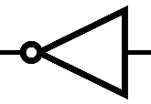
Voltage
Y
X
X
F
Y
Time
F(Y,X;T+1) = XYF’(Y,X;T) ; F(Y,X;0) = 0

Slide 8
Voltage
Y
X
Δt: XYF’(0)=110’=111=1
X
F
Δt
Y
Time
F(Y,X;T+1) = XYF’(Y,X;T) ; F(Y,X;0) = 0

Slide 9
Voltage
Y
X
2×Δt: XYF’₁=111’=110=0
X
F
Δt
Y
Time
F(Y,X;T+1) = XYF’(Y,X;T) ; F(Y,X;0) = 0

Slide 10
Voltage
Y
X
3×Δt: XYF’₂=100’=101=0
X
F
Δt
Y
Time
F(Y,X;T+1) = XYF’(Y,X;T) ; F(Y,X;0) = 0

Slide 11
Voltage
Y
X
4×Δt: XYF’₃=000’=001=0
X
F
Δt
Y
Time
F(Y,X;T+1) = XYF’(Y,X;T) ; F(Y,X;0) = 0

Slide 12
Voltage
Y
X
?
X
F
Δt
Y
Time
F(Y,X;T+1) = XYF’(Y,X;T) ; F(Y,X;0) = 0

Slide 13
Voltage
Y
X
X
F
Δt
Y
Time
F(Y,X;T+1) = XYF’(Y,X;T) ; F(Y,X;0) = 0

Slide 14
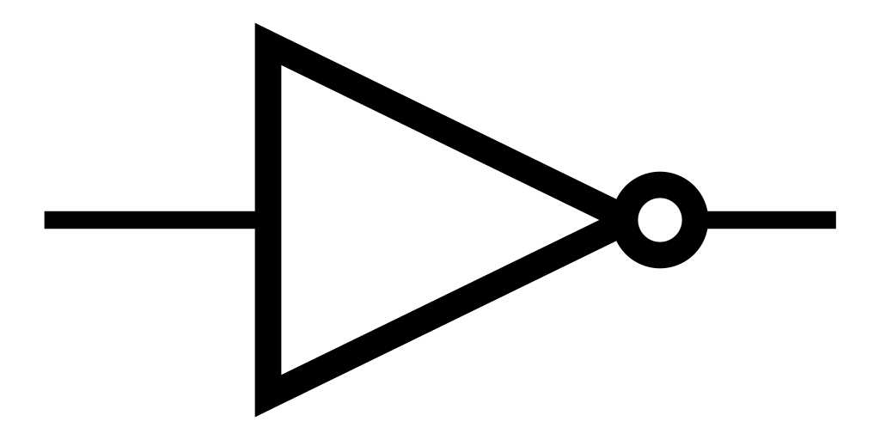
1
1
By feedback we can memorize 1

Slide 15
0
0
By feedback we can memorize 0

Slide 16
X
This design is logically incorrect! Why?

Slide 17
X
This design is logically incorrect! Why?
Buffer gate accepts one input.
We have two inputs: X and X_{T-1}

Slide 18
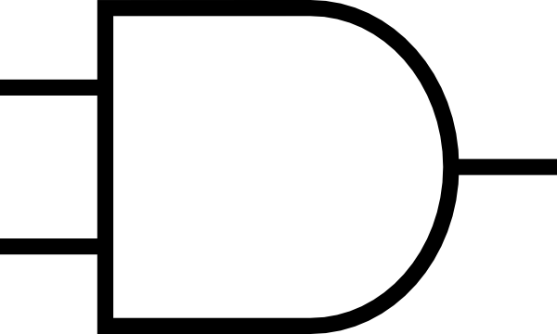
X
This design is logically correct!
But what’s the problem?

Slide 19
X
This design is also logically correct!
But what’s the problem?

Slide 20
X
F₁
F₂
Y

Slide 21
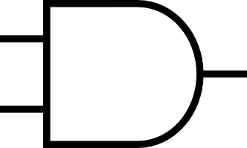
X=0
F₁
F₂
Y=0
Y | X | F₁(T+1) | F₂(T+1)
0 | 0

Slide 22
X=0
F₁
F₂(T)
F₁(T)
F₂
Y=0
Y | X | F₁(T+1) | F₂(T+1)
0 | 0

Slide 23
X=0
0
F₁
F₂(T)
F₁(T)
F₂
Y=0
0
Y | X | F₁(T+1) | F₂(T+1)
0 | 0 | 0 | 0

Slide 24
F₂(T)
X=1
F₁
F₂(T)
F₁(T)
F₂
Y=0
0
Y | X | F₁(T+1) | F₂(T+1)
0 | 0 | 0 | 0
0 | 1 | F₂(T) | 0

Slide 25
0
X=0
F₁
F₂(T)
F₁(T)
F₂
Y=1
F₁(T)
Y | X | F₁(T+1) | F₂(T+1)
0 | 0 | 0 | 0
0 | 1 | F₂(T) | 0
1 | 0 | 0 | F₁(T)

Slide 26
F₂(T)
X=1
F₁(T+1)
F₂(T)
F₁(T)
F₂(T+1)
Y=1
F₁(T)
Y | X | F₁(T+1) | F₂(T+1)
0 | 0 | 0 | 0
0 | 1 | F₂(T) | 0
1 | 0 | 0 | F₁(T)
1 | 1 | F₂(T) | F₁(T)

Slide 27
X=1
F₁(T+1)
F₂(T)
F₁(T)
F₂(T+1)
Y=1
When it goes to 00 state, never recover to 1!
Y | X | F₁(T+1) | F₂(T+1)
0 | 0 | 0 | 0
0 | 1 | F₂(T) | 0
1 | 0 | 0 | F₁(T)
1 | 1 | F₂(T) | F₁(T)

Slide 28
X=1
F₁(T+1)
F₂(T)
F₁(T)
F₂(T+1)
Y=1
When it goes to 00 state, never recover to 1!
Y | X | F₁(T+1) | F₂(T+1)
0 | 0 | 0 | 0
0 | 1 | 0 | 0
1 | 0 | 0 | 0
1 | 1 | 0 | 0

Slide 29
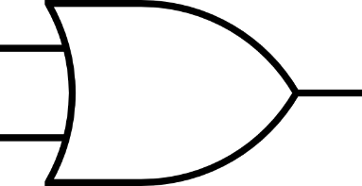
X
F₁(T+1)
F₂(T)
F₁(T)
F₂(T+1)
Y
How about OR gates? Do they solve the problem?
Y | X | F₁(T+1) | F₂(T+1)
0 | 0
0 | 1
1 | 0
1 | 1

Slide 30
X
F₁(T+1)
F₂(T)
F₁(T)
F₂(T+1)
Y
How about OR gates? Do they solve the problem? No! Why?
Y | X | F₁(T+1) | F₂(T+1)
0 | 0
0 | 1
1 | 0
1 | 1

Slide 31
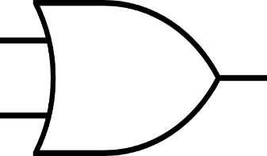
X
F₁(T+1)
F₂(T)
F₁(T)
F₂(T+1)
Y
How about NOR gates? Do they solve the problem?
Y | X | F₁(T+1) | F₂(T+1)
0 | 0
0 | 1
1 | 0
1 | 1

Slide 32
X=0
F’₂(T)
F₁(T+1)
F₂(T)
F₁(T)
F₂(T+1)
Y=0
F’₁(T)
How about NOR gates? Do they solve the problem?
Y | X | F₁(T+1) | F₂(T+1)
0 | 0 | F’₂(T) | F’₁(T)
0 | 1
1 | 0
1 | 1

Slide 33
X=1
0
F₁(T+1)
F₂(T)
F₁(T)
F₂(T+1)
Y=0
F’₁(T)
How about NOR gates? Do they solve the problem?
Y | X | F₁(T+1) | F₂(T+1)
0 | 0 | F’₂(T) | F’₁(T)
0 | 1 | 0 | F’₁(T)
1 | 0
1 | 1

Slide 34
X=0
F’₂(T)
F₁(T+1)
F₂(T)
F₁(T)
F₂(T+1)
Y=1
0
How about NOR gates? Do they solve the problem?
Y | X | F₁(T+1) | F₂(T+1)
0 | 0 | F’₂(T) | F’₁(T)
0 | 1 | 0 | F’₁(T)
1 | 0 | F’₂(T) | 0
1 | 1

Slide 35
X=1
0
F₁(T+1)
F₂(T)
F₁(T)
F₂(T+1)
Y=1
0
How about NOR gates? Do they solve the problem?
Y | X | F₁(T+1) | F₂(T+1)
0 | 0 | F’₂(T) | F’₁(T)
0 | 1 | 0 | F’₁(T)
1 | 0 | F’₂(T) | 0
1 | 1 | 0 | 0

Slide 36
X
F₁(T+1)
F₂(T)
F₁(T)
F₂(T+1)
Y
Seems working. But we have to check all possible current states?
Y | X | F₁(T+1) | F₂(T+1)
0 | 0 | F’₂(T) | F’₁(T)
0 | 1 | 0 | F’₁(T)
1 | 0 | F’₂(T) | 0
1 | 1 | 0 | 0

Slide 37
X
F₁(T+1)
F₂(T)
F₁(T)
F₂(T+1)
Y
Current State
Next State
Y | X | F₁(T) | F₂(T) | F₁(T+1) | F₂(T+1)
0 | 0 | 0 | 0 | F’₂(T) | F’₁(T)
0 | 1 |  |  | 0 | F’₁(T)
1 | 0 |  |  | F’₂(T) | 0
1 | 1 |  |  | 0 | 0

Slide 38
X
F₁(T+1)
F₂(T)
F₁(T)
F₂(T+1)
Y
Current State
Next State
Y | X | F₁(T) | F₂(T) | F₁(T+1) | F₂(T+1)
0 | 0 | 0 | 0 | 1 | 1
0 | 1 |  |  | 0 | 1
1 | 0 |  |  | 1 | 0
1 | 1 |  |  | 0 | 0

Slide 39
X=1
F₁(T+1)
F₂(T)
F₁(T)
F₂(T+1)
Y=0
Reset Action
Reset State
Y | X | F₁(T) | F₂(T) | F₁(T+1) | F₂(T+1)
0 | 0 | 0 | 0 | 1 | 1
0 | 1 |  |  | 0 | 1
1 | 0 |  |  | 1 | 0
1 | 1 |  |  | 0 | 0

Slide 40
X=0
F₁(T+1)
F₂(T)
F₁(T)
F₂(T+1)
Y=1
Set Action
Set State
Y | X | F₁(T) | F₂(T) | F₁(T+1) | F₂(T+1)
0 | 0 | 0 | 0 | 1 | 1
0 | 1 |  |  | 0 | 1
1 | 0 |  |  | 1 | 0
1 | 1 |  |  | 0 | 0

Slide 41
X
F₁(T+1)
F₂(T)
F₁(T)
F₂(T+1)
Y
F₁ = F’₂
Y | X | F₁(T) | F₂(T) | F₁(T+1) | F₂(T+1)
0 | 0 | 0 | 0 | 1 | 1
0 | 1 |  |  | 0 | 1
1 | 0 |  |  | 1 | 0
1 | 1 |  |  | 0 | 0

Slide 42
X
F₁(T+1)
F₂(T)
F₁(T)
F₂(T+1)
Y
Current State
Next State
Y | X | F₁(T) | F₂(T) | F₁(T+1) | F₂(T+1)
0 | 0 | 1 | 1 | F’₂(T) | F’₁(T)
0 | 1 |  |  | 0 | F’₁(T)
1 | 0 |  |  | F’₂(T) | 0
1 | 1 |  |  | 0 | 0

Slide 43
X
F₁(T+1)
F₂(T)
F₁(T)
F₂(T+1)
Y
Current State
Next State
Y | X | F₁(T) | F₂(T) | F₁(T+1) | F₂(T+1)
0 | 0 | 1 | 1 | 0 | 0
0 | 1 |  |  | 0 | 0
1 | 0 |  |  | 0 | 0
1 | 1 |  |  | 0 | 0

Slide 44
X
F₁(T+1)
F₂(T)
F₁(T)
F₂(T+1)
Y
Default State
Y | X | F₁(T) | F₂(T) | F₁(T+1) | F₂(T+1)
0 | 0 | 1 | 1 | 0 | 0
0 | 1
1 | 0
1 | 1

Slide 45
X
F₁(T+1)
F₂(T)
F₁(T)
F₂(T+1)
Y
Current State
Next State
Y | X | F₁(T) | F₂(T) | F₁(T+1) | F₂(T+1)
0 | 0 | 1 | 0 | F’₂(T) | F’₁(T)
0 | 1 |  |  | 0 | F’₁(T)
1 | 0 |  |  | F’₂(T) | 0
1 | 1 |  |  | 0 | 0

Slide 46
X
F₁(T+1)
F₂(T)
F₁(T)
F₂(T+1)
Y
Set State
Y | X | F₁(T) | F₂(T) | F₁(T+1) | F₂(T+1)
0 | 0 | 1 | 0 | F’₂(T) | F’₁(T)
0 | 1 |  |  | 0 | F’₁(T)
1 | 0 |  |  | F’₂(T) | 0
1 | 1 |  |  | 0 | 0

Slide 47
X
F₁(T+1)
F₂(T)
F₁(T)
F₂(T+1)
Y
Current State
Next State
Y | X | F₁(T) | F₂(T) | F₁(T+1) | F₂(T+1)
0 | 0 | 1 | 0 | 1 | 0
0 | 1 |  |  | 0 | 0
1 | 0 |  |  | 1 | 0
1 | 1 |  |  | 0 | 0

Slide 48
X
F₁(T+1)
F₂(T)
F₁(T)
F₂(T+1)
Y
Store/Hold
Y | X | F₁(T) | F₂(T) | F₁(T+1) | F₂(T+1)
0 | 0 | 1 | 0 | 1 | 0
0 | 1 |  |  | 0 | 0
1 | 0 |  |  | 1 | 0
1 | 1 |  |  | 0 | 0

Slide 49
X
F₁(T+1)
F₂(T)
F₁(T)
F₂(T+1)
Y
Set Action
Y | X | F₁(T) | F₂(T) | F₁(T+1) | F₂(T+1)
0 | 0 | 1 | 0 | 1 | 0
0 | 1 |  |  | 0 | 0
1 | 0 |  |  | 1 | 0
1 | 1 |  |  | 0 | 0

Slide 50
X
F₁(T+1)
F₂(T)
F₁(T)
F₂(T+1)
Y
Reset Action
F₁ ≠ F’₂
Y | X | F₁(T) | F₂(T) | F₁(T+1) | F₂(T+1)
0 | 0 | 1 | 0 | 1 | 0
0 | 1 |  |  | 0 | 0
1 | 0 |  |  | 1 | 0
1 | 1 |  |  | 0 | 0

Slide 51
X
F₁(T+1)
F₂(T)
F₁(T)
F₂(T+1)
Y
Reset Action
F₁ = F’₂
Y | X | F₁(T) | F₂(T) | F₁(T+1) | F₂(T+1) | F₁(T+2) | F₂(T+2)
0 | 0 | 1 | 0 | 1 | 0 | 1 | 0
0 | 1 |  |  | 0 | 0 | 0 | 1
1 | 0 |  |  | 1 | 0 | 1 | 0
1 | 1 |  |  | 0 | 0 | 0 | 0

Slide 52
X
F₁(T+1)
F₂(T)
F₁(T)
F₂(T+1)
Y
Current State
Next State
Y | X | F₁(T) | F₂(T) | F₁(T+2) | F₂(T+2)
0 | 0 | 1 | 0 | 1 | 0
0 | 1 |  |  | 0 | 1
1 | 0 |  |  | 1 | 0
1 | 1 |  |  | 0 | 0

Slide 53
X
F₁(T+1)
F₂(T)
F₁(T)
F₂(T+1)
Y
Current State
Next State
Y | X | F₁(T) | F₂(T) | F₁(T+1) | F₂(T+1)
0 | 0 | 0 | 1 | F’₂(T) | F’₁(T)
0 | 1 |  |  | 0 | F’₁(T)
1 | 0 |  |  | F’₂(T) | 0
1 | 1 |  |  | 0 | 0

Slide 54
X
F₁(T+1)
F₂(T)
F₁(T)
F₂(T+1)
Y
Reset State
Y | X | F₁(T) | F₂(T) | F₁(T+1) | F₂(T+1)
0 | 0 | 0 | 1 | F’₂(T) | F’₁(T)
0 | 1 |  |  | 0 | F’₁(T)
1 | 0 |  |  | F’₂(T) | 0
1 | 1 |  |  | 0 | 0

Slide 55
X
F₁(T+1)
F₂(T)
F₁(T)
F₂(T+1)
Y
Store/Hold
Y | X | F₁(T) | F₂(T) | F₁(T+1) | F₂(T+1)
0 | 0 | 0 | 1 | 0 | 1
0 | 1 |  |  | 0 | 1
1 | 0 |  |  | 0 | 0
1 | 1 |  |  | 0 | 0

Slide 56
X
F₁(T+1)
F₂(T)
F₁(T)
F₂(T+1)
Y
Reset Action
Y | X | F₁(T) | F₂(T) | F₁(T+1) | F₂(T+1)
0 | 0 | 0 | 1 | 0 | 1
0 | 1 |  |  | 0 | 1
1 | 0 |  |  | 0 | 0
1 | 1 |  |  | 0 | 0

Slide 57
X
F₁(T+1)
F₂(T)
F₁(T)
F₂(T+1)
Y
Set Action
Y | X | F₁(T) | F₂(T) | F₁(T+1) | F₂(T+1)
0 | 0 | 0 | 1 | 0 | 1
0 | 1 |  |  | 0 | 1
1 | 0 |  |  | 0 | 0
1 | 1 |  |  | 0 | 0

Slide 58
X
F₁(T+1)
F₂(T)
F₁(T)
F₂(T+1)
Y
Set Action
Y | X | F₁(T) | F₂(T) | F₁(T+1) | F₂(T+1) | F₁(T+2) | F₂(T+2)
0 | 0 | 0 | 1 | 0 | 1 | 0 | 1
0 | 1 |  |  | 0 | 1 | 0 | 1
1 | 0 |  |  | 0 | 0 | 1 | 0
1 | 1 |  |  | 0 | 0 | 0 | 0

Slide 59
X
F₁(T+1)
F₂(T)
F₁(T)
F₂(T+1)
Y
Current State
Next State
Y | X | F₁(T) | F₂(T) | F₁(T+2) | F₂(T+2)
0 | 0 | 0 | 1 | 0 | 1
0 | 1 | 0 | 1 | 0 | 1
1 | 0 | 0 | 1 | 1 | 0
1 | 1 | 0 | 1 | 0 | 0

Slide 60
Recap

Slide 61
X
F₁(T+1)
F₂(T)
F₁(T)
F₂(T+1)
Y
Current State
Next State
Y | X | F₁(T) | F₂(T) | F₁(T+1) | F₂(T+1)
0 | 0 | 0 | 0 | 1 | 1
0 | 1 |  |  | 0 | 1
1 | 0 |  |  | 1 | 0
1 | 1 |  |  | 0 | 0

Slide 62
X
F₁(T+1)
F₂(T)
F₁(T)
F₂(T+1)
Y
Current State
Next State
Y | X | F₁(T) | F₂(T) | F₁(T+1) | F₂(T+1)
0 | 0 | 1 | 1 | 0 | 0
0 | 1 |  |  | 0 | 0
1 | 0 |  |  | 0 | 0
1 | 1 |  |  | 0 | 0

Slide 63
X
F₁(T+1)
F₂(T)
F₁(T)
F₂(T+1)
Y
Y | X | F₁(T) | F₂(T) | F₁(T+1) | F₂(T+1) | F₁(T+2) | F₂(T+2)
0 | 0 | 1 | 1 | 0 | 0 | 1 | 1
0 | 1 |  |  |  |  | 0 | 1
1 | 0 |  |  |  |  | 1 | 0
1 | 1 |  |  |  |  | 0 | 0

Slide 64
X
F₁(T+1)
F₂(T)
F₁(T)
F₂(T+1)
Y
Current State
Next State
Y | X | F₁(T) | F₂(T) | F₁(T+2) | F₂(T+2)
0 | 0 | 1 | 0 | 1 | 0
0 | 1 |  |  | 0 | 1
1 | 0 |  |  | 1 | 0
1 | 1 |  |  | 0 | 0

Slide 65
X
F₁(T+1)
F₂(T)
F₁(T)
F₂(T+1)
Y
Current State
Next State
Y | X | F₁(T) | F₂(T) | F₁(T+2) | F₂(T+2)
0 | 0 | 0 | 1 | 0 | 1
0 | 1 |  |  | 0 | 1
1 | 0 |  |  | 1 | 0
1 | 1 |  |  | 0 | 0

Slide 66
X
F₁(T+1)
F₂(T)
F₁(T)
F₂(T+1)
Y
Y | X | F₁(T+2) | F₂(T+2)
0 | 0 | F₁(T) | F₂(T)
0 | 1 | 0 | 1
1 | 0 | 1 | 0
1 | 1 | X | X

Slide 67
X=R
F₁(T+2)=Q
F₂(T)
F₁(T)
F₂₂(T+2)=Q’
Y=S
Y=S | X=R | F₁(T+2)=Q | F₂(T+2)=Q’
0 | 0 | Q_{t} | Q’_{t}
0 | 1 | 0 | 1
1 | 0 | 1 | 0
1 | 1 | X | X

Slide 68
R
Q
Q’
S
S | R | Q | Q’
0 | 0 | Q_{t} | Q’_{t}
0 | 1 | 0 | 1
1 | 0 | 1 | 0
1 | 1 | X | X

Slide 69
R
Q
Q’
S
S | R | Q | Q’
0 | 0 | Q_{t} | Q’_{t}
0 | 1 | 0 | 1
1 | 0 | 1 | 0
1 | 1 | X | X

Slide 70
R
S
S | R | Q | Q’
0 | 0 | Q_{t} | Q’_{t}
0 | 1 | 0 | 1
1 | 0 | 1 | 0
1 | 1 | X | X

Slide 71
Voltage
R
S
R
S
Time

Slide 72
Voltage
R
S
R
S
Time

Slide 73
Voltage
R
S
R
S
Time

Slide 74
Voltage
R
S
R
S
Time
Set Action

Slide 75
Voltage
R
S
R
S
Time
Store

Slide 76
Voltage
R
S
R
S
Time
Reset Action

Slide 77
Voltage
R
S
R
S
Time
Forbidden

Slide 78
Voltage
R
S
R
S
Time
Set Action

Slide 79
Voltage
R
S
R
S
Time
Store Action

Slide 80
Voltage
R
S
R
S
Time
Reset Action

Slide 81
Voltage
R
S
R
S
Time
Forbidden

Slide 82
Voltage
R
S
R
S
Time
Set Action

Slide 83
Voltage
R
S
R
S
Time
Store Action

Slide 84
Voltage
R
S
R
S
Time
Reset Action

Slide 85
Voltage
R
S
R
S
Time
Store Action

