Slide 1


Sequential Logic

Slide 2
Student Evaluations of Teaching (SET)
UWinsite Student
Thursday, November 26 – Wednesday, December 9, 2020
http://ask.uwindsor.ca/app/answers/detail/a_id/176

Slide 3
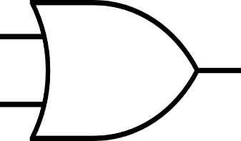
X
F₁(T+1)
F₂(T)
F₁(T)
F₂(T+1)
Y
Y | X | F₁(T+1) | F₂(T+1)
0 | 0 | F’₂(T) | F’₁(T)
0 | 1 | 0 | F’₁(T)
1 | 0 | F’₂(T) | 0
1 | 1 | 0 | 0

Slide 4
X
F₁(T+2)
F₂(T+1)
F₁(T+1)
F₂(T+2)
Y
Y | X | F₁(T+2) | F₂(T+2)
0 | 0 | F’₂(T+1) | F’₁(T+1)
0 | 1 | 0 | F’₁(T+1)
1 | 0 | F’₂(T+1) | 0
1 | 1 | 0 | 0

Slide 5
X
F₁(T+2)
F₂(T)
F₁(T)
F₂(T+2)
Y
Y | X | F₁(T+1) | F₂(T+1) | F₁(T+2) | F₂(T+2)
0 | 0 | F’₂(T) | F’₁(T) | F’₂(T+1) = F₁(T) | F’₁(T+1)=F₂(T)
0 | 1 | 0 | F’₁(T) | 0 | F’₁(T+1)=1
1 | 0 | F’₂(T) | 0 | F’₂(T+1)=1 | 0
1 | 1 | 0 | 0 | 0 | 0

Slide 6
X
F₁(T+2)
F₂(T+2)
Y
Y | X | F₁(T+2) | F₂(T+2)
0 | 0 | F₁(T) | F₂(T)
0 | 1 | 0 | 1
1 | 0 | 1 | 0
1 | 1 | 0 | 0

Slide 7
X=R
F₁(T+2)=Q
F₂(T+2)=Q’
Y=S
Y=S | X=R | F₁(T+2)=Q | F₂(T+2)=Q’
0 | 0 | Q_{t} | Q’_{t}
0 | 1 | 0 | 1
1 | 0 | 1 | 0
1 | 1 | X | X

Slide 8
R
Q
Q’
S
S | R | Q | Q’
0 | 0 | Q_{t} | Q’_{t}
0 | 1 | 0 | 1
1 | 0 | 1 | 0
1 | 1 | X | X

Slide 9
R
Q
Q’
S
S | R | Q | Q’
0 | 0 | Q_{t} | Q’_{t}
0 | 1 | 0 | 1
1 | 0 | 1 | 0
1 | 1 | X | X

Slide 10
R
S
S | R | Q | Q’
0 | 0 | Q_{t} | Q’_{t}
0 | 1 | 0 | 1
1 | 0 | 1 | 0
1 | 1 | X | X

Slide 11
Voltage
R
S
R
S
Time

Slide 12
S and R control how the state changes.

Slide 13
SR Latch

Slide 14
Put a control on when change applies
SR w/ enable input

Slide 15
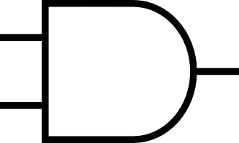
R
R
E
S
S
E | S | R | S | R | Q | Q’
0 | X | X | 0 | 0 | Q_{t} | Q’_{t}
1 | 0 | 0 | 0 | 0 | Q_{t} | Q’_{t}
1 | 0 | 1 | 0 | 1 | 0 | 1
1 | 1 | 0 | 1 | 0 | 1 | 0
1 | 1 | 1 | 1 | 1 | X | X

Slide 16
R
SR Latch
R
S
S
E

Slide 17
Voltage
E
R
S
R
Latch
S
E
Time

Slide 18
Voltage
E
R
S
R
Latch
S
Default 0 state, regardless of the R,S
E
Time

Slide 19
Voltage
E
R
S
R
Now, E=1, so we check R,S: Set Action
Latch
S
E
Time

Slide 20
Voltage
E
R
S
R
Regardless of R,S, Store
Latch
S
E
Time

Slide 21
Voltage
E
R
S
R
E=1, so we check R,S: Forbidden
Latch
S
E
Time

Slide 22
Voltage
E
R
S
R
Regardless of R,S, Store
Latch
S
E
Time

Slide 23
Voltage
E
R
S
R
Latch
S
E
Time

Slide 24
Voltage
E
R
S
R
Latch
S
E
Time

Slide 25
Voltage
E
R
S
R
Store
Latch
S
E
Time

Slide 26
Voltage
E
R
S
R
Latch
S
E
Time

Slide 27
Voltage
E
R
S
Reset Action
R
Latch
S
E
Time

Slide 28
Voltage
E
R
S
Forbidden
R
Latch
S
E
Time

Slide 29
Voltage
E
R
S
R
Latch
S
E
Time

Slide 30
Voltage
E
R
S
R
Latch
S
E
Time

Slide 31
Voltage
E
R
S
R
Latch
S
E
Time

Slide 32
Voltage
E
R
S
R
Latch
S
E
Time

Slide 33
Voltage
E
R
S
R
Latch
S
E
Time

Slide 34
Clock
shortened as clk
timing device that generates a train of pulses

Slide 35
One period is called pulse!

Slide 36
Clock
shortened as clk
Synchronize all the memory units
when to work

Slide 37
Clock
Positive Level (default)

Slide 38
R
SR Latch
Active High
R
S
S
E

Slide 39
Clock
Negative Level

Slide 40
R
SR Latch
Active Low
R
S
S
E

Slide 41
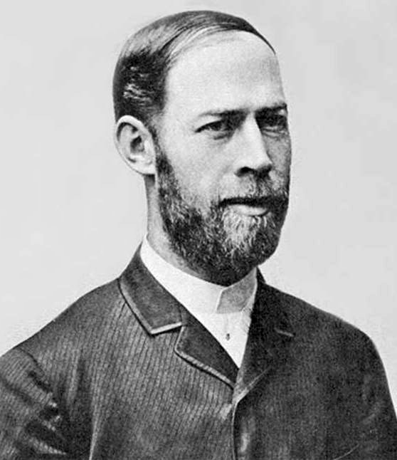
Clock
Frequency (Hz)
Heinrich Rudolf Hertz
A Metric for Speed
Notes:
electromagnetic waves

Slide 42
How many pulse in 1 sec?

Slide 43
1 sec
1 Hertz (Hz)
2 Hertz (Hz)
~3 Hertz (Hz)
How many pulse in 1 sec?

Slide 44
1 sec
1/1= 1 sec
1/2= 0.5 sec
1/3 ~ 0.3 sec
How long is one pulse?
1/freq. (Hz)

Slide 45
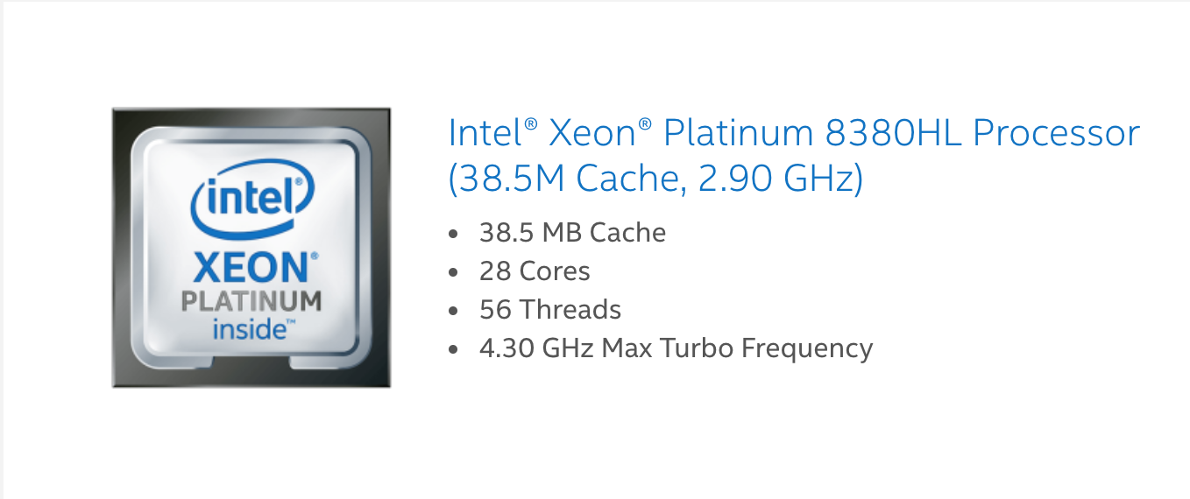
1,000,000,000 (one billion) Hz (hertz)
1,000,000,000 (one billion) pulse per sec!

Slide 46
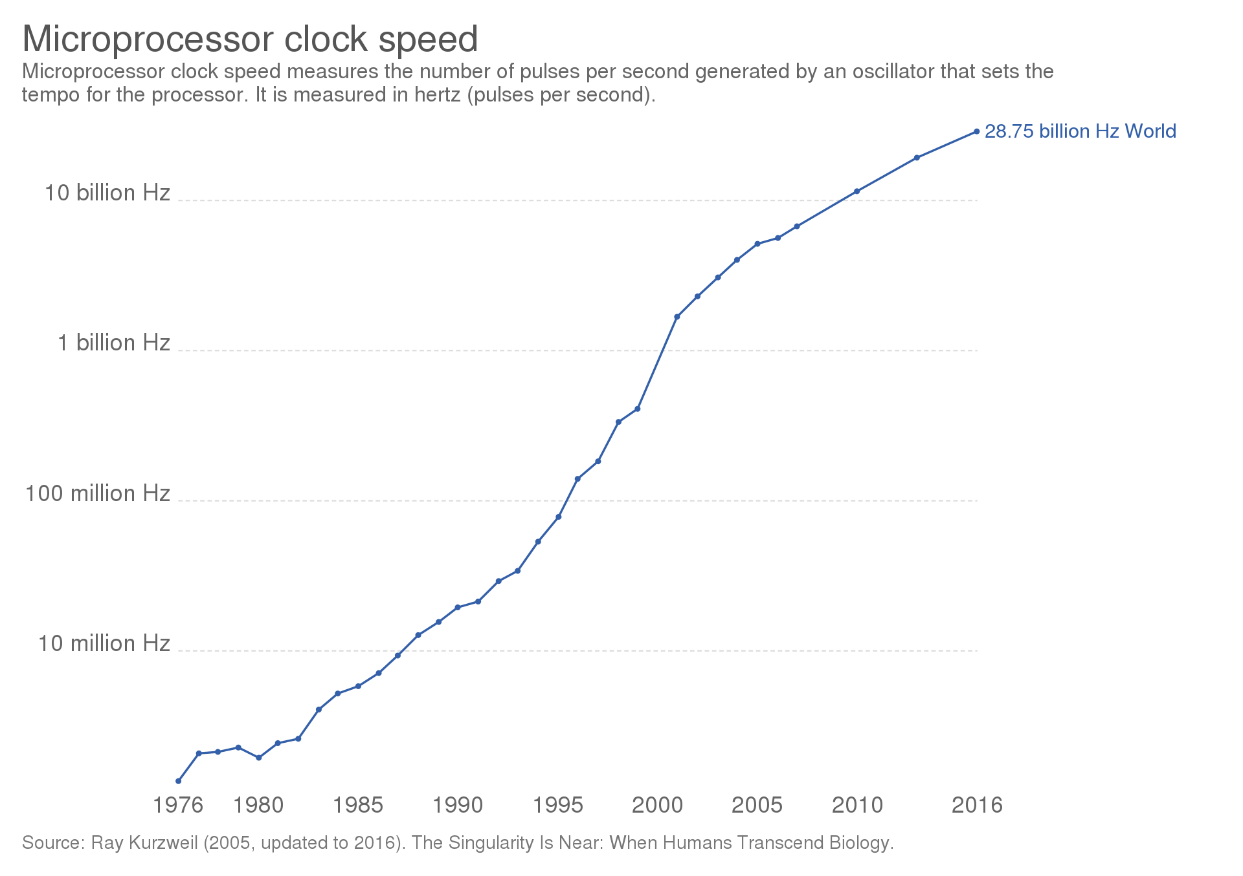
https://en.wikipedia.org/wiki/Clock_rate

Slide 47
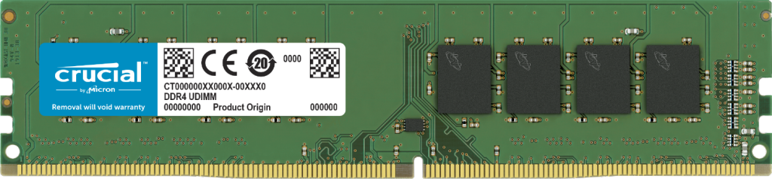
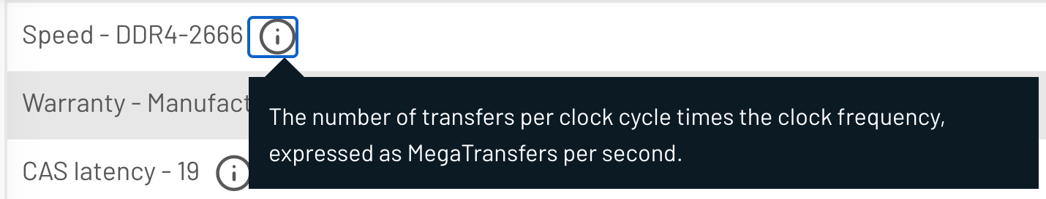

Slide 48
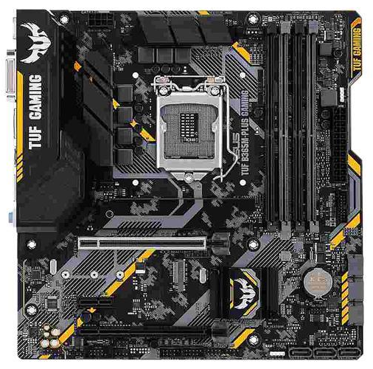
CPU: X Hz
Memory: Y Hz
Mainboard (BUS): Z Hz
Final Speed?

Slide 49
CPU: X Hz
Memory: Y Hz
Mainboard (BUS): Z Hz
At market:
X > Y = Z
X=2.9GHz
Y=Z= 2.6GHz

Slide 50
CPU: X Hz
Memory: Y Hz
Mainboard (BUS): Z Hz
Final Speed:
CPU internal: X
CPU external ←→ Memory
Y=Z= 2.6GHz
Overclock?

Slide 51
SR Latch
NAND

Slide 52
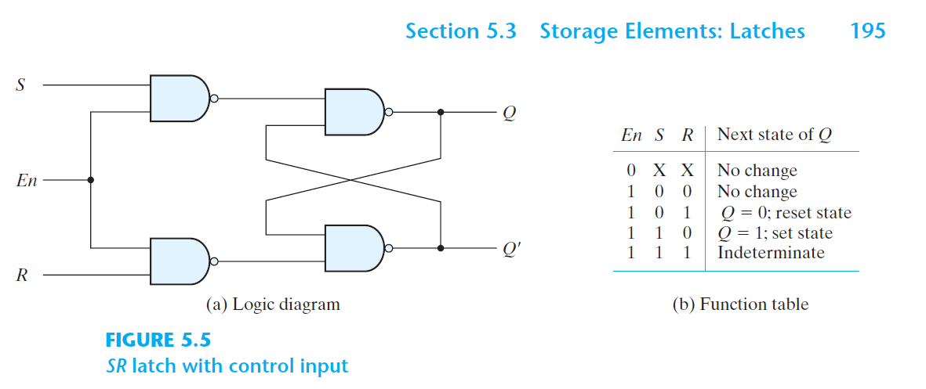

Slide 54
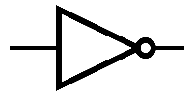
X
R
SR Latch
R
S
S
E

Slide 55
X
R
SR Latch
R
S
S
E
X | E | S | R | Q | Q’
0 | 0 | X | X | Q_{t} | Q’_{t}
1 | 0 | X | X | Q_{t} | Q’_{t}
0 | 1 | 1 | 0 | 1 | 0
1 | 1 | 0 | 1 | 0 | 1
Never happens |  | 1 | 1 | X | X

Slide 56
X=0
R=0
1
R
S=1
S
E
X | E | S | R | Q | Q’
0 | 0 | X | X | Q_{t} | Q’_{t}
1 | 0 | X | X | Q_{t} | Q’_{t}
0 | 1 | 1 | 0 | 1 | 0
1 | 1 | 0 | 1 | 0 | 1
Never happens |  | 1 | 1 | X | X

Slide 57
X=1
R=1
0
R
S=0
S
E
X | E | S | R | Q | Q’
0 | 0 | X | X | Q_{t} | Q’_{t}
1 | 0 | X | X | Q_{t} | Q’_{t}
0 | 1 | 1 | 0 | 1 | 0
1 | 1 | 0 | 1 | 0 | 1
Never happens |  | 1 | 1 | X | X

Slide 58
R
SR Latch
R
X
S
S
E

Slide 59
R
SR Latch
R
X
S
S
E
X | E | S | R | Q | Q’
0 | 0 | X | X | Q_{t} | Q’_{t}
1 | 0 | X | X | Q_{t} | Q’_{t}
0 | 1 | 0 | 1 | 0 | 1
1 | 1 | 1 | 0 | 1 | 0
Never happens |  | 1 | 1 | X | X

Slide 60
R=1
0
R
X=0
S=0
S
E
X | E | S | R | Q | Q’
0 | 0 | X | X | Q_{t} | Q’_{t}
1 | 0 | X | X | Q_{t} | Q’_{t}
0 | 1 | 0 | 1 | 0 | 1
1 | 1 | 1 | 0 | 1 | 0
Never happens |  | 1 | 1 | X | X

Slide 61
R=0
1
R
X=1
S=1
S
E
X | E | S | R | Q | Q’
0 | 0 | X | X | Q_{t} | Q’_{t}
1 | 0 | X | X | Q_{t} | Q’_{t}
0 | 1 | 0 | 1 | 0 | 1
1 | 1 | 1 | 0 | 1 | 0
Never happens |  | 1 | 1 | X | X

Slide 62
D Latch
R
D
S
E
D | E | Q
0 | 0 | Q_{t}
1 | 0 | Q_{t}
0 | 1 | 0
1 | 1 | 1

Slide 63
D Latch
R
D
S
E
D | Q
0 | 0
1 | 1

Slide 64
R
R
D
S
S
E

Slide 65
R
R
D
S
S
E

Slide 66
R
D
S
Latch
E
E
S | R | Q
0 | 0 | Q_{t}
0 | 1 | 0
1 | 0 | 1
1 | 1 | X
D | Q
0 | 0
1 | 1

Slide 67
R
R
Q(T+1) = Q’(T)
D
Q(T)
S
S
E

Slide 68
R
R
Q(T+1) = Q’(T)
D
Q(T) → Q’(T)
S
S
E

Slide 69
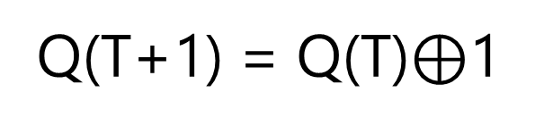
R
R
Q(T+1) = Q(T)$⊕$1
D
Q(T)
S
S
E

Slide 70
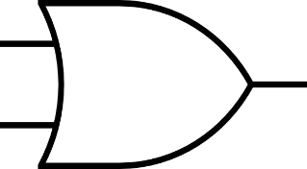
R
R
T=1
D
Q(T)→ Q’(T)
S
S
E

Slide 71
R
R
T=0
D
Q(T) → Q(T)
S
S
E

Slide 72
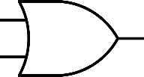

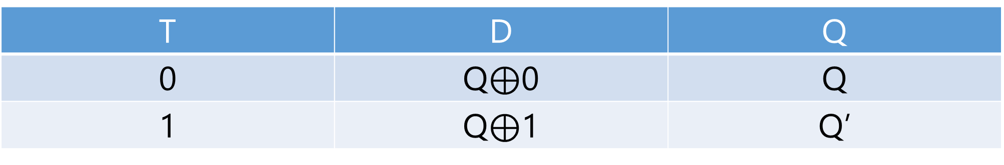
R
R
T
D
S
S
E
Store
T | D | Q
0 | Q$⊕$0 | Q
1 | Q$⊕$1 | Q’

Slide 73
R
R
T
D
S
S
E
Complement
T | D | Q
0 | Q$⊕$0 | Q
1 | Q$⊕$1 | Q’

Slide 74
R
R
R
R
D
T
S
S
S
S
E

Slide 75
R
R
R
R
D
T
T Latch
S
S
S
S
E
E

Slide 76
R
D
T
S
E
E
E
S | R | Q
0 | 0 | Q_{t}
0 | 1 | 0
1 | 0 | 1
1 | 1 | X
D | Q
0 | 0
1 | 1
T | Q
0 | Q_{t}
1 | Q’_{t}

Slide 77
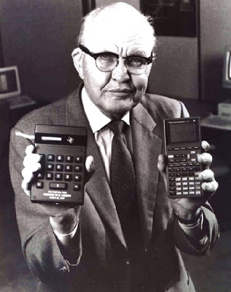
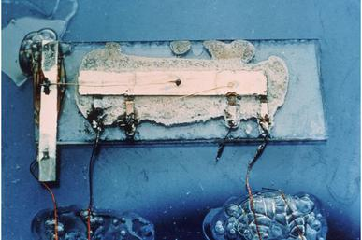
Jack St. Clair Kilby
(Nov. 8, 1923 – June 20, 2005) Electrical Engineer
The 1st integrated circuit
1958
Nobel Prize in Physics, 2000

Slide 78
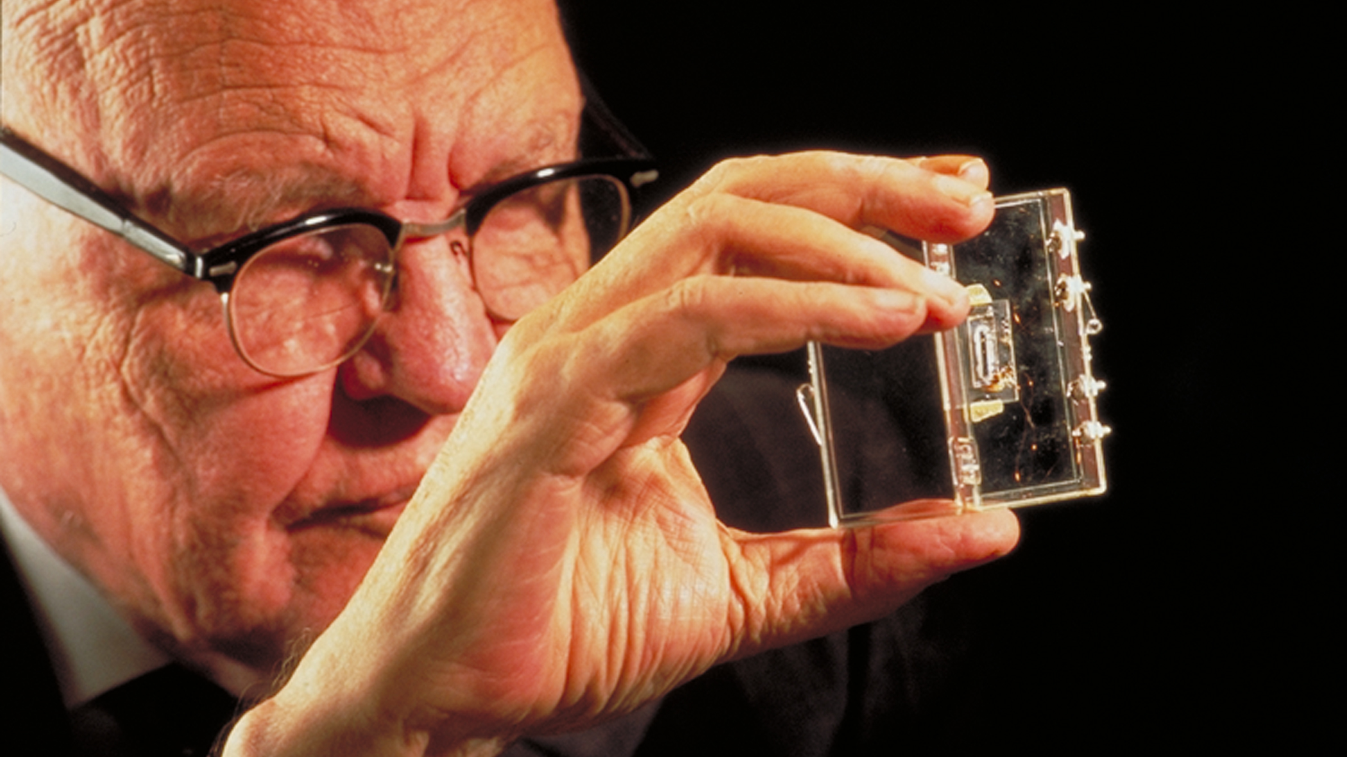

Slide 79
JK Latch

Slide 80
R
R
SR Latch
?
R
S
S
S
E

Slide 81
R
R
SR Latch
R
S
S
S
E

Slide 82
R
R
SR Latch
R
Q
S
S
Q’
E
S
S | R | S | R
0 | 0 | 0 | 0
0 | 1 | 0 | Q_{t}
1 | 0 | Q’_{t} | 0
1 | 1 | Q’_{t} | Q_{t}

Slide 83
R
R
1
R
Q
S
S
Q’
E
S
S | R | S | R
0 | 0 | 0 | 0
0 | 1 | 0 | Q_{t}=1
1 | 0 | Q’_{t}=0 | 0
1 | 1 | Q’_{t}=0 | Q_{t}=1

Slide 84
R
R
1
R
Q
S
S
Q’
E
S
S | R | S | R | Q
0 | 0 | 0 | 0 | Store=Q_{t}=1
0 | 1 | 0 | Q_{t}=1 | Reset=0
1 | 0 | Q’_{t}=0 | 0 | Store=Q_{t}=1
1 | 1 | Q’_{t}=0 | Q_{t}=1 | Reset=0

Slide 85
R
R
0
R
Q
S
S
Q’
E
S
S | R | S | R
0 | 0 | 0 | 0
0 | 1 | 0 | Q_{t}=0
1 | 0 | Q’_{t}=1 | 0
1 | 1 | Q’_{t}=1 | Q_{t}=0

Slide 86
R
R
0
R
Q
S
S
Q’
E
S
S | R | S | R | Q
0 | 0 | 0 | 0 | Store=Q_{t}=0
0 | 1 | 0 | Q_{t}=0 | Store=Q_{t}=0
1 | 0 | Q’_{t}=1 | 0 | Set=1
1 | 1 | Q’_{t}=1 | Q_{t}=0 | Set=1

Slide 87
R
K
SR Latch
R
Q
J
S
Q’
E
S
S=J | R=K | Q
0 | 0 | Store=Q_{t}
0 | 1 | Reset = 0
1 | 0 | Set = 1
1 | 1 | Comp. =Q’_{t}

Slide 88
R
D
T
K
S
J
E
E
E
E
S | R | Q
0 | 0 | Q_{t}
0 | 1 | 0
1 | 0 | 1
1 | 1 | X
D | Q
0 | 0
1 | 1
T | Q
0 | Q_{t}
1 | Q’_{t}
J | K | Q
0 | 0 | Q_{t}
0 | 1 | 0
1 | 0 | 1
1 | 1 | Q’_{t}

Slide 89
State Transition Diagram
Life Cycle
Theory of Automata
COMP-2140: Computer Languages, Grammars, and Translators

Slide 90
R
S
SR=00
SR=00
E
SR=01
0
1
SR=10
SR=01
SR=10
S | R | Q
0 | 0 | Q_{t}
0 | 1 | 0
1 | 0 | 1
1 | 1 | X
SR=01
SR=10
SR=11
SR=11

Slide 91
D
D=0
D=1
E
D=0
0
1
D | Q
0 | 0
1 | 1
D=1

Slide 92
T
T=0
T=0
E
T=1
0
1
T | Q
0 | Q_{t}
1 | Q’_{t}
T=1

Slide 93
K
J
E
JK=00
JK=00
JK=01
JK=11
J | K | Q
0 | 0 | Q_{t}
0 | 1 | 0
1 | 0 | 1
1 | 1 | Q’_{t}
0
1
JK=10
JK=01
JK=10
JK=11

Slide 94
Flip-Flop

