Slide 1

2001: A Space Odyssey (Stanley Kubrick-1968)

Slide 2

2020: A Digital Odyssey
Notes:
https://www.pinterest.ca/pin/231302130841121655/

Slide 3


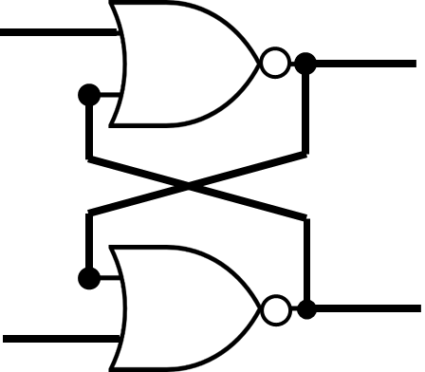
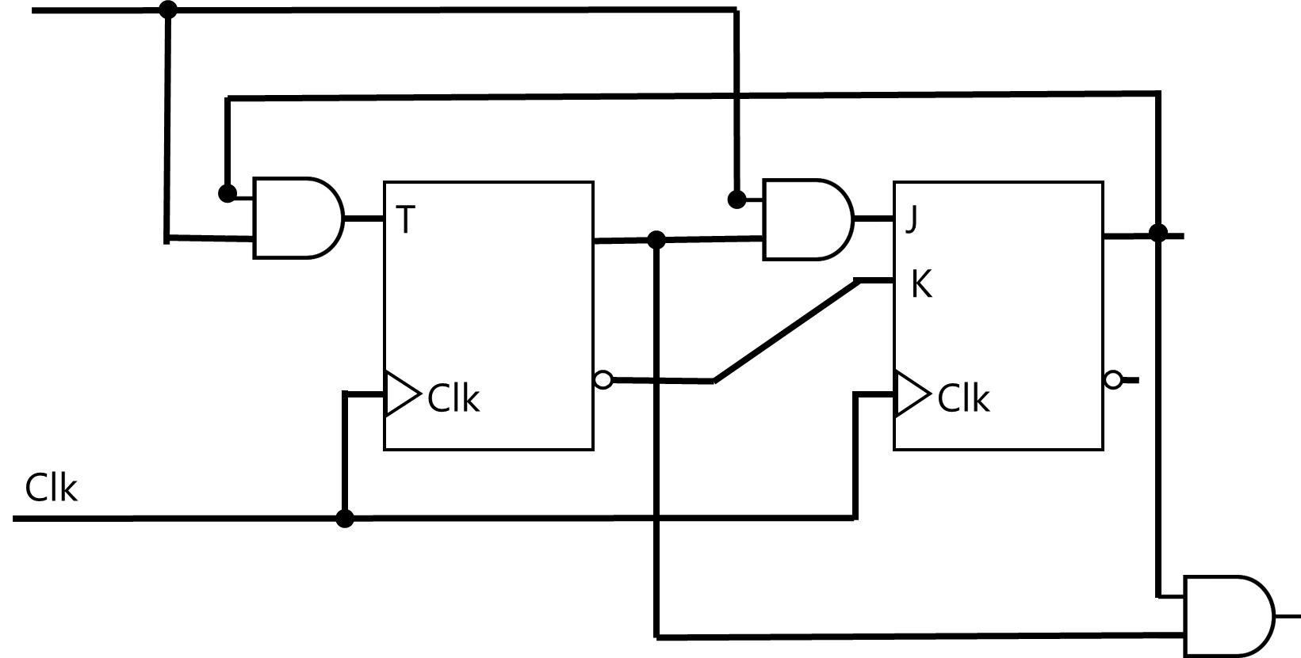
Number Systems |
(12)₁₀ → (1100)₂
Number Systems | Logic Gates |
Number Systems | Logic Gates | Combinational Logic |
Number Systems | Logic Gates | Combinational Logic | Flip-Flops |
Number Systems | Logic Gates | Combinational Logic | Flip-Flops | Sequential Logic |
Number Systems | Logic Gates | Combinational Logic | Flip-Flops| Sequential Logic | Computer Systems

Slide 4
Design a Computer System

Slide 5
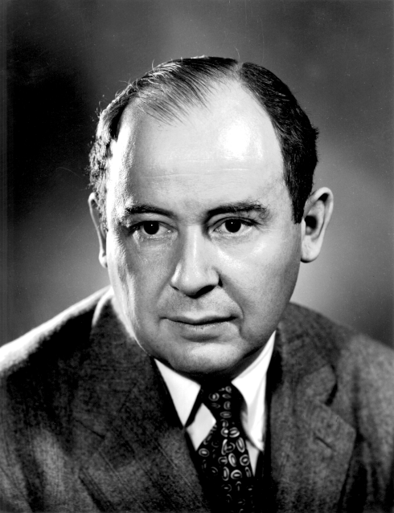
John von Neumann
(/vɒn ˈnɔɪmən/)
1903 –1957
Mathematician, Physicist, Computer Scientist, Engineer
Polymath
He integrated pure and applied sciences. He made major contributions to many fields, including:
Mathematics
Physics
Economics (game theory)
Computing
Statistics

Slide 6

Problems
Computer
Memory to Store
Data (Input, Output)
int a=1; int b=2; int c;
Data
Instructions (Code)
c = a + b;
Bus
Algorithm
Processor

Slide 7
von Neumann Architecture
Principles
Data and instructions are both stored in the main memory
The content of the memory is addressable by location (regardless of what is stored in that location)
Instructions are executed sequentially unless the order is explicitly modified

Slide 8
Computer
System
Computer
Memory to Store
Data (Input, Output)
int a=1; int b=2; int c;
Instructions (Code)
c = a + b;
Input/Output
Devices
scanf("%d", &a);
scanf("%d", &b);
printf("%d", c);
Bus
Bus
Bus
Permanent Storage
fprintf() fscanf() fread() fwrite() fseek()
Processor

Slide 9
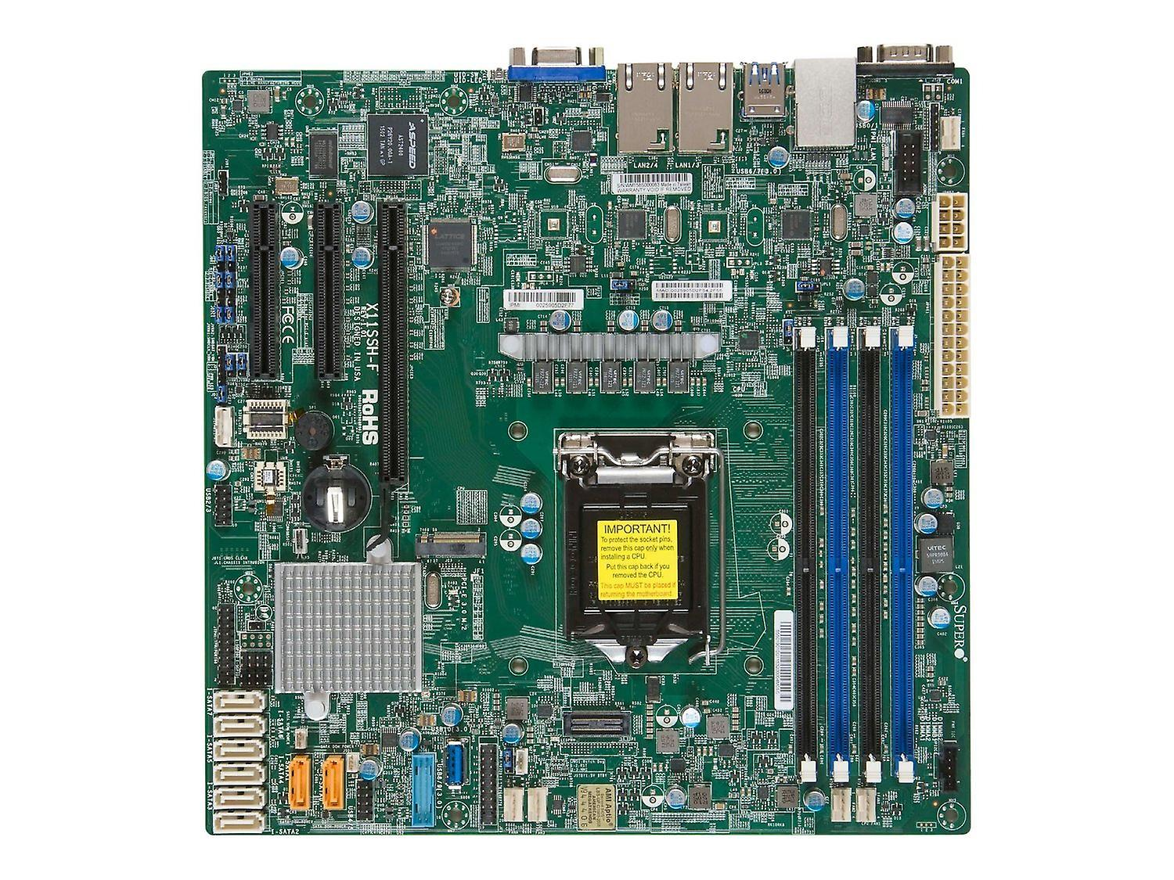
I/O
I/O
Power
Processor
Memory to Store
I/O

Slide 10
I/O
I/O
Power
Processor
Memory to Store
I/O

Slide 11
Design Processor
Do Calculation

Slide 12
Design Processor
Calculation on Data → Calculation on Numbers

Slide 13
Design Processor
Number → Binary

Slide 14
Computer
Memory to Store
Data (Input, Output)
int a=1; int b=2; int c;
Instructions (Code)
c = a + b;
Bus
Processor
We instruct the processor what to do!
Write instructions (programs)
Processor does our instructions

Slide 15
Design Processor
Instruction Set
Cannot instruct a processor to do whatever we want!
Any processors have limitations.
Some can only do addition,
Some can do both addition and subtraction, but no division

Slide 16
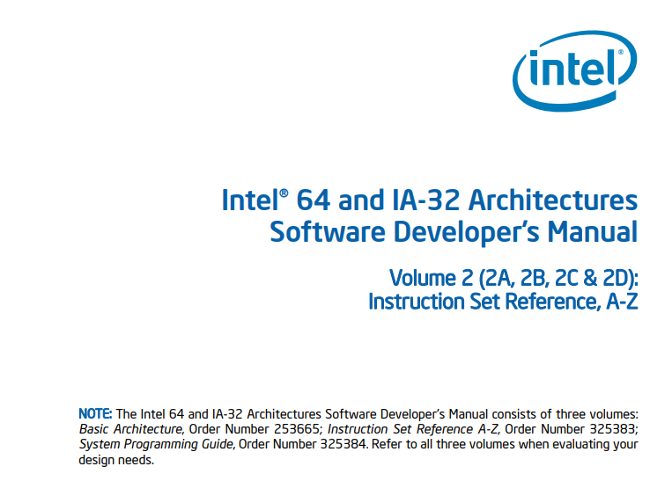
https://www.intel.com/content/dam/www/public/us/en/documents/manuals/64-ia-32-architectures-software-developer-instruction-set-reference-manual-325383.pdf
Notes:
https://www.intel.com/content/dam/www/public/us/en/documents/manuals/64-ia-32-architectures-software-developer-instruction-set-reference-manual-325383.pdf

Slide 17
Design Processor
Assembly Language
Writing programs using the Instruction Set of a particular processor
RISC (/rɪsk/): Reduced Instruction Set Computer
CISC (/ˈsɪsk/): Complex Instruction Set Computer

Slide 18
Design Processor
RISC
Small but highly optimized set of instructions
e.g., integer calculation
https://en.wikipedia.org/wiki/Reduced_instruction_set_computer

Slide 19
Design Processor
CISC
Large and NOT highly optimized set of instructions
e.g., integer and floating-point calculations
https://en.wikipedia.org/wiki/Complex_instruction_set_computer

Slide 20
Current Processors
x86, x64
By Intel and AMD
instruction set size: ~981
How Many x86-64 Instructions Are There Anyway?

Slide 21
Human Natural Language | Type | Example
High Level Programing Language | Imperative (What) | SQL SELECT * FROM Students
Middle Level Programming Language | Declarative (What + How) | C, C++, Java, Python int a = 1; a = a + 1;
Low Level Programming Language (Assembly Language) |  | Assembly x86, Assembly Z80 MOV 1, AX INC AX
Binary Digits (Machine Language) |  | 00010011 00001011

Slide 22
Compilers
Interpreters
Human Natural Language | Type | Example
High Level Programing Language | Imperative (What) | SQL SELECT * FROM Students
Middle Level Programming Language | Declarative (What + How) | C, C++, Java, Python int a = 1; a = a + 1;
Low Level Programming Language (Assembly Language) |  | Assembly x86, Assembly Z80 MOV 1, AX INC AX
Binary Digits (Machine Language) |  | 00010011 00001011

Slide 23
C/C++
Hossein’s Computer

Slide 24
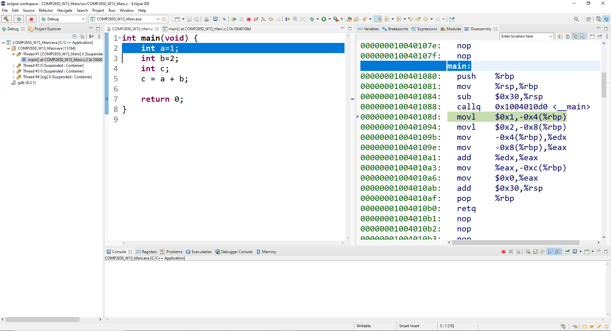

Slide 26
Memory Addresses
To see the actual binary machine language (OP Code) for each instruction,
open your executable file that the compiler makes. E.g., *.exe in Windows systems.

Slide 27
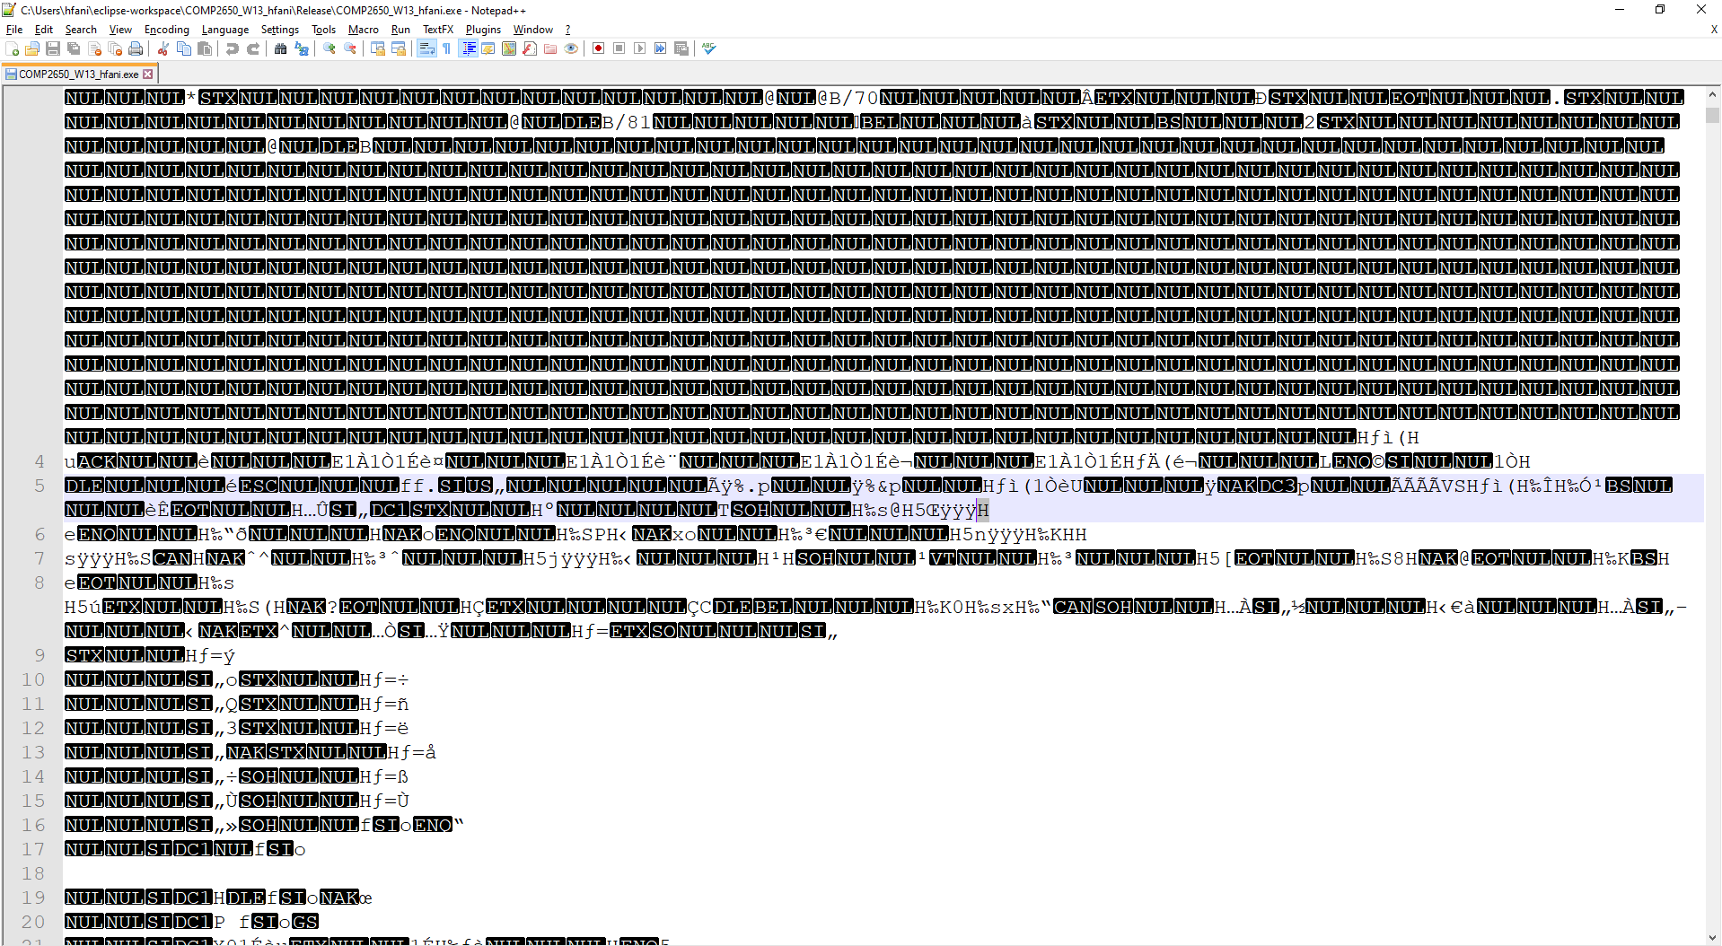

Slide 28
Program vs. Process
Program: dead body of the instructions stored in permanent place (flash drive, ssd, hard disk, paper!)
Process: live body of the instructions stored in memory, ready to be fetched by the Processor and be executed!

Slide 29
Program vs. Process
C, C++, Java, Python int a = 1; a = a + 1;
Assembly x86, Assembly Z80 MOV 1, AX INC AX
00010011 00001011
00010011 00001011
00010011 00001011
00010011 00001011
Load into Memory
(Run)
Program
Process
Finished/Killed

Slide 30
Compilers vs. Interpreters
Instruction Encoders
Compilers
C, C++, Java, Python int a = 1; a = a + 1;
Assembly x86, Assembly Z80 MOV 1, AX INC AX
00010011 00001011
Interpreters
Load into Memory
(Run)
Program
Process
int a = 1; → 00010011 a = a + 1; → 00001011
Finished/Killed

Slide 31
Instruction | Operation Code (OP Code)
c = a + b | 000 XXXX YYYY ZZZZ
c = a – b | 001 XXXX YYYY ZZZZ
c = a / b | 010 XXXX YYYY ZZZZ
c = a * b | 011 XXXX YYYY ZZZZ
c = {number} | 100 XXXX XXX XXXX
… | …
Instruction Encoders
very simplified version!

Slide 32
Design Processor
Processor can only see binary-coded instructions
Processor only understand machine language
Instruction Set →Instruction Decoder

Slide 33
Operation Code (OP Code) | What to do?
000 XXXX YYYY ZZZZ | Fetch the first operand from memory at XXXX address Store the first operand inside somewhere (AX) Fetch the second operand from memory at YYYY address Store the first operand inside somewhere else (BX) Use the n-bit Adder to add AX and BX Store the result inside somewhere else (CX) Push CX to memory at ZZZZ address
001 XXXX YYYY ZZZZ
010 XXXX YYYY ZZZZ
011 XXXX YYYY ZZZZ
100 XXXX XXX XXXX
…
Instruction Decoder
very simplified version!

Slide 34
Operation Code (OP Code) | What to do?
000 XXXX YYYY ZZZZ | Fetch the first operand from memory at XXXX address Store the first operand inside somewhere (AX) Fetch the second operand from memory at YYYY address Store the first operand inside somewhere else (BX) Use the n-bit Adder to add AX and BX Store the result inside somewhere else (CX) Push CX to memory at ZZZZ address
001 XXXX YYYY ZZZZ
010 XXXX YYYY ZZZZ
011 XXXX YYYY ZZZZ
100 XXXX XXX XXXX
…
Instruction Decoder
very simplified version!

Slide 35
Internal Data Bus
Registers
Operand 1
Operand 2
Arithmetic
Logic
Result
Internal Control Bus
Address Bus
Data Bus
Control Bus
Control
Internal Clock

Slide 36
Internal Data Bus
Registers
Operand 1
Operand 2
Arithmetic
Logic
City
- Streets
1-way
2-way
- Gates
- Bridges
- Warehouses
- Policing
Result
Internal Control Bus
Address Bus
Data Bus
Control Bus
Control
Internal Clock

Slide 37
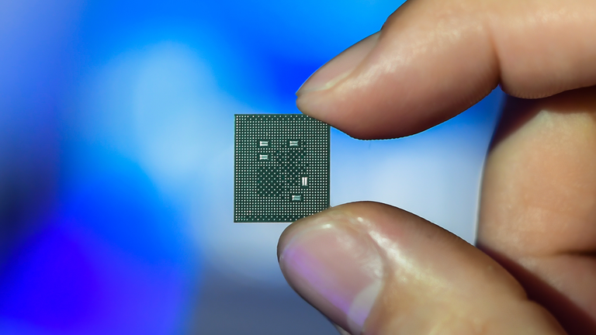
Internal Data Bus
Registers
Operand 1
Operand 2
Arithmetic
Logic
City
- Streets
1-way
2-way
- Gates
- Bridges
- Warehouses
- Policing
Result
Internal Control Bus
Address Bus
Data Bus
Control Bus
Control
Internal Clock

Slide 38
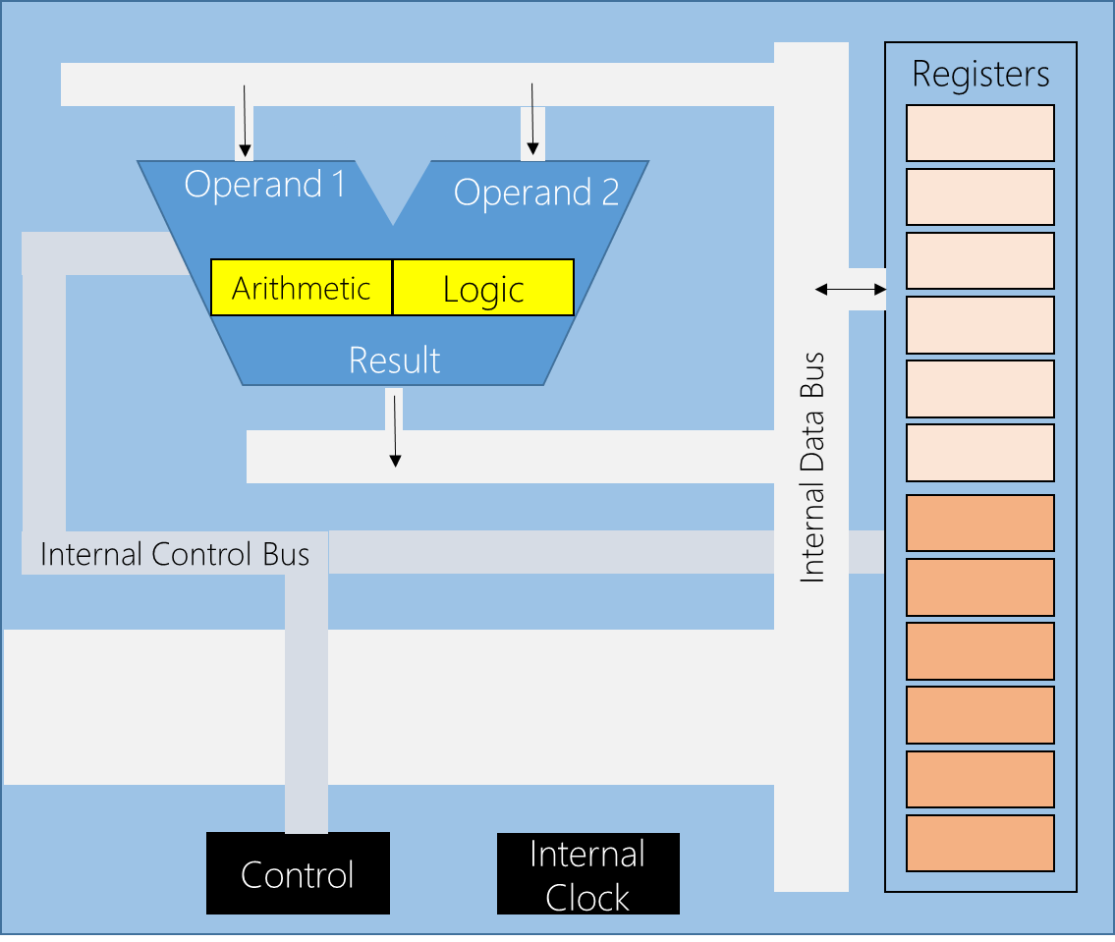
Registers
Some vectors of FFs

Slide 39
Instruction Pointer (IP)
aka. Program Counter (PC), Instruction Address Register (IAR), Instruction Counter
Keep track of the address of next instruction in memory

Slide 40
Instruction Pointer (IP)
aka. Program Counter (PC), Instruction Address Register (IAR), Instruction Counter
Keep track of the address of next instruction in memory
Why is it called ‘counter’?

Slide 41

Address | Memory | High Level Instr.
0000 | 100 0111 0001 0000 | int a = 1;
0001 | 100 1000 0010 0000 | int b = 2; Current Instruction
0010 | 100 1001 0000 0000 | int c;
0011 | 001 0111 1000 1001 | c = a + b;
0100 | …
… | ….
Address Bus
Where is the next instruction to be fetched and execute?

Slide 42
Address | Memory | High Level Instr.
0000 | 100 0111 0001 0000 | int a = 1;
0001 | 100 1000 0010 0000 | int b = 2; Current Instruction
0010 | 100 1001 0000 0000 | int c;
0011 | 001 0111 1000 1001 | c = a + b;
0100 | 100 0111 0001 0000 | …
… | …. | …
Address Bus
In von Neumann architecture, instructions are executed sequentially!
So, the next would be the address of current + 1

Slide 43
Instruction Pointer (IP)
aka. Program Counter (PC), Instruction Address Register (IAR), Instruction Counter
We already designed a 3-bit counter
00, 01, 10, 11

Slide 44
Instruction Pointer (IP)
aka. Program Counter (PC), Instruction Address Register (IAR), Instruction Counter
IP is a n-bit counter. What is n?

Slide 45
Instruction Pointer (IP)
aka. Program Counter (PC), Instruction Address Register (IAR), Instruction Counter
IP is a n-bit counter. What is n?
IP contains a memory address.
Address bus contains a memory address at a time.
So, IP is the same size as address bus. Here, 4-bit address bus, we have 4-bit IP.

Slide 46
Where is the current instruction?

Slide 47
Instruction Register (IR or IX)
Holds the current instruction that is fetched from memory and is just about to be executed.
As soon as the instruction placed in IR, the processor starts executing the instruction and IP++ to point to the next instruction to be executed next.

Slide 48

Address | Memory | High Level Instr.
0000 | 100 0111 0001 0000 | int a = 1;
0001 | 100 1000 0010 0000 | int b = 2; Current Instruction
0010 | 100 1001 0000 0000 | int c;
0011 | 001 0111 1000 1001 | c = a + b;
0100 | 100 0111 0001 0000 | …
… | …. | …
IX=100 1000 0010 0000
IP=0010
Address Bus

Slide 49
Address | Memory | High Level Instr.
0000 | 100 0111 0001 0000 | int a = 1;
0001 | 100 1000 0010 0000 | int b = 2; Current Done!
0010 | 100 1001 0000 0000 | int c;
0011 | 001 0111 1000 1001 | c = a + b;
0100 | 100 0111 0001 0000 | …
… | …. | …
IX=100 1000 0010 0000
IP=0010
Address Bus
0010
1) Load address bus with IP

Slide 50
Address | Memory | High Level Instr.
0000 | 100 0111 0001 0000 | int a = 1;
0001 | 100 1000 0010 0000 | int b = 2; Current Done!
0010 | 100 1001 0000 0000 | int c;
0011 | 001 0111 1000 1001 | c = a + b;
0100 | 100 0111 0001 0000 | …
… | …. | …
IX=100 1000 0010 0000
IP=0010
Address Bus
0010
Control Bus
C=0 (Read)
2) Load control bus to read from memory

Slide 51
Address | Memory | High Level Instr.
0000 | 100 0111 0001 0000 | int a = 1;
0001 | 100 1000 0010 0000 | int b = 2; Current Done!
0010 | 100 1001 0000 0000 | int c;
0011 | 001 0111 1000 1001 | c = a + b;
0100 | 100 0111 0001 0000 | …
… | …. | …
IX=100 1001 0000 0000
IP=0010
Data Bus
100 1001 0000 0000
Address Bus
0010
Control Bus
C=0 (Read)
3) Read data bus and load it into IX

Slide 52
Address | Memory | High Level Instr.
0000 | 100 0111 0001 0000 | int a = 1;
0001 | 100 1000 0010 0000 | int b = 2; Current Done!
0010 | 100 1001 0000 0000 | int c;
0011 | 001 0111 1000 1001 | c = a + b;
0100 | 100 0111 0001 0000 | …
… | …. | …
IX= 100 1001 0000 0000
IP=0011
Data Bus
Address Bus
Control Bus
4) Increment IP

Slide 53
Instruction Register (IR or IX)
n-bit Register. What is n?

Slide 54
Fetch Instruction Cycle
Load address bus with IP
Load control bus to read from memory
Read data bus and load it into IX
Increment IP

Slide 55
Memory Address Register (MAR)
Holds the address of memory location to Read/Write data from.

Slide 56
Memory Data Register (MDR)
Holds the actual value that is either
Read from memory, or
To be written to memory

Slide 57
Memory Address Register (MAR)
Memory Data Register (MDR)
Work hand-in-hand to facilitate the communication of the processor and the main memory
What are their sizes?

Slide 58
Address | Memory | High Level Instr.
0000 | 100 0111 0001 0000 | int a = 1;
0001 | 100 1000 0010 0000 | int b = 2; Current Done!
0010 | 100 1001 0000 0000 | int c;
0011 | 001 0111 1000 1001 | c = a + b;
0100 | 100 0111 0001 0000 | …
… | …. | …
IX=001 0111 1000 1001
IP=0100
Data Bus
Address Bus
Control Bus
What are the steps to execute this instruction?

Slide 59
IX= 001 0111 1000 1001
Address | Memory | High Level Instr.
0011 | 001 0111 1000 1001 | c = a + b;
0100
0101
0110
0111 | 000 0000 0000 0001
MAR=0111
MDR=000 0000 0000 0001
Data Bus
Address Bus
Control Bus
Fetch the first operand from memory
Load MAR with the address of ‘a’ from the instruction op code
Load address bus with MAR
Load control bus with C=0 (Read)
Load MDR with the content of data bus

Slide 60
IX= 001 0111 1000 1001
Address | Memory | High Level Instr.
0011 | 001 0111 1000 1001 | c = a + b;
0100
0101
0110
0111 | 000 0000 0000 0001
1000 | 000 0000 0000 0010
MAR=1000
MDR=000 0000 0000 0010
Data Bus
Address Bus
Control Bus
2) Fetch the second operand from memory
Load MAR with the address of ‘b’ from the instruction op code
Load address bus with MAR
Load control bus with C=0 (Read)
Load MDR with the content of data bus

Slide 61
IX= 001 0111 1000 1001
Address | Memory | High Level Instr.
0011 | 001 0111 1000 1001 | c = a + b;
0100
0101
0110
0111 | 000 0000 0000 0001
1000 | 000 0000 0000 0010
MAR=1000
MDR=000 0000 0000 0010
Data Bus
Address Bus
Control Bus
2) Fetch the second operand from memory
Load MAR with the address of ‘b’ from the instruction op code
Load address bus with MAR
Load control bus with C=0 (Read)
Load MDR with the content of data bus. Wait! I lost the value of ‘a’ inside the processor!

Slide 62
IX= 001 0111 1000 1001
Address | Memory | High Level Instr.
0011 | 001 0111 1000 1001 | c = a + b;
0100
0101
0110
0111 | 000 0000 0000 0001
1000 | 000 0000 0000 0010
MAR=1000
MDR=000 0000 0000 0010
Data Bus
Address Bus
Control Bus
2) Fetch the second operand from memory
Move MDR (value of ‘a’) to somewhere (AX) first!
Load MAR with the address of ‘b’ from the instruction op code
Load address bus with MAR
Load control bus with C=0 (Read)
Load MDR with the content of data bus.

Slide 63
Address | Memory | High Level Instr.
0011 | 001 0111 1000 1001 | c = a + b;
MDR=000 0000 0000 0010
AX= 000 0000 0000 0001
3) Use the n-bit Adder to add AX and MDR

Slide 64
Address | Memory | High Level Instr.
0011 | 001 0111 1000 1001 | c = a + b;
MDR=000 0000 0000 0010
AX= 000 0000 0000 0001
4) Store the result somewhere. Where?

Slide 65
Address | Memory | High Level Instr.
0011 | 001 0111 1000 1001 | c = a + b;
MDR=000 0000 0000 0010
AX= 000 0000 0000 0001
4) Store the result somewhere. Where?
We want to write it back to memory at location for ‘c’
So, better to store it in MDR

Slide 66
Address | Memory | High Level Instr.
0011 | 001 0111 1000 1001 | c = a + b;
MDR=000 0000 0000 0011
AX= 000 0000 0000 0001
4) Store the result somewhere. Where?
What do we want to do next?
We want to write it back to memory at location for ‘c’
So, better to store it in MDR

Slide 67
IX= 001 0111 1000 1001
Address | Memory | High Level Instr.
0011 | 001 0111 1000 1001 | c = a + b;
 | …
1001 | 000 0000 0000 0011
MAR= 1001
Data Bus
000 0000 0011
MDR=000 0000 0011
Address Bus
1001
Control Bus
1
5) Write the result back to memory at location for ‘c’.
Find the address of ‘c’ in op code
Load it into MAR
Load address bus with MAR
Load data bus with MDR
Load control bus with C=1 (Write)

Slide 68
Accumulator (AX)
This is the most frequently used register.
Any intermediate results
somewhere → AX

Slide 69
General Purpose Registers
R₁, R₂, …, R_{i}

Slide 70
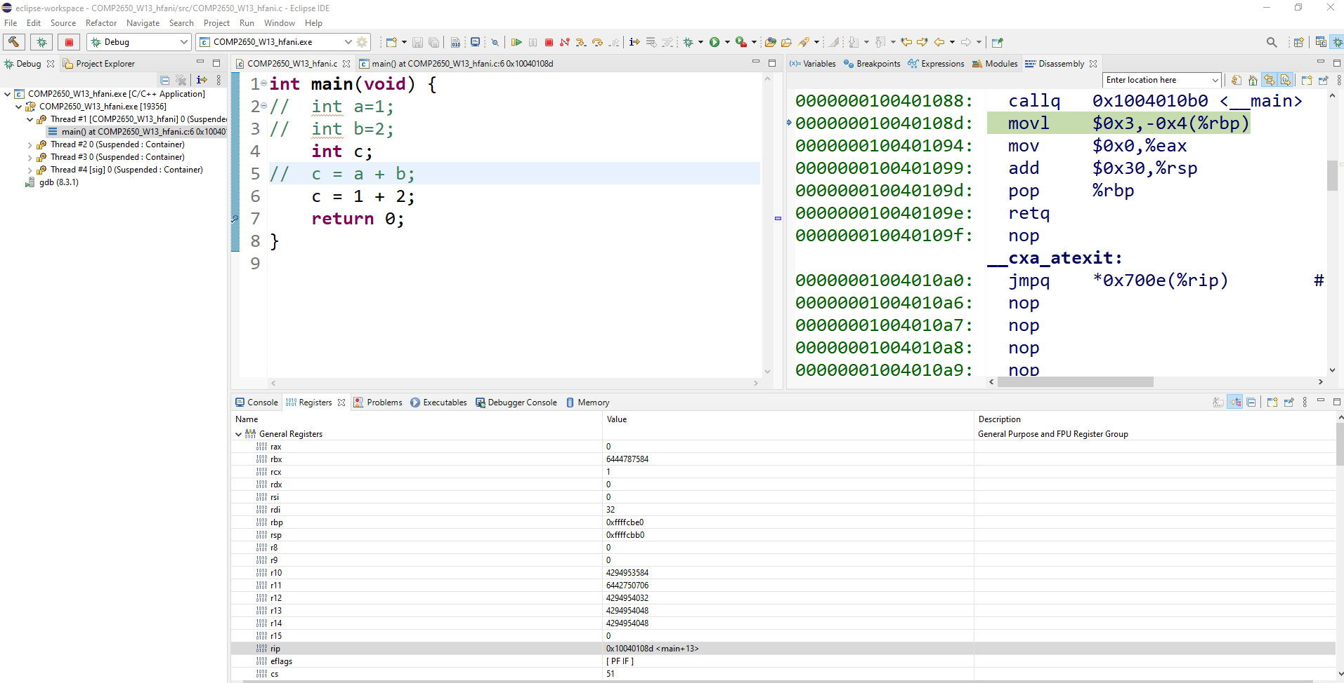

Slide 72
Arithmetic & Logic Unit
(ALU)

Slide 73
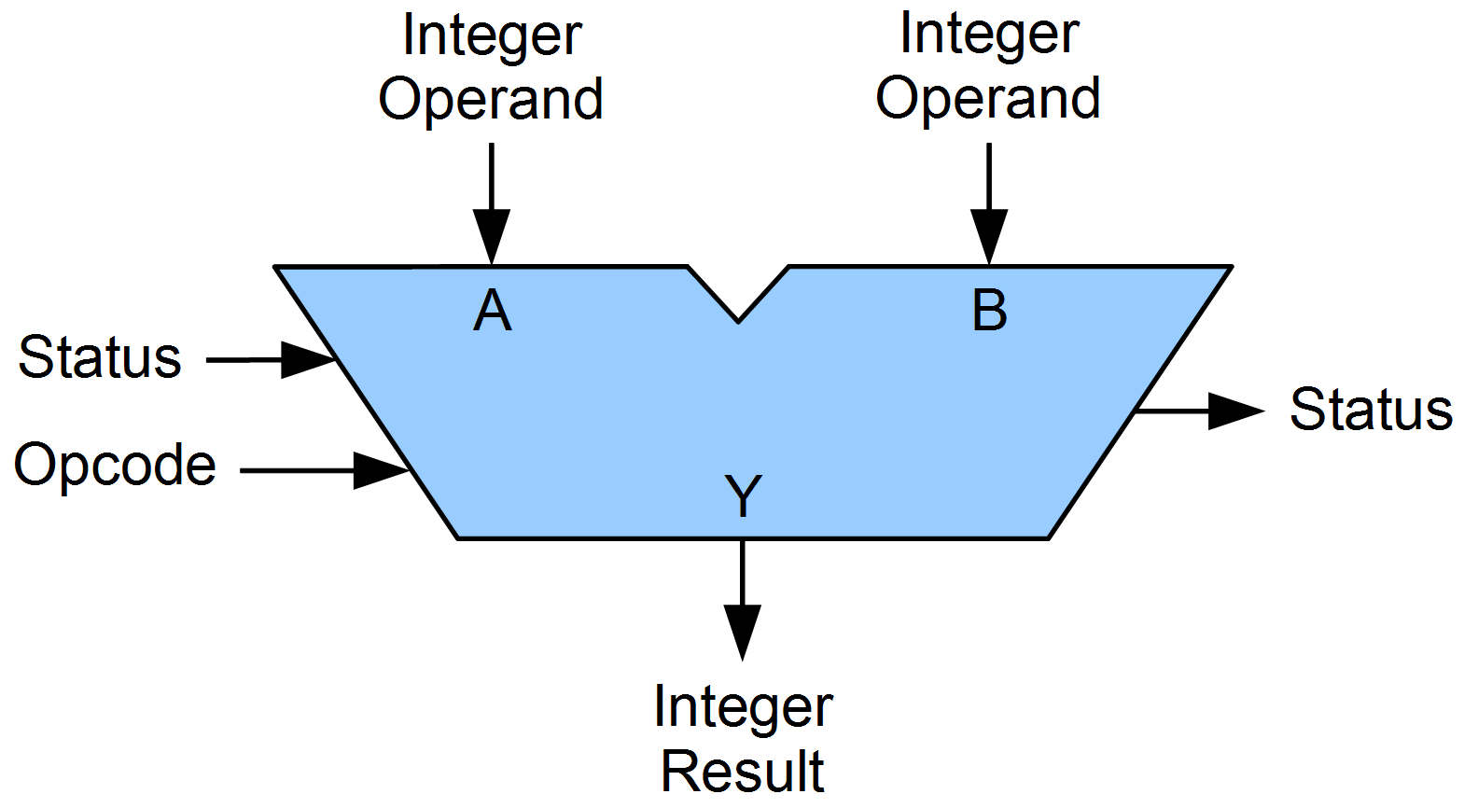
Arithmetic Unit
Integer Arithmetic (Addition, Subtraction)
- Multiplication: multiple addition
- Division: multiple subtraction
Floating Point Arithmetic (FPU)

Slide 74
Logic Unit
Bitwise
AND, OR, XOR, 1’s Comp.

Slide 75
Recap
Fetch Instruction Cycle
Execution Cycle
Depends on OP Code
Arithmetic
Logic

Slide 76
I/O
I/O
Power
Processor
Memory to Store
I/O

Slide 77
Microprocessor
Central Processing Unit (CPU)
Intel (Xeon), AMD (Ryzen)
Graphic Processing Unit (GPU)
nVidia (GeForce) for Video Card (Gaming)
AI Acceleration (Neural Nets)
Tensor Processing Unit (TPU)
Google (TensorFlow AI Lib for Neural Nets)

Slide 78
COMP-2660
Computer Architecture II
Microprocessor Programming

Slide 79
Postscript
Office Hours Before Week
- Practice on questions
Office Hours Final Exam
- Review exam questions

