Slide 1
Analog systems
Continuous

Slide 2
Voltage
Time
Notes:
physical quantities called signals. Electrical signals such as voltages and currents are the most common. Electronic devices called transistors predominate in the circuitry that implement, represent, and manipulate these signals.

Slide 3
digital systems
Discrete
Notes:
Thus, a digital system is a system that manipulates discrete elements of information represented internally in binary form.

Slide 4
Electricity
Number system

Slide 5
base-?

Slide 6
base-10

Slide 7
Voltage
[9,10)
[8,9)
[7,8)
[6,7)
[5,6)
[4,5)
[3,4)
[2,3)
[1,2)
[0,1)
Time

Slide 8
Voltage
[0,1) | [1,2) | [2,3) | [3,4) | [4,5) | [5,6) | [6,7) | [7,8) | [9,10) | [10,11) | [11,12) | [12,13) | [13,14) | [14,15) | [15,16)
Time

Slide 9
Voltage
[9,10)
[8,9)
[7,8)
[6,7)
[5,6)
[4,5)
[3,4)
[2,3)
[1,2)
[0,1)
[0,1) | [1,2) | [2,3) | [3,4) | [4,5) | [5,6) | [6,7) | [7,8) | [9,10) | [10,11) | [11,12) | [12,13) | [13,14) | [14,15) | [15,16)
Time

Slide 10
Voltage
[9,10)
[8,9)
[7,8)
[6,7)
[5,6)
[4,5)
[3,4)
[2,3)
[1,2)
[0,1)
░ | ░ | 5 | ░ | 2 | 2 | ░ | 9 | ░ | ░ | ░ | 7 | ░ | ░ | ░
Time
Value

Slide 11
granularity

Slide 12
Voltage
[9,10)
[8,9)
[7,8)
[6,7)
[5,6)
[4,5)
[3,4)
[2,3)
[1,2)
[0,1)
░ | ░ | ░ | 6 | 5 | ░ | ░ | ░ | 2 | 2 | 2 | 3 | ░ | ░ | 9
Time
Value

Slide 13
Voltage
[9,∞)
[6,9)
[3,6)
[0,3)
░ | ░ | 2 | 1 | 0 | 0 | ░ | 3 | 3 | 3 | 3 | ░ | 2 | 1 | ░
Time
Value

Slide 14
Voltage
[5,∞)
[0,5)
░ | 1 | 1 | ░ | 0 | 0 | 1 | 1 | 1 | 1 | 1 | 1 | 1 | 0 | 0
Time
Value

Slide 15
reliability
Robust to Noise
Fundamentally Hardware/Engineering Problem

Slide 16
Ternary computer
https://en.wikipedia.org/wiki/Ternary_computer
Balanced Trinary {−1,0,1}
Entirely from Wood!
Thomas Fowler 1840
More History and Etymology → https://en.wikipedia.org/wiki/Computer
Notes:
Kinetic energy

Slide 17
decimal computer
https://en.wikipedia.org/wiki/Decimal_computer
They are not actually base-10! We’ll cover them later.

Slide 18
True vs. false

Slide 19

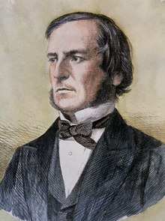
George Boole (/buːl/)
Mathematician
Philosopher
Logician
The Laws of Thought (1854)
Boolean Algebra!
Notes:
The cost of circuits that implement binary logic in all of today’s digital devices and computers is an important factor addressed by designers—be they computer engineers, electrical engineers, or computer scientists.
Finding simpler and cheaper, but equivalent, realizations of a circuit can reap huge payoffs in reducing the overall cost of the design. Mathematical methods that simplify circuits rely primarily on Boolean algebra.

Slide 20
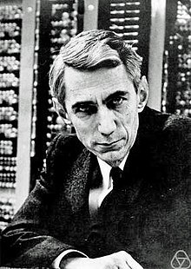
Claude Elwood Shannon
Mathematician
Electrical Engineer
Cryptographer
M.Sc. Thesis (1937)
A Symbolic Analysis of Relay and Switching Circuits
21 years old!
Switching Algebra!
Notes:
He is also well known for founding digital circuit design theory in 1937, when—as a 21-year-old master's degree student at the Massachusetts Institute of Technology (MIT)—he wrote his thesis demonstrating that electrical applications of Boolean algebra could construct any logical numerical relationship

Slide 21
binary computer

Slide 22
+5V | 1
+2V | ░
+0.8V | 0
0V
Positive logic
https://www.electronics-tutorials.ws/logic/logic_1.html

Slide 23
Voltage
HIGH
[2,5]
[0.8,2)
[0,0.8)
0 | 1 | ░ | ░ | 1 | 1 | 1 | 1 | 0 | 0 | 0 | 0 | 1 | 1 | 0
noise
LOW
Time
Value

Slide 24

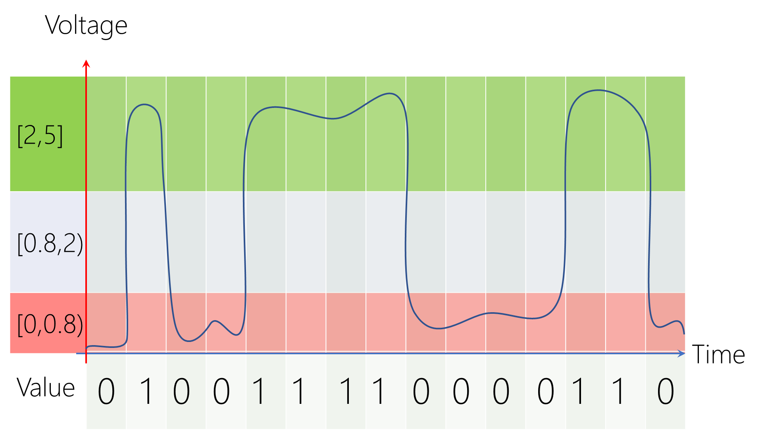
+5V
+5V
0
1
00
Δt
Δt
0V
0V
Earth (Ground)
Earth (Ground)

Slide 25
+5V | 0
+2V | ░
+0.8V | 1
0V
negative logic
https://www.electronics-tutorials.ws/logic/logic_1.html

Slide 26
Voltage
HIGH
[2,5]
[0.8,2)
[0,0.8)
1 | 0 | ░ | ░ | 0 | 0 | 0 | 0 | 1 | 1 | 1 | 1 | 0 | 0 | 1
noise
LOW
Time
Value

Slide 27
+5V
+5V
1
0
00
Δt
Δt
0V
0V
Earth (Ground)
Earth (Ground)

Slide 28
design computer
Positive Logic
Button-Up Approach
Notes:
The cost of circuits that implement binary logic in all of today’s digital devices and computers is an important factor addressed by designers—be they computer engineers, electrical engineers, or computer scientists.
Finding simpler and cheaper, but equivalent, realizations of a circuit can reap huge payoffs in reducing the overall cost of the design. Mathematical methods that simplify circuits rely primarily on Boolean algebra.

Slide 29
design computer
Positive Logic
Button-Up Approach
Finding simpler, but equivalent, computers reduces the overall cost!
Rely primarily on mathematical methods in Boolean algebra!
Notes:
The cost of circuits that implement binary logic in all of today’s digital devices and computers is an important factor addressed by designers—be they computer engineers, electrical engineers, or computer scientists.
Finding simpler and cheaper, but equivalent, realizations of a circuit can reap huge payoffs in reducing the overall cost of the design. Mathematical methods that simplify circuits rely primarily on Boolean algebra.

Slide 30
build computer
Electrical and Computer Engineering

Slide 31
Logic gates
Boolean gates

Slide 32


Slide 33
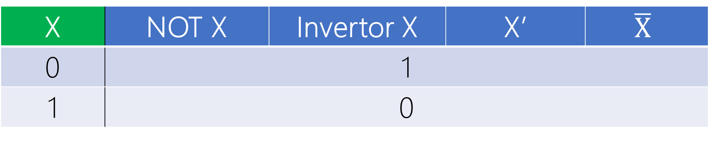
Inversion Bubble
X
F = X’
X | NOT X | Invertor X | X’ | $$\overline{X}$$
0 | 1
1 | 0
Boolean Expression/Function: F = X’
> inverse of X gives F <

Slide 34
W | Z | Y | X
X’
Y’
Z’
W’
F₁ = X’
F₂ = Y’
F₃ = Z’
F₄ = W’
1’s Complement

Slide 35
Binary Variable
aka. Boolean variable
A variable that can have a value in {0,1}
X, Y, Z, W, …

Slide 36
Boolean function
aka. Boolean Expression
A function that accept Boolean variable(s) and output a value in {0,1}, e.g., F(X) = X’

Slide 37


Slide 38
X
F = YX
Y
Y | X | X AND Y | Y . X | Y * X
0 | 0 | 0
0 | 1 | 0
1 | 0 | 0
1 | 1 | 1

Slide 39
X
F =YX=XY
Commutative
Y
X | Y | Y AND X | X . Y | X * Y
0 | 0 | 0
0 | 1 | 0
1 | 0 | 0
1 | 1 | 1

Slide 40
X
F = 0
0
F = X0 = 0
Y | X | YX
0 | 1 | 0
0 | 0 | 0

Slide 41
0
F = 0
Y
F = 0Y = 0
Y | X | YX
0 | 0 | 0
1 | 0 | 0

Slide 42
X
F = X
1
F = X1 = 1111X1111 = X
Y | X | YX
1 | 0 | 0
1 | 1 | 1

Slide 43
X
F = X
X
F = XX = X
X | X | XX
0 | 0 | 0
1 | 1 | 1

Slide 44
X
F = X
F = XX = X
X | X | XX
0 | 0 | 0
1 | 1 | 1

Slide 45
X
F = 0
X
F = XX’ = 0
X’ | X | X’X
1 | 0 | 0
0 | 1 | 0

Slide 46
X
F = 0
Inversion Bubble
F = XX’ = 0
X’ | X | X’X
1 | 0 | 0
0 | 1 | 0

Slide 47
X
F = 0
X’
F = XX’ = 0
X’ | X | X’X
1 | 0 | 0
0 | 1 | 0

Slide 48
3-Input and

Slide 49
Z | Y | X | ZYX
0 | 0 | 0 | 0
0 | 0 | 1 | 0
0 | 1 | 0 | 0
0 | 1 | 1 | 0
1 | 0 | 0 | 0
1 | 0 | 1 | 0
1 | 1 | 0 | 0
1 | 1 | 1 | 1

Slide 50
X
Y
F = Z(YX)
Z
Z | Y | X | Z(YX)
0 | 0 | 0 | 0
0 | 0 | 1 | 0
0 | 1 | 0 | 0
0 | 1 | 1 | 0
1 | 0 | 0 | 0
1 | 0 | 1 | 0
1 | 1 | 0 | 0
1 | 1 | 1 | 1

Slide 51
X
Y
F=Z(YX)=Z(XY)=(ZX)Y=(XZ)Y=XZY
Associative
Z
Z | Y | X | Z(YX) | Z(XY) | (ZX)Y | XZY
0 | 0 | 0 | 0 | 0 | 0 | 0
0 | 0 | 1 | 0 | 0 | 0 | 0
0 | 1 | 0 | 0 | 0 | 0 | 0
0 | 1 | 1 | 0 | 0 | 0 | 0
1 | 0 | 0 | 0 | 0 | 0 | 0
1 | 0 | 1 | 0 | 0 | 0 | 0
1 | 1 | 0 | 0 | 0 | 0 | 0
1 | 1 | 1 | 1 | 1 | 1 | 1

Slide 52
X
Y
F = ZYX
Z
Z | Y | X | ZYX
0 | 0 | 0 | 0
0 | 0 | 1 | 0
0 | 1 | 0 | 0
0 | 1 | 1 | 0
1 | 0 | 0 | 0
1 | 0 | 1 | 0
1 | 1 | 0 | 0
1 | 1 | 1 | 1

Slide 53
X
Y
Z
F₁ = W(Z(YX))
W
X
Y
F₂ = (WZ)(YX)
Z
W

Slide 54
X
X
Y
Y
Z
F₁ = W(Z(YX))
F₂ = (WZ)(YX)
W
Z
W
F = WZYX | F₁ | F₂
Effective (True) | Yes | Yes
Efficient (Fast) | Hmm, 3 levels, No! | Yes! 2 levels
Min. Cost | 3 gates, Yes | 3 gates, Yes

Slide 55
X
Y
Z
F = WZYX
W
X
Y
F = WZYX
Z
W

Slide 56

OR

Slide 57
X
F = Y+X
Y
Y | X | Y OR X | Y+X
0 | 0 | 0
0 | 1 | 1
1 | 0 | 1
1 | 1 | 1

Slide 58
X
F=Y+X=X+Y
Commutative
Y
X | Y | X OR Y | X+Y
0 | 0 | 0
0 | 1 | 1
1 | 0 | 1
1 | 1 | 1

Slide 59
X
F = 1
1
F = X+1 = 1
Y | X | Y+X
1 | 0 | 1
1 | 1 | 1

Slide 60
X
F = X
0
F = X + 0 = X
Y | X | Y+X
0 | 0 | 0
0 | 1 | 1

Slide 61
X
F = X
F = X+X = X
X | X | X+X
0 | 0 | 0
1 | 1 | 1

Slide 62
X
F = 1
X’
F = X + X’ = 1
X’ | X | X’+X
1 | 0 | 1
0 | 1 | 1

Slide 63
3-Input OR

Slide 64
X
Y
F = Z+(X+Y)
Z
Z | Y | X | Z+(X+Y)
0 | 0 | 0 | 0
0 | 0 | 1 | 1
0 | 1 | 0 | 1
0 | 1 | 1 | 1
1 | 0 | 0 | 1
1 | 0 | 1 | 1
1 | 1 | 0 | 1
1 | 1 | 1 | 1

Slide 65
X
F=Z+(Y+X)=Z+(X+Y)=(Z+X)+Y
= Z+Y+X
Associative
Y
Z
Z | Y | X | Z+(Y+X) | Z+(X+Y) | (Z+X)+Y | ZXY
0 | 0 | 0 | 0
0 | 0 | 1 | 1
0 | 1 | 0 | 1
0 | 1 | 1 | 1
1 | 0 | 0 | 1
1 | 0 | 1 | 1
1 | 1 | 0 | 1
1 | 1 | 1 | 1

Slide 66
X
Y
F = Z+Y+X
Z
Z | Y | X | Z+(Y+X) | Z+(X+Y) | (Z+X)+Y | ZXY
0 | 0 | 0 | 0
0 | 0 | 1 | 1
0 | 1 | 0 | 1
0 | 1 | 1 | 1
1 | 0 | 0 | 1
1 | 0 | 1 | 1
1 | 1 | 0 | 1
1 | 1 | 1 | 1

Slide 67
X
Y
Z
F₁ = W+(Z+(Y+X))
W
X
Y
F₂ = (W+Z)+(Y+X)
Z
W

Slide 68
X
X
Y
Y
Z
W
Z
W
F₂ = (W+Z)+(Y+X)
F₁ = W+(Z+(Y+X))
F = W+Z+Y+X | F₁ | F₂
Effective (True) | Yes | Yes
Efficient (Fast) | Hmm, 3 levels, No! | Yes! 2 levels
Min. Cost | 3 gates, Yes | 3 gates, Yes

Slide 69
Analysis I
System analysis is given the structure of a system, find its functionality.
Determine the functionality exhibited by a structure.

Slide 70
X
F
Y

Slide 71
X
F
Y
Y | X | F = ?
0 | 0 | ?
0 | 1 | ?
1 | 0 | ?
1 | 1 | ?

Slide 72

X
F₁
Y
Y | X | F₁ = YX
0 | 0 | 0
0 | 1 | 0
1 | 0 | 0
1 | 1 | 1

Slide 73
X
F₁
F
Y
Y | X | F₁ = YX | F = (YX)’
0 | 0 | 0 | 1
0 | 1 | 0 | 1
1 | 0 | 0 | 1
1 | 1 | 1 | 0

Slide 74
Inversion Bubble
X
F
Y
NAND (Not – AND)

Slide 75
X
F
Y
Y | X | F = (YX)’ | F=Y ↑ X
0 | 0 | 1
0 | 1 | 1
1 | 0 | 1
1 | 1 | 0

Slide 76
X
F
Y
F= (YX)’ = (XY)’ = Y ↑ X = X ↑ Y
Commutative

Slide 77
X
F
X | F = ?
0
1

Slide 78
X
F₁
F
X | F₁ = XX | F = ?
0 | 0
1 | 1

Slide 79
X
F₁
F
X | F₁ = XX | F = (XX)’
0 | 0 | 1
1 | 1 | 0

Slide 80
X
F
X | F = (XX)’=X↑X = X’
0 | 1
1 | 0

Slide 81
3-Input nand

Slide 82
Z | Y | X | F=(ZYX)’
0 | 0 | 0 | 1
0 | 0 | 1 | 1
0 | 1 | 0 | 1
0 | 1 | 1 | 1
1 | 0 | 0 | 1
1 | 0 | 1 | 1
1 | 1 | 0 | 1
1 | 1 | 1 | 0

Slide 83
X
Y
F
Z
Z | Y | X | F = ?
0 | 0 | 0
0 | 0 | 1
0 | 1 | 0
0 | 1 | 1
1 | 0 | 0
1 | 0 | 1
1 | 1 | 0
1 | 1 | 1

Slide 84
X
F₁
Y
F
Z
Z | Y | X | F₁ = (YX)’ | F = ?
0 | 0 | 0 | 1
0 | 0 | 1 | 1
0 | 1 | 0 | 1
0 | 1 | 1 | 0
1 | 0 | 0 | 1
1 | 0 | 1 | 1
1 | 1 | 0 | 1
1 | 1 | 1 | 0

Slide 85
X
F₁
Y
F
Z
Z | Y | X | F₁ = (YX)’ | F = (ZF₁)’ = (Z(YX)’)’
0 | 0 | 0 | 1 | 1
0 | 0 | 1 | 1 | 1
0 | 1 | 0 | 1 | 1
0 | 1 | 1 | 0 | 1
1 | 0 | 0 | 1 | 0
1 | 0 | 1 | 1 | 0
1 | 1 | 0 | 1 | 0
1 | 1 | 1 | 0 | 1

Slide 86
X
F₁
Y
F=(Z(YX)’)’
F≠(ZYX)’
Z
Z | Y | X | F₁ = (YX)’ | F = (ZF₁)’ = (Z(YX)’)’ | F=(ZYX)’
0 | 0 | 0 | 1 | 1 | 1
0 | 0 | 1 | 1 | 1 | 1
0 | 1 | 0 | 1 | 1 | 1
0 | 1 | 1 | 0 | 1 | 1
1 | 0 | 0 | 1 | 0 | 1
1 | 0 | 1 | 1 | 0 | 1
1 | 1 | 0 | 1 | 0 | 1
1 | 1 | 1 | 0 | 1 | 0

Slide 87
NOT (3-Input and)

Slide 88
X
Y
F=(ZYX)’
Z
Z | Y | X | F=(ZYX)’ | F=(ZYX)’
0 | 0 | 0 | 1 | 1
0 | 0 | 1 | 1 | 1
0 | 1 | 0 | 1 | 1
0 | 1 | 1 | 1 | 1
1 | 0 | 0 | 1 | 1
1 | 0 | 1 | 1 | 1
1 | 1 | 0 | 1 | 1
1 | 1 | 1 | 0 | 0

Slide 89
X
Y
F=(ZYX)’=(XZY)’
Z
Associative
Z | Y | X | F=(ZYX)’ | F=(ZYX)’
0 | 0 | 0 | 1 | 1
0 | 0 | 1 | 1 | 1
0 | 1 | 0 | 1 | 1
0 | 1 | 1 | 1 | 1
1 | 0 | 0 | 1 | 1
1 | 0 | 1 | 1 | 1
1 | 1 | 0 | 1 | 1
1 | 1 | 1 | 0 | 0

Slide 90
X
X
Y
F₁=(Z(YX)’)’
Y
F₂=(ZYX)’
Z
Z
F = (ZYX)’ | F₁ | F₂
Effective (True) | No! | Yes
Efficient (Fast) | ░ | ░
Min. Cost | ░ | ░

Slide 91
X
Y
F=Z ↑ (Y ↑ X)
Associative?
Z
Z | Y | X | F = (Z(YX)’)’ = Z ↑ (Y ↑ X)
0 | 0 | 0 | 1
0 | 0 | 1 | 1
0 | 1 | 0 | 1
0 | 1 | 1 | 1
1 | 0 | 0 | 0
1 | 0 | 1 | 0
1 | 1 | 0 | 0
1 | 1 | 1 | 1

Slide 92
Analysis II
System analysis is given the structure of a system, find its functionality.
Determine the functionality exhibited by a structure.

Slide 93
X
F
Y

Slide 94
X
F
Y
Y | X | F = ?
0 | 0 | ?
0 | 1 | ?
1 | 0 | ?
1 | 1 | ?

Slide 95
X
F₁
Y
Y | X | F₁ = Y+X
0 | 0 | 0
0 | 1 | 1
1 | 0 | 1
1 | 1 | 1

Slide 96
X
F₁
F
Y
Y | X | F₁ = Y+X | F = (Y+X)’
0 | 0 | 0 | 1
0 | 1 | 1 | 0
1 | 0 | 1 | 0
1 | 1 | 1 | 0

Slide 97
Inversion Bubble
X
F
Y
NOR (Not – OR)

Slide 98
X
F
Y
Y | X | F = (Y+X)’ | F=Y ↓ X
0 | 0 | 1
0 | 1 | 0
1 | 0 | 0
1 | 1 | 0

Slide 99
X
F
Y
F= (Y+X)’ = (X+Y)’ = Y ↓ X = X ↓ Y
Commutative

Slide 100
X
F
F=?

Slide 101
X
F
X | F = ?
0
1

Slide 102
X
F₁
F
X | F₁ = X+X | F = ?
0 | 0
1 | 1

Slide 103
X
F₁
F
X | F₁ = X+X | F = (X+X)’
0 | 0 | 1
1 | 1 | 0

Slide 104
X
F
X | F = (X+X)’= X↓X =X’
0 | 1
1 | 0

Slide 105
3-Input NOR

Slide 106
Z | Y | X | F=(Z+Y+X)’
0 | 0 | 0 | 1
0 | 0 | 1 | 0
0 | 1 | 0 | 0
0 | 1 | 1 | 0
1 | 0 | 0 | 0
1 | 0 | 1 | 0
1 | 1 | 0 | 0
1 | 1 | 1 | 0

Slide 107
X
Y
F
Z
Z | Y | X | F = ?
0 | 0 | 0
0 | 0 | 1
0 | 1 | 0
0 | 1 | 1
1 | 0 | 0
1 | 0 | 1
1 | 1 | 0
1 | 1 | 1

Slide 108
X
F₁
Y
F
Z
Z | Y | X | F₁ = (Y+X)’ | F = (Z+F₁)’ = (Z+(Y+X)’)’
0 | 0 | 0 | 1 | 0
0 | 0 | 1 | 0 | 1
0 | 1 | 0 | 0 | 1
0 | 1 | 1 | 0 | 1
1 | 0 | 0 | 1 | 0
1 | 0 | 1 | 0 | 0
1 | 1 | 0 | 0 | 0
1 | 1 | 1 | 0 | 0

Slide 109
X
F=(Z+(Y+X)’)’
F≠(Z+Y+X)’
Y
Z
Z | Y | X | F = (Z+F₁)’ = (Z+(Y+X)’)’ | F=(Z+Y+X)’
0 | 0 | 0 | 0 | 1
0 | 0 | 1 | 1 | 0
0 | 1 | 0 | 1 | 0
0 | 1 | 1 | 1 | 0
1 | 0 | 0 | 0 | 0
1 | 0 | 1 | 0 | 0
1 | 1 | 0 | 0 | 0
1 | 1 | 1 | 0 | 0

Slide 110
NOT (3-Input OR)

Slide 111
X
Y
F=(Z+Y+X)’
F=(X+Y+Z)’
Z
Associative
Z | Y | X | F=(Z+Y+X)’ | F=(X+Y+Z)’
0 | 0 | 0 | 1 | 1
0 | 0 | 1 | 0 | 0
0 | 1 | 0 | 0 | 0
0 | 1 | 1 | 0 | 0
1 | 0 | 0 | 0 | 0
1 | 0 | 1 | 0 | 0
1 | 1 | 0 | 0 | 0
1 | 1 | 1 | 0 | 0

Slide 112
X
X
Y
F₁=(Z+(Y+X)’)’
Y
F₂=(Z+Y+X)’
Z
Z
F = (Z+Y+X)’ | F₁ | F₂
Effective (True) | No! | Yes
Efficient (Fast) | ░ | ░
Min. Cost | ░ | ░

Slide 113
X
Y
F=Z ↓ (Y ↓ X)
Associative?
Z
Z | Y | X | F = (Z(YX)’)’ = Z ↓ (Y ↓ X)
0 | 0 | 0 | 1
0 | 0 | 1 | 1
0 | 1 | 0 | 1
0 | 1 | 1 | 1
1 | 0 | 0 | 0
1 | 0 | 1 | 0
1 | 1 | 0 | 0
1 | 1 | 1 | 1

Slide 114
recap

Slide 115
Gate | When f=1
NOT | The input is 0
AND | All the inputs are 1
OR | At least one input is 1
NAND | At least one input is 0
NOR | All the inputs are 0

