Slide 1
Design
a design algorithm for any digital units (logic circuits), given truth table

Slide 2
minterm
aka. Standard Product

Slide 3
X’ vs. x
1 binary variable appear either:
in its normal form X, or
in its complement form X’

Slide 4
m₀ | X’
m₁ | X

Slide 5
YX vs. YX’ vs. Y’x vs. Y’X’
2 binary variables appear either in one of these forms:

Slide 6
m₀ | Y’X’
m₁ | Y’X
m₂ | YX’
m₃ | YX

Slide 7
ZYX vs. ZYX’ vs. …
3 binary variables appear either in one of these forms: how many?

Slide 8
ZYX vs. ZYX’ vs. …
3 binary variables appear either in one of these forms: how many?
Each variable can take 2 forms (normal and complement)
We have 3 variables, 2×2×2 = 2³ = 8

Slide 9
m₀ | Z’Y’X’
m₁ | Z’Y’X
m₂ | Z’YX’
m₃ | Z’YX
m₄ | ZY’X’
m₅ | ZY’X
m₆ | ZYX’
m₇ | ZYX

Slide 10
A_{n-1}…A₂A₁A₀ vs. A_{n-1}…A₂A₁A’₀ …
n binary variables appear either in one of these forms: how many?
Each variable can take 2 forms (normal and complement)
We have n variables, 2×2×2× … ×2 = 2^{n}

Slide 11
m₀ | A’_{n-1}…A’₂A’₁A’₀
m₁ | A’_{n-1}…A’₂A’₁A₀
m₂ | A’_{n-1}…A’₂A₁A’₀
… | …
… | …
m₂^{n}₋₃ | A_{n-1}…A₂A’₁A₀
m₂^{n}₋₂ | A_{n-1}…A₂A₁A’₀
m₂^{n}₋₁ | A_{n-1}…A₂A₁A₀

Slide 12
Truth table
en.wikipedia.org/wiki/Truth_table

Slide 13
X | F = F(X) = ?
0 | ?
1 | ?

Slide 14
X | F = F(X) = 0
0 | 0
1 | 0

Slide 15
X | F = F(X) =1
0 | 1
1 | 1

Slide 16
X | F = F(X) = X’
0 | 1
1 | 0

Slide 17
m₀ | X’
m₁ | X

Slide 18
X | F = F(X) = X’ = m₀
0 | 1
1 | 0

Slide 19
X | F = F(X) = X’ = m₀
0 | 1
1 | 0

Slide 20

X
F = X’=m₀

Slide 21
X | F = F(X) = X
0 | 0
1 | 1

Slide 22
X | F = F(X) = X = m₁
0 | 0
1 | 1

Slide 23
X | F = F(X) = X = m₁
0 | 0
1 | 1

Slide 24
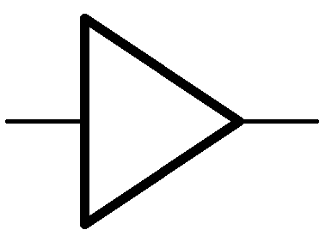
X
F = X=m₁
Digital Buffer
X’
X
X

Slide 25
Truth table ↔ minterm

Slide 26
Y | X | F = F(Y,X) = ?
0 | 0 | ?
0 | 1 | ?
1 | 0 | ?
1 | 1 | ?

Slide 27
Y | X | F = F(Y,X) = 0
0 | 0 | 0
0 | 1 | 0
1 | 0 | 0
1 | 1 | 0

Slide 28
Y | X | F = F(Y,X) = YX
0 | 0 | 0
0 | 1 | 0
1 | 0 | 0
1 | 1 | 1

Slide 29

X
F = YX = m₃
Y

Slide 30
m₀ | Y’X’
m₁ | Y’X
m₂ | YX’
m₃ | YX

Slide 31
Y | X | F = F(Y,X) = YX =m₃
0 | 0 | 0
0 | 1 | 0
1 | 0 | 0
1 | 1 | 1

Slide 32
Y | X | F = F(Y,X) = YX =m₃
0 | 0 | 0
0 | 1 | 0
1 | 0 | 0
1 | 1 | 1

Slide 33
Y | X | F = F(Y,X) = YX’ =m₂
0 | 0 | 0
0 | 1 | 0
1 | 0 | 1
1 | 1 | 0

Slide 34
Y | X | F = F(Y,X) = YX’ =m₂
0 | 0 | 0
0 | 1 | 0
1 | 0 | 1
1 | 1 | 0

Slide 35
X
F = YX’ = m₂
Y

Slide 36
Y | X | F = F(Y,X) = Y’X =m₁
0 | 0 | 0
0 | 1 | 1
1 | 0 | 0
1 | 1 | 0

Slide 37
Y | X | F = F(Y,X) = Y’X =m₁
0 | 0 | 0
0 | 1 | 1
1 | 0 | 0
1 | 1 | 0

Slide 38
X
F = Y’X=m₁
Y

Slide 39
Y | X | F = F(Y,X) = Y’X’ =m₀
0 | 0 | 1
0 | 1 | 0
1 | 0 | 0
1 | 1 | 0

Slide 40
Y | X | F = F(Y,X) = Y’X’ =m₀
0 | 0 | 1
0 | 1 | 0
1 | 0 | 0
1 | 1 | 0

Slide 41
X
F = Y’X’=m₀
Y

Slide 42
Y | X | F = F(Y,X) = ?
0 | 0 | 1
0 | 1 | 1
1 | 0 | 0
1 | 1 | 0

Slide 43
Y | X | F = F(Y,X) = Y’X’
0 | 0 | 1
0 | 1 | 1
1 | 0 | 0
1 | 1 | 0

Slide 44
Y | X | F = F(Y,X) = Y’X’+Y’X
0 | 0 | 1
0 | 1 | 1
1 | 0 | 0
1 | 1 | 0

Slide 45
Y | X | F = F(Y,X) = m₀+m₁
0 | 0 | 1
0 | 1 | 1
1 | 0 | 0
1 | 1 | 0

Slide 46
Y | X | F = F(Y,X) = ∑m(0,1)
0 | 0 | 1
0 | 1 | 1
1 | 0 | 0
1 | 1 | 0

Slide 47

Y
X
Y’X’
Y’X’+Y’X
Y’X

Slide 48
Y
X
Y’X’
Y’X’+Y’X
Y’X

Slide 49
Y | X | F = F(Y,X) = ?
0 | 0 | 0
0 | 1 | 1
1 | 0 | 1
1 | 1 | 0

Slide 50
Y | X | F = F(Y,X) = Y’X
0 | 0 | 0
0 | 1 | 1
1 | 0 | 1
1 | 1 | 0

Slide 51
Y | X | F = F(Y,X) = m₁+m₂
0 | 0 | 0
0 | 1 | 1
1 | 0 | 1
1 | 1 | 0

Slide 52
Y | X | F = F(Y,X) = ∑m(1,2)
0 | 0 | 0
0 | 1 | 1
1 | 0 | 1
1 | 1 | 0

Slide 53
Y
Y
X
X
Y’X
Y’X+YX’
YX’

Slide 54
Exclusive-OR (XOR)
X
Y+X
Y
Y | X | F = F(Y,X) = Y’X+YX’ = m₁+m₂
0 | 0 | 0
0 | 1 | 1
1 | 0 | 1
1 | 1 | 0

Slide 55
Y | X | F = F(Y,X) = ?
0 | 0 | 1
0 | 1 | 0
1 | 0 | 0
1 | 1 | 1

Slide 56
Y | X | F = F(Y,X) = Y’X’
0 | 0 | 1
0 | 1 | 0
1 | 0 | 0
1 | 1 | 1

Slide 57
Y | X | F = F(Y,X) = Y’X’+YX
0 | 0 | 1
0 | 1 | 0
1 | 0 | 0
1 | 1 | 1

Slide 58
Y | X | F = F(Y,X) = m₀+m₃
0 | 0 | 1
0 | 1 | 0
1 | 0 | 0
1 | 1 | 1

Slide 59
Y | X | F = F(Y,X) = ∑m(0,3)
0 | 0 | 1
0 | 1 | 0
1 | 0 | 0
1 | 1 | 1

Slide 60
Y
Y
X
X
Y’X’
Y’X’+YX
YX

Slide 61
NOT Exclusive-OR (XNOR)
X
Y X
Y
Y | X | F = F(Y,X) = Y’X’+YX = m₀+m₃
0 | 0 | 1
0 | 1 | 0
1 | 0 | 0
1 | 1 | 1

Slide 62
Y | X | F = F(Y,X) = ?
0 | 0 | 1
0 | 1 | 1
1 | 0 | 0
1 | 1 | 1

Slide 63
Y | X | F = F(Y,X) = Y’X’
0 | 0 | 1
0 | 1 | 1
1 | 0 | 0
1 | 1 | 1

Slide 64
Y | X | F = F(Y,X) = Y’X’+Y’X
0 | 0 | 1
0 | 1 | 1
1 | 0 | 0
1 | 1 | 1

Slide 65
Y | X | F = F(Y,X) = Y’X’+Y’X+YX
0 | 0 | 1
0 | 1 | 1
1 | 0 | 0
1 | 1 | 1

Slide 66
Y | X | F=F(Y,X)=m₀+m₁+m₃ =∑m(0,1,3)
0 | 0 | 1
0 | 1 | 1
1 | 0 | 0
1 | 1 | 1

Slide 67
Y
Y
X
X
Y’X’
Y’X
Y’X’+Y’X+YX
YX

Slide 68
SUM OF PRODUCTS
(SOP)

Slide 69
Y
Y
X
X
Y’X’
Y’X
Y’X’+Y’X+YX
YX

Slide 70
2 LEVELS
AND → OR

Slide 71
Y
Y
X
X
Y’X’
Y’X
Y’X’+Y’X+YX
YX

Slide 72
Given 3 inputs, design a circuit to determine if there is even number of 1

Slide 73
Truth table ↔ minterm

Slide 74
INPUTS/Binary Variables
OUTPUTS/Boolean Functions

Slide 75
Z | Y | X | F(Z,Y,X)=?
0 | 0 | 0 | ?
0 | 0 | 1 | ?
0 | 1 | 0 | ?
0 | 1 | 1 | ?
1 | 0 | 0 | ?
1 | 0 | 1 | ?
1 | 1 | 0 | ?
1 | 1 | 1 | ?

Slide 76
Z | Y | X | F(Z,Y,X)=?
0 | 0 | 0 | 1
0 | 0 | 1 | 0
0 | 1 | 0 | 0
0 | 1 | 1 | 1
1 | 0 | 0 | 0
1 | 0 | 1 | 1
1 | 1 | 0 | 1
1 | 1 | 1 | 0

Slide 77
Z | Y | X | F(Z,Y,X)=Z’Y’X’
0 | 0 | 0 | 1
0 | 0 | 1 | 0
0 | 1 | 0 | 0
0 | 1 | 1 | 1
1 | 0 | 0 | 0
1 | 0 | 1 | 1
1 | 1 | 0 | 1
1 | 1 | 1 | 0

Slide 78
Z | Y | X | F(Z,Y,X)=Z’Y’X’+Z’YX
0 | 0 | 0 | 1
0 | 0 | 1 | 0
0 | 1 | 0 | 0
0 | 1 | 1 | 1
1 | 0 | 0 | 0
1 | 0 | 1 | 1
1 | 1 | 0 | 1
1 | 1 | 1 | 0

Slide 79
Z | Y | X | F(Z,Y,X)=Z’Y’X’+Z’YX+ZY’X
0 | 0 | 0 | 1
0 | 0 | 1 | 0
0 | 1 | 0 | 0
0 | 1 | 1 | 1
1 | 0 | 0 | 0
1 | 0 | 1 | 1
1 | 1 | 0 | 1
1 | 1 | 1 | 0

Slide 80
Z | Y | X | F(Z,Y,X)=Z’Y’X’+Z’YX+ZY’X+ZYX’
0 | 0 | 0 | 1
0 | 0 | 1 | 0
0 | 1 | 0 | 0
0 | 1 | 1 | 1
1 | 0 | 0 | 0
1 | 0 | 1 | 1
1 | 1 | 0 | 1
1 | 1 | 1 | 0

Slide 81
Z | Y | X | F(Z,Y,X)=m₀+m₃+m₅+m₆
0 | 0 | 0 | 1
0 | 0 | 1 | 0
0 | 1 | 0 | 0
0 | 1 | 1 | 1
1 | 0 | 0 | 0
1 | 0 | 1 | 1
1 | 1 | 0 | 1
1 | 1 | 1 | 0

Slide 82
Z | Y | X | F(Z,Y,X)=m₀+m₃+m₅+m₆=∑m(0,3,5,6)
0 | 0 | 0 | 1
0 | 0 | 1 | 0
0 | 1 | 0 | 0
0 | 1 | 1 | 1
1 | 0 | 0 | 0
1 | 0 | 1 | 1
1 | 1 | 0 | 1
1 | 1 | 1 | 0

Slide 83
Y
Y
X
Z
X
Z’Y’X’+Z’YX+ZY’X+ZYX’

Slide 84
SUM OF PRODUCTS (SOP)
2 LEVELS AND-OR

Slide 85
Y
Y
X
Z
X
Z’Y’X’+Z’YX+ZY’X+ZYX’

Slide 86
Y
Y
X
Z
X
Z’Y’X’+Z’YX+ZY’X+ZYX’

Slide 87
Show the remainder (MOD)
number % 3 = ?

Slide 88
Truth table ↔ minterm

Slide 89
INPUTS/Binary Variables
OUTPUTS/Boolean Functions

Slide 90
What is the range of numbers?

Slide 91
What is the range of numbers?
[0, 15]₁₀

Slide 92
How many input binary variables?
[0, 15]₁₀ = [0,1111]₂ = [0000,1111]₂

Slide 93
W | Z | Y | X
0 | 0 | 0 | 0
0 | 0 | 0 | 1
0 | 0 | 1 | 0
0 | 0 | 1 | 1
0 | 1 | 0 | 0
0 | 1 | 0 | 1
0 | 1 | 1 | 0
0 | 1 | 1 | 1
1 | 0 | 0 | 0
1 | 0 | 0 | 1
1 | 0 | 1 | 0
1 | 0 | 1 | 1
1 | 1 | 0 | 0
1 | 1 | 0 | 1
1 | 1 | 1 | 0
1 | 1 | 1 | 1

Slide 94
What is the range of output?

Slide 95
What is the range of output?
The remainder of any number divided by 3 is 0, 1, 2

Slide 96
What is the range of output?
[0, 2]₁₀

Slide 97
How many Boolean function?
[0, 2]₁₀ = [0, 10]₂ = [00, 10]₂

Slide 98
W | Z | Y | X | F₁ | F₂
0 | 0 | 0 | 0
0 | 0 | 0 | 1
0 | 0 | 1 | 0
0 | 0 | 1 | 1
0 | 1 | 0 | 0
0 | 1 | 0 | 1
0 | 1 | 1 | 0
0 | 1 | 1 | 1
1 | 0 | 0 | 0
1 | 0 | 0 | 1
1 | 0 | 1 | 0
1 | 0 | 1 | 1
1 | 1 | 0 | 0
1 | 1 | 0 | 1
1 | 1 | 1 | 0
1 | 1 | 1 | 1

Slide 99
W | Z | Y | X | F₁ | F₂
0 | 0 | 0 | 0 | 0 | 0
0 | 0 | 0 | 1
0 | 0 | 1 | 0
0 | 0 | 1 | 1
0 | 1 | 0 | 0
0 | 1 | 0 | 1
0 | 1 | 1 | 0
0 | 1 | 1 | 1
1 | 0 | 0 | 0
1 | 0 | 0 | 1
1 | 0 | 1 | 0
1 | 0 | 1 | 1
1 | 1 | 0 | 0
1 | 1 | 0 | 1
1 | 1 | 1 | 0
1 | 1 | 1 | 1

Slide 100
W | Z | Y | X | F₁ | F₂
0 | 0 | 0 | 0 | 0 | 0
0 | 0 | 0 | 1 | 0 | 1
0 | 0 | 1 | 0
0 | 0 | 1 | 1
0 | 1 | 0 | 0
0 | 1 | 0 | 1
0 | 1 | 1 | 0
0 | 1 | 1 | 1
1 | 0 | 0 | 0
1 | 0 | 0 | 1
1 | 0 | 1 | 0
1 | 0 | 1 | 1
1 | 1 | 0 | 0
1 | 1 | 0 | 1
1 | 1 | 1 | 0
1 | 1 | 1 | 1

Slide 101
W | Z | Y | X | F₁ | F₂
0 | 0 | 0 | 0 | 0 | 0
0 | 0 | 0 | 1 | 0 | 1
0 | 0 | 1 | 0 | 1 | 0
0 | 0 | 1 | 1
0 | 1 | 0 | 0
0 | 1 | 0 | 1
0 | 1 | 1 | 0
0 | 1 | 1 | 1
1 | 0 | 0 | 0
1 | 0 | 0 | 1
1 | 0 | 1 | 0
1 | 0 | 1 | 1
1 | 1 | 0 | 0
1 | 1 | 0 | 1
1 | 1 | 1 | 0
1 | 1 | 1 | 1

Slide 102
W | Z | Y | X | F₁ | F₂
0 | 0 | 0 | 0 | 0 | 0
0 | 0 | 0 | 1 | 0 | 1
0 | 0 | 1 | 0 | 1 | 0
0 | 0 | 1 | 1 | 0 | 0
0 | 1 | 0 | 0
0 | 1 | 0 | 1
0 | 1 | 1 | 0
0 | 1 | 1 | 1
1 | 0 | 0 | 0
1 | 0 | 0 | 1
1 | 0 | 1 | 0
1 | 0 | 1 | 1
1 | 1 | 0 | 0
1 | 1 | 0 | 1
1 | 1 | 1 | 0
1 | 1 | 1 | 1

Slide 103
W | Z | Y | X | F₁ | F₂
0 | 0 | 0 | 0 | 0 | 0
0 | 0 | 0 | 1 | 0 | 1
0 | 0 | 1 | 0 | 1 | 0
0 | 0 | 1 | 1 | 0 | 0
0 | 1 | 0 | 0 | 0 | 1
0 | 1 | 0 | 1 | 1 | 0
0 | 1 | 1 | 0 | 0 | 0
0 | 1 | 1 | 1 | 0 | 1
1 | 0 | 0 | 0 | 1 | 0
1 | 0 | 0 | 1 | 0 | 0
1 | 0 | 1 | 0 | 0 | 1
1 | 0 | 1 | 1 | 1 | 0
1 | 1 | 0 | 0 | 0 | 0
1 | 1 | 0 | 1 | 0 | 1
1 | 1 | 1 | 0 | 1 | 0
1 | 1 | 1 | 1 | 0 | 0

Slide 104
minterms

Slide 105
W | Z | Y | X | F₁=m₂+m₅+m₈+m₁₁+m₁₄ | F₂
0 | 0 | 0 | 0 | 0 | 0
0 | 0 | 0 | 1 | 0 | 1
0 | 0 | 1 | 0 | 1 | 0
0 | 0 | 1 | 1 | 0 | 0
0 | 1 | 0 | 0 | 0 | 1
0 | 1 | 0 | 1 | 1 | 0
0 | 1 | 1 | 0 | 0 | 0
0 | 1 | 1 | 1 | 0 | 1
1 | 0 | 0 | 0 | 1 | 0
1 | 0 | 0 | 1 | 0 | 0
1 | 0 | 1 | 0 | 0 | 1
1 | 0 | 1 | 1 | 1 | 0
1 | 1 | 0 | 0 | 0 | 0
1 | 1 | 0 | 1 | 0 | 1
1 | 1 | 1 | 0 | 1 | 0
1 | 1 | 1 | 1 | 0 | 0

Slide 106
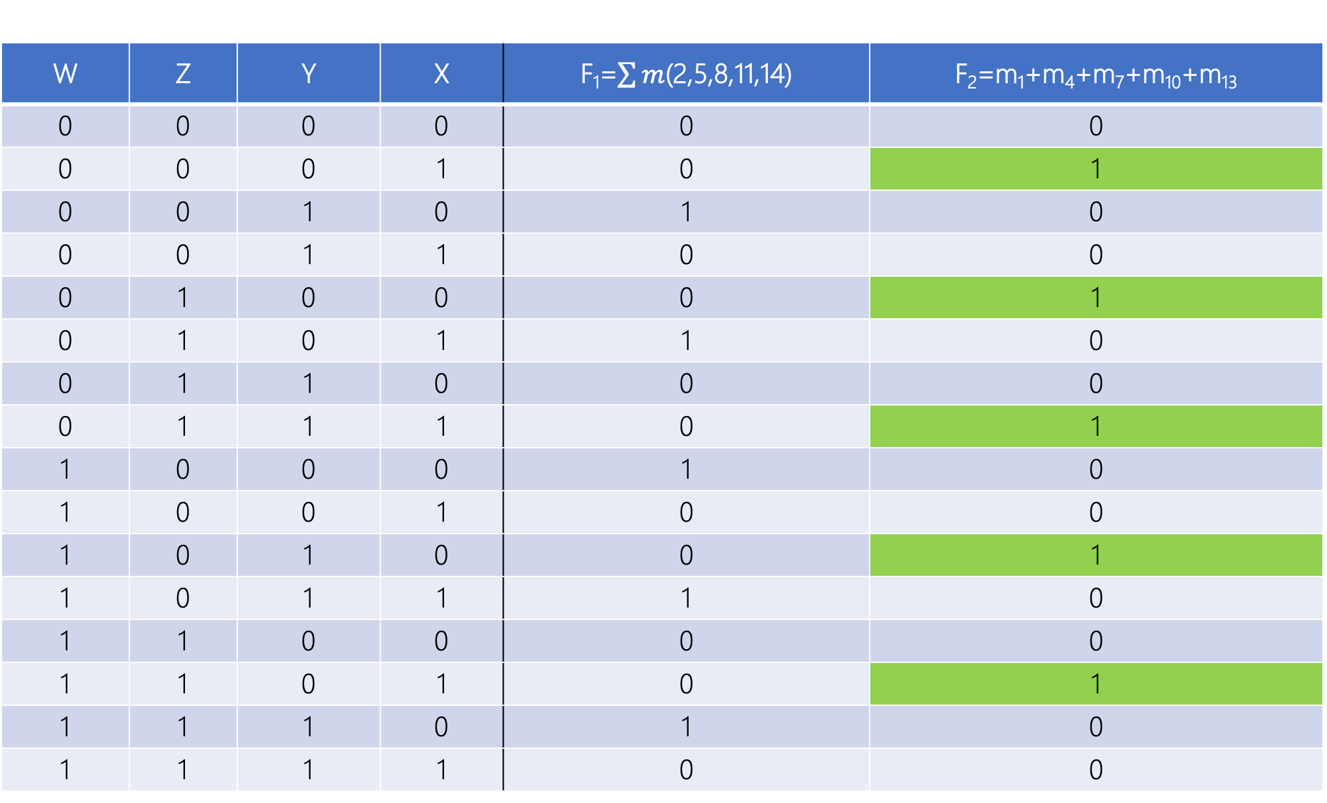
W | Z | Y | X | F₁=$\sum{m}$(2,5,8,11,14) | F₂=m₁+m₄+m₇+m₁₀+m₁₃
0 | 0 | 0 | 0 | 0 | 0
0 | 0 | 0 | 1 | 0 | 1
0 | 0 | 1 | 0 | 1 | 0
0 | 0 | 1 | 1 | 0 | 0
0 | 1 | 0 | 0 | 0 | 1
0 | 1 | 0 | 1 | 1 | 0
0 | 1 | 1 | 0 | 0 | 0
0 | 1 | 1 | 1 | 0 | 1
1 | 0 | 0 | 0 | 1 | 0
1 | 0 | 0 | 1 | 0 | 0
1 | 0 | 1 | 0 | 0 | 1
1 | 0 | 1 | 1 | 1 | 0
1 | 1 | 0 | 0 | 0 | 0
1 | 1 | 0 | 1 | 0 | 1
1 | 1 | 1 | 0 | 1 | 0
1 | 1 | 1 | 1 | 0 | 0

Slide 107
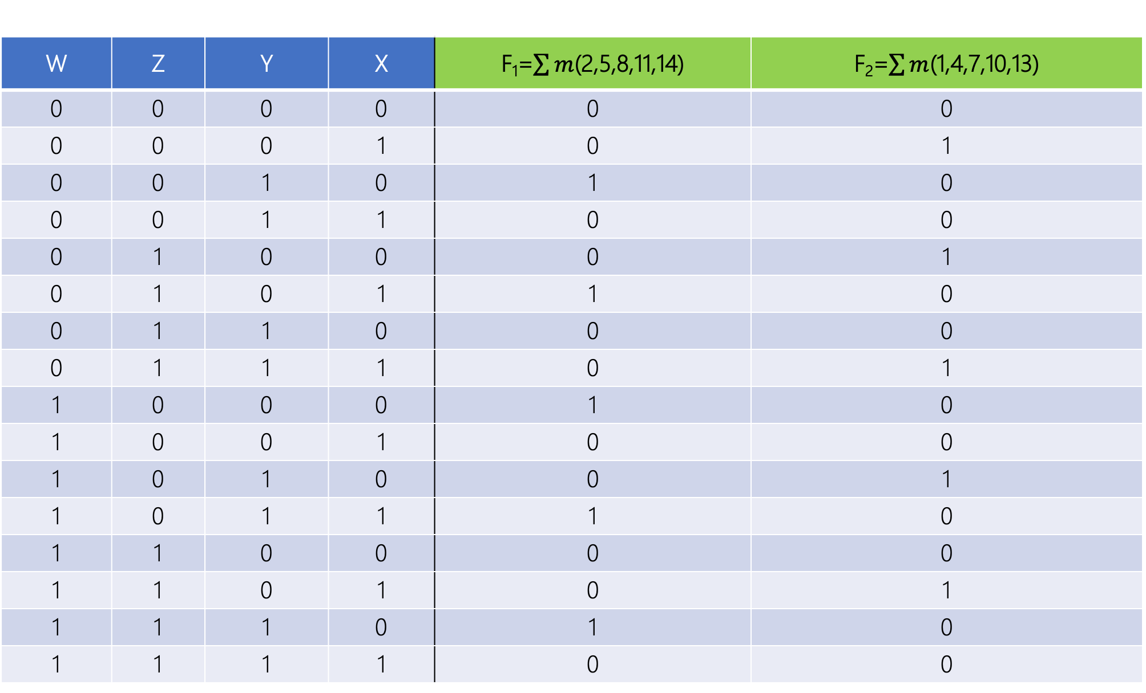
W | Z | Y | X | F₁=$\sum{m}$(2,5,8,11,14) | F₂=$\sum{m}$(1,4,7,10,13)
0 | 0 | 0 | 0 | 0 | 0
0 | 0 | 0 | 1 | 0 | 1
0 | 0 | 1 | 0 | 1 | 0
0 | 0 | 1 | 1 | 0 | 0
0 | 1 | 0 | 0 | 0 | 1
0 | 1 | 0 | 1 | 1 | 0
0 | 1 | 1 | 0 | 0 | 0
0 | 1 | 1 | 1 | 0 | 1
1 | 0 | 0 | 0 | 1 | 0
1 | 0 | 0 | 1 | 0 | 0
1 | 0 | 1 | 0 | 0 | 1
1 | 0 | 1 | 1 | 1 | 0
1 | 1 | 0 | 0 | 0 | 0
1 | 1 | 0 | 1 | 0 | 1
1 | 1 | 1 | 0 | 1 | 0
1 | 1 | 1 | 1 | 0 | 0

Slide 108
