Slide 1
Design
an algorithm for designing any digital units (logic circuits), given truth table

Slide 2
minterm
aka. Standard Product

Slide 3
Truth table
en.wikipedia.org/wiki/Truth_table

Slide 4
SUM OF PRODUCTS (SOP)
2 LEVELS AND-OR
with product meaning the ANDing
with sum meaning the ORing

Slide 5
Z | Y | X | F(Z,Y,X)=m₀+m₃+m₅+m₆=∑m(0,3,5,6)
0 | 0 | 0 | 1
0 | 0 | 1 | 0
0 | 1 | 0 | 0
0 | 1 | 1 | 1
1 | 0 | 0 | 0
1 | 0 | 1 | 1
1 | 1 | 0 | 1
1 | 1 | 1 | 0

Slide 6



Y
Y
X
Z
X
F=Z’Y’X’+Z’YX+ZY’X+ZYX’

Slide 7
Y
Y
X
Z
X
F=Z’Y’X’+Z’YX+ZY’X+ZYX’

Slide 8
Multiple Boolean functions
F₁, F₂, …

Slide 9
Z | Y | X | F₁(Z,Y,X)=∑m(0,3,5,6)
0 | 0 | 0 | 1
0 | 0 | 1 | 0
0 | 1 | 0 | 0
0 | 1 | 1 | 1
1 | 0 | 0 | 0
1 | 0 | 1 | 1
1 | 1 | 0 | 1
1 | 1 | 1 | 0

Slide 10
Y
Y
X
Z
X
F₁=Z’Y’X’+Z’YX+ZY’X+ZYX’

Slide 11
Z | Y | X | F₂(Z,Y,X)=∑m(4,5)
0 | 0 | 0 | 0
0 | 0 | 1 | 0
0 | 1 | 0 | 0
0 | 1 | 1 | 0
1 | 0 | 0 | 1
1 | 0 | 1 | 1
1 | 1 | 0 | 0
1 | 1 | 1 | 0

Slide 12
Y
Y
X
Z
X
F₂=ZY’X’+ZY’X

Slide 13
Z | Y | X | F₁(Z,Y,X)=∑m(0,3,5,6) | F₂(Z,Y,X)=∑m(4,5)
0 | 0 | 0 | 1 | 0
0 | 0 | 1 | 0 | 0
0 | 1 | 0 | 0 | 0
0 | 1 | 1 | 1 | 0
1 | 0 | 0 | 0 | 1
1 | 0 | 1 | 1 | 1
1 | 1 | 0 | 1 | 0
1 | 1 | 1 | 0 | 0

Slide 14
Z
Y
X
F₁=Z’Y’X’+Z’YX+ZY’X+ZYX’
F₂=ZY’X’+ZY’X
Re-use minterms

Slide 15
Show the remainder (MOD)
number % 3 = ?

Slide 16
Truth table ↔ minterm

Slide 17
INPUTS/Binary Variables
OUTPUTS/Boolean Functions

Slide 18
What is the range of numbers?

Slide 19
What is the range of numbers?
[0, 15]₁₀

Slide 20
How many input binary variables?
[0, 15]₁₀ = [0,1111]₂ = [0000,1111]₂

Slide 21
W | Z | Y | X
0 | 0 | 0 | 0
0 | 0 | 0 | 1
0 | 0 | 1 | 0
0 | 0 | 1 | 1
0 | 1 | 0 | 0
0 | 1 | 0 | 1
0 | 1 | 1 | 0
0 | 1 | 1 | 1
1 | 0 | 0 | 0
1 | 0 | 0 | 1
1 | 0 | 1 | 0
1 | 0 | 1 | 1
1 | 1 | 0 | 0
1 | 1 | 0 | 1
1 | 1 | 1 | 0
1 | 1 | 1 | 1

Slide 22
What is the range of output?

Slide 23
What is the range of output?
The remainder of any number divided by 3 is 0, 1, 2

Slide 24
What is the range of output?
[0, 2]₁₀

Slide 25
How many Boolean function?
[0, 2]₁₀ = [0, 10]₂ = [00, 10]₂

Slide 26
W | Z | Y | X | F₁ | F₂
0 | 0 | 0 | 0
0 | 0 | 0 | 1
0 | 0 | 1 | 0
0 | 0 | 1 | 1
0 | 1 | 0 | 0
0 | 1 | 0 | 1
0 | 1 | 1 | 0
0 | 1 | 1 | 1
1 | 0 | 0 | 0
1 | 0 | 0 | 1
1 | 0 | 1 | 0
1 | 0 | 1 | 1
1 | 1 | 0 | 0
1 | 1 | 0 | 1
1 | 1 | 1 | 0
1 | 1 | 1 | 1

Slide 27
W | Z | Y | X | F₁ | F₂
0 | 0 | 0 | 0 | 0 | 0
0 | 0 | 0 | 1
0 | 0 | 1 | 0
0 | 0 | 1 | 1
0 | 1 | 0 | 0
0 | 1 | 0 | 1
0 | 1 | 1 | 0
0 | 1 | 1 | 1
1 | 0 | 0 | 0
1 | 0 | 0 | 1
1 | 0 | 1 | 0
1 | 0 | 1 | 1
1 | 1 | 0 | 0
1 | 1 | 0 | 1
1 | 1 | 1 | 0
1 | 1 | 1 | 1

Slide 28
W | Z | Y | X | F₁ | F₂
0 | 0 | 0 | 0 | 0 | 0
0 | 0 | 0 | 1 | 0 | 1
0 | 0 | 1 | 0
0 | 0 | 1 | 1
0 | 1 | 0 | 0
0 | 1 | 0 | 1
0 | 1 | 1 | 0
0 | 1 | 1 | 1
1 | 0 | 0 | 0
1 | 0 | 0 | 1
1 | 0 | 1 | 0
1 | 0 | 1 | 1
1 | 1 | 0 | 0
1 | 1 | 0 | 1
1 | 1 | 1 | 0
1 | 1 | 1 | 1

Slide 29
W | Z | Y | X | F₁ | F₂
0 | 0 | 0 | 0 | 0 | 0
0 | 0 | 0 | 1 | 0 | 1
0 | 0 | 1 | 0 | 1 | 0
0 | 0 | 1 | 1
0 | 1 | 0 | 0
0 | 1 | 0 | 1
0 | 1 | 1 | 0
0 | 1 | 1 | 1
1 | 0 | 0 | 0
1 | 0 | 0 | 1
1 | 0 | 1 | 0
1 | 0 | 1 | 1
1 | 1 | 0 | 0
1 | 1 | 0 | 1
1 | 1 | 1 | 0
1 | 1 | 1 | 1

Slide 30
W | Z | Y | X | F₁ | F₂
0 | 0 | 0 | 0 | 0 | 0
0 | 0 | 0 | 1 | 0 | 1
0 | 0 | 1 | 0 | 1 | 0
0 | 0 | 1 | 1 | 0 | 0
0 | 1 | 0 | 0
0 | 1 | 0 | 1
0 | 1 | 1 | 0
0 | 1 | 1 | 1
1 | 0 | 0 | 0
1 | 0 | 0 | 1
1 | 0 | 1 | 0
1 | 0 | 1 | 1
1 | 1 | 0 | 0
1 | 1 | 0 | 1
1 | 1 | 1 | 0
1 | 1 | 1 | 1

Slide 31
W | Z | Y | X | F₁ | F₂
0 | 0 | 0 | 0 | 0 | 0
0 | 0 | 0 | 1 | 0 | 1
0 | 0 | 1 | 0 | 1 | 0
0 | 0 | 1 | 1 | 0 | 0
0 | 1 | 0 | 0 | 0 | 1
0 | 1 | 0 | 1 | 1 | 0
0 | 1 | 1 | 0 | 0 | 0
0 | 1 | 1 | 1 | 0 | 1
1 | 0 | 0 | 0 | 1 | 0
1 | 0 | 0 | 1 | 0 | 0
1 | 0 | 1 | 0 | 0 | 1
1 | 0 | 1 | 1 | 1 | 0
1 | 1 | 0 | 0 | 0 | 0
1 | 1 | 0 | 1 | 0 | 1
1 | 1 | 1 | 0 | 1 | 0
1 | 1 | 1 | 1 | 0 | 0

Slide 32
minterms

Slide 33
W | Z | Y | X | F₁=m₂+m₅+m₈+m₁₁+m₁₄ | F₂
0 | 0 | 0 | 0 | 0 | 0
0 | 0 | 0 | 1 | 0 | 1
0 | 0 | 1 | 0 | 1 | 0
0 | 0 | 1 | 1 | 0 | 0
0 | 1 | 0 | 0 | 0 | 1
0 | 1 | 0 | 1 | 1 | 0
0 | 1 | 1 | 0 | 0 | 0
0 | 1 | 1 | 1 | 0 | 1
1 | 0 | 0 | 0 | 1 | 0
1 | 0 | 0 | 1 | 0 | 0
1 | 0 | 1 | 0 | 0 | 1
1 | 0 | 1 | 1 | 1 | 0
1 | 1 | 0 | 0 | 0 | 0
1 | 1 | 0 | 1 | 0 | 1
1 | 1 | 1 | 0 | 1 | 0
1 | 1 | 1 | 1 | 0 | 0

Slide 34
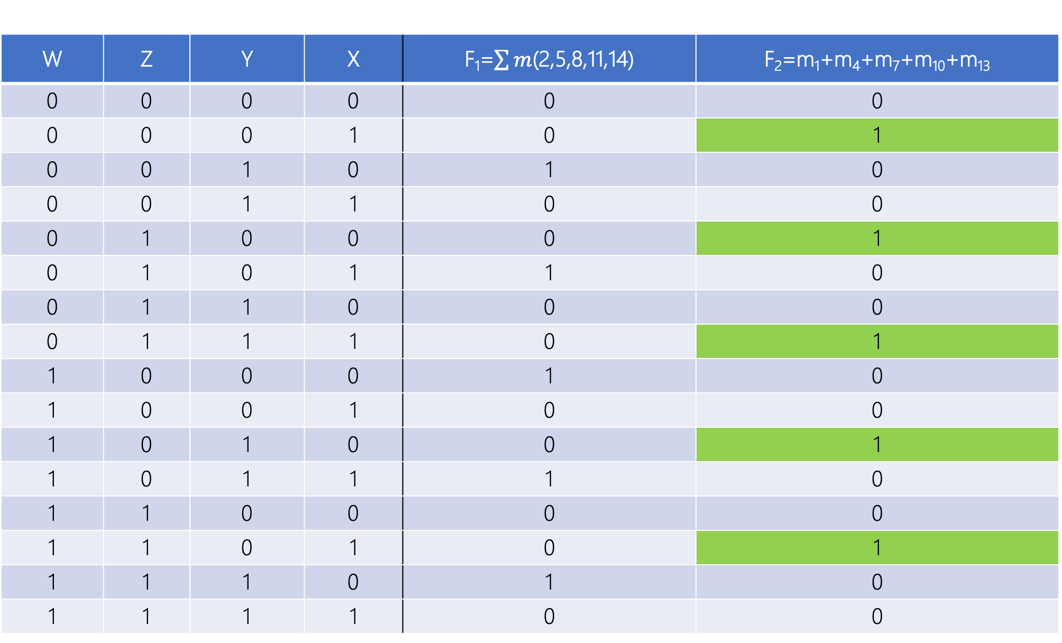
W | Z | Y | X | F₁=$\sum{m}$(2,5,8,11,14) | F₂=m₁+m₄+m₇+m₁₀+m₁₃
0 | 0 | 0 | 0 | 0 | 0
0 | 0 | 0 | 1 | 0 | 1
0 | 0 | 1 | 0 | 1 | 0
0 | 0 | 1 | 1 | 0 | 0
0 | 1 | 0 | 0 | 0 | 1
0 | 1 | 0 | 1 | 1 | 0
0 | 1 | 1 | 0 | 0 | 0
0 | 1 | 1 | 1 | 0 | 1
1 | 0 | 0 | 0 | 1 | 0
1 | 0 | 0 | 1 | 0 | 0
1 | 0 | 1 | 0 | 0 | 1
1 | 0 | 1 | 1 | 1 | 0
1 | 1 | 0 | 0 | 0 | 0
1 | 1 | 0 | 1 | 0 | 1
1 | 1 | 1 | 0 | 1 | 0
1 | 1 | 1 | 1 | 0 | 0

Slide 35
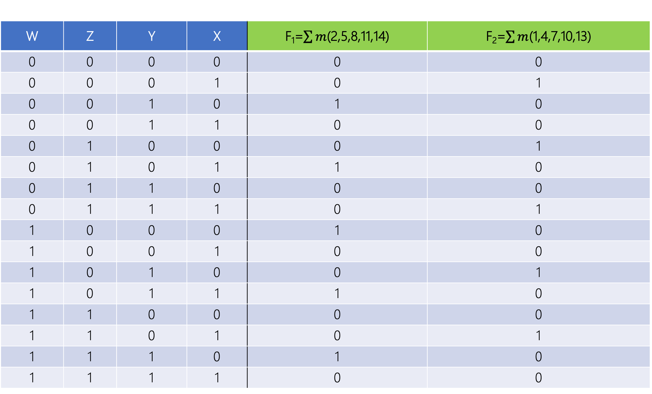
W | Z | Y | X | F₁=$\sum{m}$(2,5,8,11,14) | F₂=$\sum{m}$(1,4,7,10,13)
0 | 0 | 0 | 0 | 0 | 0
0 | 0 | 0 | 1 | 0 | 1
0 | 0 | 1 | 0 | 1 | 0
0 | 0 | 1 | 1 | 0 | 0
0 | 1 | 0 | 0 | 0 | 1
0 | 1 | 0 | 1 | 1 | 0
0 | 1 | 1 | 0 | 0 | 0
0 | 1 | 1 | 1 | 0 | 1
1 | 0 | 0 | 0 | 1 | 0
1 | 0 | 0 | 1 | 0 | 0
1 | 0 | 1 | 0 | 0 | 1
1 | 0 | 1 | 1 | 1 | 0
1 | 1 | 0 | 0 | 0 | 0
1 | 1 | 0 | 1 | 0 | 1
1 | 1 | 1 | 0 | 1 | 0
1 | 1 | 1 | 1 | 0 | 0

Slide 36
Circuit /Logic Diagram

Slide 37
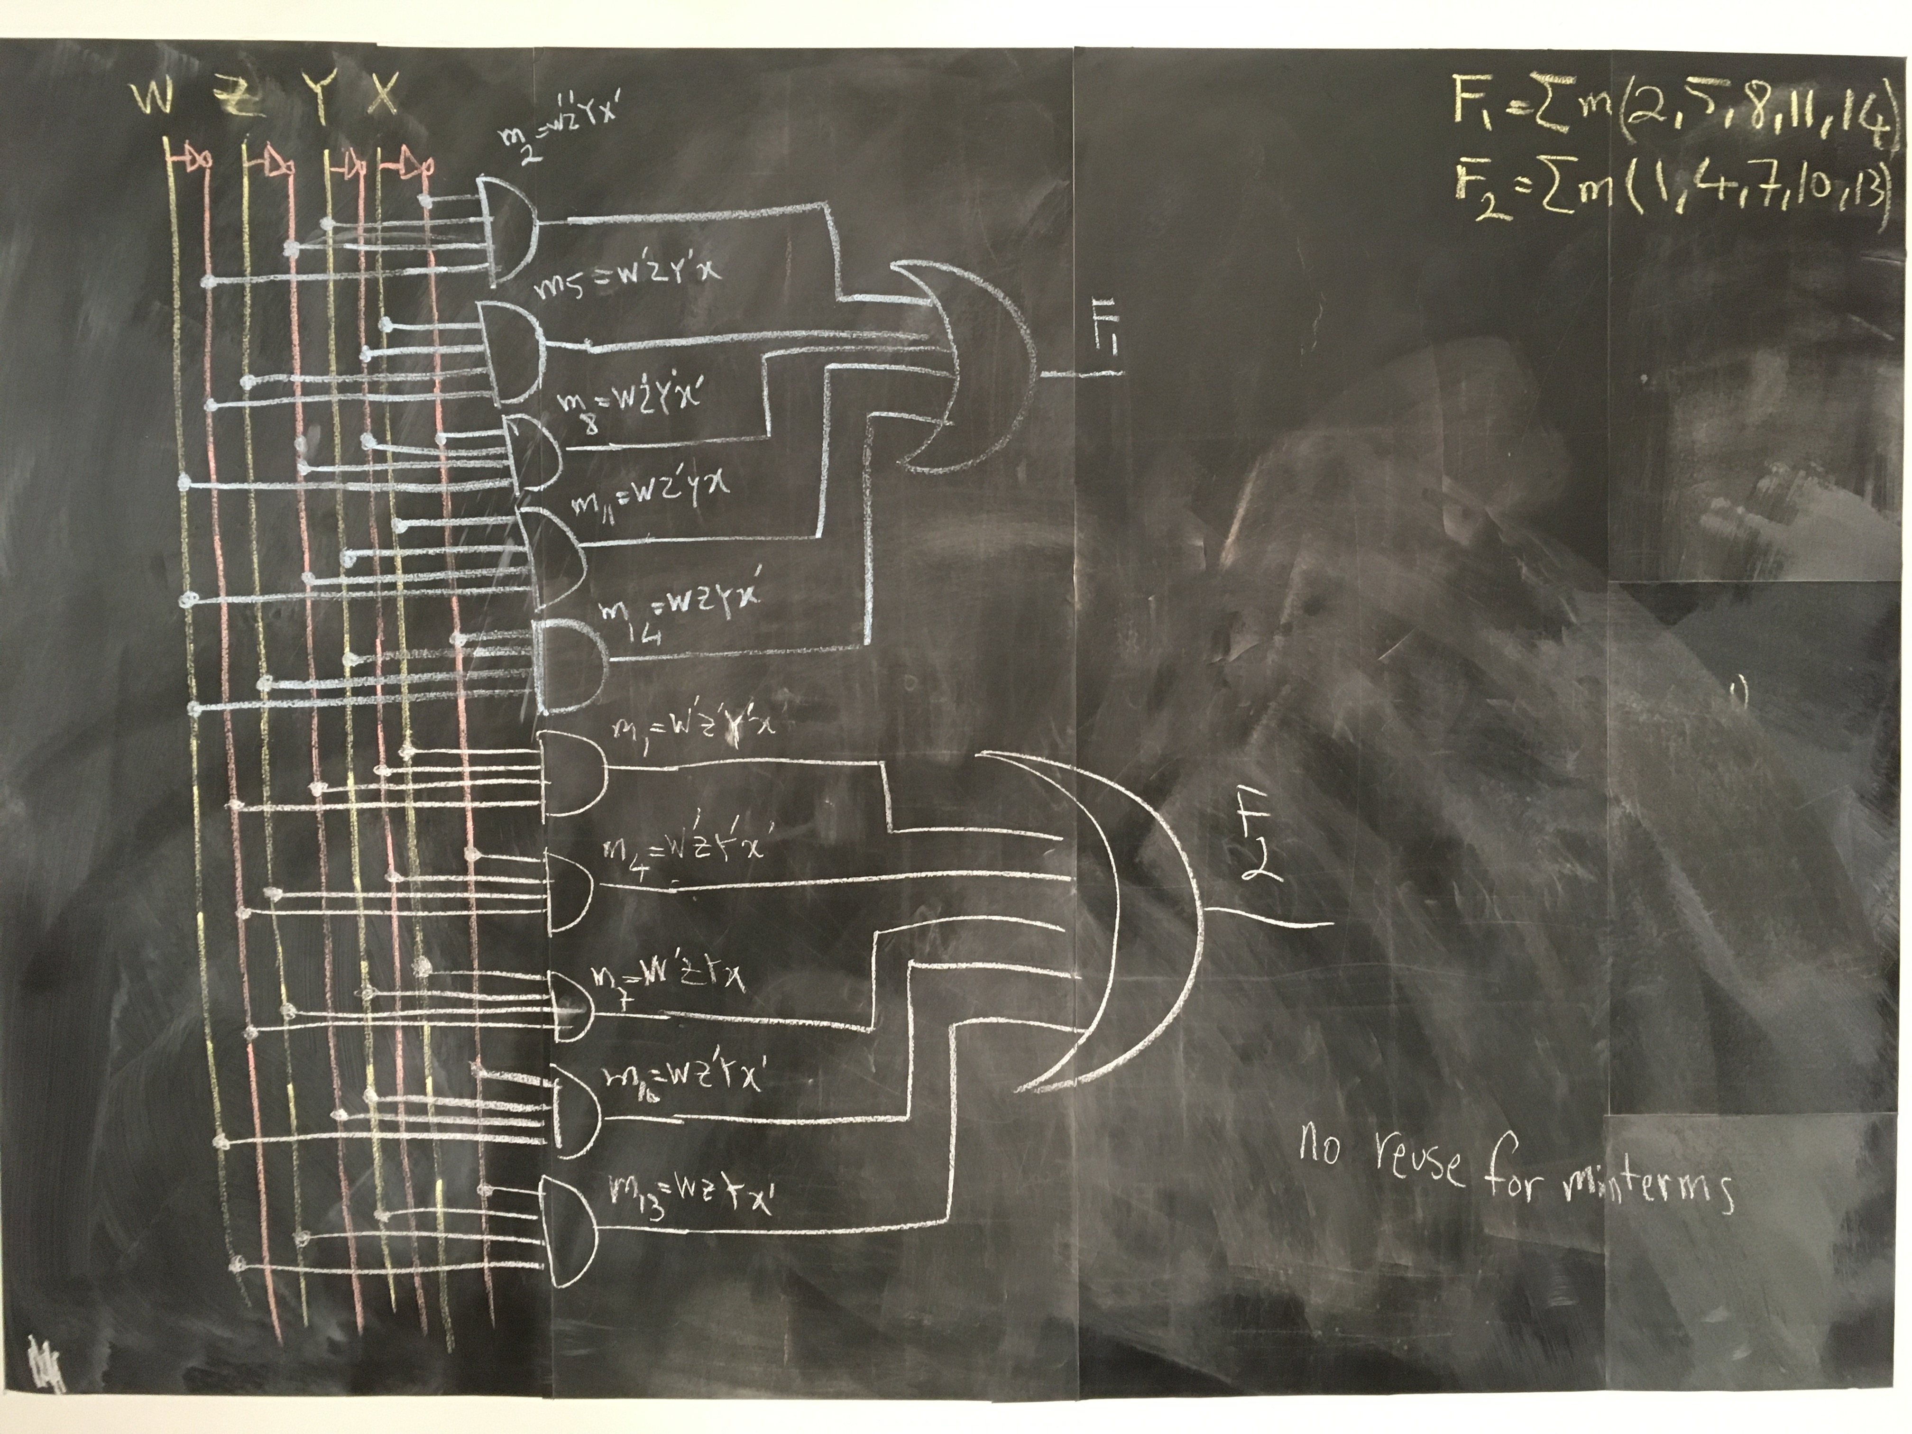

Slide 38
Design II
a new algorithm for designing any logic circuits, given truth table

Slide 39
MAXTERM
aka. Standard Sum

Slide 40
X’ vs. x
1 binary variable appear either:
in its normal form X, or
in its complement form X’

Slide 41
M₀=m’₀ | (X’)=(X’)’=X
M₁=m’₁ | X’

Slide 42
Y+X vs. Y+X’ vs. Y’+x vs. Y’+X’
2 binary variables appear either in one of these forms:

Slide 43
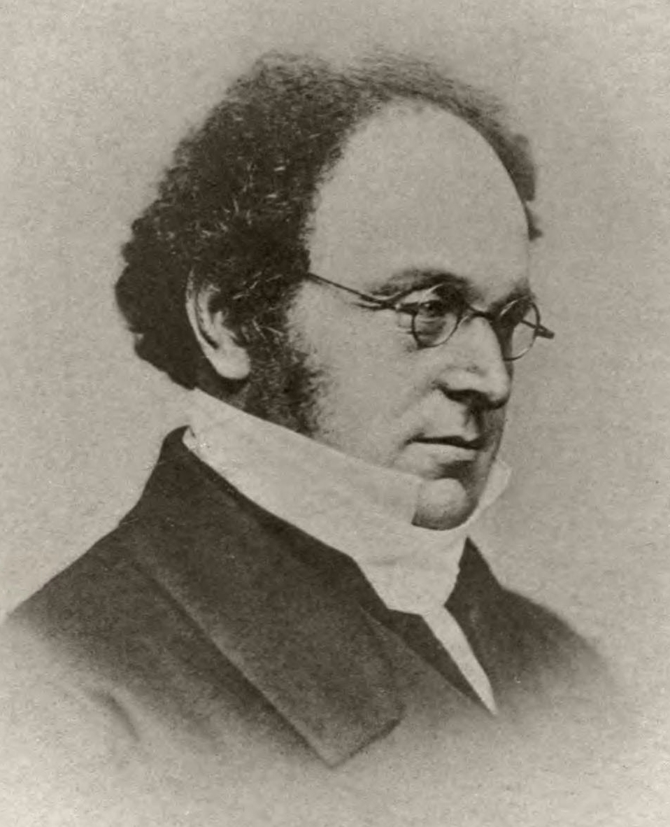
Augustus De Morgan
(1806–1871)
Mathematician
Logician
De Morgan's laws
► (YX)’= Y’+X’
► (Y+X)’= Y’X’

Slide 44
M₀=m’₀ | (Y’X’)’ = y+x
M₁=m’₁ | (Y’X)’ = y+X’
M₂=m’₂ | (YX’)’ = y’+x
M₃=m’₃ | (YX)’ = y’+X’

Slide 45
Z+Y+X vs. Z+Y+X’ vs. …
3 binary variables appear either in one of these forms: how many?

Slide 46
Z+Y+X vs. Z+Y+X’ vs. …
3 binary variables appear either in one of these forms: how many?
Each variable can take 2 forms (normal and complement)
We have 3 variables, 2×2×2 = 2³ = 8

Slide 47
M₀=m’₀ | (Z’Y’X’)’=Z+y+X
M₁=m’₁ | (Z’Y’X)’=Z+Y+X’
M₂=m’₂ | (Z’YX’)’=Z+Y’+X
M₃=m’₃ | (Z’YX)’=Z+Y’+X’
M₄=m’₄ | (ZY’X’)’=Z’+Y+X
M₅=m’₅ | (ZY’X)’=Z’+Y+X’
M₆=m’₆ | (ZYX’)’=Z’+Y’+X
M₇=m’₇ | (ZYX)’=Z’+Y’+X’

Slide 48
A_{n}+…A₂+A₁+A₀ vs. A_{n}+…A₂+A₁+A’₀ …
n binary variables appear either in one of these forms: how many?
Each variable can take 2 forms (normal and complement)
We have n variables, 2×2×2× … ×2 = 2^{n}

Slide 49
M₀=m’₀ | A_{n}+A₂+A₁+A₀
M₁=m’₁ | A_{n}+…A₂+A₁+A’₀
M₂=m’₂ | A_{n}+…A₂+A’₁+A₀
… | …
… | …
M₂^{n}₋₃=m’₂^{n}₋₃ | A’_{n}+…A’₂+A₁+A’₀
M₂^{n}₋₂=m’₂^{n}₋₂ | A’_{n}+…A’₂+A’₁+A₀
M₂^{n}₋₁=m’₂^{n}₋₁ | A’_{n}+…A’₂+A’₁+A’₀

Slide 50
Truth table
en.wikipedia.org/wiki/Truth_table

Slide 51
Truth table ↔ MAXTERM

Slide 52
Y | X | F=m₀+m₁
0 | 0 | 1
0 | 1 | 1
1 | 0 | 0
1 | 1 | 0

Slide 53
Y
X
Y’X’
F_{sop}=Y’X’+Y’X
Y’X

Slide 54
Y | X | F=m₀+m₁ | F’=m₂+m₃
0 | 0 | 1 | 0
0 | 1 | 1 | 0
1 | 0 | 0 | 1
1 | 1 | 0 | 1

Slide 55
Y | X | F=m₀+m₁ | F’=m₂+m₃ | (F’)’=(m₂+m₃)’
0 | 0 | 1 | 0 | 1
0 | 1 | 1 | 0 | 1
1 | 0 | 0 | 1 | 0
1 | 1 | 0 | 1 | 0

Slide 56
Y | X | F=(F’)’=(m₂+m₃)’=m’₂m’₃
0 | 0 | 1
0 | 1 | 1
1 | 0 | 0
1 | 1 | 0

Slide 57
Y | X | F=(F’)’=m’₂m’₃=M₂M₃
0 | 0 | 1
0 | 1 | 1
1 | 0 | 0
1 | 1 | 0

Slide 58
Y | X | F=(F’)’=m’₂m’₃=M₂M₃
0 | 0 | 1
0 | 1 | 1
1 | 0 | 0
1 | 1 | 0

Slide 59
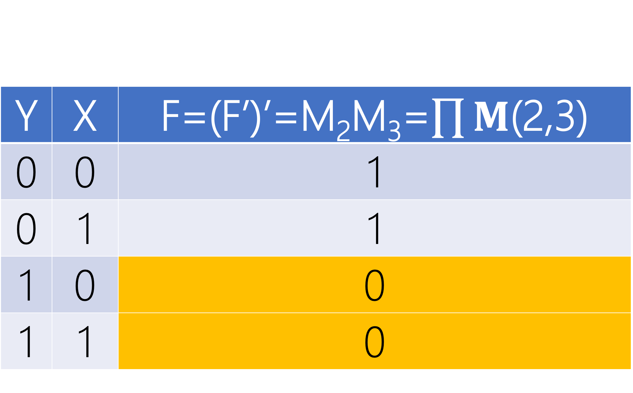
Y | X | F=(F’)’=M₂M₃=$\prod{M}$(2,3)
0 | 0 | 1
0 | 1 | 1
1 | 0 | 0
1 | 1 | 0

Slide 60
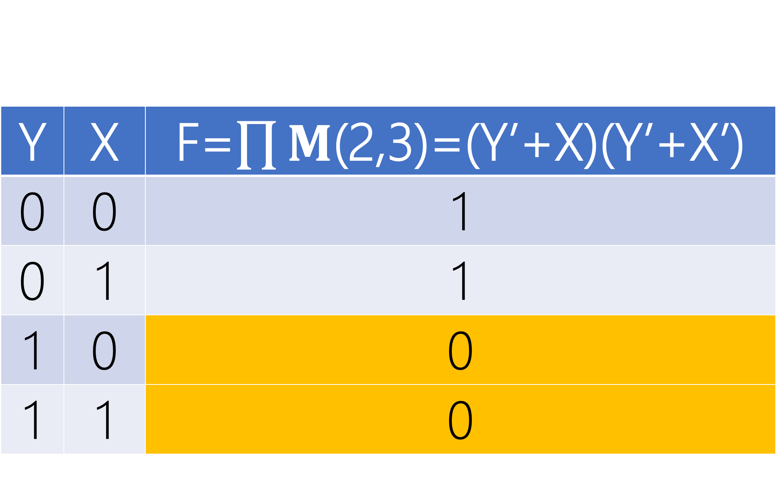
Y | X | F=$\prod{M}$(2,3)=(Y’+X)(Y’+X’)
0 | 0 | 1
0 | 1 | 1
1 | 0 | 0
1 | 1 | 0

Slide 61
Y
X
Y’+X
F=(Y’+X)(Y’+X’)
Y’+X’

Slide 62
PRODUCT OF SUMS
(POS)

Slide 63
Y
X
Y’+X
F=(Y’+X)(Y’+X’)
Y’+X’

Slide 64
Y
X
Y’+X
F=(Y’+X)(Y’+X’)
Y’+X’

Slide 65
2 LEVELS
OR → AND

Slide 66
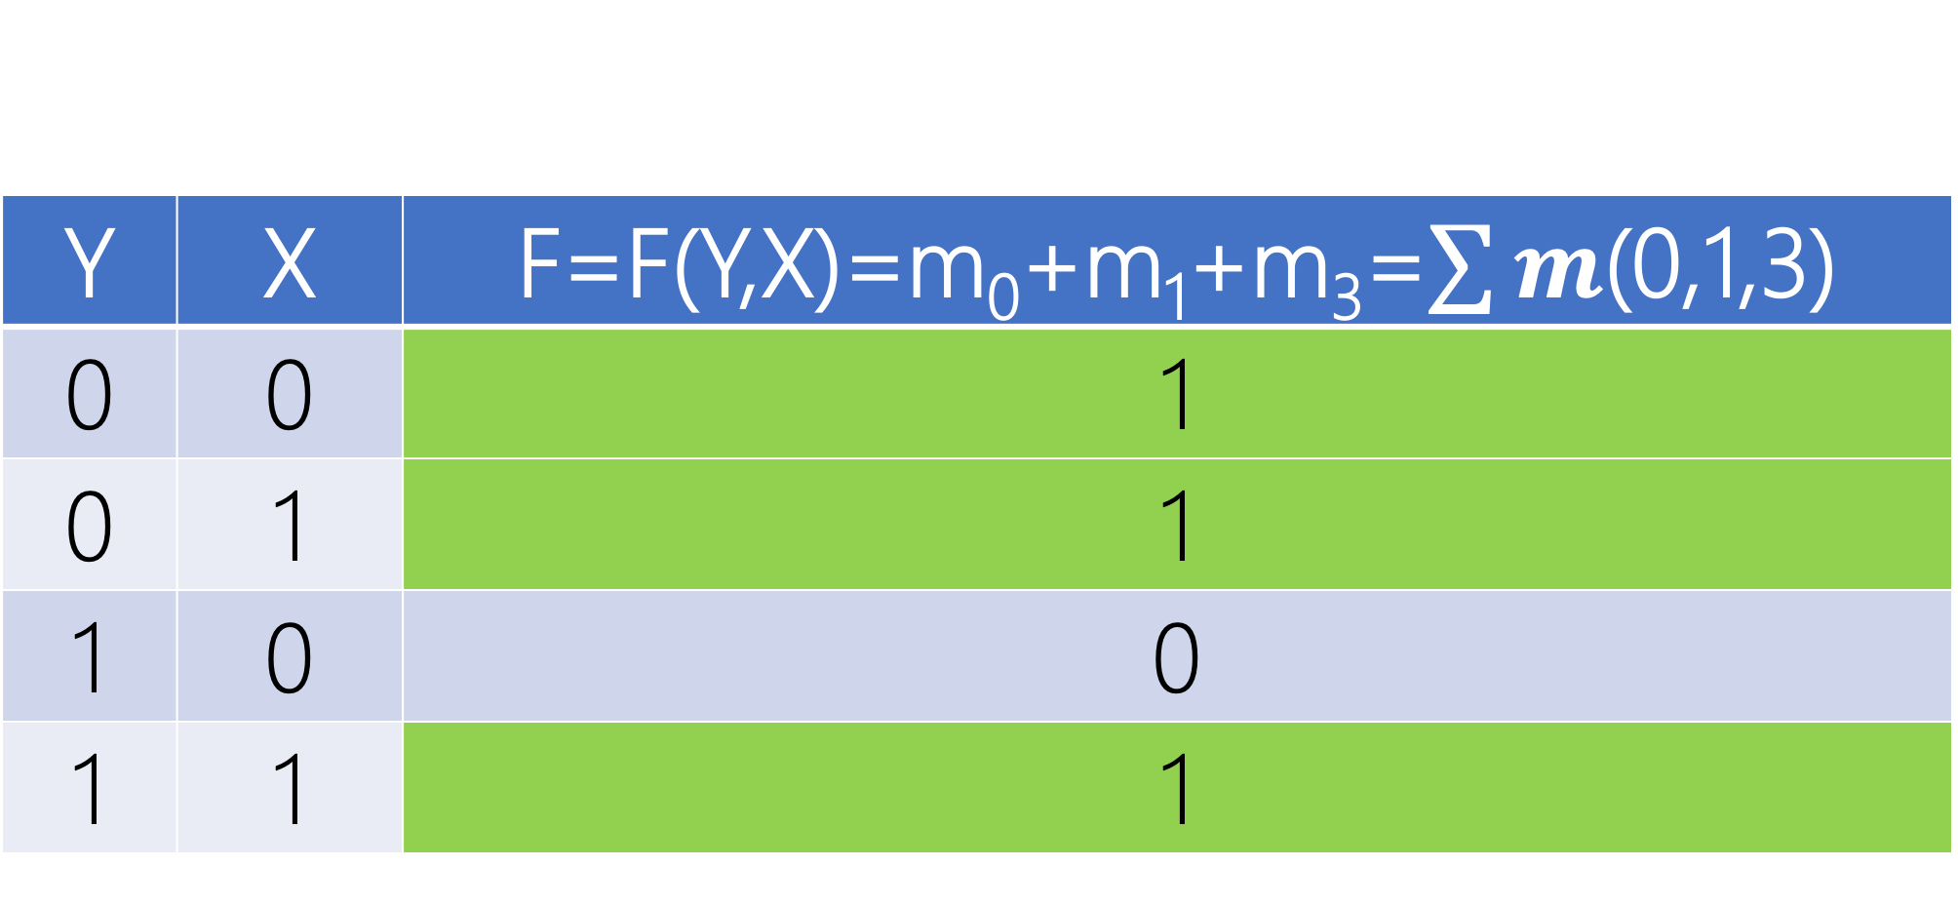
Y | X | F=F(Y,X)=m₀+m₁+m₃=$\sum{m}$(0,1,3)
0 | 0 | 1
0 | 1 | 1
1 | 0 | 0
1 | 1 | 1

Slide 67
Y
Y
X
X
Y’X’
Y’X
F_{sop}=Y’X’+Y’X+YX
YX

Slide 68
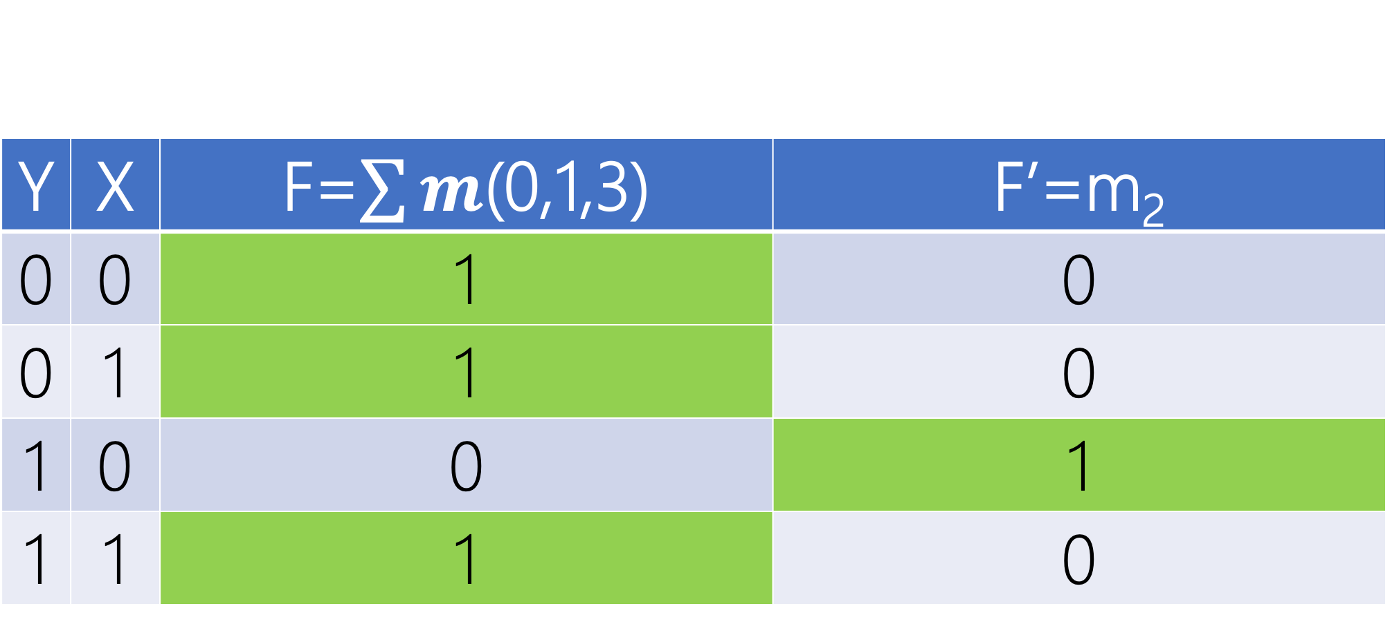
Y | X | F=$\sum{m}$(0,1,3) | F’=m₂
0 | 0 | 1 | 0
0 | 1 | 1 | 0
1 | 0 | 0 | 1
1 | 1 | 1 | 0

Slide 69
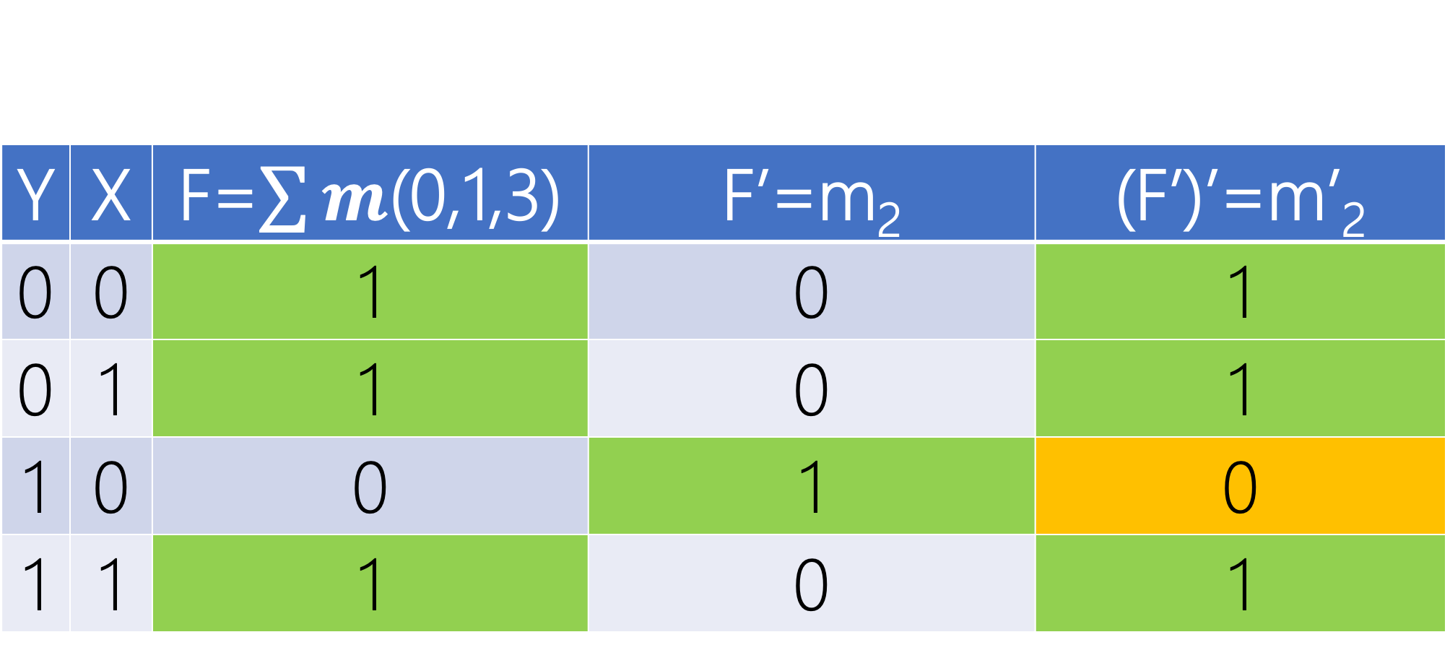
Y | X | F=$\sum{m}$(0,1,3) | F’=m₂ | (F’)’=m’₂
0 | 0 | 1 | 0 | 1
0 | 1 | 1 | 0 | 1
1 | 0 | 0 | 1 | 0
1 | 1 | 1 | 0 | 1

Slide 70
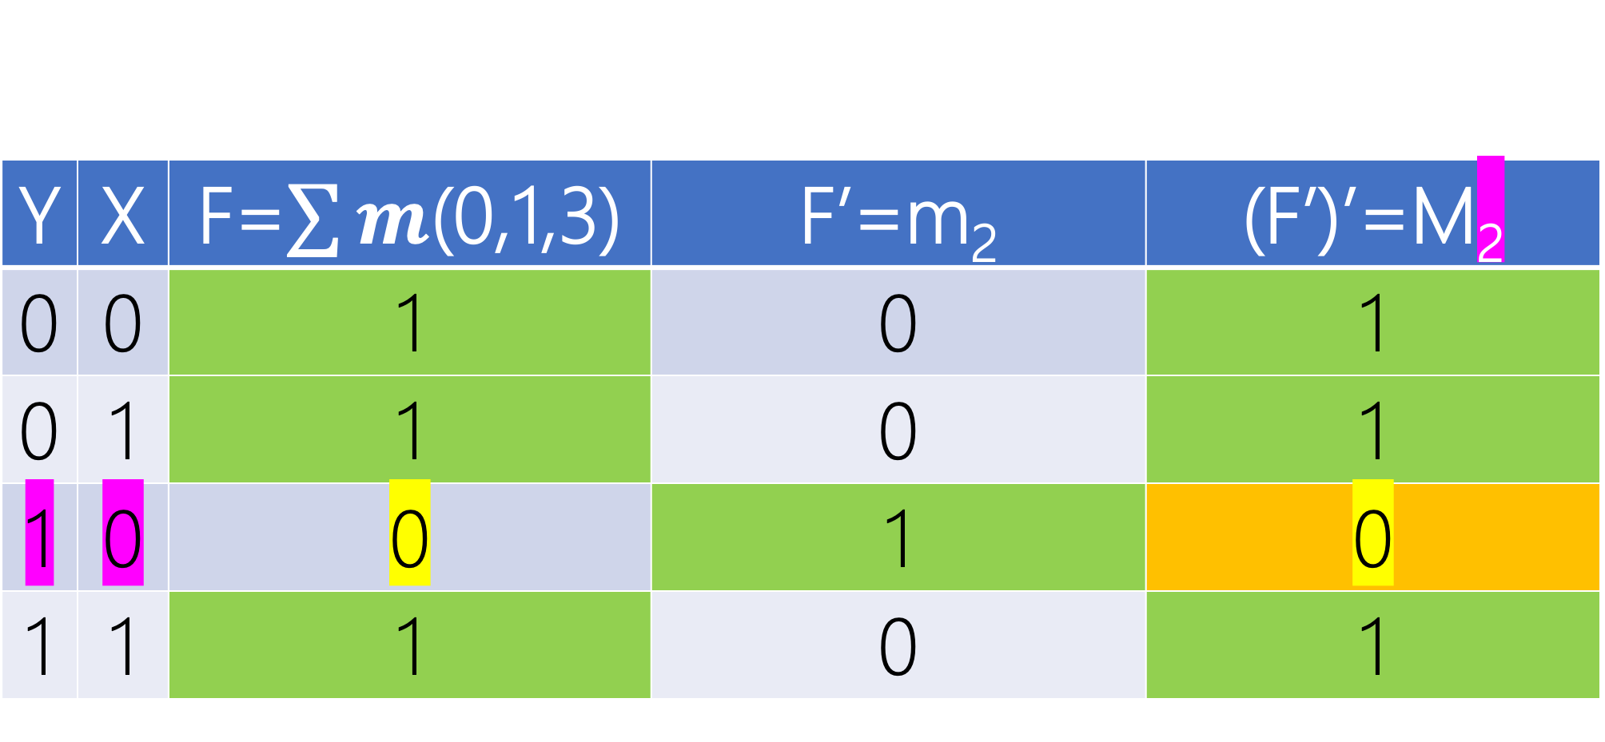
Y | X | F=$\sum{m}$(0,1,3) | F’=m₂ | (F’)’=M₂
0 | 0 | 1 | 0 | 1
0 | 1 | 1 | 0 | 1
1 | 0 | 0 | 1 | 0
1 | 1 | 1 | 0 | 1

Slide 71
Y
Y
X
X
Y’+X
F_{pos}=M₂=m’₂=(YX’)’=(Y’+X)

Slide 72
Y
Y
X
X
Y’+X
1
F_{pos}=M₂=m’₂=(YX’)’=(Y’+X)(1)

Slide 73
DESIGN I vs. II
SoP vs. PoS
Lecture Assignment

Slide 74
Given 3 inputs, design a circuit to determine if there is even number of 1

Slide 75
Z | Y | X | F(Z,Y,X)=?
0 | 0 | 0 | ?
0 | 0 | 1 | ?
0 | 1 | 0 | ?
0 | 1 | 1 | ?
1 | 0 | 0 | ?
1 | 0 | 1 | ?
1 | 1 | 0 | ?
1 | 1 | 1 | ?

Slide 76
Z | Y | X | F(Z,Y,X)=?
0 | 0 | 0 | 1
0 | 0 | 1 | 0
0 | 1 | 0 | 0
0 | 1 | 1 | 1
1 | 0 | 0 | 0
1 | 0 | 1 | 1
1 | 1 | 0 | 1
1 | 1 | 1 | 0

Slide 77
Z | Y | X | F(Z,Y,X)=Σm(0,3,5,6)
0 | 0 | 0 | 1
0 | 0 | 1 | 0
0 | 1 | 0 | 0
0 | 1 | 1 | 1
1 | 0 | 0 | 0
1 | 0 | 1 | 1
1 | 1 | 0 | 1
1 | 1 | 1 | 0

Slide 78
Y
Y
X
Z
X
Z’Y’X’+Z’YX+ZY’X+ZYX’

Slide 79
Z | Y | X | F(Z,Y,X)=M₁
0 | 0 | 0 | 1
0 | 0 | 1 | 0
0 | 1 | 0 | 0
0 | 1 | 1 | 1
1 | 0 | 0 | 0
1 | 0 | 1 | 1
1 | 1 | 0 | 1
1 | 1 | 1 | 0

Slide 80
Z | Y | X | F(Z,Y,X)=M₁M₂
0 | 0 | 0 | 1
0 | 0 | 1 | 0
0 | 1 | 0 | 0
0 | 1 | 1 | 1
1 | 0 | 0 | 0
1 | 0 | 1 | 1
1 | 1 | 0 | 1
1 | 1 | 1 | 0

Slide 81
Z | Y | X | F(Z,Y,X)=M₁M₂M₄
0 | 0 | 0 | 1
0 | 0 | 1 | 0
0 | 1 | 0 | 0
0 | 1 | 1 | 1
1 | 0 | 0 | 0
1 | 0 | 1 | 1
1 | 1 | 0 | 1
1 | 1 | 1 | 0

Slide 82
Z | Y | X | F(Z,Y,X)=M₁M₂M₄M₇
0 | 0 | 0 | 1
0 | 0 | 1 | 0
0 | 1 | 0 | 0
0 | 1 | 1 | 1
1 | 0 | 0 | 0
1 | 0 | 1 | 1
1 | 1 | 0 | 1
1 | 1 | 1 | 0

Slide 83
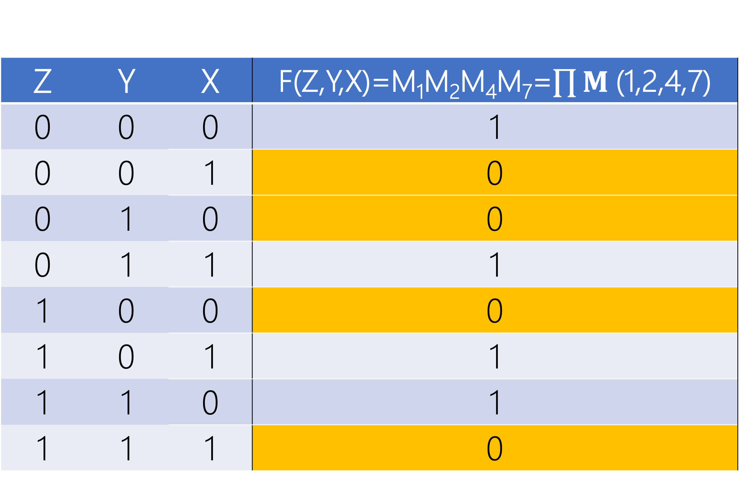
Z | Y | X | F(Z,Y,X)=M₁M₂M₄M₇=$\prod{M}$(1,2,4,7)
0 | 0 | 0 | 1
0 | 0 | 1 | 0
0 | 1 | 0 | 0
0 | 1 | 1 | 1
1 | 0 | 0 | 0
1 | 0 | 1 | 1
1 | 1 | 0 | 1
1 | 1 | 1 | 0

Slide 84
Y
Y
X
Z
X
M₁=Z+Y+X’
M₂=Z+Y’+X
M₄=Z’+Y+X
M₇=Z’+Y’+X’
F=(Z+Y+X’)(Z+Y’+X)(Z’+Y+X)(Z’+Y’+X’)

Slide 85
Universality

