Slide 1
Universality

Slide 2
Universal SET
Is it possible to implement ALL the possible Boolean functions using NOT, AND, OR, NAND, NOR? Yes!

Slide 3
Universal SET
What if we are not given some!
What if some are very costly! E.g., NOT
Can we reduce this set? E.g., building NOT by NAND/ NOR

Slide 4
Set | Universal set
{NOT, AND, OR, NAND, NOR} | Yes! (a Full Set)
{NOT, AND, OR} | Yes, (a Full Set) NAND = AND-NOT NOR = OR-NOT
{NOT, AND} | If we could design OR
{NOT, OR} | If we could design AND
{NOT} | If we could design AND, OR
{AND} | If we could design NOT, OR
{OR} | If we could design NOT, AND
{NAND} | If we could design NOT, AND, OR
{NOR} | If we could design NOT, AND, OR

Slide 5
Set | Universal set
{NOT, AND, OR, NAND, NOR} | Yes! (a Full Set)
{NOT, AND, OR} | Yes, (a Full Set) NAND = AND-NOT NOR = OR-NOT
{NOT, AND} | If we could design OR (a Complete Set)
{NOT, OR} | If we could design AND (a Complete Set)
{NOT} | If we could design AND, OR
{AND} | If we could design NOT, OR
{OR} | If we could design NOT, AND
{NAND} | If we could design NOT, AND, OR
{NOR} | If we could design NOT, AND, OR

Slide 6
Universal SET
{NOT, AND}

Slide 7
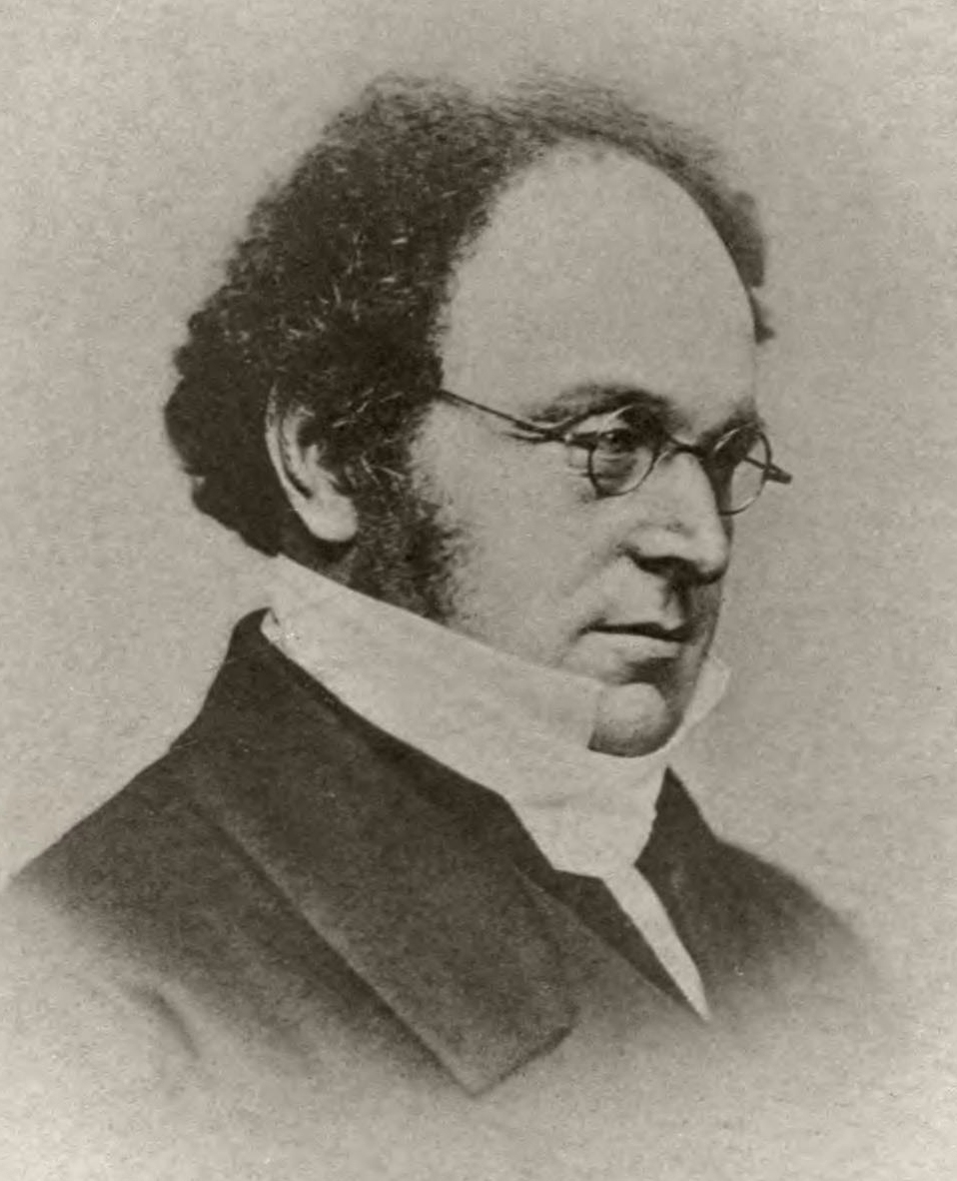
Augustus De Morgan
(1806–1871)
Mathematician
Logician
De Morgan's laws
► (Y+X)’= Y’X’
((Y+X)’)’= (Y’X’)’
Y+X= (Y’X’)’

Slide 8


X’
X
Y’X’=(Y+X)’
Y+X
Y’
Y

Slide 9
X
Y+X
Y
OR

Slide 10
Set | Universal set
{NOT, AND, OR, NAND, NOR} | Yes! (a Full Set)
{NOT, AND, OR} | Yes, (a Full Set) NAND = AND-NOT NOR = OR-NOT
{NOT, AND} | If we could design OR (a Complete Set)
{NOT, OR} | If we could design AND (a Complete Set)
{NOT} | If we could design AND, OR
{AND} | If we could design NOT, OR
{OR} | If we could design NOT, AND
{NAND} | If we could design NOT, AND, OR
{NOR} | If we could design NOT, AND, OR

Slide 11
Universal SET
{NOT, OR}

Slide 12
Augustus De Morgan
(1806–1871)
Mathematician
Logician
De Morgan's laws
► Y’+X’ = (YX)’
(Y’+X’)’ = ((YX)’)’
(Y’+X’)’ = YX

Slide 13

X’
X
Y’+X’=(YX)’
YX
Y’
Y

Slide 14
X
YX
Y
AND

Slide 15
Set | Universal set
{NOT, AND, OR, NAND, NOR} | Yes! (a Full Set)
{NOT, AND, OR} | Yes, (a Full Set) NAND = AND-NOT NOR = OR-NOT
{NOT, AND} | If we could design OR (a Complete Set)
{NOT, OR} | If we could design AND (a Complete Set)
{NOT} | If we could design AND, OR
{AND} | If we could design NOT, OR
{OR} | If we could design NOT, AND
{NAND} | If we could design NOT, AND, OR
{NOR} | If we could design NOT, AND, OR

Slide 16
Universal GATE
{NAND}

Slide 17
NOT ► (XX)’ = (X↑X) = X’
X
X’

Slide 18
AND►NOT (NAND) = ((Y↑X))’=YX
X
(Y↑X)
Y
(Y↑X)’= YX

Slide 19
OR ► DE Morgan's law
(Y+X)’ = Y’X’
((Y+X)’)’ = (Y’X’)’
Y + X = (Y’X’)’
Y + X = Y’ ↑ X’

Slide 20
OR: DE Morgan's law
X’
X
(Y’X’)’ =
Y+X =
Y’ ↑ X’
Y
Y’

Slide 21
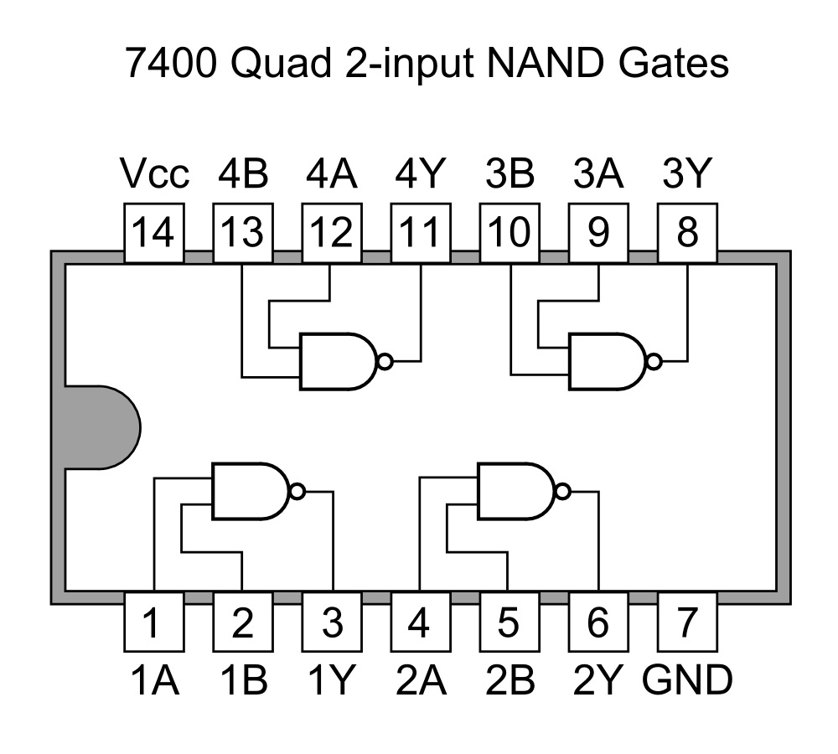
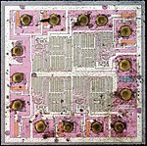
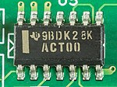
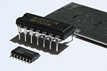
https://commons.wikimedia.org/wiki/7400_series_overview

Slide 22
X’
Y’
Y+X
X
X
X’
Y
Y
Y’

Slide 23
Set | Universal set
{NOT, AND, OR, NAND, NOR} | Yes! (a Full Set)
{NOT, AND, OR} | Yes, (a Full Set) NAND = AND-NOT NOR = OR-NOT
{NOT, AND} | If we could design OR (a Complete Set)
{NOT, OR} | If we could design AND (a Complete Set)
{NOT} | If we could design AND, OR
{AND} | If we could design NOT, OR
{OR} | If we could design NOT, AND
{NAND} | If we could design NOT, AND, OR
{NOR} | If we could design NOT, AND, OR

Slide 24
Universal GATE
{NOR}

Slide 25
NOT ► (X+X)’ = (XX) = X’
OR ► NOT (NOR)
AND ► De Morgan's law
(Y’+X’)’ = YX = (Y’↓X’)

Slide 26
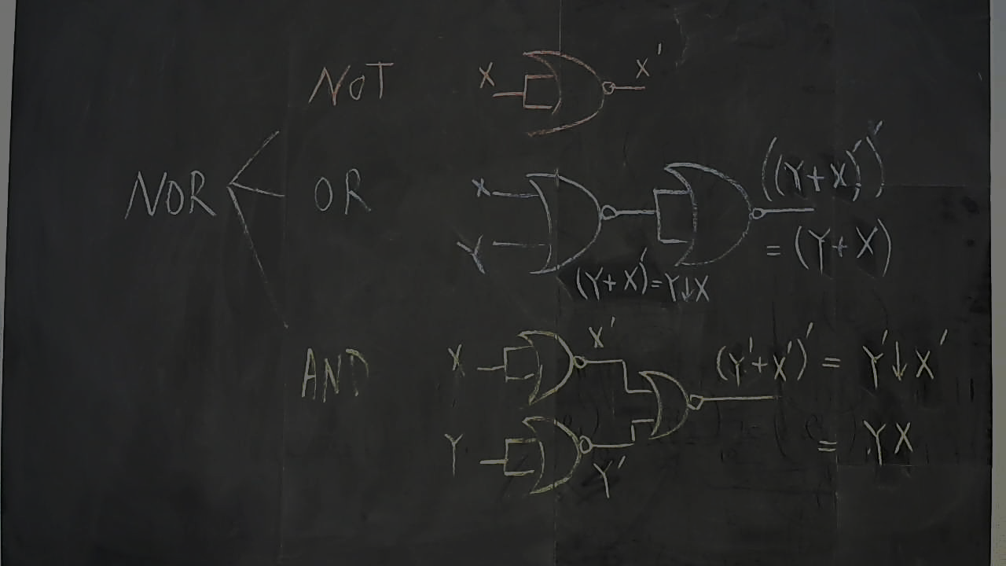

Slide 27
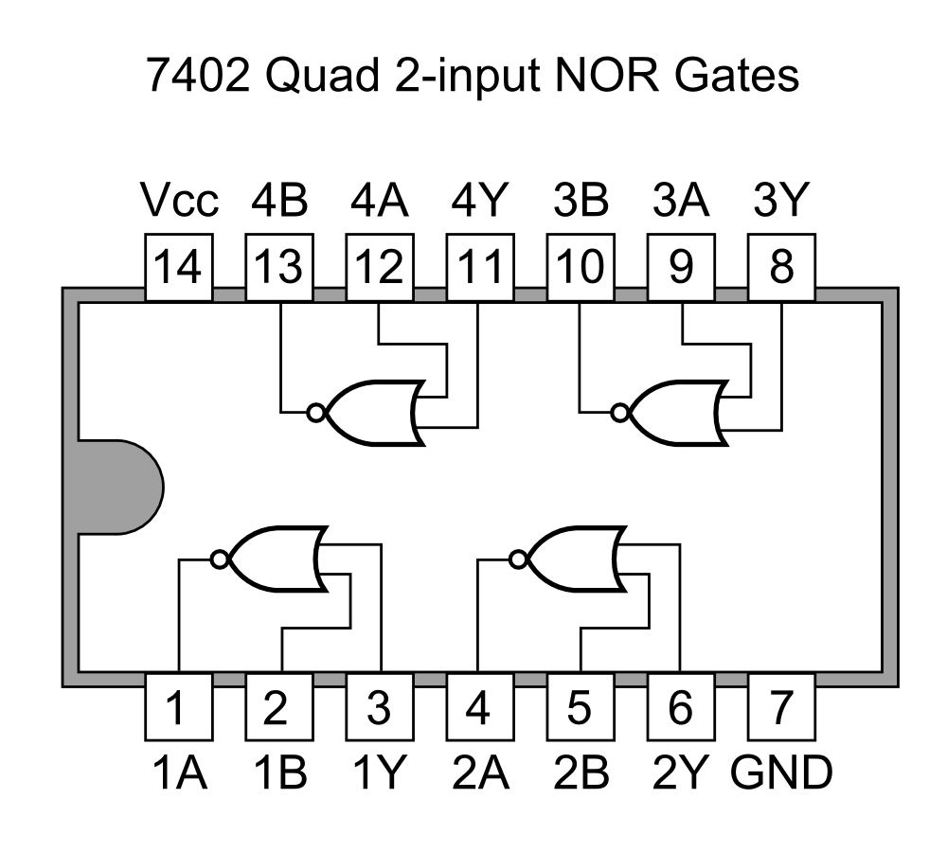
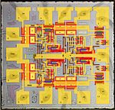
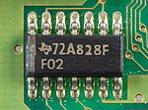
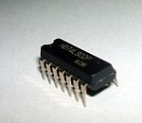
https://commons.wikimedia.org/wiki/7400_series_overview

Slide 28
YX
Y’
X’
X’
X
X
Y’
Y
Y

Slide 29
Universal GATE
SoP → {NAND}

Slide 30
Z
Y
X
F₁=Z’Y’X’+Z’YX+ZY’X+ZYX’
F₂=ZY’X’+ZY’X

Slide 31
Z
Y
X
F₂=ZY’X’+ZY’X

Slide 32
Z
Y
X
F₂= m₄+m₅
F₂= ((F₂)’)’

Slide 33
Z
Y
X
F₂= m₄+m₅
F₂= ((F₂)’)’
F₂= ((m₄+m₅)’)’

Slide 34
Z
Y
X
F₂= m₄+m₅
F₂= ((F₂)’)’
F₂= ((m₄+m₅)’)’
F₂= (m’₄m’₅)’

Slide 35
Z
Y
X
F₂= m₄+m₅
F₂= ((F₂)’)’
F₂= ((m₄+m₅)’)’
F₂= (m’₄m’₅)’
F₂= ((ZY’X’)’ (ZY’X)’)’

Slide 36
Z
Y
X
F₂= m₄+m₅
F₂= ((F₂)’)’
F₂= ((m₄+m₅)’)’
F₂= (m’₄m’₅)’
F₂= ((ZY’X’)’ (ZY’X)’)’
F₂= ((Z↑Y’↑X’) (Z↑Y’↑X))’

Slide 37
Z
Y
X
F₂= m₄+m₅
F₂= ((F₂)’)’
F₂= ((m₄+m₅)’)’
F₂= (m’₄m’₅)’
F₂= ((ZY’X’)’ (ZY’X)’)’
F₂= ((Z↑Y’↑X’) (Z↑Y’↑X))’
F₂= ((Z↑Y’↑X’)↑(Z↑Y’↑X))

Slide 38
Z
Y
X
F₂= ((Z↑Y’↑X’)↑(Z↑Y’↑X))

Slide 39
Z
Y
X
F₁=Z’Y’X’+Z’YX+ZY’X+ZYX’

Slide 40
Z
Y
X
F₁=Z’Y’X’+Z’YX+ZY’X+ZYX’
F₁= ((F₁)’)’

Slide 41
Z
Y
X
F₁=Z’Y’X’+Z’YX+ZY’X+ZYX’
F₁= ((F₁)’)’
F1= ((m₀+m₃+m₅+m₆)’)’

Slide 42
Z
Y
X
F₁=Z’Y’X’+Z’YX+ZY’X+ZYX’
F₁= ((F₁)’)’
F1= ((m₀+m₃+m₅+m₆)’)’
F1= (m’₀ m’₃ m’₅ m’₆)’

Slide 43
Z
Y
X
F₁=Z’Y’X’+Z’YX+ZY’X+ZYX’
F₁= ((F₁)’)’
F1= ((m₀+m₃+m₅+m₆)’)’
F1= (m’₀ m’₃ m’₅ m’₆)’
F1= ((Z’Y’X’)’ (Z’YX)’ (ZY’X)’ (ZYX’)’)’

Slide 44
Z
Y
X
F₁=Z’Y’X’+Z’YX+ZY’X+ZYX’
F₁= ((F₁)’)’
F1= ((m₀+m₃+m₅+m₆)’)’
F1= (m’₀ m’₃ m’₅ m’₆)’
F1= ((Z’Y’X’)’ (Z’YX)’ (ZY’X)’ (ZYX’)’)’
F₁= ((Z’↑Y’↑X’) (Z’↑Y↑X) (Z↑Y’↑X) (Z↑Y↑X’))’

Slide 45
Z
Y
X
F₁=Z’Y’X’+Z’YX+ZY’X+ZYX’
F₁= ((F₁)’)’
F1= ((m₀+m₃+m₅+m₆)’)’
F1= (m’₀ m’₃ m’₅ m’₆)’
F1= ((Z’Y’X’)’ (Z’YX)’ (ZY’X)’ (ZYX’))’
F₁= ((Z’↑Y’↑X’) (Z’↑Y↑X) (Z↑Y’↑X) (Z↑Y↑X’))’
F₁= ((Z’↑Y’↑X’)↑(Z’↑Y↑X)↑(Z↑Y’↑X)↑(Z↑Y↑X’))

Slide 46
Z
Y
X
F₁= ((F₁)’)’
F1= ((m₀+m₃+m₅+m₆)’)’
F1= (m’₀ m’₃ m’₅ m’₆)’
F1= ((Z’Y’X’)’ (Z’YX)’ (ZY’X)’ (ZYX’))’
F₁= ((Z’↑Y’↑X’) (Z’↑Y↑X) (Z↑Y’↑X) (Z↑Y↑X’))’
F₁= ((Z’↑Y’↑X’)↑(Z’↑Y↑X)↑(Z↑Y’↑X)↑(Z↑Y↑X’))

Slide 47
Z
Y
X
F₁= ((Z’↑Y’↑X’)↑(Z’↑Y↑X)↑(Z↑Y’↑X)↑(Z↑Y↑X’))
F₂= ((Z↑Y’↑X’)↑(Z↑Y’↑X))

Slide 48
Z
Y
X
F₁= ((Z’↑Y’↑X’)↑(Z’↑Y↑X)↑(Z↑Y’↑X)↑(Z↑Y↑X’))
NOT by NAND?
F₂= ((Z↑Y’↑X’)↑(Z↑Y’↑X))

Slide 49
Z
Y
X
F₁= ((Z’↑Y’↑X’)↑(Z’↑Y↑X)↑(Z↑Y’↑X)↑(Z↑Y↑X’))
NOT by NAND?
F₂= ((Z↑Y’↑X’)↑(Z↑Y’↑X))

Slide 50
Universal GATE {NAND}
F=(F’)’=(SoP’)’

Slide 51
Universal GATE
{NOR}

Slide 52
Universal GATE
PoS → {NOR}
F_{PoS} = (F’)’
Lecture Assignment

Slide 53
RECAP
Any Boolean Function F:
- Sum (OR) of Products (ANDs)
- Sum of minterms for Entries with 1
- ANDs-OR
- NAND via (F’)’
- Product (AND) of Sums (ORs)
- Product of MAXTERMS (NOT minterms) for Entries with 0
- ORs-AND
- NOR via (F’)’

Slide 54
Universal GATE
SoP → {NAND}
SoP → {NOR} ?
PoS → {NOR}
PoS → {NAND} ?
Lecture Assignment

