Slide 1
Logic
Circuits
Sequential
Combinational

Slide 2
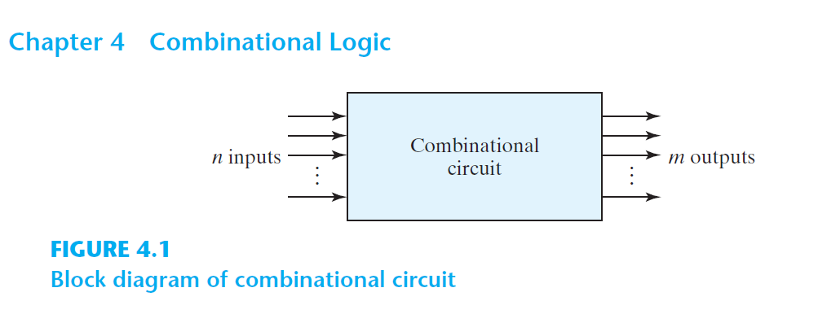

Slide 3

Feedback

Slide 4
Combinational Logic
aka. Combinational Circuit
Combination of logic gates on the present inputs → the outputs at any time!
A combinational circuit performs an operation that can be specified logically by a set of Boolean functions.

Slide 5
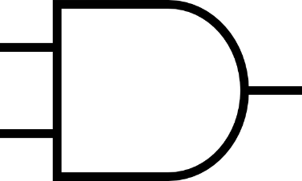
Voltage
Y
X
X
F
Y
Time

Slide 6
Voltage
Y
X
X
F
Y
Time
Propagation Delay (Gate Delay) ≈ Δt
https://en.wikipedia.org/wiki/Propagation_delay#Electronics

Slide 7
Voltage
Y
X
X
F
Y
Time
Propagation Delay (Gate Delay) ≈ Δt ≈ 0
https://en.wikipedia.org/wiki/Propagation_delay#Electronics

Slide 8
What we’ve done so far
Combinational Logic aka. Combinational Circuit

Slide 9
Design a combinational logic circuit:
Truth Table (Inputs, Outputs)
Output Boolean Functions (SoP: ∑m | PoS: ∏M)
Minimization
Algebraically | K-Map | Quine-McCluskey
Logic Diagram | Circuit

Slide 10
Arithmatic
&
Logical Op
Combinational
Logic
Data
Transmission
Coders

Slide 11
Coders
Binary Codes (BCD, Excess-3, Gray)
Binary Adder, Binary Subtractor, Binary Multiplier
Binary Comparator (Magnitude Comparator)
Arithmatic
&
Logical Op
Decoder, Encoder
Multiplexer (MUX, MPX), De-Multiplexer (Demux)
Data
Transmission

Slide 12
Coders
Binary Codes (BCD, Excess-3, Gray)
Binary Adder, Binary Subtractor, Binary Multiplier
Binary Comparator (Magnitude Comparator)
Arithmatic
&
Logical Op
Decoder, Encoder
Multiplexer (MUX, MPX), De-Multiplexer (Demux)
Data
Transmission

Slide 13
Coding

Slide 14

A $→$ Encode$→$B

Slide 15

A $←$ Decode $←$ B

Slide 16
A ↔ [Enc][Dec]code ↔ B
By a convention
Math, e.g., conversion in radix numbering system
Non-math, e.g., in base-64, the value of characters
Engineering
etc

Slide 17


1-way Coding
A $→$ Encode $→$B
A $↚$ Decode $↚$ B

Slide 18
2-way Coding
A ↔ Look up Table ↔ B

Slide 19
Base-64
A ↔ Look up Table ↔ B

Slide 20
Digit | Value | → | Digit | Value | → | Digit | Value | → | Digit | Value
A | 0 |  | Q | 16 |  | g | 32 |  | w | 48
B | 1 |  | R | 17 |  | h | 33 |  | x | 49
C | 2 |  | S | 18 |  | i | 34 |  | y | 50
D | 3 |  | T | 19 |  | j | 35 |  | z | 51
E | 4 |  | U | 20 |  | k | 36 |  | 0 | 52
F | 5 |  | V | 21 |  | l | 37 |  | 1 | 53
G | 6 |  | W | 22 |  | m | 38 |  | 2 | 54
H | 7 |  | X | 23 |  | n | 39 |  | 3 | 55
I | 8 |  | Y | 24 |  | o | 40 |  | 4 | 56
J | 9 |  | Z | 25 |  | p | 41 |  | 5 | 57
K | 10 |  | a | 26 |  | q | 42 |  | 6 | 58
L | 11 |  | b | 27 |  | r | 43 |  | 7 | 59
M | 12 |  | c | 28 |  | s | 44 |  | 8 | 60
N | 13 |  | d | 29 |  | t | 45 |  | 9 | 61
O | 14 |  | e | 30 |  | u | 46 |  | + | 62
P | 15 |  | f | 31 |  | v | 47 |  | / | 63

Slide 21
Binary Codes
Assigning binary numbers to things
A ↔ Look up Table ↔ Binary Number

Slide 22
Binary Coded Decimal
BCD (8421)
Decimal ↔ Look up Table ↔ Binary Number

Slide 23
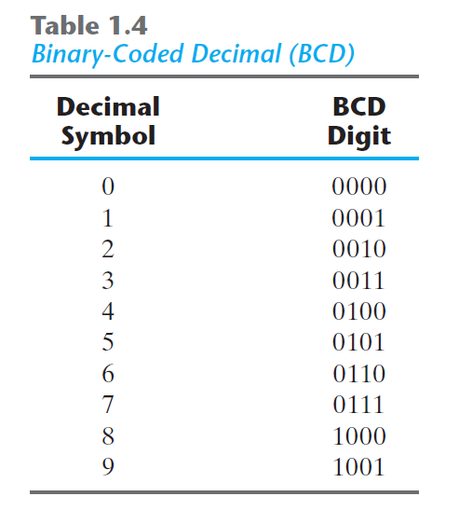

Slide 24
Decimal | BCD (Binary Code) | Binary Number
10 | 0001 0000 | 0000 1010
11 | 0001 0001 | 0000 1011
12 | 0001 0010 | 0000 1100
13 | 0001 0011 | 0000 1101
14 | 0001 0100 | 0000 1110
15 | 0001 0101 | 0000 1111
16 | 0001 0110 | 0001 0000
17 | 0001 0111 | 0001 0001
18 | 0001 1000 | 0001 0010
19 | 0001 1001 | 0001 0011
20 | 0010 0000 | 0001 0100
21 | 0010 0001 | 0001 0101
22 | 0010 0010 | 0001 0110
23 | 0010 0011 | 0001 0111
… | … | …

Slide 25
Decimal | BCD (Binary Code) | Binary Number
10 | 0001 0000 | 0000 1010
11 | 0001 0001 | 0000 1011
12 | 0001 0010 | 0000 1100
13 | 0001 0011 | 0000 1101
14 | 0001 0100 | 0000 1110
15 | 0001 0101 | 0000 1111
16 | 0001 0110 | 0001 0000
17 | 0001 0111 | 0001 0001
18 | 0001 1000 | 0001 0010
19 | 0001 1001 | 0001 0011
20 | 0010 0000 | 0001 0100
21 | 0010 0001 | 0001 0101
22 | 0010 0010 | 0001 0110
23 | 0010 0011 | 0001 0111
… | … | …

Slide 26
(185)₁₀ = (?)_{BCD} = (?)₂

Slide 27
(185)₁₀ = (0001)_{BCD} = (?)₂

Slide 28
(185)₁₀ = (0001 1000)_{BCD} = (?)₂

Slide 29
(185)₁₀ = (0001 1000 0101)_{BCD} = (?)₂

Slide 30
(185)₁₀ = (0001 1000 0101)_{BCD} = (?)₂

Slide 31
(185)₁₀ = (0001 1000 0101)_{BCD} = (?)₂
 | Remainder
185÷2 | 1
92÷2 | 0
46÷2 | 0
23÷2 | 1
11÷2 | 1
5÷2 | 1
2÷2 | 0
1÷2 | 1
0

Slide 32
(185)₁₀ = (0001 1000 0101)_{BCD} = (10111001)₂

Slide 33
Other Binary Codes
A ↔ Look up Table ↔ B

Slide 34
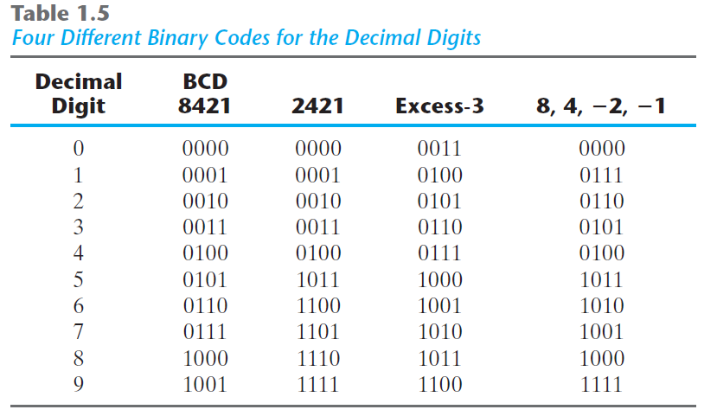
Aiken

Slide 35
Other Binary Codes
Aiken (2421)
/ˈeɪkən/
https://en.wikipedia.org/wiki/Aiken_code

Slide 36
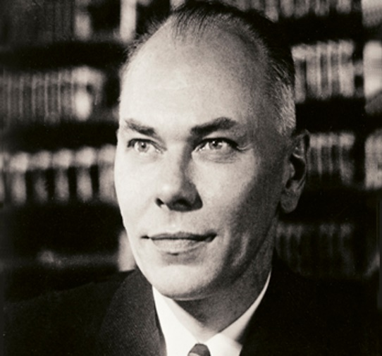
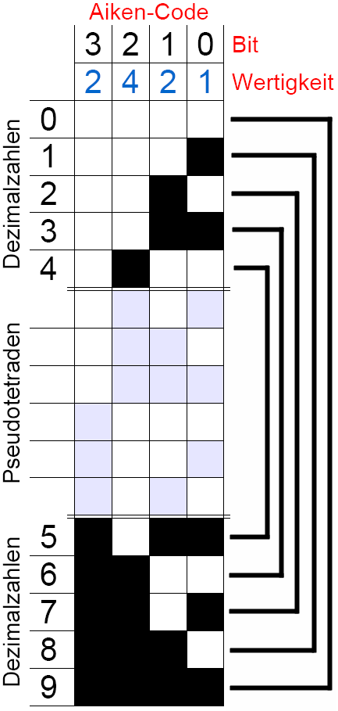
Howard Hathaway Aiken
(March 8, 1900 – March 14, 1973)
Physicist
Pioneer in computing
Original conceptual designer behind IBM's Harvard Mark I
Notes:
The Aiken code differs from the standard 8421 BCD code in that the Aiken code does not weight the fourth digit as 8 as with the standard BCD code but with 2.

Slide 37
Aiken
NOT

Slide 38
(185)₁₀ = (0001 1000 0101)_{BCD (8421)}
(185)₁₀ = (10111001)₂
(185)₁₀ = (0001 NOT(1) NOT(4))_{Aiken (2421)}

Slide 39
(185)₁₀ = (0001 1000 0101)_{BCD (8421)}
(185)₁₀ = (10111001)₂
(185)₁₀ = (0001 NOT(0001) NOT(0100))_{Aiken (2421)}

Slide 40
(185)₁₀ = (0001 1000 0101)_{BCD (8421)}
(185)₁₀ = (10111001)₂
(185)₁₀ = (0001 1110 1011)_{Aiken (2421)}

Slide 41
Other Binary Codes
Excess-3 (XS-3)
https://en.wikipedia.org/wiki/Excess-3

Slide 42
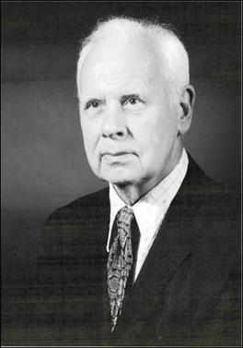
George Robert Stibitz
(April 30, 1904 – January 31, 1995)
Bell Labs researcher
One of the fathers of the modern first digital computer
Aiken
+3

Slide 43
(185)₁₀ = (0001 1000 0101)_{BCD (8421)}
(185)₁₀ = (10111001)₂
(185)₁₀ = (0001 1110 1011)_{Aiken (2421)}
(185)₁₀ = ((1+3) (8+3) (5+3))_{Excess-3}

Slide 44
(185)₁₀ = (0001 1000 0101)_{BCD (8421)}
(185)₁₀ = (10111001)₂
(185)₁₀ = (0001 1110 1011)_{Aiken (2421)}
(185)₁₀ = ((4) (11) (8))_{Excess-3}

Slide 45
(185)₁₀ = (0001 1000 0101)_{BCD (8421)}
(185)₁₀ = (10111001)₂
(185)₁₀ = (0001 1110 1011)_{Aiken (2421)}
(185)₁₀ = (0100 1011 1000)_{Excess-3}

Slide 46
Other Binary Codes
84(-2)(-1)

Slide 47
Aiken
NOT

Slide 48
(185)₁₀ = (0001 1000 0101)_{BCD (8421)}
(185)₁₀ = (10111001)₂
(185)₁₀ = (0001 1110 1011)_{Aiken (2421)}
(185)₁₀ = (0100 1011 1000)_{Excess-3}
(185)₁₀ = (0111 1000 1011)₈₄₋₂₋₁

Slide 49
What’s nice about some binary codes?

Slide 50
Self-complementing
The 9’s complement of the decimal number
=
The 1’s complement (NOT) of its binary code

Slide 51
(185)₁₀ = (0001 1110 1011)_{Aiken (2421)}
(185)₁₀ = (0100 1011 1000)_{Excess-3}
(185)₁₀ = (0111 1000 1011)₈₄₋₂₋₁
9’s-comp(185)₁₀ = (814)₁₀
9’s-comp(185)10= NOT(0001 1110 1011)_{Aiken (2421)}
9’s-comp(185)10= NOT(0100 1011 1000)_{Excess-3}
9’s-comp(185)10= NOT(0111 1000 1011)₈₄₋₂₋₁

Slide 52
(185)₁₀ = (0001 1110 1011)_{Aiken (2421)}
(185)₁₀ = (0100 1011 1000)_{Excess-3}
(185)₁₀ = (0111 1000 1011)₈₄₋₂₋₁
9’s-comp(185)₁₀ = (814)₁₀
9’s-comp(185)10= (1110 0001 0100)_{Aiken (2421)}
9’s-comp(185)10= (1011 0100 0111)_{Excess-3}
9’s-comp(185)10= (1000 0111 0100)₈₄₋₂₋₁

Slide 53
Other Binary Codes
Gray

Slide 54
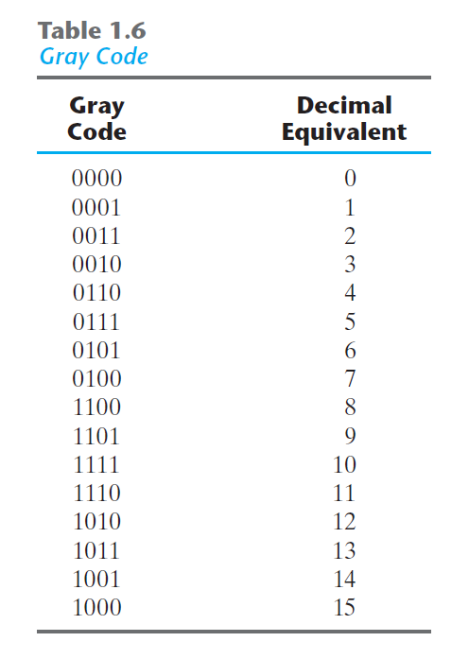

Slide 55

Gray Code
Analog $→$ Digital

Slide 56
1-bit change

Slide 57

Gray Code
Analog $→$ Digital
Straight binary number sequence for 7 to 8: 0111 $→$ 1000; causes all four bits to change values.
Gray code for 7 $→$ 8: 0100 to 1100; only the first bit changes from 0 to 1; the other three bits remain the same.

Slide 58
Gray Code
Algorithm
Step 0: Convert the decimal number to binary number.
Step 1: The MSB (Most Significant Bit) of a gray code and binary code is the same.
Step 2: The next digit of gray code is the XOR of the previous and current digit in the binary code.

Slide 59
Step 0: Convert the decimal number to binary number.
(20)₁₀ | Binary Number | 1 | 0 | 1 | 0 | 0
 | Gray Code

Slide 60
Step 1: The MSB (Most Significant Bit) of a gray code and binary code is the same.
(20)₁₀ | Binary Number | 1 | 0 | 1 | 0 | 0
 | Gray Code | 1

Slide 61
Step 2: The next digit of gray code is the XOR of the previous and current digit in the binary code.
(20)₁₀ | Binary Number | 1 | 0 | 1 | 0 | 0
 | Gray Code | 1 | 1$⊕$0=1

Slide 62
Step 2: The next digit of gray code is the XOR of the previous and current digit in the binary code.
(20)₁₀ | Binary Number | 1 | 0 | 1 | 0 | 0
 | Gray Code | 1 | 1 | 0$⊕$1=1

Slide 63
Step 2: The next digit of gray code is the XOR of the previous and current digit in the binary code.
(20)₁₀ | Binary Number | 1 | 0 | 1 | 0 | 0
 | Gray Code | 1 | 1 | 1 | 1$⊕$0=1

Slide 64
Step 2: The next digit of gray code is the XOR of the previous and current digit in the binary code.
(20)₁₀ | Binary Number | 1 | 0 | 1 | 0 | 0
 | Gray Code | 1 | 1 | 1 | 1 | 0$⊕$0=0

Slide 65
Step 2: The next digit of gray code is the XOR of the previous and current digit in the binary code.
(20)₁₀ | Binary Number | 1 | 0 | 1 | 0 | 0
 | Gray Code | 1 | 1 | 1 | 1 | 0
(21)₁₀ | Binary Number | 1 | 0 | 1 | 0 | 1
 | Gray Code | 1 | 1 | 1 | 1 | 1

Slide 66
ASCII Code
American Standard Code for Information Interchange

Slide 67
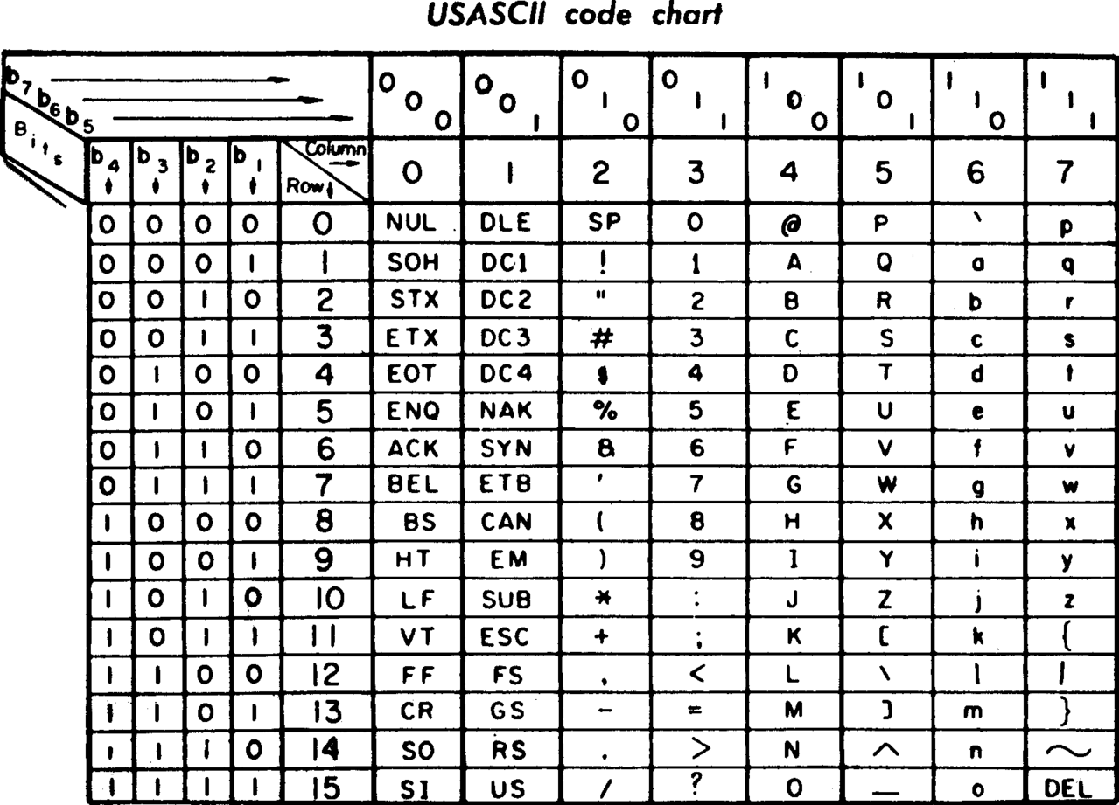

Slide 68
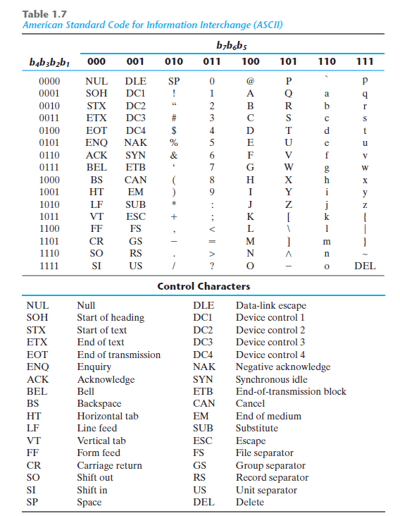
“0” = (011 0000)₂ = (48)₁₀

Slide 69
Combinational Logic
Binary Codes

Slide 70
Combinational Logic
Code Conversion

Slide 71
Aiken

