Slide 1
Coders
Binary Codes (BCD, Excess-3, Gray)
Binary Adder, Binary Subtractor, Binary Multiplier
Binary Comparator (Magnitude Comparator)
Arithmatic
&
Logical Op
Decoder, Encoder
Multiplexer (MUX, MPX), De-Multiplexer (Demux)
Data
Transmission

Slide 2
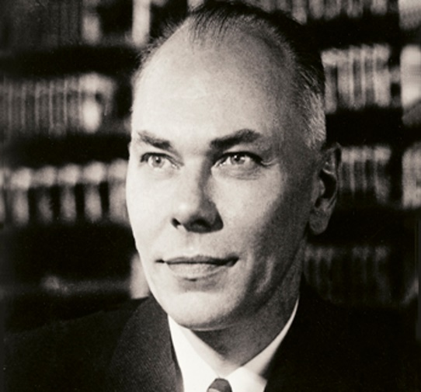
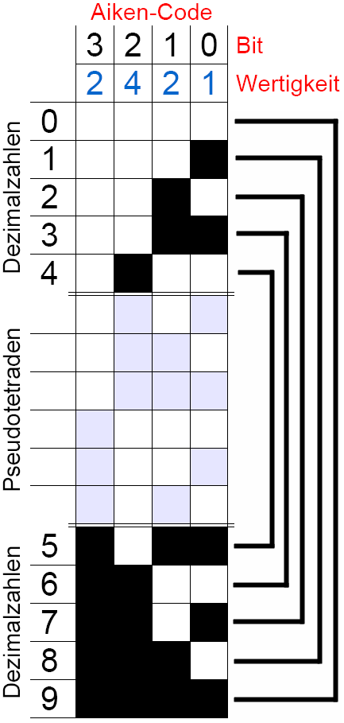
Howard Hathaway Aiken
(March 8, 1900 – March 14, 1973)
Physicist
Pioneer in computing
Original conceptual designer behind IBM's Harvard Mark I
Notes:
The Aiken code differs from the standard 8421 BCD code in that the Aiken code does not weight the fourth digit as 8 as with the standard BCD code but with 2.

Slide 3
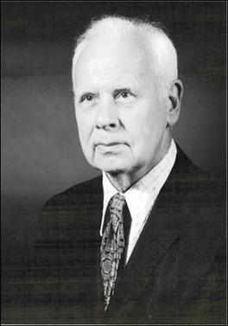
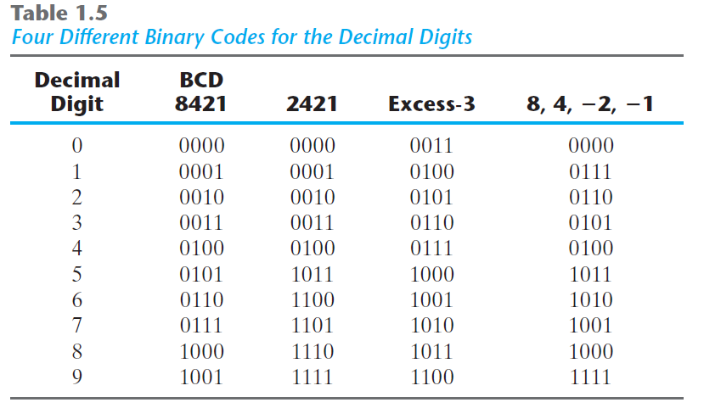
George Robert Stibitz
(April 30, 1904 – January 31, 1995)
Bell Labs researcher
One of the fathers of the modern first digital computer
Aiken
+3

Slide 4
Self-complementing
The 9’s complement of the decimal number
=
The 1’s complement (NOT) of its binary code

Slide 5
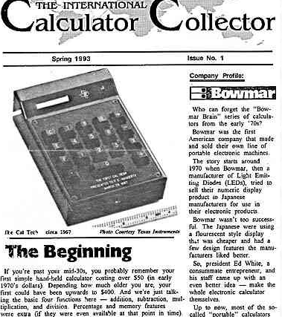
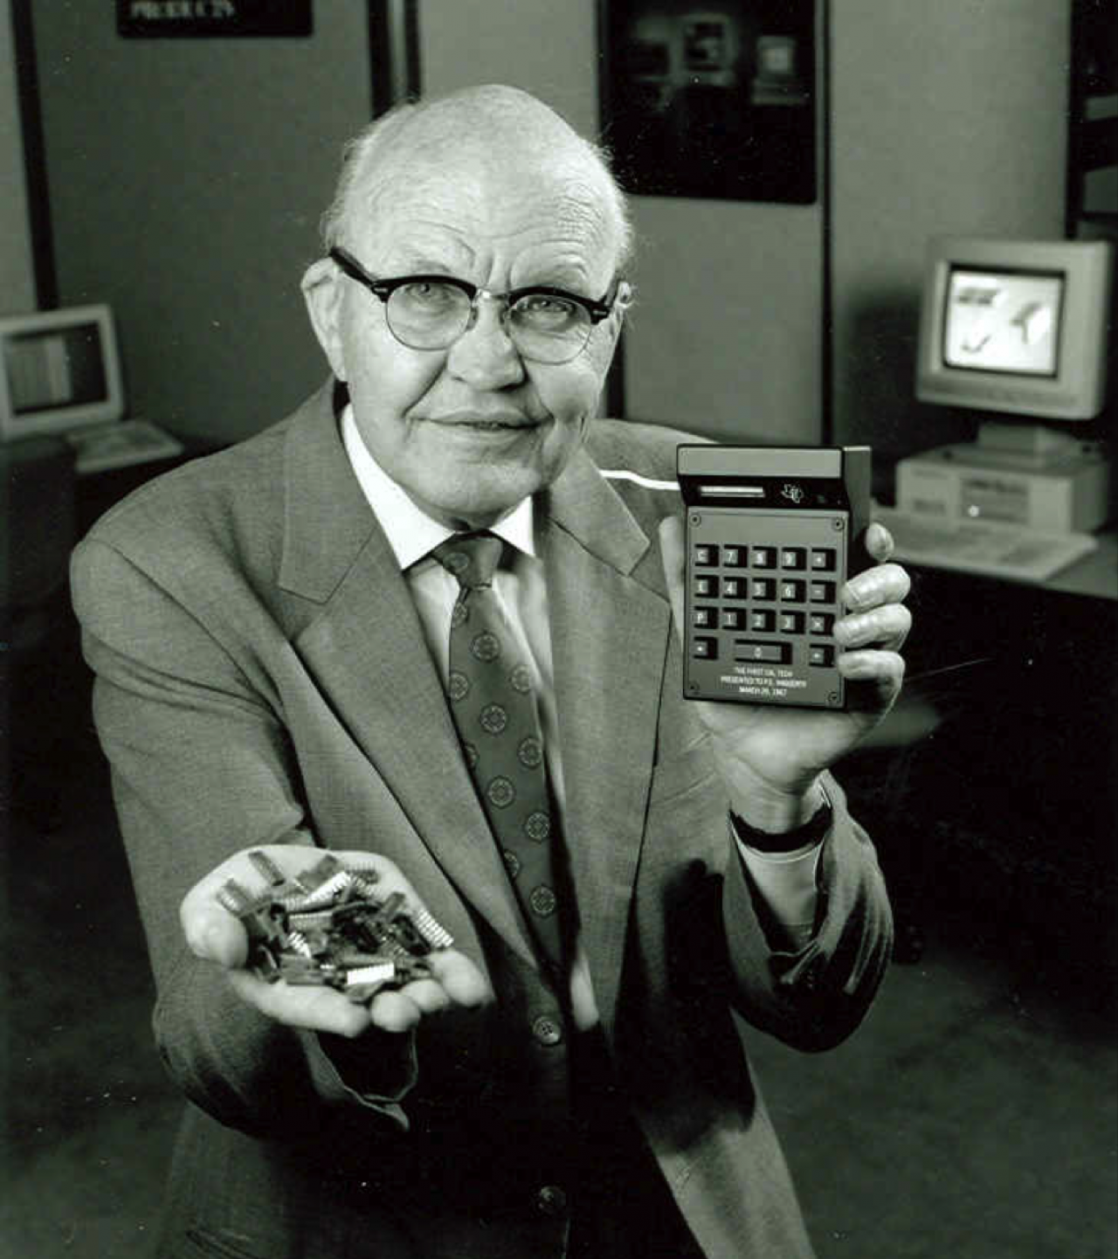

Slide 6

Gray Code
Analog $→$ Digital
Straight binary number sequence for 7 to 8: 0111 $→$ 1000; causes all four bits to change values.
Gray code for 7 $→$ 8: 0100 to 1100; only the first bit changes from 0 to 1; the other three bits remain the same.

Slide 7
Gray Code
Algorithm
Step 0: Convert the decimal number to binary number.
Step 1: The MSB (Most Significant Bit) of a gray code and binary code is the same.
Step 2: The next digit of gray code is the XOR of the previous and current digit in the binary code.

Slide 8
ASCII Code
American Standard Code for Information Interchange

Slide 9
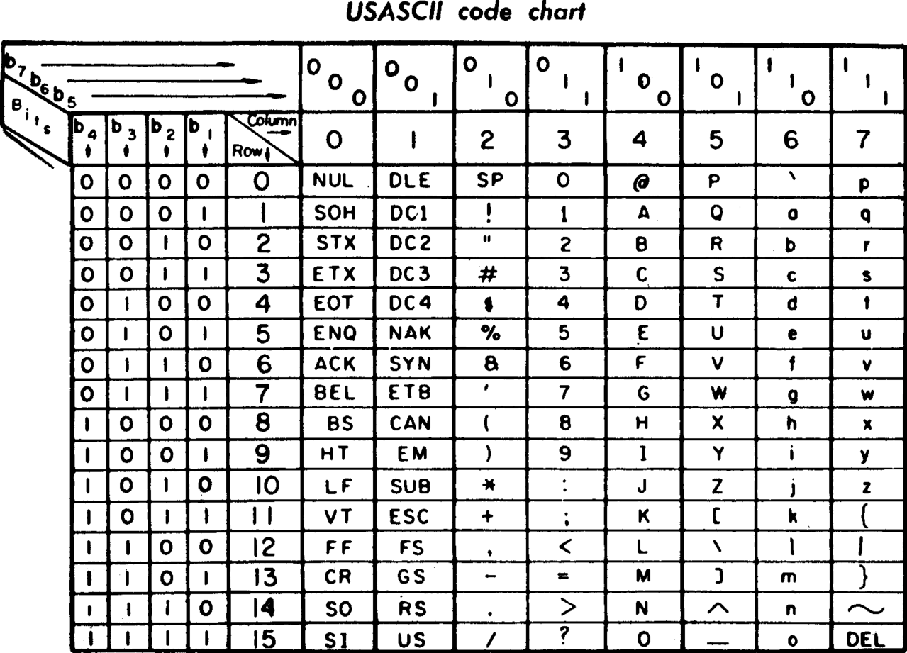

Slide 10
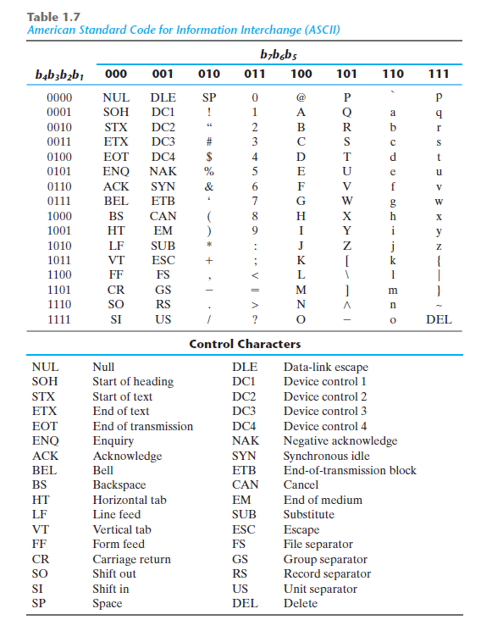
“0” = (011 0000)₂ = (48)₁₀

Slide 11
Combinational Logic
Binary Codes

Slide 12
Combinational Logic
Code Conversion

Slide 13
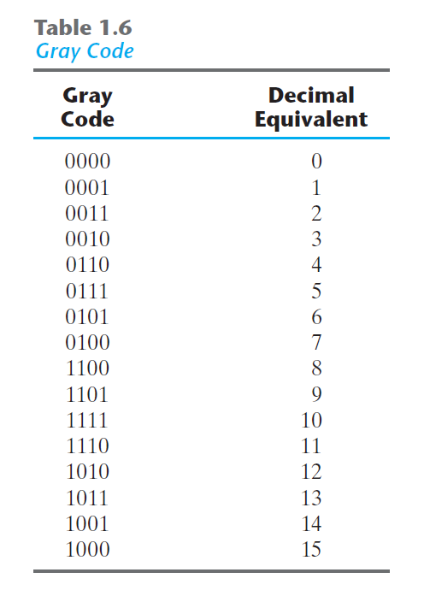
Aiken

Slide 14
Aiken
0001 0000
0001 0000
0001 0001
0001 0010
0001 0011
0001 0100
0001 1011
You fill it
at home
You fill it
at home
0001 0001
0001 0010
0001 0011
0001 0100
0001 0101

Slide 15





Aiken
$$↔$$
$$↔$$
$$↔$$
$$↔$$
$$↔$$
0001 0000
0001 0000
0001 0001
0001 0010
0001 0011
0001 0100
0001 1011
You fill it
at home
You fill it
at home
0001 0001
0001 0010
0001 0011
0001 0100
0001 0101

Slide 16
Combinational Logic
Code Conversion
BCD (8421) → Excess-3

Slide 17
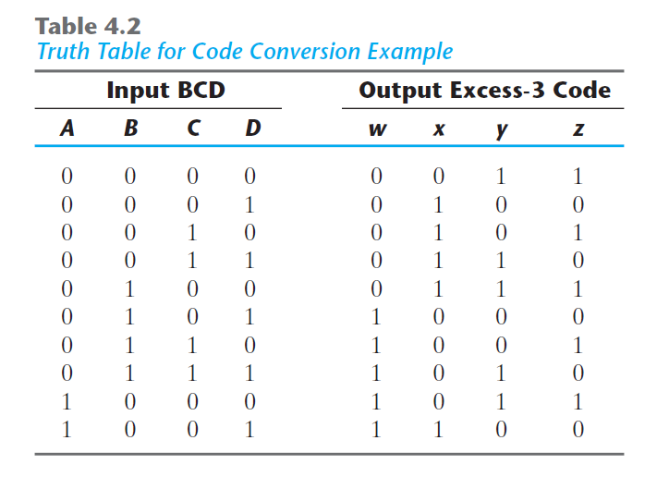

Slide 18
A | B | C | D | W | X | Y | Z
0 | 0 | 0 | 0 | 0 | 0 | 1 | 1
0 | 0 | 0 | 1 | 0 | 1 | 0 | 0
0 | 0 | 1 | 0 | 0 | 1 | 0 | 1
0 | 0 | 1 | 1 | 0 | 1 | 1 | 0
0 | 1 | 0 | 0 | 0 | 1 | 1 | 1
0 | 1 | 0 | 1 | 1 | 0 | 0 | 0
0 | 1 | 1 | 0 | 1 | 0 | 0 | 1
0 | 1 | 1 | 1 | 1 | 0 | 1 | 0
1 | 0 | 0 | 0 | 1 | 0 | 1 | 1
1 | 0 | 0 | 1 | 1 | 1 | 0 | 0
1 | 0 | 1 | 0 | ? | ? | ? | ?
1 | 0 | 1 | 1 | ? | ? | ? | ?
1 | 1 | 0 | 0 | ? | ? | ? | ?
1 | 1 | 0 | 1 | ? | ? | ? | ?
1 | 1 | 1 | 0 | ? | ? | ? | ?
1 | 1 | 1 | 1 | ? | ? | ? | ?

Slide 19
Don’t Care Conditions
In practice, in some applications the function is not specified for certain combinations of the variables.

Slide 20
Don’t Care Conditions
Functions that have unspecified outputs for some input combinations are called incompletely specified functions.
Don’t-care conditions can be used on a map to provide further simplification of the Boolean expression.

Slide 21
Don’t Care Conditions
To distinguish the don’t-care condition from 1’s and 0’s, an X is used.
Notes:
Thus, an X inside a square in the map indicates that we don’t care
whether the value of 0 or 1 is assigned to F for the particular minterm.

Slide 22
A | B | C | D | W | X | Y | Z
0 | 0 | 0 | 0 | 0 | 0 | 1 | 1
0 | 0 | 0 | 1 | 0 | 1 | 0 | 0
0 | 0 | 1 | 0 | 0 | 1 | 0 | 1
0 | 0 | 1 | 1 | 0 | 1 | 1 | 0
0 | 1 | 0 | 0 | 0 | 1 | 1 | 1
0 | 1 | 0 | 1 | 1 | 0 | 0 | 0
0 | 1 | 1 | 0 | 1 | 0 | 0 | 1
0 | 1 | 1 | 1 | 1 | 0 | 1 | 0
1 | 0 | 0 | 0 | 1 | 0 | 1 | 1
1 | 0 | 0 | 1 | 1 | 1 | 0 | 0
1 | 0 | 1 | 0 | X | X | X | X
1 | 0 | 1 | 1 | X | X | X | X
1 | 1 | 0 | 0 | X | X | X | X
1 | 1 | 0 | 1 | X | X | X | X
1 | 1 | 1 | 0 | X | X | X | X
1 | 1 | 1 | 1 | X | X | X | X

Slide 23
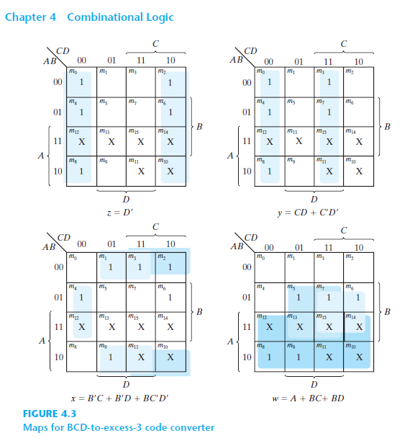
W(A,B,C,D) = ∑(5,6,7,8,9) + d(10,11,12,13,14,15)

Slide 24
X(A,B,C,D) = ∑(1,2,3,4,9) + d(10,11,12,13,14,15)

Slide 25
Y(A,B,C,D) = ∑(0,3,4,7,8) + d(10,11,12,13,14,15)

Slide 26
Z(A,B,C,D) = ∑(0,2,4,6,8) + d(10,11,12,13,14,15)

Slide 27
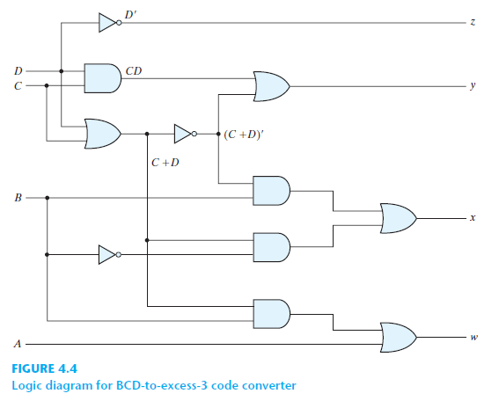

Slide 28
BCD-to-Excess-3

Slide 29
MAXTERM
Notes:
Thus, an X inside a square in the map indicates that we don’t care
whether the value of 0 or 1 is assigned to F for the particular minterm.

Slide 30
W(A,B,C,D) = ∑(5,6,7,8,9) + d(10,11,12,13,14,15)
W(A,B,C,D) = ∏(?)

Slide 31
W(A,B,C,D) = ∑(5,6,7,8,9) + d(10,11,12,13,14,15)
W(A,B,C,D) = ∏(0,1,2,3,4)

Slide 32
W(A,B,C,D) = ∑(5,6,7,8,9) + d(10,11,12,13,14,15)
W(A,B,C,D) = ∏(0,1,2,3,4) + D(10,11,12,13,14,15)
We can assume the don’t care conditions are 0 if they help to more simplification

Slide 33
W(A,B,C,D) = ∑(5,6,7,8,9) + d(10,11,12,13,14,15)
W(A,B,C,D) = ∏(0,1,2,3,4) + D(10,11,12,13,14,15)
W(A,B,C,D) = ()’
 |  | CD
 |  | 00 | 01 | 11 | 10
AB | 00 | 0 | 0 | 0 | 0
 | 01 | 0 | 1 | 1 | 1
 | 11 | X | X | X | X
 | 10 | 1 | 1 | X | X
m₀ | m₁ | m₃ | m₂
m₄ | m₅ | m₇ | m₆
m₁₂ | m₁₃ | m₁₅ | m₁₄
m₈ | m₉ | m₁₁ | m₁₀

Slide 34
W(A,B,C,D) = ∑(5,6,7,8,9) + d(10,11,12,13,14,15)
W(A,B,C,D) = ∏(0,1,2,3,4) + D(10,11,12,13,14,15)
W(A,B,C,D) = ((A’B’))’
 |  | CD
 |  | 00 | 01 | 11 | 10
AB | 00 | 0 | 0 | 0 | 0
 | 01 | 0 | 1 | 1 | 1
 | 11 | X | X | X | X
 | 10 | 1 | 1 | X | X
m₀ | m₁ | m₃ | m₂
m₄ | m₅ | m₇ | m₆
m₁₂ | m₁₃ | m₁₅ | m₁₄
m₈ | m₉ | m₁₁ | m₁₀

Slide 35
W(A,B,C,D) = ∑(5,6,7,8,9) + d(10,11,12,13,14,15)
W(A,B,C,D) = ∏(0,1,2,3,4) + D(10,11,12,13,14,15)
W(A,B,C,D) = ((A’B’)+(A’C’D’))’
 |  | CD
 |  | 00 | 01 | 11 | 10
AB | 00 | 0 | 0 | 0 | 0
 | 01 | 0 | 1 | 1 | 1
 | 11 | X | X | X | X
 | 10 | 1 | 1 | X | X
m₀ | m₁ | m₃ | m₂
m₄ | m₅ | m₇ | m₆
m₁₂ | m₁₃ | m₁₅ | m₁₄
m₈ | m₉ | m₁₁ | m₁₀

Slide 36
W(A,B,C,D) = ∑(5,6,7,8,9) + d(10,11,12,13,14,15)
W(A,B,C,D) = ∏(0,1,2,3,4) + D(10,11,12,13,14,15)
W(A,B,C,D) = ((A’B’)+(A’C’D’))’ Here the “don’t care conditions” did not help ☹
W(A,B,C,D) = (A+B)(A+C+D)
 |  | CD
 |  | 00 | 01 | 11 | 10
AB | 00 | 0 | 0 | 0 | 0
 | 01 | 0 | 1 | 1 | 1
 | 11 | X | X | X | X
 | 10 | 1 | 1 | X | X
m₀ | m₁ | m₃ | m₂
m₄ | m₅ | m₇ | m₆
m₁₂ | m₁₃ | m₁₅ | m₁₄
m₈ | m₉ | m₁₁ | m₁₀

Slide 37
X(A,B,C,D) = ∑(1,2,3,4,9) + d(10,11,12,13,14,15)
Z(A,B,C,D) = ∏(0,5,6,7,8) + D(10,11,12,13,14,15)
Z(A,B,C,D) = ((BD)+(BC)+(B’C’D’))’ Here the “don’t care conditions” helped ☺
Z(A,B,C,D) = (B’+D’)(B’+C’)(B+C+D)
 |  | CD
 |  | 00 | 01 | 11 | 10
AB | 00 | 0 | 1 | 1 | 1
 | 01 | 1 | 0 | 0 | 0
 | 11 | X | X | X | X
 | 10 | 0 | 1 | X | X
m₀ | m₁ | m₃ | m₂
m₄ | m₅ | m₇ | m₆
m₁₂ | m₁₃ | m₁₅ | m₁₄
m₈ | m₉ | m₁₁ | m₁₀

Slide 38
Y(A,B,C,D) = ∑(0,3,4,7,8) + d(10,11,12,13,14,15)
Y(A,B,C,D) = ?
Z(A,B,C,D) = ∑(0,2,4,6,8) + d(10,11,12,13,14,15)
Z(A,B,C,D) = ?
Your Turn!

Slide 39
Excess-3-to-BCD
BCD-to-Aiken
Aiken-to-BCD
Aiken-to-Excess-3
…

Slide 40
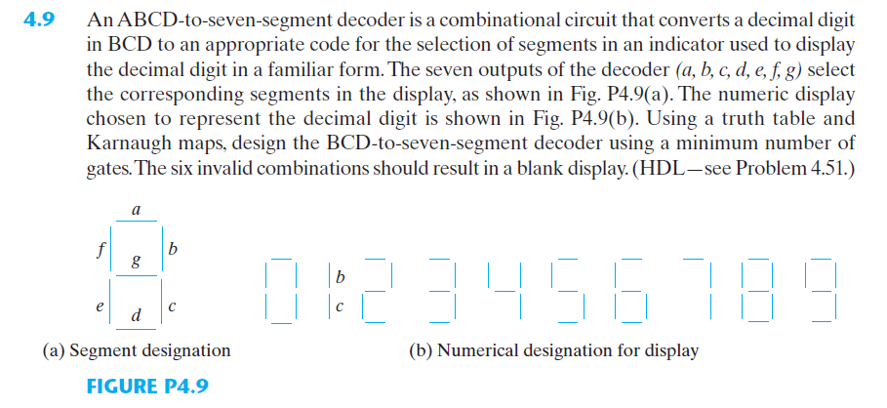

Slide 41
Combinational Logic
Display Decoder

Slide 42
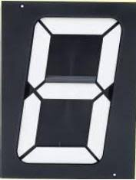
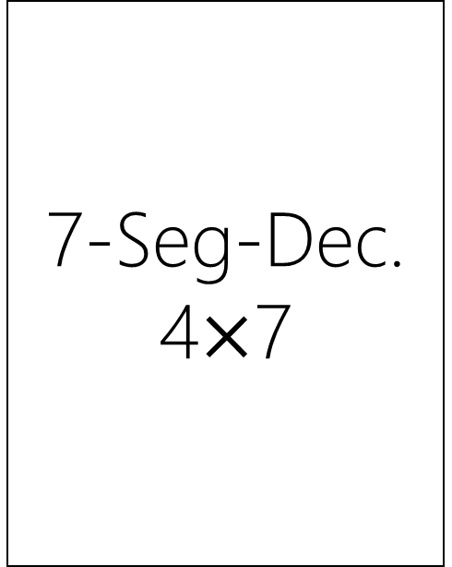
7-Seg-Dec.
4$×$7
Binary Number
BCD
Excess-3
Aiken
Gray
…
A
B
C
D

Slide 43
7-Seg-Dec.
4$×$7
Binary Number
BCD
Excess-3
Aiken
Gray
…
A
B
C
D

Slide 44
7-Seg-Dec.
4$×$7
Binary Number
BCD
Excess-3
Aiken
Gray
…
A
B
C
D

Slide 45
7-Seg-Dec.
4$×$7
Binary Number
BCD
Excess-3
Aiken
Gray
…
A
B
C
D

Slide 46
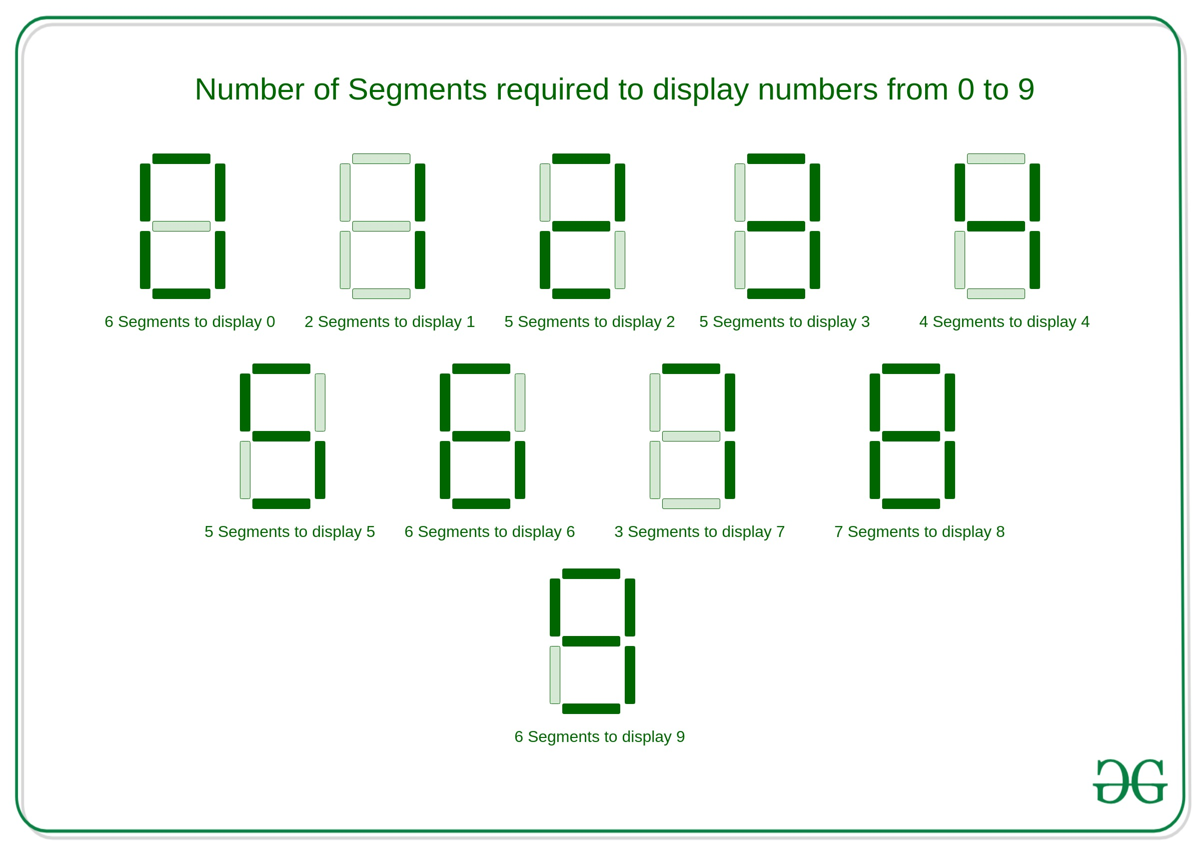
7-Seg-Dec.
4$×$7
a
Binary Number
BCD
Excess-3
Aiken
Gray
…
a
b
c
d
e
f
g
A
f
b
B
g
C
e
c
D
d

Slide 47
7-Seg-Dec.
4$×$7
Binary Number
a
0
a=1
b=1
c=1
d=1
e=1
f=1
g=0
0
f
b
g
0
e
c
0
d

Slide 48
7-Seg-Dec.
4$×$7
Binary Number
a
0
a=0
b=1
c=1
d=0
e=0
f=1
g=1
0
f
b
g
1
e
c
0
d

Slide 49
7-Seg-Dec.
4$×$7
Binary Number
a=x
b=x
c=x
d=x
e=x
f=x
g=x
1
1
1
1
From 10 to 15, don’t care conditions!

Slide 50
7-Seg-Dec.
4$×$7
Excess-3
a
0
a=1
b=1
c=1
d=1
e=1
f=1
g=0
0
f
b
g
1
e
c
1
d

Slide 51
7-Seg-Dec.
4$×$7
Excess-3
a
1
a=0
b=1
c=1
d=0
e=0
f=1
g=1
1
f
b
g
1
e
c
0
d

Slide 52
7-Seg-Dec.
4$×$7
Excess-3
a=x
b=x
c=x
d=x
e=x
f=x
g=x
0
0
0
0
0,1,2,13,14,15, don’t care conditions!

Slide 53
Combinational Logic
Binary Code Arithmetic

Slide 54
Combinational Logic
BCD Adder
Book: Page 144-146

