Slide 1
Logic
Circuits
Sequential
Combinational

Slide 2
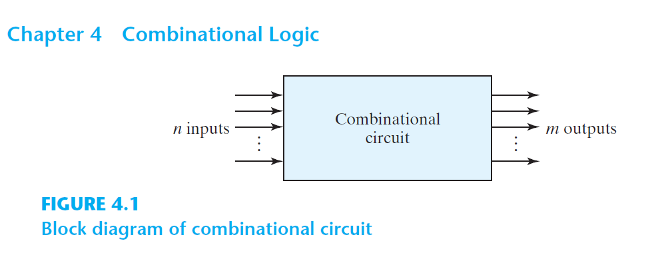

Slide 3
Combinational Logic
aka. Combinational Circuit
Combination of logic gates on the present inputs → the outputs at any time!
A combinational circuit performs an operation that can be specified logically by a set of Boolean functions.

Slide 4
Arithmatic
&
Logical Op
Combinational
Logic
Data
Transmission
Coders

Slide 5
Coders
Binary Codes (BCD, Excess-3, Gray)
Binary Adder, Binary Subtractor, Binary Multiplier
Binary Comparator (Magnitude Comparator)
Arithmatic
&
Logical Op
Decoder, Encoder
Multiplexer (MUX, MPX), De-Multiplexer (Demux)
Data
Transmission

Slide 6
Binary Adder

Slide 7
Design a logic circuit that adds two binary digits (bit).

Slide 8
Range of inputs:
2 bits

Slide 9
Input binary variables:
X and Y

Slide 10
Range of outputs?

Slide 11
 | 0 |  | 0 |  | 1 |  | 1
+ | 0 |  | 1 |  | 0 |  | 1
 | 0 |  | 1 |  | 1 |  | 0
C=1

Slide 12
 | 0 |  | 0 |  | 1 |  | 1
+ | 0 |  | 1 |  | 0 |  | 1
 | 0 |  | 1 |  | 1 |  | 0
C=0
C=0
C=0
C=1

Slide 13
 | X
+ | Y
 | S
C

Slide 14
Range of outputs?
2 bits

Slide 15
Output binary variables:
Carry and Sum

Slide 16
Y | X | F₂=C(Y,X)=YX | F₁=S(Y,X)=Y’X+YX’
0 | 0 | 0 | 0
0 | 1 | 0 | 1
1 | 0 | 0 | 1
1 | 1 | 1 | 0

Slide 17
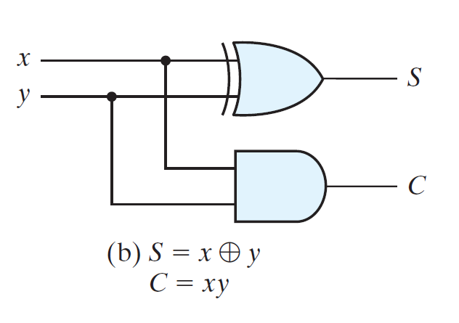

Slide 18
Half Adder: Just 2 bits: X+Y

Slide 20
Half Adder

Slide 21
Design a logic circuit that adds two binary numbers!

Slide 22
Range of inputs:
2 binary numbers in range [00,11]₂

Slide 23
Input binary variables:
X=X₂X₁ and Y=Y₂Y₁

Slide 24
Range of outputs?

Slide 25
 | 00 |  | 00 |  | 00 | … | 11
+ | 00 |  | 01 |  | 10 | … | 11
 | 00 |  | 01 |  | 10 |  | 10
C=0
C=0
C=0
C=1

Slide 26
 | X₂X₁
+ | Y₂Y₁
 | S₂S₁
C

Slide 27
Range of outputs?
Carry, S₂, S₁

Slide 28
Y₂ | Y₁ | X₂ | X₁ | C(Y₁,Y₂,X₂,X₁) | S₂(Y₁,Y₂,X₂,X₁) | S₁(Y₁,Y₂,X₂,X₁)
0 | 0 | 0 | 0 | 0 | 0 | 0
0 | 0 | 0 | 1 | 0 | 0 | 1
0 | 0 | 1 | 0 | 0 | 1 | 0
0 | 0 | 1 | 1 | 0 | 1 | 1
0 | 1 | 0 | 0 | 0 | 0 | 1
0 | 1 | 0 | 1 | 0 | 1 | 0
0 | 1 | 1 | 0 | 0 | 1 | 1
0 | 1 | 1 | 1 | 1 | 0 | 0
1 | 0 | 0 | 0 | 0 | 1 | 0
1 | 0 | 0 | 1 | 0 | 1 | 1
1 | 0 | 1 | 0 | 1 | 0 | 0
1 | 0 | 1 | 1 | 1 | 0 | 1
1 | 1 | 0 | 0 | 0 | 1 | 1
1 | 1 | 0 | 1 | 1 | 0 | 0
1 | 1 | 1 | 0 | 1 | 0 | 1
1 | 1 | 1 | 1 | 1 | 1 | 0

Slide 29
Y₂ | Y₁ | X₂ | X₁ | C(Y₁,Y₂,X₂,X₁) | S₂(Y₁,Y₂,X₂,X₁) | S₁(Y₁,Y₂,X₂,X₁)
0 | 0 | 0 | 0 | 0 | 0 | 0
0 | 0 | 0 | 1 | 0 | 0 | 1
0 | 0 | 1 | 0 | 0 | 1 | 0
0 | 0 | 1 | 1 | 0 | 1 | 1
0 | 1 | 0 | 0 | 0 | 0 | 1
0 | 1 | 0 | 1 | 0 | 1 | 0
0 | 1 | 1 | 0 | 0 | 1 | 1
0 | 1 | 1 | 1 | 1 | 0 | 0
1 | 0 | 0 | 0 | 0 | 1 | 0
1 | 0 | 0 | 1 | 0 | 1 | 1
1 | 0 | 1 | 0 | 1 | 0 | 0
1 | 0 | 1 | 1 | 1 | 0 | 1
1 | 1 | 0 | 0 | 0 | 1 | 1
1 | 1 | 0 | 1 | 1 | 0 | 0
1 | 1 | 1 | 0 | 1 | 0 | 1
1 | 1 | 1 | 1 | 1 | 1 | 0
Wait a sec!
Can we re-use the half adder?
Half adder for adding 2 bits.
How about having 2 half adders for adding 2 × 2 bits?

Slide 30
 | X₂X₁
+ | Y₂Y₁
 | S₂S₁
C

Slide 31
Half Adder
Half Adder

Slide 32
Y₂
X₂
Y₁
X₁
Half Adder
Half Adder
C
S₂
S₁

Slide 33
Y₂
X₂
Y₁
X₁
Half Adder
Half Adder
C
S₂
S₁

Slide 34
C=1
 | 0 1
+ | 0 1
 | 1 0
C=0

Slide 35
Y₂
X₂
Y₁
X₁
Half Adder
Half Adder

Slide 36
C_{p}
 | X
+ | Y
 | S
C

Slide 37
Y
X
C _{Previous}
Full Adder

Slide 38
Design a logic circuit that adds two binary digits (bit) and a carry bit.

Slide 39
C_{p} | Y | X | C=∑m(3,5,6,7) | S=∑m(1,2,4,7)
0 | 0 | 0 | 0 | 0
0 | 0 | 1 | 0 | 1
0 | 1 | 0 | 0 | 1
0 | 1 | 1 | 1 | 0
1 | 0 | 0 | 0 | 1
1 | 0 | 1 | 1 | 0
1 | 1 | 0 | 1 | 0
1 | 1 | 1 | 1 | 1

Slide 40
 |  | YX
 |  | 00 | 01 | 11 | 10
C_{p} | 0 | m₀ | m₁ | m₃ | m₂
 | 1 | m₄ | m₅ | m₇ | m₆
S=∑m(1,2,4,7)
0 | 1 | 0 | 1
1 | 0 | 1 | 0
 |  | YX
 |  | 00 | 01 | 11 | 10
C_{p} | 0 | m₀ | m₁ | m₃ | m₂
 | 1 | m₄ | m₅ | m₇ | m₆
C=∑m(3,5,6,7)
0 | 0 | 1 | 0
0 | 1 | 1 | 1

Slide 41
 |  | YX
 |  | 00 | 01 | 11 | 10
C_{p} | 0 | m₀ | m₁ | m₃ | m₂
 | 1 | m₄ | m₅ | m₇ | m₆
S=∑m(1,2,4,7)
S=C’_{p}Y’X+C’_{p}YX’+C_{p}Y’X’+C_{p}YX
0 | 1 | 0 | 1
1 | 0 | 1 | 0
m₀ | m₁ | m₃ | m₂
m₄ | m₅ | m₇ | m₆

Slide 42
 |  | YX
 |  | 00 | 01 | 11 | 10
C_{p} | 0 | m₀ | m₁ | m₃ | m₂
 | 1 | m₄ | m₅ | m₇ | m₆
S=∑m(1,2,4,7)
S=C’_{p}Y’X+C’_{p}YX’+C_{p}Y’X’+C_{p}YX
S=C’_{p}(Y’X+YX’)+C_{p}(Y’X’+YX)
0 | 1 | 0 | 1
1 | 0 | 1 | 0
m₀ | m₁ | m₃ | m₂
m₄ | m₅ | m₇ | m₆

Slide 43
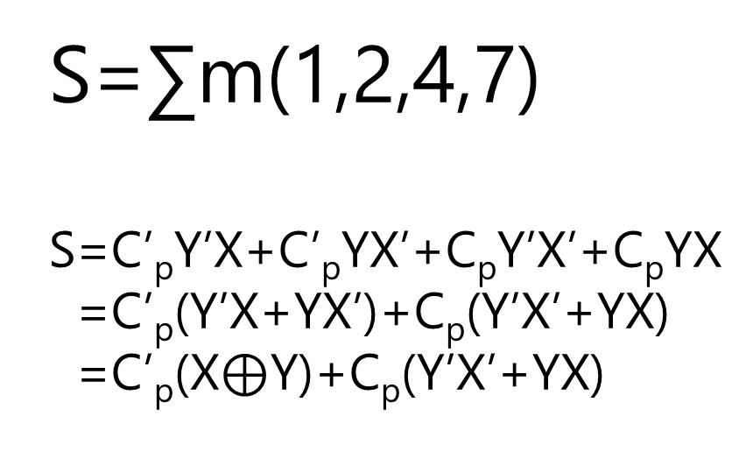
 |  | YX
 |  | 00 | 01 | 11 | 10
C_{p} | 0 | m₀ | m₁ | m₃ | m₂
 | 1 | m₄ | m₅ | m₇ | m₆
S=∑m(1,2,4,7)
S=C’_{p}Y’X+C’_{p}YX’+C_{p}Y’X’+C_{p}YX
S=C’_{p}(Y’X+YX’)+C_{p}(Y’X’+YX)
S=C’_{p}(X$⊕$Y)+C_{p}(Y’X’+YX)
0 | 1 | 0 | 1
1 | 0 | 1 | 0
m₀ | m₁ | m₃ | m₂
m₄ | m₅ | m₇ | m₆

Slide 44
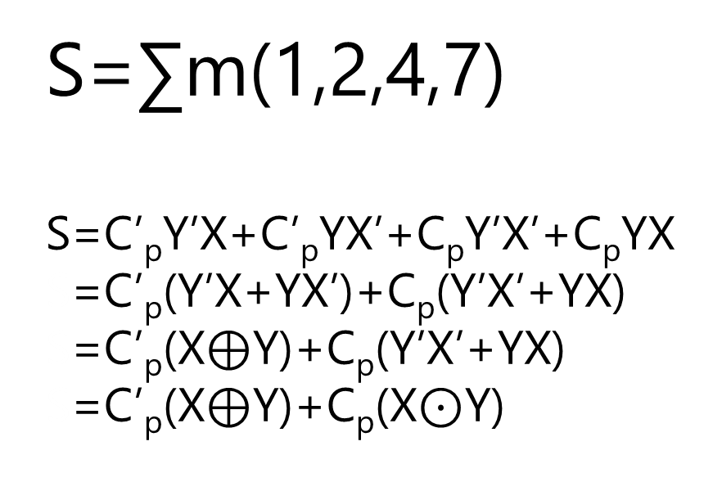
 |  | YX
 |  | 00 | 01 | 11 | 10
C_{p} | 0 | m₀ | m₁ | m₃ | m₂
 | 1 | m₄ | m₅ | m₇ | m₆
S=∑m(1,2,4,7)
S=C’_{p}Y’X+C’_{p}YX’+C_{p}Y’X’+C_{p}YX
S=C’_{p}(Y’X+YX’)+C_{p}(Y’X’+YX)
S=C’_{p}(X$⊕$Y)+C_{p}(Y’X’+YX)
S=C’_{p}(X$⊕$Y)+C_{p}(X$⊙$Y)
0 | 1 | 0 | 1
1 | 0 | 1 | 0
m₀ | m₁ | m₃ | m₂
m₄ | m₅ | m₇ | m₆

Slide 45
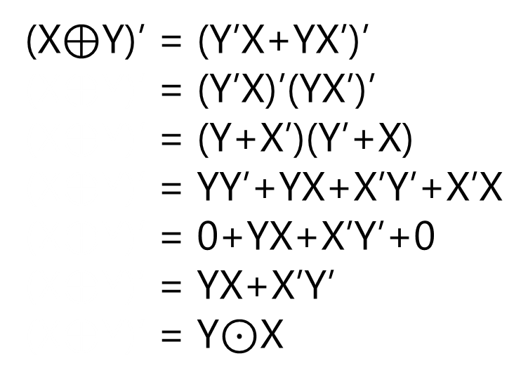
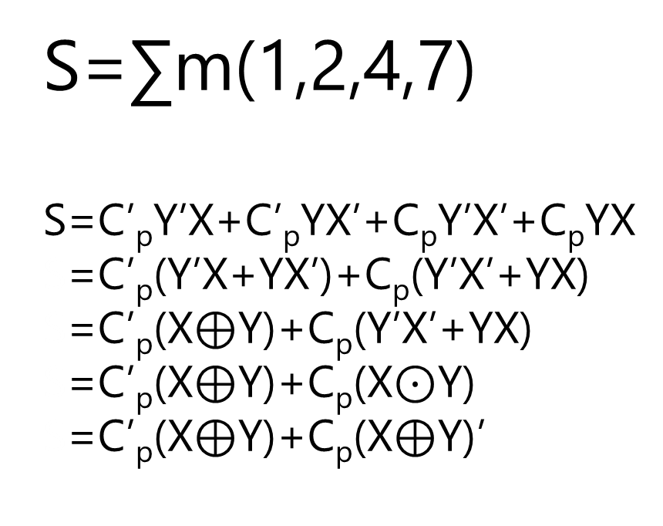
 |  | YX
 |  | 00 | 01 | 11 | 10
C_{p} | 0 | m₀ | m₁ | m₃ | m₂
 | 1 | m₄ | m₅ | m₇ | m₆
S=∑m(1,2,4,7)
S=C’_{p}Y’X+C’_{p}YX’+C_{p}Y’X’+C_{p}YX
S=C’_{p}(Y’X+YX’)+C_{p}(Y’X’+YX)
S=C’_{p}(X$⊕$Y)+C_{p}(Y’X’+YX)
S=C’_{p}(X$⊕$Y)+C_{p}(X$⊙$Y)
S=C’_{p}(X$⊕$Y)+C_{p}(X$⊕$Y)’
0 | 1 | 0 | 1
1 | 0 | 1 | 0
m₀ | m₁ | m₃ | m₂
m₄ | m₅ | m₇ | m₆
(X$⊕$Y)’ = (Y’X+YX’)’
(X$⊕$Y)’ = (Y’X)’(YX’)’
(X$⊕$Y)’ = (Y+X’)(Y’+X)
(X$⊕$Y)’ = YY’+YX+X’Y’+X’X
(X$⊕$Y)’ = 0+YX+X’Y’+0
(X$⊕$Y)’ = YX+X’Y’
(X$⊕$Y)’ = Y$⊙$X

Slide 46
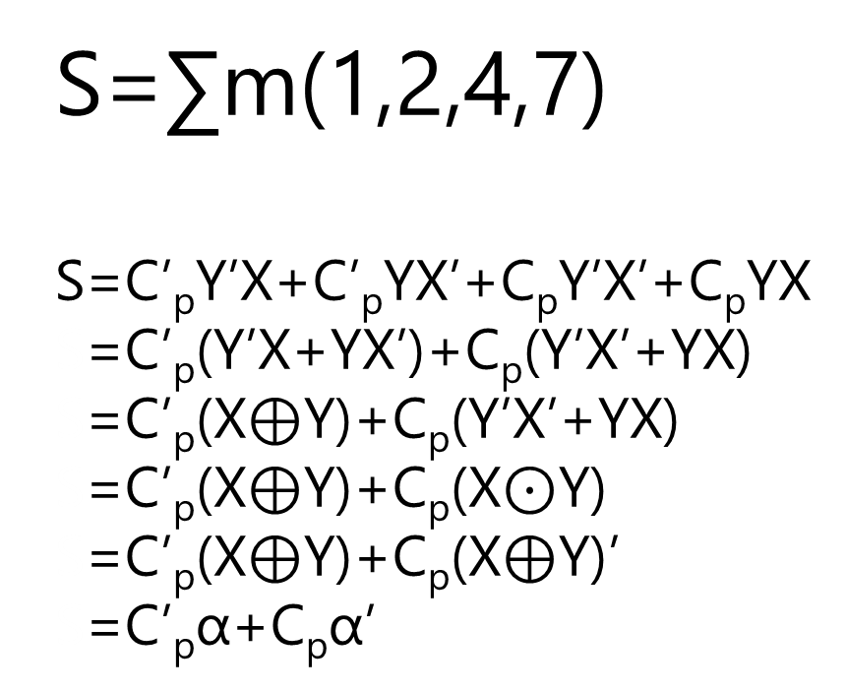
 |  | YX
 |  | 00 | 01 | 11 | 10
C_{p} | 0 | m₀ | m₁ | m₃ | m₂
 | 1 | m₄ | m₅ | m₇ | m₆
S=∑m(1,2,4,7)
S=C’_{p}Y’X+C’_{p}YX’+C_{p}Y’X’+C_{p}YX
S=C’_{p}(Y’X+YX’)+C_{p}(Y’X’+YX)
S=C’_{p}(X$⊕$Y)+C_{p}(Y’X’+YX)
S=C’_{p}(X$⊕$Y)+C_{p}(X$⊙$Y)
S=C’_{p}(X$⊕$Y)+C_{p}(X$⊕$Y)’
S=C’_{p}α+C_{p}α’
0 | 1 | 0 | 1
1 | 0 | 1 | 0
m₀ | m₁ | m₃ | m₂
m₄ | m₅ | m₇ | m₆

Slide 47
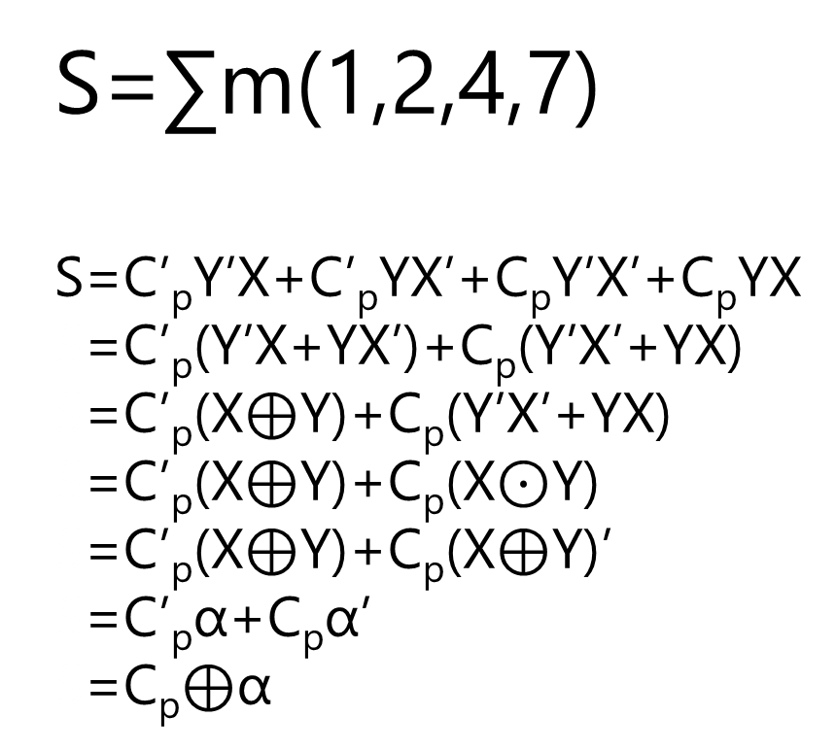
 |  | YX
 |  | 00 | 01 | 11 | 10
C_{p} | 0 | m₀ | m₁ | m₃ | m₂
 | 1 | m₄ | m₅ | m₇ | m₆
S=∑m(1,2,4,7)
S=C’_{p}Y’X+C’_{p}YX’+C_{p}Y’X’+C_{p}YX
S=C’_{p}(Y’X+YX’)+C_{p}(Y’X’+YX)
S=C’_{p}(X$⊕$Y)+C_{p}(Y’X’+YX)
S=C’_{p}(X$⊕$Y)+C_{p}(X$⊙$Y)
S=C’_{p}(X$⊕$Y)+C_{p}(X$⊕$Y)’
S=C’_{p}α+C_{p}α’
S=C_{p}$⊕$α
0 | 1 | 0 | 1
1 | 0 | 1 | 0
m₀ | m₁ | m₃ | m₂
m₄ | m₅ | m₇ | m₆

Slide 48
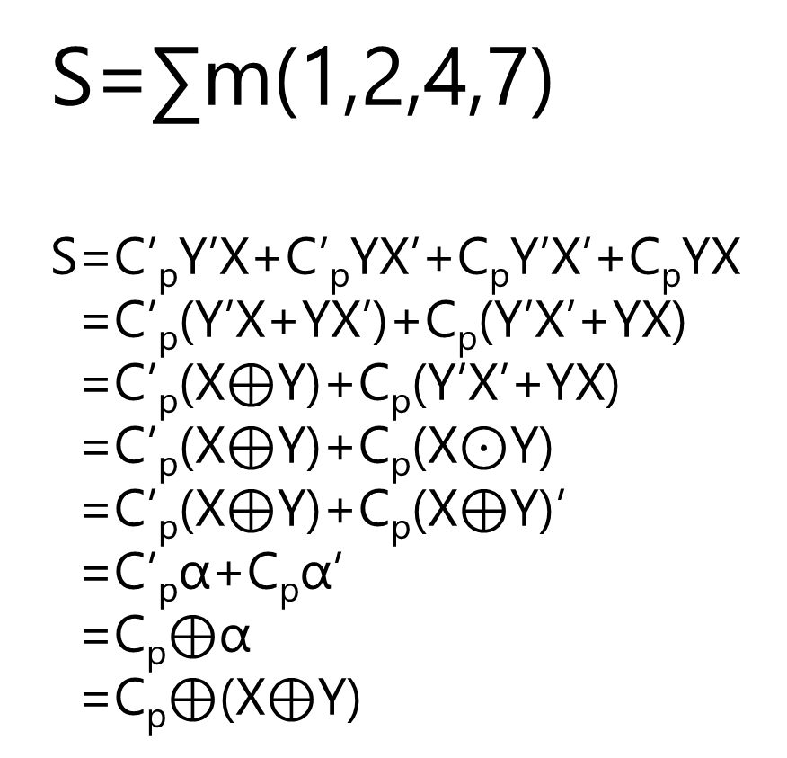
 |  | YX
 |  | 00 | 01 | 11 | 10
C_{p} | 0 | m₀ | m₁ | m₃ | m₂
 | 1 | m₄ | m₅ | m₇ | m₆
S=∑m(1,2,4,7)
S=C’_{p}Y’X+C’_{p}YX’+C_{p}Y’X’+C_{p}YX
S=C’_{p}(Y’X+YX’)+C_{p}(Y’X’+YX)
S=C’_{p}(X$⊕$Y)+C_{p}(Y’X’+YX)
S=C’_{p}(X$⊕$Y)+C_{p}(X$⊙$Y)
S=C’_{p}(X$⊕$Y)+C_{p}(X$⊕$Y)’
S=C’_{p}α+C_{p}α’
S=C_{p}$⊕$α
S=C_{p}$⊕$(X$⊕$Y)
0 | 1 | 0 | 1
1 | 0 | 1 | 0
m₀ | m₁ | m₃ | m₂
m₄ | m₅ | m₇ | m₆

Slide 49
 |  | YX
 |  | 00 | 01 | 11 | 10
C_{p} | 0 | m₀ | m₁ | m₃ | m₂
 | 1 | m₄ | m₅ | m₇ | m₆
S=∑m(1,2,4,7)
S=C_{p}⊕(X⊕Y)
⊕ is associative, we can drop ( ). But let’s keep them!
0 | 1 | 0 | 1
1 | 0 | 1 | 0
m₀ | m₁ | m₃ | m₂
m₄ | m₅ | m₇ | m₆

Slide 50
 |  | YX
 |  | 00 | 01 | 11 | 10
C_{p} | 0 | m₀ | m₁ | m₃ | m₂
 | 1 | m₄ | m₅ | m₇ | m₆
C=∑m(3,5,6,7)
C=YX+C_{p}X+C_{p}Y
0 | 0 | 1 | 0
0 | 1 | 1 | 1

Slide 51
C_{p}
Y
X
S
C

Slide 52
C_{p}
X
Y
S
C

Slide 53
C_{p}
X
Y
Full Adder
S
C

Slide 54
C
0
 | X₂X₁
+ | Y₂Y₁
 | S₂S₁
 | X₂X₁
+ | Y₂Y₁
 | S₂S₁
C
C

Slide 55
C_{p}
C_{p}=0
X₂
X₁
Y₂
Y₁
S₁
Full Adder
S₂
Full Adder
C
C

Slide 56
C_{p}
X
Y
S
C

Slide 57
C_{p}
Y
X
X
Half Adder
Y
S
C₀
S₀
C
Full Adder = Half Adder + …

Slide 58

C_{p}
Y
X
X
Half Adder
Y
S
C₀
S₀
C
Full Adder $=^{?}$ 2 Half Adder + …

Slide 59

Full Adder $∝$ 2 Half Adder

Slide 61
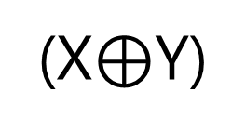
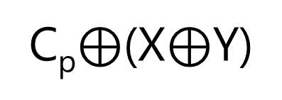
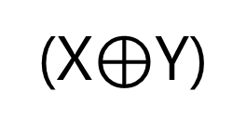
C_{p}
(X$⊕$Y)
S
C_{p}$⊕$(X$⊕$Y)
(X$⊕$Y)

Slide 62
C_{p}
(X$⊕$Y)
C_{p}$⊕$(X$⊕$Y)
(X$⊕$Y)

Slide 63
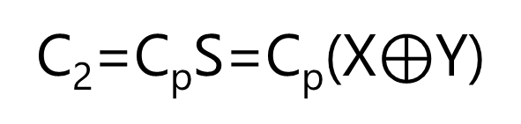
C_{p}
(X$⊕$Y)
C_{p}$⊕$(X$⊕$Y)
(X$⊕$Y)
C₂=C_{p}S=C_{p}(X$⊕$Y)
C₁=XY

Slide 64
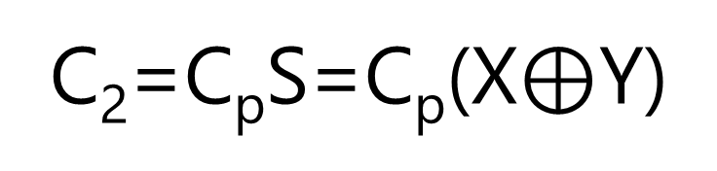
C₁=XY
C = XY + C_{p}X + C_{p}Y
C₂=C_{p}S=C_{p}(X$⊕$Y)

Slide 65
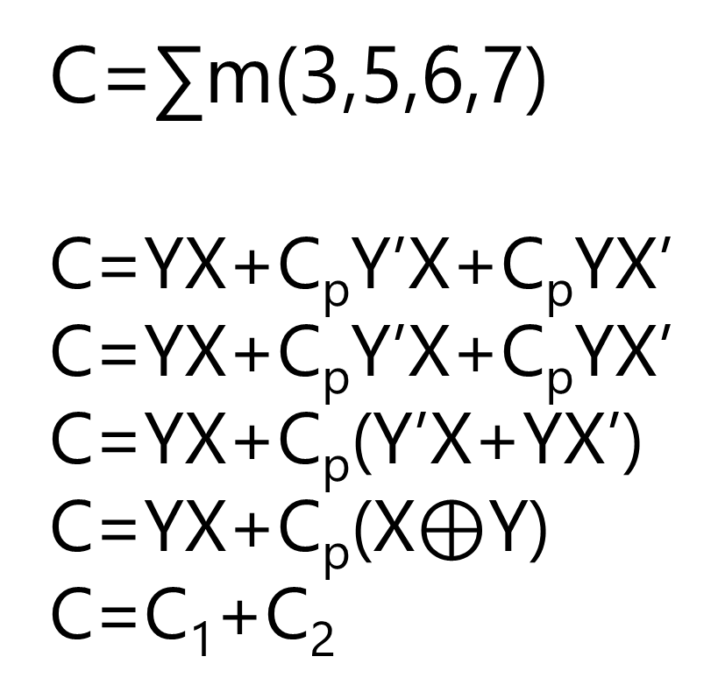
 |  | YX
 |  | 00 | 01 | 11 | 10
C_{p} | 0 | m₀ | m₁ | m₃ | m₂
 | 1 | m₄ | m₅ | m₇ | m₆
C=∑m(3,5,6,7)
C=YX+C_{p}Y’X+C_{p}YX’
C=YX+C_{p}Y’X+C_{p}YX’
C=YX+C_{p}(Y’X+YX’)
C=YX+C_{p}(X$⊕$Y)
C=C₁+C₂
0 | 0 | 1 | 0
0 | 1 | 1 | 1

Slide 66
Y
X
C_{p}
C
S

Slide 67
Y
X
C_{p}
Half Adder
Half Adder
C
S
Full Adder = 2 Half Adder + OR

Slide 68
Y
X
C_{p}
Full Adder
C
S

Slide 69
Design a logic circuit that adds two binary numbers!

Slide 70
C₃C₂C₁C₀
C₀=0
 | X₄X₃X₂X₁
+ | Y₄Y₃Y₂Y₁
 | S₄S₃S₂S₁
C4

Slide 71
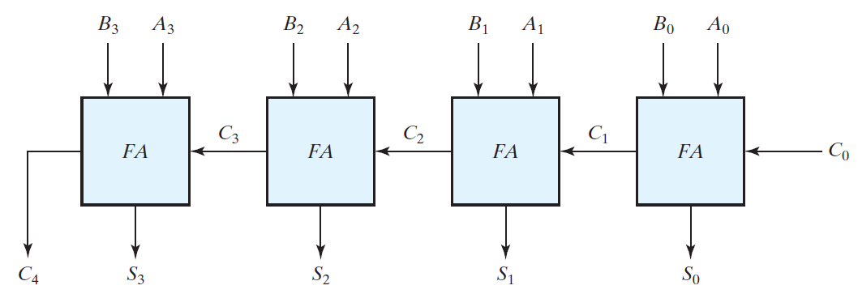
Y₄
X₄
Y₃
X₃
Y₂
X₂
Y₁
X₁
=0
S₄
S₃
S₂
S₁

Slide 72
Y₄
X₄
Y₃
X₃
Y₂
X₂
Y₁
X₁
4-bit Adder
=0
S₄
S₃
S₂
S₁

Slide 73
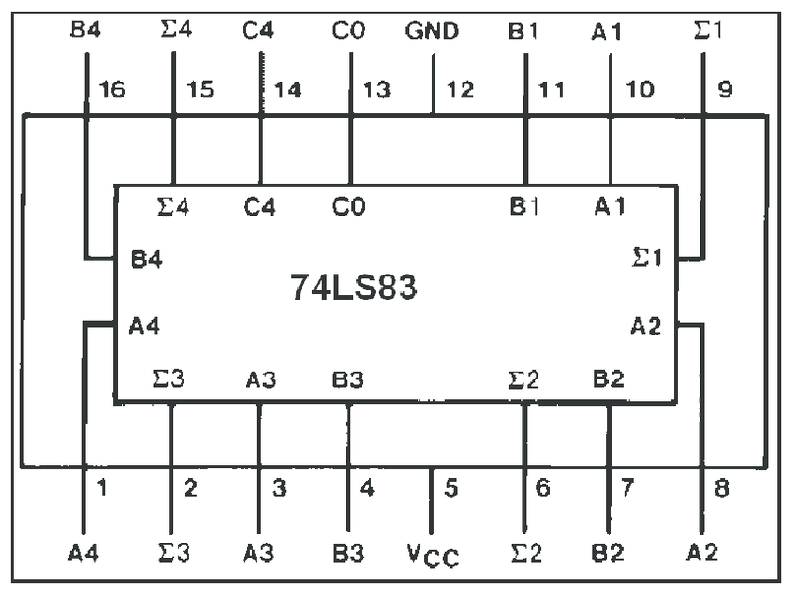
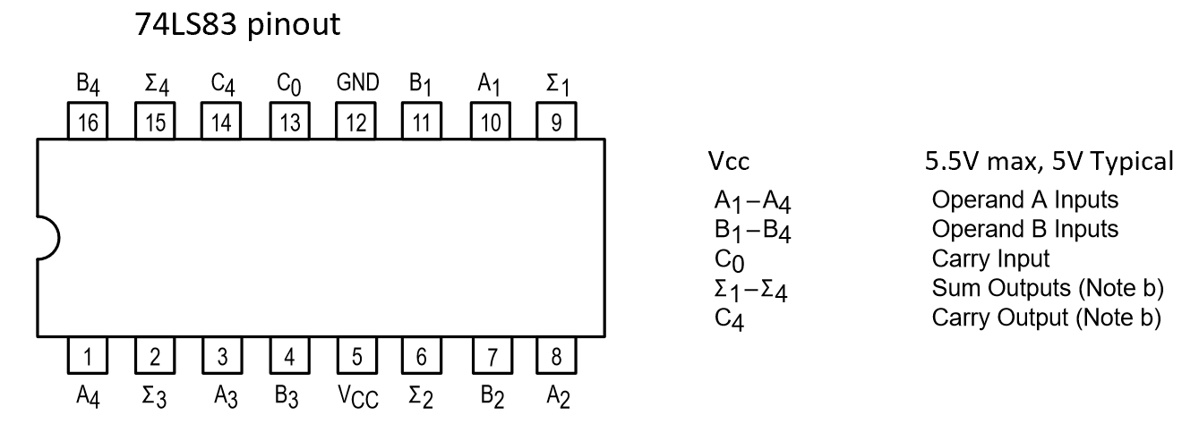

Slide 74
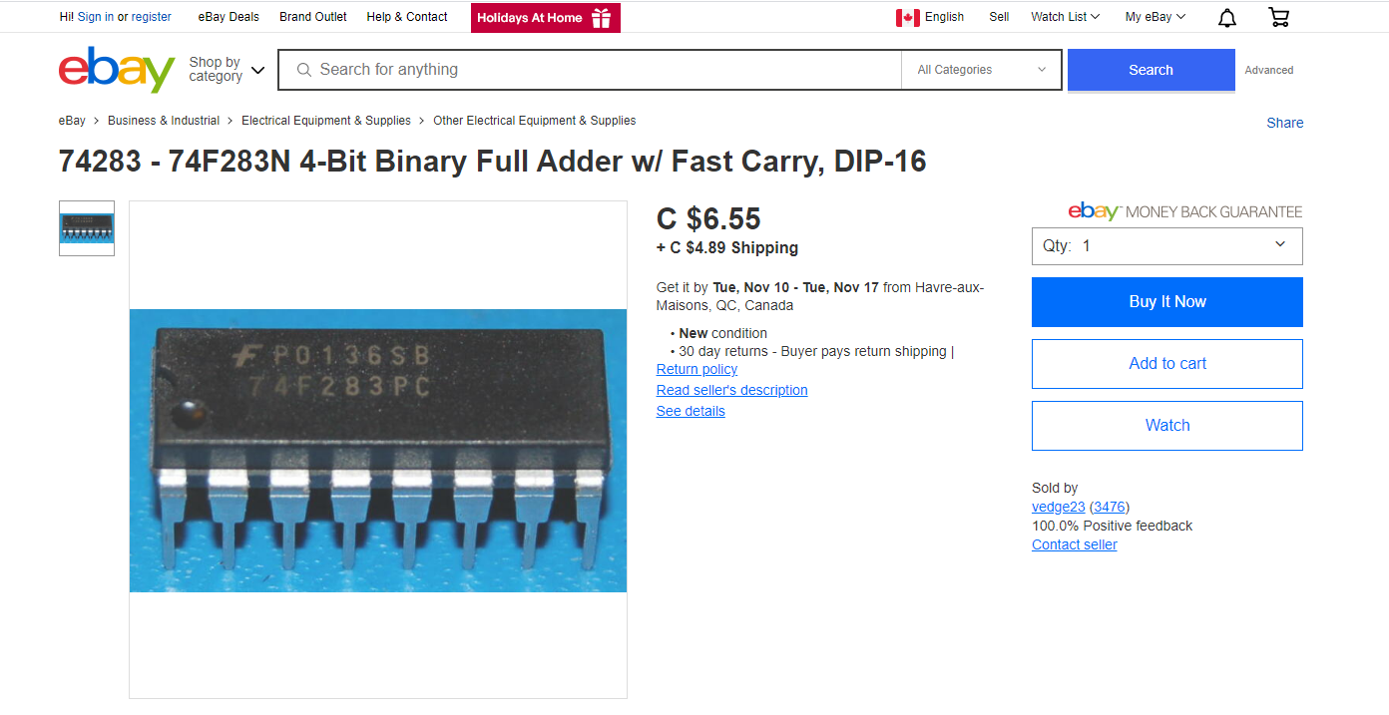

Slide 75
Carry Propagation

Slide 76
Y₄
X₄
Y₃
X₃
Y₂
X₂
Y₁
X₁
C₀
C₄
S₄
C₃
S₃
C₂
S₂
C₁
S₁
If gate delay is Δt, how long does it take to see the S=S₄S₃S₂S₁?

Slide 77
Y₄
X₄
Y₃
X₃
Y₂
X₂
Y₁
X₁
C₀
C₄
S₄
C₃
S₃
C₂
S₂
C₁
S₁
If gate delay is Δt, how long does it take to see the S=S₄S₃S₂S₁?
S₁: 2 × Δt
S₂: 2 × Δt + C₁
S₃: 2 × Δt + C₂
S₄: 2 × Δt + C₃

Slide 78
Y₄
X₄
Y₃
X₃
Y₂
X₂
Y₁
X₁
C₀
C₄
S₄
C₃
S₃
C₂
S₂
C₁
S₁
If gate delay is Δt, how long does it take to see the S=S₄S₃S₂S₁?
S₁: 2 × Δt
S₂: 2 × Δt + C₁
S₃: 2 × Δt + C₂
S₄: 2 × Δt + C₃
In parallel

Slide 79
Y₄
X₄
Y₃
X₃
Y₂
X₂
Y₁
X₁
C₀
C₄
S₄
C₃
S₃
C₂
S₂
C₁
S₁
If gate delay is Δt, how long does it take to see the S=S₄S₃S₂S₁?
S₁: 2 × Δt
S₂: 2 × Δt + C₁
S₃: 2 × Δt + C₂
S₄: 2 × Δt + C₃
In parallel

Slide 80
Y₄
X₄
Y₃
X₃
Y₂
X₂
Y₁
X₁
C₀
C₄
S₄
C₃
S₃
C₂
S₂
C₁
S₁
If gate delay is Δt, how long does it take to see the S=S_{n}…S₃S₂S₁?

Slide 81
Y₄
X₄
Y₃
X₃
Y₂
X₂
Y₁
X₁
C₀
C₄
S₄
C₃
S₃
C₂
S₂
C₁
S₁
If gate delay is Δt, how long does it take to see the C₄?

Slide 82
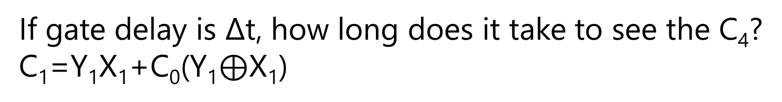
Y₄
X₄
Y₃
X₃
Y₂
X₂
Y₁
X₁
C₀
C₄
S₄
C₃
S₃
C₂
S₂
C₁
S₁
If gate delay is Δt, how long does it take to see the C₄?
C₁=Y₁X₁+C₀(Y₁$⊕$X₁)

Slide 83
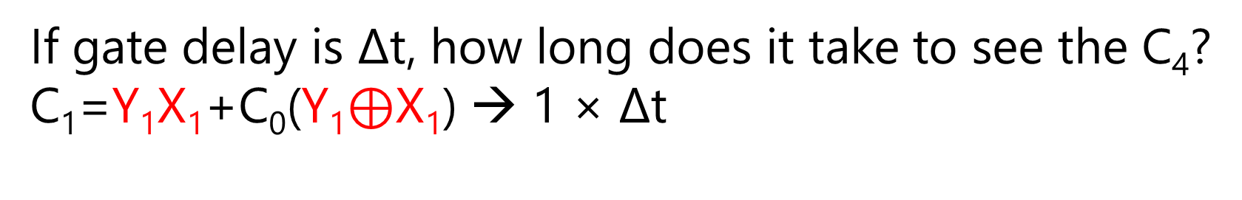
Y₄
X₄
Y₃
X₃
Y₂
X₂
Y₁
X₁
C₀
C₄
S₄
C₃
S₃
C₂
S₂
C₁
S₁
If gate delay is Δt, how long does it take to see the C₄?
C₁=Y₁X₁+C₀(Y₁$⊕$X₁) → 1 × Δt
AND and XOR can be done in parallel.

Slide 84
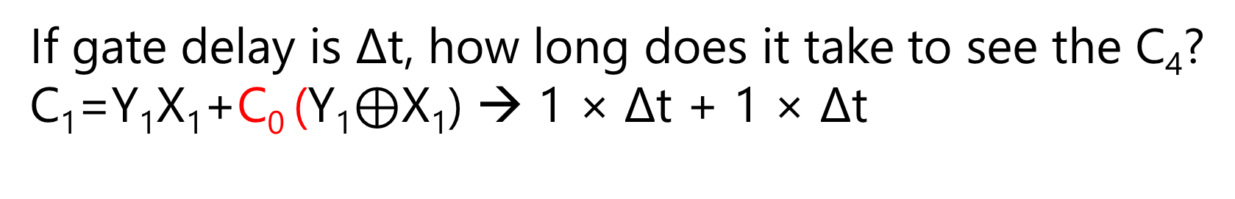
Y₄
X₄
Y₃
X₃
Y₂
X₂
Y₁
X₁
C₀
C₄
S₄
C₃
S₃
C₂
S₂
C₁
S₁
If gate delay is Δt, how long does it take to see the C₄?
C₁=Y₁X₁+C₀ (Y₁$⊕$X₁) → 1 × Δt + 1 × Δt
C₀ AND

Slide 85
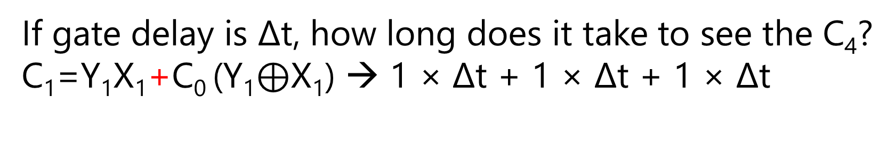
Y₄
X₄
Y₃
X₃
Y₂
X₂
Y₁
X₁
C₀
C₄
S₄
C₃
S₃
C₂
S₂
C₁
S₁
If gate delay is Δt, how long does it take to see the C₄?
C₁=Y₁X₁+C₀ (Y₁$⊕$X₁) → 1 × Δt + 1 × Δt + 1 × Δt
OR

Slide 86
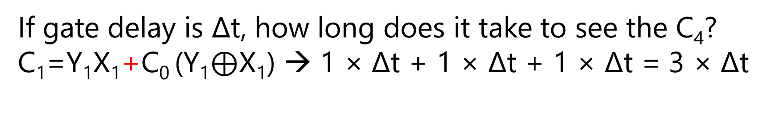
Y₄
X₄
Y₃
X₃
Y₂
X₂
Y₁
X₁
C₀
C₄
S₄
C₃
S₃
C₂
S₂
C₁
S₁
If gate delay is Δt, how long does it take to see the C₄?
C₁=Y₁X₁+C₀ (Y₁$⊕$X₁) → 1 × Δt + 1 × Δt + 1 × Δt = 3 × Δt

Slide 87
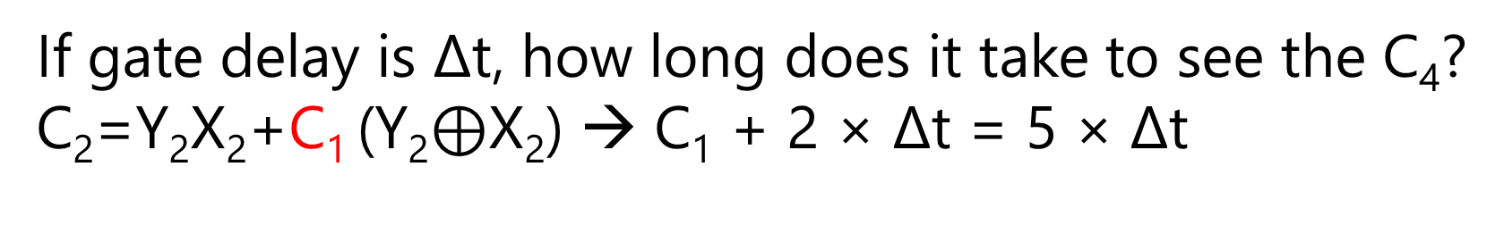
Y₄
X₄
Y₃
X₃
Y₂
X₂
Y₁
X₁
C₀
C₄
S₄
C₃
S₃
C₂
S₂
C₁
S₁
If gate delay is Δt, how long does it take to see the C₄?
C₂=Y₂X₂+C₁ (Y₂$⊕$X₂) → C₁ + 2 × Δt = 5 × Δt
C₁ AND then OR
In the meantime, in parallel, we can do the Y₂X₂ and Y₂$⊕$X₂

Slide 88

Y₄
X₄
Y₃
X₃
Y₂
X₂
Y₁
X₁
C₀
C₄
S₄
C₃
S₃
C₂
S₂
C₁
S₁
If gate delay is Δt, how long does it take to see the C₄?
C₃=Y₃X₃+C₂ (Y₃$⊕$X₃) → C₂ + 2 × Δt = 7 × Δt

Slide 89

Y₄
X₄
Y₃
X₃
Y₂
X₂
Y₁
X₁
C₀
C₄
S₄
C₃
S₃
C₂
S₂
C₁
S₁
If gate delay is Δt, how long does it take to see the C₄?
C₄=Y₄X₄+C₃ (Y₄$⊕$X₄) → C₃ + 2 × Δt = 9 × Δt

Slide 90
Y₄
X₄
Y₃
X₃
Y₂
X₂
Y₁
X₁
C₀
C₄
S₄
C₃
S₃
C₂
S₂
C₁
S₁
If gate delay is Δt, how long does it take to see the C_{n}?

Slide 91
Carry Lookahead
C_{1:n} → Constant Delay
Book Page 138-141

Slide 92
Binary Adder
Does it matter we have signed or unsigned binary numbers?
Justify your answer.

Slide 93
Binary Adder, Binary Subtractor, Binary Multiplier
Binary Comparator (Magnitude Comparator)
Arithmatic
&
Logical Op

Slide 94
Binary Subtractor
Signed-2’s-Complement

Slide 95

X $−$ Y
Subtraction in Signed-2’s-Complement

Slide 96
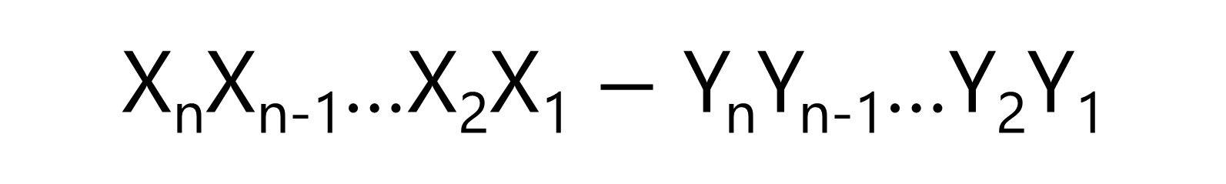
X_{n}X_{n-1}…X₂X₁ $−$ Y_{n}Y_{n-1}…Y₂Y₁
Subtraction in Signed-2’s-Complement

Slide 97
X + 2’s-comp(Y)
Subtraction in Signed-2’s-Complement

Slide 98
X + 1’s-comp(Y) + 1
Subtraction in Signed-2’s-Complement

Slide 99
bitwise
X + Y’ + 1
Subtraction in Signed-2’s-Complement

Slide 100
bitwise
X + Y’ + (C₀=1)
Subtraction in Signed-2’s-Complement

Slide 101
Y’₄
X₄
Y’₃
X₃
Y’₂
X₂
Y’₁
X₁
4-bit Adder
=1
S₄
S₃
S₂
S₁

Slide 102
Y₄
Y₃
Y₂
Y₁
Y’₄
X₄
Y’₃
X₃
Y’₂
X₂
Y’₁
X₁
4-bit Adder | Subtractor
= 0
= 1
S₄
S₃
S₂
S₁

Slide 103
Y₄
Y₃
Y₂
Y₁
Y’₄
X₄
Y’₃
X₃
Y’₂
X₂
Y’₁
X₁
4-bit Adder | Subtractor
= 0
= 1
S₄
S₃
S₂
S₁

Slide 104
Y₄
Y₃
Y₂
Y₁
Y’₄
X₄
Y’₃
X₃
Y’₂
X₂
Y’₁
X₁
4-bit Adder | Subtractor
= 0
= 1
S₄
S₃
S₂
S₁

Slide 105
A ? 0 = A
A ? 1 = A’

Slide 106

A $⨁$ 0 = A
A $⨁$ 1 = A’

Slide 107
Y₄
Y₃
Y₂
Y₁
Y’₄
X₄
Y’₃
X₃
Y’₂
X₂
Y’₁
X₁
4-bit Adder | Subtractor
M
S₄
S₃
S₂
S₁
M=0 → Adder
M=1 → Subtractor

Slide 108
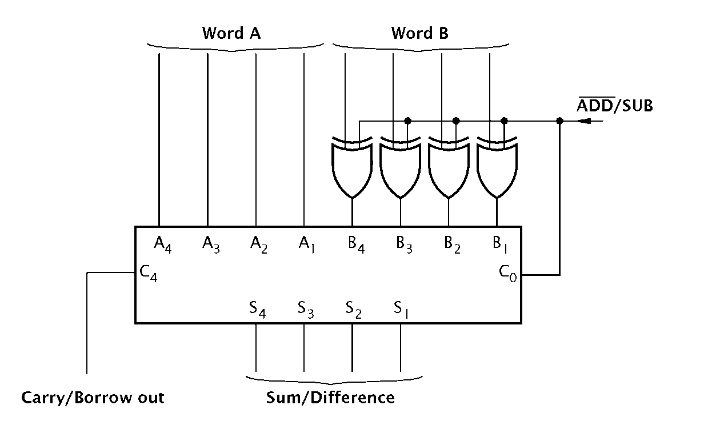

Slide 109
Overflow
Signed-2’s-Complement

Slide 110
Design a logic circuit that detects overflow?
Signed-2’s-Complement
Truth Table

Slide 111
Y4 | Y3 | Y2 | Y1 | X4 | X3 | X2 | X1 | C | OVF
4-Bit Adder |  |  |  |  |  |  |  |  | ?
Y3 | Y2 | Y1 | X3 | X2 | X1 | C | OVF
3-Bit Adder |  |  |  |  |  |  | ?
Y2 | Y1 | X2 | X1 | C | OVF
2-Bit Adder |  |  |  |  | ?

Slide 112
Design a logic circuit that detects overflow?
Signed-2’s-Complement
Using Prior Knowledge

Slide 113
Design a logic circuit that detects overflow?
Signed-2’s-Complement
(I)
Subtraction → Addition with 2’s Comp.

Slide 114
Design a logic circuit that detects overflow?
Signed-2’s-Complement
(II)
Sum of Positive Numbers → Negative: OVF=1
Sum of Negative Numbers → Positive: OVF=1

Slide 115
Design a logic circuit that detects overflow?
Signed-2’s-Complement
(III)
Binary System→ The most significant bit → Sign

Slide 116
Base-r in Radix Complement
r^{n–1} | r^{n–2} | r^{n–3} |  | … | r² |  | r¹ | r⁰
0 <= |  |  | Positive Numbers Nothing to do! |  |  | <= (r^{n} –1)÷2 Base-2: 0,111,…,111 Base-4: 1,333,…,333 Base-8: 3,777,…,777 Base-10: 4,999,…,999 Base-16: 7,FFF,…,FFF
Number System

Slide 117
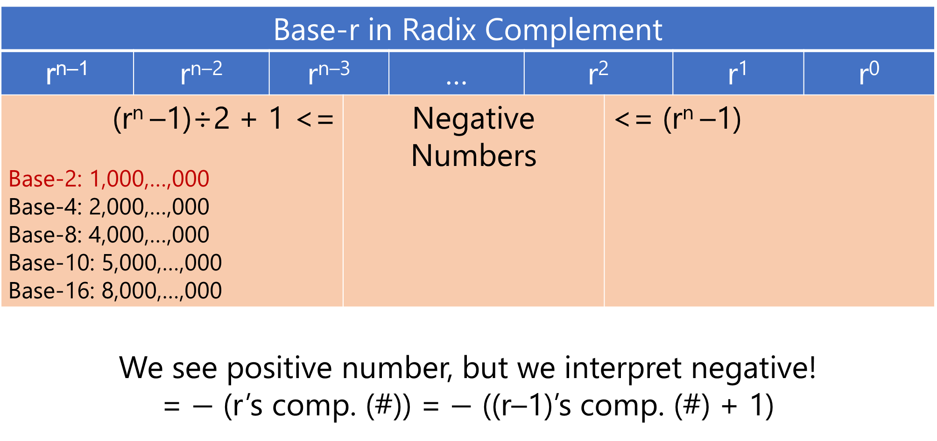
Base-r in Radix Complement
r^{n–1} | r^{n–2} | r^{n–3} |  | … | r² |  | r¹ | r⁰
(r^{n} –1)÷2 + 1 <= Base-2: 1,000,…,000 Base-4: 2,000,…,000 Base-8: 4,000,…,000 Base-10: 5,000,…,000 Base-16: 8,000,…,000 |  |  | Negative Numbers |  |  | <= (r^{n} –1)
We see positive number, but we interpret negative! = $−$ (r’s comp. (#)) = $−$ ((r–1)’s comp. (#) + 1)
Number System

Slide 118
C₃C₂C₁C₀
 | X₄X₃X₂X₁
+ | Y₄Y₃Y₂Y₁
 | S₄S₃S₂S₁
C4
Either was addition originally
Or was subtraction and became addition with 2’s-comp

Slide 119
C₃C₂C₁C₀
 | X₄=0 X₃X₂X₁
+ | Y₄=0 Y₃Y₂Y₁
 | S₄=1 S₃S₂S₁
C4
OVF!

Slide 120
C₃=1 C₂C₁C₀
 | X₄=0 X₃X₂X₁
+ | Y₄=0 Y₃Y₂Y₁
 | S₄=1 S₃S₂S₁
C4=0
OVF!
C’₄C₃

Slide 121
C₃C₂C₁C₀
 | X₄=1 X₃X₂X₁
+ | Y₄=0 Y₃Y₂Y₁
 | S₄=? S₃S₂S₁
C4
S₄ is guaranteed to be correct in signed-2’s-comp.
Don’t believe it, try!

Slide 122
C₃C₂C₁C₀
 | X₄=0 X₃X₂X₁
+ | Y₄=1 Y₃Y₂Y₁
 | S₄=? S₃S₂S₁
C4
S₄ is guaranteed to be correct in signed-2’s-comp.
Don’t believe it, try!

Slide 123
C₃C₂C₁C₀
 | X₄=1 X₃X₂X₁
+ | Y₄=1 Y₃Y₂Y₁
 | S₄=0 S₃S₂S₁
C4
OVF!

Slide 124
C₃=0 C₂C₁C₀
 | X₄=1 X₃X₂X₁
+ | Y₄=1 Y₃Y₂Y₁
 | S₄=0 S₃S₂S₁
C4=1
OVF!
C₄C’₃

Slide 125
Design a logic circuit that detects overflow?
Signed-2’s-Complement
OVF = C’₄C₃ + C₄C’₃ = C₄$⊕$C₃

Slide 126
Y₄
Y₃
Y₂
Y₁
Y’₄
X₄
Y’₃
X₃
Y’₂
X₂
Y’₁
X₁
4-bit Adder | Subtractor
M
S₄
S₃
S₂
S₁
M=0 → Adder
M=1 → Subtractor

Slide 127
Y₄
Y₃
Y₂
Y₁
Y’₄
X₄
Y’₃
X₃
Y’₂
X₂
Y’₁
X₁
M
S₄
S₃
S₂
S₁
M=0 → Adder
M=1 → Subtractor
OVF

Slide 128
Binary Adder | Subtractor | Overflow
Unsigned?

Slide 129
Hossein’s way!
Unsigned: Signed Positive

Slide 130
Binary Adder
Unsigned: Signed Positive

Slide 131
C₃C₂C₁C₀
 | 0 X₃X₂X₁
+ | 0 Y₃Y₂Y₁
 | S₄S₃S₂S₁
C4

Slide 132
Binary Subtractor
Unsigned: Signed Positive

Slide 133
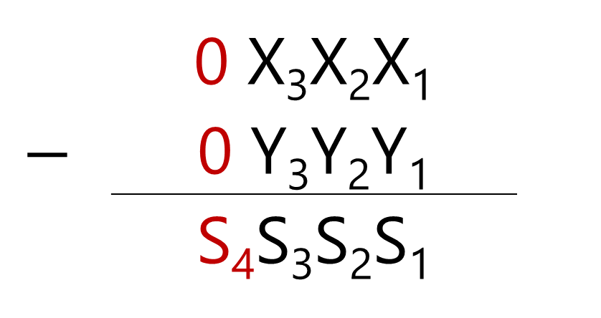
C₃C₂C₁C₀
 | 0 X₃X₂X₁
$$−$$ | 0 Y₃Y₂Y₁
 | S₄S₃S₂S₁
C4

Slide 134
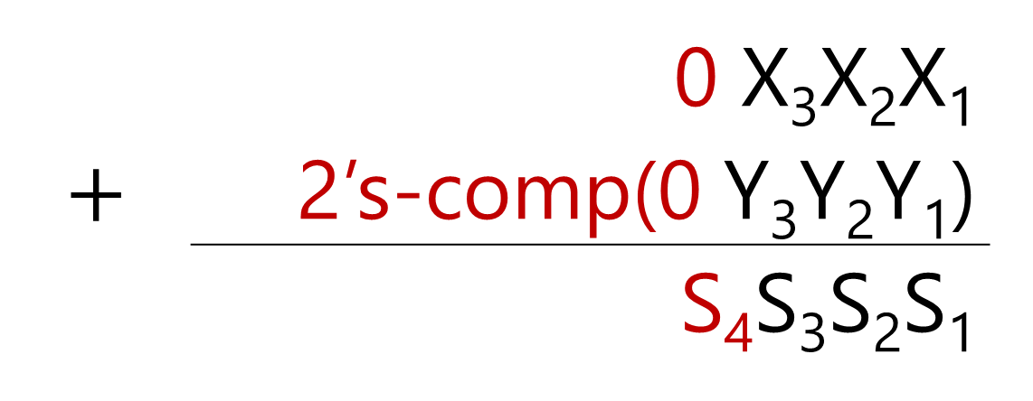
C₃C₂C₁C₀
 | 0 X₃X₂X₁
$$+$$ | 2’s-comp(0 Y₃Y₂Y₁)
 | S₄S₃S₂S₁
C4

Slide 135
Binary Overflow
Unsigned: Signed Positive

Slide 136
C₃C₂C₁C₀
 | 0 X₃X₂X₁
+ | 0 Y₃Y₂Y₁
 | 1 S₃S₂S₁
C4
OVF!

Slide 137
C₃=1C₂C₁C₀
 | 0 X₃X₂X₁
+ | 0 Y₃Y₂Y₁
 | 1 S₃S₂S₁
C4
OVF!

Slide 138
Binary Overflow
Unsigned: Signed Positive
OVF = C₃ for 3-bit unsigned adder!

Slide 139
Book’s way!
Unsigned

Slide 140
Y₄
Y₃
Y₂
Y₁
Y’₄
X₄
Y’₃
X₃
Y’₂
X₂
Y’₁
X₁
4-bit Adder | Subtractor
M
S₄
S₃
S₂
S₁
M=0 → Adder
M=1 → Subtractor

