Slide 1
Logic
Circuits
Sequential
Combinational

Slide 2
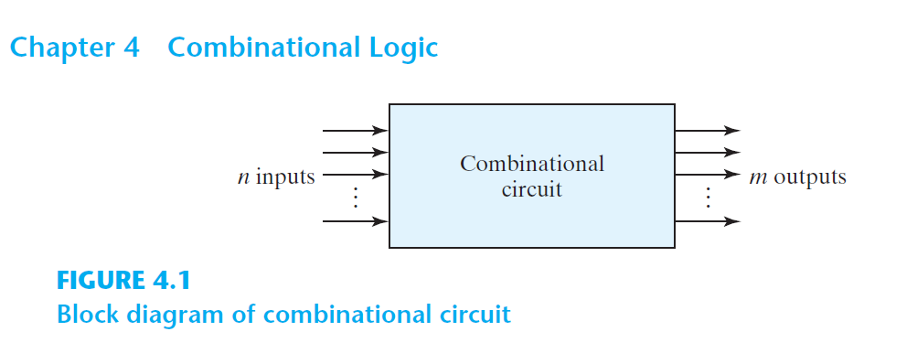

Slide 3
Combinational Logic
aka. Combinational Circuit
Combination of logic gates on the present inputs → the outputs at any time!
A combinational circuit performs an operation that can be specified logically by a set of Boolean functions.

Slide 4
Arithmatic
&
Logical Op
Combinational
Logic
Data
Transmission
Coders

Slide 5
Decoder, Encoder
Multiplexer (MUX, MPX), De-Multiplexer (Demux)
Data
Transmission

Slide 6
Binary Decoder
Binary Code Decoder
Display Decoder

Slide 7
Decoder
Decode Binary to 1-hot
1-hot: a vector of bits with a single 1 and all the others 0
[0010000000]
[0000000100]
[0010010000]

Slide 8
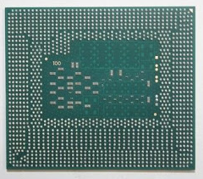
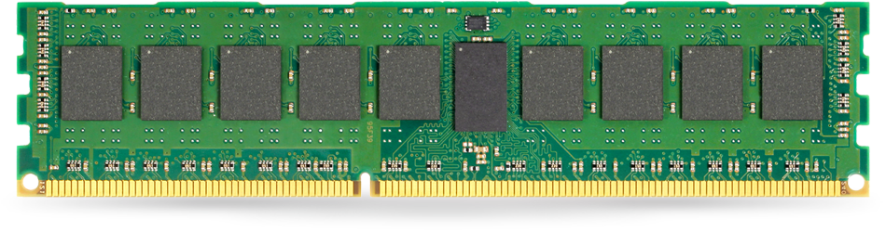

Slide 9
0
0
0
0
0
0
0
0
0
Address

Slide 10
1
0
0
0
0
0
0
0
0
Address

Slide 11
0
1
0
0
0
0
0
0
0
Address

Slide 12
0
0
1
0
0
0
0
0
0
Address

Slide 13
D₀
D₁
X

Slide 14
D₀=1
D₁=0
0

Slide 15
D₀=0
D₁=1
1

Slide 16
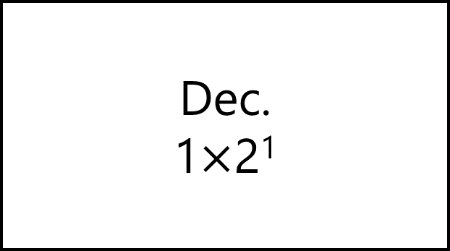
D₀
D₁
Dec.
1$×$2¹
X

Slide 17
X | D₀ | D₁
0 | 1 | 0
1 | 0 | 1

Slide 18
X | D₀=m₀ | D₁=m₁
0 | 1 | 0
1 | 0 | 1

Slide 19
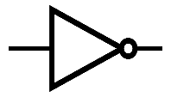
D₀
D₁
X

Slide 20
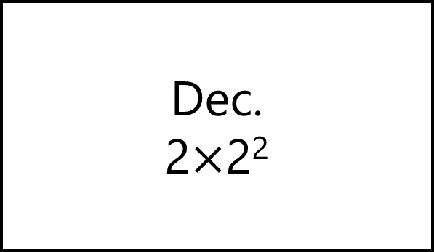
D₀
D₁
D₂
D₃
Dec.
2$×$2²
X
Y

Slide 21
D₀=1
D₁=0
D₂=0
D₃=0
Dec.
2$×$2²
0
0

Slide 22
D₀=0
D₁=1
D₂=0
D₃=0
Dec.
2$×$2²
1
0

Slide 23
D₀=0
D₁=0
D₂=1
D₃=0
Dec.
2$×$2²
0
1

Slide 24
D₀=0
D₁=0
D₂=0
D₃=1
Dec.
2$×$2²
1
1

Slide 25
Y | X | D₀=m₀ | D₁=m₁ | D₂=m₂ | D₃=m₃
0 | 0 | 1 | 0 | 0 | 0
0 | 1 | 0 | 1 | 0 | 0
1 | 0 | 0 | 0 | 1 | 0
1 | 1 | 0 | 0 | 0 | 1

Slide 26
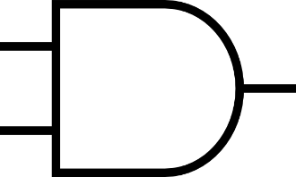
D₀
D₁
D₂
D₃
X
Y

Slide 27
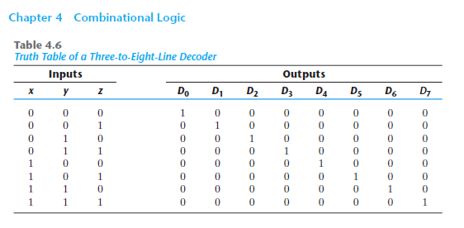

Slide 28
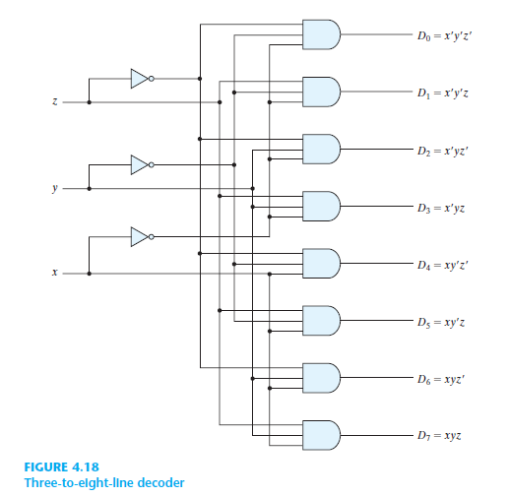

Slide 29
Decoder
Decode 4-Bit Binary to 2⁴ One-hot

Slide 30
Decoder
Decode n-Bit Binary to 2^{n} One-hot

Slide 31

Decoder
Decode 2-Bit Binary to 2² One-hot
Re-Use 1$×$2¹ Decoder

Slide 32

D₀
D₁
D₂
D₃
Dec.
2$×$4
X
Y

Slide 33
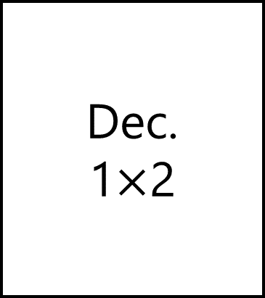

Dec.
1$×$2
D₀
D₁
D₂
D₃
D₀
X
D₁
X
Y
Dec.
1$×$2
D₀
X
D₁

Slide 34
Dec.
1$×$2
D₀=1
D₁=0
D₂=1
D₃=0
D₀
X
D₁
0
0
Dec.
1$×$2
D₀
X
D₁

Slide 35
Dec.
1$×$2
D₀=0
D₁=1
D₂=1
D₃=0
D₀
X
D₁
1
0
Dec.
1$×$2
D₀
X
D₁

Slide 36
Decoder
Enable input

Slide 37
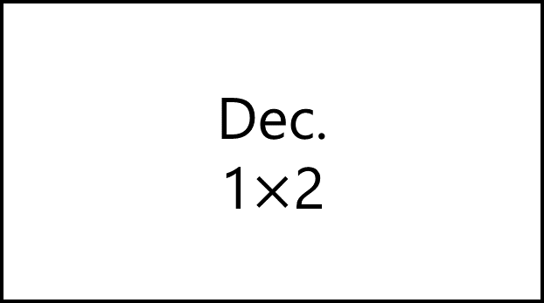
D₀
D₁
Dec.
1$×$2
X
E

Slide 38
D₀=0
D₁=0
Dec.
1$×$2
X
E=0

Slide 39
D₀
D₁
Dec.
1$×$2
X
E=1

Slide 40
E | X | D₀=m₂ | D₁=m₃
0 | 0 | 0 | 0
0 | 1 | 0 | 0
1 | 0 | 1 | 0
1 | 1 | 0 | 1

Slide 41
E | X | D₀=m₀ | D₁=m₁
1 | 0 | 1 | 0
1 | 1 | 0 | 1

Slide 42
D₀
D₁
X
E

Slide 43
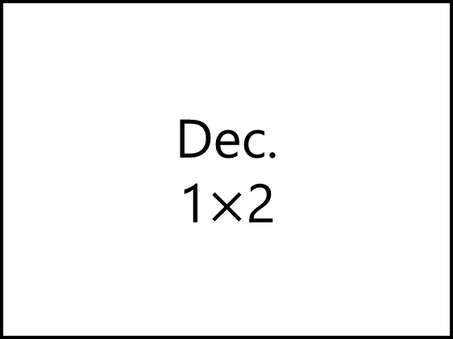
Dec.
1$×$2
D₀
D₁
X
E

Slide 44

Dec.
1$×$2
D₀
X
D₁
E

Slide 45

Dec.
1$×$2
D₀
D₁
D₂
D₃
D₀
X
D₁
E
X
Y
Dec.
1$×$2
D₀
X
D₁
E

Slide 46

Dec.
1$×$2
D₀
D₁
D₂
D₃
D₀
X
D₁
E
X
0
Dec.
1$×$2
D₀
X
D₁
E

Slide 47
Dec.
1$×$2
D₀=1
D₁=0
D₂=0
D₃=0
D₀
X
D₁
E
0
0
Dec.
1$×$2
D₀
X
D₁
E

Slide 48
Dec.
1$×$2
D₀=0
D₁=1
D₂=0
D₃=0
D₀
X
D₁
E
1
0
Dec.
1$×$2
D₀
X
D₁
E

Slide 49

Dec.
1$×$2
D₀
D₁
D₂
D₃
D₀
X
D₁
E
X
1
Dec.
1$×$2
D₀
X
D₁
E

Slide 50
Dec.
1$×$2
D₀=0
D₁=0
D₂=1
D₃=0
D₀
X
D₁
E
0
1
Dec.
1$×$2
D₀
X
D₁
E

Slide 51
Dec.
1$×$2
D₀=0
D₁=0
D₂=0
D₃=1
D₀
X
D₁
E
1
1
Dec.
1$×$2
D₀
X
D₁
E

Slide 52

Dec.
1$×$2
D₀
D₁
D₂
D₃
D₀
X
D₁
E
X
Y
Dec.
1$×$2
D₀
X
Dec.
1$×$2
D₁
D₀
E
1
X
D₁
E

Slide 53

Dec.
1$×$2
D₀=0
D₁=0
D₂=1
D₃=0
D₀
X
D₁
E
0
1
Dec.
1$×$2
D₀
X
Dec.
1$×$2
D₁
D₀
E
1
X
D₁
E

Slide 54

Decoder
Decode 3-Bit Binary to 2³ One-hot
Re-Use 2$×$2² Decoder

Slide 55


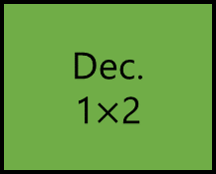
D₀
D₁
D₂
D₃
D₄
D₅
D₆
D₇
Dec.
2$×$4
D₀
X
D₁
Y
D₂
X
Y
Z
E
D₃
Dec.
1$×$2
D₀
Dec.
2$×$4
D₀
X
D₁
X
D₁
E
Y
D₂
E
D₃

Slide 56

D₀=0
D₁=0
D₂=0
D₃=0
D₄=0
D₅=0
D₆=1
D₇=0
Dec.
2$×$4
D₀
X
D₁
Y
D₂
0
1
1
E
D₃
Dec.
1$×$2
D₀
Dec.
2$×$4
D₀
X
D₁
X
D₁
E
Y
D₂
E
D₃

Slide 57

D₀
D₁
D₂
D₃
D₄
D₅
D₆
D₇
Decoder
3 $×$ 2³
Dec.
2$×$4
D₀
X
D₁
Y
D₂
X
Y
Z
E
D₃
Dec.
1$×$2
D₀
Dec.
2$×$4
D₀
X
D₁
X
D₁
E
Y
D₂
E
D₃

Slide 58

Decoder
Decode 4-Bit Binary to 2⁴ One-hot
Re-Use 1$×$2¹ Decoder
Re-Use 2$×$2² Decoder
Re-Use 3$×$2³ Decoder

Slide 59
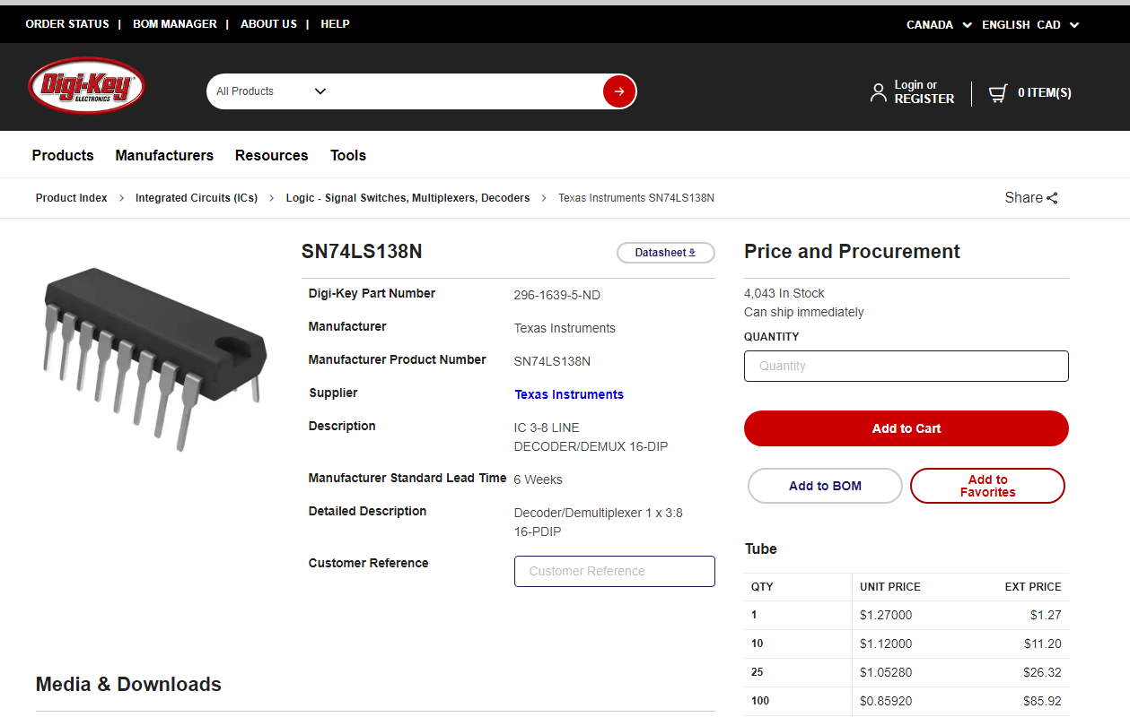
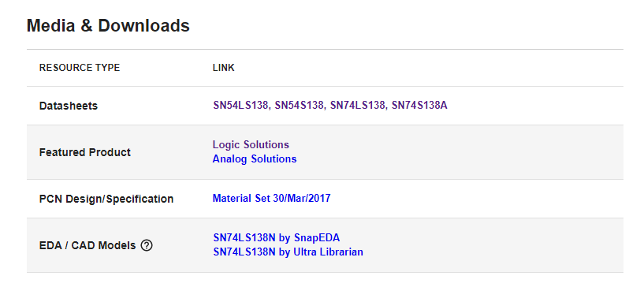
Notes:
https://www.ti.com/lit/ds/sdls014/sdls014.pdf?ts=1604890033918&ref_url=https%253A%252F%252Fwww.google.com%252F

Slide 60
Decoder
Boolean Function
F_{SoP} = ∑m(…)
F_{PoS} = ∏M(…)

Slide 61
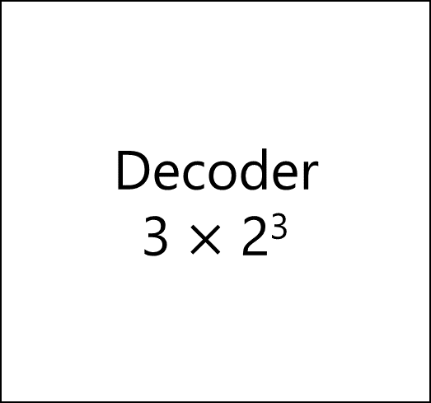
Decoder
3 $×$ 2³
D₀
D₁
D₂
D₃
D₄
D₅
D₆
D₇
m₀
m₁
m₂
m₃
m₄
m₅
m₆
m₇
X
Y
Z

Slide 62
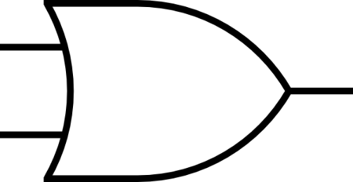
Decoder
3 $×$ 2³
D₀
D₁
D₂
D₃
D₄
D₅
D₆
D₇
X
Y
Z
F_{SoP} = ∑m(2,4,7)

Slide 63
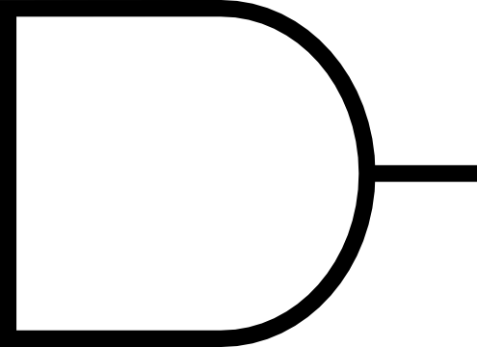
Decoder
3 $×$ 2³
D₀
D₁
D₂
D₃
D₄
D₅
D₆
D₇
X
Y
Z
F_{PoS} = ∏M(0,1,3,5,6)

Slide 64
Decoder
Full Adder
S = ∑m(1,2,4,7)
C = ∑m(3,5,6,7)

Slide 65
C_{p} | Y | X | C=∑m(3,5,6,7) | S=∑m(1,2,4,7)
0 | 0 | 0 | 0 | 0
0 | 0 | 1 | 0 | 1
0 | 1 | 0 | 0 | 1
0 | 1 | 1 | 1 | 0
1 | 0 | 0 | 0 | 1
1 | 0 | 1 | 1 | 0
1 | 1 | 0 | 1 | 0
1 | 1 | 1 | 1 | 1

Slide 66
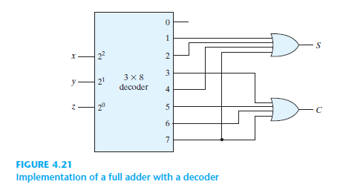
C_{p}
Y
X

Slide 67
Binary Adder, Binary Subtractor, Binary Multiplier
Binary Comparator (Magnitude Comparator)
Arithmatic
&
Logical Op
Decoder, Encoder
Multiplexer (MUX, MPX), De-Multiplexer (Demux)
Data
Transmission
Coders
Binary Codes (BCD, Excess-3, Gray)

Slide 68
Multiplexer
Shortened to MUX or MPX

Slide 69
Address to Select

Slide 70
Transfer

Slide 80

Multiplexer
2¹$×$1

Slide 81

I₀
MUX
2$×$1
F
I₁
S

Slide 82
I₀
F=I₀
I₁
S=0

Slide 83
I₀
F=I₁
I₁
S=1

Slide 84
S | I₁ | I₀ | F
0 | 0 | 0 | 0
0 | 0 | 1 | 1
0 | 1 | 0 | 0
0 | 1 | 1 | 1
1 | 0 | 0 | 0
1 | 0 | 1 | 0
1 | 1 | 0 | 1
1 | 1 | 1 | 1

Slide 85
S | I₁ | I₀ | F
0 | 0 | 0 | 0
0 | 0 | 1 | 1
0 | 1 | 0 | 0
0 | 1 | 1 | 1
1 | 0 | 0 | 0
1 | 0 | 1 | 0
1 | 1 | 0 | 1
1 | 1 | 1 | 1

Slide 86
 |  | I₁I₀
 |  | 00 | 01 | 11 | 10
S | 0 | m₀ | m₁ | m₃ | m₂
 | 1 | m₄ | m₅ | m₇ | m₆
0 | 1 | 1 | 0
0 | 0 | 1 | 1
F=S’I₀+SI₁

Slide 87
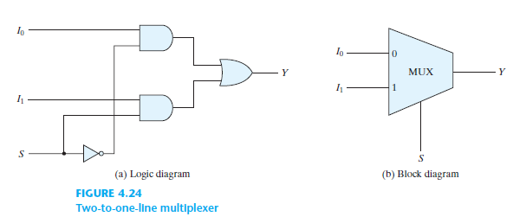

Slide 88
S | F=S’I₀+SI₁
0 | I₀
1 | I₁

Slide 89

Multiplexer
2²$×$1

Slide 90

I₀
I₁
MUX
4$×$1
F
I₂
I₃
S₁
S₀

Slide 91
I₀
I₁
MUX
4$×$1
F
I₂
I₃
0
0

Slide 92
I₀
I₁
MUX
4$×$1
F
I₂
I₃
0
1

Slide 93
I₀
I₁
MUX
4$×$1
F
I₂
I₃
1
0

Slide 94
I₀
I₁
MUX
4$×$1
F
I₂
I₃
1
1

Slide 95
S₁ | S₀ | I₃ | I₂ | I₁ | I₀ | F
0 | 0 | X | X | X | 0 | 0
0 | 0 | X | X | X | 1 | 1
0 | 1 | X | X | 0 | X | 0
0 | 1 | X | X | 1 | X | 1
1 | 0 | X | 0 | X | X | 0
1 | 0 | X | 1 | X | X | 1
1 | 1 | 0 | X | X | X | 0
1 | 1 | 1 | X | X | X | 1

Slide 96
S₁ | S₀ | F=S’₁S’₀I₀+S’₁S₀I₁+S₁S’₀I₂+S₁S₀I₃
0 | 0 | I₀
0 | 1 | I₁
1 | 0 | I₂
1 | 1 | I₃

Slide 97
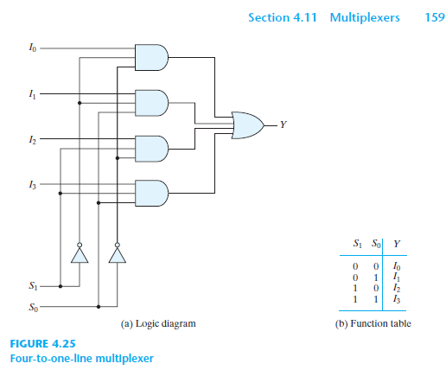

Slide 98

Multiplexer
2^{n}$×$1

Slide 99
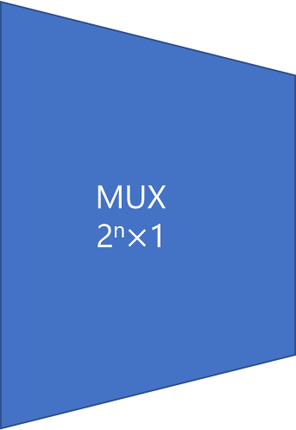
I₀
MUX
2^{n}$×$1
I₁
…
F
I₂^{n}₋₁
I₂^{n}
…
S_{n}
S_{n-1}
… S₁
S₀

Slide 100
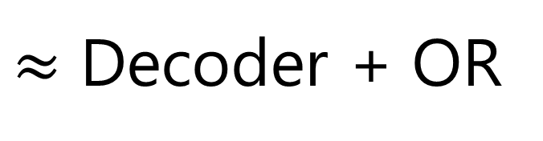
$≈$ Decoder + OR

Slide 102
Sum of Products
2 Levels
ANDs-OR

Slide 103
Multiplexer
Boolean Function
F_{SoP} = ∑m(…)
F_{PoS} = ∏M(…)

Slide 104
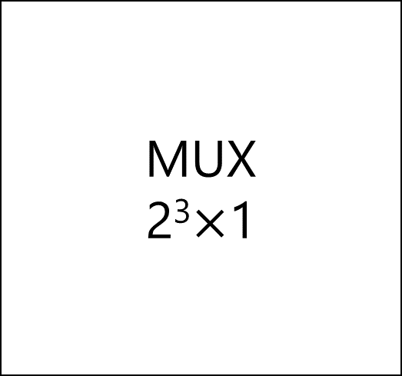
MUX
2³$×$1
I₀
I₁
I₂
I₃
I₄
I₅
I₆
I₇
F
S₂ | S₁ | S₀

Slide 105
m₀
m₁
m₂
m₃
m₄
m₅
m₆
m₇
MUX
2³$×$1
I₀
I₁
I₂
I₃
I₄
I₅
I₆
I₇
F
S₂ | S₁ | S₀
Z | Y | X

Slide 106
MUX
Full Adder
S = ∑m(1,2,4,7)
C = ∑m(3,5,6,7)

Slide 107
C_{p} | Y | X | C=∑m(3,5,6,7) | S=∑m(1,2,4,7)
0 | 0 | 0 | 0 | 0
0 | 0 | 1 | 0 | 1
0 | 1 | 0 | 0 | 1
0 | 1 | 1 | 1 | 0
1 | 0 | 0 | 0 | 1
1 | 0 | 1 | 1 | 0
1 | 1 | 0 | 1 | 0
1 | 1 | 1 | 1 | 1

Slide 108

m₀ | 0
m₁ | 1
m₂ | 1
m₃ | 0
m₄ | 1
m₅ | 0
m₆ | 0
m₇ | 1
MUX
2³$×$1
I₀
I₁
I₂
I₃
I₄
I₅
I₆
I₇
S
S₂ | S₁ | S₀
C_{p} | Y | X
S = ∑m(1,2,4,7)

Slide 109

m₀ | 0
m₁ | 0
m₂ | 0
m₃ | 1
m₄ | 0
m₅ | 1
m₆ | 1
m₇ | 1
MUX
2³$×$1
I₀
I₁
I₂
I₃
I₄
I₅
I₆
I₇
C
S₂ | S₁ | S₀
C_{p} | Y | X
C = ∑m(3,5,6,7)

Slide 110
Multiplexer
Boolean Function II
Book: Page 161

Slide 111

MUX
2²$×$1
I₀
I₁
I₂
I₃
S
S₁ | S₀
C_{p} | Y | X
S = ∑m(1,2,4,7)

Slide 112
MUX
2²$×$1
I₀
I₁
I₂
I₃
C’_{p}
S
S₁ | S₀
0 | 0 | 1
S = ∑m(1,2,4,7)

Slide 113
MUX
2²$×$1
I₀
I₁
I₂
I₃
C’_{p}
S
C’_{p}
S₁ | S₀
0 | 1 | 0
S = ∑m(1,2,4,7)

Slide 114
MUX
2²$×$1
I₀
I₁
I₂
I₃
C_{p}
C’_{p}
S
C’_{p}
S₁ | S₀
1 | 0 | 0
S = ∑m(1,2,4,7)

Slide 115
MUX
2²$×$1
I₀
I₁
I₂
I₃
C_{p}
C’_{p}
S
C’_{p}
C_{p}
S₁ | S₀
1 | 1 | 1
S = ∑m(1,2,4,7)

Slide 116
MUX
2²$×$1
I₀
I₁
I₂
I₃
C
S₁ | S₀
C_{p} | Y | X
C = ∑m(3,5,6,7)

Slide 117
MUX
2²$×$1
I₀
I₁
I₂
I₃
C
C’_{p}
S₁ | S₀
0 | 1 | 1
C = ∑m(3,5,6,7)

Slide 118
MUX
2²$×$1
I₀
I₁
I₂
I₃
C_{p}
C
C’_{p}
S₁ | S₀
1 | 0 | 1
C = ∑m(3,5,6,7)

Slide 119
MUX
2²$×$1
I₀
I₁
I₂
I₃
C_{p}
C
C_{p}
C’_{p}
S₁ | S₀
1 | 1 | 0
C = ∑m(3,5,6,7)

Slide 120
MUX
2²$×$1
I₀
I₁
I₂
I₃
C_{p}
C
C_{p}
C’_{p}+ C_{p}=1
S₁ | S₀
1 | 1 | 1
C = ∑m(3,5,6,7)

Slide 121
MUX
2²$×$1
I₀
I₁
I₂
I₃
0
C_{p}
C
C_{p}
C’_{p}+ C_{p}=1
S₁ | S₀
C_{p} | Y | X
C = ∑m(3,5,6,7)

Slide 122
MUX
2²$×$1
I₀
I₁
I₂
I₃
0
C_{p}
C
C_{p}
C’_{p}+ C_{p}=1
S₁ | S₀
C_{p} | Y | X
C = ∑m(3,5,6,7)

Slide 123
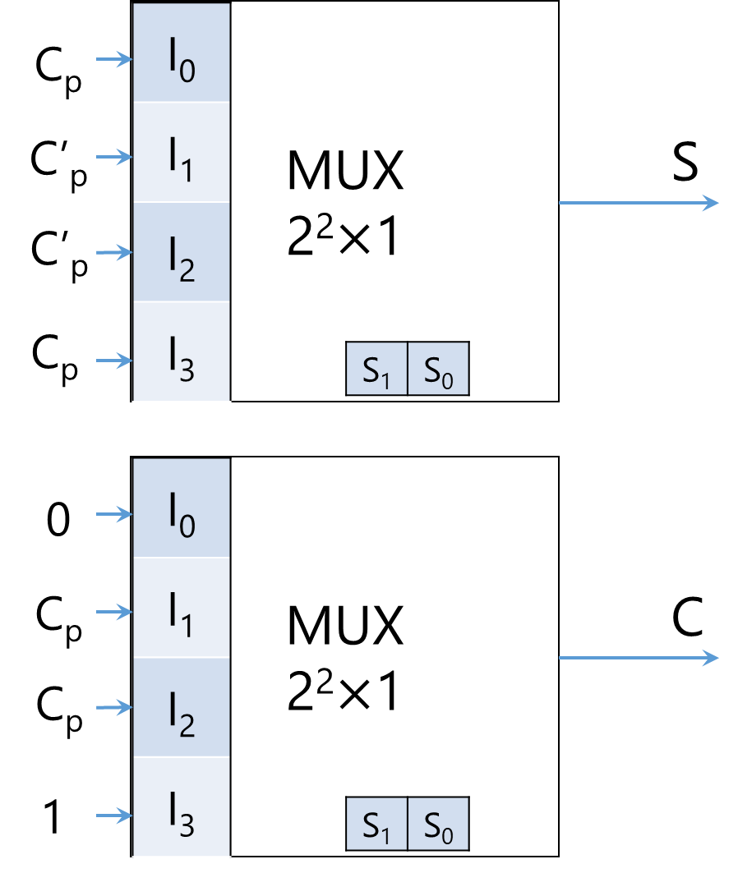
X
Y
C_{p}

Slide 124
Multiplexer
Three-State Gates + Decoders
Book: Page 162-164

Slide 125
Decoder, Encoder
Multiplexer (MUX, MPX), De-Multiplexer (Demux)
Data
Transmission

Slide 126
Encoder

Slide 127
Encoder
1-hot to Binary

Slide 128
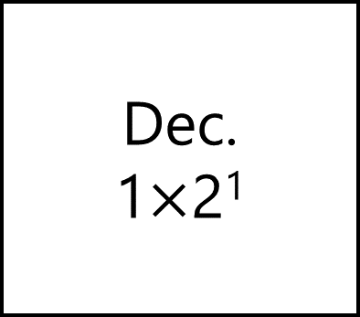
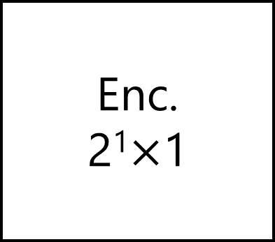
D₀
D₁
Dec.
1$×$2¹
Enc.
2¹$×$1
X
X

Slide 129
D₀
D₁
Enc.
2¹$×$1
X

Slide 130
D₁ | D₀ | F₁
0 | 0 | X
0 | 1 | 0
1 | 0 | 1
1 | 1 | X
X: Don’t Care Conditions

Slide 131
D₁ | D₀ | F₁
0 | 0 | X
0 | 1 | 0
1 | 0 | 1
1 | 1 | X
 |  | D₀
 |  | 0 | 1
D₁ | 0 | m₀ | m₁
 | 1 | m₂ | m₃
X | 0
1 | X

Slide 132
D₁ | D₀ | F₁
0 | 0 | X
0 | 1 | 0
1 | 0 | 1
1 | 1 | X
 |  | D₀
 |  | 0 | 1
D₁ | 0 | m₀ | m₁
 | 1 | m₂ | m₃
X | 0
1 | X
F₁ = D’₀

Slide 133
D₁ | D₀ | F₁
0 | 0 | X
0 | 1 | 0
1 | 0 | 1
1 | 1 | X
 |  | D₀
 |  | 0 | 1
D₁ | 0 | m₀ | m₁
 | 1 | m₂ | m₃
X | 0
1 | X
F₁ = D₁

Slide 134
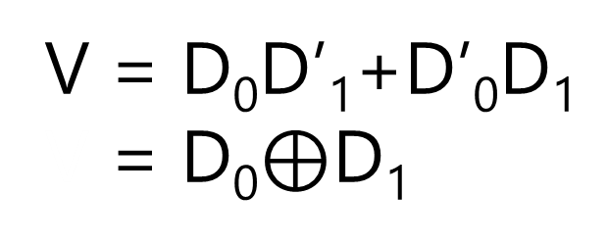
D₁ | D₀ | F₁ | V
0 | 0 | X | 0
0 | 1 | 0 | 1
1 | 0 | 1 | 1
1 | 1 | X | 0
 |  | D₀
 |  | 0 | 1
D₁ | 0 | m₀ | m₁
 | 1 | m₂ | m₃
 |  | D₀
 |  | 0 | 1
D₁ | 0 | m₀ | m₁
 | 1 | m₂ | m₃
X | 0
1 | X
0 | 1
1 | 0
F₁ = D₁
V = D₀D’₁+D’₀D₁
V = D₀$⊕$D₁

Slide 135
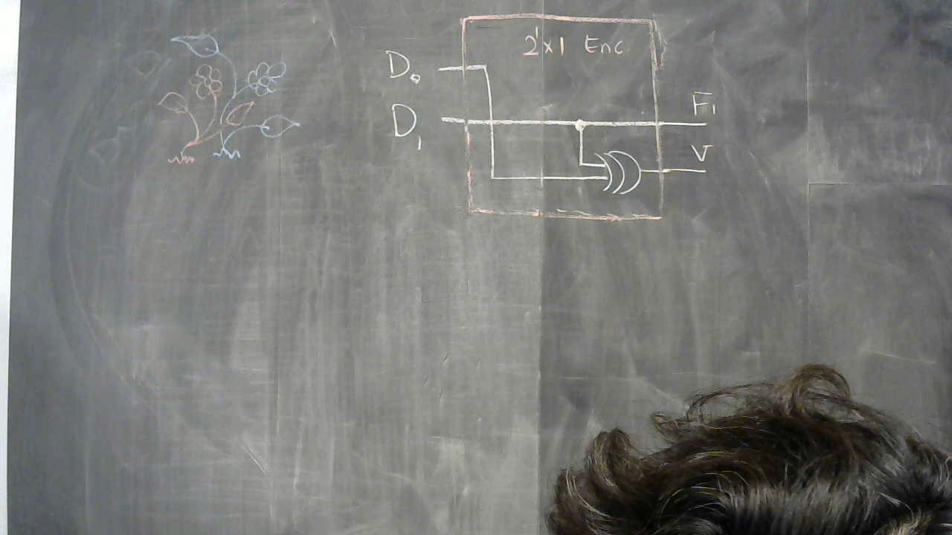

Slide 136
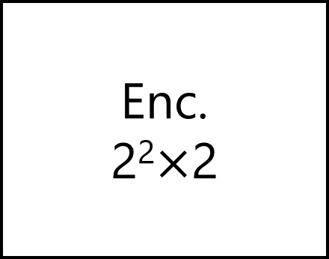
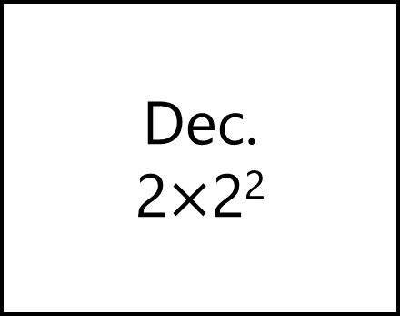
D₀
D₁
D₂
D₃
Dec.
2$×$2²
Enc.
2²$×$2
X
Y
X
Y
V

Slide 137
D₃ | D₂ | D₁ | D₀ | F₂=Y | F₁=X | F₃=V
0 | 0 | 0 | 0 | X | X | 0
0 | 0 | 0 | 1 | 0 | 0 | 1
0 | 0 | 1 | 0 | 0 | 1 | 1
0 | 0 | 1 | 1 | X | X | 0
0 | 1 | 0 | 0 | 1 | 0 | 1
0 | 1 | 0 | 1 | X | X | 0
0 | 1 | 1 | 0 | X | X | 0
0 | 1 | 1 | 1 | X | X | 0
1 | 0 | 0 | 0 | 1 | 1 | 1
1 | 0 | 0 | 1 | X | X | 0
1 | 0 | 1 | 0 | X | X | 0
1 | 0 | 1 | 1 | X | X | 0
1 | 1 | 0 | 0 | X | X | 0
1 | 1 | 0 | 1 | X | X | 0
1 | 1 | 1 | 0 | X | X | 0
1 | 1 | 1 | 1 | X | X | 0

Slide 138
 |  | D₁D₀
 |  | 00 | 01 | 11 | 10
D₃D₂ | 00 | m₀ | m₁ | m₃ | m₂
 | 01 | m₄ | m₅ | m₇ | m₆
 | 11 | m₁₂ | m₁₃ | m₁₅ | m₁₄
 | 10 | m₈ | m₉ | m₁₁ | m₁₀
X | 0 | X | 1
0 | X | X | X
X | X | X | X
1 | X | X | X
F₁ = X = D₁+D₃

Slide 139
 |  | D₁D₀
 |  | 00 | 01 | 11 | 10
D₃D₂ | 00 | m₀ | m₁ | m₃ | m₂
 | 01 | m₄ | m₅ | m₇ | m₆
 | 11 | m₁₂ | m₁₃ | m₁₅ | m₁₄
 | 10 | m₈ | m₉ | m₁₁ | m₁₀
X | 0 | X | 0
1 | X | X | X
X | X | X | X
1 | X | X | X
F₂ = Y = D₂+D₃

Slide 140
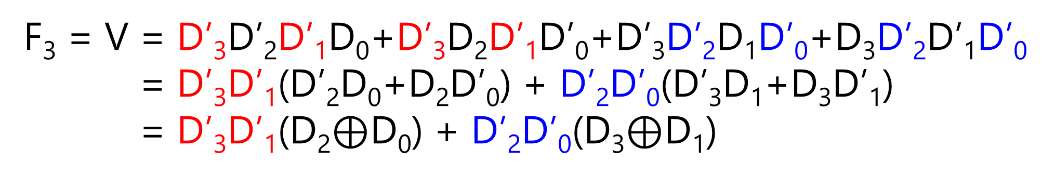
 |  | D₁D₀
 |  | 00 | 01 | 11 | 10
D₃D₂ | 00 | m₀ | m₁ | m₃ | m₂
 | 01 | m₄ | m₅ | m₇ | m₆
 | 11 | m₁₂ | m₁₃ | m₁₅ | m₁₄
 | 10 | m₈ | m₉ | m₁₁ | m₁₀
0 | 1 | 0 | 1
1 | 0 | 0 | 0
0 | 0 | 0 | 0
1 | 0 | 0 | 0
F₃ = V = D’₃D’₂D’₁D₀+D’₃D₂D’₁D’₀+D’₃D’₂D₁D’₀+D₃D’₂D’₁D’₀
F₃ = V = D’₃D’₁(D’₂D₀+D₂D’₀) + D’₂D’₀(D’₃D₁+D₃D’₁)
F₃ = V = D’₃D’₁(D₂$⊕$D₀) + D’₂D’₀(D₃$⊕$D₁)

Slide 141
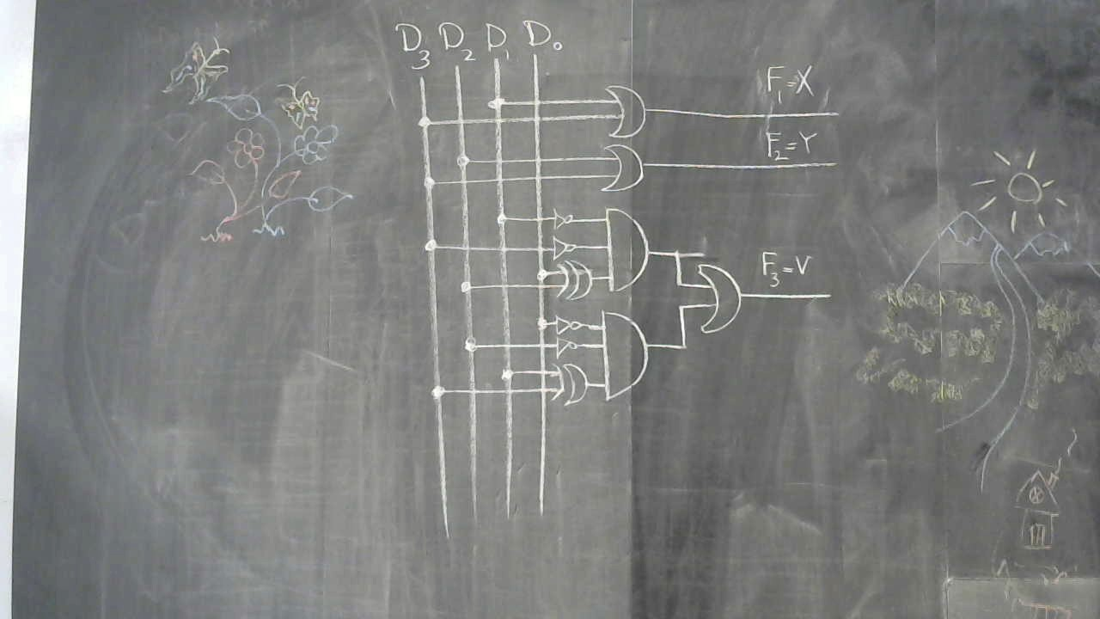

Slide 142
Priority Encoder
at home!

Slide 143
D₃ | D₂ | D₁ | D₀ | F₂=Y | F₁=X | F₃=V
0 | 0 | 0 | 0 | X | X | 0
0 | 0 | 0 | 1 | 0 | 0 | 1
0 | 0 | 1 | 0 | 0 | 1 | 1
0 | 0 | 1 | 1 | X | X | 0
0 | 1 | 0 | 0 | 1 | 0 | 1
0 | 1 | 0 | 1 | X | X | 0
0 | 1 | 1 | 0 | X | X | 0
0 | 1 | 1 | 1 | X | X | 0
1 | 0 | 0 | 0 | 1 | 1 | 1
1 | 0 | 0 | 1 | X | X | 0
1 | 0 | 1 | 0 | X | X | 0
1 | 0 | 1 | 1 | X | X | 0
1 | 1 | 0 | 0 | X | X | 0
1 | 1 | 0 | 1 | X | X | 0
1 | 1 | 1 | 0 | X | X | 0
1 | 1 | 1 | 1 | X | X | 0

Slide 144
D₃ | D₂ | D₁ | D₀ | F₂=Y | F₁=X | F₃=V
0 | 0 | 0 | 0 | X | X | 0
0 | 0 | 0 | 1 | 0 | 0 | 1
0 | 0 | 1 | 0 | 0 | 1 | 1
0 | 0 | 1 | 1 | X | X | 0
0 | 1 | 0 | 0 | 1 | 0 | 1
0 | 1 | 0 | 1 | X | X | 0
0 | 1 | 1 | 0 | X | X | 0
0 | 1 | 1 | 1 | X | X | 0
1 | 0 | 0 | 0 | 1 | 1 | 1
1 | 0 | 0 | 1 | X | X | 0
1 | 0 | 1 | 0 | X | X | 0
1 | 0 | 1 | 1 | X | X | 0
1 | 1 | 0 | 0 | X | X | 0
1 | 1 | 0 | 1 | X | X | 0
1 | 1 | 1 | 0 | X | X | 0
1 | 1 | 1 | 1 | X | X | 0

Slide 145
D₃ | D₂ | D₁ | D₀ | F₂=Y | F₁=X | F₃=V
0 | 0 | 0 | 0 | X | X | 0
0 | 0 | 0 | 1 | 0 | 0 | 1
0 | 0 | 1 | 0 | 0 | 1 | 1
0 | 0 | 1 | 1 | 0 | 1 | 1
0 | 1 | 0 | 0 | 1 | 0 | 1
0 | 1 | 0 | 1 | X | X | 0
0 | 1 | 1 | 0 | X | X | 0
0 | 1 | 1 | 1 | X | X | 0
1 | 0 | 0 | 0 | 1 | 1 | 1
1 | 0 | 0 | 1 | X | X | 0
1 | 0 | 1 | 0 | X | X | 0
1 | 0 | 1 | 1 | X | X | 0
1 | 1 | 0 | 0 | X | X | 0
1 | 1 | 0 | 1 | X | X | 0
1 | 1 | 1 | 0 | X | X | 0
1 | 1 | 1 | 1 | X | X | 0

Slide 146
D₃ | D₂ | D₁ | D₀ | F₂=Y | F₁=X | F₃=V
0 | 0 | 0 | 0 | X | X | 0
0 | 0 | 0 | 1 | 0 | 0 | 1
0 | 0 | 1 | 0 | 0 | 1 | 1
0 | 0 | 1 | 1 | 0 | 1 | 1
0 | 1 | 0 | 0 | 1 | 0 | 1
0 | 1 | 0 | 1 | X | X | 0
0 | 1 | 1 | 0 | X | X | 0
0 | 1 | 1 | 1 | X | X | 0
1 | 0 | 0 | 0 | 1 | 1 | 1
1 | 0 | 0 | 1 | X | X | 0
1 | 0 | 1 | 0 | X | X | 0
1 | 0 | 1 | 1 | X | X | 0
1 | 1 | 0 | 0 | X | X | 0
1 | 1 | 0 | 1 | X | X | 0
1 | 1 | 1 | 0 | X | X | 0
1 | 1 | 1 | 1 | X | X | 0

Slide 147
D₃ | D₂ | D₁ | D₀ | F₂=Y | F₁=X | F₃=V
0 | 0 | 0 | 0 | X | X | 0
0 | 0 | 0 | 1 | 0 | 0 | 1
0 | 0 | 1 | 0 | 0 | 1 | 1
0 | 0 | 1 | 1 | 0 | 1 | 1
0 | 1 | 0 | 0 | 1 | 0 | 1
0 | 1 | 0 | 1 | 1 | 0 | 1
0 | 1 | 1 | 0 | X | X | 0
0 | 1 | 1 | 1 | X | X | 0
1 | 0 | 0 | 0 | 1 | 1 | 1
1 | 0 | 0 | 1 | X | X | 0
1 | 0 | 1 | 0 | X | X | 0
1 | 0 | 1 | 1 | X | X | 0
1 | 1 | 0 | 0 | X | X | 0
1 | 1 | 0 | 1 | X | X | 0
1 | 1 | 1 | 0 | X | X | 0
1 | 1 | 1 | 1 | X | X | 0

Slide 148
D₃ | D₂ | D₁ | D₀ | F₂=Y | F₁=X | F₃=V
0 | 0 | 0 | 0 | X | X | 0
0 | 0 | 0 | 1 | 0 | 0 | 1
0 | 0 | 1 | 0 | 0 | 1 | 1
0 | 0 | 1 | 1 | 0 | 1 | 1
0 | 1 | 0 | 0 | 1 | 0 | 1
0 | 1 | 0 | 1 | 1 | 0 | 1
0 | 1 | 1 | 0 | 1 | 0 | 1
0 | 1 | 1 | 1 | X | X | 0
1 | 0 | 0 | 0 | 1 | 1 | 1
1 | 0 | 0 | 1 | X | X | 0
1 | 0 | 1 | 0 | X | X | 0
1 | 0 | 1 | 1 | X | X | 0
1 | 1 | 0 | 0 | X | X | 0
1 | 1 | 0 | 1 | X | X | 0
1 | 1 | 1 | 0 | X | X | 0
1 | 1 | 1 | 1 | X | X | 0

Slide 149
D₃ | D₂ | D₁ | D₀ | F₂=Y | F₁=X | F₃=V
0 | 0 | 0 | 0 | X | X | 0
0 | 0 | 0 | 1 | 0 | 0 | 1
0 | 0 | 1 | 0 | 0 | 1 | 1
0 | 0 | 1 | 1 | 0 | 1 | 1
0 | 1 | 0 | 0 | 1 | 0 | 1
0 | 1 | 0 | 1 | 1 | 0 | 1
0 | 1 | 1 | 0 | 1 | 0 | 1
0 | 1 | 1 | 1 | 1 | 0 | 1
1 | 0 | 0 | 0 | 1 | 1 | 1
1 | 0 | 0 | 1 | X | X | 0
1 | 0 | 1 | 0 | X | X | 0
1 | 0 | 1 | 1 | X | X | 0
1 | 1 | 0 | 0 | X | X | 0
1 | 1 | 0 | 1 | X | X | 0
1 | 1 | 1 | 0 | X | X | 0
1 | 1 | 1 | 1 | X | X | 0

Slide 150
D₃ | D₂ | D₁ | D₀ | F₂=Y | F₁=X | F₃=V
0 | 0 | 0 | 0 | X | X | 0
0 | 0 | 0 | 1 | 0 | 0 | 1
0 | 0 | 1 | 0 | 0 | 1 | 1
0 | 0 | 1 | 1 | 0 | 1 | 1
0 | 1 | 0 | 0 | 1 | 0 | 1
0 | 1 | 0 | 1 | 1 | 0 | 1
0 | 1 | 1 | 0 | 1 | 0 | 1
0 | 1 | 1 | 1 | 1 | 0 | 1
1 | 0 | 0 | 0 | 1 | 1 | 1
1 | 0 | 0 | 1 | 1 | 1 | 1
1 | 0 | 1 | 0 | 1 | 1 | 1
1 | 0 | 1 | 1 | 1 | 1 | 1
1 | 1 | 0 | 0 | 1 | 1 | 1
1 | 1 | 0 | 1 | 1 | 1 | 1
1 | 1 | 1 | 0 | 1 | 1 | 1
1 | 1 | 1 | 1 | 1 | 1 | 1

Slide 151
D₃ | D₂ | D₁ | D₀ | F₂=Y | F₁=X | F₃=V
0 | 0 | 0 | 0 | X | X | 0
0 | 0 | 0 | 1 | 0 | 0 | 1
0 | 0 | 1 | X | 0 | 1 | 1
0 | 0 | 1 | X | 0 | 1 | 1
0 | 1 | X | X | 1 | 0 | 1
0 | 1 | X | X | 1 | 0 | 1
0 | 1 | X | X | 1 | 0 | 1
0 | 1 | X | X | 1 | 0 | 1
1 | X | X | X | 1 | 1 | 1
1 | X | X | X | 1 | 1 | 1
1 | X | X | X | 1 | 1 | 1
1 | X | X | X | 1 | 1 | 1
1 | X | X | X | 1 | 1 | 1
1 | X | X | X | 1 | 1 | 1
1 | X | X | X | 1 | 1 | 1
1 | X | X | X | 1 | 1 | 1

Slide 152
D₃ | D₂ | D₁ | D₀ | F₂=Y | F₁=X | F₃=V
0 | 0 | 0 | 0 | X | X | 0
0 | 0 | 0 | 1 | 0 | 0 | 1
0 | 0 | 1 | X | 0 | 1 | 1
0 | 1 | X | X | 1 | 0 | 1
1 | X | X | X | 1 | 1 | 1

Slide 153
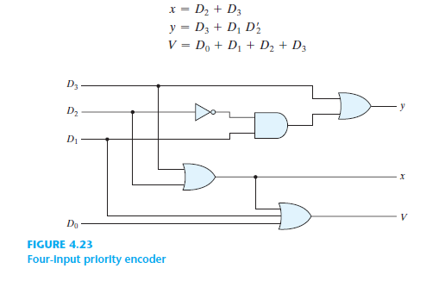

Slide 154
Positional Encoders

Slide 155
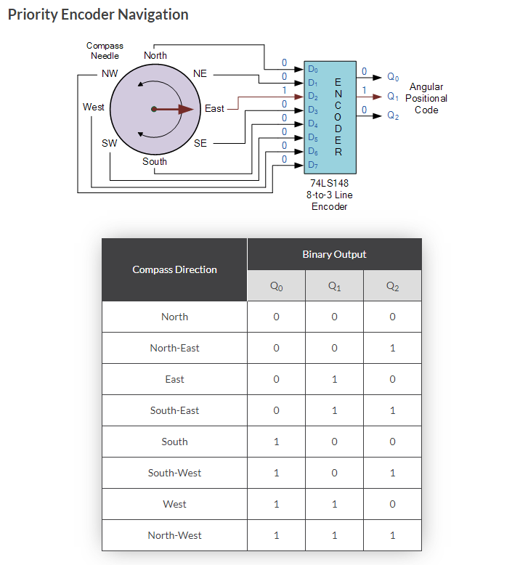
https://www.electronics-tutorials.ws/

Slide 156
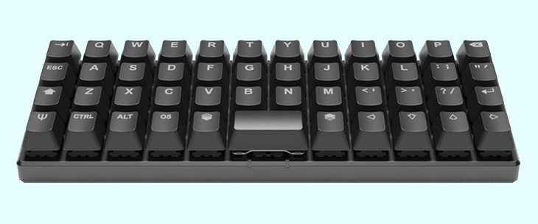
Keyboard Encoders

Slide 157
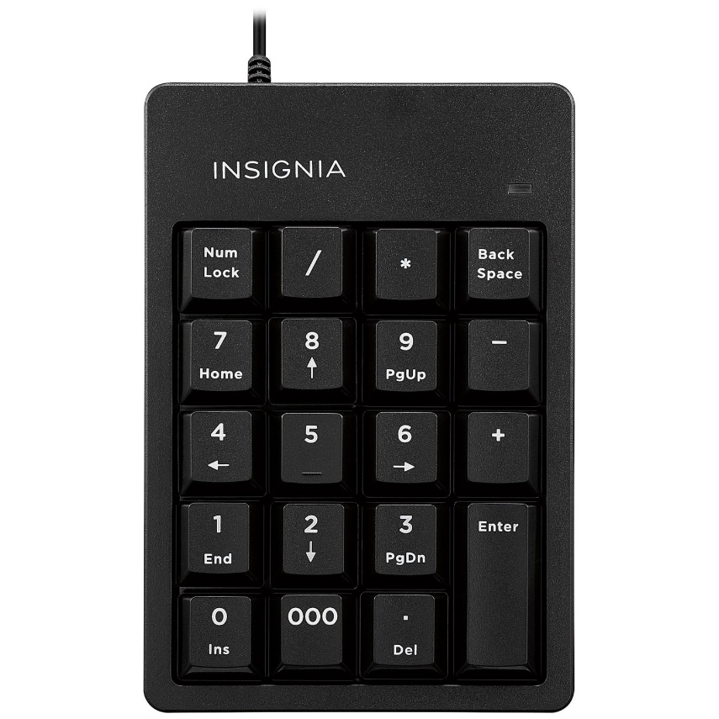


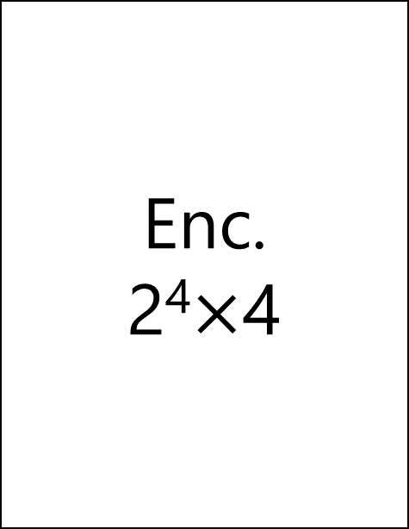
Enc.
2⁴$×$4
Binary Number
BCD
Excess-3
Aiken
Gray
…
. . .
. . .
0
0

Slide 158
Decoder, Encoder
Multiplexer (MUX, MPX), De-Multiplexer (Demux)
Data
Transmission

Slide 159
De-multiplexer

Slide 160


O₀
I₀
O₁
I₁
MUX
4$×$1
De-MUX
1$×$4
F
O₂
I₂
O₃
I₃
S₁
S₀
S₁
S₀

Slide 161

S₁ | S₀ | F | O₀ | O₁ | O₂ | O₃
0 | 0 | 0 | 0 | 0 | 0 | 0
0 | 0 | 1 | 1 | 0 | 0 | 0
0 | 1 | 0 | 0 | 0 | 0 | 0
0 | 1 | 1 | 0 | 1 | 0 | 0
1 | 0 | 0 | 0 | 0 | 0 | 0
1 | 0 | 1 | 0 | 0 | 1 | 0
1 | 1 | 0 | 0 | 0 | 0 | 1
1 | 1 | 1 | 0 | 0 | 0 | 0
O₀
O₁
De-MUX
1$×$4
F
O₂
O₃
S₁
S₀

Slide 162
S₁ | S₀ | F | O₀ | O₁ | O₂ | O₃
0 | 0 | 0 | 0 | 0 | 0 | 0
0 | 0 | 1 | 1 | 0 | 0 | 0
0 | 1 | 0 | 0 | 0 | 0 | 0
0 | 1 | 1 | 0 | 1 | 0 | 0
1 | 0 | 0 | 0 | 0 | 0 | 0
1 | 0 | 1 | 0 | 0 | 1 | 0
1 | 1 | 0 | 0 | 0 | 0 | 1
1 | 1 | 1 | 0 | 0 | 0 | 0
O₀
O₁
De-MUX
1$×$4
F
O₂
O₃
S₁
S₀

Slide 163
S₁ | S₀ | F | O₀ | O₁ | O₂ | O₃
0 | 0 | 0 | 0 | 0 | 0 | 0
0 | 0 | 1 | 1 | 0 | 0 | 0
0 | 1 | 0 | 0 | 0 | 0 | 0
0 | 1 | 1 | 0 | 1 | 0 | 0
1 | 0 | 0 | 0 | 0 | 0 | 0
1 | 0 | 1 | 0 | 0 | 1 | 0
1 | 1 | 0 | 0 | 0 | 0 | 1
1 | 1 | 1 | 0 | 0 | 0 | 0
O₀
O₁
De-MUX
1$×$4
F
O₂
O₃
S₁
S₀

Slide 164
S₁ | S₀ | F | O₀ | O₁ | O₂ | O₃
0 | 0 | 0 | 0 | 0 | 0 | 0
0 | 0 | 1 | 1 | 0 | 0 | 0
0 | 1 | 0 | 0 | 0 | 0 | 0
0 | 1 | 1 | 0 | 1 | 0 | 0
1 | 0 | 0 | 0 | 0 | 0 | 0
1 | 0 | 1 | 0 | 0 | 1 | 0
1 | 1 | 0 | 0 | 0 | 0 | 0
1 | 1 | 1 | 0 | 0 | 0 | 1
O₀
O₁
De-MUX 1$×$4
F
O₂
O₃
S₁
S₀

Slide 165
S₁ | S₀ | O₀ | O₁ | O₂ | O₃
0 | 0 | F | 0 | 0 | 0
0 | 1 | 0 | F | 0 | 0
1 | 0 | 0 | 0 | F | 0
1 | 1 | 0 | 0 | 0 | F
O₀
O₁
De-MUX
1$×$4
F
O₂
O₃
S₁
S₀

Slide 166
S₁ | S₀ | O₀= S’₁S’₀F | O₁= S’₁S₀F | O₂= S₁S’₀F | O₃= S₁S₀F
0 | 0 | F | 0 | 0 | 0
0 | 1 | 0 | F | 0 | 0
1 | 0 | 0 | 0 | F | 0
1 | 1 | 0 | 0 | 0 | F
O₀
O₁
De-MUX 1$×$4
F
O₂
O₃
S₁
S₀

Slide 167
F
O₀
O₁
F
O₂
O₃
1-to-4 De-mux

Slide 168
De-multiplexer = Decoder w/ Enable input
How come?!

