Slide 1


Sequential Logic

Slide 2

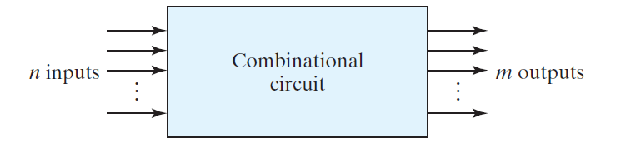
Feedback

Slide 3
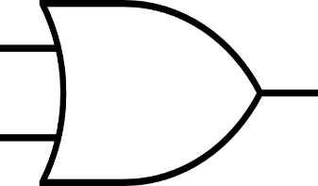
R
S
S | R | Q | Q’
0 | 0 | Q_{t} | Q’_{t}
0 | 1 | 0 | 1
1 | 0 | 1 | 0
1 | 1 | X | X

Slide 4
Voltage
R
S
R
S
Time

Slide 5
S and R control how the state changes.

Slide 6
Put a gate/latch on when change applies
SR w/ enable input

Slide 7
SR Latch

Slide 8
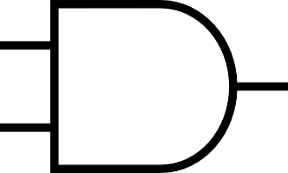
R
R
E
S
S
E | S | R | S | R | Q | Q’
0 | X | X | 0 | 0 | Q_{t} | Q’_{t}
1 | 0 | 0 | 0 | 0 | Q_{t} | Q’_{t}
1 | 0 | 1 | 0 | 1 | 0 | 1
1 | 1 | 0 | 1 | 0 | 1 | 0
1 | 1 | 1 | 1 | 1 | X | X

Slide 9
R
SR Latch
Gated SR
R
S
S
E

Slide 10
Voltage
E
R
S
R
S
E
Time

Slide 11
Voltage
E
R
S
R
S
E
Time

Slide 12
Voltage
E
R
S
R
S
E
Time

Slide 13
Voltage
E
R
S
R
Now, E=1, Set Action
S
E
Time

Slide 14
Voltage
E
R
S
R
Gate is closed! Store.
S
E
Time

Slide 15
Voltage
E
R
S
R
E=1, Gate is open. Reset.
S
E
Time

Slide 16
Voltage
E
R
S
R
E=1, Gate is closed. Store.
S
E
Time

Slide 17
SR Latch
NAND

Slide 18
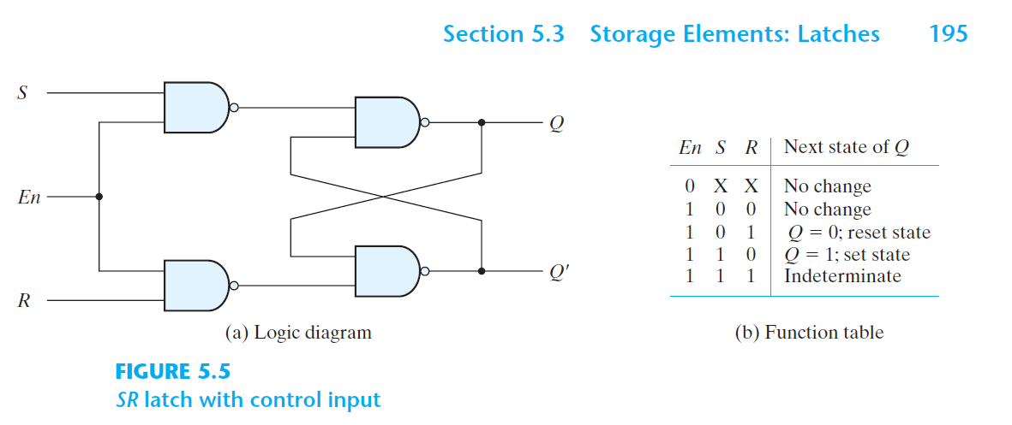

Slide 20
Block Diagram
State Transition Diagram
R
S
SR=00
SR=00
E
SR=01
0
1
SR=10
SR=01
Characteristic Table
SR=10
S | R | Q
0 | 0 | Q_{t}
0 | 1 | 0
1 | 0 | 1
1 | 1 | X
SR=01
SR=10
SR=11
SR=11

Slide 21
Other Latches

Slide 22
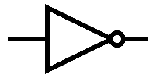
R
SR Latch
R
X
S
S
E
Let’s avoid the forbidden action! R≠S
R=S’ and S=R’

Slide 23
R
SR Latch
R
X
S
S
E
X | E | S | R | Q | Q’
0 | 0 | X | X | Q_{t} | Q’_{t}
1 | 0 | X | X | Q_{t} | Q’_{t}
0 | 1 | 0 | 1 | 0 | 1
1 | 1 | 1 | 0 | 1 | 0
Never happens |  | 1 | 1 | X | X

Slide 24
R=1
Q_{t}→ 0
R
X=0
S=0
S
E
X | E | S | R | Q | Q’
0 | 0 | X | X | Q_{t} | Q’_{t}
1 | 0 | X | X | Q_{t} | Q’_{t}
0 | 1 | 0 | 1 | 0 | 1
1 | 1 | 1 | 0 | 1 | 0
Never happens |  | 1 | 1 | X | X

Slide 25
R=0
Q_{t}→ 1
R
X=1
S=1
S
E
X | E | S | R | Q | Q’
0 | 0 | X | X | Q_{t} | Q’_{t}
1 | 0 | X | X | Q_{t} | Q’_{t}
0 | 1 | 0 | 1 | 0 | 1
1 | 1 | 1 | 0 | 1 | 0
Never happens |  | 1 | 1 | X | X

Slide 26
D Latch
R
D
S
E
D | E | Q
0 | 0 | Q_{t}
1 | 0 | Q_{t}
0 | 1 | 0
1 | 1 | 1

Slide 27
D Latch
R
D
S
E
D | Q
0 | 0
1 | 1

Slide 28
R
R
D
S
S
E

Slide 29
Block Diagram
State Transition Diagram
D
Latch
D=0
D=1
E
D=0
Characteristic Table
0
1
D | Q
0 | 0
1 | 1
D=1

Slide 30
T Latch

Slide 31
R
R
D
T | Q
0 | Q_{t}
1 | Q’_{t}
S
S
E

Slide 32
R
R
Q(T)
D
T | Q
0 | Q_{t}
1 | Q’_{t}
Q(T)
S
Q’(T)
S
E

Slide 33
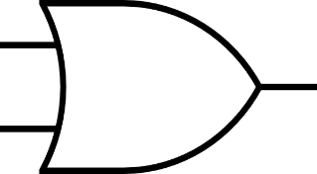
R
R
T=1
D
Q(T)→ Q’(T)
S
S
E

Slide 34
R
R
T=0
D
Q(T) → Q(T)
S
S
E

Slide 35
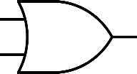

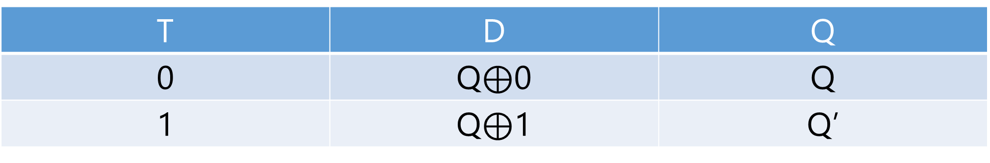
R
R
T
D
S
S
E
Store
T | D | Q
0 | Q$⊕$0 | Q
1 | Q$⊕$1 | Q’

Slide 36
R
R
T
D
S
S
E
Complement
T | D | Q
0 | Q$⊕$0 | Q
1 | Q$⊕$1 | Q’

Slide 37
R
R
R
R
D
T
S
S
S
S
E

Slide 38
Block Diagram
T
State Transition Diagram
T=0
T=0
E
T=1
Characteristic Table
0
1
T | Q
0 | Q_{t}
1 | Q’_{t}
T=1

Slide 39
JK Latch

Slide 40
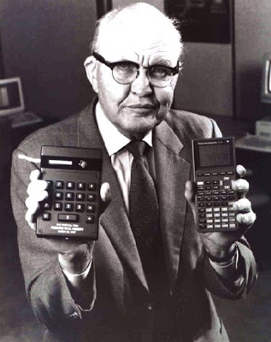
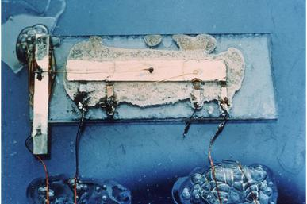
Jack St. Clair Kilby
(Nov. 8, 1923 – June 20, 2005) Electrical Engineer
The 1st integrated circuit
1958
Nobel Prize in Physics, 2000

Slide 41
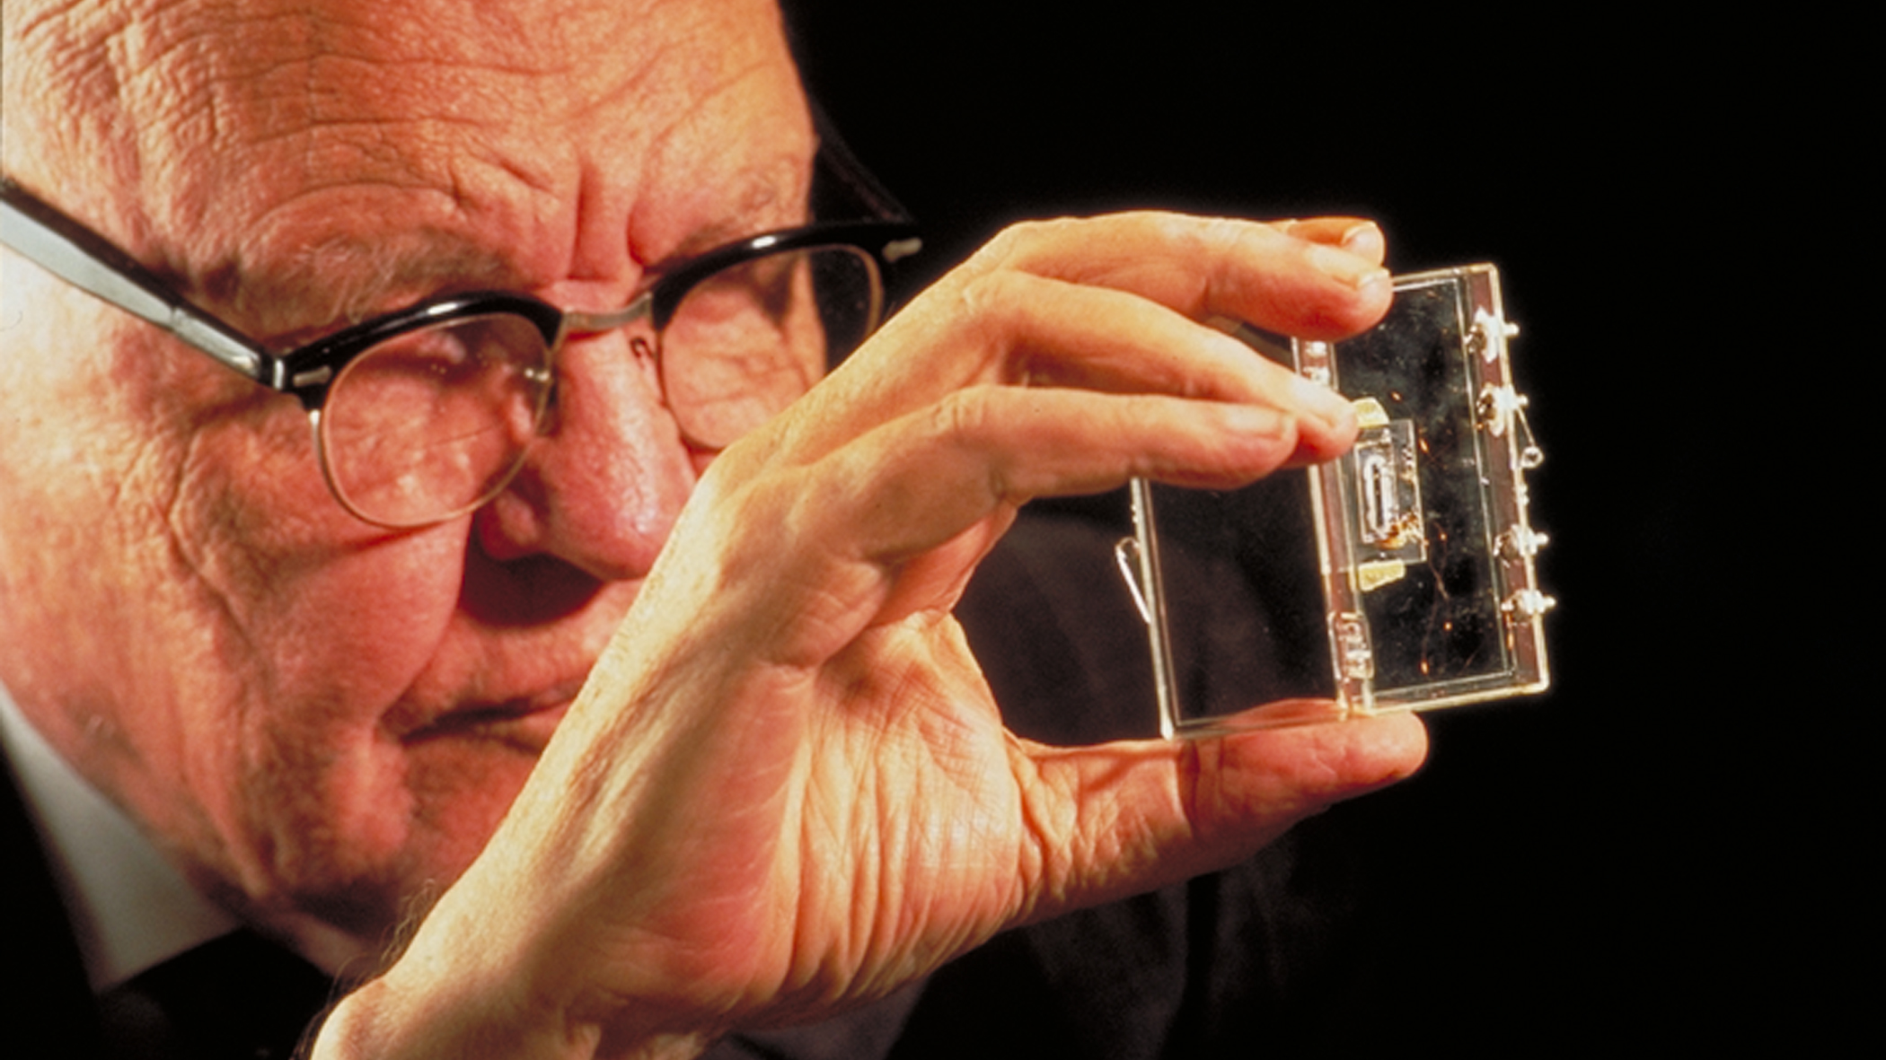

Slide 42
R
R
SR Latch
?
R
S
S
S
E
Although you have to guess, we'll see a design algorithm it ☺

Slide 43
R
R
SR Latch
R
S
S
S
E

Slide 44
R
R
1 → ?
R
Q
S
S
Q’
E
S
S | R | S | R | Q
0 | 0 | 0 | 0 | Store=Q_{t}=1
0 | 1 | 0 | 1 | Reset=0
1 | 0 | 0 | 0 | Store=Q_{t}=1
1 | 1 | 0 | 1 | Reset=0

Slide 45
R
R
0 → ?
R
Q
S
S
Q’
E
S
S | R | S | R | Q
0 | 0 | 0 | 0 | Store=Q_{t}=0
0 | 1 | 0 | 0 | Store=Q_{t}=0
1 | 0 | 1 | 0 | Set=1
1 | 1 | 1 | 0 | Set=1

Slide 46
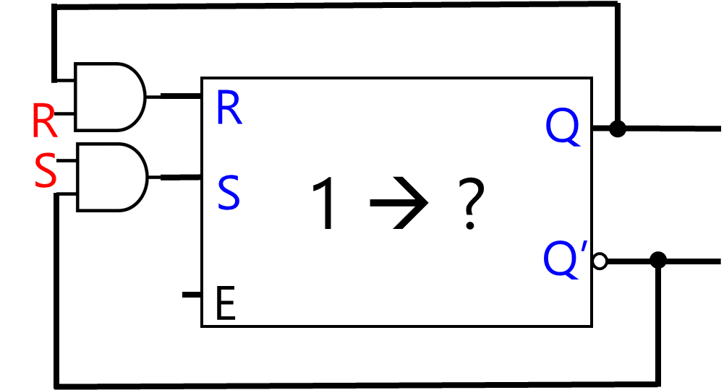
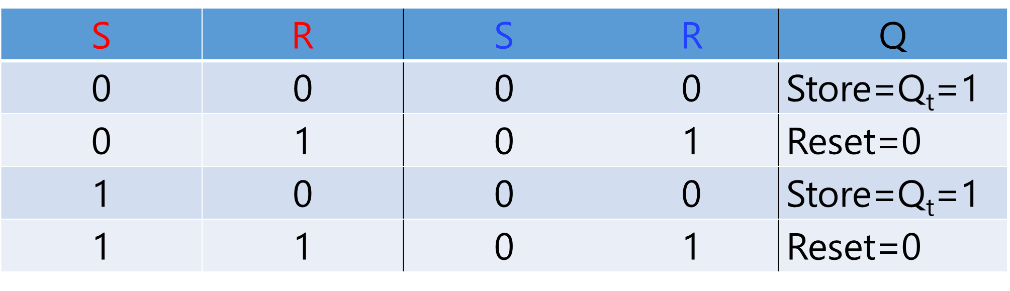

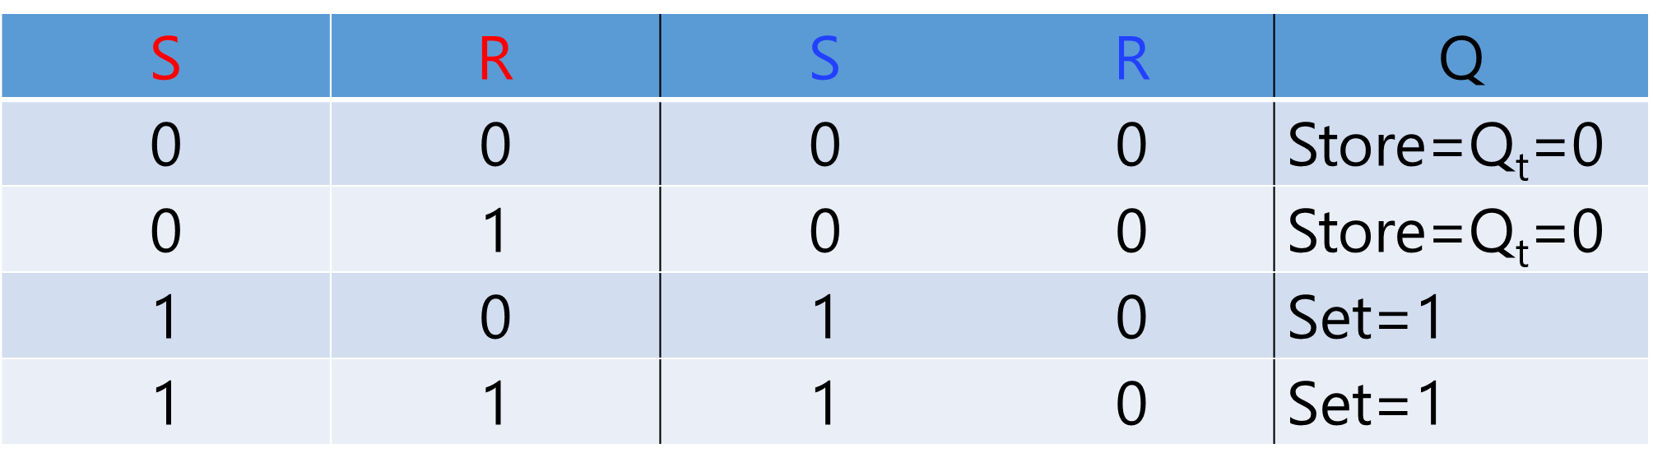
S=J | R=K | Q
0 | 0 | Store=Q_{t}
0 | 1 | Reset = 0
1 | 0 | Set = 1
1 | 1 | Comp. =Q’_{t}

Slide 47
Block Diagram
State Transition Diagram
K
J
E
JK=00
JK=00
JK=01
JK=11
Characteristic Table
J | K | Q
0 | 0 | Q_{t}
0 | 1 | 0
1 | 0 | 1
1 | 1 | Q’_{t}
0
1
JK=10
JK=01
JK=10
JK=11

Slide 48
Recap

Slide 49
R
D
T
K
S
J
E
E
E
E
S | R | Q
0 | 0 | Q_{t}
0 | 1 | 0
1 | 0 | 1
1 | 1 | X
D | Q
0 | 0
1 | 1
T | Q
0 | Q_{t}
1 | Q’_{t}
J | K | Q
0 | 0 | Q_{t}
0 | 1 | 0
1 | 0 | 1
1 | 1 | Q’_{t}

Slide 50
Clock
shortened as clk
timing device that generates a train of pulses

Slide 51
One period is called pulse!

Slide 52
Clock
shortened as clk
Synchronize all the memory units
when to work

Slide 53
Clock
Positive Level (default)

Slide 54
R
SR Latch
Active High
R
S
S
E

Slide 55
Clock
Negative Level

Slide 56
R
SR Latch
Active Low
R
S
S
E

Slide 57
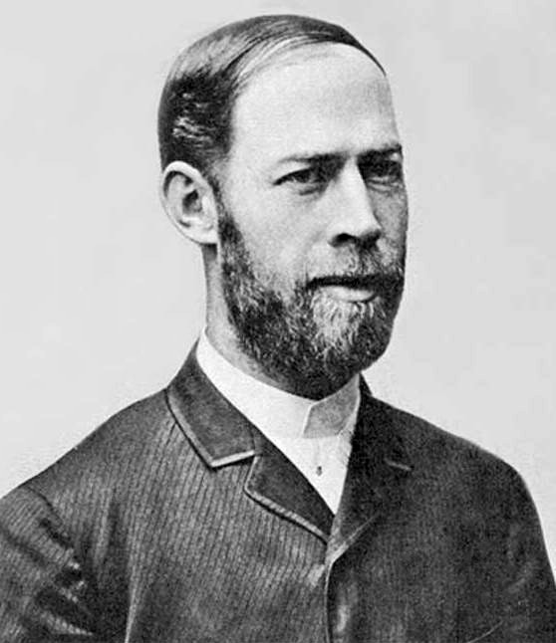
Clock
Frequency (Hz)
Heinrich Rudolf Hertz
A Metric for Speed
Notes:
electromagnetic waves

Slide 58
How many pulse in 1 sec?

Slide 59
1 sec
1 Hertz (Hz)
2 Hertz (Hz)
~3 Hertz (Hz)
How many pulse in 1 sec?

Slide 60
1 sec
1/1= 1 sec
1/2= 0.5 sec
1/3 ~ 0.3 sec
How long is one pulse?
1/freq. (Hz)

Slide 61
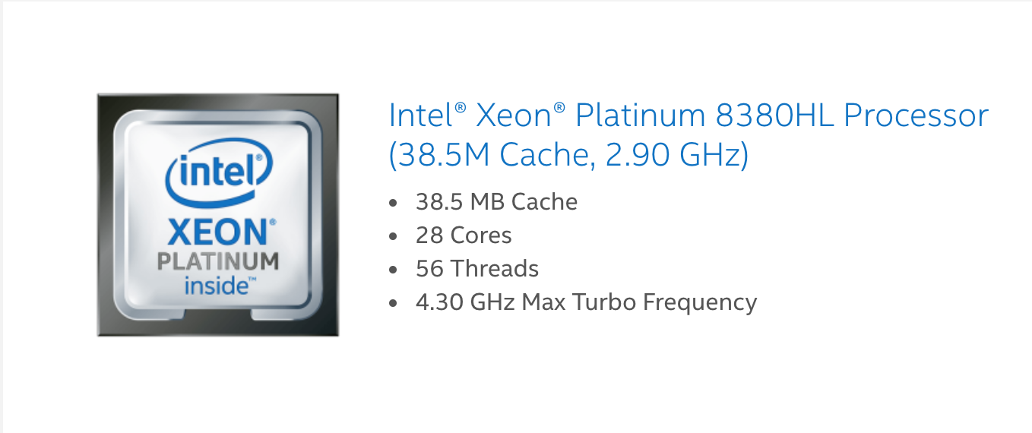
1,000,000,000 (one billion) Hz (hertz)
1,000,000,000 (one billion) pulse per sec!

Slide 62
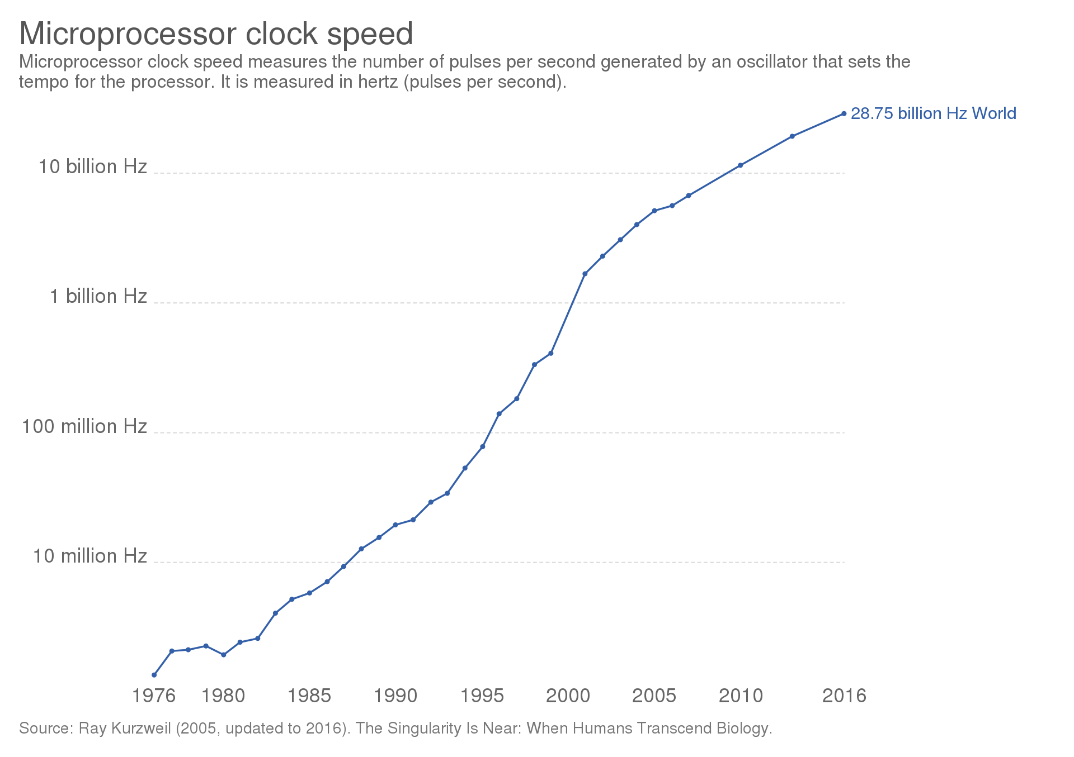
https://en.wikipedia.org/wiki/Clock_rate

Slide 63
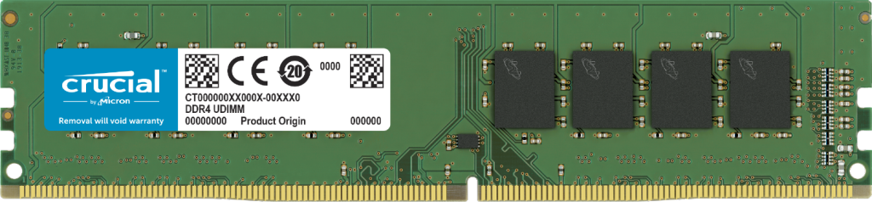
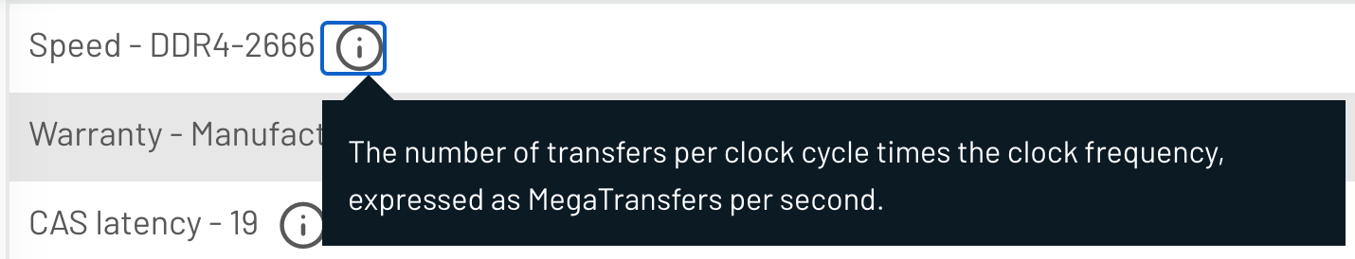

Slide 64
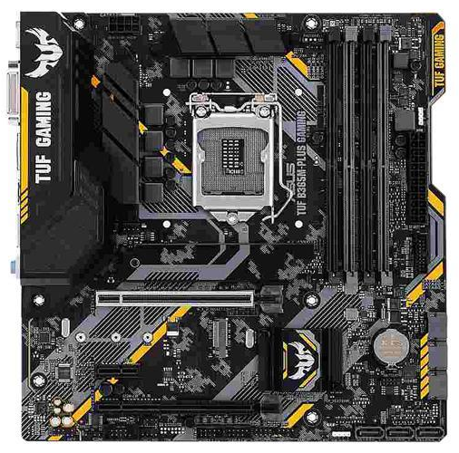

CPU: X Hz
Memory: Y Hz
Mainboard (BUS): Z Hz
Final Speed?

Slide 65
CPU: X Hz
Memory: Y Hz
Mainboard (BUS): Z Hz
At market:
X > Y = Z
X=2.9GHz
Y=Z= 2.6GHz

Slide 66
CPU: X Hz
Memory: Y Hz
Mainboard (BUS): Z Hz
Final Speed:
CPU internal: X
CPU external ←→ Memory
Y=Z= 2.6GHz
Overclock?

Slide 67
Flip-Flop

