Slide 1

W2021: A Digital Odyssey
Notes:
https://www.pinterest.ca/pin/231302130841121655/

Slide 2


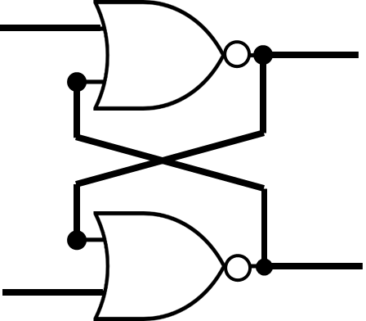
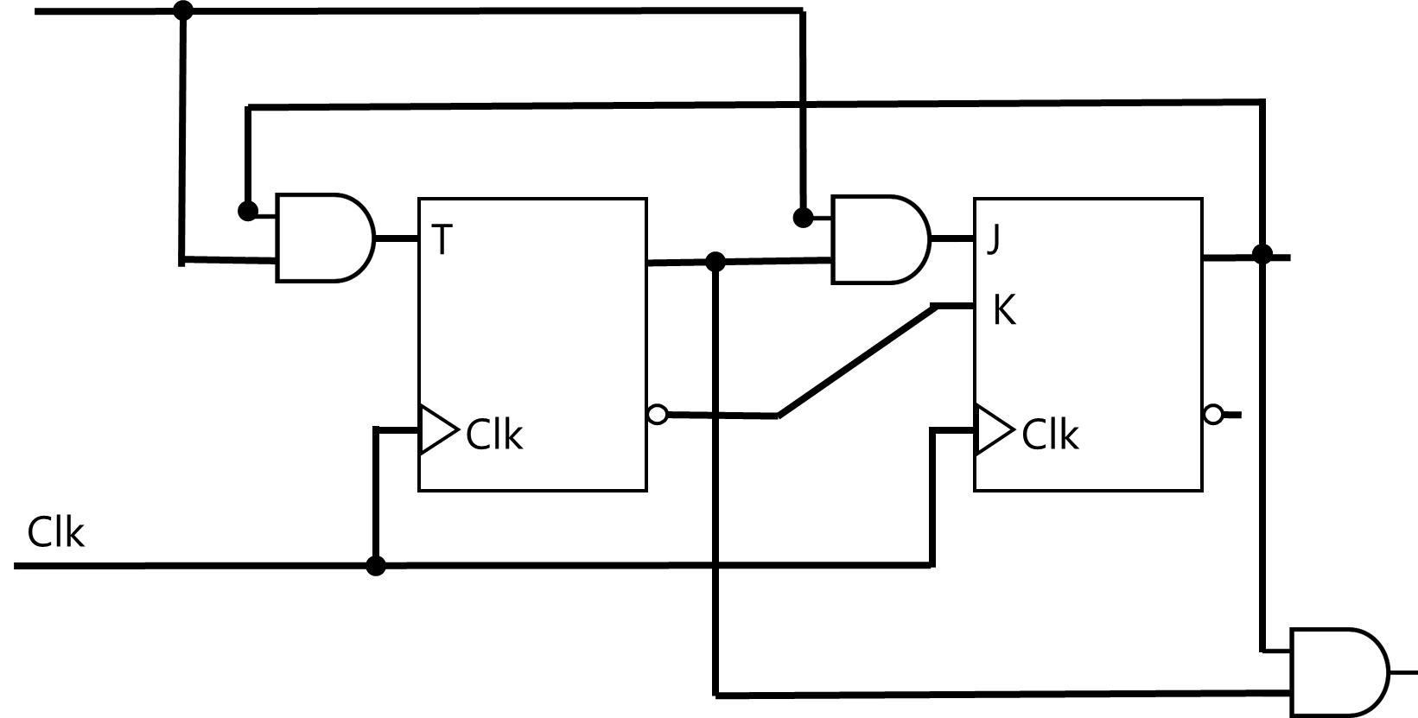
Number Systems |
(12)₁₀ → (1100)₂
Number Systems | Logic Gates |
Number Systems | Logic Gates | Combinational Logic |
Number Systems | Logic Gates | Combinational Logic | Flip-Flops |
Number Systems | Logic Gates | Combinational Logic | Flip-Flops | Sequential Logic |
Number Systems | Logic Gates | Combinational Logic | Flip-Flops| Sequential Logic | Computer Systems

Slide 3
Minimization
aka. Simplification

Slide 4
Minimization
Number of Gates
Number of Inputs (2-input vs 4-input)
Number of Interconnections
Propagation Time
Cost of Gates
Circuit Area
. . .
A circuit may not satisfy all due to conflicting constraints!

Slide 5
Minimization
aka. Simplification
SoP (ANDs-OR) → Simplify → NAND
PoS (ORs-AND) → Simplify → NOR d

Slide 6
Minimization
Boolean Algebra (algebraically)

Slide 7
Minimization
II) Map (Karnaugh map, K-map)

Slide 8
algebra
A set of elements
A set of operators
A set of axioms | postulates | assumptions | definitions

Slide 9
algebra
A set of elements: e.g.,
{0,1}
{-1,0,1}
{1,2,3,4,…}
{…, -2,-1,0,1,2,…}

Slide 10

algebra
A set of operators
{+, ×}
{+, $−$, ×, ÷}
{~, ≤, ≥}

Slide 11
algebra
Unary: !x, -x, x’, …
Binary: x+y, x÷y, x^y, …
Ternary: x?y:z (Elvis), x BETWEEN y AND z (SQL)

Slide 12
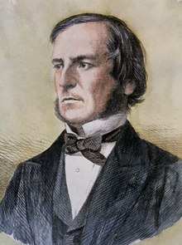
George Boole (/buːl/)
Mathematician
Philosopher
Logician
The Laws of Thought (1854)
Boolean Algebra!
Notes:
The cost of circuits that implement binary logic in all of today’s digital devices and computers is an important factor addressed by designers—be they computer engineers, electrical engineers, or computer scientists.
Finding simpler and cheaper, but equivalent, realizations of a circuit can reap huge payoffs in reducing the overall cost of the design. Mathematical methods that simplify circuits rely primarily on Boolean algebra.

Slide 13
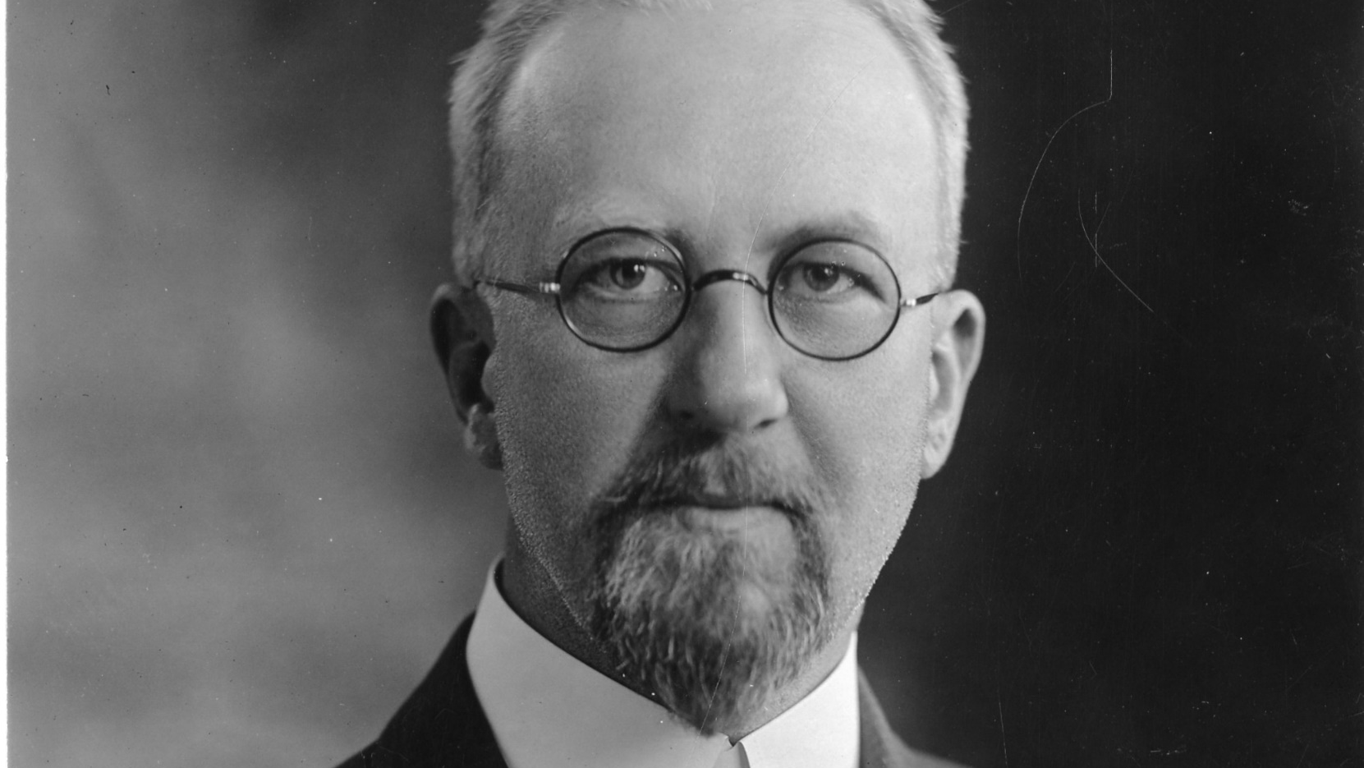
Edward Vermilye Huntington
1874 – 1952
In 1904, he put Boolean algebra
on a sound axiomatic foundation
Notes:
American postulate theorists, devising sets of axioms (which he called "postulates")
In 1904, Huntington put Boolean algebra on a sound axiomatic foundation

Slide 14
postulate
aka. Axiom, Assumption
https://en.wikipedia.org/wiki/Axiom
A statement that is taken to be TRUE
Serve as a premise or starting point for further reasoning
Notes:
An axiom, postulate or assumption is a statement that is taken to be true, to serve as a premise or starting point for further reasoning and arguments. The word comes from the Greek axíōma (ἀξίωμα) 'that which is thought worthy or fit' or 'that which commends itself as evident.'^{[1][2]}

Slide 15
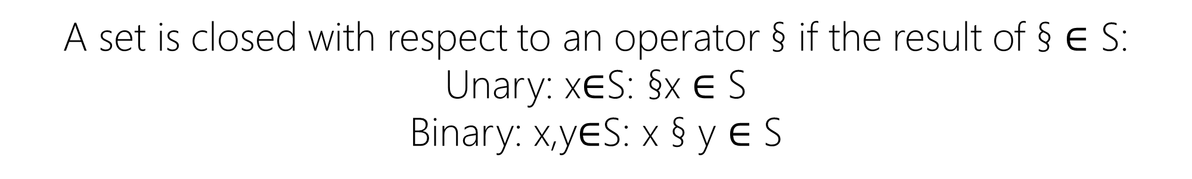
I. closure
A set is closed with respect to an operator § if the result of § $∈$ S:
Unary: x$∈$S: §x $∈$ S
Binary: x,y$∈$S: x § y $∈$ S
Notes:
Section Sign – §
Daggers – †

Slide 16
I. closure
S = {…, -2,-1,0,1,2,…}
§ = + (addition), - (subtraction), × (multiplication), – (negation), ! (fact)
S is closed with respect to +, -, ×, –, !

Slide 17
I. closure
S = {…, -2,-1,0,1,2,…}
§ = ^ (power)
S is NOT closed with respect to ^ for 2^(-1)∉S

Slide 18
I. closure
S = {0,1}
§ = + (OR), × (AND), ‘ (NOT)
S is closed with respect to +, ×, ‘

Slide 19
I. closure
S = {0,1}
§ = – (negation)
S is NOT closed with respect to – for (–1)∉S

Slide 20
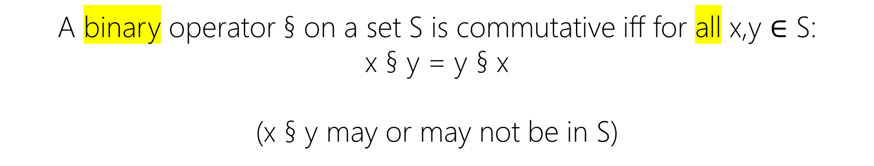
II. Commutative
A binary operator § on a set S is commutative iff for all x,y $∈$ S:
x § y = y § x
(x § y may or may not be in S)

Slide 21
II. Commutative
S = {…, -2,-1,0,1,2,…}
§ = + (addition), × (multiplication)
+ and × are commutative on S for x+y=y+x and x×y=y×x

Slide 22
II. Commutative
S = {…, -2,-1,0,1,2,…}
§ = - (subtraction)
- is NOT commutative on S for x-y≠y-x

Slide 23
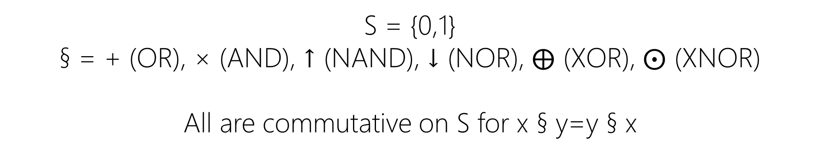
II. Commutative
S = {0,1}
§ = + (OR), × (AND), ↑ (NAND), ↓ (NOR), $⨁$ (XOR), $⨀$ (XNOR)
All are commutative on S for x § y=y § x

Slide 24
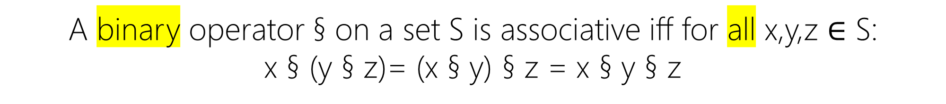
III. Associative
A binary operator § on a set S is associative iff for all x,y,z $∈$ S:
x § (y § z)= (x § y) § z = x § y § z

Slide 25
III. Associative
S = {…, -2,-1,0,1,2,…}
§ = + (addition), × (multiplication), - (subtraction)
+, -, × are associative on S for
x±(y±z)=(x±y) ±z=x±y±z
x×(y×z)=(x×y)×z=x×y×z

Slide 26
III. Associative
S = {…, -2,-1,0,1,2,…}
§ = ^ (power)
^ is NOT associative on S for 2^(1^3)≠(2^1)^3

Slide 27
III. Associative
S = {0,1}
§ = + (OR), × (AND)
+,× are associative on S for
x+(y+z)=(x+y)+z=x+y+z
x×(y×z)=(x×y)×z=x×y×z

Slide 28
IV. Distributive
If § and † are two binary operators on a set S, § is distributive over † iff:
Left Distributivity: x § (y † z) = (x § y) † (x § z)
Right Distributivity: (y § x) † (z § x) = (y † z) § x

Slide 29
IV. Distributive
If § and † are two binary operators on a set S, § is distributive over † iff:
If § Commutative: x § (y † z) = (x § y) † (x § z) = (y † z) § x

Slide 30
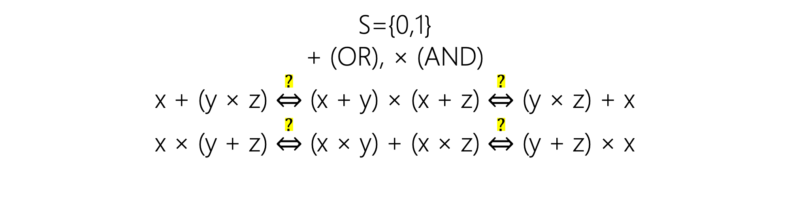
IV. Distributive
S={0,1}
+ (OR), × (AND)
x + (y × z) $\underset{⇔}{?}$ (x + y) × (x + z) $\underset{⇔}{?}$ (y × z) + x
x × (y + z) $\underset{⇔}{?}$ (x × y) + (x × z) $\underset{⇔}{?}$ (y + z) × x

Slide 31
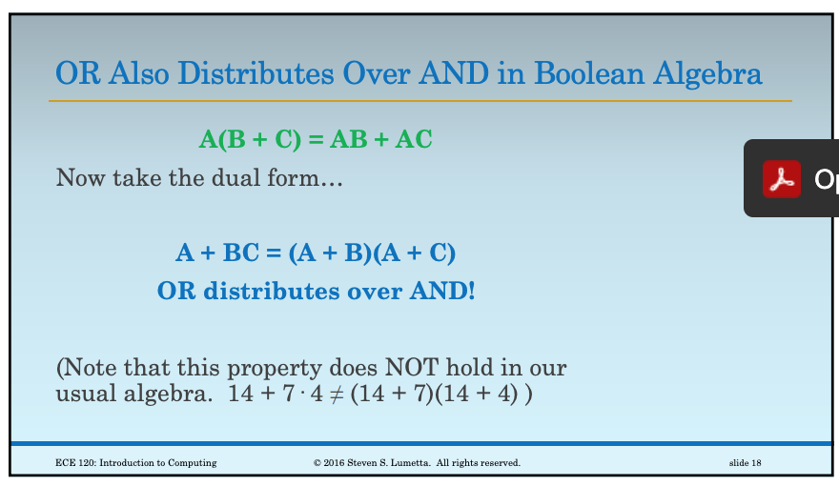

Slide 32
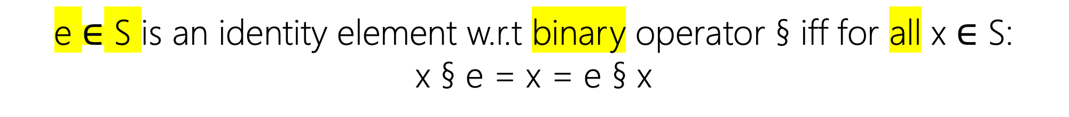
V. Identity
e $∈$ S is an identity element w.r.t binary operator § iff for all x $∈$ S:
x § e = x = e § x

Slide 33
V. Identity
S = {…, -2,-1,0,1,2,…}
§ = + (addition), × (multiplication)
e₊= 0 : x+0=0+x=x
e×= 1 : x×1=1×x=x

Slide 34
V. Identity
S = {…, -2,-1,0,1,2,…}
§ = - (subtraction)
e = 0
x-0≠0-x≠x
NO identity element for – (subtraction) in S

Slide 35
V. Identity
S = {0,1}
§ = + (OR), × (AND)
e₊= 0 : x+0=0+x=x
e×= 1 : x×1=1×x=x

Slide 36
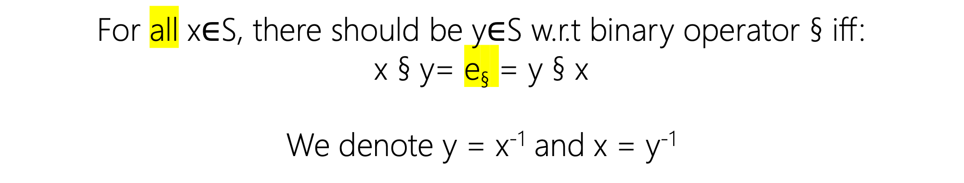
VI. inverse
For all x$∈$S, there should be y$∈$S w.r.t binary operator § iff:
x § y= e§ = y § x
We denote y = x⁻¹ and x = y⁻¹

Slide 37
VI. inverse
S = {…, -2,-1,0,1,2,…}
§ = + (addition)
x+(-x)=(-x)+x= e₊= 0
x⁻¹=-x

Slide 38

VI. inverse
S = {…, -2,-1,0,1,2,…}
§ = × (multiplication)
S does not have the inverse property for × since
2×½ = ½×2= e×= 1 but ½ $∉$ S

Slide 39
VI. inverse
S = {0,1}
§ = + (OR), × (AND)
1+?=?+1 ≠ e₊= 0
0×?=?×0 ≠ e×= 1

Slide 40
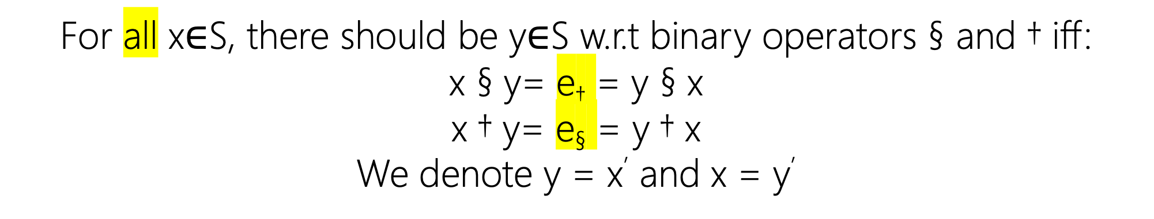
VII. Complement
For all x$∈$S, there should be y$∈$S w.r.t binary operators § and † iff:
x § y= e† = y § x
x † y= e§ = y † x
We denote y = x’ and x = y’

Slide 41
VII. Complement (NOT)
S = {0,1}
§ = + (OR), × (AND)
1+0=0+1 = e×= 1
0×1=1×0 = e₊= 0
0’ = 1, 1’ = 0

Slide 42
Boolean algebra
A set S with at least two elements x, y and x ≠ y.
Two binary operators § and †
S is closed, commutative, distributive, and complement w.r.t § , †
e§ and e† exist

Slide 43
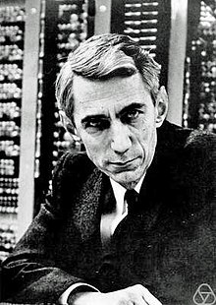
Claude Elwood Shannon
Mathematician
Electrical Engineer
Cryptographer
M.Sc. Thesis (1937)
A Symbolic Analysis of Relay and Switching Circuits
Switching Algebra!
2-valued Boolean algebra
Notes:
He is also well known for founding digital circuit design theory in 1937, when—as a 21-year-old master's degree student at the Massachusetts Institute of Technology (MIT)—he wrote his thesis demonstrating that electrical applications of Boolean algebra could construct any logical numerical relationship

Slide 44
Switching algebra
S={0,1}
§ = × (AND), † = + (OR)
S is closed, commutative, distributive, complement w.r.t × , +
e× = 1 and e₊ = 0
0 × 1 = e₊ = 0
0 + 1 = e× = 1
0’ = 1; 1’ = 0

Slide 45
Switching algebra
Is-A
Boolean algebra
It satisfies all conditions of Boolean algebra!
Prove → Book: 2.3 axiomatic definition of Boolean algebra

Slide 46
Another sample of algebra in CS:
Relational Algebra (SQL)
Is relational algebra a Boolean algebra? Check this when you take
COMP-3150: Database Management Systems!

Slide 47
Basic Theorems
prove by truth table
For equality proof, F₁=F₂, for all possibility in the input variables (all rows), both side of equation must have equal value for same input variables.
For inequality proof, F₁≠F₂, find at least one possibility (a row) that have different values.

Slide 48
Basic Theorems
Prove by postulates

