Slide 1

W2021: A Digital Odyssey
Notes:
https://www.pinterest.ca/pin/231302130841121655/

Slide 2


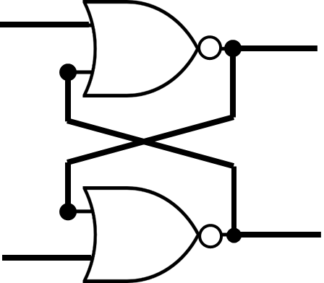
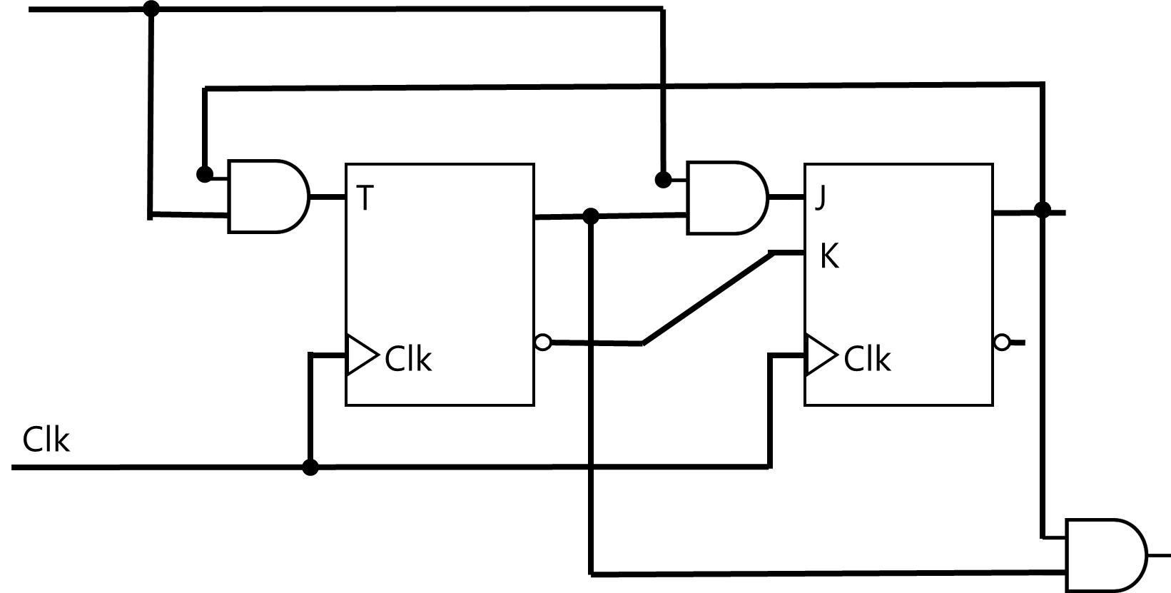
Number Systems |
(12)₁₀ → (1100)₂
Number Systems | Logic Gates |
Number Systems | Logic Gates | Combinational Logic |
Number Systems | Logic Gates | Combinational Logic | Flip-Flops |
Number Systems | Logic Gates | Combinational Logic | Flip-Flops | Sequential Logic |
Number Systems | Logic Gates | Combinational Logic | Flip-Flops| Sequential Logic | Computer Systems

Slide 3
Minimization
aka. Simplification

Slide 4
Minimization
Number of Gates
Number of Inputs (2-input vs 4-input)
Number of Interconnections
Propagation Time
Cost of Gates
Circuit Area
. . .
A circuit may not satisfy all due to conflicting constraints!

Slide 5
Minimization
Boolean Algebra (algebraically)
Needs to be smart. It is hard due to guesswork (which rules to apply?)
If the number of variables (ABCDEF…) and/or number of minterms (MAXTERMS) grows
No Algorithm
Is the result minimal?!

Slide 6
Minimization
II) Map (Karnaugh map, K-map)
aka. Graphical Manipulation

Slide 7
Minimization
II) Map (Karnaugh map, K-map)
aka. Graphical Manipulation
Algorithm; Straightforward, up to six variables
Result is always minimal

Slide 8

Maurice Karnaugh
Physicist
Mathematician
Inventor
Bell Labs (1954)
"The Map Method for Synthesis of
Combinational Logic Circuits”

Slide 9
KARNAUGH MAP
/ˈkɑːrnɔː/

Slide 10
1-Variable KARNAUGH MAP

Slide 11
X | F
0 | m₀
1 | m₁
X
0 | 1
m₀ | m₁

Slide 12
2-Variable KARNAUGH MAP

Slide 13
Y | X | F
0 | 0 | m₀
0 | 1 | m₁
1 | 0 | m₂
1 | 1 | m₃
 |  | X
 |  | 0 | 1
Y | 0 | m₀ | m₁
 | 1 | m₂ | m₃

Slide 14
Y | X | F
0 | 0 | m₀
0 | 1 | m₁
1 | 0 | m₂
1 | 1 | m₃
 |  | X
 |  | 0 | 1
Y | 0 | m₀ | m₁
 | 1 | m₂ | m₃

Slide 15
Y | X | F
0 | 0 | 1
0 | 1 | 0
1 | 0 | 0
1 | 1 | 0
F(Y,X) = m₀ = Y’X’
 |  | X
 |  | 0 | 1
Y | 0 | 1 | 0
 | 1 | 0 | 0
F(Y,X) = Y’X’

Slide 16
Y | X | F
0 | 0 | 0
0 | 1 | 1
1 | 0 | 0
1 | 1 | 0
F(Y,X) = m₁ = Y’X
 |  | X
 |  | 0 | 1
Y | 0 | 0 | 1
 | 1 | 0 | 0
F(Y,X) = Y’X

Slide 17
Y | X | F
0 | 0 | 0
0 | 1 | 0
1 | 0 | 1
1 | 1 | 0
F(Y,X) = m₂ = YX’
 |  | X
 |  | 0 | 1
Y | 0 | 0 | 0
 | 1 | 1 | 0
F(Y,X) = YX’

Slide 18
Y | X | F
0 | 0 | 0
0 | 1 | 0
1 | 0 | 0
1 | 1 | 1
F(Y,X) = m₃ = YX
 |  | X
 |  | 0 | 1
Y | 0 | 0 | 0
 | 1 | 0 | 1
F(Y,X) = YX

Slide 19
Y | X | F
0 | 0 | 1
0 | 1 | 1
1 | 0 | 0
1 | 1 | 0
F(Y,X) = m₀ + m₁ F(Y,X) = Y’X’ + Y’X F(Y,X) = Y’(X’ + X) F(Y,X) = Y’
 |  | X
 |  | 0 | 1
Y | 0 | 1 | 1
 | 1 | 0 | 0
F(Y,X) = Y’

Slide 20
Y | X | F
0 | 0 | 0
0 | 1 | 0
1 | 0 | 1
1 | 1 | 1
F(Y,X) = m₂ + m₃ F(Y,X) = YX’ + YX F(Y,X) = Y(X’ + X) F(Y,X) = Y
 |  | X
 |  | 0 | 1
Y | 0 | 0 | 0
 | 1 | 1 | 1
F(Y,X) = Y

Slide 21
Y | X | F
0 | 0 | 0
0 | 1 | 1
1 | 0 | 0
1 | 1 | 1
F(Y,X) = m₁ + m₃ F(Y,X) = Y’X + YX F(Y,X) = X(Y’ + Y) F(Y,X) = X
 |  | X
 |  | 0 | 1
Y | 0 | 0 | 1
 | 1 | 0 | 1
F(Y,X) = X

Slide 22
Y | X | F
0 | 0 | 1
0 | 1 | 0
1 | 0 | 1
1 | 1 | 0
F(Y,X) = m₀ + m₂ F(Y,X) = Y’X’ + YX’ F(Y,X) = X’(Y’ + Y) F(Y,X) = X’
 |  | X
 |  | 0 | 1
Y | 0 | 1 | 0
 | 1 | 1 | 0
F(Y,X) = X’

Slide 23
Y | X | F
0 | 0 | 1
0 | 1 | 1
1 | 0 | 1
1 | 1 | 0
F(Y,X) = m₀ + m₁ + m₂ F(Y,X) = Y’X’ + Y’X + YX’ F(Y,X) = Y’(X’ + X) + YX’ F(Y,X) = Y’ + YX’
 |  | X
 |  | 0 | 1
Y | 0 | 1 | 1
 | 1 | 1 | 0
F(Y,X) = Y’ + YX’

Slide 24
Y | X | F
0 | 0 | 1
0 | 1 | 1
1 | 0 | 1
1 | 1 | 0
F(Y,X) = m₀ + m₁ + m₂ F(Y,X) = Y’X’ + Y’X + YX’ F(Y,X) = X’(Y’ + Y) + Y’X F(Y,X) = X’ + Y’X
 |  | X
 |  | 0 | 1
Y | 0 | 1 | 1
 | 1 | 1 | 0
F(Y,X) = X’ + Y’X

Slide 25
Y | X | F
0 | 0 | 1
0 | 1 | 1
1 | 0 | 1
1 | 1 | 0
F(Y,X) = m₀ + m₁ + m₂ F(Y,X) = Y’X’ + Y’X + YX’ F(Y,X) = Y’X’ + Y’X’ + Y’X + YX’ F(Y,X) = Y’(X’ + X) + Y’X’ + YX’ F(Y,X) = Y’ + Y’X’ + YX’ F(Y,X) = Y’ + X’(Y’ + Y) F(Y,X) = Y’ + X’
 |  | X
 |  | 0 | 1
Y | 0 | 1 | 1
 | 1 | 1 | 0
F(Y,X) = Y’ + X’

Slide 26
Y | X | F
0 | 0 | 1
0 | 1 | 1
1 | 0 | 1
1 | 1 | 1
F(Y,X) = m₀ + m₁ + m₂ + m₃ F(Y,X) = Y’X’ + Y’X + YX’ + YX F(Y,X) = Y’(X’ + X) + Y(X’ + X) F(Y,X) = Y’ + Y F(Y,X) = 1
 |  | X
 |  | 0 | 1
Y | 0 | 1 | 1
 | 1 | 1 | 1
F(Y,X) = m₀+m₁+m₂+m₃
F(Y,X) = 1

Slide 27
Y | X | F
0 | 0 | 0
0 | 1 | 1
1 | 0 | 1
1 | 1 | 0
F(Y,X) = m₁ + m₂ F(Y,X) = Y’X + YX’
 |  | X
 |  | 0 | 1
Y | 0 | 0 | 1
 | 1 | 1 | 0
F(Y,X) = m₁ + m₂
F(Y,X) = Y’X + YX’

Slide 28
Y | X | F
0 | 0 | 1
0 | 1 | 0
1 | 0 | 0
1 | 1 | 1
F(Y,X) = m₀ + m₃ F(Y,X) = Y’X’ + YX
 |  | X
 |  | 0 | 1
Y | 0 | 1 | 0
 | 1 | 0 | 1
F(Y,X) = m₀ + m₂
F(Y,X) = Y’X’ + YX

Slide 29
3-Variable KARNAUGH MAP

Slide 30
 |  | X
 |  | 0 | 1
Y | 0 | m₀ | m₁
 | 1 | m₂ | m₃
 |  | X
 |  | 0 | 1
Y | 0 | m₀ | m₁
 | 1 | m₂ | m₃
Z | Y | X | F
0 | 0 | 0 | m₀
0 | 0 | 1 | m₁
0 | 1 | 0 | m₂
0 | 1 | 1 | m₃
1 | 0 | 0 | m₄
1 | 0 | 1 | m₅
1 | 1 | 0 | m₆
1 | 1 | 1 | m₇
 |  | YX
 |  | 00 | 01 | 11 | 10
Z | 0 | m₀ | m₁ | m₃ | m₂
 | 1 | m₄ | m₅ | m₇ | m₆

Slide 31
 |  | X
 |  | 0 | 1
Y | 0 | m₀ | m₁
 | 1 | m₂ | m₃
 |  | X
 |  | 0 | 1
Y | 0 | m₀ | m₁
 | 1 | m₂ | m₃
Z | Y | X | F
0 | 0 | 0 | m₀
0 | 0 | 1 | m₁
0 | 1 | 0 | m₂
0 | 1 | 1 | m₃
1 | 0 | 0 | m₄
1 | 0 | 1 | m₅
1 | 1 | 0 | m₆
1 | 1 | 1 | m₇
 |  | YX
 |  | 00 | 01 | 11 | 10
Z | 0 | m₀ | m₁ | m₃ | m₂
 | 1 | m₄ | m₅ | m₇ | m₆

Slide 32
Z | Y | X | F
0 | 0 | 0 | m₀
0 | 0 | 1 | m₁
0 | 1 | 0 | m₂
0 | 1 | 1 | m₃
1 | 0 | 0 | m₄
1 | 0 | 1 | m₅
1 | 1 | 0 | m₆
1 | 1 | 1 | m₇
 |  | YX
 |  | 00 | 01 | 11 | 10
Z | 0 | m₀ | m₁ | m₃ | m₂
 | 1 | m₄ | m₅ | m₇ | m₆
Z

Slide 33
Z | Y | X | F
0 | 0 | 0 | m₀
0 | 0 | 1 | m₁
0 | 1 | 0 | m₂
0 | 1 | 1 | m₃
1 | 0 | 0 | m₄
1 | 0 | 1 | m₅
1 | 1 | 0 | m₆
1 | 1 | 1 | m₇
 |  | YX
 |  | 00 | 01 | 11 | 10
Z | 0 | m₀ | m₁ | m₃ | m₂
 | 1 | m₄ | m₅ | m₇ | m₆
Z’

Slide 34
Z | Y | X | F
0 | 0 | 0 | m₀
0 | 0 | 1 | m₁
0 | 1 | 0 | m₂
0 | 1 | 1 | m₃
1 | 0 | 0 | m₄
1 | 0 | 1 | m₅
1 | 1 | 0 | m₆
1 | 1 | 1 | m₇
 |  | YX
 |  | 00 | 01 | 11 | 10
Z | 0 | m₀ | m₁ | m₃ | m₂
 | 1 | m₄ | m₅ | m₇ | m₆
Y

Slide 35
Z | Y | X | F
0 | 0 | 0 | m₀
0 | 0 | 1 | m₁
0 | 1 | 0 | m₂
0 | 1 | 1 | m₃
1 | 0 | 0 | m₄
1 | 0 | 1 | m₅
1 | 1 | 0 | m₆
1 | 1 | 1 | m₇
 |  | YX
 |  | 00 | 01 | 11 | 10
Z | 0 | m₀ | m₁ | m₃ | m₂
 | 1 | m₄ | m₅ | m₇ | m₆
Y'

Slide 36
Z | Y | X | F
0 | 0 | 0 | m₀
0 | 0 | 1 | m₁
0 | 1 | 0 | m₂
0 | 1 | 1 | m₃
1 | 0 | 0 | m₄
1 | 0 | 1 | m₅
1 | 1 | 0 | m₆
1 | 1 | 1 | m₇
 |  | YX
 |  | 00 | 01 | 11 | 10
Z | 0 | m₀ | m₁ | m₃ | m₂
 | 1 | m₄ | m₅ | m₇ | m₆
X

Slide 37
Z | Y | X | F
0 | 0 | 0 | m₀
0 | 0 | 1 | m₁
0 | 1 | 0 | m₂
0 | 1 | 1 | m₃
1 | 0 | 0 | m₄
1 | 0 | 1 | m₅
1 | 1 | 0 | m₆
1 | 1 | 1 | m₇
 |  | YX
 |  | 00 | 01 | 11 | 10
Z | 0 | m₀ | m₁ | m₃ | m₂
 | 1 | m₄ | m₅ | m₇ | m₆
X’ ?

Slide 38
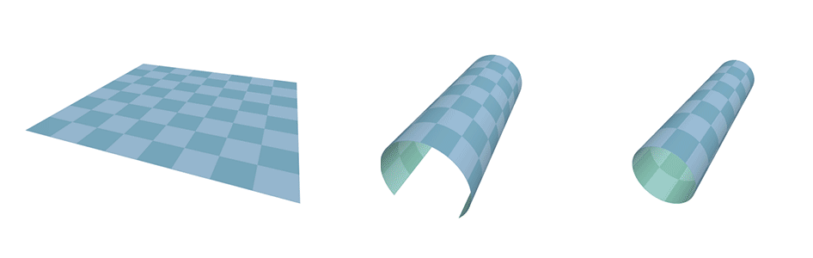
Z | Y | X | F
0 | 0 | 0 | m₀
0 | 0 | 1 | m₁
0 | 1 | 0 | m₂
0 | 1 | 1 | m₃
1 | 0 | 0 | m₄
1 | 0 | 1 | m₅
1 | 1 | 0 | m₆
1 | 1 | 1 | m₇
 |  | YX
 |  | 00 | 01 | 11 | 10
Z | 0 | m₀ | m₁ | m₃ | m₂
 | 1 | m₄ | m₅ | m₇ | m₆

Slide 39

Z | Y | X | F
0 | 0 | 0 | m₀
0 | 0 | 1 | m₁
0 | 1 | 0 | m₂
0 | 1 | 1 | m₃
1 | 0 | 0 | m₄
1 | 0 | 1 | m₅
1 | 1 | 0 | m₆
1 | 1 | 1 | m₇
 |  | YX
 |  | 00 | 01 | 11 | 10
Z | 0 | m₀ | m₁ | m₃ | m₂ | 0 | Z
 | 1 | m₄ | m₅ | m₇ | m₆ | 1
X’
X’

Slide 40
Z | Y | X | F
0 | 0 | 0 | 1
0 | 0 | 1 | 1
0 | 1 | 0 | 1
0 | 1 | 1 | 1
1 | 0 | 0 | 0
1 | 0 | 1 | 0
1 | 1 | 0 | 1
1 | 1 | 1 | 1
 |  | YX
 |  | 00 | 01 | 11 | 10
Z | 0 | 1 | 1 | 1 | 1
 | 1 | 0 | 0 | 1 | 1
F(Z,Y,X) = ∑ m(0,1,2,3,6,7)
F(Y,X) = Z’Y’X’+Z’Y’X+Z’YX’+Z’YX+ZYX’+ZYX
F(Y,X) = ?

Slide 41
Z | Y | X | F
0 | 0 | 0 | 1
0 | 0 | 1 | 1
0 | 1 | 0 | 1
0 | 1 | 1 | 1
1 | 0 | 0 | 0
1 | 0 | 1 | 0
1 | 1 | 0 | 1
1 | 1 | 1 | 1
 |  | YX
 |  | 00 | 01 | 11 | 10
Z | 0 | 1 | 1 | 1 | 1
 | 1 | 0 | 0 | 1 | 1
F(Z,Y,X) = ∑ m(0,1,2,3,6,7)
FX(Y,X) = Z’ +
F(Z,Y,X) = ∑ m(0,1,2,3,6,7)
F(Y,X) = Z’Y’X’+Z’Y’X+Z’YX’+Z’YX+ZYX’+ZYX
F(Y,X) = ?

Slide 42
Z | Y | X | F
0 | 0 | 0 | 1
0 | 0 | 1 | 1
0 | 1 | 0 | 1
0 | 1 | 1 | 1
1 | 0 | 0 | 0
1 | 0 | 1 | 0
1 | 1 | 0 | 1
1 | 1 | 1 | 1
 |  | YX
 |  | 00 | 01 | 11 | 10
Z | 0 | 1 | 1 | 1 | 1
 | 1 | 0 | 0 | 1 | 1
F(Z,Y,X) = ∑ m(0,1,2,3,6,7)
F(Y,X) = Z’ + ZY
F(Z,Y,X) = ∑ m(0,1,2,3,6,7)
F(Y,X) = Z’Y’X’+Z’Y’X+Z’YX’+Z’YX+ZYX’+ZYX
F(Y,X) = ?

Slide 43
Z | Y | X | F
0 | 0 | 0 | 1
0 | 0 | 1 | 1
0 | 1 | 0 | 1
0 | 1 | 1 | 1
1 | 0 | 0 | 0
1 | 0 | 1 | 0
1 | 1 | 0 | 1
1 | 1 | 1 | 1
 |  | YX
 |  | 00 | 01 | 11 | 10
Z | 0 | 1 | 1 | 1 | 1
 | 1 | 0 | 0 | 1 | 1
F(Z,Y,X) = ∑ m(0,1,2,3,6,7)
F(Y,X) = Z’ + Y
F(Z,Y,X) = ∑ m(0,1,2,3,6,7)
F(Y,X) = Z’Y’X’+Z’Y’X+Z’YX’+Z’YX+ZYX’+ZYX
F(Y,X) = ?

Slide 44
MAXTERMS

Slide 45
Z | Y | X | F
0 | 0 | 0 | 1
0 | 0 | 1 | 1
0 | 1 | 0 | 1
0 | 1 | 1 | 1
1 | 0 | 0 | 0
1 | 0 | 1 | 0
1 | 1 | 0 | 1
1 | 1 | 1 | 1
 |  | YX
 |  | 00 | 01 | 11 | 10
Z | 0 | 1 | 1 | 1 | 1
 | 1 | 0 | 0 | 1 | 1
F(Z,Y,X) = Π M(4,5)
F(Y,X) = ?
F(Z,Y,X) = Π M(4,5)
F(Y,X) = (Z’+Y+X) (Z’+Y+X’)
F(Y,X) = ?

Slide 46
Z | Y | X | F
0 | 0 | 0 | 1
0 | 0 | 1 | 1
0 | 1 | 0 | 1
0 | 1 | 1 | 1
1 | 0 | 0 | 0
1 | 0 | 1 | 0
1 | 1 | 0 | 1
1 | 1 | 1 | 1
 |  | YX
 |  | 00 | 01 | 11 | 10
Z | 0 | 0 | 0 | 0 | 0
 | 1 | 1 | 1 | 0 | 0
F’(Z,Y,X) = ∑ m(4,5)
F’(Y,X) = ZY’
F(Z,Y,X) = Π M(4,5)
F(Y,X) = (Z’+Y+X) (Z’+Y+X’)
F(Y,X) = ?

Slide 47
Z | Y | X | F
0 | 0 | 0 | 1
0 | 0 | 1 | 1
0 | 1 | 0 | 1
0 | 1 | 1 | 1
1 | 0 | 0 | 0
1 | 0 | 1 | 0
1 | 1 | 0 | 1
1 | 1 | 1 | 1
 |  | YX
 |  | 00 | 01 | 11 | 10
Z | 0 | 1 | 1 | 1 | 1
 | 1 | 0 | 0 | 1 | 1
F(Z,Y,X) = Π M(4,5)
F(Y,X) = (F’)’
F(Y,X) = (ZY’)’
F(Y,X) = Z’+Y
F(Z,Y,X) = Π M(4,5)
F(Y,X) = (Z’+Y+X) (Z’+Y+X’)
F(Y,X) = ?

Slide 48
 |  | YX
 |  | 00 | 01 | 11 | 10
Z | 0 | 1 | 1 | 1 | 1
 | 1 | 0 | 0 | 1 | 1
Z | Y | X | F
0 | 0 | 0 | 1
0 | 0 | 1 | 1
0 | 1 | 0 | 1
0 | 1 | 1 | 1
1 | 0 | 0 | 0
1 | 0 | 1 | 0
1 | 1 | 0 | 1
1 | 1 | 1 | 1
F(Z,Y,X) = ∑ m(0,1,2,3,6,7)
F(Y,X) = Z’ + Y
 |  | YX
 |  | 00 | 01 | 11 | 10
Z | 0 | 1 | 1 | 1 | 1
 | 1 | 0 | 0 | 1 | 1
F(Z,Y,X) = ∑ m(0,1,2,3,6,7)
F(Y,X) = Z’Y’X’+Z’Y’X+Z’YX’+Z’YX+ZYX’+ZYX
F(Y,X) = ?
F(Z,Y,X) = Π M(4,5)
F(Y,X) = (Z’+Y+X) (Z’+Y+X’)
F(Y,X) = ?
F(Z,Y,X) = Π M(4,5)
F(Y,X) = (F’)’
F(Y,X) = (ZY’)’
F(Y,X) = Z’+Y

Slide 49
Z | Y | X | F
0 | 0 | 0 | 1
0 | 0 | 1 | 0
0 | 1 | 0 | 1
0 | 1 | 1 | 0
1 | 0 | 0 | 1
1 | 0 | 1 | 0
1 | 1 | 0 | 1
1 | 1 | 1 | 0
 |  | YX
 |  | 00 | 01 | 11 | 10
Z | 0 | 1 | 0 | 0 | 1
 | 1 | 1 | 0 | 0 | 1
F(Z,Y,X) = ∑ m(0,2,4, 6)
F(Y,X) = Z’Y’X’+Z’YX’+ZY’X’+ZYX’
F(Y,X) = ?

Slide 50
Z | Y | X | F
0 | 0 | 0 | 1
0 | 0 | 1 | 0
0 | 1 | 0 | 1
0 | 1 | 1 | 0
1 | 0 | 0 | 1
1 | 0 | 1 | 0
1 | 1 | 0 | 1
1 | 1 | 1 | 0
 |  | YX
 |  | 00 | 01 | 11 | 10
Z | 0 | 1 | 0 | 0 | 1
 | 1 | 1 | 0 | 0 | 1
F(Z,Y,X) = ∑ m(0,2,4, 6)
F(Y,X) = X’
F(Z,Y,X) = ∑ m(0,2,4, 6)
F(Y,X) = Z’Y’X’+Z’YX’+ZY’X’+ZYX’
F(Y,X) = ?

Slide 51
MAXTERMS

Slide 52
Z | Y | X | F
0 | 0 | 0 | 1
0 | 0 | 1 | 0
0 | 1 | 0 | 1
0 | 1 | 1 | 0
1 | 0 | 0 | 1
1 | 0 | 1 | 0
1 | 1 | 0 | 1
1 | 1 | 1 | 0
 |  | YX
 |  | 00 | 01 | 11 | 10
Z | 0 | 1 | 0 | 0 | 1
 | 1 | 1 | 0 | 0 | 1
F(Z,Y,X) = Π M(1,3,5,7)
F(Y,X) = (X)’
F(Y,X) = X’
F(Z,Y,X) = Π M(1,3,5,7)
F(Y,X) = (Z+Y+X’)(Z+Y’+X’)(Z’+Y+X’)(Z’+Y’+X’)
F(Y,X) = ?

Slide 53
4-Variable KARNAUGH MAP

Slide 54
 |  | YX
 |  | 00 | 01 | 11 | 10
WZ | 00 | m₀ | m₁ | m₃ | m₂
 | 01 | m₄ | m₅ | m₇ | m₆
 | 11 | m₁₂ | m₁₃ | m₁₅ | m₁₄
 | 10 | m₈ | m₉ | m₁₁ | m₁₀

Slide 55
 |  | YX
 |  | 00 | 01 | 11 | 10
WZ | 00 | m₀ | m₁ | m₃ | m₂
 | 01 | m₄ | m₅ | m₇ | m₆
 | 11 | m₁₂ | m₁₃ | m₁₅ | m₁₄
 | 10 | m₈ | m₉ | m₁₁ | m₁₀

Slide 56
 |  | YX
 |  | 00 | 01 | 11 | 10
WZ | 00 | m₀ | m₁ | m₃ | m₂
 | 01 | m₄ | m₅ | m₇ | m₆
 | 11 | m₁₂ | m₁₃ | m₁₅ | m₁₄
 | 10 | m₈ | m₉ | m₁₁ | m₁₀

Slide 57
 |  | YX
 |  | 00 | 01 | 11 | 10
WZ | 00 | m₀ | m₁ | m₃ | m₂
 | 01 | m₄ | m₅ | m₇ | m₆
 | 11 | m₁₂ | m₁₃ | m₁₅ | m₁₄
 | 10 | m₈ | m₉ | m₁₁ | m₁₀
F (W,Z,Y,X) = ∑m(0, 1, 2, 4, 5, 6, 8, 9, 12, 13, 14)

Slide 58
 |  | YX
 |  | 00 | 01 | 11 | 10
WZ | 00 | 1 | 1 | 0 | 1
 | 01 | 1 | 1 | 0 | 1
 | 11 | 1 | 1 | 0 | 1
 | 10 | 1 | 1 | 0 | 0
m₀ | m₁ | m₃ | m₂
m₄ | m₅ | m₇ | m₆
m₁₂ | m₁₃ | m₁₅ | m₁₄
m₈ | m₉ | m₁₁ | m₁₀
F (W,Z,Y,X) = ∑m(0, 1, 2, 4, 5, 6, 8, 9, 12, 13, 14)

Slide 59
 |  | YX
 |  | 00 | 01 | 11 | 10
WZ | 00 | 1 | 1 | 0 | 1
 | 01 | 1 | 1 | 0 | 1
 | 11 | 1 | 1 | 0 | 1
 | 10 | 1 | 1 | 0 | 0
m₀ | m₁ | m₃ | m₂
m₄ | m₅ | m₇ | m₆
m₁₂ | m₁₃ | m₁₅ | m₁₄
m₈ | m₉ | m₁₁ | m₁₀
F (W,Z,Y,X) = ∑m(0, 1, 2, 4, 5, 6, 8, 9, 12, 13, 14)
F (W,Z,Y,X) = Y’ +

Slide 60
 |  | YX
 |  | 00 | 01 | 11 | 10
WZ | 00 | 1 | 1 | 0 | 1
 | 01 | 1 | 1 | 0 | 1
 | 11 | 1 | 1 | 0 | 1
 | 10 | 1 | 1 | 0 | 0
m₀ | m₁ | m₃ | m₂
m₄ | m₅ | m₇ | m₆
m₁₂ | m₁₃ | m₁₅ | m₁₄
m₈ | m₉ | m₁₁ | m₁₀
Warning!
W={0,1}, the value of W matters in m₁₀
Z={0,1}
Y={1}
X={0}
F (W,Z,Y,X) = ∑m(0, 1, 2, 4, 5, 6, 8, 9, 12, 13, 14)
F (W,Z,Y,X) = Y’ +

Slide 61
 |  | YX
 |  | 00 | 01 | 11 | 10
WZ | 00 | 1 | 1 | 0 | 1
 | 01 | 1 | 1 | 0 | 1
 | 11 | 1 | 1 | 0 | 1
 | 10 | 1 | 1 | 0 | 0
m₀ | m₁ | m₃ | m₂
m₄ | m₅ | m₇ | m₆
m₁₂ | m₁₃ | m₁₅ | m₁₄
m₈ | m₉ | m₁₁ | m₁₀
F (W,Z,Y,X) = ∑m(0, 1, 2, 4, 5, 6, 8, 9, 12, 13, 14)
F (W,Z,Y,X) = Y’ + W’YX’

Slide 62
 |  | YX
 |  | 00 | 01 | 11 | 10
WZ | 00 | 1 | 1 | 0 | 1
 | 01 | 1 | 1 | 0 | 1
 | 11 | 1 | 1 | 0 | 1
 | 10 | 1 | 1 | 0 | 0
m₀ | m₁ | m₃ | m₂
m₄ | m₅ | m₇ | m₆
m₁₂ | m₁₃ | m₁₅ | m₁₄
m₈ | m₉ | m₁₁ | m₁₀
F (W,Z,Y,X) = ∑m(0, 1, 2, 4, 5, 6, 8, 9, 12, 13, 14)
F (W,Z,Y,X) = Y’ + W’YX’ + WZYX’

Slide 63
 |  | YX
 |  | 00 | 01 | 11 | 10
WZ | 00 | 1 | 1 | 0 | 1
 | 01 | 1 | 1 | 0 | 1
 | 11 | 1 | 1 | 0 | 1
 | 10 | 1 | 1 | 0 | 0
m₀ | m₁ | m₃ | m₂
m₄ | m₅ | m₇ | m₆
m₁₂ | m₁₃ | m₁₅ | m₁₄
m₈ | m₉ | m₁₁ | m₁₀
F (W,Z,Y,X) = ∑m(0, 1, 2, 4, 5, 6, 8, 9, 12, 13, 14)
F (W,Z,Y,X) = Y’ + W’YX’ + ZYX’

Slide 64
 |  | YX
 |  | 00 | 01 | 11 | 10
WZ | 00 | 1 | 1 | 0 | 1
 | 01 | 1 | 1 | 0 | 1
 | 11 | 1 | 1 | 0 | 1
 | 10 | 1 | 1 | 0 | 0
m₀ | m₁ | m₃ | m₂
m₄ | m₅ | m₇ | m₆
m₁₂ | m₁₃ | m₁₅ | m₁₄
m₈ | m₉ | m₁₁ | m₁₀
F (W,Z,Y,X) = ∑m(0, 1, 2, 4, 5, 6, 8, 9, 12, 13, 14)
F (W,Z,Y,X) = Y’ + W’X’ + WYX’

Slide 65
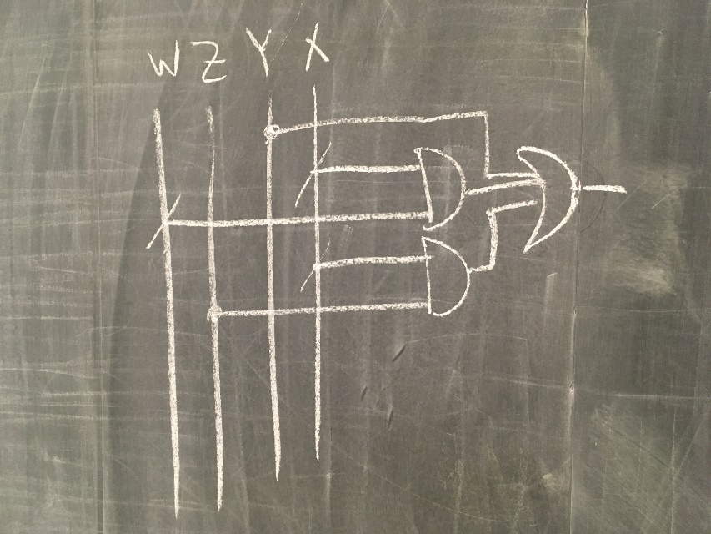
 |  | YX
 |  | 00 | 01 | 11 | 10
WZ | 00 | 1 | 1 | 0 | 1
 | 01 | 1 | 1 | 0 | 1
 | 11 | 1 | 1 | 0 | 1
 | 10 | 1 | 1 | 0 | 0
m₀ | m₁ | m₃ | m₂
m₄ | m₅ | m₇ | m₆
m₁₂ | m₁₃ | m₁₅ | m₁₄
m₈ | m₉ | m₁₁ | m₁₀
F (W,Z,Y,X) = ∑m(0, 1, 2, 4, 5, 6, 8, 9, 12, 13, 14)
F (W,Z,Y,X) = Y’ + W’X’ + ZX’

Slide 66
MAXTERMS

Slide 67
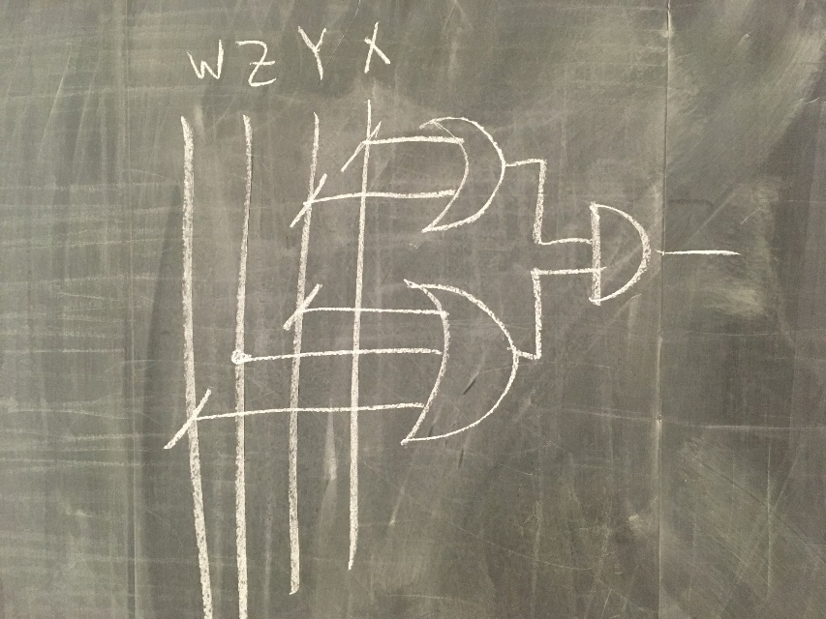
 |  | YX
 |  | 00 | 01 | 11 | 10
WZ | 00 | 1 | 1 | 0 | 1
 | 01 | 1 | 1 | 0 | 1
 | 11 | 1 | 1 | 0 | 1
 | 10 | 1 | 1 | 0 | 0
m₀ | m₁ | m₃ | m₂
m₄ | m₅ | m₇ | m₆
m₁₂ | m₁₃ | m₁₅ | m₁₄
m₈ | m₉ | m₁₁ | m₁₀
F (W,Z,Y,X) = ∏M(3, 7, 10, 11, 15)
F (W,Z,Y,X) = (YX)’(WZ’Y)’
F (W,Z,Y,X) = (Y’+X’)(W’+Z+Y’)

Slide 68
Click to Play!
https://en.wikipedia.org/wiki/Karnaugh_map#/media/File:Torus_from_rectangle.gif

Slide 69
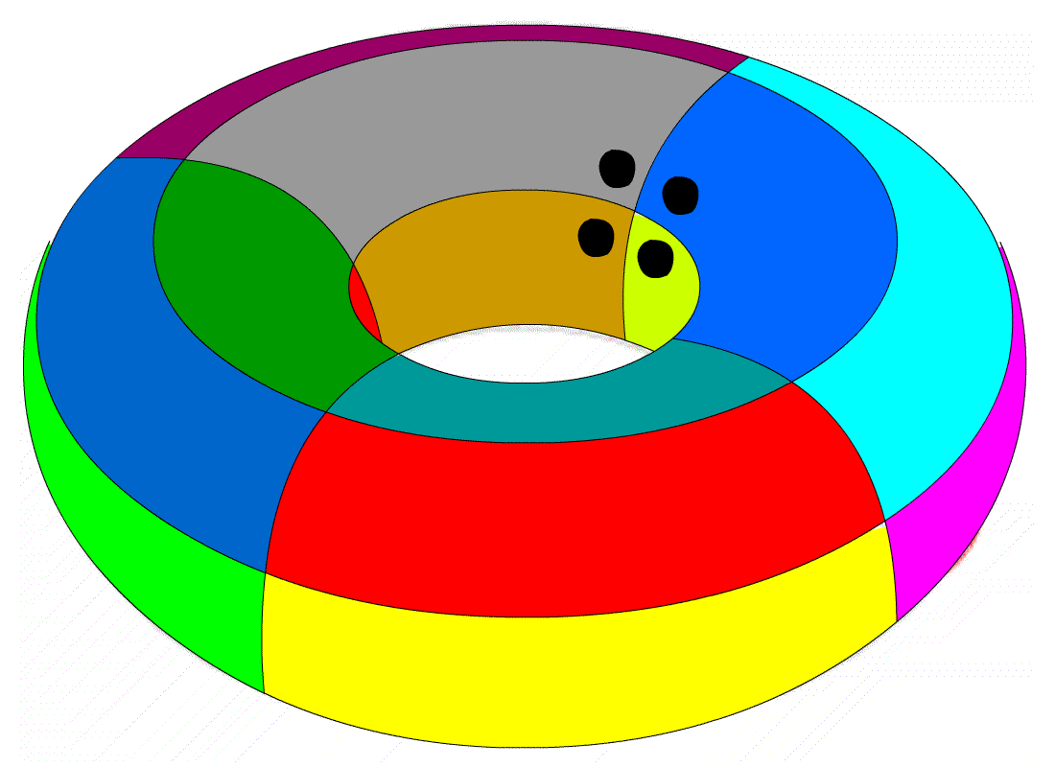
 |  | YX
 |  | 00 | 01 | 11 | 10
WZ | 00 | 1 | 0 | 0 | 1
 | 01 | 0 | 0 | 0 | 0
 | 11 | 0 | 0 | 0 | 0
 | 10 | 1 | 0 | 0 | 1
m₀ | m₁ | m₃ | m₂
m₄ | m₅ | m₇ | m₆
m₁₂ | m₁₃ | m₁₅ | m₁₄
m₈ | m₉ | m₁₁ | m₁₀
F (W,Z,Y,X) = ∑m(0, 2, 8, 10)
F (W,Z,Y,X) = Z’X’
torus

Slide 70
MAXTERMS

Slide 71
 |  | YX
 |  | 00 | 01 | 11 | 10
WZ | 00 | 1 | 0 | 0 | 1
 | 01 | 0 | 0 | 0 | 0
 | 11 | 0 | 0 | 0 | 0
 | 10 | 1 | 0 | 0 | 1
m₀ | m₁ | m₃ | m₂
m₄ | m₅ | m₇ | m₆
m₁₂ | m₁₃ | m₁₅ | m₁₄
m₈ | m₉ | m₁₁ | m₁₀
F (W,Z,Y,X) = ∑m(0, 2, 8, 10)
F (W,Z,Y,X) = Z’X’
F (W,Z,Y,X) = ∏M(1,3-7,9,11-15)
F (W,Z,Y,X) = (X)’(Z)’
F (W,Z,Y,X) = X’Z’
torus

Slide 72
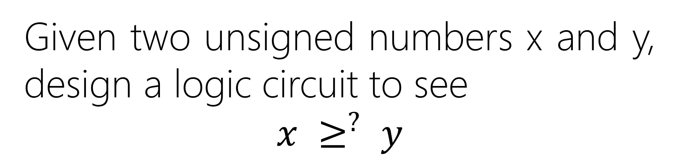
Given two unsigned numbers x and y, design a logic circuit to see
$$x ≥^{?} y$$

Slide 73
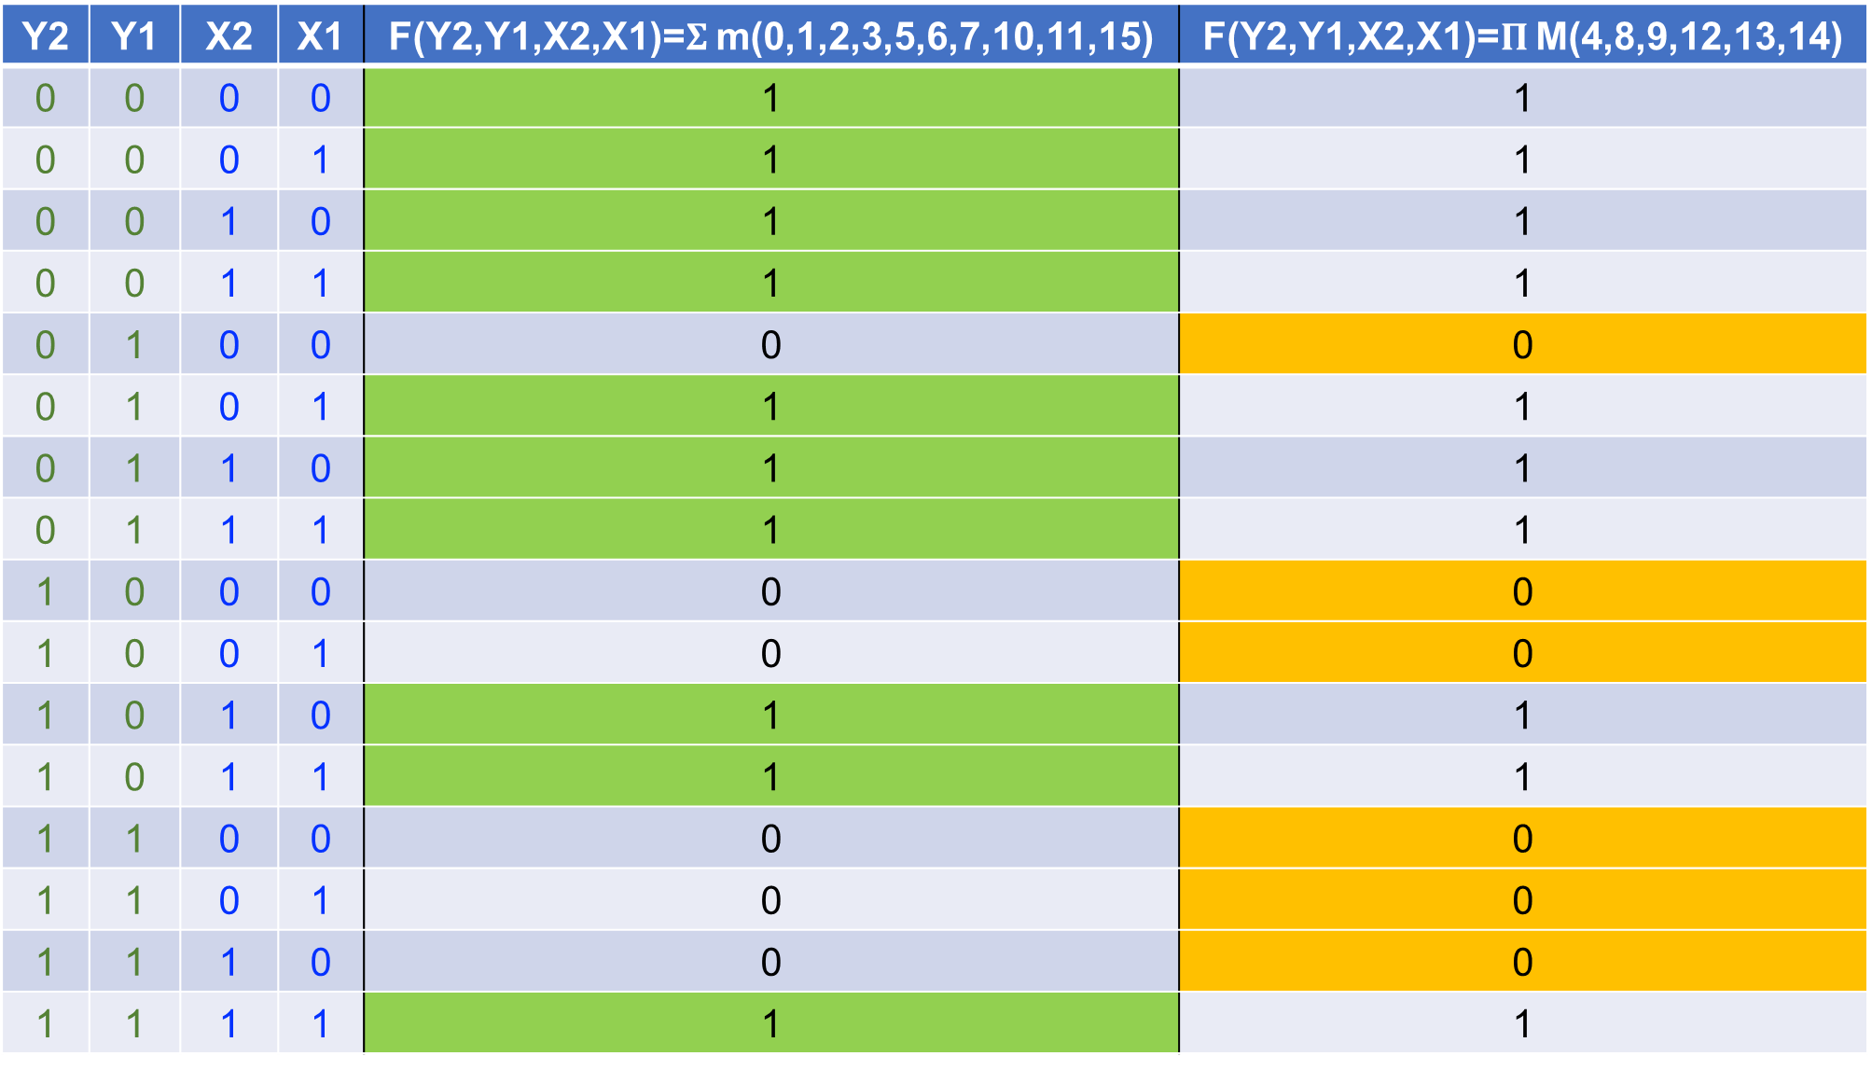
Y2 | Y1 | X2 | X1 | F(Y2,Y1,X2,X1)=$Σ$ m(0,1,2,3,5,6,7,10,11,15) | F(Y2,Y1,X2,X1)=$Π$ M(4,8,9,12,13,14)
0 | 0 | 0 | 0 | 1 | 1
0 | 0 | 0 | 1 | 1 | 1
0 | 0 | 1 | 0 | 1 | 1
0 | 0 | 1 | 1 | 1 | 1
0 | 1 | 0 | 0 | 0 | 0
0 | 1 | 0 | 1 | 1 | 1
0 | 1 | 1 | 0 | 1 | 1
0 | 1 | 1 | 1 | 1 | 1
1 | 0 | 0 | 0 | 0 | 0
1 | 0 | 0 | 1 | 0 | 0
1 | 0 | 1 | 0 | 1 | 1
1 | 0 | 1 | 1 | 1 | 1
1 | 1 | 0 | 0 | 0 | 0
1 | 1 | 0 | 1 | 0 | 0
1 | 1 | 1 | 0 | 0 | 0
1 | 1 | 1 | 1 | 1 | 1

Slide 74
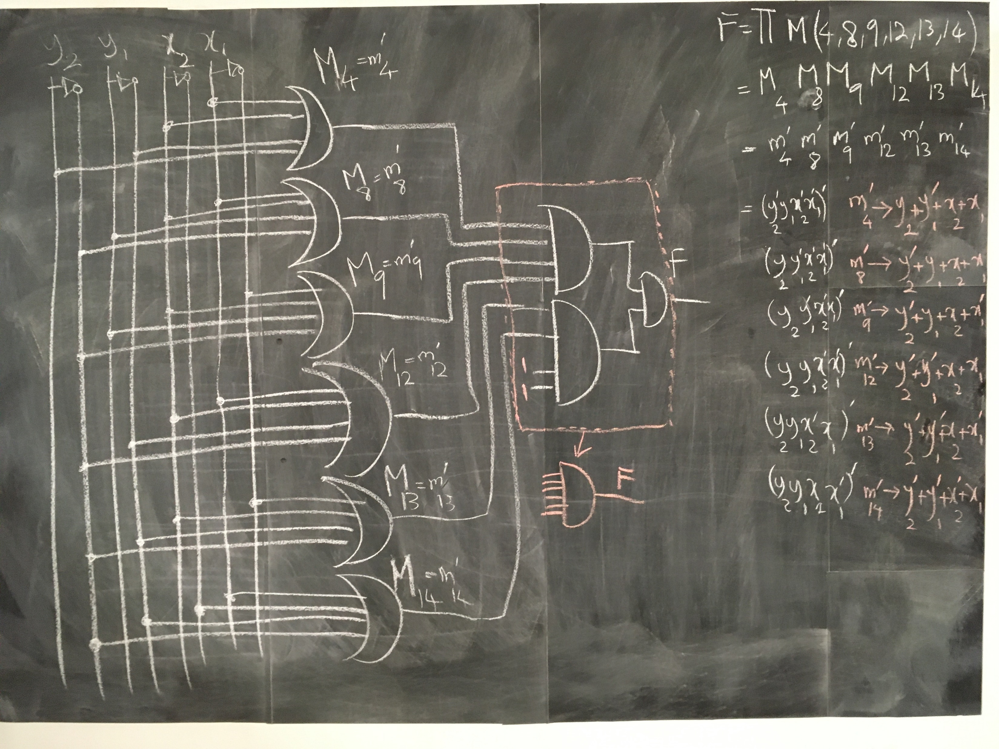

Slide 75
 |  | X₂X₁
 |  | 00 | 01 | 11 | 10
Y₂Y₁ | 00 | 1 | 1 | 1 | 1
 | 01 | 0 | 1 | 1 | 1
 | 11 | 0 | 0 | 1 | 0
 | 10 | 0 | 0 | 1 | 1
m₀ | m₁ | m₃ | m₂
m₄ | m₅ | m₇ | m₆
m₁₂ | m₁₃ | m₁₅ | m₁₄
m₈ | m₉ | m₁₁ | m₁₀
F(Y₂,Y₁,X₂,X₁)=𝚺 m(0,1,2,3,5,6,7,10,11,15)
F(Y₂,Y₁,X₂,X₁)=𝚷 M(4,8,9,12,13,14)

Slide 76
 |  | X₂X₁
 |  | 00 | 01 | 11 | 10
Y₂Y₁ | 00 | 1 | 1 | 1 | 1
 | 01 | 0 | 1 | 1 | 1
 | 11 | 0 | 0 | 1 | 0
 | 10 | 0 | 0 | 1 | 1
m₀ | m₁ | m₃ | m₂
m₄ | m₅ | m₇ | m₆
m₁₂ | m₁₃ | m₁₅ | m₁₄
m₈ | m₉ | m₁₁ | m₁₀
F(Y₂,Y₁,X₂,X₁)=𝚺 m(0,1,2,3,5,6,7,10,11,15)
F(Y2,Y1,X2,X1)=Y’₂Y’₁ +

Slide 77
 |  | X₂X₁
 |  | 00 | 01 | 11 | 10
Y₂Y₁ | 00 | 1 | 1 | 1 | 1
 | 01 | 0 | 1 | 1 | 1
 | 11 | 0 | 0 | 1 | 0
 | 10 | 0 | 0 | 1 | 1
m₀ | m₁ | m₃ | m₂
m₄ | m₅ | m₇ | m₆
m₁₂ | m₁₃ | m₁₅ | m₁₄
m₈ | m₉ | m₁₁ | m₁₀
F(Y₂,Y₁,X₂,X₁)=𝚺 m(0,1,2,3,5,6,7,10,11,15)
F(Y2,Y1,X2,X1)= Y’₂Y’₁ + X₂X₁

Slide 78
 |  | X₂X₁
 |  | 00 | 01 | 11 | 10
Y₂Y₁ | 00 | 1 | 1 | 1 | 1
 | 01 | 0 | 1 | 1 | 1
 | 11 | 0 | 0 | 1 | 0
 | 10 | 0 | 0 | 1 | 1
m₀ | m₁ | m₃ | m₂
m₄ | m₅ | m₇ | m₆
m₁₂ | m₁₃ | m₁₅ | m₁₄
m₈ | m₉ | m₁₁ | m₁₀
F(Y₂,Y₁,X₂,X₁)=𝚺 m(0,1,2,3,5,6,7,10,11,15)
F(Y2,Y1,X2,X1)= Y’₂Y’₁ + X₂X₁ + Y’₂X₁

Slide 79
 |  | X₂X₁
 |  | 00 | 01 | 11 | 10
Y₂Y₁ | 00 | 1 | 1 | 1 | 1
 | 01 | 0 | 1 | 1 | 1
 | 11 | 0 | 0 | 1 | 0
 | 10 | 0 | 0 | 1 | 1
m₀ | m₁ | m₃ | m₂
m₄ | m₅ | m₇ | m₆
m₁₂ | m₁₃ | m₁₅ | m₁₄
m₈ | m₉ | m₁₁ | m₁₀
F(Y₂,Y₁,X₂,X₁)=𝚺 m(0,1,2,3,5,6,7,10,11,15)
F(Y2,Y1,X2,X1)= Y’₂Y’₁ + X₂X₁ + Y’₂X₁ + Y’₂X₂

Slide 80
 |  | X₂X₁
 |  | 00 | 01 | 11 | 10
Y₂Y₁ | 00 | 1 | 1 | 1 | 1
 | 01 | 0 | 1 | 1 | 1
 | 11 | 0 | 0 | 1 | 0
 | 10 | 0 | 0 | 1 | 1
m₀ | m₁ | m₃ | m₂
m₄ | m₅ | m₇ | m₆
m₁₂ | m₁₃ | m₁₅ | m₁₄
m₈ | m₉ | m₁₁ | m₁₀
F(Y₂,Y₁,X₂,X₁)=𝚺 m(0,1,2,3,5,6,7,10,11,15)
F(Y2,Y1,X2,X1)= Y’₂Y’₁ + X₂X₁ + Y’₂X₁ + Y’₂X₂ + Y’₁X₂

Slide 81
 |  | YX
 |  | 00 | 01 | 11 | 10
WZ | 00 | 1 | 1 | 1 | 1
 | 01 | 0 | 1 | 1 | 1
 | 11 | 0 | 0 | 1 | 0
 | 10 | 0 | 0 | 1 | 1
m₀ | m₁ | m₃ | m₂
m₄ | m₅ | m₇ | m₆
m₁₂ | m₁₃ | m₁₅ | m₁₄
m₈ | m₉ | m₁₁ | m₁₀
Change of Variable:
X1 → X
X2 → Y
Y1 → Z
Y2 → W
F(Y₂,Y₁,X₂,X₁)=𝚷 M(4,8,9,12,13,14)

Slide 82
 |  | YX
 |  | 00 | 01 | 11 | 10
WZ | 00 | 1 | 1 | 1 | 1
 | 01 | 0 | 1 | 1 | 1
 | 11 | 0 | 0 | 1 | 0
 | 10 | 0 | 0 | 1 | 1
m₀ | m₁ | m₃ | m₂
m₄ | m₅ | m₇ | m₆
m₁₂ | m₁₃ | m₁₅ | m₁₄
m₈ | m₉ | m₁₁ | m₁₀
Change of Variable:
X1 → X
X2 → Y
Y1 → Z
Y2 → W
F(Y₂,Y₁,X₂,X₁)=𝚷 M(4,8,9,12,13,14)
F(W,Z,Y,X)=()’

Slide 83
MAXTERMS

Slide 84
 |  | YX
 |  | 00 | 01 | 11 | 10
WZ | 00 | 1 | 1 | 1 | 1
 | 01 | 0 | 1 | 1 | 1
 | 11 | 0 | 0 | 1 | 0
 | 10 | 0 | 0 | 1 | 1
m₀ | m₁ | m₃ | m₂
m₄ | m₅ | m₇ | m₆
m₁₂ | m₁₃ | m₁₅ | m₁₄
m₈ | m₉ | m₁₁ | m₁₀
F(Y₂,Y₁,X₂,X₁)=𝚷 M(4,8,9,12,13,14)
F(W,Z,Y,X))=(WY’ + )’

Slide 85
 |  | YX
 |  | 00 | 01 | 11 | 10
WZ | 00 | 1 | 1 | 1 | 1
 | 01 | 0 | 1 | 1 | 1
 | 11 | 0 | 0 | 1 | 0
 | 10 | 0 | 0 | 1 | 1
m₀ | m₁ | m₃ | m₂
m₄ | m₅ | m₇ | m₆
m₁₂ | m₁₃ | m₁₅ | m₁₄
m₈ | m₉ | m₁₁ | m₁₀
F(Y₂,Y₁,X₂,X₁)=𝚷 M(4,8,9,12,13,14)
F(W,Z,Y,X))=(WY’ + ZY’X’ + )’

Slide 86
 |  | YX
 |  | 00 | 01 | 11 | 10
WZ | 00 | 1 | 1 | 1 | 1
 | 01 | 0 | 1 | 1 | 1
 | 11 | 0 | 0 | 1 | 0
 | 10 | 0 | 0 | 1 | 1
m₀ | m₁ | m₃ | m₂
m₄ | m₅ | m₇ | m₆
m₁₂ | m₁₃ | m₁₅ | m₁₄
m₈ | m₉ | m₁₁ | m₁₀
F(Y₂,Y₁,X₂,X₁)=𝚷 M(4,8,9,12,13,14)
F(W,Z,Y,X))=(WY’ + ZY’X’ + WZX’)’

Slide 87
 |  | YX
 |  | 00 | 01 | 11 | 10
WZ | 00 | 1 | 1 | 1 | 1
 | 01 | 0 | 1 | 1 | 1
 | 11 | 0 | 0 | 1 | 0
 | 10 | 0 | 0 | 1 | 1
m₀ | m₁ | m₃ | m₂
m₄ | m₅ | m₇ | m₆
m₁₂ | m₁₃ | m₁₅ | m₁₄
m₈ | m₉ | m₁₁ | m₁₀
F(Y₂,Y₁,X₂,X₁)=𝚷 M(4,8,9,12,13,14)
F(W,Z,Y,X))=(WY’ + ZY’X’ + WZX’)’
F(Y2,Y1,X2,X1)=(WY’)’ (ZY’X’)’ (WZX’)’
F(Y2,Y1,X2,X1)=(W’+Y) (Z’+Y+X)’ (W’+Z’+X)

Slide 88
5-Variable KARNAUGH MAP

Slide 89
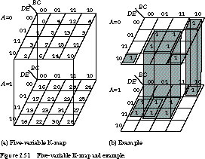

Slide 91
n-Variable KARNAUGH MAP

Slide 92
n-Variable
Quine–McCluskey Algorithm
https://en.wikipedia.org/wiki/Quine%E2%80%93McCluskey_algorithm
1878 ← 1937 ← 1952 ← 1956

Slide 93
Demo
Quine–McCluskey Algorithm
https://www.mathematik.uni-marburg.de/~thormae/lectures/ti1/code/qmc/

Slide 94
Don’t Care Conditions
In practice, in some applications the function is not specified for certain combinations of the variables.

Slide 95
Z | Y | X | F=if input is positive(2’s comp.) then 1 else 0
0 | 0 | 0 | ?
0 | 0 | 1 | ?
0 | 1 | 0 | ?
0 | 1 | 1 | ?
1 | 0 | 0 | ?
1 | 0 | 1 | ?
1 | 1 | 0 | ?
1 | 1 | 1 | ?

Slide 96
Z | Y | X | F=if input is positive(2’s comp.) then 1 else 0
0 | 0 | 0 | 0
0 | 0 | 1 | 1
0 | 1 | 0 | 1
0 | 1 | 1 | 1
1 | 0 | 0 | 0
1 | 0 | 1 | 0
1 | 1 | 0 | 0
1 | 1 | 1 | 0
In math, 0 is not positive neither negative!

Slide 97
Z | Y | X | F=∑m(1,2,3)=∏M(0,4,5,6,7)
0 | 0 | 0 | 0
0 | 0 | 1 | 1
0 | 1 | 0 | 1
0 | 1 | 1 | 1
1 | 0 | 0 | 0
1 | 0 | 1 | 0
1 | 1 | 0 | 0
1 | 1 | 1 | 0

Slide 98
 |  | YX
 |  | 00 | 01 | 11 | 10
Z | 0 | 0 | 1 | 1 | 1
 | 1 | 0 | 0 | 0 | 0
m₀ | m₁ | m₃ | m₂
m₄ | m₅ | m₇ | m₆
F (Z,Y,X) = ∑m(1, 2, 3)
F (W,Z,Y = Z’X + Z’Y
Boolean algebra → Z’(X+Y)

Slide 99
MAXTERMS

Slide 100
 |  | YX
 |  | 00 | 01 | 11 | 10
Z | 0 | 0 | 1 | 1 | 1
 | 1 | 0 | 0 | 0 | 0
m₀ | m₁ | m₃ | m₂
m₄ | m₅ | m₇ | m₆
F(Z,Y,X) = Π M(0,4,5,6,7)
FX.(Y,X) = (Z + Y’X’)’
F(X,Y,X) = Z’ (Y+X)

Slide 101
Z | Y | X | F=if positive(2’s comp.) then 1 if negative 0
0 | 0 | 0 | 0
0 | 0 | 1 | 1
0 | 1 | 0 | 1
0 | 1 | 1 | 1
1 | 0 | 0 | 0
1 | 0 | 1 | 0
1 | 1 | 0 | 0
1 | 1 | 1 | 0
In math, 0 is not positive neither negative!

Slide 102
Z | Y | X | F=if positive(2’s comp.) then 1 if negative 0
0 | 0 | 0 | ░
0 | 0 | 1 | 1
0 | 1 | 0 | 1
0 | 1 | 1 | 1
1 | 0 | 0 | 0
1 | 0 | 1 | 0
1 | 1 | 0 | 0
1 | 1 | 1 | 0

Slide 103
 |  | YX
 |  | 00 | 01 | 11 | 10
Z | 0 | ░ | 1 | 1 | 1
 | 1 | 0 | 0 | 0 | 0
m₀ | m₁ | m₃ | m₂
m₄ | m₅ | m₇ | m₆
F (Z,Y,X) = ∑m(1, 2, 3) + ∑d(0)
F (W,Z,Y = Z’X + Z’Y

Slide 104
 |  | YX
 |  | 00 | 01 | 11 | 10
Z | 0 | 1 | 1 | 1 | 1
 | 1 | 0 | 0 | 0 | 0
m₀ | m₁ | m₃ | m₂
m₄ | m₅ | m₇ | m₆
F (Z,Y,X) = ∑m(1, 2, 3) + ∑m(0)
F (W,Z,Y = Z’
In this case, the don’t care condition help to more simplification

Slide 105
MAXTERMS

Slide 106
 |  | YX
 |  | 00 | 01 | 11 | 10
Z | 0 | ░ | 1 | 1 | 1
 | 1 | 0 | 0 | 0 | 0
m₀ | m₁ | m₃ | m₂
m₄ | m₅ | m₇ | m₆
F(Z,Y,X) = Π M(4,5,6,7) + ∑D(0)
FX.(Y,X) = (Z)’
FX.(Y,X) = Z’

Slide 107
 |  | YX
 |  | 00 | 01 | 11 | 10
Z | 0 | 0 | 1 | 1 | 1
 | 1 | 0 | 0 | 0 | 0
m₀ | m₁ | m₃ | m₂
m₄ | m₅ | m₇ | m₆
F(Z,Y,X) = Π M(0,4,5,6,7) + ∑M(0)
FX.(Y,X) = (Z + Y’X’)’
F(X,Y,X) = Z’ (Y+X)
In this case, the don’t care condition does NOT help to more simplification

Slide 108
Don’t Care Conditions
Functions that have unspecified outputs for some input combinations are called incompletely specified functions.
Don’t-care conditions can be used on a map to provide further simplification of the Boolean expression.

Slide 109
Don’t Care Conditions
To distinguish the don’t-care condition from 1’s and 0’s, an X is used.
Notes:
Thus, an X inside a square in the map indicates that we don’t care
whether the value of 0 or 1 is assigned to F for the particular minterm.

Slide 110
 |  | YX
 |  | 00 | 01 | 11 | 10
Z | 0 | X | 1 | 1 | 1
 | 1 | 0 | 0 | 0 | 0
m₀ | m₁ | m₃ | m₂
m₄ | m₅ | m₇ | m₆
F (Z,Y,X) = ∑m(1, 2, 3) + ∑d(0)
F (Z,Y,X) = Π M(4,5,6,7) + ∑D(0)

