Slide 1


Sequential Logic

Slide 2
Only
Flip-Flop
Sequential
Logic
Flip-Flop
+
Inputs
Flip-Flop
+
Inputs
+
Outputs

Slide 3
Only
Flip-Flop
Sequential
Logic
Flip-Flop
+
Inputs
Flip-Flop
+
Inputs
+
Outputs

Slide 4
Only
Flip-Flop
Sequential
Logic
Flip-Flop
+
Inputs
Flip-Flop
+
Inputs
+
Outputs

Slide 5
Only
Flip-Flop
Sequential
Logic
Flip-Flop
+
Inputs
Flip-Flop
+
Inputs
+
Outputs

Slide 6
Analysis
vs.
Design

Slide 7
Analysis: Given a sequential circuit, show the behavior
vs.
Design: Given a behavior, build the sequential circuit

Slide 8
Flip-Flop
+
Inputs
+
Outputs
Sequential
Logic
Mealy Model
Moore Model

Slide 9
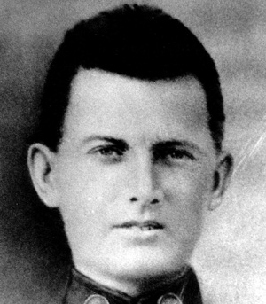
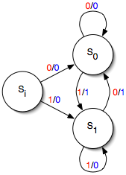
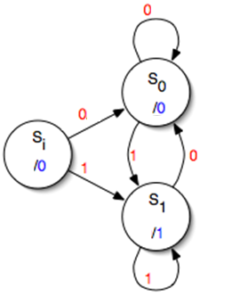

George H. Mealy
(1927 – 2010)
Mathematician and Computer Scientist
Invented Mealy Machine
Also a pioneer of modular programming
Outputs = Function(Current State, Inputs)
Edward Forrest Moore
(1925 – 2003)
Mathematician and Computer Scientist
Inventor of the Moore Machine
Also an early pioneer of artificial life
Outputs = Function(Current State, Inputs)

Slide 10
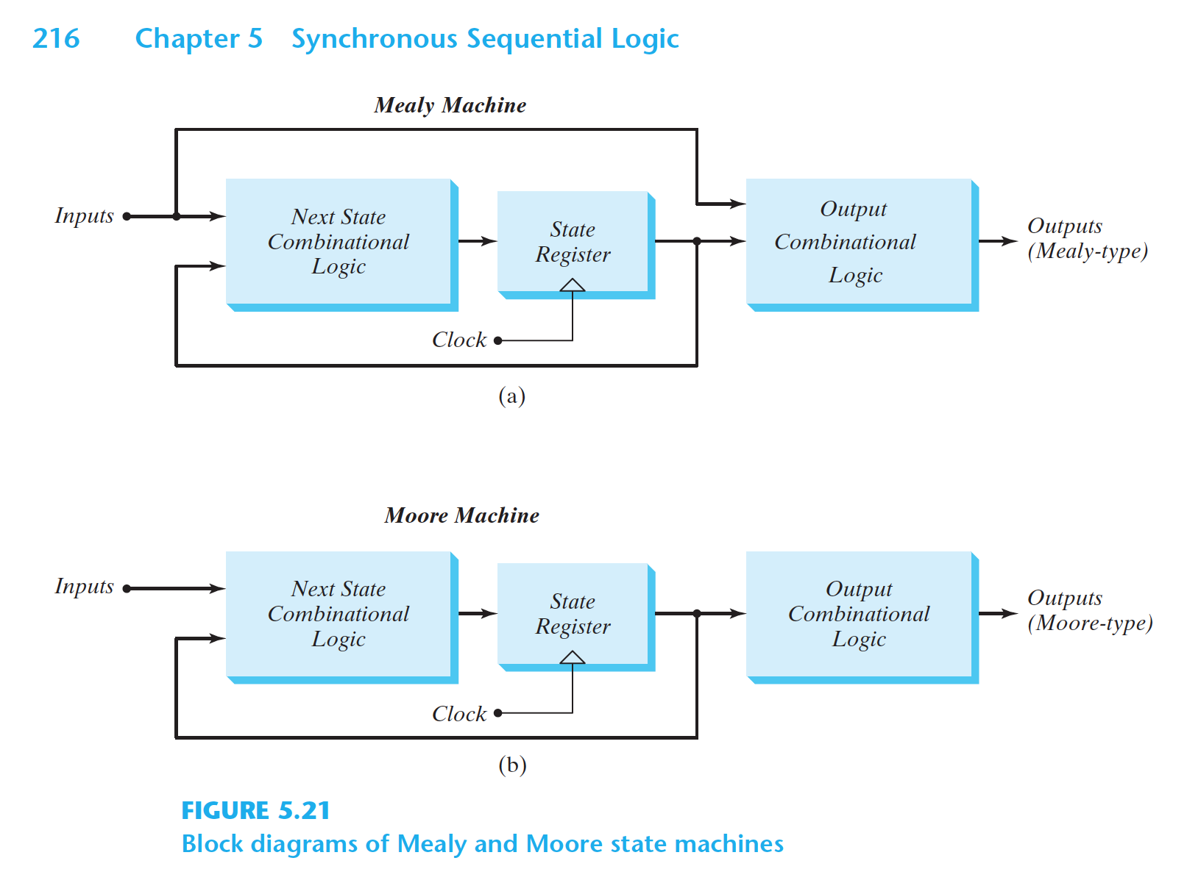

Slide 12
Flip-Flop
+
Inputs
+
Outputs
Sequential
Logic
Mealy Model
Moore Model

Slide 13
Analysis (Moore model in output)
by an example

Slide 14
Analysis (Recap)
0. Is the circuit sequential or combinational? Any FF or feedback → Sequential
1. What are the flip-flops? RS, D, T, JK, or mixed (e.g., 2 JK, 1 RS, …)
2. What are the state combinations? 2^{#FF}
3. Form “State” table:
a) Columns: for each FF, two columns:
one for current state,
one for next state
b) Rows: for each state combination
In total: 2^{#FF}
4. Fill the state table for next state columns based on:
the current state
the inputs to the FFs
5. Form State Transition Diagram
6. (Optional) Analyze paths and states in state transition diagram

Slide 15
Analysis (+ Input + Moore Model Output)
0. Is the circuit sequential or combinational? Any FF or feedback → Sequential
1. What are the flip-flops? RS, D, T, JK, or mixed (e.g., 2 JK, 1 RS, …)
2. What are the state combinations? 2^{#FF}
3. Form “State” table:
a) Columns: for each FF, two columns:
one for current state,
one for next state
b) Rows: for each state combination
In total: 2^{#FF}
4. Fill the state table for next state columns based on:
the current state
the inputs to the FFs
5. Form State Transition Diagram
6. (Optional) Analyze paths and states in state transition diagram

Slide 16
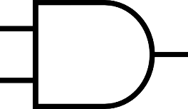

X
T
J
K
Clk
Clk
Clk
F

Slide 17
Analysis (Recap)
0. Is the circuit sequential or combinational? Any FF or feedback → Sequential

Slide 18
Analysis (Recap)
0. Is the circuit sequential or combinational? Sequential
1. What are the flip-flops?

Slide 19
X
T
J
K
Clk
Clk
Clk
F

Slide 20
Analysis (Recap)
0. Is the circuit sequential or combinational? Sequential
1. What are the flip-flops? T, JK
2. What are the state combinations?

Slide 21
X
T
J
K
Clk
Clk
Clk
F
#FFs + #Inputs = 2+1 → 2³ = 8 combinations

Slide 22
Analysis (Recap)
0. Is the circuit sequential or combinational? Sequential
1. What are the flip-flops? T, JK
2. What are the state combinations? 2^{#FF} × 2^{#inputs} = 2^{#FF+#inputs} = 2³ = 8
3. Form “State” table:
a) Columns:
For each FF, two columns: one for current state, one for next state
For each input, one column
For each output, one column
b) Rows: See item 2

Slide 23
X
B
A
T
J
K
Clk
Clk
Clk
F
Inputs | Q(T) |  | Q(T+1) |  | Outputs
X | B | A | B | A | F

Slide 24
X
B
A
T
J
K
Clk
Clk
Clk
F
Q(T) |  | Q(T+1) when X=0 |  | Q(T+1) when X=1 |  | Outputs
B | A | B | A | B | A | F
Moore model:
does not depend on X
Alternative State Table

Slide 25
Analysis (Recap)
0. Is the circuit sequential or combinational? Sequential
1. What are the flip-flops? T, JK
2. What are the state combinations? 2^{#FF} × 2^{#inputs} = 2^{#FF+#inputs} = 2³ = 8
3. Form “State” table:
a) Columns:
For each FF, two columns: one for current state, one for next state
For each input, one column
For each output, one column
b) Rows: See item 2
4. Fill the state table for
a) next state columns
b) the output value

Slide 26
X
B
A
T
J
K
Clk
Clk
Clk
F
Inputs | Q(T) |  | Q(T+1) |  | Outputs
X | B | A | B | A | F=BA
0 | 0 | 0
0 | 0 | 1
0 | 1 | 0
0 | 1 | 1
1 | 0 | 0
1 | 0 | 1
1 | 1 | 0
1 | 1 | 1

Slide 27
X
B
A
T
J
K
Clk
Clk
Clk
F
Inputs | Q(T) |  | Q(T+1) |  | Outputs
X | B | A | B | A | F=BA
0 | 0 | 0 |  |  | 0
0 | 0 | 1 |  |  | 0
0 | 1 | 0 |  |  | 0
0 | 1 | 1 |  |  | 1
1 | 0 | 0 |  |  | 0
1 | 0 | 1 |  |  | 0
1 | 1 | 0 |  |  | 0
1 | 1 | 1 |  |  | 1
Moore Model
Only depends on current state
X is not involved!

Slide 28
X
B
A
T
J
K
Clk
Clk
Clk
F
Inputs | Q(T) |  | Q(T+1) |  | Outputs
X | B | A | B | A | F=BA
0 | 0 | 0 |  |  | 0
0 | 0 | 1 |  |  | 0
0 | 1 | 0 |  |  | 0
0 | 1 | 1 |  |  | 1
1 | 0 | 0 |  |  | 0
1 | 0 | 1 |  |  | 0
1 | 1 | 0 |  |  | 0
1 | 1 | 1 |  |  | 1

Slide 29
X
B
A
T
J
K
Clk
Clk
Clk
F
Inputs | Q(T) |  | Q(T+1) |  | Outputs
X | B | A | B | A | F=BA
0 | 0 | 0 |  | A=0 J_{A}=XB=00=0 K_{A}=B’=0’=1 -------------- Reset → 0 | 0
0 | 0 | 1 |  |  | 0
0 | 1 | 0 |  |  | 0
0 | 1 | 1 |  |  | 1
1 | 0 | 0 |  |  | 0
1 | 0 | 1 |  |  | 0
1 | 1 | 0 |  |  | 0
1 | 1 | 1 |  |  | 1

Slide 30
X
B
A
T
J
K
Clk
Clk
Clk
F
Inputs | Q(T) |  | Q(T+1) |  | Outputs
X | B | A | B | A | F=BA
0 | 0 | 0 | B=0 T_{B}=XA=00=0 -------------- Store → 0 | 0 | 0
0 | 0 | 1 |  |  | 0
0 | 1 | 0 |  |  | 0
0 | 1 | 1 |  |  | 1
1 | 0 | 0 |  |  | 0
1 | 0 | 1 |  |  | 0
1 | 1 | 0 |  |  | 0
1 | 1 | 1 |  |  | 1

Slide 31
X
B
A
T
J
K
Clk
Clk
Clk
F
Inputs | Q(T) |  | Q(T+1) |  | Outputs
X | B | A | B | A | F=BA
0 | 0 | 0 | 0 | 0 | 0
0 | 0 | 1 |  |  | 0
0 | 1 | 0 |  |  | 0
0 | 1 | 1 |  |  | 1
1 | 0 | 0 |  |  | 0
1 | 0 | 1 |  |  | 0
1 | 1 | 0 |  |  | 0
1 | 1 | 1 |  |  | 1

Slide 32
X
B
A
T
J
K
Clk
Clk
Clk
F
Inputs | Q(T) |  | Q(T+1) |  | Outputs
X | B | A | B | A | F=BA
0 | 0 | 0 | 0 | 0 | 0
0 | 0 | 1 | 0 | 0 | 0
0 | 1 | 0 | 1 | 0 | 0
0 | 1 | 1 | 1 | 1 | 1
1 | 0 | 0 | 0 | 0 | 0
1 | 0 | 1 | ? | 0 | 0
1 | 1 | 0 | 1 | 1 | 0
1 | 1 | 1 | 0 | 1 | 1

Slide 33
X
B
A
T
J
K
Clk
Clk
Clk
F
Inputs | Q(T) |  | Q(T+1) |  | Outputs
X | B | A | B | A | F=BA
0 | 0 | 0 | 0 | 0 | 0
0 | 0 | 1 | 0 | 0 | 0
0 | 1 | 0 | 1 | 0 | 0
0 | 1 | 1 | 1 | 1 | 1
1 | 0 | 0 | 0 | 0 | 0
1 | 0 | 1 | B=0 TB=XA=11=1 --------- Comp. → 1 | 0 | 0
1 | 1 | 0 | 1 | 1 | 0
1 | 1 | 1 | 0 | 1 | 1

Slide 34
X
B
A
T
J
K
Clk
Clk
Clk
F
Inputs | Q(T) |  | Q(T+1) |  | Outputs
X | B | A | B | A | F=BA
0 | 0 | 0 | 0 | 0 | 0
0 | 0 | 1 | 0 | 0 | 0
0 | 1 | 0 | 1 | 0 | 0
0 | 1 | 1 | 1 | 1 | 1
1 | 0 | 0 | 0 | 0 | 0
1 | 0 | 1 | 1 | 0 | 0
1 | 1 | 0 | 1 | 1 | 0
1 | 1 | 1 | 0 | 1 | 1

Slide 35
Analysis (Recap)
0. Is the circuit sequential or combinational? Sequential
1. What are the flip-flops? T, JK
2. What are the state combinations? 2^{#FF} × 2^{#inputs} = 2^{#FF+#inputs} = 2³ = 8
3. Form “State” table:
a) Columns:
For each FF, two columns: one for current state, one for next state
For each input, one column
For each output, one column
b) Rows: See item 2
4. Fill the state table for
a) next state columns
b) the output value
5. Form state (transition) diagram
a) nodes for states, directed edges for transitions between states
b) labels for edges by the value of input
c) labels for nodes by the value of output

Slide 36
1
BA
00
0
Labels on edges based on value of X
0
01
1
X
10
0
1
1
11
0

Slide 37
1
00
/0
0
Labels on nodes based on value of F
0
01
/0
BA
/F
1
10
/0
0
1
1
11
/1
0

Slide 38
Analysis
6) (Optional) Path on State Transitions

Slide 39
Life lock!
1
00
/0
0
0
01
/0
1
10
/0
0
1
1
11
/1
0

Slide 40
Synchronization

Slide 41
BA
X
1
00
/0
0
0
B
A
01
/0
T
J
1
K
10
/0
0
Clk
Clk
Clk
1
1
F
11
/1
0
Voltage
Clk
X
A
B
F
Time

Slide 42
Asynchronized

Slide 43
X
T
J
K
Clk
Clk
Clk
F
Mealy Model
F depends on X

Slide 44
X
T
J
K
Clk
Clk
Clk
F
Mealy Model
F depends on X, so, F can change out of Clk synchronization!

Slide 45
X
B
A
T
J
K
Clk
Clk
Clk
F
Inputs | Q(T) |  | Q(T+1) |  | Outputs
X | B | A | B | A | F=XBA
0 | 0 | 0 | 0 | 0 | 0
0 | 0 | 1 | 1 | 0 | 0
0 | 1 | 0 | 1 | 0 | 0
0 | 1 | 1 | 1 | 1 | 0
1 | 0 | 0 | 0 | 0 | 0
1 | 0 | 1 | 1 | 0 | 0
1 | 1 | 0 | 1 | 1 | 0
1 | 1 | 1 | 0 | 1 | 1

Slide 46
1/0
00
0/0
Labels go on edges
for F:
X/F
0/0
01
1/0
10
0/0
1/0
1/1
11
0/0

Slide 47
Only
Flip-Flop
Sequential
Logic
Flip-Flop
+
Inputs
Flip-Flop
+
Inputs
+
Outputs

Slide 48
Design
by an example

Slide 49
Counter Up-Down
Switch to count up from i to i+1
Switch to count down from i to i-1
Turn on the light if the current number is even

Slide 50
Design (Recap)
0. Do we need combinational logic or sequential logic? Do we need memory?

Slide 51
Counter up/down
0 → 1 → 2 → 3 → … → N-1 → N
N → N-1 → … → 3 → 2 → 1 → 0

Slide 52
Design (Recap)
0. Do we need combinational logic or sequential logic? Do we need memory?
1. How many storage (flip-flops)? #FF

Slide 53
Counter up/down
N=7
000→001→010→011→100→101→110→111
000←001←010←011←100←101←110←111
For each intermediate state, we need 3 bits → 3 flip-flops

Slide 54
Design (Recap)
0. Do we need combinational logic or sequential logic? Do we need memory?
1. How many storage (flip-flops)? #FF
2. How many input and output?

Slide 55
Counter up/down
N=7
000→001→010→011→100→101→110→111
000←001←010←011←100←101←110←111
We need to switch between up and down → 1 binary variable
X=0 Count Up
X=1 Count Down

Slide 56
Counter up/down
N=7
X=0: 000→001→010→011→100→101→110→111
X=1: 111→110→101→100→011→010→001→000
We need to turn on the light when the number is even
→ 1 binary variable → F

Slide 57
Design (Recap)
0. Do we need combinational logic or sequential logic? Do we need memory?
How many storage (flip-flops)? #FF
2. How many input and output?
3. Form the state (transition) diagram

Slide 58
000
0
001
0
010
0
011
0
100
0
101
0
0
110
Count Up
X=0
0
111

Slide 59
000
1
001
1
010
1
1
011
1
100
1
101
1
110
Count Down
X=1
1
111

Slide 60
000
1
0
001
1
0
010
1
1
0
011
1
0
100
1
0
101
0
1
0
110
1
0
111

Slide 61
000
/1
1
0
F=1 : even
F=0 : else
Moore model
001
/0
1
0
010
/1
1
1
0
011
/0
1
0
100
/1
1
0
101
/0
0
1
0
110
/1
1
0
111
/0

Slide 62
Design (Recap)
0. Do we need combinational logic or sequential logic? Do we need memory?
1. How many storage (flip-flops)? #FF
2. How many input and output?
3. Form the state (transition) diagram
4. Form the state table
5. Fill the state table

Slide 63
Inputs | Q(T) |  |  | Q(T+1) |  |  | Outputs
X | C | B | A | C | B | A | F
0 | 0 | 0 | 0 | 0 | 0 | 1
0 | 0 | 0 | 1 | 0 | 1 | 0
0 | 0 | 1 | 0 | 0 | 1 | 1
0 | 0 | 1 | 1 | 1 | 0 | 0
0 | 1 | 0 | 0 | 1 | 0 | 1
0 | 1 | 0 | 1 | 1 | 1 | 0
0 | 1 | 1 | 0 | 1 | 1 | 1
0 | 1 | 1 | 1 | 0 | 0 | 0
1 | 0 | 0 | 0 | 1 | 1 | 1
1 | 0 | 0 | 1 | 0 | 0 | 0
1 | 0 | 1 | 0 | 0 | 0 | 1
1 | 0 | 1 | 1 | 0 | 1 | 0
1 | 1 | 0 | 0 | 0 | 1 | 1
1 | 1 | 0 | 1 | 1 | 0 | 0
1 | 1 | 1 | 0 | 1 | 0 | 1
1 | 1 | 1 | 1 | 1 | 1 | 0
Count Up
X=0
Count Down
X=1

Slide 64
Inputs | Q(T) |  |  | Q(T+1) |  |  | Outputs
X | C | B | A | C | B | A | F
0 | 0 | 0 | 0 | 0 | 0 | 1 | 1
0 | 0 | 0 | 1 | 0 | 1 | 0 | 0
0 | 0 | 1 | 0 | 0 | 1 | 1 | 1
0 | 0 | 1 | 1 | 1 | 0 | 0 | 0
0 | 1 | 0 | 0 | 1 | 0 | 1 | 1
0 | 1 | 0 | 1 | 1 | 1 | 0 | 0
0 | 1 | 1 | 0 | 1 | 1 | 1 | 1
0 | 1 | 1 | 1 | 0 | 0 | 0 | 0
1 | 0 | 0 | 0 | 1 | 1 | 1 | 1
1 | 0 | 0 | 1 | 0 | 0 | 0 | 0
1 | 0 | 1 | 0 | 0 | 0 | 1 | 1
1 | 0 | 1 | 1 | 0 | 1 | 0 | 0
1 | 1 | 0 | 0 | 0 | 1 | 1 | 1
1 | 1 | 0 | 1 | 1 | 0 | 0 | 0
1 | 1 | 1 | 0 | 1 | 0 | 1 | 1
1 | 1 | 1 | 1 | 1 | 1 | 0 | 0
F depends only on current state of
CBA

Slide 65
Inputs | Q(T) |  |  | Q(T+1) |  |  | Outputs
X | C | B | A | C | B | A | F
0 | 0 | 0 | 0 | 0 | 0 | 1 | 1
0 | 0 | 0 | 1 | 0 | 1 | 0 | 0
0 | 0 | 1 | 0 | 0 | 1 | 1 | 1
0 | 0 | 1 | 1 | 1 | 0 | 0 | 0
0 | 1 | 0 | 0 | 1 | 0 | 1 | 1
0 | 1 | 0 | 1 | 1 | 1 | 0 | 0
0 | 1 | 1 | 0 | 1 | 1 | 1 | 1
0 | 1 | 1 | 1 | 0 | 0 | 0 | 0
1 | 0 | 0 | 0 | 1 | 1 | 1 | 1
1 | 0 | 0 | 1 | 0 | 0 | 0 | 0
1 | 0 | 1 | 0 | 0 | 0 | 1 | 1
1 | 0 | 1 | 1 | 0 | 1 | 0 | 0
1 | 1 | 0 | 0 | 0 | 1 | 1 | 1
1 | 1 | 0 | 1 | 1 | 0 | 0 | 0
1 | 1 | 1 | 0 | 1 | 0 | 1 | 1
1 | 1 | 1 | 1 | 1 | 1 | 0 | 0

Slide 66
Design (Recap)
0. Do we need combinational logic or sequential logic? Do we need memory?
1. How many storage (flip-flops)? #FF
2. How many input and output?
3. Form the state (transition) diagram
4. Form the state table
5. Fill the state table
6. What type of storage (flip-flop)? RS, D, T, JK, or Mixed

Slide 67
Counter Up/Down
Let’s pick mix FFs: 1×T-FF, 1×D-FF, 1×JK-FF

Slide 68
X
T
D
C
B
A
J
K
Clk
F

Slide 69
Design (Recap)
0. Do we need combinational logic or sequential logic? Do we need memory?
1. How many storage (flip-flops)? #FF
2. How many input and output?
3. Form the state (transition) diagram
4. Form the state table
5. Fill the state table
6. What type of storage (flip-flop)? RS, D, T, JK, or Mixed
7. Input (excitation) equations for each FF
8. Minimization of input (excitation) equations

Slide 70
Excitation Equations
A | J_{A}=F(X, C, B, A) | K_{A}=F(X, C, B, A)
B | D_{B}=F(X, C, B, A)
C | T_{C}=F(X, C, B, A)
Flip-Flops
Input

Slide 71
Excitation Equations
A | J_{A}=F(X, C, B, A) | K_{A}=F(X, C, B, A)
B | D_{B}=
C | T_{C}=

Slide 72
Inputs | Q(T) |  |  | Q(T+1) |  |  | Outputs | Excitation for A
X | C | B | A | C | B | A | F | Action | J_{A} | K_{A}
0 | 0 | 0 | 0 | 0 | 0 | 1 | 1 | Set/Cmp | 1 | X
0 | 0 | 0 | 1 | 0 | 1 | 0 | 0 | Rst/Cmp | X | 1
0 | 0 | 1 | 0 | 0 | 1 | 1 | 1 | Set/Cmp | 1 | X
0 | 0 | 1 | 1 | 1 | 0 | 0 | 0 | Rst/Cmp | X | 1
0 | 1 | 0 | 0 | 1 | 0 | 1 | 1 | Set/Cmp | 1 | X
0 | 1 | 0 | 1 | 1 | 1 | 0 | 0 | Rst/Cmp | X | 1
0 | 1 | 1 | 0 | 1 | 1 | 1 | 1 | Set/Cmp | 1 | X
0 | 1 | 1 | 1 | 0 | 0 | 0 | 0 | Rst/Cmp | X | 1
1 | 0 | 0 | 0 | 1 | 1 | 1 | 1 | Set/Cmp | 1 | X
1 | 0 | 0 | 1 | 0 | 0 | 0 | 0 | Rst/Cmp | X | 1
1 | 0 | 1 | 0 | 0 | 0 | 1 | 1 | Set/Cmp | 1 | X
1 | 0 | 1 | 1 | 0 | 1 | 0 | 0 | Rst/Cmp | X | 1
1 | 1 | 0 | 0 | 0 | 1 | 1 | 1 | Set/Cmp | 1 | X
1 | 1 | 0 | 1 | 1 | 0 | 0 | 0 | Rst/Cmp | X | 1
1 | 1 | 1 | 0 | 1 | 0 | 1 | 1 | Set/Cmp | 1 | X
1 | 1 | 1 | 1 | 1 | 1 | 0 | 0 | Rst/Cmp | X | 1

Slide 73
Excitation Equations
A | J_{A}=∑(0,2,4,6,8,10,12,14)+d(1,3,5,7,9,11,13,15) | K_{A}=∑(1,3,5,7,9,11,13,15)+d(0,2,4,6,8,10,12,14)
B | D_{B}=
C | T_{C}=

Slide 74
Inputs | Q(T) |  |  | Q(T+1) |  |  | Outputs | Excitation for B
X | C | B | A | C | B | A | F | Action | D_{B}
0 | 0 | 0 | 0 | 0 | 0 | 1 | 1 | Rst | 0
0 | 0 | 0 | 1 | 0 | 1 | 0 | 0 | Set | 1
0 | 0 | 1 | 0 | 0 | 1 | 1 | 1 | Set | 1
0 | 0 | 1 | 1 | 1 | 0 | 0 | 0 | Rst | 0
0 | 1 | 0 | 0 | 1 | 0 | 1 | 1 | Rst | 0
0 | 1 | 0 | 1 | 1 | 1 | 0 | 0 | Set | 1
0 | 1 | 1 | 0 | 1 | 1 | 1 | 1 | Set | 1
0 | 1 | 1 | 1 | 0 | 0 | 0 | 0 | Rst | 0
1 | 0 | 0 | 0 | 1 | 1 | 1 | 1 | Set | 1
1 | 0 | 0 | 1 | 0 | 0 | 0 | 0 | Rst | 0
1 | 0 | 1 | 0 | 0 | 0 | 1 | 1 | Rst | 0
1 | 0 | 1 | 1 | 0 | 1 | 0 | 0 | Set | 1
1 | 1 | 0 | 0 | 0 | 1 | 1 | 1 | Set | 1
1 | 1 | 0 | 1 | 1 | 0 | 0 | 0 | Rst | 0
1 | 1 | 1 | 0 | 1 | 0 | 1 | 1 | Rst | 0
1 | 1 | 1 | 1 | 1 | 1 | 0 | 0 | Set | 1

Slide 75
Excitation Equations
A | J_{A}=∑(0,2,4,6,8,10,12,14)+d(1,3,5,7,9,11,13,15) | K_{A}=∑(1,3,5,7,9,11,13,15)+d(0,2,4,6,8,10,12,14)
B | D_{B}=∑(1,2,5,6,8,11,12,15) Never “don’t care condition” happens in D-FF
C | T_{C}=

Slide 76
Inputs | Q(T) |  |  | Q(T+1) |  |  | Outputs | Excitation for C
X | C | B | A | C | B | A | F | Action | T_{C}
0 | 0 | 0 | 0 | 0 | 0 | 1 | 1 | Store | 0
0 | 0 | 0 | 1 | 0 | 1 | 0 | 0 | Store | 0
0 | 0 | 1 | 0 | 0 | 1 | 1 | 1 | Store | 0
0 | 0 | 1 | 1 | 1 | 0 | 0 | 0 | Comp | 1
0 | 1 | 0 | 0 | 1 | 0 | 1 | 1 | Store | 0
0 | 1 | 0 | 1 | 1 | 1 | 0 | 0 | Store | 0
0 | 1 | 1 | 0 | 1 | 1 | 1 | 1 | Store | 0
0 | 1 | 1 | 1 | 0 | 0 | 0 | 0 | Comp | 1
1 | 0 | 0 | 0 | 1 | 1 | 1 | 1 | Comp | 1
1 | 0 | 0 | 1 | 0 | 0 | 0 | 0 | Store | 0
1 | 0 | 1 | 0 | 0 | 0 | 1 | 1 | Store | 0
1 | 0 | 1 | 1 | 0 | 1 | 0 | 0 | Store | 0
1 | 1 | 0 | 0 | 0 | 1 | 1 | 1 | Comp | 1
1 | 1 | 0 | 1 | 1 | 0 | 0 | 0 | Store | 0
1 | 1 | 1 | 0 | 1 | 0 | 1 | 1 | Store | 0
1 | 1 | 1 | 1 | 1 | 1 | 0 | 0 | Store | 0

Slide 77
Excitation Equations
A | J_{A}=∑(0,2,4,6,8,10,12,14)+d(1,3,5,7,9,11,13,15) | K_{A}=∑(1,3,5,7,9,11,13,15)+d(0,2,4,6,8,10,12,14)
B | D_{B}=∑(1,2,5,6,8,11,12,15) Never “don’t care condition” happens in D-FF
C | T_{C}=∑(3,7,8,12) Never “don’t care condition” happens in T-FF

Slide 78
Minimization for excitation equations
?-Variable K-Map

Slide 79
Excitation Equations
A | J_{A}=∑(0,2,4,6,8,10,12,14)+d(1,3,5,7,9,11,13,15) | K_{A}=∑(1,3,5,7,9,11,13,15)+d(0,2,4,6,8,10,12,14)
B | D_{B}=∑(1,2,5,6,8,11,12,15) Never “don’t care condition” happens in D-FF
C | T_{C}=∑(3,7,8,12) Never “don’t care condition” happens in T-FF
Minimization
4-Variable K-Map
F(X, C, B, A)

Slide 80
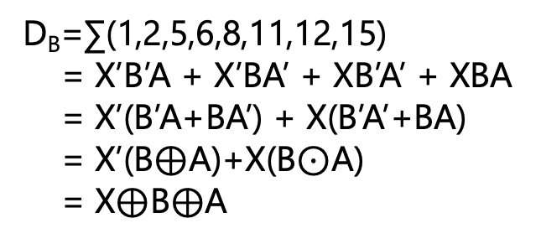
 |  | BA
 |  | 00 | 01 | 11 | 10
XC | 00 | m₀ | m₁ | m₃ | m₂
 | 01 | m₄ | m₅ | m₇ | m₆
 | 11 | m₁₂ | m₁₃ | m₁₅ | m₁₄
 | 10 | m₈ | m₉ | m₁₁ | m₁₀
1 | X | X | 1
1 | X | X | 1
1 | X | X | 1
1 | X | X | 1
 |  | BA
 |  | 00 | 01 | 11 | 10
XC | 00 | m₀ | m₁ | m₃ | m₂
 | 01 | m₄ | m₅ | m₇ | m₆
 | 11 | m₁₂ | m₁₃ | m₁₅ | m₁₄
 | 10 | m₈ | m₉ | m₁₁ | m₁₀
 |  | BA
 |  | 00 | 01 | 11 | 10
XC | 00 | m₀ | m₁ | m₃ | m₂
 | 01 | m₄ | m₅ | m₇ | m₆
 | 11 | m₁₂ | m₁₃ | m₁₅ | m₁₄
 | 10 | m₈ | m₉ | m₁₁ | m₁₀
0 | 0 | 1 | 0
0 | 0 | 1 | 0
1 | 0 | 0 | 0
1 | 0 | 0 | 0
0 | 1 | 0 | 1
0 | 1 | 0 | 1
1 | 0 | 1 | 0
1 | 0 | 1 | 0
J_{A}=∑(0,2,4,6,8,10,12,14)+
d(1,3,5,7,9,11,13,15) = 1
 |  | BA
 |  | 00 | 01 | 11 | 10
XC | 00 | m₀ | m₁ | m₃ | m₂
 | 01 | m₄ | m₅ | m₇ | m₆
 | 11 | m₁₂ | m₁₃ | m₁₅ | m₁₄
 | 10 | m₈ | m₉ | m₁₁ | m₁₀
T_{C}=∑(3,7,8,12)
= X’BA + XB’A’
D_{B}=∑(1,2,5,6,8,11,12,15)
= X’B’A + X’BA’ + XB’A’ + XBA
= X’(B’A+BA’) + X(B’A’+BA)
= X’(B$⊕$A)+X(B$⊙$A)
= X$⊕$B$⊕$A
X | 1 | 1 | X
X | 1 | 1 | X
X | 1 | 1 | X
X | 1 | 1 | X
K_{A}=∑(1,3,5,7,9,11,13,15)+
d(0,2,4,6,8,10,12,14) = 1

Slide 81
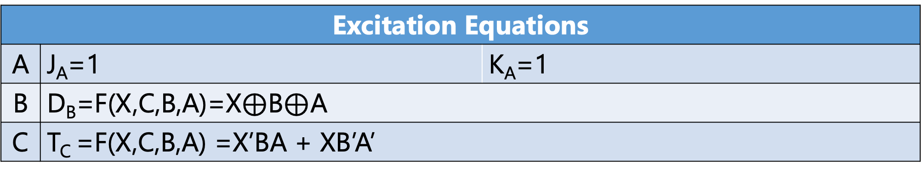
Excitation Equations
A | J_{A}=1 | K_{A}=1
B | D_{B}=F(X,C,B,A)=X$⊕$B$⊕$A
C | T_{C} =F(X,C,B,A) =X’BA + XB’A’

Slide 82
Design (Recap)
0. Do we need combinational logic or sequential logic? Do we need memory?
1. How many storage (flip-flops)? #FF
2. How many input and output?
3. Form the state (transition) diagram
4. Form the state table
5. Fill the state table
6. What type of storage (flip-flop)? RS, D, T, JK, or Mixed
7. Input (excitation) equations for each FF
8. Minimization of input (excitation) equations
9. Boolean function for the output
10. Minimization of output variable

Slide 83
Inputs | Q(T) |  |  | Q(T+1) |  |  | Outputs
X | C | B | A | C | B | A | F
0 | 0 | 0 | 0 | 0 | 0 | 1 | 1
0 | 0 | 0 | 1 | 0 | 1 | 0 | 0
0 | 0 | 1 | 0 | 0 | 1 | 1 | 1
0 | 0 | 1 | 1 | 1 | 0 | 0 | 0
0 | 1 | 0 | 0 | 1 | 0 | 1 | 1
0 | 1 | 0 | 1 | 1 | 1 | 0 | 0
0 | 1 | 1 | 0 | 1 | 1 | 1 | 1
0 | 1 | 1 | 1 | 0 | 0 | 0 | 0
1 | 0 | 0 | 0 | 1 | 1 | 1 | 1
1 | 0 | 0 | 1 | 0 | 0 | 0 | 0
1 | 0 | 1 | 0 | 0 | 0 | 1 | 1
1 | 0 | 1 | 1 | 0 | 1 | 0 | 0
1 | 1 | 0 | 0 | 0 | 1 | 1 | 1
1 | 1 | 0 | 1 | 1 | 0 | 0 | 0
1 | 1 | 1 | 0 | 1 | 0 | 1 | 1
1 | 1 | 1 | 1 | 1 | 1 | 0 | 0

Slide 84
Inputs | Q(T) |  |  | Q(T+1) |  |  | Outputs
X | C | B | A | C | B | A | Y
0 | 0 | 0 | 0 | 0 | 0 | 1 | 1
0 | 0 | 0 | 1 | 0 | 1 | 0 | 0
0 | 0 | 1 | 0 | 0 | 1 | 1 | 1
0 | 0 | 1 | 1 | 1 | 0 | 0 | 0
0 | 1 | 0 | 0 | 1 | 0 | 1 | 1
0 | 1 | 0 | 1 | 1 | 1 | 0 | 0
0 | 1 | 1 | 0 | 1 | 1 | 1 | 1
0 | 1 | 1 | 1 | 0 | 0 | 0 | 0
1 | 0 | 0 | 0 | 1 | 1 | 1 | 1
1 | 0 | 0 | 1 | 0 | 0 | 0 | 0
1 | 0 | 1 | 0 | 0 | 0 | 1 | 1
1 | 0 | 1 | 1 | 0 | 1 | 0 | 0
1 | 1 | 0 | 0 | 0 | 1 | 1 | 1
1 | 1 | 0 | 1 | 1 | 0 | 0 | 0
1 | 1 | 1 | 0 | 1 | 0 | 1 | 1
1 | 1 | 1 | 1 | 1 | 1 | 0 | 0
F = F(C,B,A) = ∑(0,2,4,6)

Slide 85
Inputs | Q(T) |  |  | Q(T+1) |  |  | Outputs
X | C | B | A | C | B | A | Y
0 | 0 | 0 | 0 | 0 | 0 | 1 | 1
0 | 0 | 0 | 1 | 0 | 1 | 0 | 0
0 | 0 | 1 | 0 | 0 | 1 | 1 | 1
0 | 0 | 1 | 1 | 1 | 0 | 0 | 0
0 | 1 | 0 | 0 | 1 | 0 | 1 | 1
0 | 1 | 0 | 1 | 1 | 1 | 0 | 0
0 | 1 | 1 | 0 | 1 | 1 | 1 | 1
0 | 1 | 1 | 1 | 0 | 0 | 0 | 0
1 | 0 | 0 | 0 | 1 | 1 | 1 | 1
1 | 0 | 0 | 1 | 0 | 0 | 0 | 0
1 | 0 | 1 | 0 | 0 | 0 | 1 | 1
1 | 0 | 1 | 1 | 0 | 1 | 0 | 0
1 | 1 | 0 | 0 | 0 | 1 | 1 | 1
1 | 1 | 0 | 1 | 1 | 0 | 0 | 0
1 | 1 | 1 | 0 | 1 | 0 | 1 | 1
1 | 1 | 1 | 1 | 1 | 1 | 0 | 0
Incorrect but if we make a mistake that X is involved:
F = F(X,C,B,A) = ∑(0,2,4,6,8,10,12,14)

Slide 86
Minimization for output Y
3-Variable K-Map
Incorrectly 4-Variable K-Map

Slide 87
 |  | BA
 |  | 00 | 01 | 11 | 10
C | 0 | m₀ | m₁ | m₃ | m₂
 | 1 | m₄ | m₅ | m₇ | m₆
1 | 0 | 0 | 1
1 | 0 | 0 | 1
F = F(C,B,A) = ∑(0,2,4,6)
= A’
 |  | BA
 |  | 00 | 01 | 11 | 10
XC | 00 | m₀ | m₁ | m₃ | m₂
 | 01 | m₄ | m₅ | m₇ | m₆
 | 11 | m₁₂ | m₁₃ | m₁₅ | m₁₄
 | 10 | m₈ | m₉ | m₁₁ | m₁₀
1 | 0 | 0 | 1
1 | 0 | 0 | 1
1 | 0 | 0 | 1
1 | 0 | 0 | 1
Even if we consider the input, because Y does not depend on X in the state table, it will disappear in simplification!
F = F(X,C,B,A) = ∑(0,2,4,6,8,10,12,14)
= A’

Slide 88
Design (Recap)
0. Do we need combinational logic or sequential logic? Do we need memory?
1. How many storage (flip-flops)? #FF
2. How many input and output?
3. Form the state (transition) diagram
4. Form the state table
5. Fill the state table
6. What type of storage (flip-flop)? RS, D, T, JK, or Mixed
7. Input (excitation) equations for each FF
8. Minimization of input (excitation) equations
9. Boolean function for the output
10. Minimization of output variable
11. Draw/Sketch Logic Circuit
12. (Optional) Test

Slide 89
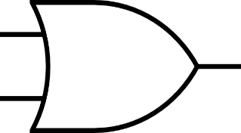
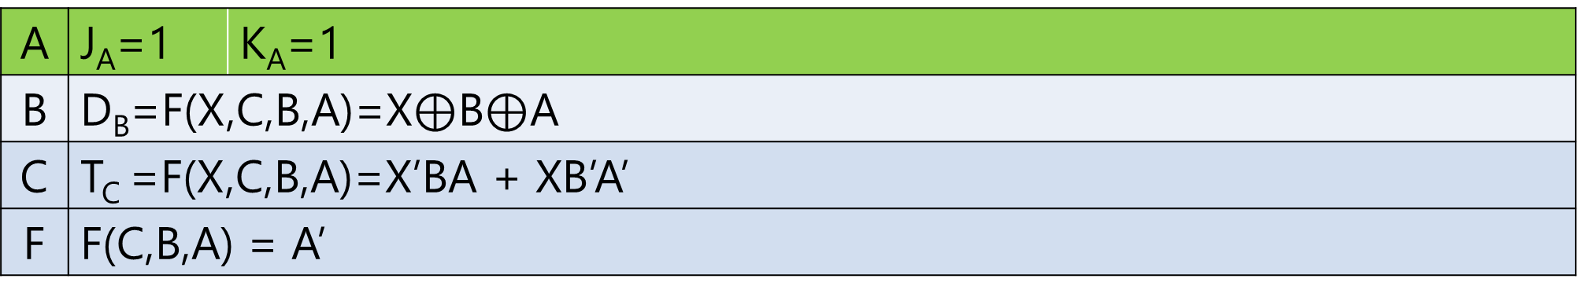
X
1
T
D
C
B
A
J
1
K
Clk
F
A | J_{A}=1 | K_{A}=1
B | D_{B}=F(X,C,B,A)=X$⊕$B$⊕$A
C | T_{C} =F(X,C,B,A)=X’BA + XB’A’
F | F(C,B,A) = A’

Slide 90
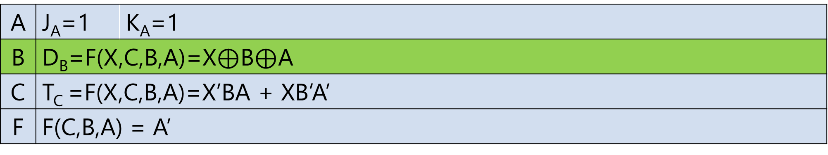
X
1
T
D
C
B
A
J
1
K
Clk
F
A | J_{A}=1 | K_{A}=1
B | D_{B}=F(X,C,B,A)=X$⊕$B$⊕$A
C | T_{C} =F(X,C,B,A)=X’BA + XB’A’
F | F(C,B,A) = A’

Slide 91
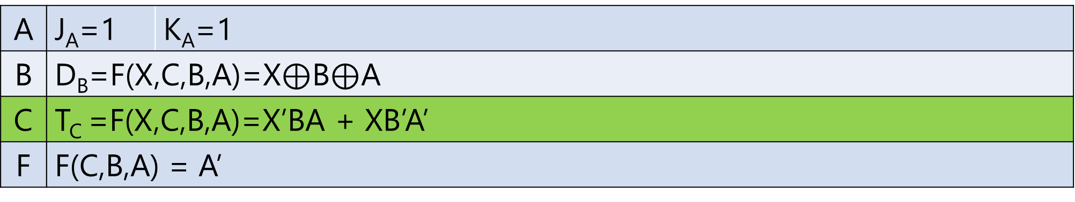
X
1
T
D
C
B
A
J
1
K
Clk
F
A | J_{A}=1 | K_{A}=1
B | D_{B}=F(X,C,B,A)=X$⊕$B$⊕$A
C | T_{C} =F(X,C,B,A)=X’BA + XB’A’
F | F(C,B,A) = A’

Slide 92
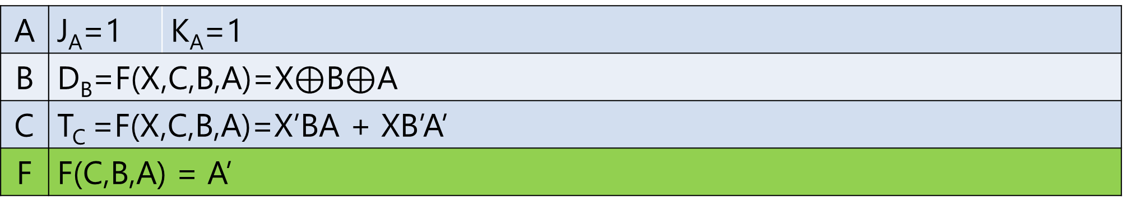
X
1
T
D
C
B
A
J
1
K
Clk
F
A | J_{A}=1 | K_{A}=1
B | D_{B}=F(X,C,B,A)=X$⊕$B$⊕$A
C | T_{C} =F(X,C,B,A)=X’BA + XB’A’
F | F(C,B,A) = A’

Slide 93
Synchronization
Practice Timing Diagram

Slide 94
Counter Up-Down
Example Mealy Model
Counting up and number is even
Counting up and number is odd
Counting down and number is odd
Counting down and number is even

Slide 95
Counter Up-Down
X=0: Count up from i to i+1
X=1: Count down from N i to i -1
F = 1 when counting up (X=0) and number is even
F = 0 when counting up (X=0) and number is odd
F = 1 when counting down (X=1) and number is odd
F = 0 when counting down (X=1) and number is even

Slide 96
000
0/1
F=1: (up AND even)
OR
(down AND odd)
F=0 : else
Y clearly depends on X
1/1
001
1/0
0/0
010
1/0
0/1
1/1
011
0/0
1/0
100
0/1
1/1
Mealy Model
101
X/F
0/0
0/0
1/0
110
0/1
1/1
111

Slide 97
Inputs | Q(T) |  |  | Q(T+1) |  |  | Outputs
X | C | B | A | C | B | A | F
0 | 0 | 0 | 0 | 0 | 0 | 1 | 1
0 | 0 | 0 | 1 | 0 | 1 | 0 | 0
0 | 0 | 1 | 0 | 0 | 1 | 1 | 1
0 | 0 | 1 | 1 | 1 | 0 | 0 | 0
0 | 1 | 0 | 0 | 1 | 0 | 1 | 1
0 | 1 | 0 | 1 | 1 | 1 | 0 | 0
0 | 1 | 1 | 0 | 1 | 1 | 1 | 1
0 | 1 | 1 | 1 | 0 | 0 | 0 | 0
1 | 0 | 0 | 0 | 1 | 1 | 1 | 0
1 | 0 | 0 | 1 | 0 | 0 | 0 | 1
1 | 0 | 1 | 0 | 0 | 0 | 1 | 0
1 | 0 | 1 | 1 | 0 | 1 | 0 | 1
1 | 1 | 0 | 0 | 0 | 1 | 1 | 0
1 | 1 | 0 | 1 | 1 | 0 | 0 | 1
1 | 1 | 1 | 0 | 1 | 0 | 1 | 0
1 | 1 | 1 | 1 | 1 | 1 | 0 | 1
Y = F(X,C,B,A) = ∑(0,2,4,6,9,11,13,15)

Slide 98
Minimization for output F
4-Variable K-Map

Slide 99
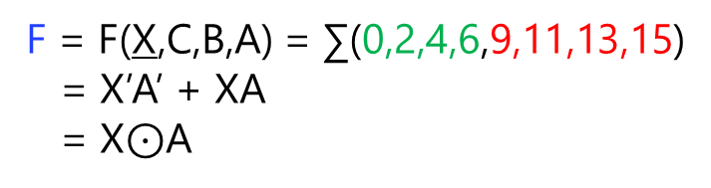
 |  | BA
 |  | 00 | 01 | 11 | 10
XC | 00 | m₀ | m₁ | m₃ | m₂
 | 01 | m₄ | m₅ | m₇ | m₆
 | 11 | m₁₂ | m₁₃ | m₁₅ | m₁₄
 | 10 | m₈ | m₉ | m₁₁ | m₁₀
1 | 0 | 0 | 1
1 | 0 | 0 | 1
0 | 1 | 1 | 0
0 | 1 | 1 | 0
F = F(X,C,B,A) = ∑(0,2,4,6,9,11,13,15)
= X’A’ + XA
= X$⊙$A

Slide 100
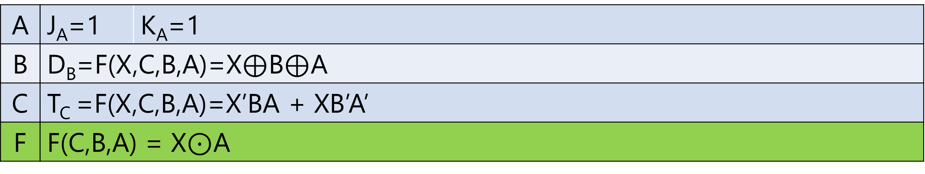
X
1
T
D
C
B
A
J
1
K
Clk
F
A | J_{A}=1 | K_{A}=1
B | D_{B}=F(X,C,B,A)=X$⊕$B$⊕$A
C | T_{C} =F(X,C,B,A)=X’BA + XB’A’
F | F(C,B,A) = X$⊙$A

Slide 101
Asynchronization
Practice Timing Diagram

