Slide 1
time:DateTimeExpr
time:inDateTime
time:TemporalEntity
sio:ProximityAdverb
sio:timeProximity
time:Instant
time:Interval
wn:early
wn:After
geo:lat
sio:ageProximity
wn:word-approximitely
geo:SpatioalThing
rdf:Literal
foaf:Image
event:place
geo:long
foaf:Agent
sio:carrying
sio:wearing
event:sub-event
foaf:agent
rdf:Literal
foaf:Person
foaf:Organization
foaf:agent
event:time
sio:preState
foaf:agent
event:Event
sio:postState
owl:Thing
event:product
sio:ServiceSecurity
sio:Subject
sio:Victim
sio:reportedTime
sio:SecurityIncident
sio:related
sio:finalState
sio:CommunityMember
sio:Voyeurism
sio:IndecentExposure
sio:Assault
sio:Robbery
sio:Student
sio:Staff
sio:FacultyMember
sio:weapon
sio:AssaultWithWeapon
sio:SexualAssault

Slide 2

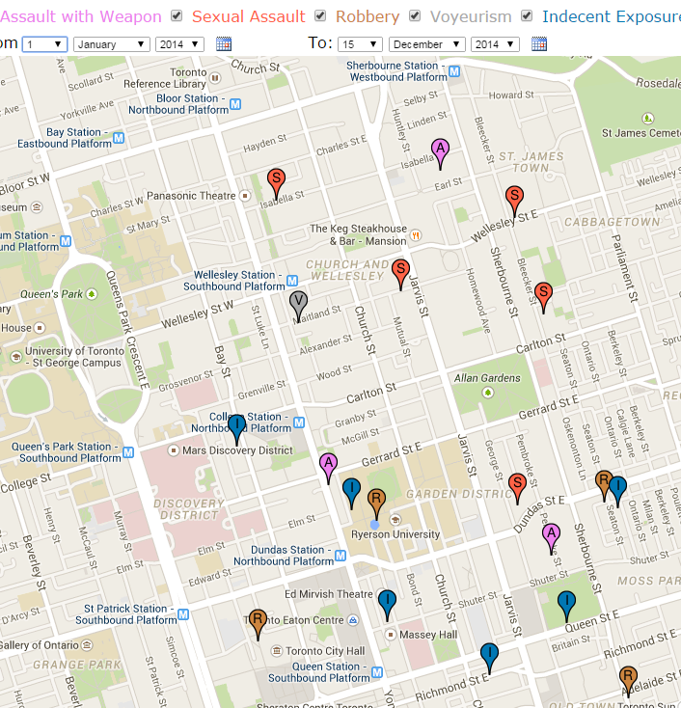
Security Incident Service
Security Incident Email
Ryerson Security <ryersonsecurity@ryerson.ca>
Poll
(120 sec)
Security Incident Data Mart
Natural Language Layer
ARC2 PHP 5.3
(arc.semsol.org)
Stanford CoreNLP
(nlp.stanford.edu)
Apache OpenNLP
(opennlp.apache.org)
Common
Semantic Web Layer
Apache Jena
(jena.apache.org)
Triple Access Layer
virtuoso.openlinksw.com
Virtuoso Jena Provider
(virtuoso.openlinksw.com)
Virtuoso
Universal
Server

