Slide 1
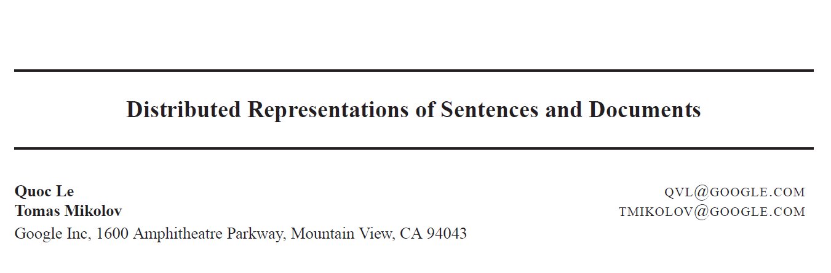
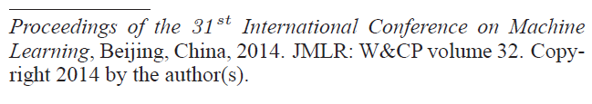

Slide 2
Bag-of-Word as a Document Vector
BoW and Bo-N-grams have little sense about the semantics of the words
Distances between “powerful,” “strong” and “Paris” are equally distant
“powerful” should be closer to “strong” than “Paris.”

Slide 3
Bag-of-Word as a Document Vector
Documents that have “powerful,” should have similar vectors as those that have “strong”!

Slide 4
Word Vectors as a Document Vector
A function on words’ vectors of a document Doc = [w₁, w₂, …, w_{n}]
f(Doc) = g(h(w₁), h(w₂), …, h(w_{n}))
h: Vocab → R^{d}
g: R^{d×n} → R^{d’}
h: could be 1-hot, Term-Doc, TF-iDF, …, Word2Vec
g: Concatenation, SUM, AVG, …

Slide 5
Word Vectors as a Document Vector
A function on words’ vectors of a document Doc = [w₁, w₂, …, w_{n}]
f(Doc) = g(h(w₁), h(w₂), …, h(w_{n}))
h: Vocab → R^{d}
g: R^{d×n} → R^{d’}
h: could be 1-hot, Term-Doc, TF-iDF, …, Word2Vec
g: unknown! Can we learn it?

Slide 6
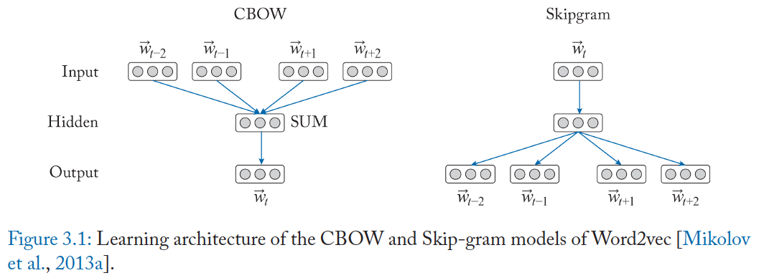
Word2Vec

Slide 7
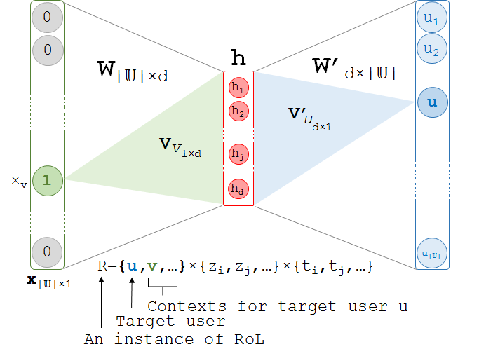
Word2Vec
$σ$((h = x^{T} W + b) W’ + b )

Slide 8
Word2Vec Predicts within a Context Window
The Context Window moves over the single stream of words.
No further context such as sentence, paragraph, or document is considered!
What if we say that the Window Context is moving within what document?

Slide 9
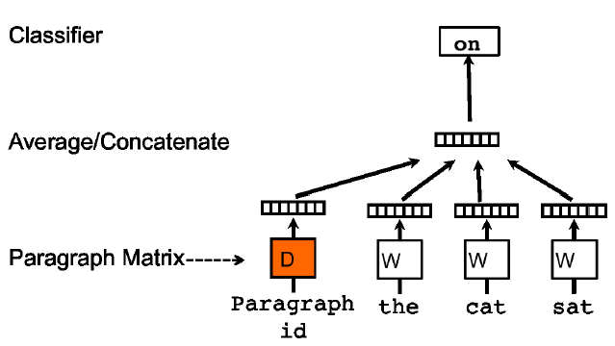
Distributed Memory Model of Paragraph Vectors (PV-DM)
$σ$((h = x^{T} W + b) W’ + b )
Window Context
1-hot
(bigrams of w_{i} → w_{o})
(occurrence vector)
Document
1-hot

Slide 10
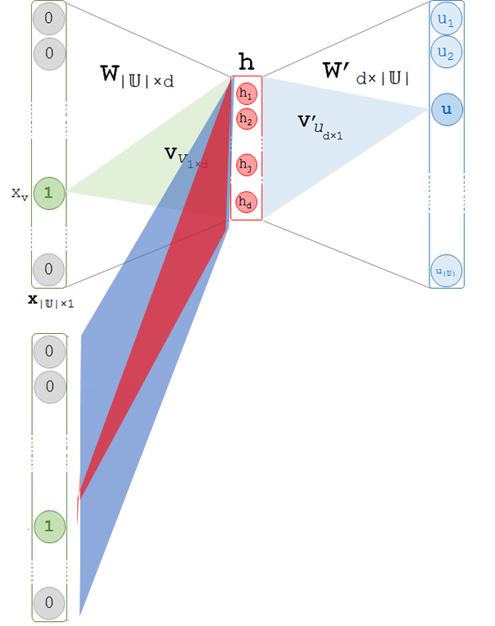

Distributed Memory Model of Paragraph Vectors (PV-DM)
0 | 1 | 0 | 1 | 0 | 1
0 | 0 | 1 | 0
 | SUM
1×V
1×D
V×h
w₀
Doc₂
D×h
w₁, w₃,w₅
w₀

Slide 11
Paragraph Vector
Continuous dense vector representations for variable length of texts
ranging from sentences to paragraph to documents.

Slide 12
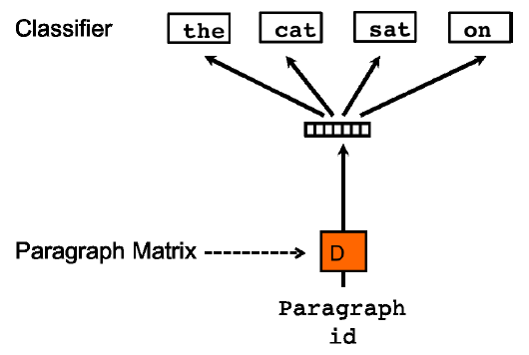
Distributed BoW of Paragraph Vectors (PV-DBOW)
0 | 0 | 1 | 0
1×D
D×h

Slide 13
Distributed Memory Model of Paragraph Vectors (PV-DM)
Pretrained Word Vectors for Unseen Documents
Freeze
0 | 1 | 0 | 1 | 0 | 1
0 | 0 | 1 | 0
 | SUM
1×V
1×D
V×h
Doc₂
w₀
w₁, w₃,w₅
w₀
D×h

Slide 14
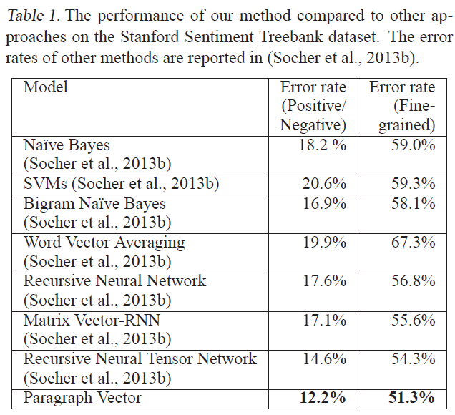
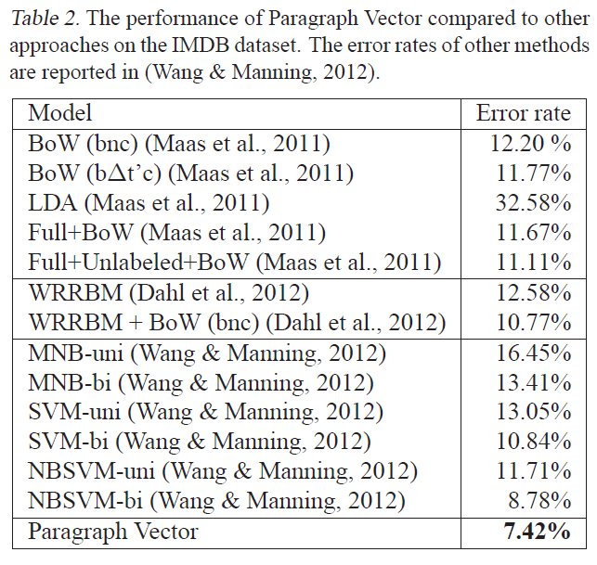
(PV-DM PV-DBOW), d=400, cw=8
fine-grained: {Very Negative, Negative, Neutral, Positive, Very Positive}
coarse-grained: {Negative, Positive}.

Slide 15
Paragraph Vector
PV-DM is consistently better than PV-DBOW.
The combination of PV-DM and PV-DBOW often work consistently better
Using concatenation in PV-DM is often better than sum.
A good guess of window size in many applications is between 5 and 12.

Slide 16
User Modeling

Slide 17
You are what you post!
Represent users by documents
a user = a document including all she said

Slide 18
You are what you post!
Modeling User Personality (Computational Social Science)
Personality traits in psychology
Big Five: extraversion, emotional stability, agreeableness, conscientiousness, and openness to experience
Modeling User Health Profile (Computational Epidemiology)
Privacy of the user, Ethical principles
Modeling Gender and Ethnicity
First names → gender; Last names → ethnicity
Modeling User Location

Slide 19
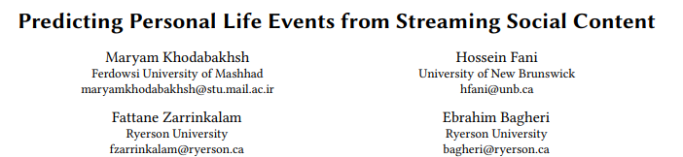
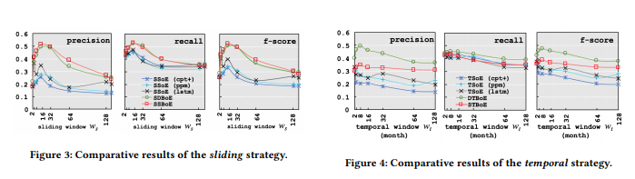
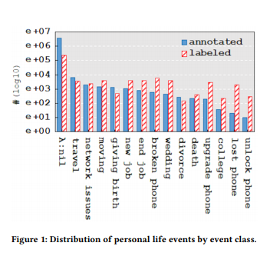
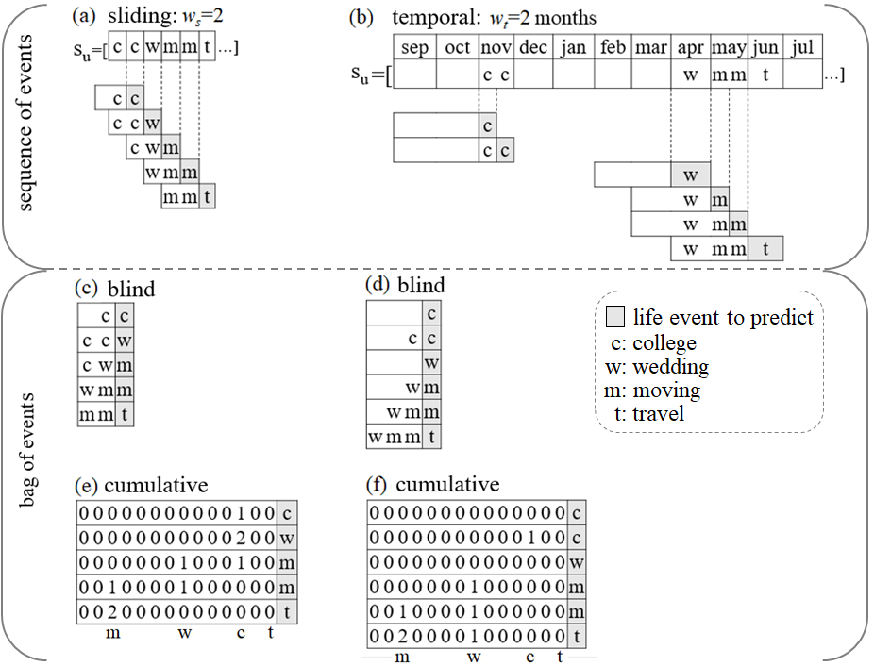
You are what you post! within time.

Slide 20

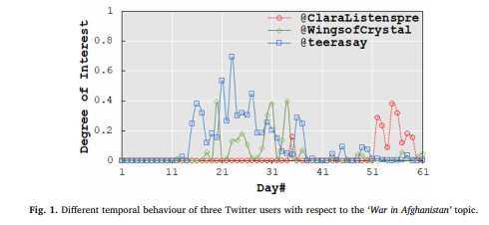
You are what you post! within time.
All users are interested in z₄₄=‘War in Afghanistan’

Slide 21
You are what you post! within time.
All users are interested in z₄₄=‘War in Afghanistan’
but not aligned in time!

Slide 22
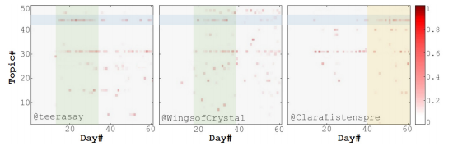
You are what you post! within time.
All users are interested in z₄₄=‘War in Afghanistan’
but not aligned in time!

Slide 23
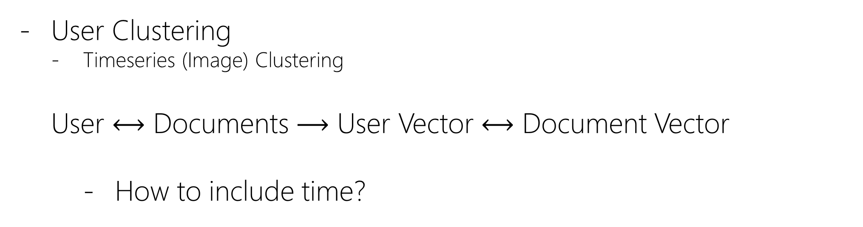
Diachronically Like-minded User Community Detection
User Clustering
Timeseries (Image) Clustering
User $⟷$ Documents $⟶$ User Vector $⟷$ Document Vector
How to include time?

Slide 24
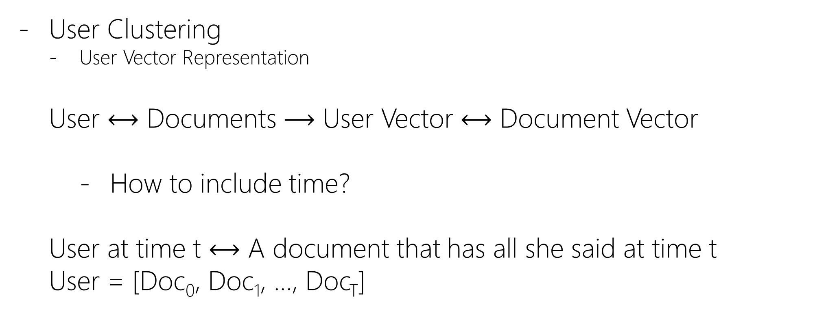
Diachronically Like-minded User Community Detection
User Clustering
User Vector Representation
User $⟷$ Documents $⟶$ User Vector $⟷$ Document Vector
How to include time?
User at time t $⟷$ A document that has all she said at time t
User = [Doc₀, Doc₁, …, Doc_{T}]

Slide 25
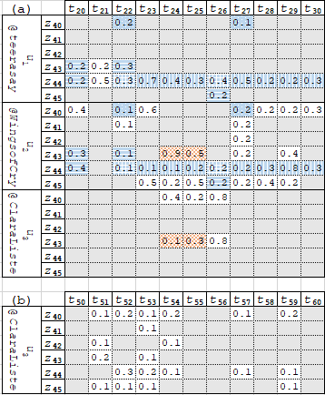

Diachronically Like-minded User Community Detection
User = [Doc₀, Doc₁, …, Doc_{T}]
LDA
User = [[z ⁽⁰⁾_{1:K}], [z ⁽¹⁾_{1:K}], …, [z^{(T)}_{1:K}]]

Slide 26
Diachronically Like-minded User Community Detection
User = [Doc₀, Doc₁, …, Doc_{T}]
LDA
User = [[z ⁽⁰⁾_{1:K}], [z ⁽¹⁾_{1:K}], …, [z^{(T)}_{1:K}]]
Two users are similar if they share more cells!
each cell = 1×1×1 cube ={u_{i}}×{z_{j}}×{t_{k}}
Shared cell = n×m×k cube
e.g., {u₁u₂}×{z₄₄}×{t₂₂ t₂₃ … t₃₀}

Slide 27
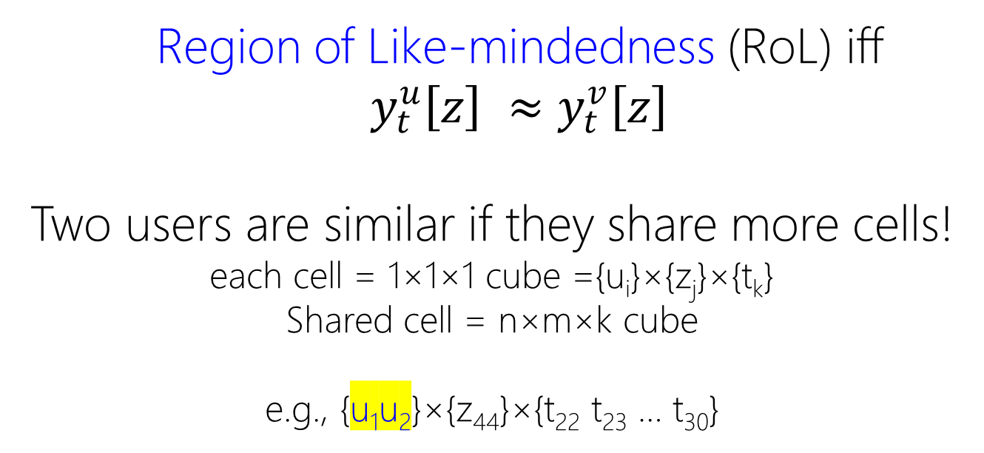
Diachronically Like-minded User Community Detection
Region of Like-mindedness (RoL) iff $y_{t}^{u}\left[z\right] ≈y_{t}^{v}\left[z\right]$
Two users are similar if they share more cells!
each cell = 1×1×1 cube ={u_{i}}×{z_{j}}×{t_{k}}
Shared cell = n×m×k cube
e.g., {u₁u₂}×{z₄₄}×{t₂₂ t₂₃ … t₃₀}

Slide 28
Diachronically Like-minded User Community Detection
User Clustering
Timeseries (Image) Clustering
User2Vec: User Vector Representation: Two Similar Users → Similar Vectors

