Slide 1
Probabilistic Topic Models

Slide 2
Probabilistic Topic Models
1.0
Words
0.5
Freq.
0
Topics

Slide 3
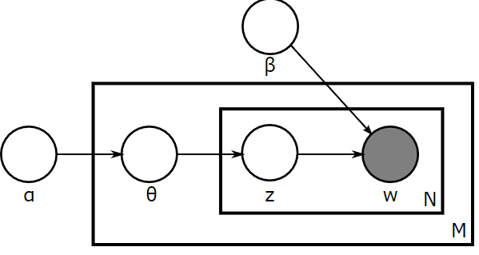
Probabilistic Topic Models
Let’s write a document?
About what? topic?
Concert in soccer stadium for Nowruz and else.

Slide 4
Probabilistic Topic Models
A document is about all topics but different distributions over topics
A topic have all words but with different distributions over words
1.0
1.0
Words
Topics
0.5
0.5
Prob.
Freq.
0
0

Slide 5
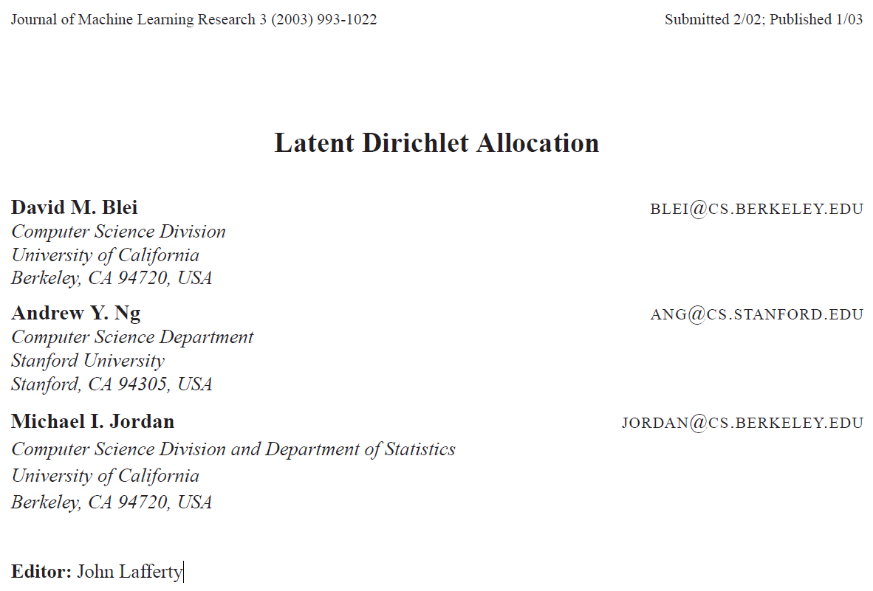

Slide 6
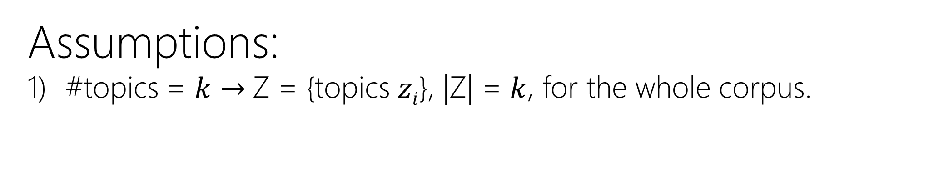
Probabilistic Topic Models
Assumptions:
#topics = $k$ $→$Z = {topics $zi$}, |Z| = $k$, for the whole corpus.

Slide 7
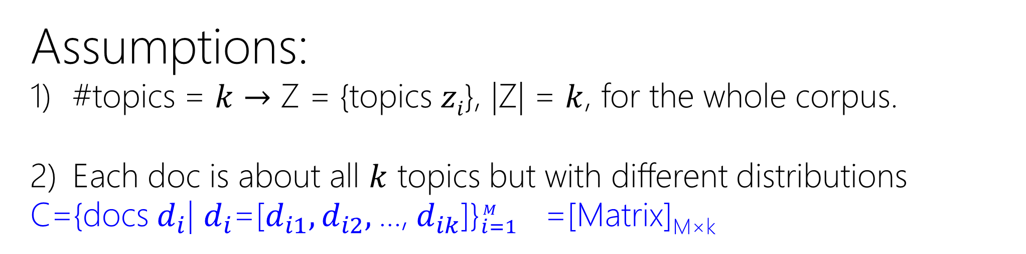
Probabilistic Topic Models
Assumptions:
#topics = $k$ $→$ Z = {topics $zi$}, |Z| = $k$, for the whole corpus.
Each doc is about all $k$ topics but with different distributions
C={docs $d_{i}$| $d_{i}$=[$d_{i1},d_{i2},$…, $d_{ik}$]}${}_{i=1}^{M }{}$ =[Matrix]_{M×k}

Slide 8
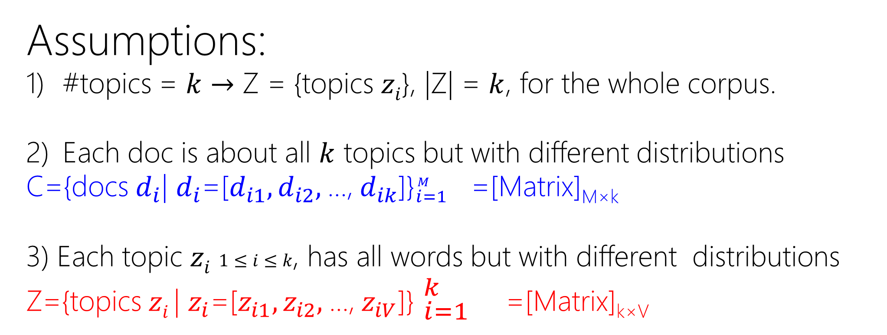
Probabilistic Topic Models
Assumptions:
#topics = $k$ $→$ Z = {topics $zi$}, |Z| = $k$, for the whole corpus.
Each doc is about all $k$ topics but with different distributions
C={docs $d_{i}$| $d_{i}$=[$d_{i1},d_{i2},$…, $d_{ik}$]}${}_{i=1}^{M }{}$ =[Matrix]_{M×k}
3) Each topic $zi$ $1≤i≤k$, has all words but with different distributions
Z={topics $zi$| $z_{i}$=[$z_{i1},z_{i2},$…, $z_{iV}$]} ${}_{i=1}^{k }{}$ =[Matrix]_{k×V}

Slide 9
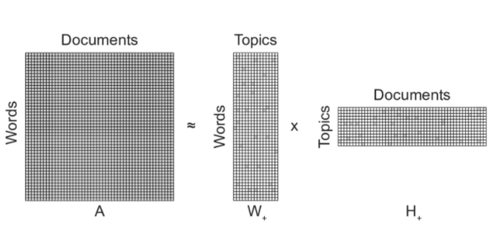


Probabilistic Topic Models
Words
Topics
$$≈$$
$$×$$
Topics
LDA can be seen as non-Negative Matrix Factorization
But learning algorithm is probabilistic!

Slide 10
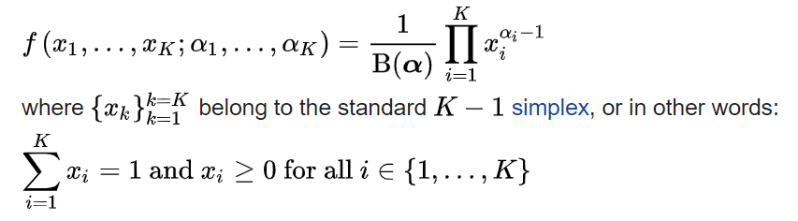
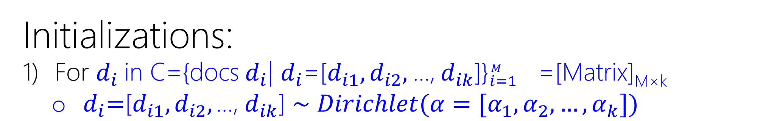
Probabilistic Topic Models
Initializations:
For $d_{i}$in C={docs $d_{i}$| $d_{i}$=[$d_{i1},d_{i2},$…, $d_{ik}$]}${}_{i=1}^{M }{}$ =[Matrix]_{M×k}
$d_{i}\text{=}\text{[}d_{i1},d_{i2}, \text{…,} d_{ik}\text{]}∼$ $Dirichlet(α=[α_{1},α_{2},…,α_{k}])$
We’ve seen this before. where?

Slide 11
Probabilistic Topic Models
Initializations:
For $d_{i}$in C={docs $d_{i}$| $d_{i}$=[$d_{i1},d_{i2},$…, $d_{ik}$]}${}_{i=1}^{M }{}$ =[Matrix]_{M×k}
$d_{i}\text{=}\text{[}d_{i1},d_{i2}, \text{…,} d_{ik}\text{]}∼$ $Dirichlet(α=[α_{1},α_{2},…,α_{k}])$
Softmax! Transforming to vector of probs. But here we generate it!

Slide 12
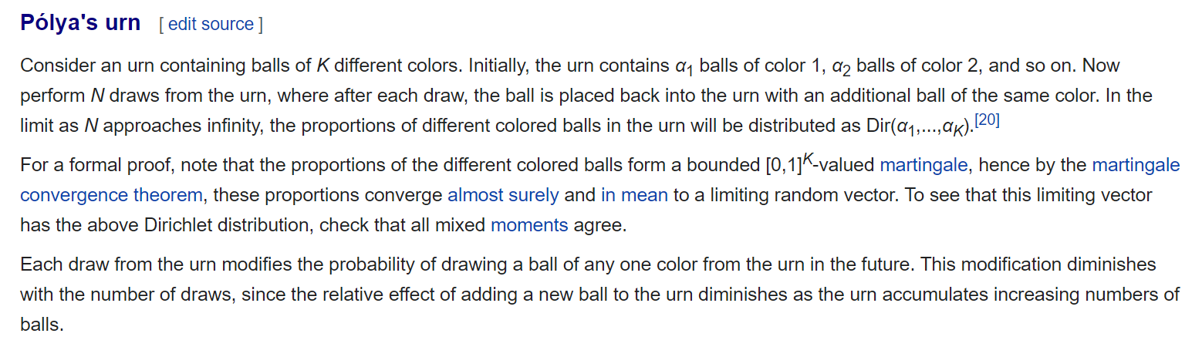

Slide 13
Probabilistic Topic Models
Initializations:
For $d_{i}$in C={docs $d_{i}$| $d_{i}$=[$d_{i1},d_{i2},$…, $d_{ik}$]}${}_{i=1}^{M }{}$ =[Matrix]_{M×k}
$d_{i}\text{=}\text{[}d_{i1},d_{i2}, \text{…,} d_{ik}\text{]}∼$ $Dirichlet(α=[α_{1},α_{2},…,α_{k}])$
We’ve seen this before. where?

Slide 14
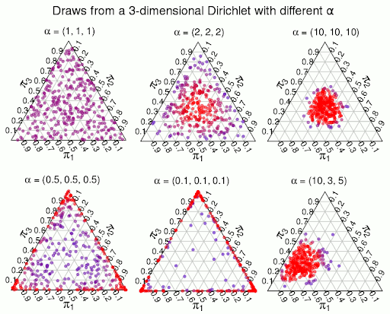
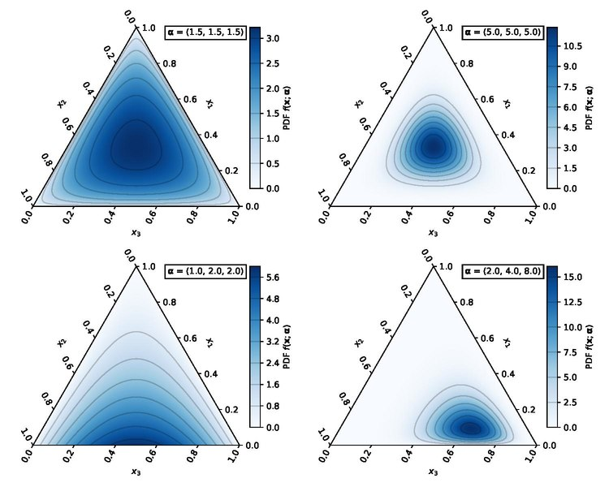
Probabilistic Topic Models
http://www.sumsar.net/blog/2015/04/the-non-parametric-bootstrap-as-a-bayesian-model/
https://en.wikipedia.org/wiki/Dirichlet_distribution

Slide 15
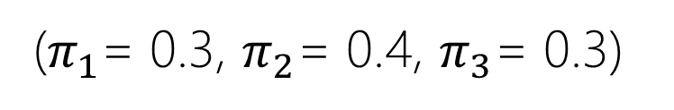
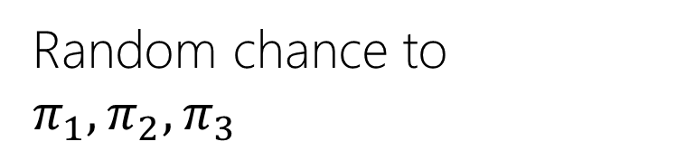
Probabilistic Topic Models
Random chance to $π_{1}, π_{2},π_{3}$
($π_{1}$= 0.3, $π_{2}$= 0.4, $π_{3}$= 0.3)

Slide 16
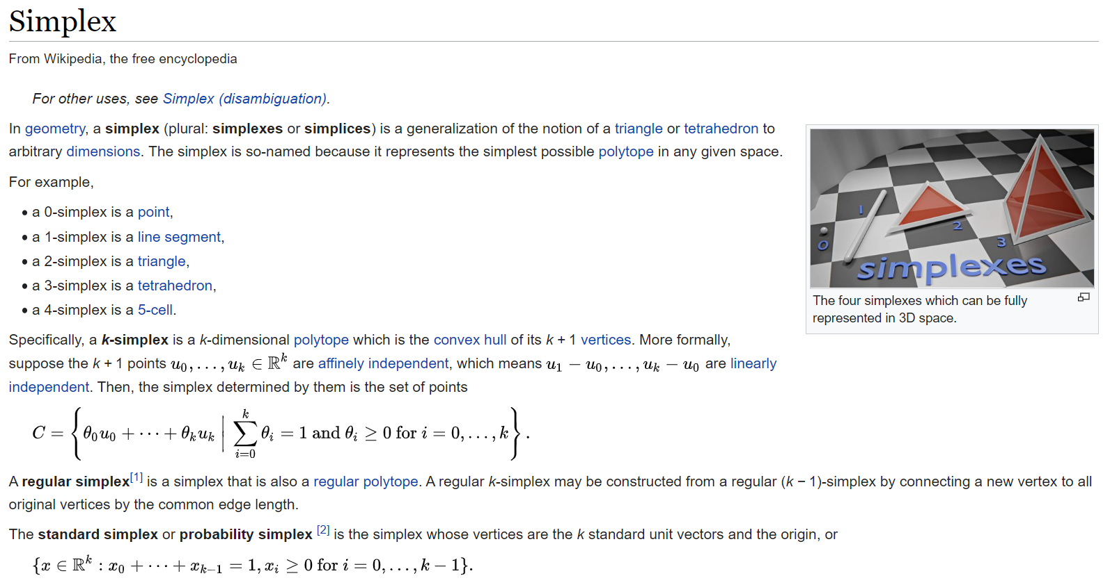

Slide 17

Probabilistic Topic Models
Initializations:
For $d_{i}$in C={docs $d_{i}$| $d_{i}$=[$d_{i1},d_{i2},$…, $d_{ik}$]}${}_{i=1}^{M }{}$ =[Matrix]_{M×k}
$d_{i}\text{=}\text{[}d_{i1},d_{i2}, \text{…,} d_{ik}\text{]}∼$ $Dirichlet(α=[α_{1},α_{2},…,α_{k}])$
Prior weight of topic k in a document
Initially the same for all topics
Normally $α_{1≤j≤k}<1$, e.g. 0.1,
Prefer sparse topic distributions, i.e., few topics per document

Slide 18
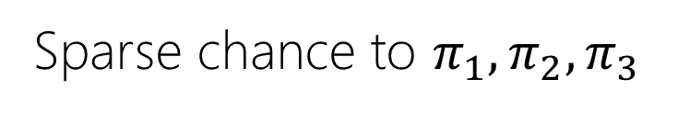
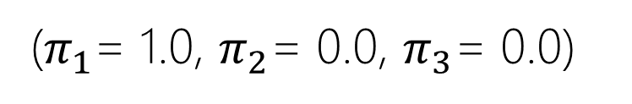
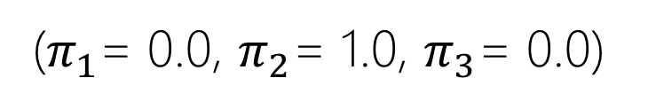
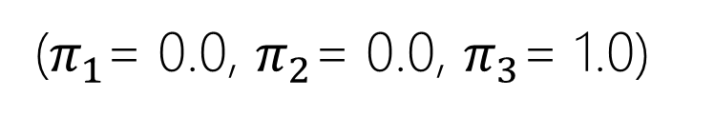
Probabilistic Topic Models
Sparse chance to $π_{1}, π_{2},π_{3}$
($π_{1}$= 0.0, $π_{2}$= 0.0, $π_{3}$= 1.0)
($π_{1}$= 1.0, $π_{2}$= 0.0, $π_{3}$= 0.0)
($π_{1}$= 0.0, $π_{2}$= 1.0, $π_{3}$= 0.0)

Slide 19


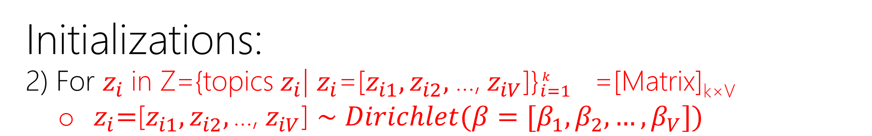


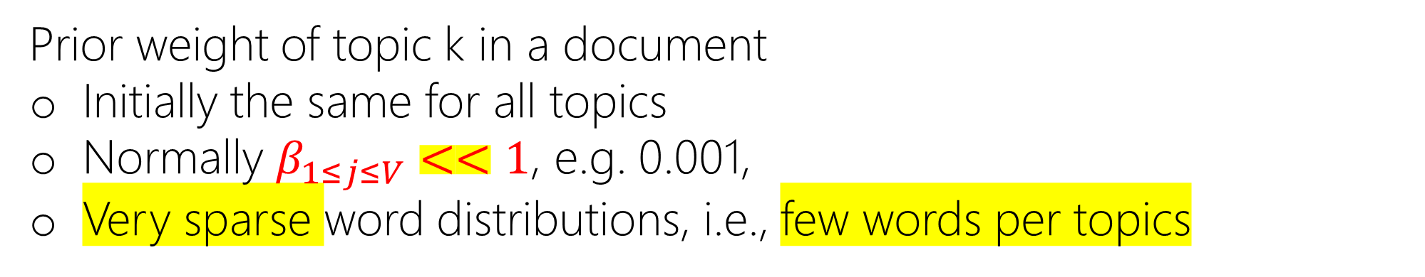

Probabilistic Topic Models
Initializations:
2) For $z_{i}$in Z={topics $z_{i}$| $z_{i}$=[$z_{i1},z_{i2},$…, $z_{iV}$]}${}_{i=1}^{k }{}$ =[Matrix]_{k×V}
$z_{i}\text{=}\text{[}z_{i1},z_{i2}, \text{…,} z_{iV}\text{]}∼$ $Dirichlet(β=[β_{1},β_{2},…,β_{V}])$
$$β$$
$$β_{V}$$
$$β_{i}$$
$$V$$
$$β$$
Prior weight of topic k in a document
Initially the same for all topics
Normally $β_{1≤j≤V}<<1$, e.g. 0.001,
Very sparse word distributions, i.e., few words per topics

Slide 20
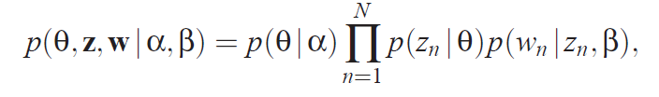

Probabilistic Topic Models
Generative Process:
Plate Notation
Graphical Model
$$d$$

Slide 21

Probabilistic Topic Models
Generative Process:
1.0
Select the topic distribution for the doc
Topics
0.5
$$d$$
Prob.
0

Slide 22
Probabilistic Topic Models
Generative Process:
1.0
For each word in the doc
Topics
0.5
$$d$$
Prob.
0

Slide 23
Probabilistic Topic Models
Generative Process:
1.0
Select a topic from the topic distribution of the doc
Topics
0.5
$$d$$
Prob.
0

Slide 24

Probabilistic Topic Models
Generative Process:
1.0
Select the word from the topic distribution
1.0
Apple
Apple
0.5
Topics
0.5
$$d$$
Words
Prob.
0
0

Slide 25
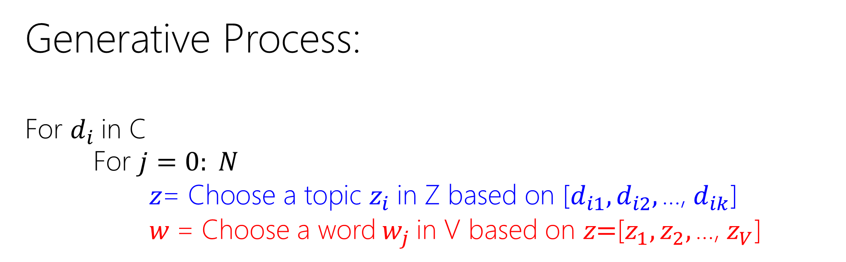
Probabilistic Topic Models
Generative Process:
For $d_{i}$in C
For $j=0: N$
$z\text{= }\text{Choose} \text{a} \text{topic} z_{i} \text{in} \text{Z} \text{based} \text{on}\text{ [}d_{i1},d_{i2}, \text{…,} d_{ik}\text{]}$
$w$ = Choose a word $w_{j}$ in V based on $z\text{=}\text{[}z_{1},z_{2}, \text{…,} z_{V}\text{]}$

Slide 26
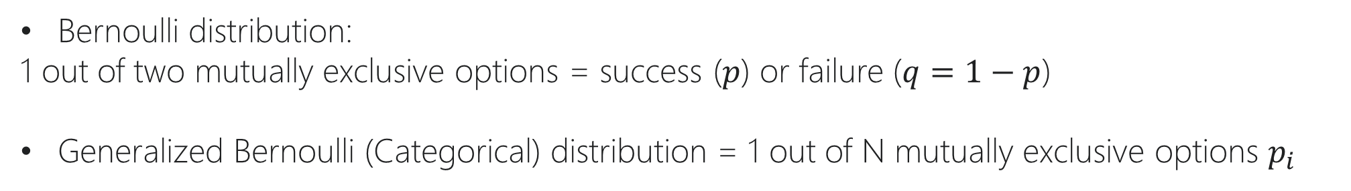
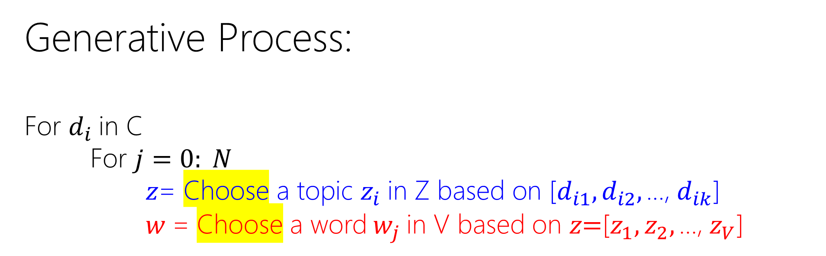
Probabilistic Topic Models
Generative Process:
For $d_{i}$in C
For $j=0: N$
$z\text{= }\text{Choose} \text{a} \text{topic} z_{i} \text{in} \text{Z} \text{based} \text{on}\text{ [}d_{i1},d_{i2}, \text{…,} d_{ik}\text{]}$
$w$ = Choose a word $w_{j}$ in V based on $z\text{=}\text{[}z_{1},z_{2}, \text{…,} z_{V}\text{]}$
Bernoulli distribution:
1 out of two mutually exclusive options = success ($p$) or failure ($q=1−p$)
Generalized Bernoulli (Categorical) distribution = 1 out of N mutually exclusive options $p_{i}$

Slide 27
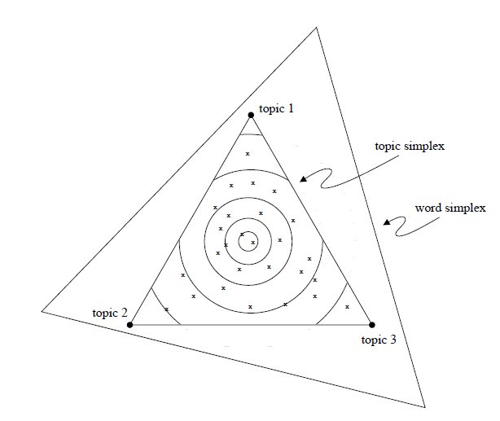




Probabilistic Topic Models
$$w_{1}$$
Geometric Intuition:
For $d_{i}$in C
For $j=0: N$
$z\text{= }\text{Choose} \text{a} \text{topic} z_{i} \text{in} \text{Z} \text{based} \text{on}\text{ [}d_{i1},d_{i2}, \text{…,} d_{ik}\text{]}$
$w$ = Choose a word $w_{j}$ in V based on $z\text{=}\text{[}z_{1},z_{2}, \text{…,} z_{V}\text{]}$
$$w_{2}$$
$$w_{3}$$

Slide 28
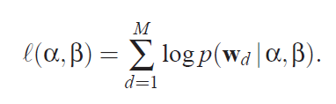

Probabilistic Topic Models
Optimization
Generated Docs $↔$ Observed Docs
For $d_{i}$in C
For $j=0: N$
$z\text{= }\text{Choose} \text{a} \text{topic} z_{i} \text{in} \text{Z} \text{based} \text{on} d_{i}\text{= [}d_{i1},d_{i2}, \text{…,} d_{ik}\text{]}$
$w$ = Choose a word $w_{j}$ in V based on $z\text{=}\text{[}z_{1},z_{2}, \text{…,} z_{V}\text{]}$

Slide 29
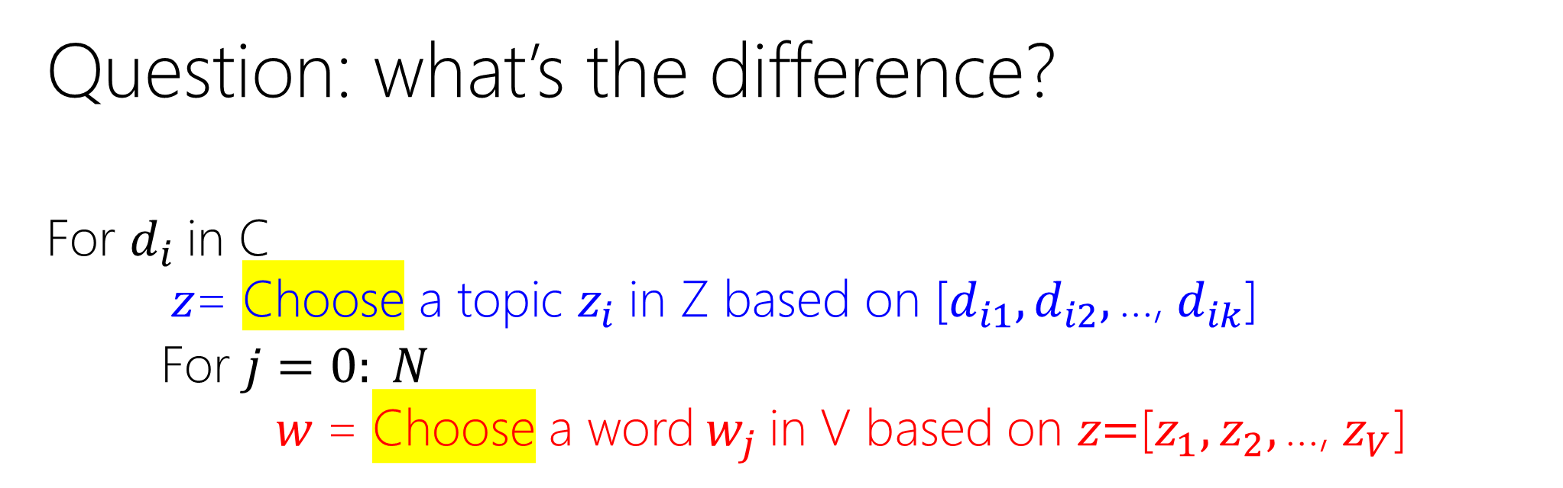
Probabilistic Topic Models
Question: what’s the difference?
For $d_{i}$in C
$z\text{= }\text{Choose} \text{a} \text{topic} z_{i} \text{in} \text{Z} \text{based} \text{on}\text{ [}d_{i1},d_{i2}, \text{…,} d_{ik}\text{]}$
For $j=0: N$
$w$ = Choose a word $w_{j}$ in V based on $z\text{=}\text{[}z_{1},z_{2}, \text{…,} z_{V}\text{]}$

Slide 30
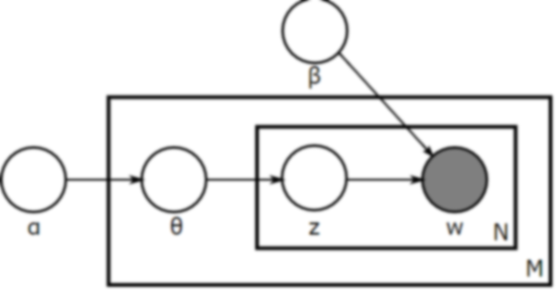


Probabilistic Topic Models
Question: what’s the difference?
For $d_{i}$in C
$z\text{= }\text{Choose} \text{a} \text{topic} z_{i} \text{in} \text{Z} \text{based} \text{on}\text{ [}d_{i1},d_{i2}, \text{…,} d_{ik}\text{]}$
For $j=0: N$
$w$ = Choose a word $w_{j}$ in V based on $z\text{=}\text{[}z_{1},z_{2}, \text{…,} z_{V}\text{]}$
$$d$$

Slide 31
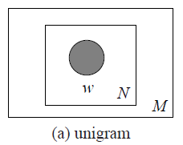

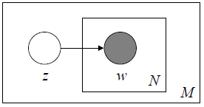


Probabilistic Topic Models
LDA vs. or as a n-gram LM
p(w) = ?
w_{i-1}
w_{i}
N
M
(b) bigram
$$d$$
(c) mixture of unigrams

Slide 32
Probabilistic Topic Models: API
MALLET (http://mallet.cs.umass.edu/topics.php)
Gensim (https://radimrehurek.com/gensim/)
Gensim wrapper for MALLET

Slide 33
Probabilistic Topic Models: Applications
Corpus Summarization
Document Clustering / Classification
Document Summarization
User Modeling

Slide 34


Probabilistic Topic Models: Applications
Corpus Summarization
Corpus → Topics → Top-k Words
Words
Topics
$$≈$$
$$×$$
Topics

Slide 35
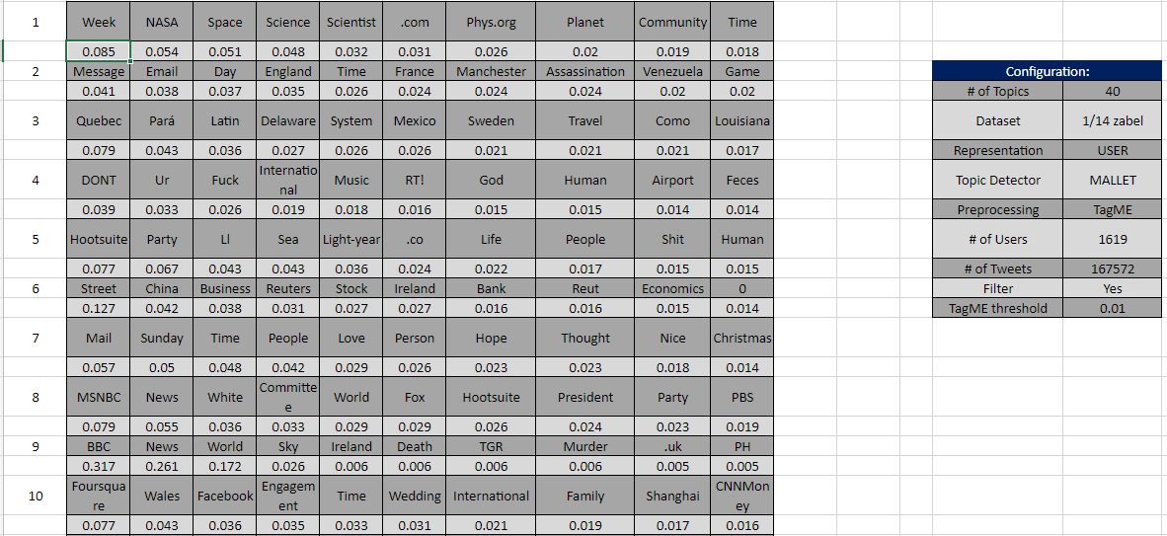
Probabilistic Topic Models: Applications

Slide 36
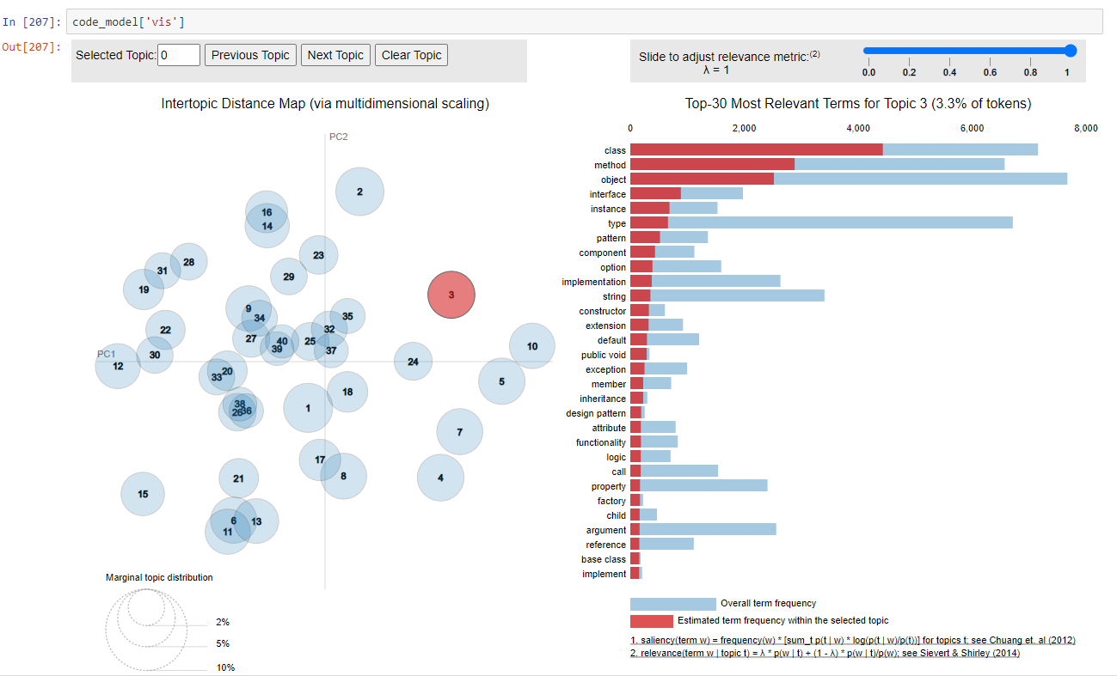
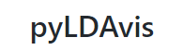
https://nbviewer.jupyter.org/github/bmabey/hacker_news_topic_modelling/blob/master/HN%20Topic%20Model%20Talk.ipynb

Slide 37


Probabilistic Topic Models: Applications
Document Clustering / Classification
Words
Topics
$$≈$$
$$×$$
Topics

Slide 38
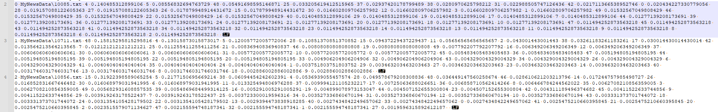
Probabilistic Topic Models: Applications
Document Clustering / Classification
Each document is a feature vector of topics
Similar documents have similar vectors/topics

Slide 39
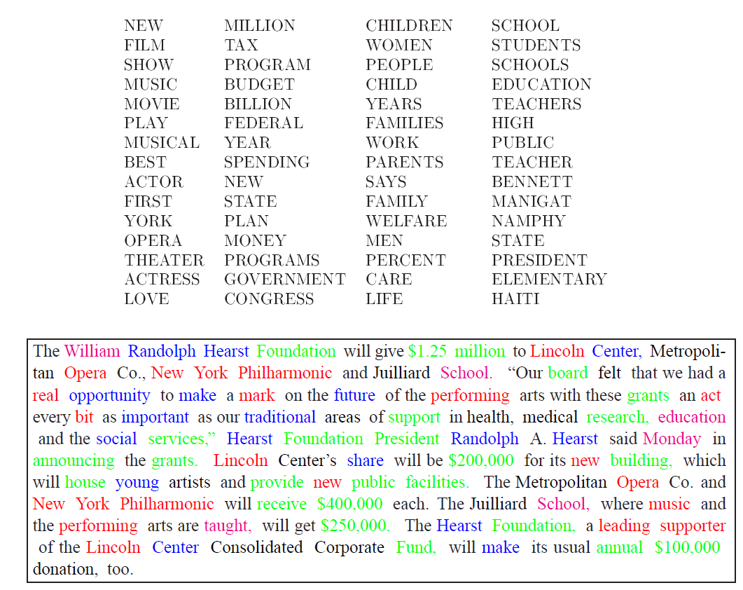
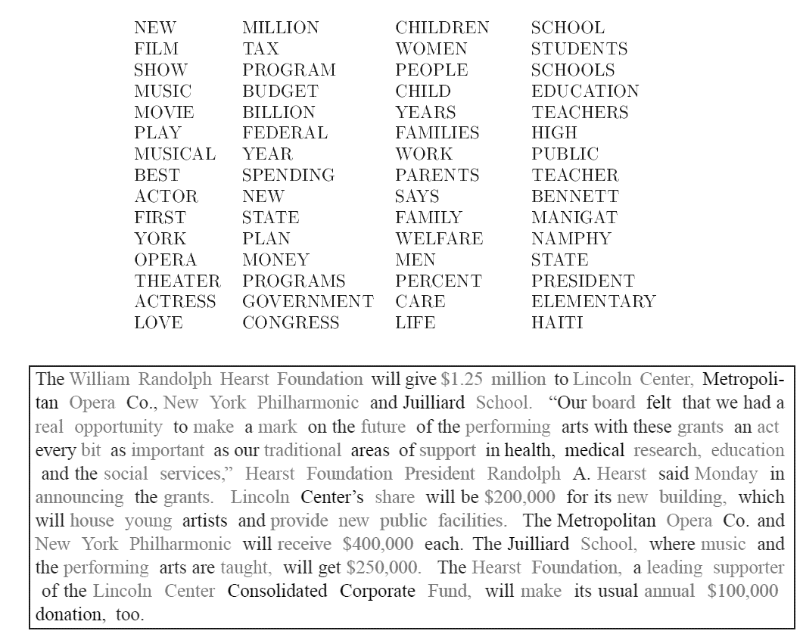
Probabilistic Topic Models: Applications
Document Summary

Slide 40
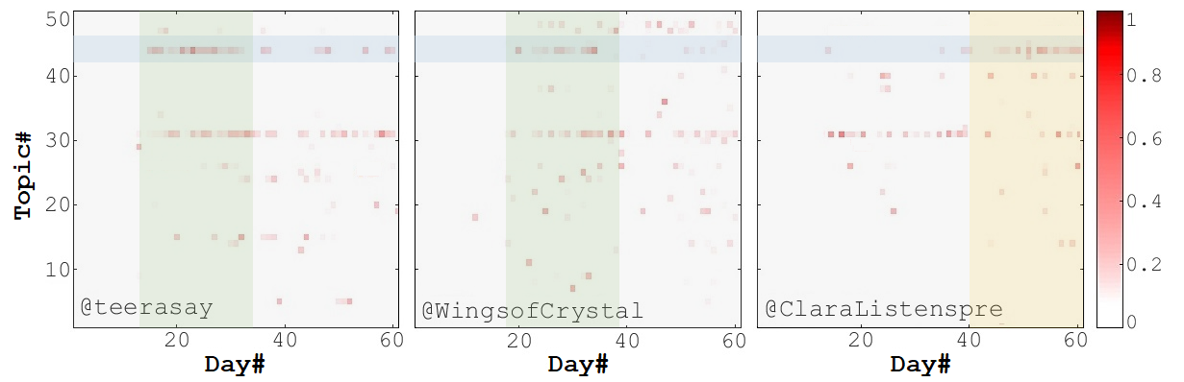
Probabilistic Topic Models: Applications
User Modeling (will be discussed more …)

Slide 41
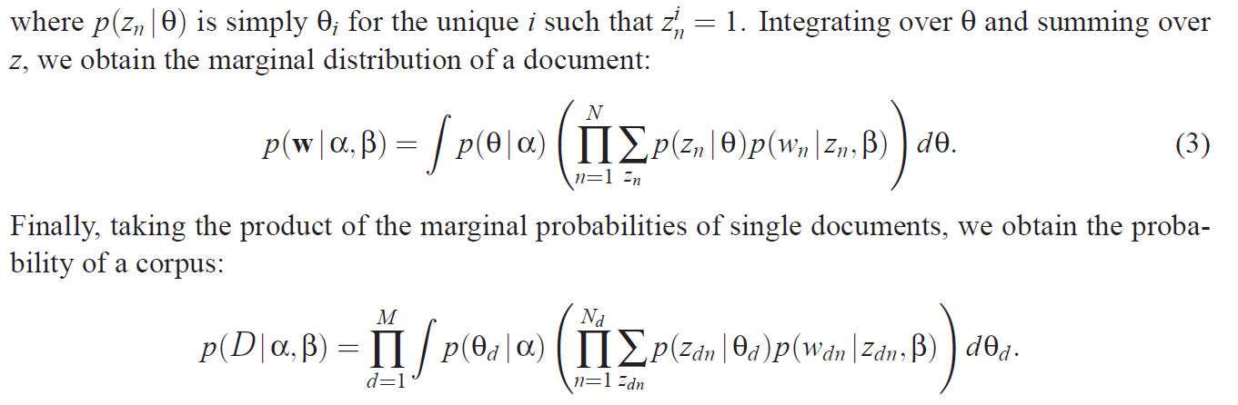
Likelihood

Slide 42
Distributed Memory Model of Paragraph Vectors
(PV-DM)
aka Doc2Vec

