Slide 1
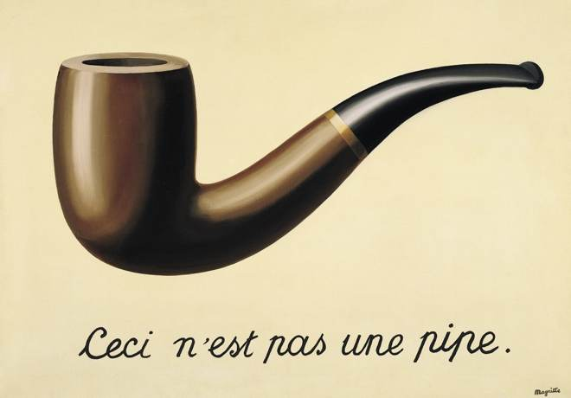

Slide 2
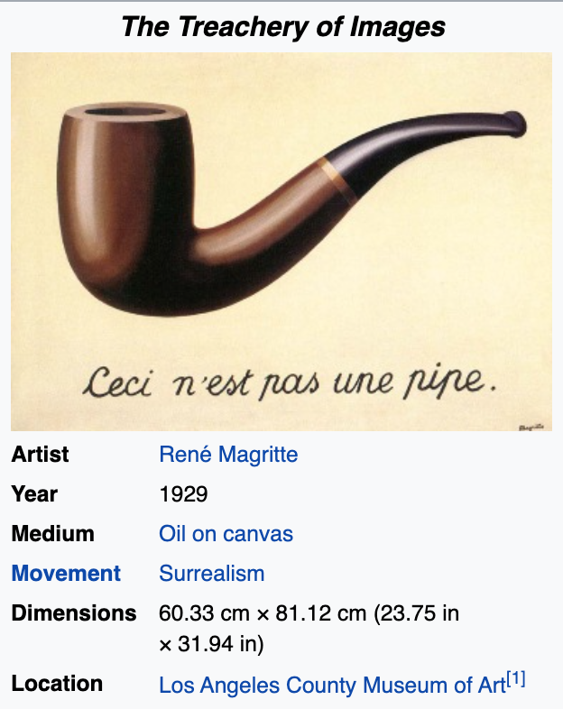
Word vector space models

Slide 3
Language Modeling
Building a model that can generate an accurate stream of tokens (words + inflection rules, punctuations, fillers, …)

Slide 4
Language Modeling
Building a model that can generate an accurate stream of tokens (words + inflection rules, punctuations, fillers, …)
No semantics were involved!
Notes:
Make an understanding of text pieces.
Extract meaning of tokens in a compositional context.

Slide 5
Semiotics
Semantics: Relation between signs and things to which they refer: meaning; sense
Syntactics: Relations among signs in formal structures
Pragmatics: Relation between signs and sign-using agents

Slide 6
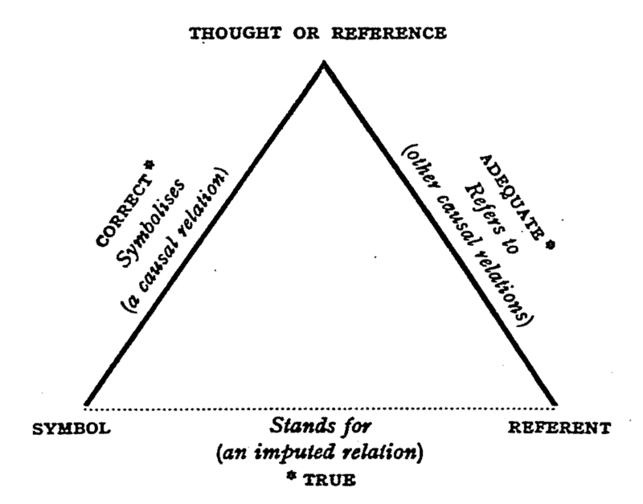
Triangle of Semiotics
(interpretant/signified)
(representamen)
(object)

Slide 7
Triangle of Semiotics
(interpretant/signified)
[cat]
(representamen)
(object)
The representamen (sign vehicle, signifier, symbol) represents the object

Slide 8

Triangle of Semiotics
(interpretant/signified)
[cat]
(representamen)
(object)
The interpretant (signified) is the sense/meaning made of the representamen and the object

Slide 9

Triangle of Semiotics
(interpretant/signified)
[cat]
(representamen)
(object)
The object of a sign is always hidden!

Slide 10
Sign
A sign is a triadic unity of:
Object
Representamen (signifier/symbol)
Interpretant (signified/mean/sense)
(interpretant/signified)
[cat]
(representamen)
(object)

Slide 11
Computational Semantics
(interpretant/signified)
The objective of computational semantics research is to automatically find the relation between a signifier and the signified/sense/meaning.
(representamen)
(object)

Slide 12
Representament Learning
Representation Learning
From school:
[‘c’, ‘a’, ‘t’]
(interpretant/signified)
(representamen)
(object)

Slide 13
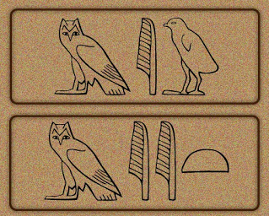
Representament Learning
Representation Learning
In hieroglyphs:
miu/mii (male)
Miit (female)
(interpretant/signified)
(representamen)
(object)

Slide 14
Representament Learning
Representation Learning
In computer ASCII code:
[99, 97, 116]
(interpretant/signified)
(representamen)
(object)

Slide 15
Representament Learning
Representation Learning
(interpretant/signified)
Help with signified/meaning/sense!
(representamen)
(object)

Slide 16
Representament → Interpretant
(interpretant/signified)
(representamen)
(object)

Slide 17
Representament → ?
We/machine see a token/symbol/signifier → What does it mean?
→ Comprehension (analyze the context)
(interpretant/signified)
(representamen)
(object)
Notes:
Reading a novel by a non-native person

Slide 18
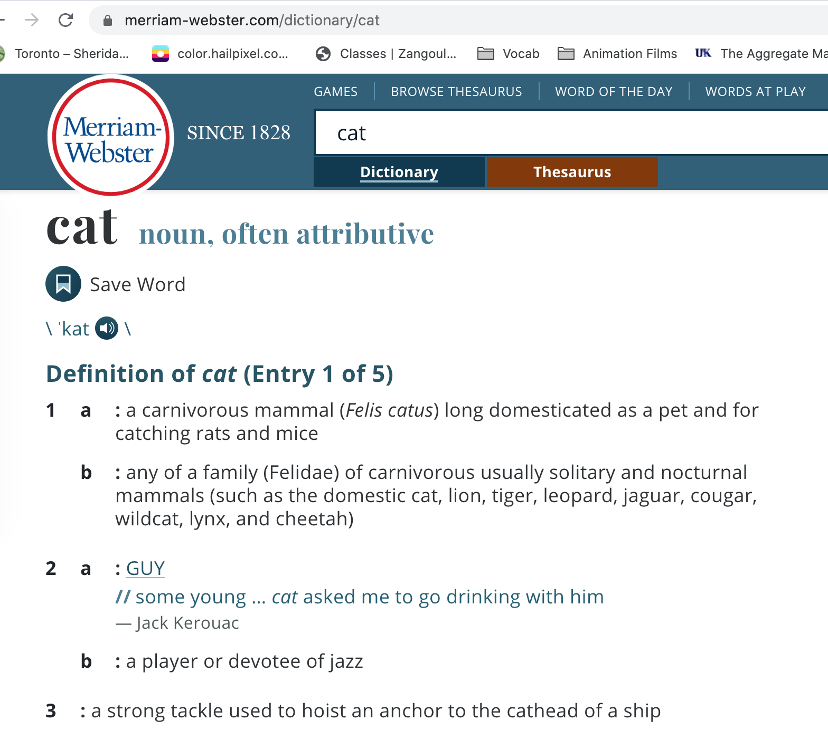

Slide 19
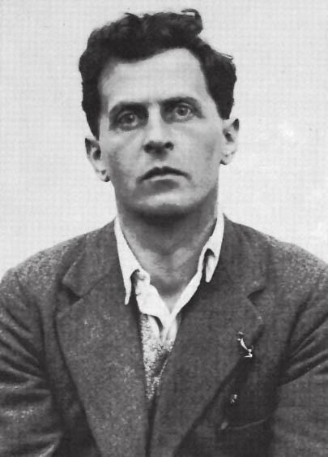
Ludwig Josef Johann Wittgenstein
/ˈvɪtɡənʃtaɪn, -staɪn/
1889 –1951
Austrian-British Philosopher
Worked primarily in:
Logic
The philosophy of mathematics
The philosophy of mind
The philosophy of language

Slide 20
Ludwig Josef Johann Wittgenstein
/ˈvɪtɡənʃtaɪn, -staɪn/
1889 –1951
Austrian-British Philosopher
Skeptical of a completely formal theory of meaning definitions for each word
→ “the meaning of a word is its use in the language” - Philosophical Investigations.

Slide 21
Token → ?
(interpretant/signified)
(representamen)
(object)
Notes:
Reading a novel by a non-native person

Slide 22
Token → Relations with other Tokens → Meaning
(interpretant/signified)
(representamen)
(object)
Notes:
Reading a novel by a non-native person

Slide 23
Lexical vs. Vector Semantics
Lemma
Wordforms
Synonyms
Antonyms
Connotations
Similar Tokens (Word Similarity)
Related Tokens (Word Relatedness)
Distribution (co-occurrences)

Slide 24
Lexical Semantics
Lemma
Wordforms
Synonyms
Antonyms
Connotations
Similar Tokens (Word Similarity)
Related Tokens (Word Relatedness)
Distribution (co-occurrences)

Slide 25
Lexical Semantics
Lemma (how?)
Wordforms (how?)
Notes:
One of the fundamenprinciple
of tal tenets of semantics, called the principle of contrast (Girard 1718, Bre´al 1897,
contrast
Clark 1987), is the assumption that a difference in linguistic form is always associated
with at least some difference in meaning. For example, the word H2O is used
in scientific contexts and would be inappropriate in a hiking guide—water would be
more appropriate— and this difference in genre is part of the meaning of the word.
In practice, the word synonym is therefore commonly used to describe a relationship
of approximate or rough synonymy.

Slide 26
Lexical Semantics
Synonyms: different signifiers near same signified, e.g., water:H₂O
The principle of contrast: difference in linguistic form [signifier] is always associated with at least some difference in meaning.
(Girard 1718, Breal 1897, Clark 1987)
[H2O] → scientific contexts
[water] → hiking guide
Difference in genre is part of the meaning of the word.

Slide 27
Lexical Semantics
Connotations
The aspects of a word’s meaning that are related to a writer or reader’s emotions, sentiment, opinions, or evaluations.
E.g., happy vs. sad
Evaluation (sentiment)
E.g., great/love vs. terrible/hate
Notes:
Connotation detection != Sentiment Anaylsis

Slide 28
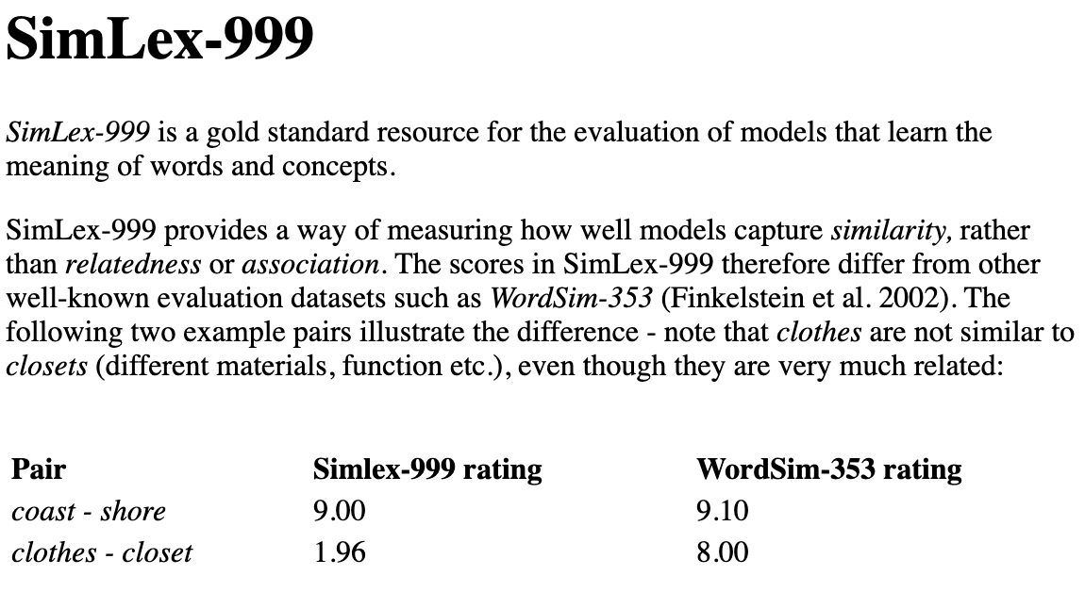
Lexical Semantics
Similar Tokens (Word Similarity)
Similarity in the signified and object
(interpretant/signified)
(representamen)
(object)

Slide 29
Lexical Semantics
Related Tokens (Word Relatedness aka. Word Associations)
Semantic Field: School, Student, Book, Teacher
Semantic Frame: events or transactions in field
registration, registrar, student, course
Semantic Role: Who does What
Student register a course. A course is taken by students.

Slide 30
Lexical Semantics
Hypernymy: Hierarchical Relation,
color → red/blue
Meronymy: Part-Whole Relation
engine → Car

Slide 31
Vector Semantics
Distribution (co-occurrences)
No supervised lexical connection for tokens
Statistical connections for tokens

Slide 32
Distributional Hypothesis
Words that occur in similar contexts tend to have similar meanings.
Meaning difference corresponds to difference in environments.
Joos, M. (1950). Description of language design. JASA, 22, 701–708.
Harris, Z. S. (1954). Distributional structure. Word, 10, 146–162.
Firth, J. R. (1957). A synopsis of linguistic theory 1930–1955.
Notes:
Joos, M. (1950). Description of language design. JASA, 22, 701–708.
Harris, Z. S. (1954). Distributional structure. Word, 10, 146–162.
Firth, J. R. (1957). A synopsis of linguistic theory 1930–1955.

Slide 33
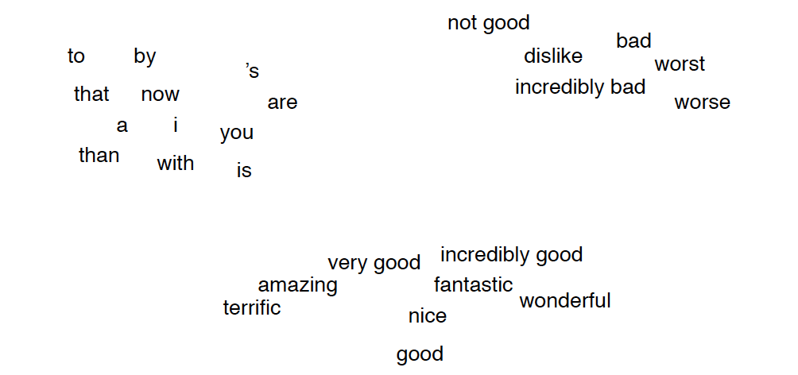
Our Mind Space!

Slide 34
2-D Space!

Slide 35
sauteed
garlic
delicious
ongchoi
2-D Space!

Slide 36
sauteed
garlic
ongchoi is delicious
context window of size 3 tokens
delicious
ongchoi
2-D Space!

Slide 37
sauteed
garlic
ongchoi is delicious
ongchoi can be sauteed with garlic
delicious
ongchoi
2-D Space!

Slide 38
sauteed
garlic
ongchoi is delicious
ongchoi can be sauteed with garlic
sauteed ongchoi on rice
delicious
ongchoi
2-D Space!

Slide 39
sauteed
garlic
ongchoi is delicious
ongchoi can be sauteed with garlic
sauteed ongchoi on rice
delicious
ongchoi
2-D Space!

Slide 40
Word Vector
Word Embedding
Word Point
Vector semantics is to represent/embed a word as a point in some multidimensional vector space as the semantic space.

Slide 41
Word Vector
Word Embedding
Word Point
Meaning Similarity → Geometric Proximity
Context Window

Slide 42
Term-Document Matrix
Context Window = Document

Slide 43
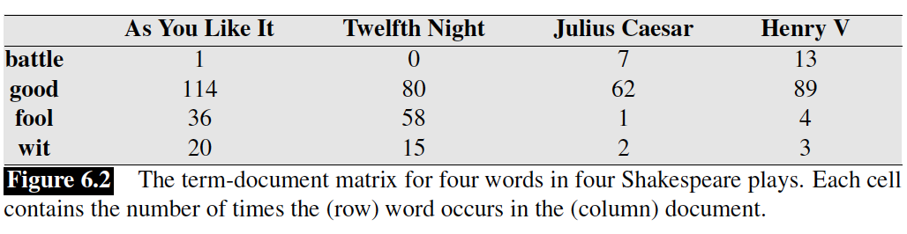
Term-Document Matrix
Context Window = Document
|Vocabs| × |Documents|

Slide 44
Term-Document Matrix
Context Window = Document
|Vocabs| × |Documents|

Slide 45
Term-Document Matrix
Words are points (vectors) in document space!
Julius Cesar
good
wit
As you like it
fool
Twelfth Night

Slide 46
Term-Document Matrix
Distribution of words in documents!
Julius Cesar
good
wit
As you like it
fool
Twelfth Night

Slide 47
Term-Document Matrix
Context Window = Document
Is it sparse or dense matrix? Why?

Slide 48
Term-Document Matrix
Distribution of documents in words.
Documents in word space!

Slide 49
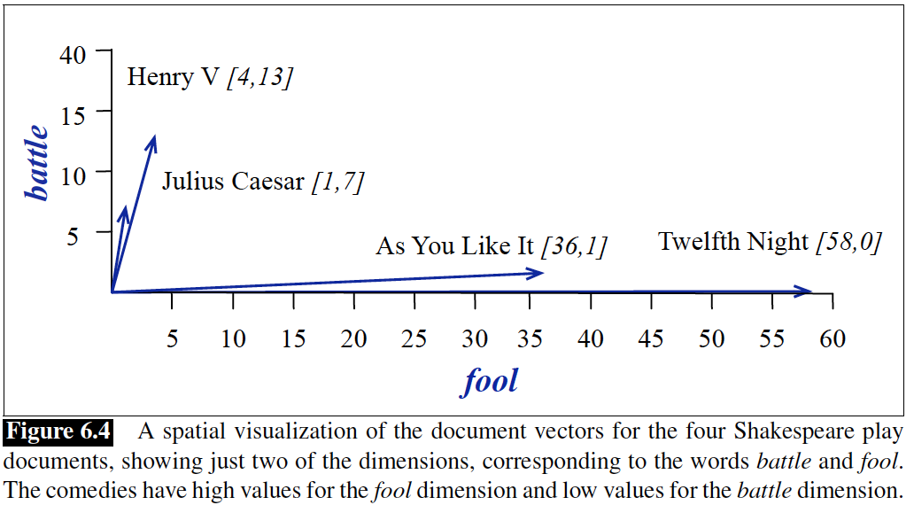

Slide 50
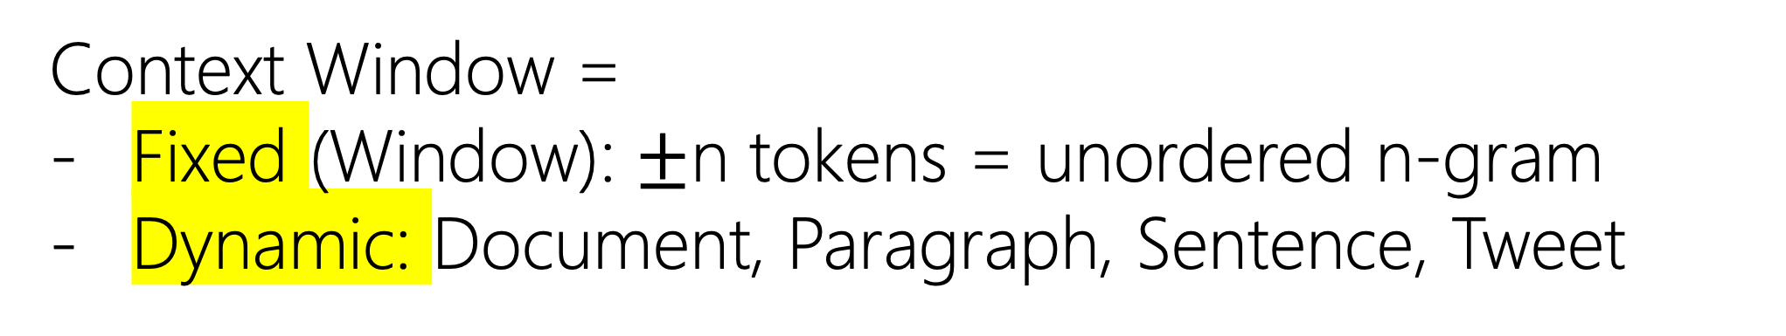
Term-Term Matrix
aka word-word matrix
aka word-context matrix
Context Window =
Fixed (Window): $±$n tokens = unordered n-gram
Dynamic: Document, Paragraph, Sentence, Tweet

Slide 51
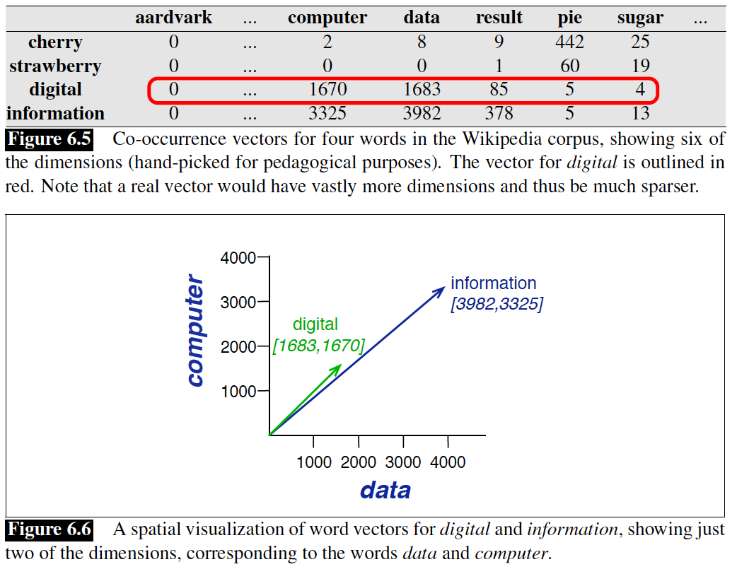
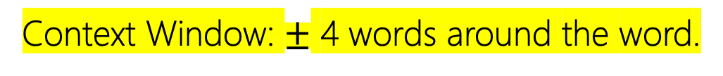
Context Window: $±$ 4 words around the word.

Slide 52
Term-Term Matrix
Matrix Size = |Vocabs|²
Is it sparse or dense? Why? Does context size matter?

Slide 53
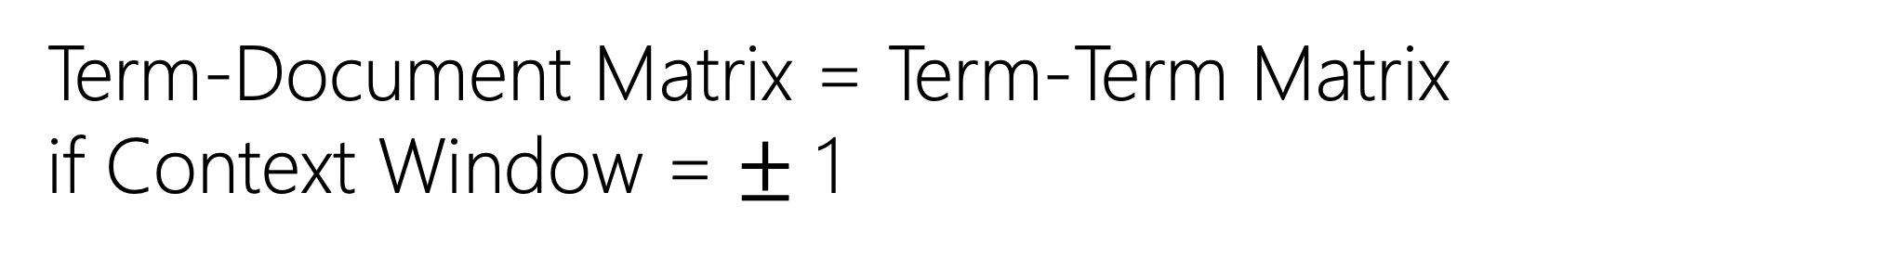
Term-Term Matrix
Term-Document Matrix = Term-Term Matrix
if Context Window = $±$ 1

Slide 54
TF-IDF
Weighted Term-Document Matrix
Context Window = Document
|Vocabs| × |Documents|

Slide 55
Term Frequency = TF = Term-Document Matrix

Slide 56
Term-Document Matrix
Context Window = Document

Slide 57
Term-Document Matrix
Non-Discriminative Words

Slide 58
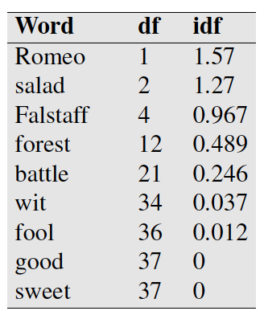
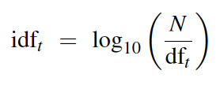
iDF = inverse Document Frequency
→
where N is the total number of documents in the collection
Notes:
→

Slide 59


TF-iDF
Notes:
→

Slide 60
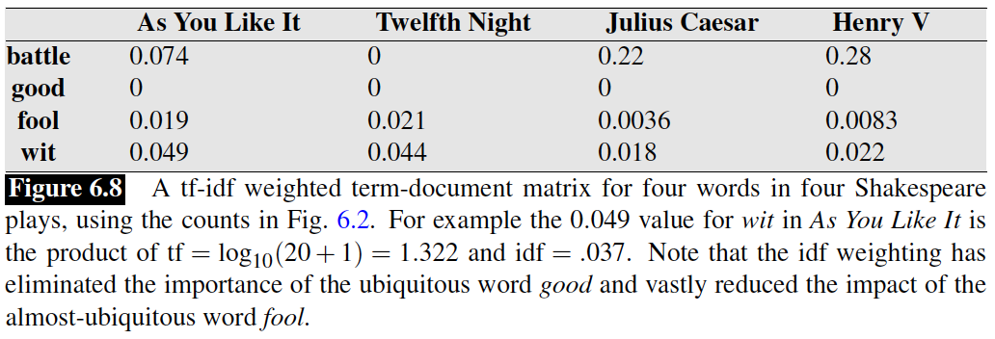
TF-iDF
Notes:
→

Slide 61
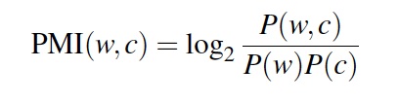
Pointwise Mutual Information (PMI)
Lecture Assignment
Church, K. W. and Hanks, P. (1990). Word association norms, mutual information, and lexicography. Computational Linguistics, 16(1), 22–29.

Slide 62
