Slide 1


Slide 2
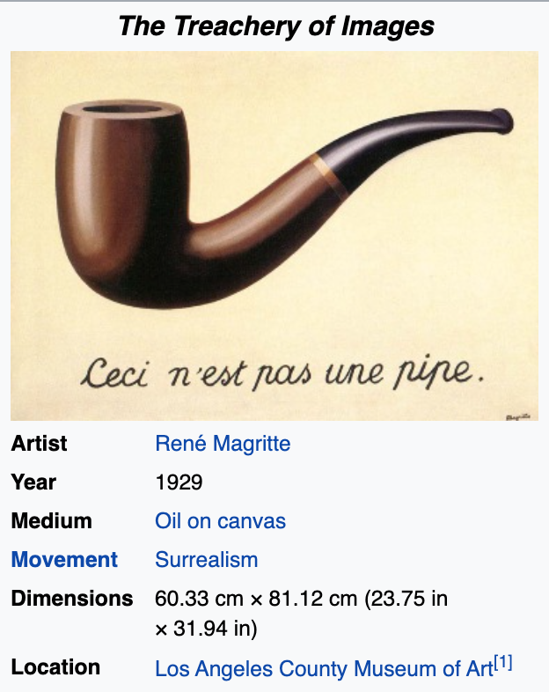
Word vector space models

Slide 3
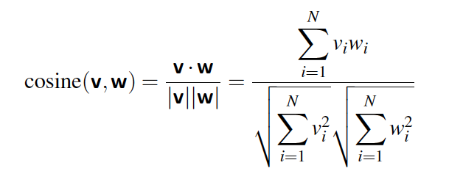
Cosine Similarity
the angle ∈ [0,360], Cosine Similarity ∈ [-1, 1]dd

Slide 4
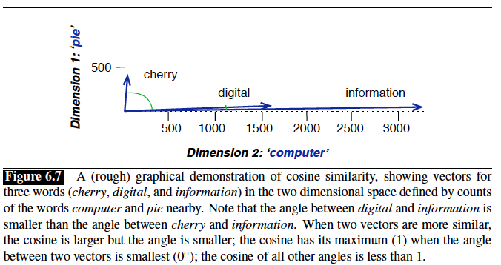

Slide 5
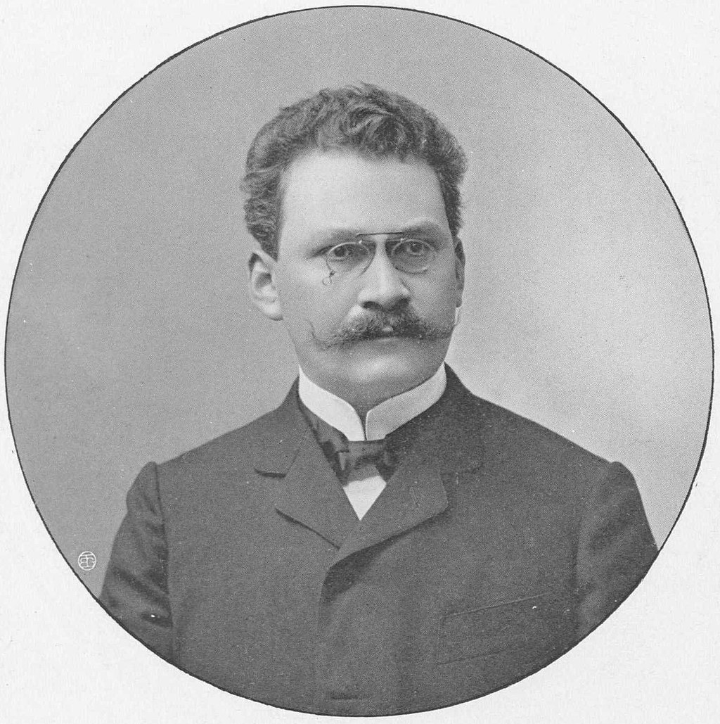
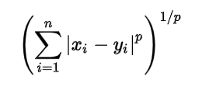
Minkowski Distance
p = 1, Manhattan Distance
p = 2, Euclidean Distance
p = ∞, Chebychev Distance

Slide 6
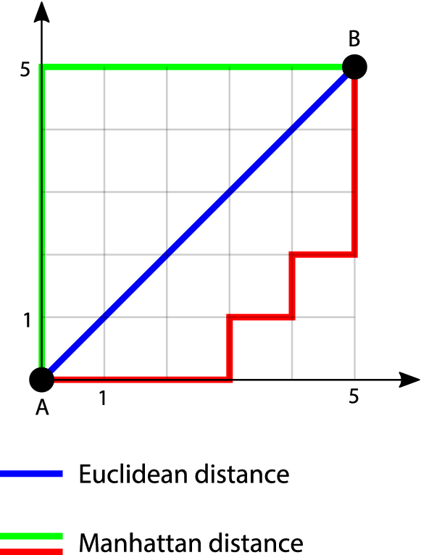
p = 1, Manhattan Distance
p = 2, Euclidean Distance

Slide 7
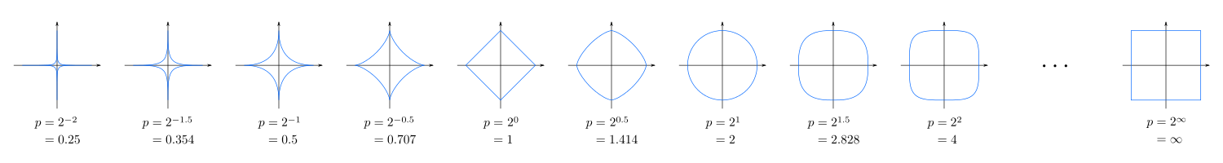
Minkowski Distance
Blue lines show all points (x,y) with same distance to the center (0,0)
Chebyshev/Chess
Manhattan
Euclidian

Slide 8
Does it matter? Why? How if yes?
Research Question (RQ) dd
Cosine Similarity
Minkowski Distance

Slide 9
Vector Semantics
Sparse vs. Dense
Method | Size of word/token/term vector | Sparse/Dense
Word-Documents (TF) | |Documents| | Sparse (Integer)
Term-Term | |Vocabs| | Sparse (Integer)
TF-iDF | |Vocabs| | Sparse (Real)
PMI | |Vocabs| | Sparse (Real)
? | 10, 100, … | Dense (Real)

Slide 10
Vector Semantics
Sparse vs. Dense
Dense vectors work better in every NLP task than sparse vectors. Why? We don’t completely understand!
Some guesses:
Dense vectors lead to a model with less parameter: 100-D vs. 50,000-D vectors for a simple binary classifier
Generalize better
Avoid overfitting
Captures word semantic dependencies
Do a better job of capturing synonymy than sparse vectors.
In word space, each dimension is a word. However, these dimensions may not be independent!

Slide 11
Dimensionality Reduction
Drop less informative dimensions (columns)
Stop-words
Matrix Factorization (Decomposition)
SVD (Eigenvalues, change of base to eigenvectors, …)

Slide 12
Predictive Models
Word2Vec

Slide 13
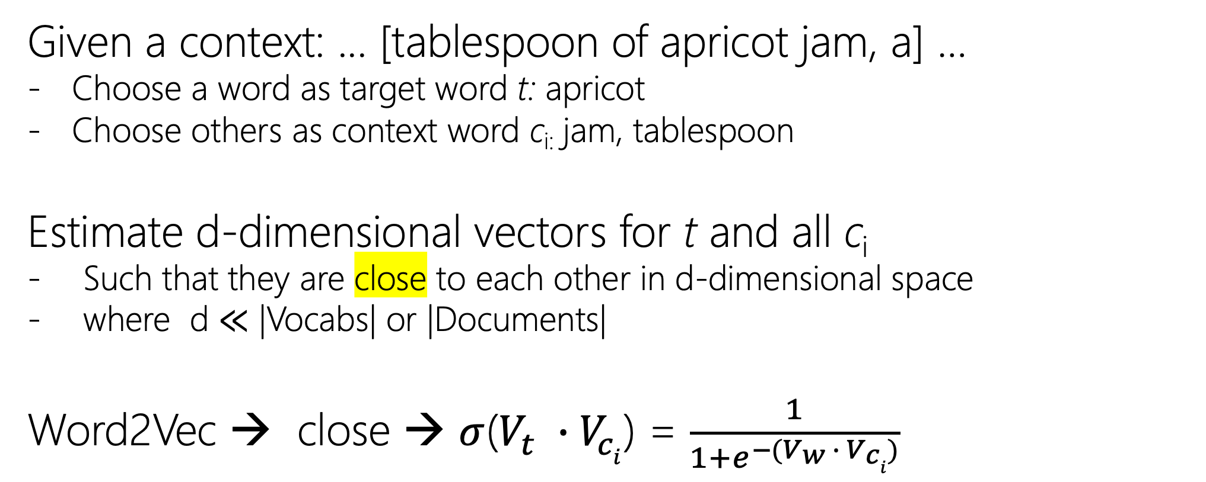
Predictive Models
Given a context: ... [tablespoon of apricot jam, a] …
Choose a word as target word t: apricot
Choose others as context word c_{i:} jam, tablespoon
Estimate d-dimensional vectors for t and all c_{i}
Such that they are close to each other in d-dimensional space
where d ≪ |Vocabs| or |Documents|
Word2Vec → close → $σ$($V_{t} ∙{ V}_{ci}$) = $\frac{1}{1+e^{−(V_{w} ∙{ V}_{ci})}}$

Slide 14
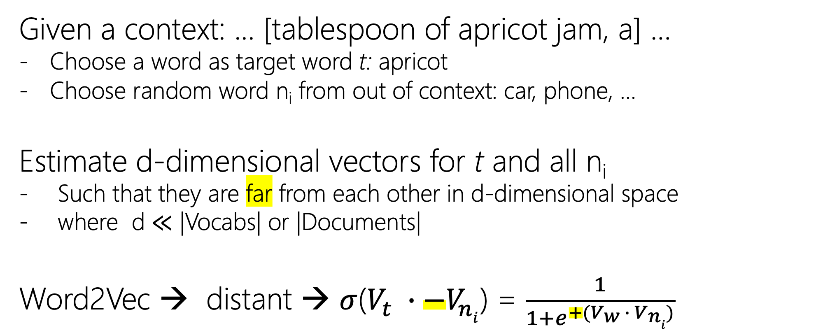
Predictive Models
Given a context: ... [tablespoon of apricot jam, a] …
Choose a word as target word t: apricot
Choose random word n_{i} from out of context: car, phone, …
Estimate d-dimensional vectors for t and all n_{i}
Such that they are far from each other in d-dimensional space
where d ≪ |Vocabs| or |Documents|
Word2Vec → distant → $σ$($V_{t} ∙{ −V}_{ni}$) = $\frac{1}{1+e^{+(V_{w} ∙{ V}_{ni})}}$

Slide 15
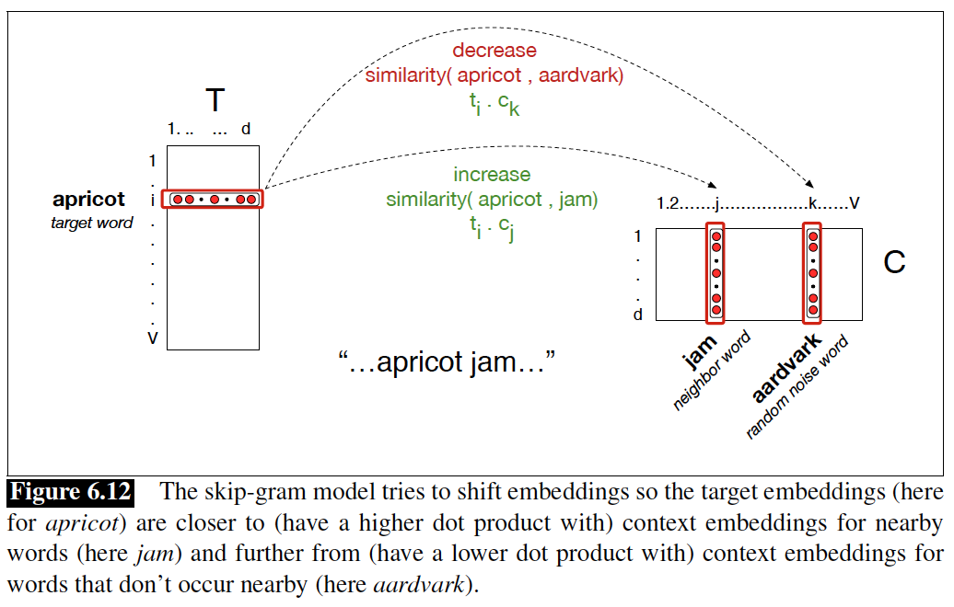
target matrix
context matrix
Is it possible to use only one matrix?

Slide 16
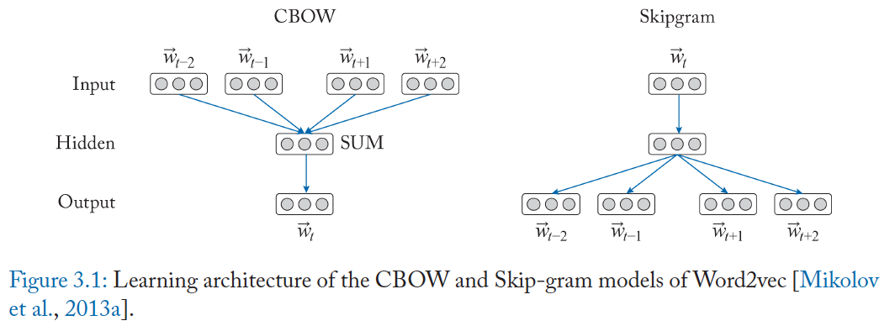
Word2Vec

Slide 17
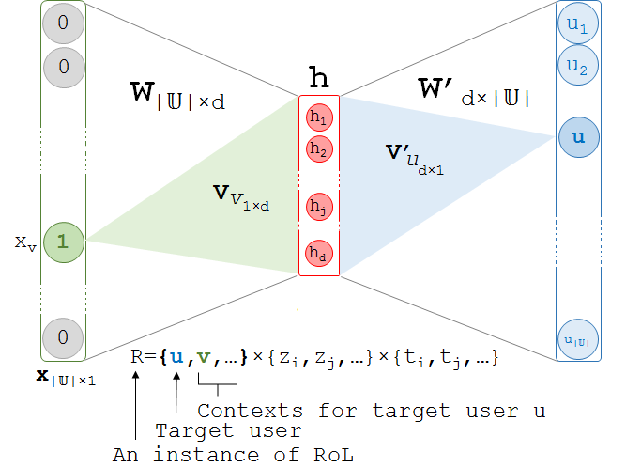
Word2Vec
$σ$((h = x^{T} W + b) W’ + b )

Slide 18

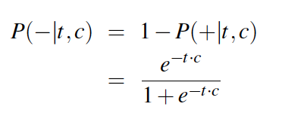
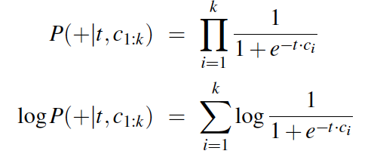

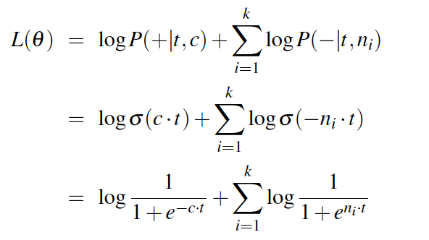
Word2Vec
Independent Assumption: P(x,y) = p(x)p(y)

Slide 19
Word2Vec
Context Window? Longer vs. Shorter?
Deterministic? Any runs of training ended with same set of vectors?
Transformation? rotation, flips, shear (skew), …
Which signifier:
[cat], [miu], [image_of_cat], [ascii_cat],
Count-based: [tf], [tf-idf], …
Learning methods: [word2vec]

Slide 20
Pre-trained Word Vectors
Available in genism python libarary:
conceptnet-numberbatch-17-06-300 (1917247 records): ConceptNet Numberbatch consists of state...
fasttext-wiki-news-subwords-300 (999999 records): 1 million word vectors trained on Wikipe...
glove-twitter-100 (1193514 records): Pre-trained vectors based on 2B tweets,...
glove-twitter-200 (1193514 records): Pre-trained vectors based on 2B tweets, ...
glove-twitter-25 (1193514 records): Pre-trained vectors based on 2B tweets, ...
glove-twitter-50 (1193514 records): Pre-trained vectors based on 2B tweets, ...
glove-wiki-gigaword-100 (400000 records): Pre-trained vectors based on Wikipedia 2...
glove-wiki-gigaword-200 (400000 records): Pre-trained vectors based on Wikipedia 2...
glove-wiki-gigaword-300 (400000 records): Pre-trained vectors based on Wikipedia 2...
glove-wiki-gigaword-50 (400000 records): Pre-trained vectors based on Wikipedia 2...
word2vec-google-news-300 (3000000 records): Pre-trained vectors trained on a part of...
word2vec-ruscorpora-300 (184973 records): Word2vec Continuous Skipgram vectors tra...

Slide 21
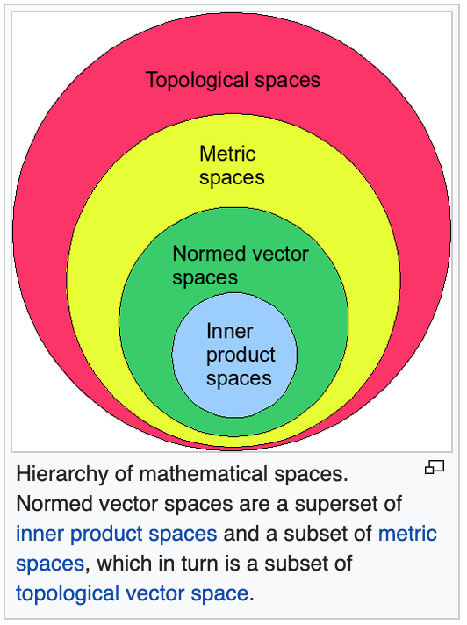
Vector Semantics Vector Space
Transformation
Linear Algebra

Slide 22
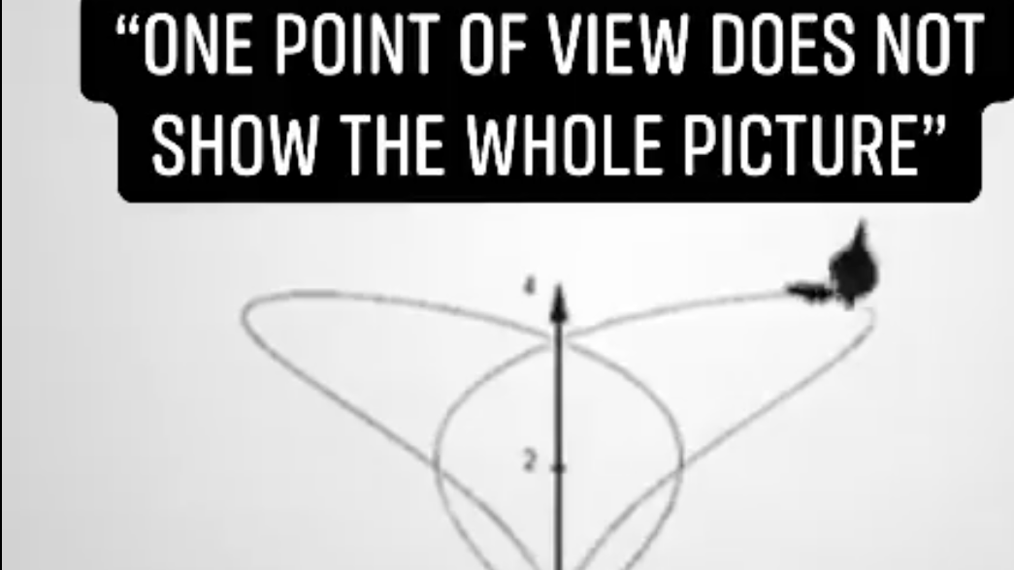
https://fb.watch/3jPmMRxpDJ/

Slide 23
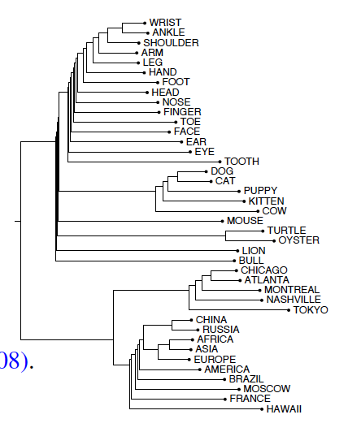
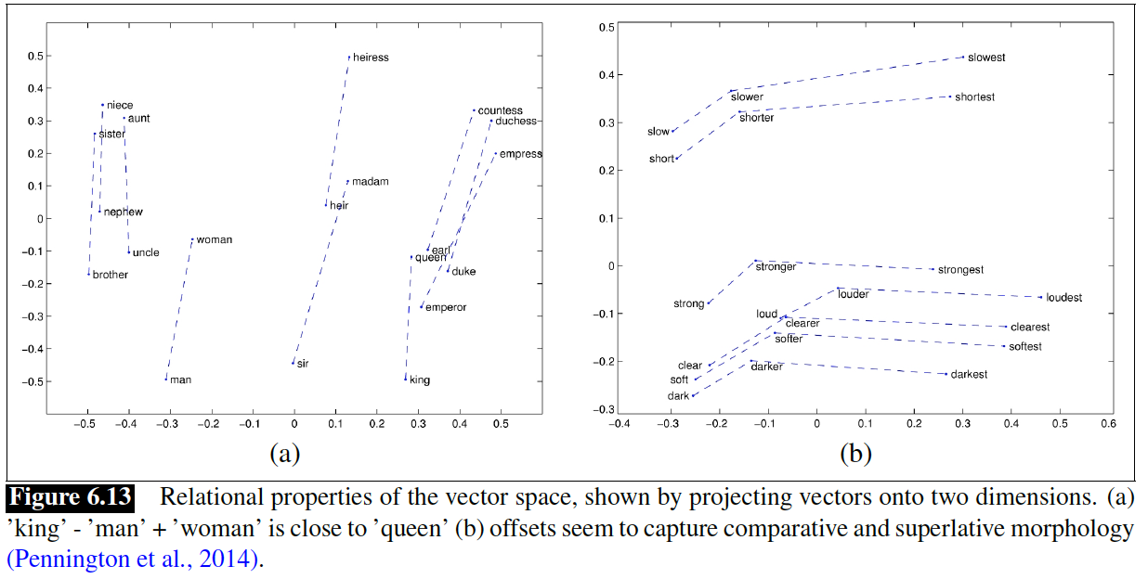
Visualization
Intuition, Geometry

Slide 24
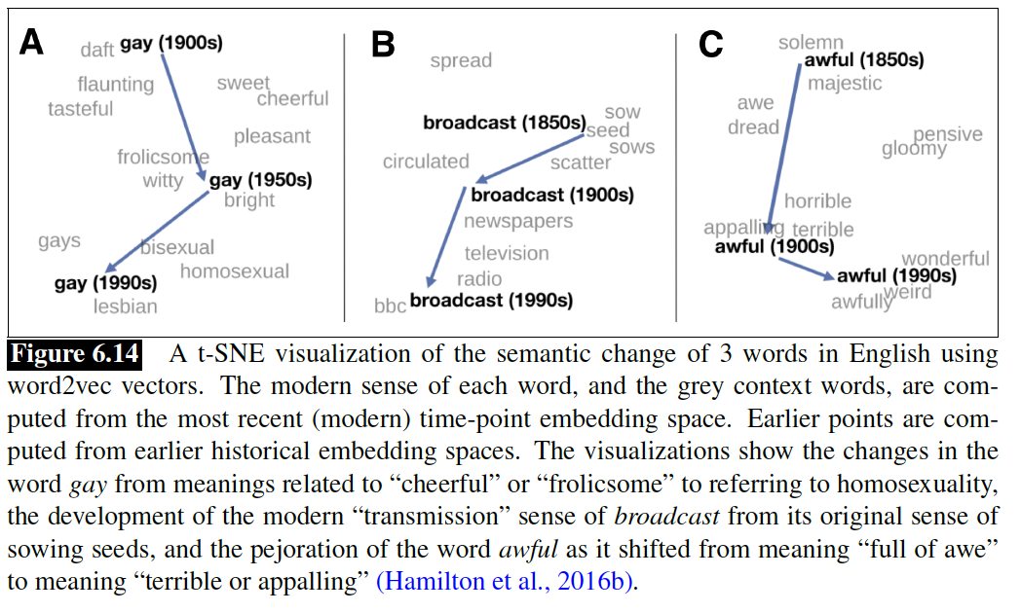
Movement
Temporality (How?)

Slide 25
Biases
Inherent/Latent/Hidden Distribution
(sare, mom, nurse), (mr., ahmed, doctor, president)
(drug, mexican), (education, usa, canada)
(flowers, pleasant, {European-American}), (insects, ugly, {African-American})
Debiasing
Gender-base: [he] remains masculine, [she] remains feminine, but [nurse],[doctor],[president] becomes neutral
Study of Bias in History

Slide 26
Evaluation
Intrinsic
Golden Standards for Semantic Similarity/Distance
No Context: just pair of words
WordSim-353
SimLex-999
With Context:
Stanford Contextual Word Similarity (SCWS) (Huang et al., 2012) and the
Word-in-Context (WiC) (Pilehvar and Camacho-Collados, 2019)
Extrinsic:
Improve the performance of underlying task
Information Retrieval (IR), Document Classification, Sentiment Analysis, …

Slide 27
CROSS-LINGUAL WORD EMBEDDINGS
Words from two or more languages are represented in the same shared low-dimensional vector space.
Level of supervision:
sentence-level: Machine Translation (MT) Corpora
document-level: Wikipedia
word-level: Bilingual Dictionaries
unsupervised: Distribution of words in monolingual corpora in a bilingual dictionary

Slide 28
How to learn representation for:
Character (autocorrection)
Sentence/Paragraph/Documents (Doc2Vec)

Slide 29
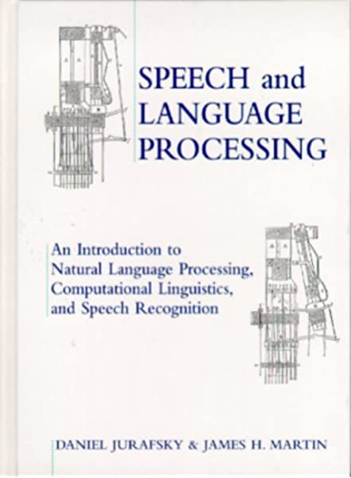

Slide 30
d₃
At least one co-occurrence with w_{k}
(0,0, x_{k})
X = word
x = (x_{i}, x_{j}, x_{k})
X = word
x = (x_{i}, x_{j}, x_{k})
(0,x_{j},0)
d₂
0
1
Domain: {0, 1}
(x_{i},0,0)
d₁
All words that do not co-occur with w_{k}
Possible Domains:
N^{|Vocabs|}
R^{|Vocabs|}

Slide 31
w_{k}
The more co-occurrence with w_{k}, closer to 1
(0,0, x_{k})
X = unknown word
x = (x_{i}, x_{j}, x_{k})
(0,x_{j},0)
w_{j}
0
1
Domain: R^{[0, 1]}
(x_{i},0,0)
w_{i}
The less co-occurrence with w_{k}, closer to 0
Possible Domains:
N^{|Vocabs|}
R^{|Vocabs|}

Slide 32
w_{k}
The more co-occurrence with w_{k}, more cosine similarity
(0,0, x_{k})
X = unknown word
x = (x_{i}, x_{j}, x_{k})
(0,x_{j},0)
w_{j}
0
1
Domain: R^{[0, 1]}
(x_{i},0,0)
w_{i}
The less co-occurrence with w_{k}, less cosine similarity
Possible Domains:
N^{|Vocabs|}
R^{|Vocabs|}

