Slide 1
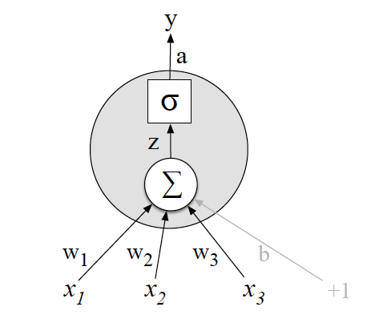
Neural language models

Slide 2

Backgrounds
Computation $↔$ Function
Computational Intelligence $↔$Learning the function

Slide 3
Function
f: M → N
Transferring elements of source space (M) to target space (N)
f: R → R : f(x) = y = x × 2 + 1
f is known
f has two parameters (a=2, b=1)

Slide 4
Function
f: M → N
Transferring elements of source space (M) to target space (N)
f: R → R : {(x, f(x))| (1,1), (2,4), (3,9), …}
f(x) = ?
f is unknown!

Slide 5
Function
f: M → N
Transferring elements of source space (M) to target space (N)
f: R → R : {(x, f(x))| (1,1), (2,4), (3,9), …}
f(x) = ?
f is unknown! Might not exist!

Slide 6
Function
f: M → N
Transferring elements of source space (M) to target space (N)
f: R → R : {(x, f(x))| (1,1), (2,4), (3,9), …}
f(x) = ?
f is unknown! If exists, there may be more that one!

Slide 7
Function
f: M → N
Transferring elements of source space (M) to target space (N)
f: R → R : {(x, f(x))| (1,1), (2,4), (3,9), …}
f(x) = ?
f is unknown! Even more than one exists, we may not find one!

Slide 8
Function
f: M → N
Transferring elements of source space (M) to target space (N)
f: R → R : {(x, f(x))| (1,1), (2,4), (3,9), …}
f(x) = ?
f is unknown! We assume at least one exists, we try to find it!

Slide 9
Transformation
f: M → N
Transferring points (vectors) of source space (M) to target space (N)
[T][X] = [Y]; X∈M, Y∈N
T is a matrix that includes the parameters of f

Slide 10

Transformation (Linear Algebra)
f: M → N
Transferring points (vectors) of source space (M) to target space (N)
[2 1]$\left[\begin{matrix}\text{x} \\ \text{1}\end{matrix}\right]$ = [2x + 1]
f(x) = 2x + 1

Slide 11

Transformation (Linear Algebra)
f: M → N
Transferring points (vectors) of source space (M) to target space (N)
[x 1]$\left[\begin{matrix}\text{2} \\ \text{1}\end{matrix}\right]$ = [2x + 1]
f(x) = 2x + 1
(AB) ^{T} = B^{T} A^{T} →

Slide 12

Transformation (Linear Algebra)
f: M → N
Transferring points (vectors) of source space (M) to target space (N)
[x 1]$\left[\begin{matrix}\text{w}\text{1} \\ \text{w}\text{2}\end{matrix}\right]$ = {(x, f(x))| (1,1), (2,4), (3,9), …}
f(x) = ?

Slide 13
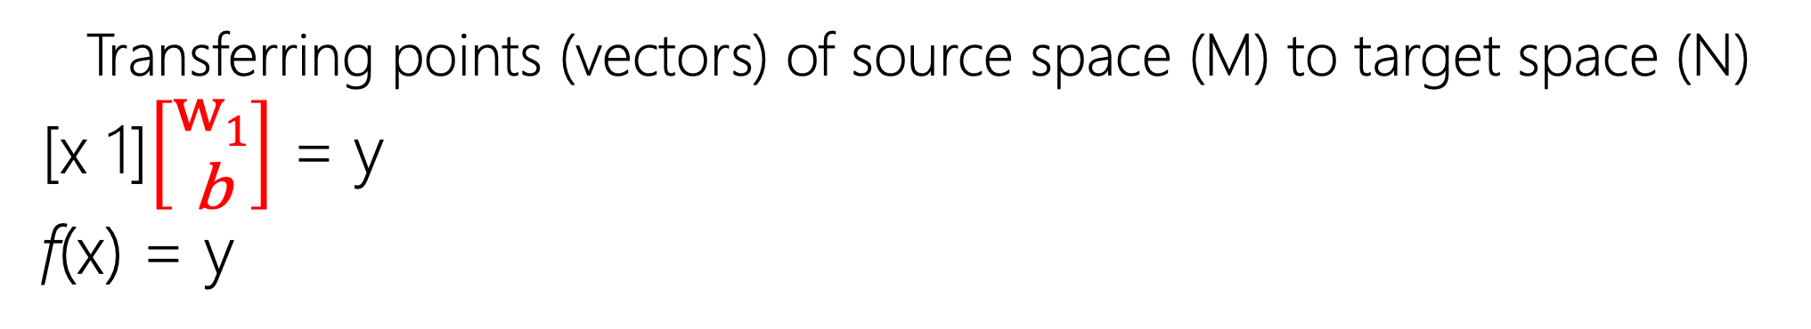


Neural Network
f: M → N
Perceptron
Transferring points (vectors) of source space (M) to target space (N)
[x 1]$\left[\begin{matrix}\text{w}\text{1} \\ \text{b}\end{matrix}\right]$ = y
f(x) = y
x
$$\text{w}\text{1}$$
Σ
$$\text{b}$$
1

Slide 14
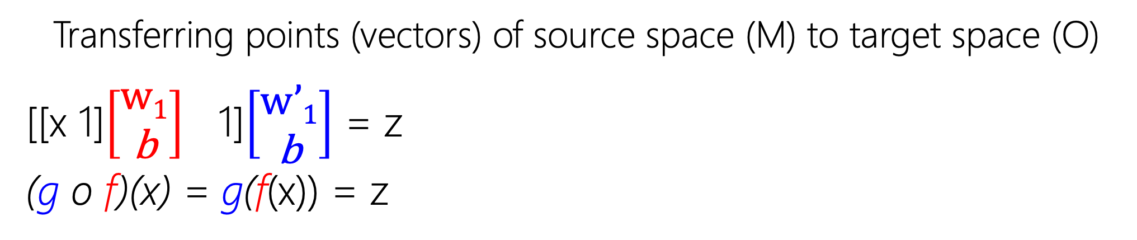




Neural Network
g: (f: M → N) → O
Transferring points (vectors) of source space (M) to target space (O)
[[x 1]$\left[\begin{matrix}\text{w}\text{1} \\ \text{b}\end{matrix}\right]$ 1]$\left[\begin{matrix}\text{w}’\text{1} \\ \text{b}\end{matrix}\right]$ = z
(g o f)(x) = g(f(x)) = z
x
$$\text{w}\text{1}$$
Σ
$$\text{w}\text{′}\text{1}$$
Σ
$$\text{b}$$
1
$$\text{b}$$
1

Slide 15
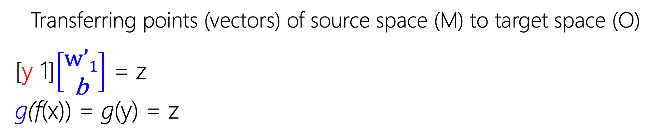
Neural Network
g: (f: M → N) → O
Transferring points (vectors) of source space (M) to target space (O)
[y 1]$\left[\begin{matrix}\text{w}’\text{1} \\ \text{b}\end{matrix}\right]$ = z
g(f(x)) = g(y) = z
x
$$\text{w}\text{1}$$
Σ
$$\text{w}\text{′}\text{1}$$
Σ
$$\text{b}$$
1
$$\text{b}$$
1

Slide 16
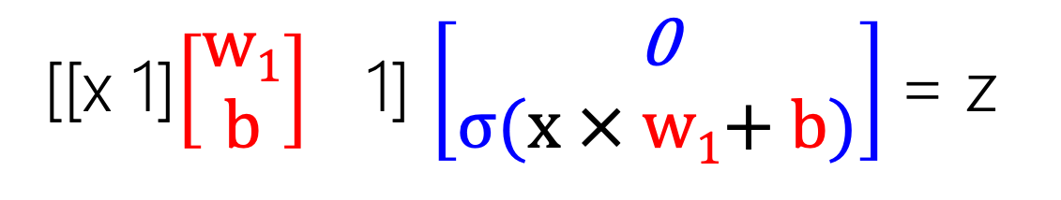
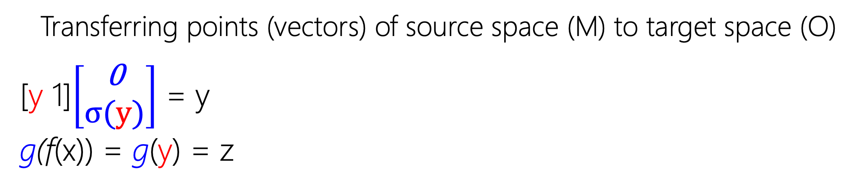


Neural Network
g: (f: M → N) → O
Transferring points (vectors) of source space (M) to target space (O)
[y 1]$\left[\begin{matrix}\text{0} \\ σ\text{(}\text{y}\text{)}\end{matrix}\right]$ = y
g(f(x)) = g(y) = z
x
$$\text{w}\text{1}$$
Σ=y
$$\text{0}$$
Σ
$$\text{b}$$
1
$$σ\text{(}\text{y}\text{)}$$
1
[[x 1]$\left[\begin{matrix}\text{w}\text{1} \\ \text{b}\end{matrix}\right]$ 1] $\left[\begin{matrix}\text{0} \\ σ\text{(}\text{x}\text{ × }\text{w}\text{1}\text{+} \text{b}\text{)}\end{matrix}\right]$= z

Slide 17




Neural Network
g: (f: M → N) → O
Transferring points (vectors) of source space (M) to target space (O)
[y 1]$\left[\begin{matrix}\text{0} \\ σ\text{(}\text{y}\text{)}\end{matrix}\right]$ = y
g(f(x)) = g(y) = z
x
$$\text{w}\text{1}$$
Σ=y
$$\text{0}$$
Σ
$$\text{b}$$
1
$$σ\text{(}\text{y}\text{)}$$
1
[[x 1]$\left[\begin{matrix}\text{w}\text{1} \\ \text{b}\end{matrix}\right]$ 1] $\left[\begin{matrix}\text{0} \\ σ\text{(}\text{x}\text{ × }\text{w}\text{1}\text{+} \text{b}\text{)}\end{matrix}\right]$= z

Slide 18
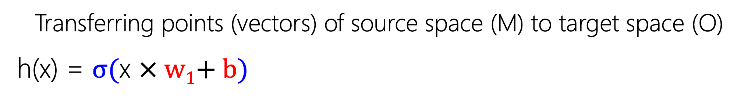
Neural Network
h: M → O
Transferring points (vectors) of source space (M) to target space (O)
h(x) = $σ\text{(}\text{x} \text{× }\text{w}\text{1}\text{+ }\text{b}\text{)}$
x
$$\text{w}\text{1}$$
Σ=y
$$\text{0}$$
Σ
$$\text{b}$$
1
$$σ\text{(}\text{y}\text{)}$$
1
[[x 1]$\left[\begin{matrix}\text{w}\text{1} \\ \text{b}\end{matrix}\right]$ 1] $\left[\begin{matrix}\text{0} \\ σ\text{(}\text{x}\text{ × }\text{w}\text{1}\text{+} \text{b}\text{)}\end{matrix}\right]$= z

Slide 19
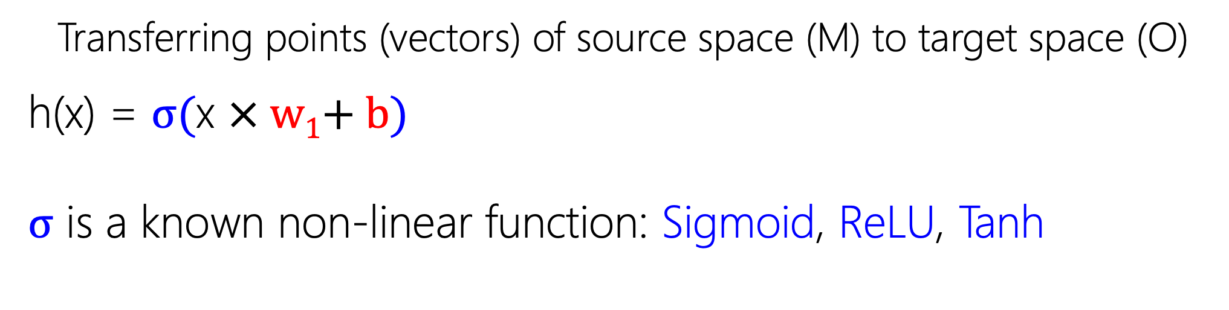
Neural Network
h: M → O
Transferring points (vectors) of source space (M) to target space (O)
h(x) = $σ\text{(}\text{x} \text{× }\text{w}\text{1}\text{+ }\text{b}\text{)}$
$σ$ is a known non-linear function: Sigmoid, ReLU, Tanh
[[x 1]$\left[\begin{matrix}\text{w}\text{1} \\ \text{b}\end{matrix}\right]$ 1] $\left[\begin{matrix}\text{0} \\ σ\text{(}\text{x}\text{ × }\text{w}\text{1}\text{+} \text{b}\text{)}\end{matrix}\right]$= z

Slide 20
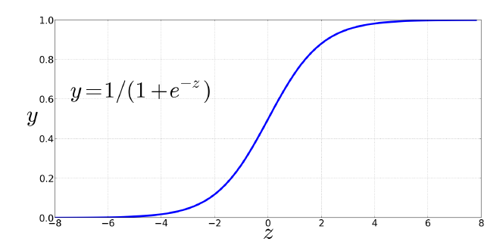
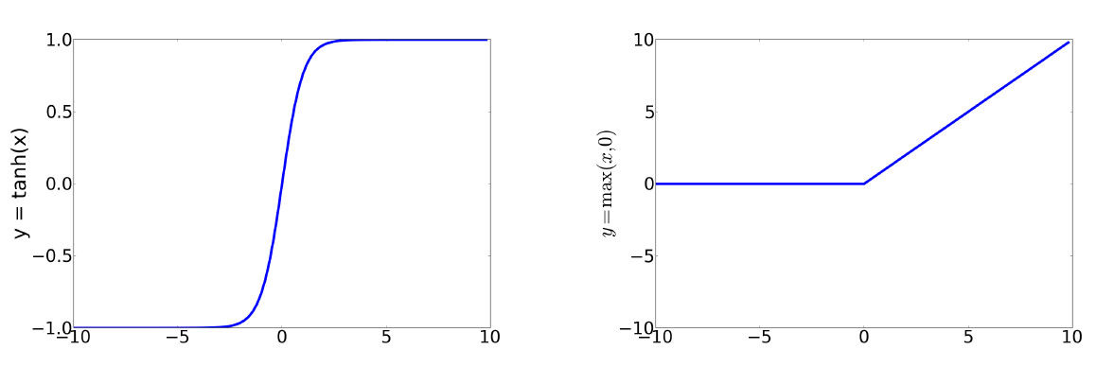

Neural Network: Activation Function $σ$

Slide 21
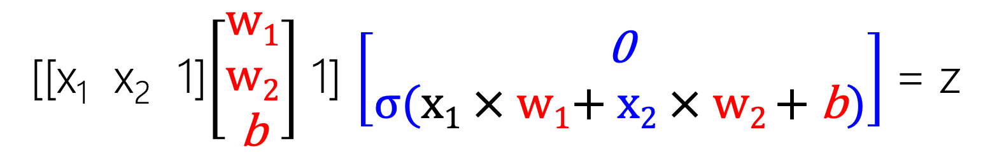
Neural Network
h: M={0,1}² → N={0,1}
M = {(0,0), (0,1), (1,0), (1,1)}
N = {0, 1}
h = {((0,0), 0), ((0,1), 0), ((1,0), 0), ((1,1), 1)}
[[x₁ x₂ 1]$\left[\begin{matrix}\text{w}\text{1} \\ \text{w}\text{2} \\ \text{b}\end{matrix}\right]$ 1] $\left[\begin{matrix}\text{0} \\ σ\text{(}\text{x}\text{1}\text{ ×} \text{w}\text{1}\text{+} \text{x}\text{2} \text{×} \text{w}\text{2} \text{+} \text{b}\text{)}\end{matrix}\right]$= z

Slide 22

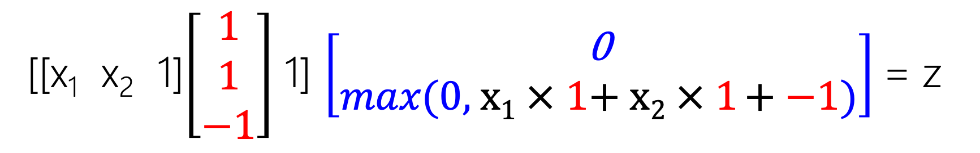




Neural Network
AND: M={0,1}² → N={0,1}
M = {(0,0), (0,1), (1,0), (1,1)}
N = {0, 1}
h = {((0,0), 0), ((0,1), 0), ((1,0), 0), ((1,1), 1)}
x₁
$$\text{1}$$
x₂
$$\text{1}$$
Σ=y
$$\text{0}$$
Σ
$$\text{−}\text{1}$$
1
$$Re\text{LU}\text{(}\text{y}\text{)}$$
1
[[x₁ x₂ 1]$\left[\begin{matrix}\text{1} \\ \text{1} \\ \text{−}\text{1}\end{matrix}\right]$ 1] $\left[\begin{matrix}\text{0} \\ max\text{(}\text{0, }\text{x}\text{1}\text{ ×} \text{1}\text{+} \text{x}\text{2} \text{×} \text{1} \text{+} \text{−1}\text{)}\end{matrix}\right]$= z

Slide 23
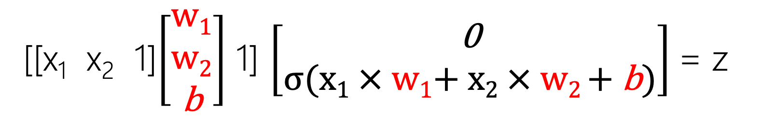
Neural Network
OR: M={0,1}² → N={0,1}
M = {(0,0), (0,1), (1,0), (1,1)}
N = {0, 1}
h = {((0,0), 0), ((0,1), 1), ((1,0), 1), ((1,1), 1)}
[[x₁ x₂ 1]$\left[\begin{matrix}\text{w}\text{1} \\ \text{w}\text{2} \\ \text{b}\end{matrix}\right]$ 1] $\left[\begin{matrix}\text{0} \\ σ\text{(}\text{x}\text{1}\text{ × }\text{w}\text{1}\text{+ }\text{x}\text{2}\text{ ×} \text{w}\text{2 }\text{+ }\text{b}\text{)}\end{matrix}\right]$= z

Slide 24
Neural Network
XOR: M={0,1}² → N={0,1}
M = {(0,0), (0,1), (1,0), (1,1)}
N = {0, 1}
h = {((0,0), 0), ((0,1), 1), ((1,0), 1), ((1,1), 0)}
[[x₁ x₂ 1]$\left[\begin{matrix}\text{w}\text{1} \\ \text{w}\text{2} \\ \text{b}\end{matrix}\right]$ 1] $\left[\begin{matrix}\text{0} \\ σ\text{(}\text{x}\text{1}\text{ × }\text{w}\text{1}\text{+ }\text{x}\text{2}\text{ ×} \text{w}\text{2 }\text{+ }\text{b}\text{)}\end{matrix}\right]$= z

Slide 25
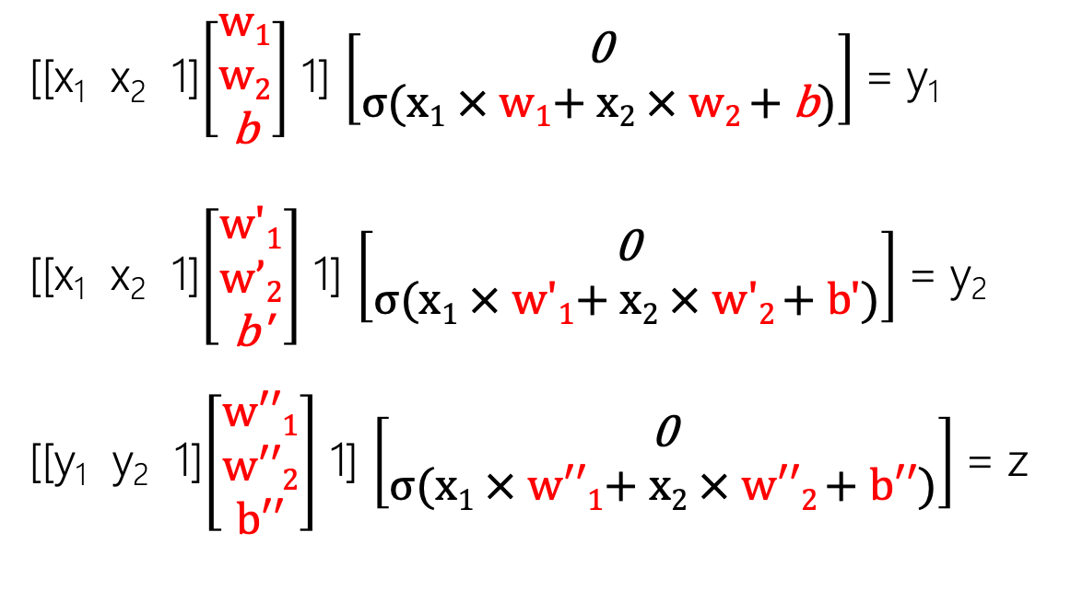
Neural Network
XOR: M={0,1}² → N={0,1,2}² → O={0,1}
M = {(0,0), (0,1), (1,0), (1,1)} → N = {(0,0), (0,1), …, (2,2)} → O = {0, 1}
h = {((0,0), 0), ((0,1), 1), ((1,0), 1), ((1,1), 0)}
[[x₁ x₂ 1]$\left[\begin{matrix}\text{w}\text{1} \\ \text{w}\text{2} \\ \text{b}\end{matrix}\right]$ 1] $\left[\begin{matrix}\text{0} \\ σ\text{(}\text{x}\text{1}\text{ × }\text{w}\text{1}\text{+ }\text{x}\text{2}\text{ ×} \text{w}\text{2 }\text{+ }\text{b}\text{)}\end{matrix}\right]$= y₁
[[x₁ x₂ 1]$\left[\begin{matrix}\text{w}\text{′}\text{1} \\ \text{w}’\text{2} \\ \text{b}\text{′}\end{matrix}\right]$ 1] $\left[\begin{matrix}\text{0} \\ σ\text{(}\text{x}\text{1}\text{ × }\text{w}\text{′}\text{1}\text{+ }\text{x}\text{2}\text{ × }\text{w}\text{′}\text{2 }\text{+ }\text{b}\text{′)}\end{matrix}\right]$= y₂
[[y₁ y₂ 1]$\left[\begin{matrix}\text{w}\text{′′}\text{1} \\ \text{w}\text{′′}\text{2} \\ \text{b}\text{′′}\end{matrix}\right]$ 1] $\left[\begin{matrix}\text{0} \\ σ\text{(}\text{x}\text{1}\text{ × }\text{w}\text{′′1+ }\text{x}\text{2}\text{ × }\text{w}\text{′′2 + }\text{b}\text{′′}\text{)}\end{matrix}\right]$= z

Slide 26
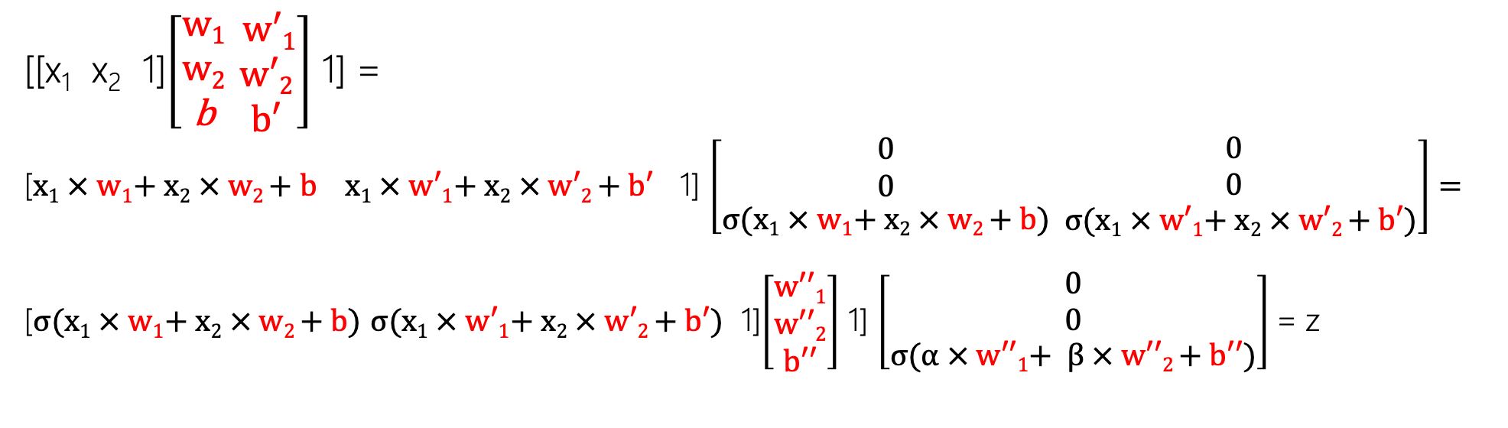


Neural Network
XOR: M={0,1}² → N={0,1,2}² → O={0,1}
M = {(0,0), (0,1), (1,0), (1,1)} → N = {(0,0), (0,1), …, (2,2)} → O = {0, 1}
h = {((0,0), 0), ((0,1), 1), ((1,0), 1), ((1,1), 0)}
[[x₁ x₂ 1]$\left[\begin{matrix}\text{w}\text{1} \\ \text{w}\text{2} \\ \text{b}\end{matrix}\begin{matrix} \text{w}\text{′1} \\ \text{w}\text{′2} \\ \text{b}\text{′}\end{matrix}\right]$ 1] =
[$\text{x}\text{1}\text{ × }\text{w}\text{1}\text{+ }\text{x}\text{2}\text{ × }\text{w}\text{2 }\text{+ }\text{b} \text{x}\text{1}\text{ × }\text{w}\text{′1+ }\text{x}\text{2}\text{ × }\text{w}\text{′2 + }\text{b}\text{′}$ 1] $\left[\begin{matrix}\begin{aligned}\text{0} \\ 0\end{aligned} \\ σ\text{(}\text{x}\text{1}\text{ × }\text{w}\text{1}\text{+ }\text{x}\text{2}\text{ × }\text{w}\text{2 }\text{+ }\text{b}\text{)}\end{matrix}\begin{matrix}\begin{aligned}\text{0} \\ 0\end{aligned} \\ σ\text{(}\text{x}\text{1}\text{ × }\text{w}\text{′1+ }\text{x}\text{2}\text{ × }\text{w}\text{′2 + }\text{b}\text{′}\text{)}\end{matrix}\right]=$
[$σ\text{(}\text{x}\text{1}\text{ × }\text{w}\text{1}\text{+ }\text{x}\text{2}\text{ × }\text{w}\text{2 }\text{+ }\text{b}\text{)}$ $σ\text{(}\text{x}\text{1}\text{ × }\text{w}\text{′1+ }\text{x}\text{2}\text{ × }\text{w}\text{′2 + }\text{b}\text{′}\text{)}$ 1]$\left[\begin{matrix}\text{w}\text{′′}\text{1} \\ \text{w}\text{′′}\text{2} \\ \text{b}\text{′′}\end{matrix}\right]$ 1] $\left[\begin{matrix}\begin{aligned}\text{0} \\ 0\end{aligned} \\ σ\text{(}α \text{× }\text{w}\text{′′1+ }β \text{× }\text{w}\text{′′2 + }\text{b}\text{′′}\text{)}\end{matrix}\right]$= z
$$α$$
$$β$$

Slide 27
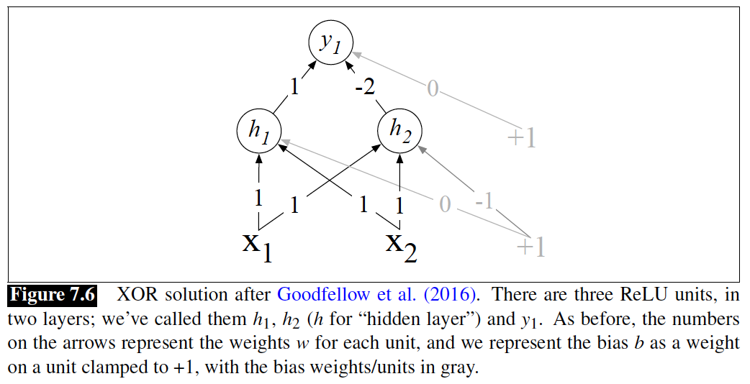
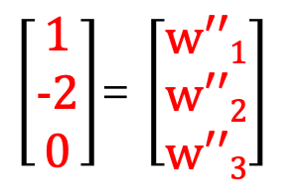

Neural Network
XOR: M={0,1}² → N={0,1,2}² → O={0,1}
M = {(0,0), (0,1), (1,0), (1,1)} → N = {(0,0), (0,1), …, (2,2)} → O = {0, 1}
h = {((0,0), 0), ((0,1), 1), ((1,0), 1), ((1,1), 0)}
$\left[\begin{matrix}\text{1} \\ \text{−2} \\ \text{0}\end{matrix}\right]$= $\left[\begin{matrix}\text{w}\text{′′1} \\ \text{w}\text{′′2} \\ \text{w}\text{′′3}\end{matrix}\right]$
$$\text{[}\text{x}\text{1} \text{x}\text{2}\text{ 1]}\left[\begin{matrix}\text{w}\text{1} \\ \text{w}\text{2} \\ \text{w}\text{3}\end{matrix}\begin{matrix} \text{w}\text{′1} \\ \text{w}\text{′2} \\ \text{w}\text{′3}\end{matrix}\right]=$$
$\text{[}\text{x}\text{1} \text{x}\text{2}\text{ 1]}\left[\begin{matrix}\text{1} \\ \text{1} \\ \text{0}\end{matrix}\begin{matrix} \text{1} \\ \text{1} \\ \text{−1}\end{matrix}\right]$=
[$\text{h}\text{1}\text{=}\text{ReLU}\text{(}\text{x}\text{1}\text{+}\text{x}\text{2}\text{) }\text{h}\text{2}\text{=}\text{ReLU}\text{(}\text{x}\text{1}\text{+}\text{x}\text{2}\text{−1}$)]

Slide 28
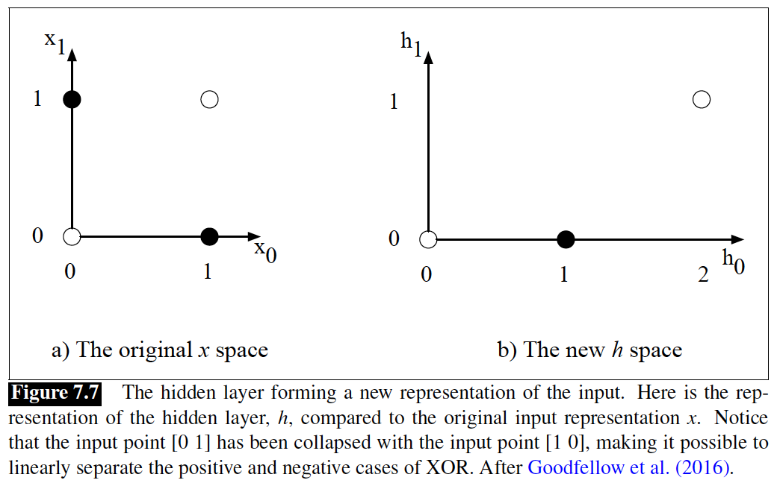
Neural Network
XOR: M={0,1}² → N={0,1,2}² → O={0,1}
M = {(0,0), (0,1), (1,0), (1,1)} → N = {(0,0), (0,1), …, (2,2)} → O = {0, 1}
(0,0) → (0,0) → (0)
(0,1) → (1,0) → (1)
(1,0) → (1,0) → (1)
(1,1) → (2,1) → (0)

Slide 29
Universal Approximation Theorem
http://neuralnetworksanddeeplearning.com/chap4.html
Be carful, it shows the existence (power) of neural nets, but it does not show which architecture is the function!
How many transformation (#layers)?
To what intermediate space (#nodes)?

Slide 30









Neural Network: Feed-forward
h^{[1]}1
h^{[L]}1
x1
h^{[1]}2
h^{[2]}1
h^{[L]}2
y1
xn
h^{[2]}2
..
…
yM
xN
h^{[2]}H₂
y$\text{ =}σ(h\left[L\right] W[L+1]+b[L+1]\text{)}$
h^{[1]}H₁
h^{[L]}H_{L}
$$W\left[L\right]:H1× M$$
$$h\left[1\right]\text{ =}σ(x W[1]+b[1])$$
$h\left[2\right]\text{ =}σ(h\left[1\right] W[2]+b[2]$)
$$h\left[L\right]\text{ =}σ(h\left[L−1\right] W[L]+b[L]\text{)}$$
$$x:1 × N$$
$$W[1]:N × H1$$
$$W[2]:H1× H2$$
$$W\left[L\right]:HL−1× HL$$

Slide 31
Neural Network: Feed-forward Train
The only known is the data (input: X, output: Y)
Given the input point X, the net should land it to Y.
If the net should land it to f(X) = Y’ → error!
Correct the net to make Y’ close to Y.
How?
x1
y1
xn
..
…
xN
yM

Slide 32
Neural Network: Feed-forward Train
How?
By minimizing the overall error.
What is error?
e = distance (Y, f(X)); for all (X, Y)
Optimization Function → Loss Function
Minimization
x1
y1
xn
..
…
xN
yM

Slide 33
Neural Network: Gradient
How?
By minimizing the overall error.
What is error?
e = distance (Y, f(X)); for all (X, Y)
We have to change f such that Y and f(X) get closer and closer!
Y and X is constant in this procedure.
x1
y1
xn
..
…
xN
yM

Slide 34

Neural Network: Gradient
How?
By minimizing the overall error.
What is error?
e = distance (Y, f(X)); for all (X, Y)
We have to change parameters such that Y and f(X) get closer and closer!
Y and X is constant in this procedure.
e($Θ$) = distance(Y, f(X; $Θ$))
x1
y1
xn
..
…
xN
yM

Slide 35

Neural Network: Gradient
f(x) = 3x+1 → f(x; $Θ$) = f(x; [3,1]) = 3x+1
f(x; [w₁,w₂]) = w₁ x+ w₂
(x, y) = (2, 1)
f(2; [w₁,w₂]) = w₁ 2+ w₂
e = e(w₁,w₂) = e($Θ$) = | f(2; [w₁,w₂]) – 1 | = w₁ 2+ w₂ – 1
How to change w₁ and w₂ to reduce the error?
x1
y1
xn
..
…
xN
yM

Slide 36
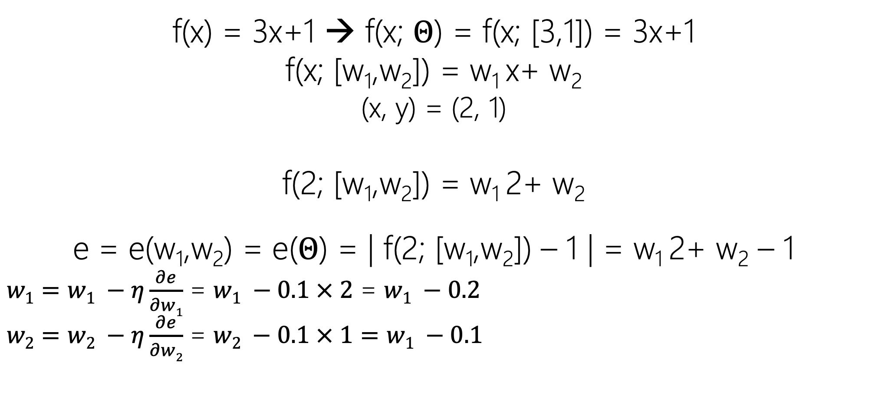
Neural Network: Gradient Descent
f(x) = 3x+1 → f(x; $Θ$) = f(x; [3,1]) = 3x+1
f(x; [w₁,w₂]) = w₁ x+ w₂
(x, y) = (2, 1)
f(2; [w₁,w₂]) = w₁ 2+ w₂
e = e(w₁,w₂) = e($Θ$) = | f(2; [w₁,w₂]) – 1 | = w₁ 2+ w₂ – 1
$w1=w1 −η\frac{∂e}{∂w1}$ = $w1 −0.1 × 2$ = $w1 −0.2$
$w2=w2 −η\frac{∂e}{∂w2}$ = $w2 −0.1 × 1=w1 −0.1$
x1
y1
xn
..
…
xN
yM

Slide 37
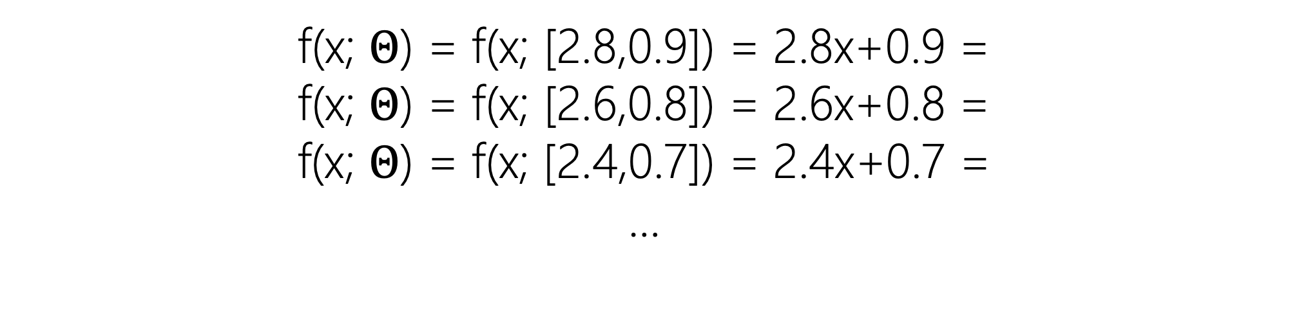
Neural Network: Gradient Descent
f(x; $Θ$) = f(x; [2.8,0.9]) = 2.8x+0.9 =
f(x; $Θ$) = f(x; [2.6,0.8]) = 2.6x+0.8 =
f(x; $Θ$) = f(x; [2.4,0.7]) = 2.4x+0.7 =
…
x1
y1
xn
..
…
xN
yM

Slide 38
Neural Network: Gradient Descent
Convex Error Function
Many Parameters (all matrices' elements)
Backpropagation!
Computation Graph
Forward Pass
Backward Differentiation.
x1
y1
xn
..
…
xN
yM

Slide 39
Neural Language Model

Slide 40
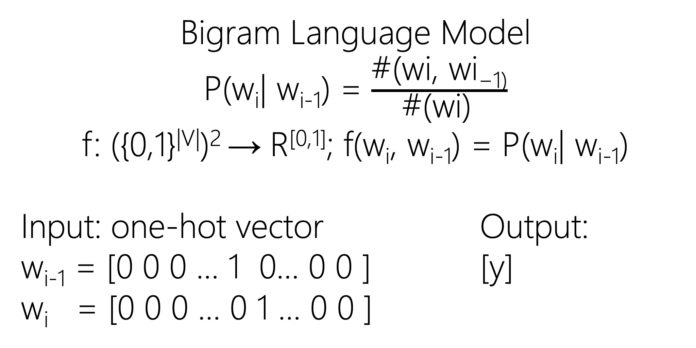
Neural Language Model
Bigram Language Model
P(w_{i}| w_{i-1}) = $\frac{\text{\#(}\text{wi}\text{, }\text{wi}\text{−1)}}{\text{\#(}\text{wi}\text{)} }$
f: ({0,1}^{|V|})² → R^{[0,1]}; f(w_{i}, w_{i-1}) = P(w_{i}| w_{i-1})
Input: one-hot vector Output:
w_{i-1} = [0 0 0 … 1 0… 0 0 ] [y]
w_{i} = [0 0 0 … 0 1 … 0 0 ]

Slide 41
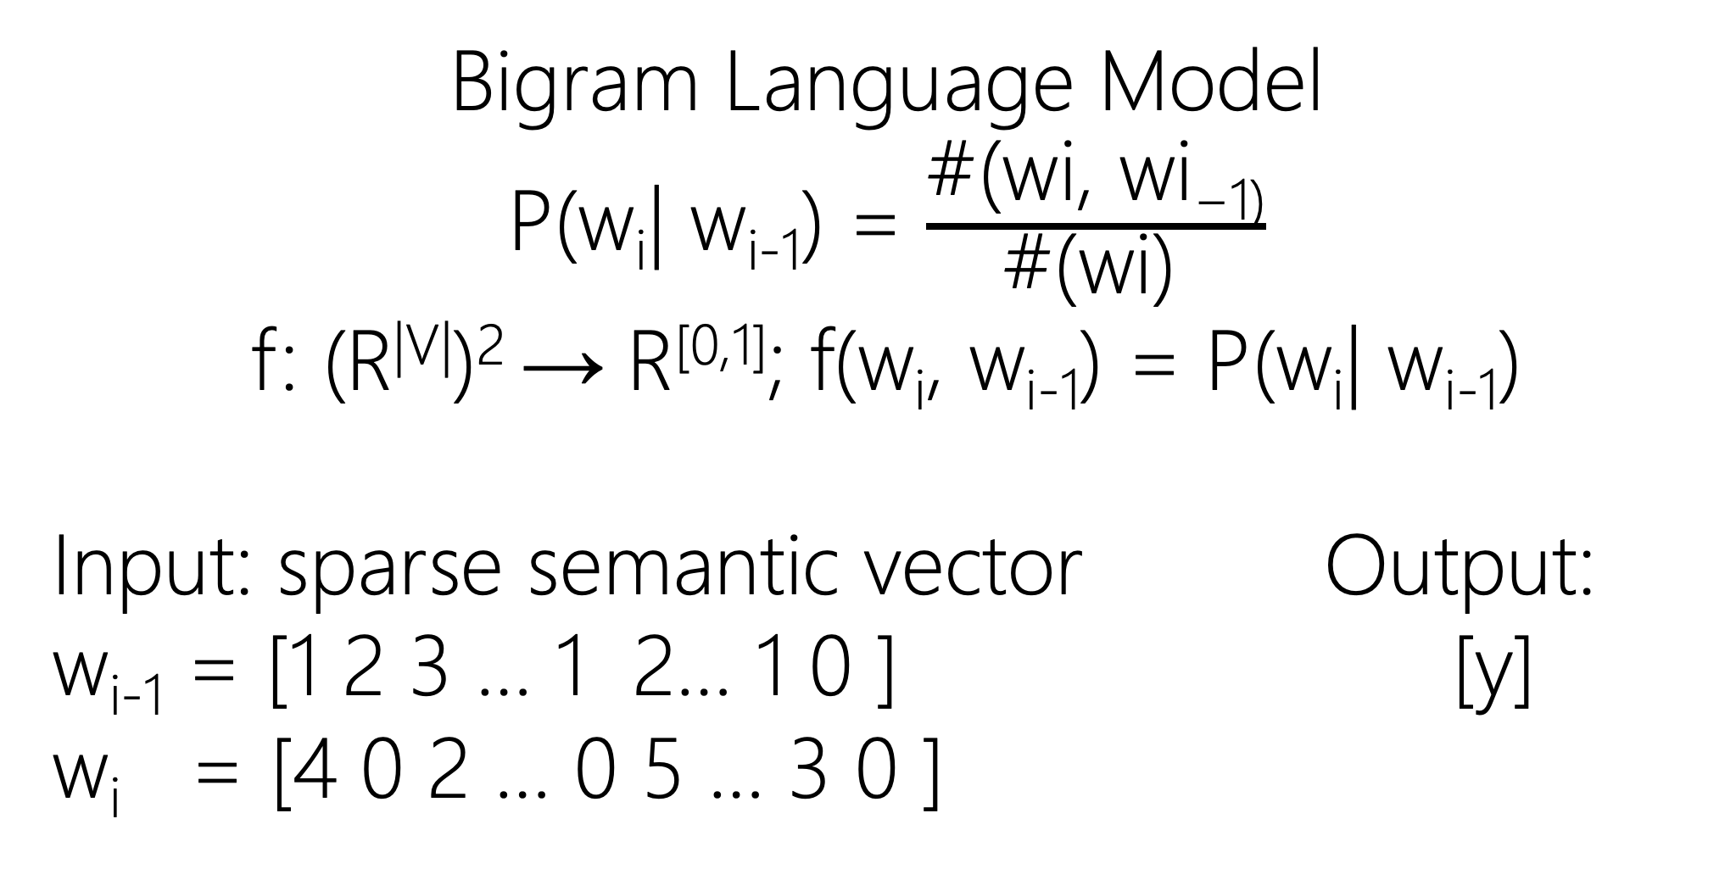
Neural Language Model
Bigram Language Model
P(w_{i}| w_{i-1}) = $\frac{\text{\#(}\text{wi}\text{, }\text{wi}\text{−1)}}{\text{\#(}\text{wi}\text{)} }$
f: (R^{|V|})² → R^{[0,1]}; f(w_{i}, w_{i-1}) = P(w_{i}| w_{i-1})
Input: sparse semantic vector Output:
w_{i-1} = [1 2 3 … 1 2… 1 0 ] [y]
w_{i} = [4 0 2 … 0 5 … 3 0 ]

Slide 42
Neural Language Model
Bigram Language Model
x1
xn
…
xV
y1
x1
xn
No use! Why?
…
xV

Slide 43
Neural Language Model
Bigram Language Model
x1
x1
xn
xn
…
…
xV
xV
P(w_{i}| w_{i-1}) = ? Unknown Initially
While enumerating the text stream, when I see [w_{i-1} w_{i}] then
f: {0,1}^{|V|} → {0,1}^{|V|}; f(w_{i-1}) → w_{i}
[0 0 0 … 1 0 … 0 0 0] → [0 0 0 … 0 1 … 0 0 0]

Slide 44
Neural Language Model
Bigram Language Model
x1
x1
xn
xn
…
…
xV
xV
P(w_{i}| w_{i-1}) = ? Unknown Initially
While enumerating the text stream, when I see [w_{i-1} w_{i}] then
f: {0,1}^{|V|} → R^{|V|}; f(w_{i-1}) → #(w_{i-1}w_{i})
[0 0 0 … 1 0 … 0 0 0] → [0 1 0 … 0 2 … 1 0 0]

Slide 45
Neural Language Model
Bigram Language Model
x1
x1
y1
xn
xn
yn
…
…
…
xV
xV
yV
P(w_{i}| w_{i-1}) = ? Unknown Initially
While enumerating the text stream, when I see [w_{i-1} w_{i}] then
f: {0,1}^{|V|} → R^{|V|}; f(w_{i-1}) → #(w_{i-1}w_{i}) → Normalized
[0 0 0 … 1 0 … 0 0 0] → [0 1 0 … 0 2 … 1 0 0] → Softmax

Slide 46
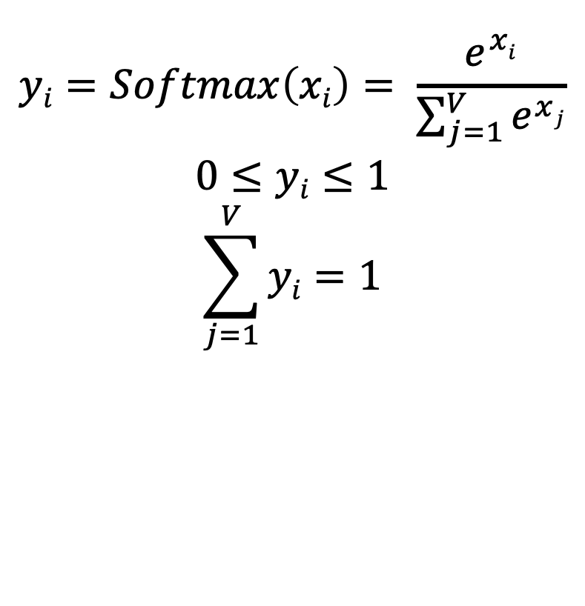
Neural Language Model
Bigram Language Model
x1
x1
$$yi=Softmax\left(xi\right)= \frac{e^{xi}}{\sum_{j=1}^{V}{e^{xj}}}$$
$$0≤yi≤1$$
$$\sum_{j=1}^{V}{yi}=1$$
y1
xn
xn
yn
…
…
…
xV
xV
yV
f: f: {0,1}^{|V|} → [0,1]^{|V|}; f(w_{i-1}) = P(w_{i}| w_{i-1})

Slide 47
Neural Language Model
Bigram Language Model
x1
x1
y1
y1
xn
xn
yn
yn
…
…
…
…
xV
xV
yV
yV
Error = Loss = - Log P(w_{i}| w_{i-1})

Slide 48
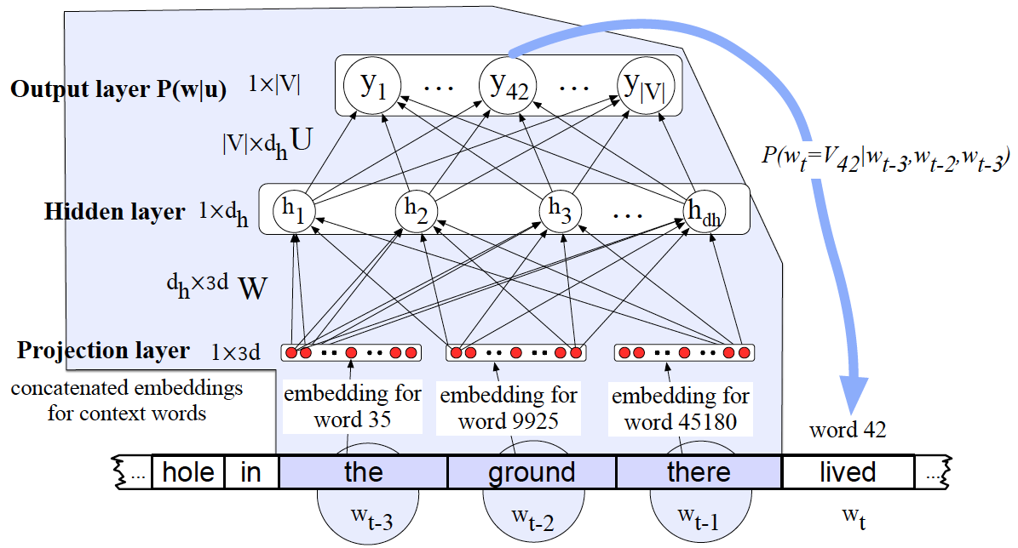
Neural Language Model
Bengio, Yoshua, et al. "A neural probabilistic language model." The journal of machine learning research 3 (2003): 1137-1155.
N-gram or Bag-of-Word?

Slide 49
Neural Language Model
Bengio, Yoshua, et al. "A neural probabilistic language model." The journal of machine learning research 3 (2003): 1137-1155.
Bottleneck → Softmax → Hierarchical Softmax

Slide 50
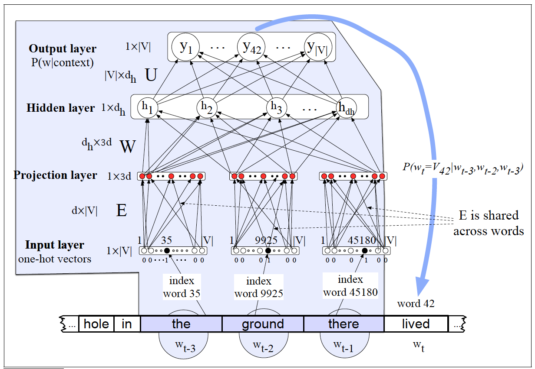
Neural Language Model

