Slide 1
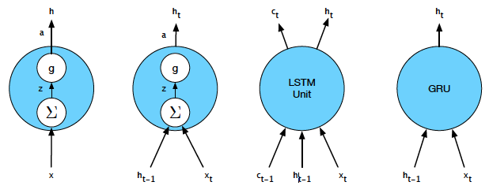
recurrent language models

Slide 2
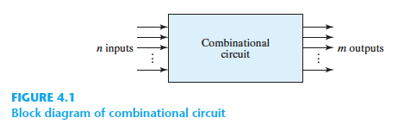
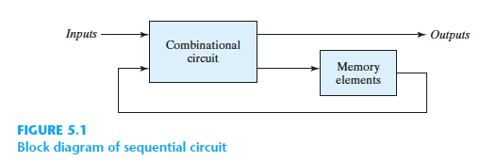
Digital Design

Slide 3
Counter: 0 → 1 → 2 → …

Slide 4
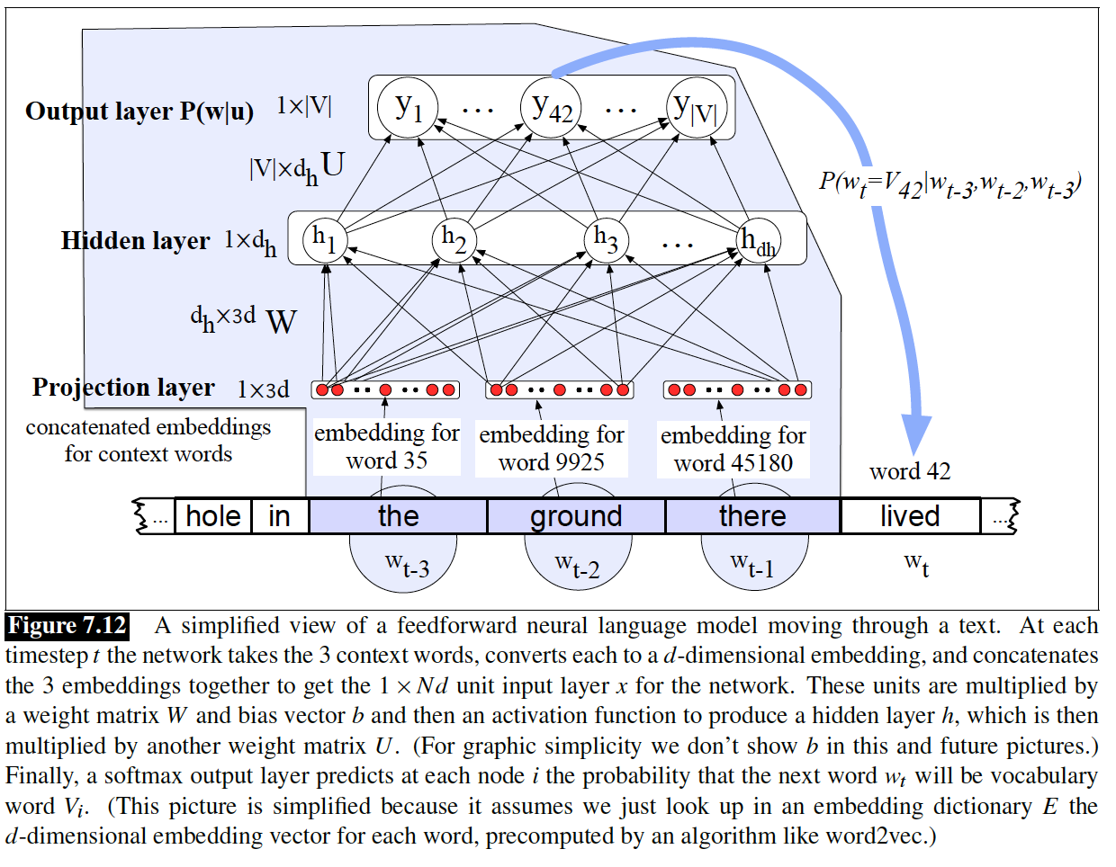
Neural Language Model
Bengio, Yoshua, et al. "A neural probabilistic language model." The journal of machine learning research 3 (2003): 1137-1155.

Slide 5
Language is Temporal
We already saw that previous context matters!
Unigram → Bigram → Trigram → …
Conversations
Social Timelines
Social Feeds

Slide 6
Language is Temporal
We already saw that previous context matters!
Unigram → Bigram → Trigram → …
Neural LM
The same in this respect!
Only different method (approach)
But ...

Slide 7
Language is Temporal
We already saw that previous context matters!
Unigram → Bigram → Trigram → …
Neural LM
The same in this respect!
Only different method (approach)
But it offers a modular structure!

Slide 8
Neural LM
Neural LM
But it offers a modular structure!
We can
Stack them
Connect different parts
Create loopback connection

Slide 9
Recurrent Neural LM
Bengio’s Neural LM
Fixed Length Context Window (n-gram)
Longer Stream
Sliding the Context Window
“we are in natural language processing class”
[we are in]
[are in natural]
[in natural language]
[natural language processing]
[language processing class]

Slide 10
Recurrent Neural LM
Bengio’s Neural LM
Fixed Length Context Window (n-gram)
Longer Stream
Sliding the Context Window
“we are in natural language processing class”
[we are in]
[are in natural]
[in natural language]
[natural language processing]
[language processing class]
Overlapping sliding carries some context from history

Slide 11
Recurrent Neural LM
Bengio’s Neural LM
Fixed Length Context Window (n-gram)
Longer Stream
Sliding the Context Window
“we are in natural language processing class”
[we are in]
[are in natural]
[in natural language]
[natural language processing]
[language processing class]
But not from far distances!

Slide 12
Recurrent Neural LM
Bengio’s Neural LM
Fixed Length Context Window (n-gram)
Longer Stream
Sliding the Context Window
“we are in natural language processing class”
[language processing class]
[are in natural]
[we are in]
[in natural language]
[natural language processing]
Also, inputs are independent!

Slide 13
Recurrent Neural LM
Bengio’s Neural LM
Fixed Length Context Window (n-gram)
Longer Stream
Sliding the Context Window
“we are in natural language processing class”
[we are in]
[are in natural]
[in natural language]
[natural language processing]
[language processing class]

Slide 14








Recurrent Neural LM
$$Y=softmax(hU)$$
$$Y′=softmax(h′U)$$
$$h= tanh⁡(X W+b)$$
$$h′= tanh⁡(X W+b+hV)$$
$$X W+b$$
+ h V
$$X′ W+b$$
$$X$$
$$X′$$
$$f\left(h\right):what part of history and how to transfer to future!$$

Slide 15





Recurrent Neural LM
$$Yn=softmax(hnU)$$
$$hn= tanh⁡(Xn W+b+hn−1V)$$
$$hn−1V$$
$$Xn W+b$$
$$Xn$$

Slide 16
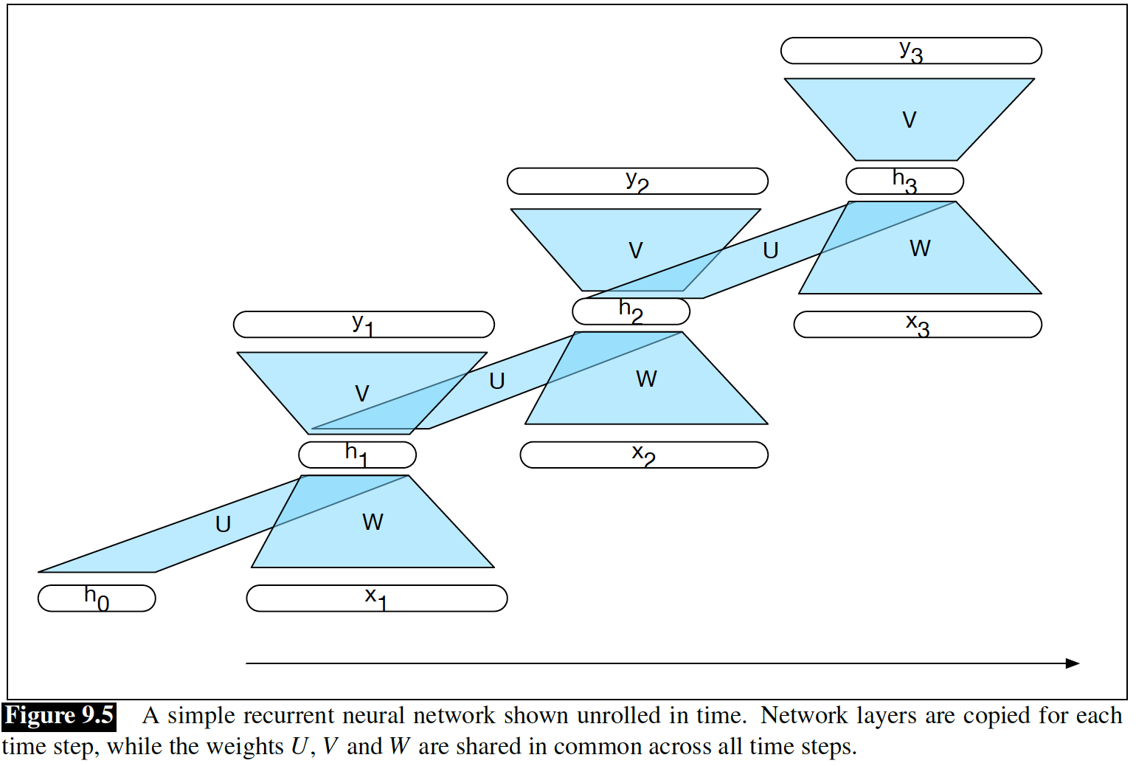






Recurrent Neural LM
$$U$$
$$U$$
$$V$$
$$U$$
$$V$$
$$V$$

Slide 17




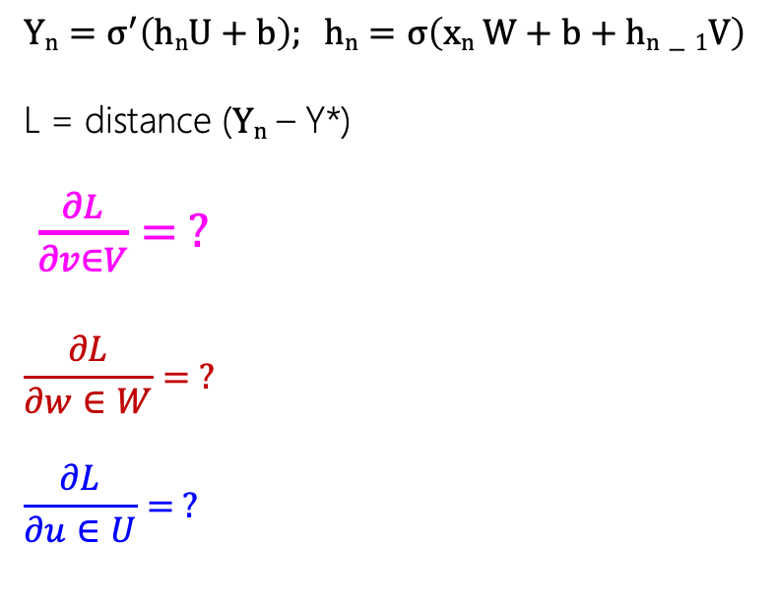


Recurrent Neural LM: Training
$$Yn=σ^{′}\left(hnU+b\right); hn=σ\left(xn W+b+hn−1V\right)$$
L = distance ($Yn$ – Y*)
$\frac{∂L}{∂v∈V}= ?$
$$\frac{∂L}{∂w∈W}= ?$$
$$\frac{∂L}{∂u∈U}= ?$$
$$U$$
$$U$$
$$V$$
$$U$$
$$V$$
$$V$$
Backpropagation Through Time (Werbos 1974, Rumelhart et al. 1986, Werbos 1990).

Slide 18
Recurrent Neural LM: Training
Mikolov, T. et al (2010). Recurrent neural network based language model. In INTERSPEECH 2010, 1045–1048.
The limited context constraint inherent in both N-gram models and sliding window approaches is avoided since the hidden state embodies information about all of the preceding words all the way back to the beginning of the sequence.
True Markovian!

Slide 19
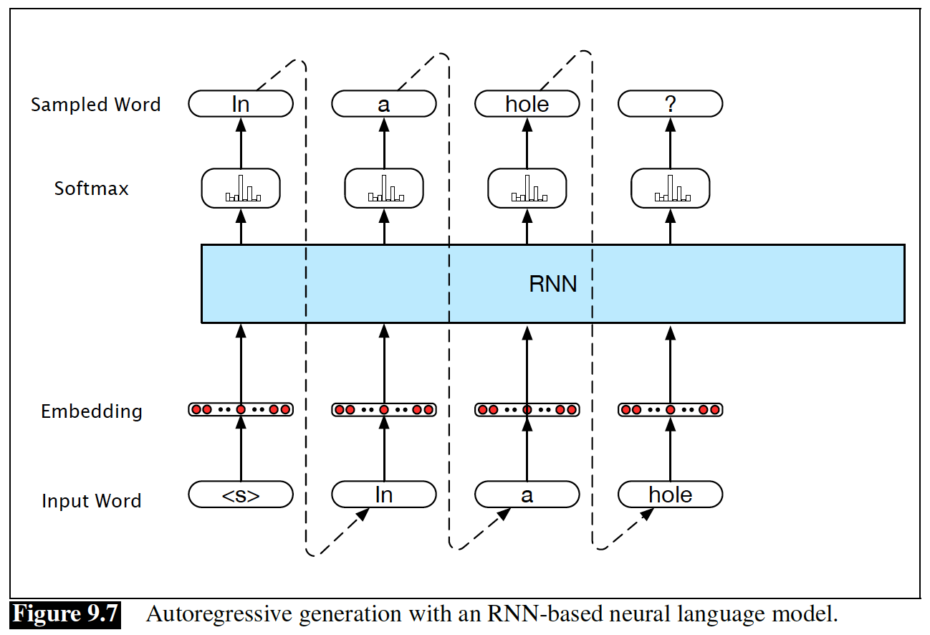
Recurrent Neural LM: Autoregression
Generate a sentence by the trained language model:

Slide 20
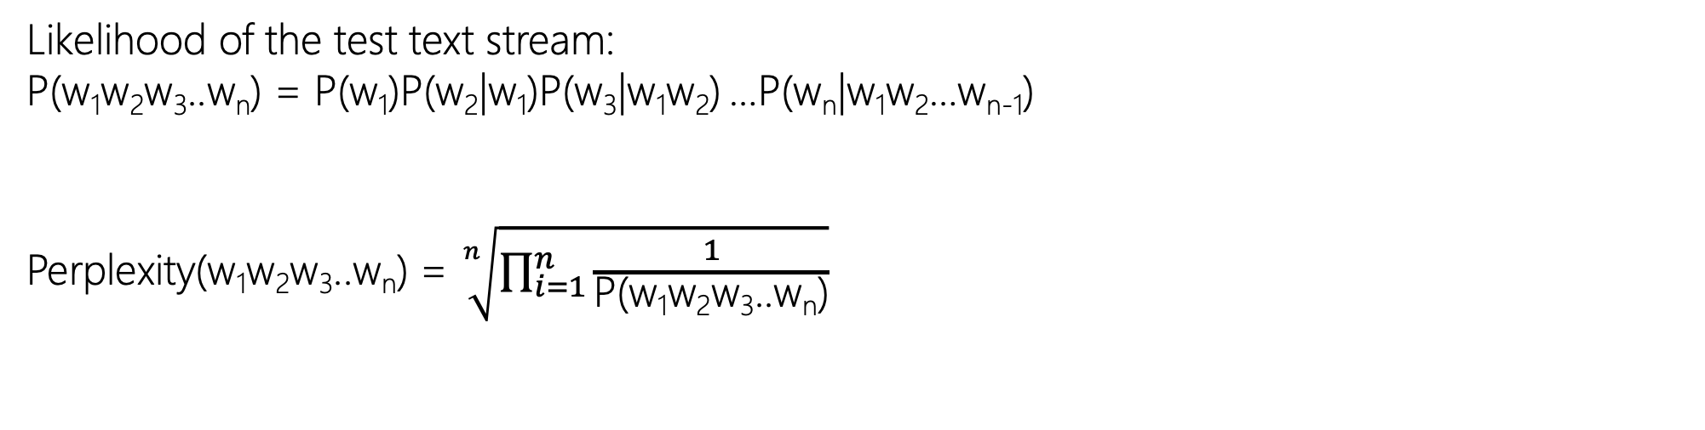
Recurrent Neural LM: Evaluation
Likelihood of the test text stream:
P(w₁w₂w₃..w_{n}) = P(w₁)P(w₂|w₁)P(w₃|w₁w₂) …P(w_{n}|w₁w₂…w_{n-1})
Perplexity(w₁w₂w₃..w_{n}) = $\sqrt[n]{\prod_{i=1}^{n}{\frac{1}{\text{P}\text{(}\text{w}\text{1}\text{w}\text{2}\text{w}\text{3}\text{..}\text{wn}\text{)}}}}$
P(w₃)
…
P(w₃)
P(w₂)
P(w₁)
<s>
w₁
w₂
w₃
…
w_{n-1}

Slide 21
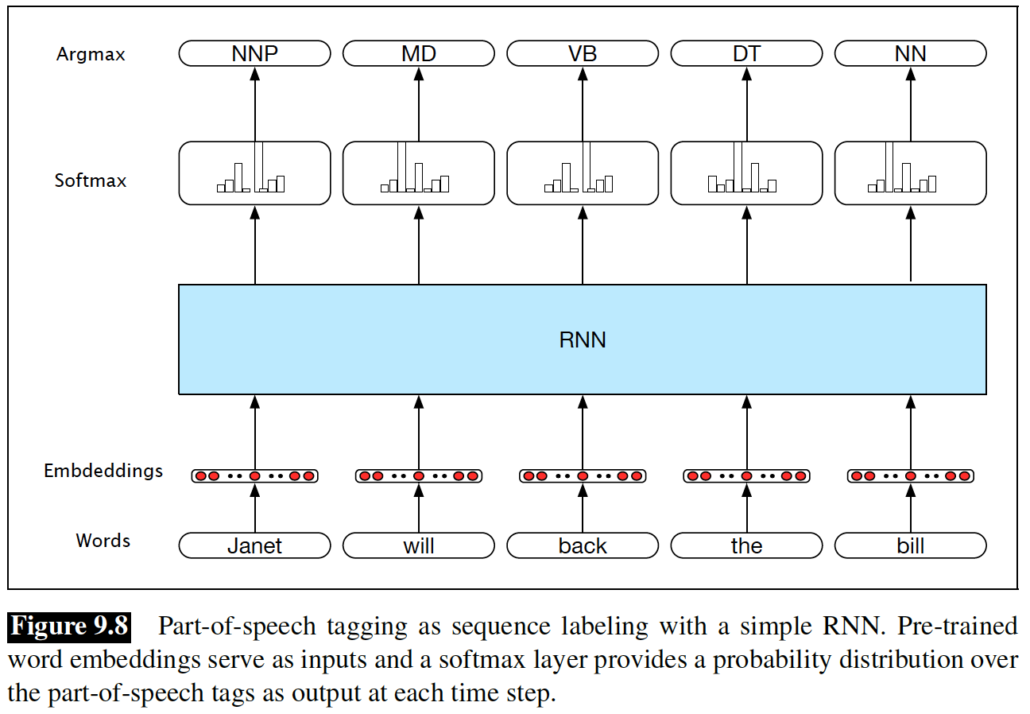
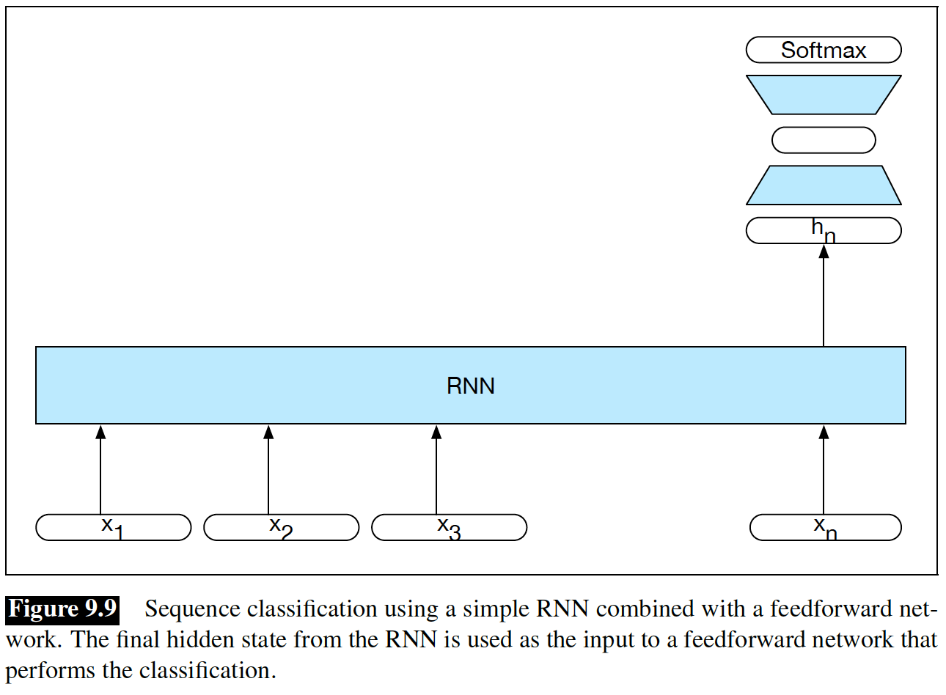
Recurrent Neural LM: Application
Part-of-Speech Tagging
Sequence Classification
end-to-end training

Slide 22

Recurrent Neural LM Bidirectional
We have the whole context
(e.g., a sentence, short dialog, …)
We have the future!
From future to the past (backward)

Slide 23
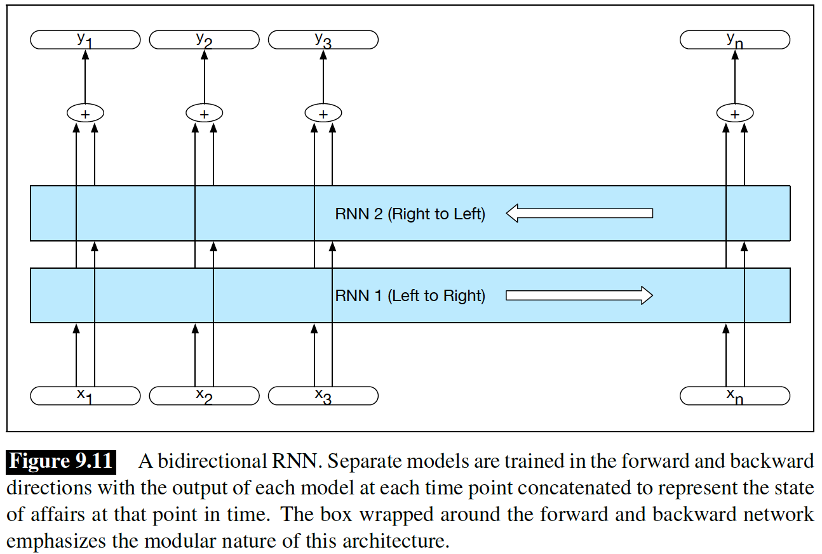
Recurrent Neural LM: Bidirectional
P(w_{i}| w₁w₂..w_{i-1} w_{i+1}…w_{n})

Slide 24
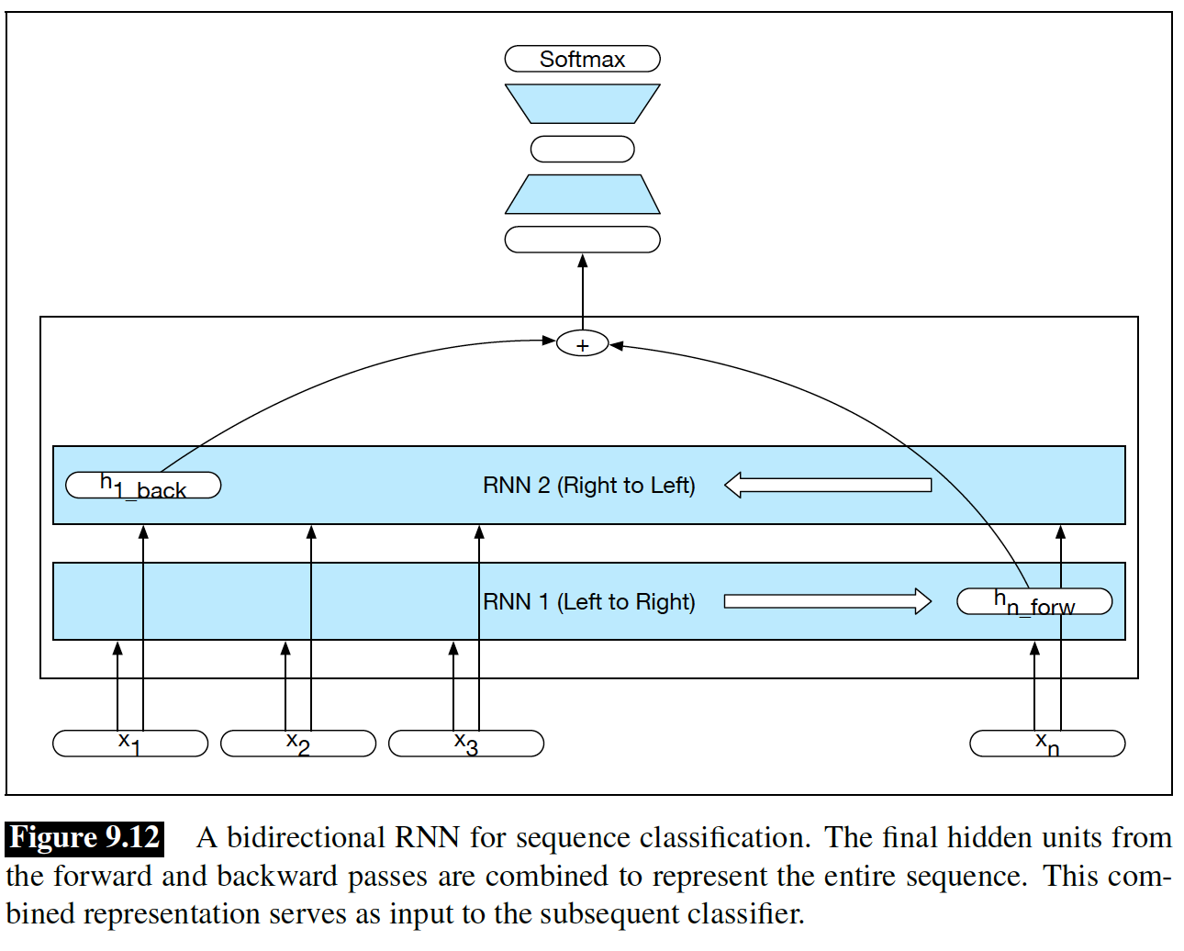
Recurrent Neural LM: Bidirectional

Slide 25
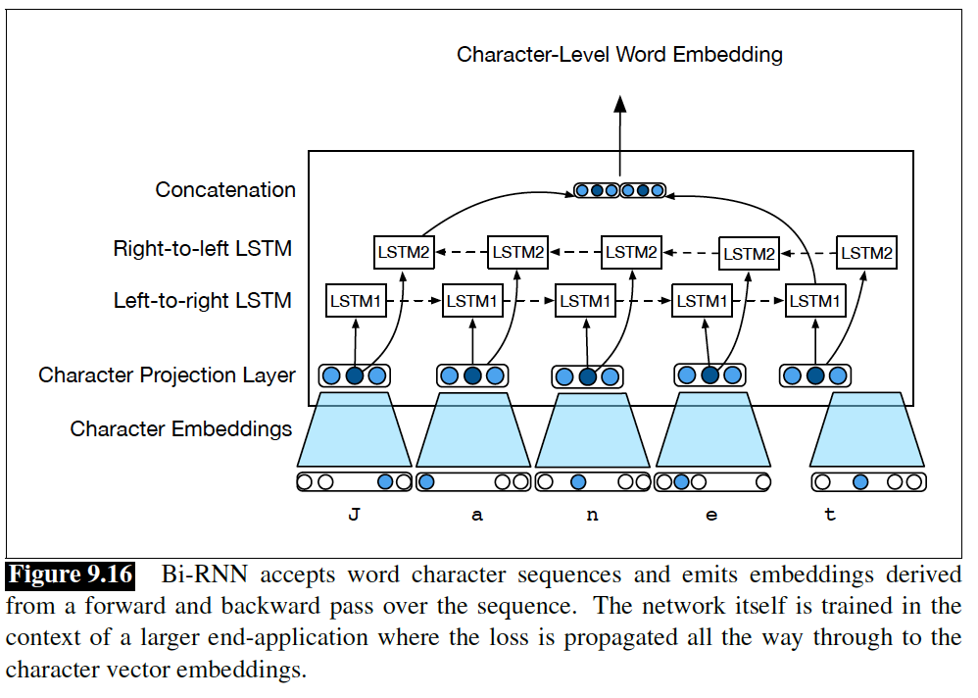
Recurrent Neural LM: Bidirectional

Slide 26
Managing Context in RNNs
$$Yn=softmax(hnU)$$
$$hn= tanh⁡(Xn W+b+hn−1V)$$
$$hn−1V$$
$$Xn W+b$$
$$Xn$$
fully consider the whole history so far

Slide 27
Managing Context in RNNs
$$Yn=softmax(hnU)$$
$$hn= tanh⁡(Xn W+b+hn−1V)$$
$$hn−1V$$
$$Xn W+b$$
$$Xn$$
Forget: drop some part of history
Remember: only consider the important ones
Recall: try to remember those that forgotten!

Slide 28
Managing Context in RNNs

Slide 29
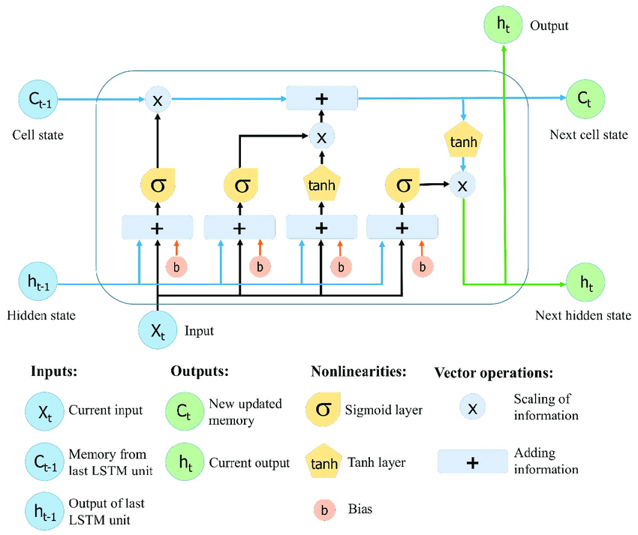
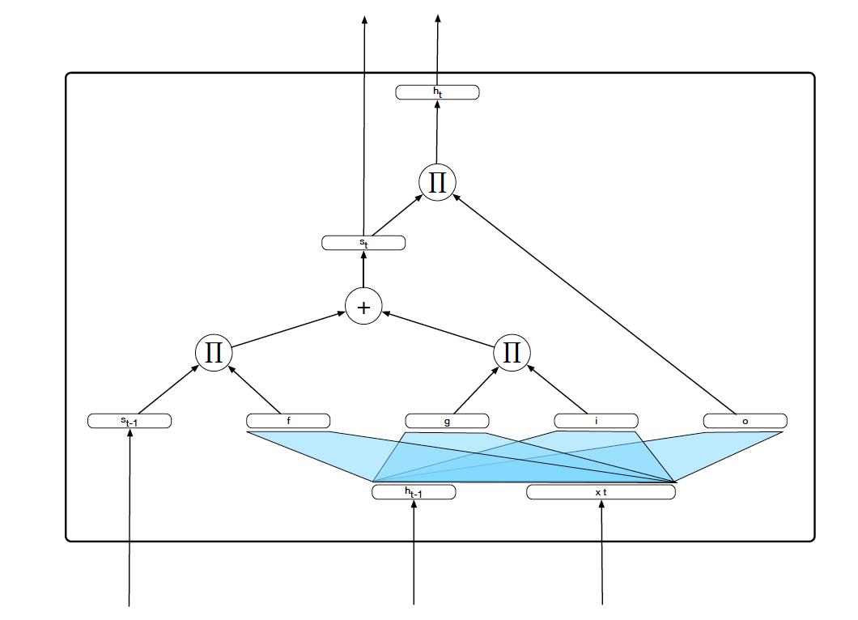
Long Short-Term Memory

Slide 30
Long Short-Term Memory
Sigmoid: Probabilistic Binary Masking

Slide 31
LSTM: Forget from the long memory

Slide 32
LSTM: Add to the long memory

Slide 33
LSTM: Updated long memory

Slide 34
LSTM: Short memory

Slide 35
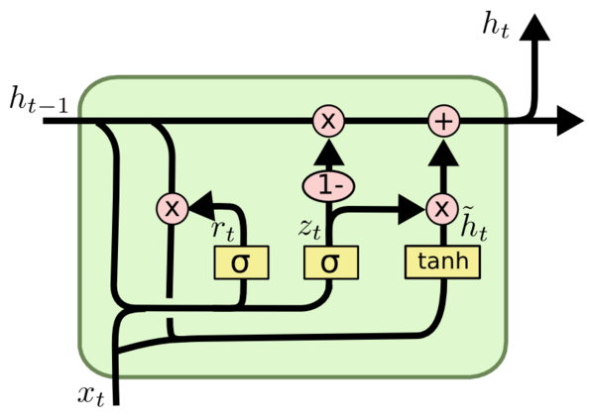
Gated Recurrent Unit (GRU)
LSTM: too many weights!

