Slide 1
Attentive language models

Slide 2
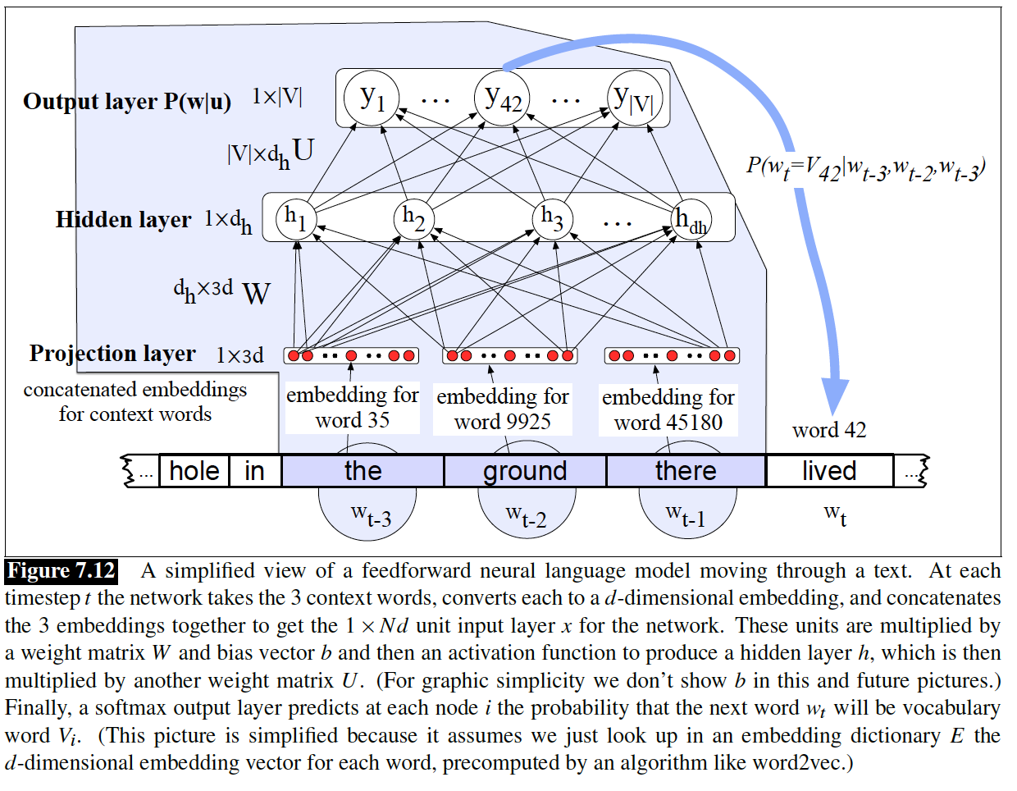





Recurrent Neural LM
$$Yn=softmax(hnU)$$
$$hn= tanh⁡(Xn W+b+hn−1V)$$
$$hn−1V$$
$$Xn W+b$$
$$Xn$$

Slide 3
Neural LM
h = σ(xW + b)

Slide 4
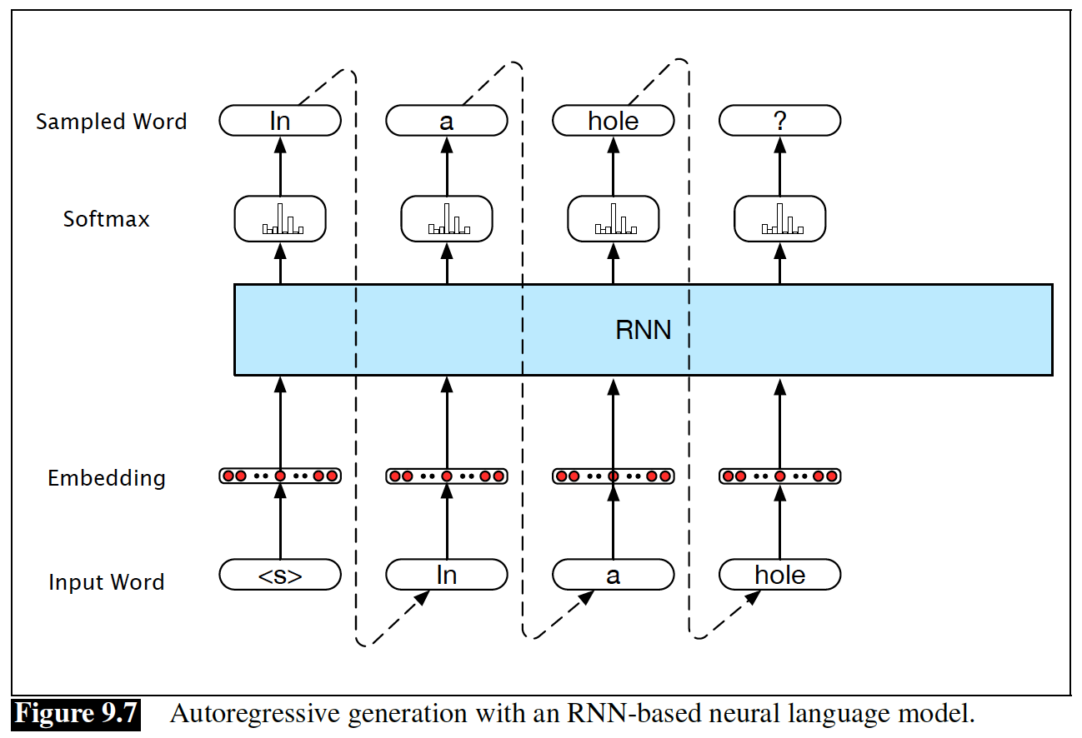
Recurrent Neural LM
h_{n} = σ(xW + b + h_{n-1}V)

Slide 5
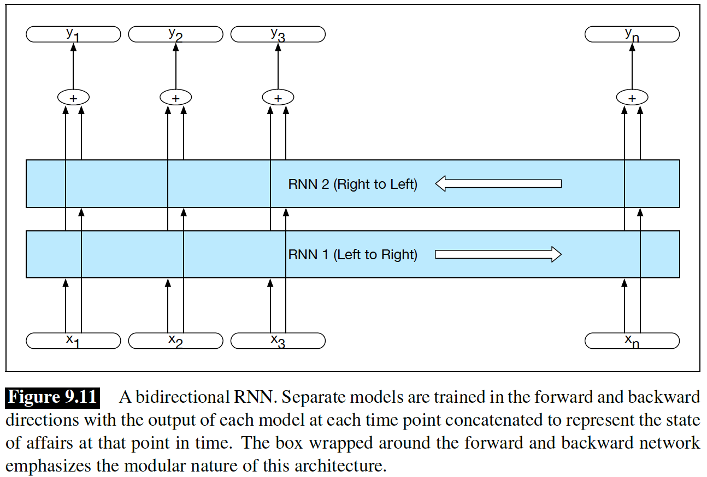
Recurrent Neural LM: Bidirection
h_{i} = σ(xW + b + h_{i-1}V)
h_{i} = σ(xW’ + b’ + h_{i+1}V)

Slide 6
Encoder-Decoder

Slide 7
Recurrent Neural LM: Encoder-Decoder
h = σ(xW + b)

Slide 8
Recurrent Neural LM: Encoder-Decoder
h_{i} = σ(xW + b + h_{i-1}V)

Slide 9
Recurrent Neural LM: Encoder-Decoder
h_{i} = σ(xW + b + h_{i-1}V)
The context helps x to reach its position. Then, we don’t need them anymore!

Slide 10
Recurrent Neural LM: Encoder-Decoder
h_{i+1} = σ(xW + b + h_{i}V)
h_{i+2} = σ(xW + b + h_{i+1}V)
…
From the final position of x, we can continue and generate other tokens (autogeneration)

Slide 11
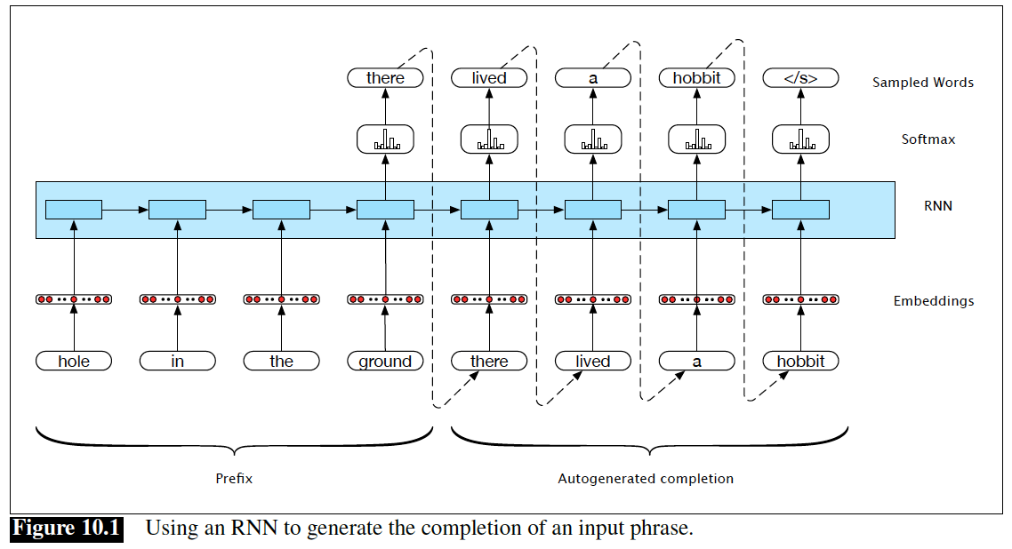
Recurrent Neural LM: Encoder-Decoder
Simply Ignore the outputs.
Just for warmup.
Just for reaching ’ground’ to its position!

Slide 12
Recurrent Neural LM: Bitext Translation
For machine, they are just sequences of tokens!
h_{i} = σ(xW + b + h_{i-1}V)
<s>Prague Stock Market falls to minus by the end of the trading day</s><s>Die Prager Börse stürzt gegen Geschäftsschluss ins Minus</s>

Slide 13
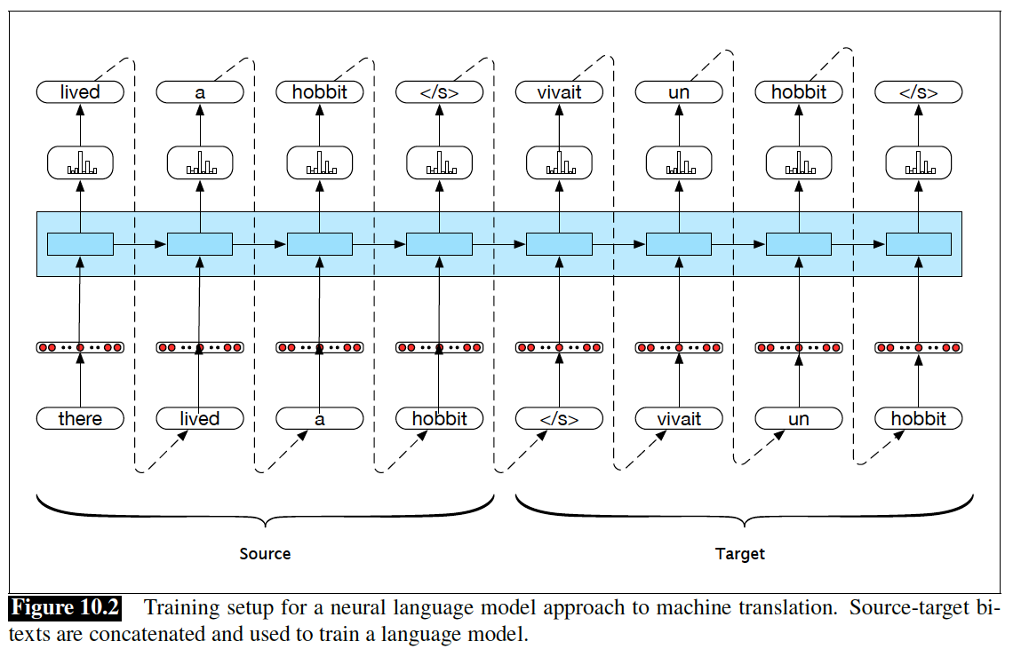
Recurrent Neural LM: Bitext Translation

Slide 14
Recurrent Neural LM: Bitext Translation
For machine, they are just sequences of tokens!
h_{i} = σ(xW + b + h_{i-1}V)
<s>Prague Stock Market falls to minus by the end of the trading day</s><s>Die Prager Börse stürzt gegen Geschäftsschluss ins Minus</s>

Slide 15
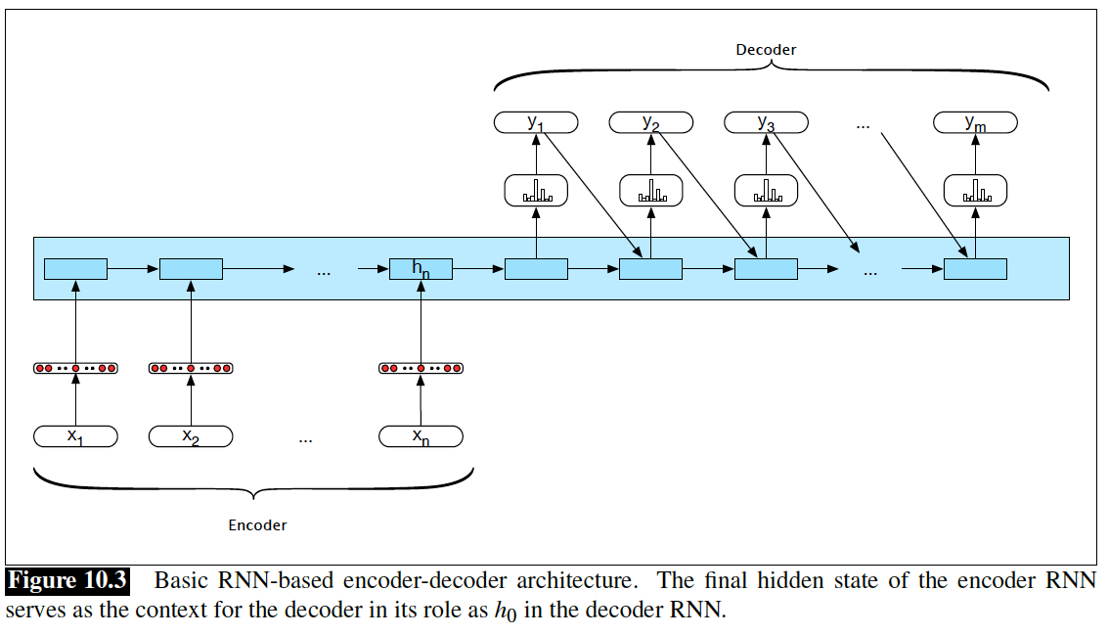
Recurrent Neural LM: Encoder-Decoder
The past and current have been encoded in this. Enough to decode the future!

Slide 16
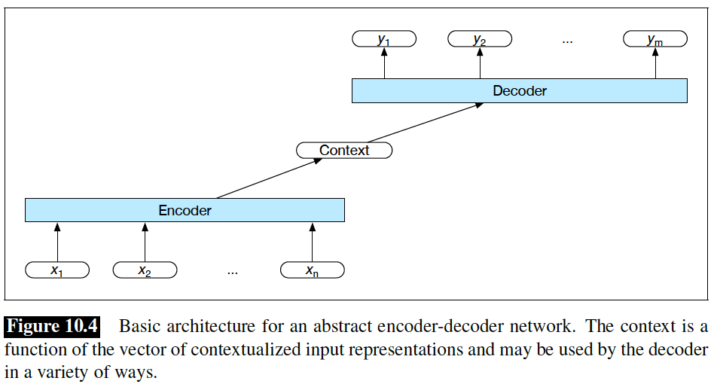
Recurrent Neural LM: Encoder-Decoder
h^{d}₀ = C
C = f(h^{e}_{n})
h^{e}₀ = 0

Slide 17
Sequence2Sequence
Sutskever, I., Vinyals, O., & Le, Q. V. (2014). Sequence to sequence learning with neural networks. In NIPS.
h^{d}₀ = C
C = f(h^{e}_{n})
LSTM
GRU
h^{e}₀ = 0

Slide 18
Question to Answers

Slide 19
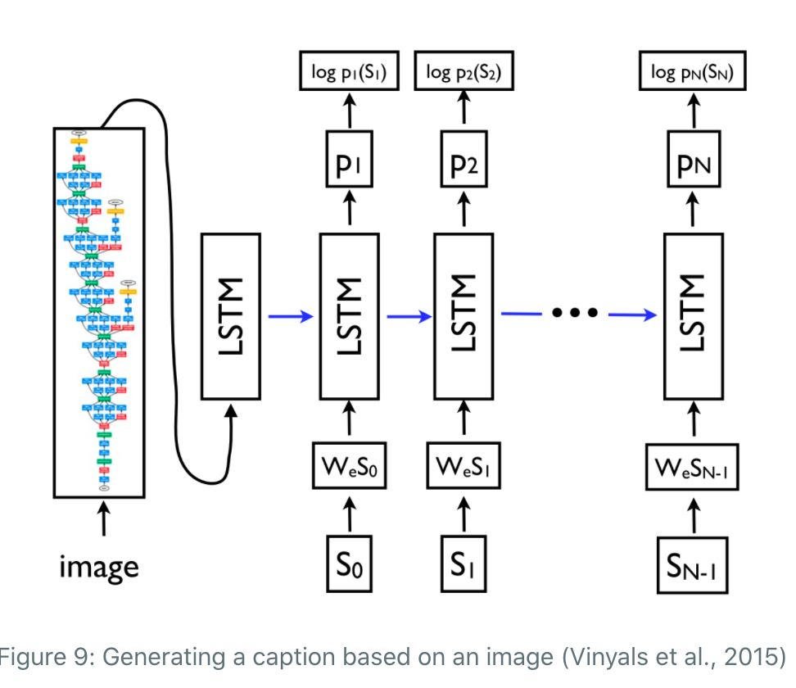
Anything to Sequence

Slide 20
Look into the Past based on future!
At each step in the future, remind what was before the bridge!
h^{d}₀ = C
h^{d}₀ = C
h^{d}₀ = C
h^{d}₀ = C
C = f(h^{e}₁, h^{e}₂, … h^{e}_{n})
LSTM
GRU
h^{e}₀ = 0

Slide 21
Recurrent Neural LM: Bitext Translation
For machine, they are just sequences of tokens!
h_{i} = σ(xW + b + h_{i-1}V)
<s>Prague Stock Market falls to minus by the end of the trading day</s><s>Die Prager Börse stürzt gegen Geschäftsschluss ins Minus</s>

Slide 22

Look into the Past based on future!
Dynamic Context:
Bring an image of every steps in the past. Based on current point in future, I remind some of them (NOT ALL, NOT LAST)
h^{d}_{i} = g(y_{i-1}; h^{d}_{i-1}; C_{i})
C_{i} = $\sum{\text{top}\text{−}\text{k} \text{most} \text{similar}}$ h^{e}_{j} to h^{d}_{i}
Similarity → Cosine
h^{e}₀ = 0

Slide 23
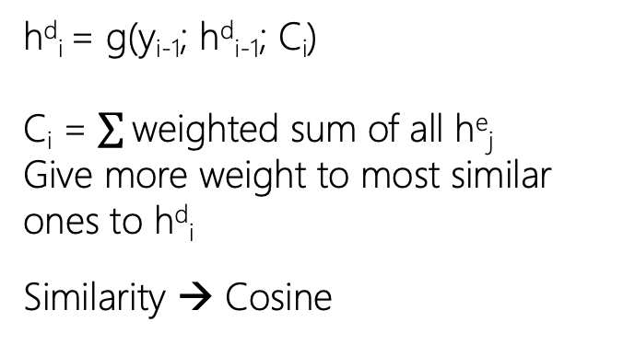
Look into the Past based on future!
Dynamic Context:
Bring an image of every steps in the past. Based on current point in future, I remind some of them (NOT ALL, NOT LAST)
h^{d}_{i} = g(y_{i-1}; h^{d}_{i-1}; C_{i})
C_{i} = $\sum{\text{weighted} \text{sum} \text{of} \text{all}}$ h^{e}_{j}
Give more weight to most similar ones to h^{d}_{i}
Similarity → Cosine
h^{e}₀ = 0

Slide 24
Attention!
For machine, they are just sequences of tokens!
<s>Prague Stock Market falls to minus by the end of the trading day</s><s>Die Prager Börse stürzt gegen Geschäftsschluss ins Minus</s>

Slide 25
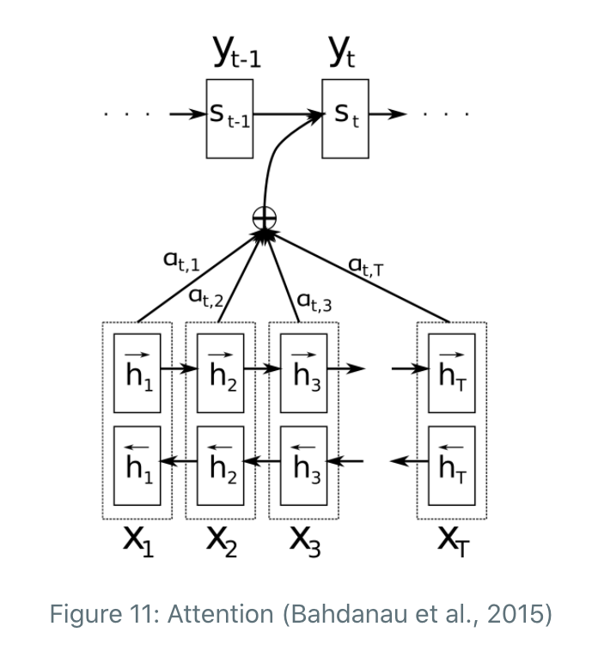
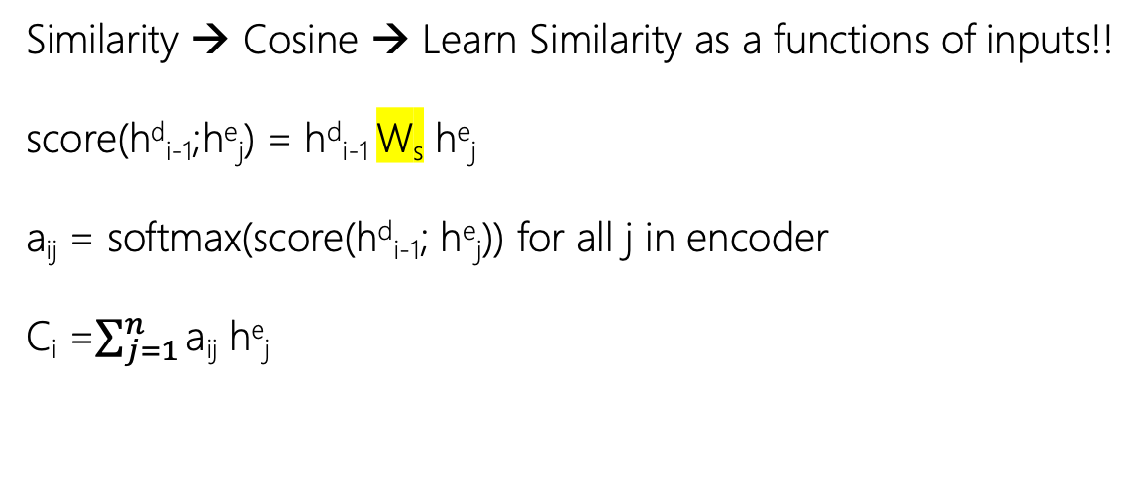
Attention!
Bahdanau, D., Cho, K., & Bengio, Y. (2015). Neural Machine Translation by Jointly Learning to Align and Translate. In ICLR 2015
Similarity → Cosine → Learn Similarity as a functions of inputs!!
score(h^{d}_{i-1};h^{e}_{j}) = h^{d}_{i-1} W_{s} h^{e}_{j}
a_{ij} = softmax(score(h^{d}_{i-1}; h^{e}_{j})) for all j in encoder
C_{i} =$\sum_{j=1}^{n}{\text{a}\text{ij}}$ h^{e}_{j}

Slide 26
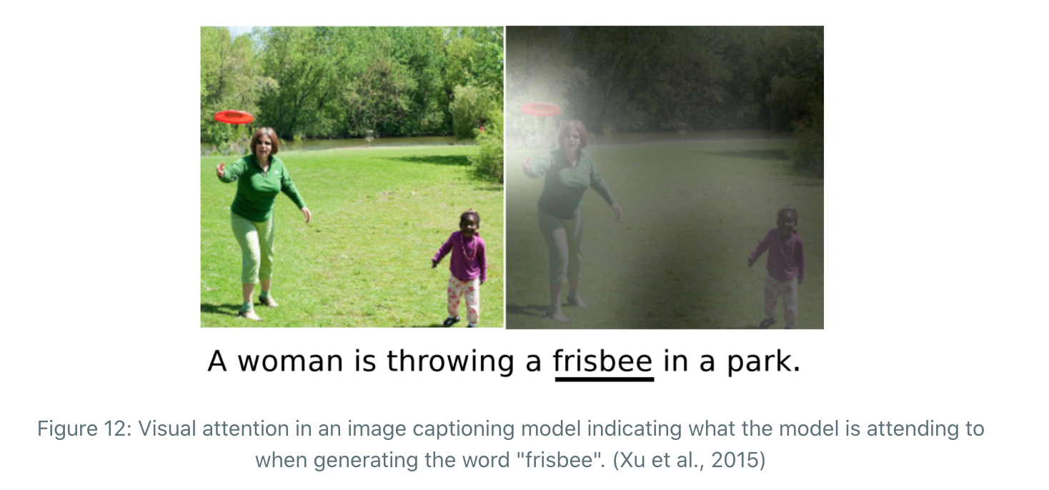
Attention!

Slide 27
Attention Is All You Need! The Transformer

Slide 28
BERT: Bidirectional Encoder Representations from Transformers

