Slide 1
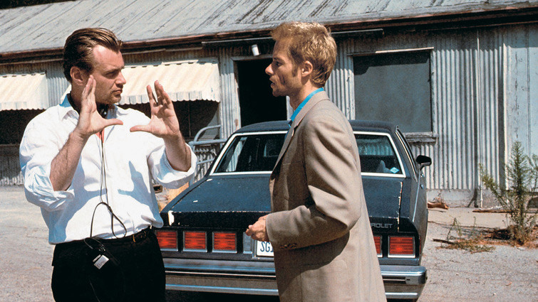
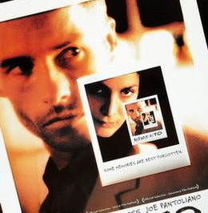
n-gram Language models

Slide 2
Language Modeling

Slide 3
Language Modeling
Building a model that can generate an accurate stream of tokens (words + inflection rules, punctuations, fillers, …)

Slide 4
Language Modeling
Context:
“How’s everything?”, somebody asks.

Slide 5
Language Modeling
Possible stream of tokens:
Awesome. I am enjoying the sunny day in a restaurant.
I cannot tell you how everything is doing.
Mind your own business! Ha ha ha …
Good. Thanks for asking.

Slide 6
Language Modeling
Context:
“How’s everything?”, a friend asks.

Slide 7
Language Modeling
Possible stream of tokens:
Awesome. I am enjoying the sunny day in a restaurant.
I cannot tell you how everything is doing.
Mind your own business! Ha ha ha …
Good. Thanks for asking.

Slide 8
Language Modeling
Context:
“How’s everything?”, a close friend asks.

Slide 9
Language Modeling
Possible stream of tokens:
Awesome. I am enjoying the sunny day in a restaurant.
I cannot tell you how everything is doing.
Mind your own business! Ha ha ha …
Good. Thanks for asking.

Slide 10
Language Modeling
Context:
Sitting in a restaurant in the middle of Windsor
The weather is sunny
You receive a call from a close friend.
“How’s everything?”, your close friend asks.

Slide 11
Language Modeling
Context_{i} → Context_{i+1}

Slide 12
n-gram Language Modeling
w₁ … w_{n-2} w_{n-1} → w_{n}
V: Vocabulary Set
w_{i} ∊ V, a word in V
a stream of n tokens (ordered)

Slide 13
n-gram Language Modeling
w_{i+1} … w_{i+n-2} w_{i+n-1} → w_{i+n}
V: Vocabulary Set
w_{i} ∊ V, a word in V
a stream of n tokens (ordered)

Slide 14
1-gram Language Modeling
unigram LM
w_{i+1} … w_{i+n-2} w_{i+n-1} → w_{i+n}
∅ → w_{i+1}
V: Vocabulary Set
w_{i} ∊ V, a word in V
a stream of 1 token (ordered)

Slide 15
2-gram Language Modeling
bigram LM
w_{i+1} … w_{i+n-2} w_{i+n-1} → w_{i+n}
w_{i+1} → w_{i+2}
V: Vocabulary Set
w_{i} ∊ V, a word in V
a stream of 2 tokens (ordered)

Slide 16
3-gram Language Modeling
trigram LM
w_{i+1} … w_{i+n-2} w_{i+n-1} → w_{i+n}
w_{i+1} w_{i+2} → w_{i+3}
V: Vocabulary Set
w_{i} ∊ V, a word in V
a stream of 3 tokens (ordered)

Slide 17
n-gram Language Modeling
Context:
Sitting in a restaurant in the middle of Windsor
The weather is sunny
You receive a call from a close friend.
“How’s everything?”, your close friend asks.

Slide 18
n-gram Language Modeling
Context:
Sitting in a restaurant in the middle of Windsor
The weather is sunny
You receive a call from a close friend.
“How’s everything?”, your close friend asks.

Slide 19
n-gram Language Modeling
Context:
Sitting in a restaurant in the middle of Windsor
The weather is sunny
You receive a call from a close friend.
“How’s everything?”, your close friend asks.
[how][is][everything][?][</s>]

Slide 20
unigram Language Modeling
Context:
Sitting in a restaurant in the middle of Windsor
The weather is sunny
You receive a call from a close friend.
“How’s everything?”, your close friend asks.
[how][is][everything][?][</s>]→ Randomly selected word from V, e.g., [nlp]
[how][is][everything][?][</s>]→ Most frequent word in V, e.g., [the]
[how][is][everything][?][</s>]→ Least frequent word in V, e.g., [precipitation]

Slide 21
bigram Language Modeling
Context:
Sitting in a restaurant in the middle of Windsor
The weather is sunny
You receive a call from a close friend.
“How’s everything?”, your close friend asks.
[how][is][everything][?][</s>]→ A word in V that comes after [</s>] most frequently, i.e., start a sentence!
→ [it]
→ [i]
→ [you]

Slide 22
trigram Language Modeling
Context:
Sitting in a restaurant in the middle of Windsor
The weather is sunny
You receive a call from a close friend.
“How’s everything?”, your close friend asks.
[how][is][everything][?][</s>]→ A word in V that comes after [?][</s>] most frequently, i.e., start an answer!
→ [you]

Slide 23
4-gram Language Modeling
Context:
Sitting in a restaurant in the middle of Windsor
The weather is sunny
You receive a call from a close friend.
“How’s everything?”, your close friend asks.
[how][is][everything][?][</s>]→ A word in V that comes after [everything] [?][</s>] most frequently
→ [it]

Slide 24
Frequentist Probability
as opposed to Bayesian Probability
Frequentist probability or frequentism is an interpretation of probability that defines an event's probability as the limit of its relative frequency in many trials - Wikipedia

Slide 25
n-gram Language Modeling
w_{i+1} … w_{i+n-2} w_{i+n-1} → w_{i+n}
P(w_{i+1} | w_{i+1} … w_{i+n-2} w_{i+n-1})
w_{i+n} could be any word in V but we pick most frequent one!

Slide 26
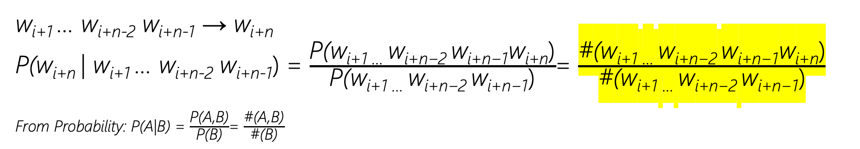
n-gram Language Modeling
w_{i+1} … w_{i+n-2} w_{i+n-1} → w_{i+n}
P(w_{i+n} | w_{i+1} … w_{i+n-2} w_{i+n-1}) = $\frac{\text{P}\text{(}\text{wi}\text{+1 … }\text{w}\text{i}\text{+}\text{n}\text{−2 }\text{w}\text{i}\text{+}\text{n}\text{−1}\text{w}\text{i}\text{+}\text{n}\text{)}}{\text{P}\text{(}\text{wi}\text{+1 … }\text{w}\text{i}\text{+}\text{n}\text{−2 }\text{w}\text{i}\text{+}\text{n}\text{−1}\text{)}}$= $\frac{\text{\#}\text{(}\text{wi}\text{+1 … }\text{w}\text{i}\text{+}\text{n}\text{−2 }\text{w}\text{i}\text{+}\text{n}\text{−1}\text{w}\text{i}\text{+}\text{n}\text{)}}{\text{\#}\text{(}\text{wi}\text{+1 … }\text{w}\text{i}\text{+}\text{n}\text{−2 }\text{w}\text{i}\text{+}\text{n}\text{−1}\text{)}}$
From Probability: P(A|B) = $\frac{\text{P}\text{(}\text{A}\text{,}\text{B}\text{)}}{\text{P}\text{(}\text{B}\text{)}}$= $\frac{\text{\#}\text{(}\text{A}\text{,}\text{B}\text{)}}{\text{\#}\text{(}\text{B}\text{)}}$

Slide 27
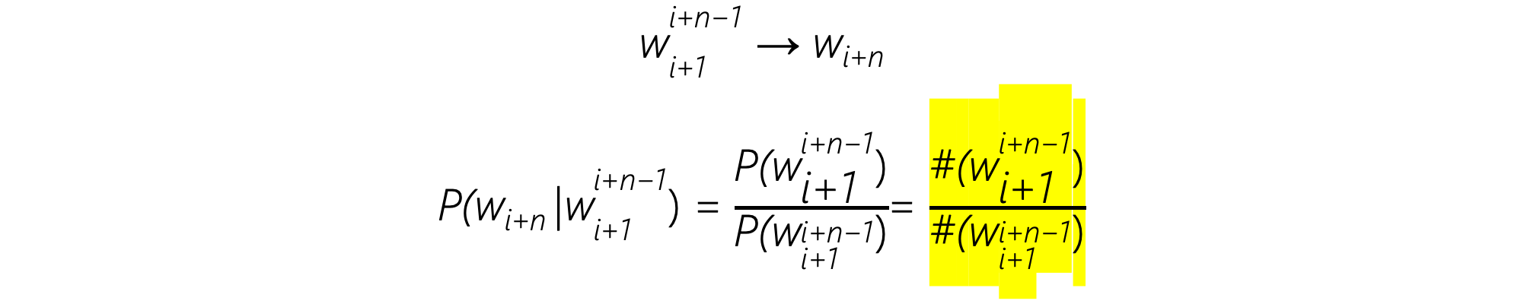
n-gram Language Modeling
${\text{w}}_{\text{i}\text{+1}}^{\text{i}\text{+}\text{n}\text{−1}}$ → w_{i+n}
P(w_{i+n} |${\text{w}}_{\text{i}\text{+1}}^{\text{i}\text{+}\text{n}\text{−1}}$) = $\frac{\text{P}\text{(}{\text{w}}_{\text{i}\text{+1}}^{\text{i}\text{+}\text{n}\text{−1}}\text{)}}{\text{P}\text{(}{\text{w}}_{\text{i}\text{+1}}^{\text{i}\text{+}\text{n}\text{−1}}\text{)}}$= $\frac{\text{\#}\text{(}{\text{w}}_{\text{i}\text{+1}}^{\text{i}\text{+}\text{n}\text{−1}}\text{)}}{\text{\#}\text{(}{\text{w}}_{\text{i}\text{+1}}^{\text{i}\text{+}\text{n}\text{−1}}\text{)}}$

Slide 28
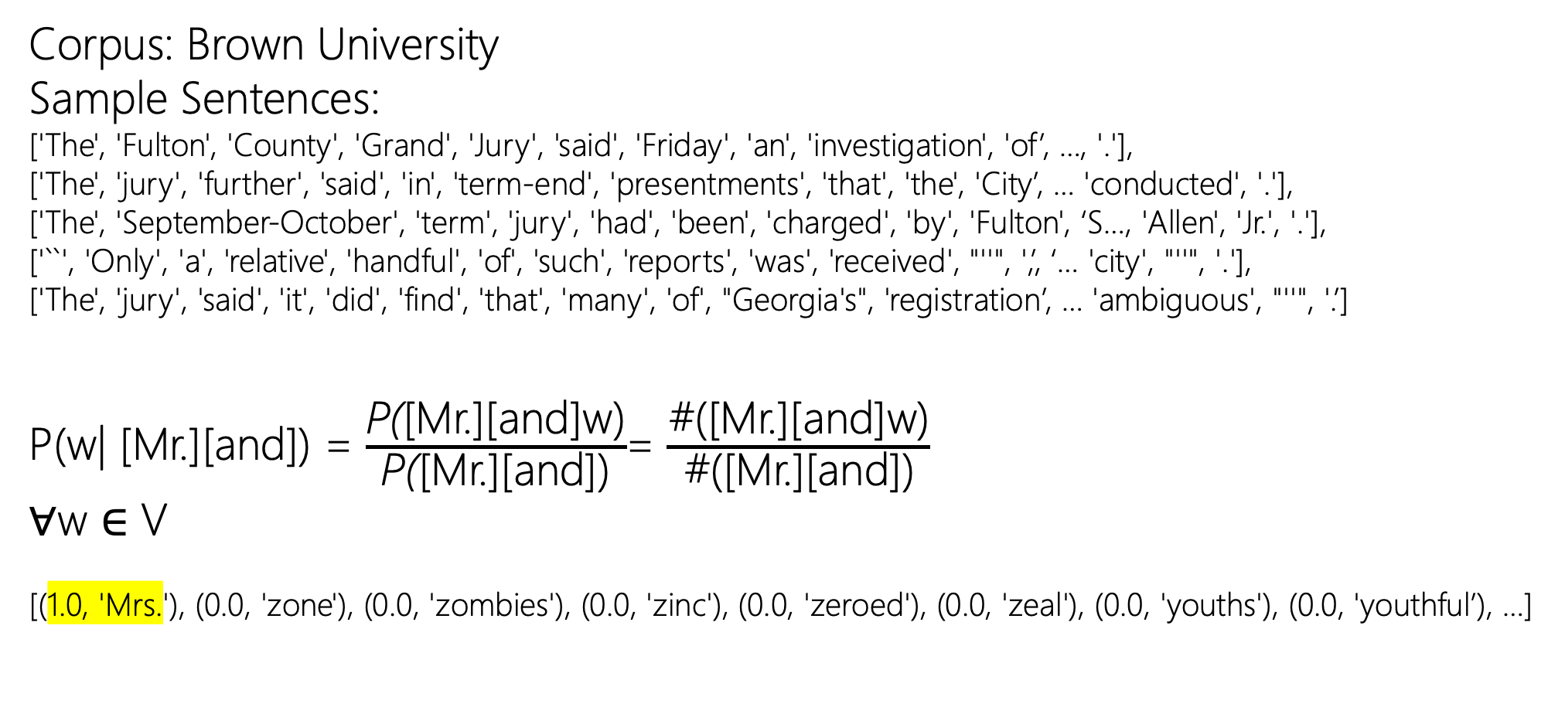
Trigram Language Modeling
Corpus: Brown University
Sample Sentences:
['The', 'Fulton', 'County', 'Grand', 'Jury', 'said', 'Friday', 'an', 'investigation', 'of’, …, '.'],
['The', 'jury', 'further', 'said', 'in', 'term-end', 'presentments', 'that', 'the', 'City’, … 'conducted', '.'],
['The', 'September-October', 'term', 'jury', 'had', 'been', 'charged', 'by', 'Fulton', ‘S…, 'Allen', 'Jr.', '.'],
['``', 'Only', 'a', 'relative', 'handful', 'of', 'such', 'reports', 'was', 'received', "''", ',’, ‘… 'city', "''", '.'],
['The', 'jury', 'said', 'it', 'did', 'find', 'that', 'many', 'of', "Georgia's", 'registration’, … 'ambiguous', "''", '.’]
P(w| [Mr.][and]) = $\frac{\text{P}\text{(}\text{[}\text{Mr}\text{.][}\text{and}\text{]}\text{w}\text{)}}{\text{P}\text{(}\text{[}\text{Mr}\text{.][}\text{and}\text{])}}$= $\frac{\text{\#}\text{(}\text{[}\text{Mr}\text{.][}\text{and}\text{]}\text{w}\text{)}}{\text{\#}\text{(}\text{[}\text{Mr}\text{.][}\text{and}\text{])}}$
∀w ∈ V
[(1.0, 'Mrs.'), (0.0, 'zone'), (0.0, 'zombies'), (0.0, 'zinc'), (0.0, 'zeroed'), (0.0, 'zeal'), (0.0, 'youths'), (0.0, 'youthful’), …]
Notes:
Trigrams / Bigrams

Slide 29
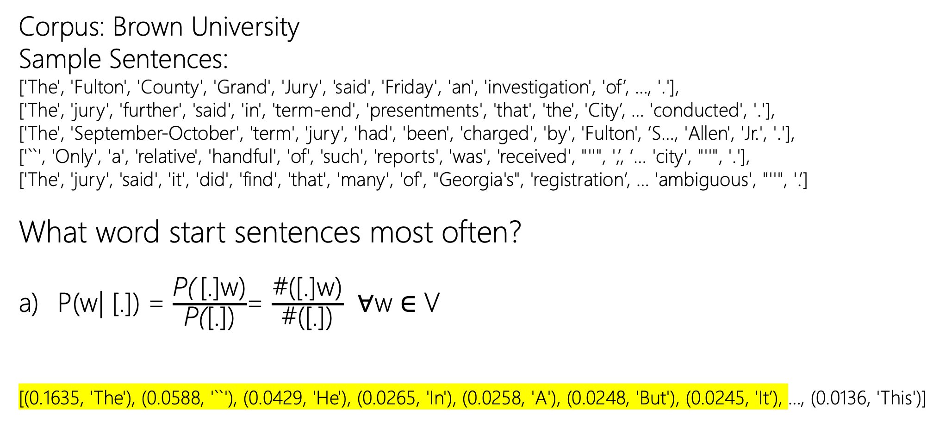
Bigram Language Modeling
Corpus: Brown University
Sample Sentences:
['The', 'Fulton', 'County', 'Grand', 'Jury', 'said', 'Friday', 'an', 'investigation', 'of’, …, '.'],
['The', 'jury', 'further', 'said', 'in', 'term-end', 'presentments', 'that', 'the', 'City’, … 'conducted', '.'],
['The', 'September-October', 'term', 'jury', 'had', 'been', 'charged', 'by', 'Fulton', ‘S…, 'Allen', 'Jr.', '.'],
['``', 'Only', 'a', 'relative', 'handful', 'of', 'such', 'reports', 'was', 'received', "''", ',’, ‘… 'city', "''", '.'],
['The', 'jury', 'said', 'it', 'did', 'find', 'that', 'many', 'of', "Georgia's", 'registration’, … 'ambiguous', "''", '.’]
What word start sentences most often?
P(w| [.]) = $\frac{\text{P}\text{(} \text{[.]}\text{w}\text{)}}{\text{P}\text{(}\text{[.]}\text{)}}$= $\frac{\text{\#}\text{(}\text{[.]}\text{w}\text{)}}{\text{\#}\text{(}\text{[.]}\text{)}}$ ∀w ∈ V
[(0.1635, 'The'), (0.0588, '``'), (0.0429, 'He'), (0.0265, 'In'), (0.0258, 'A'), (0.0248, 'But'), (0.0245, 'It’), …, (0.0136, 'This')]

Slide 30
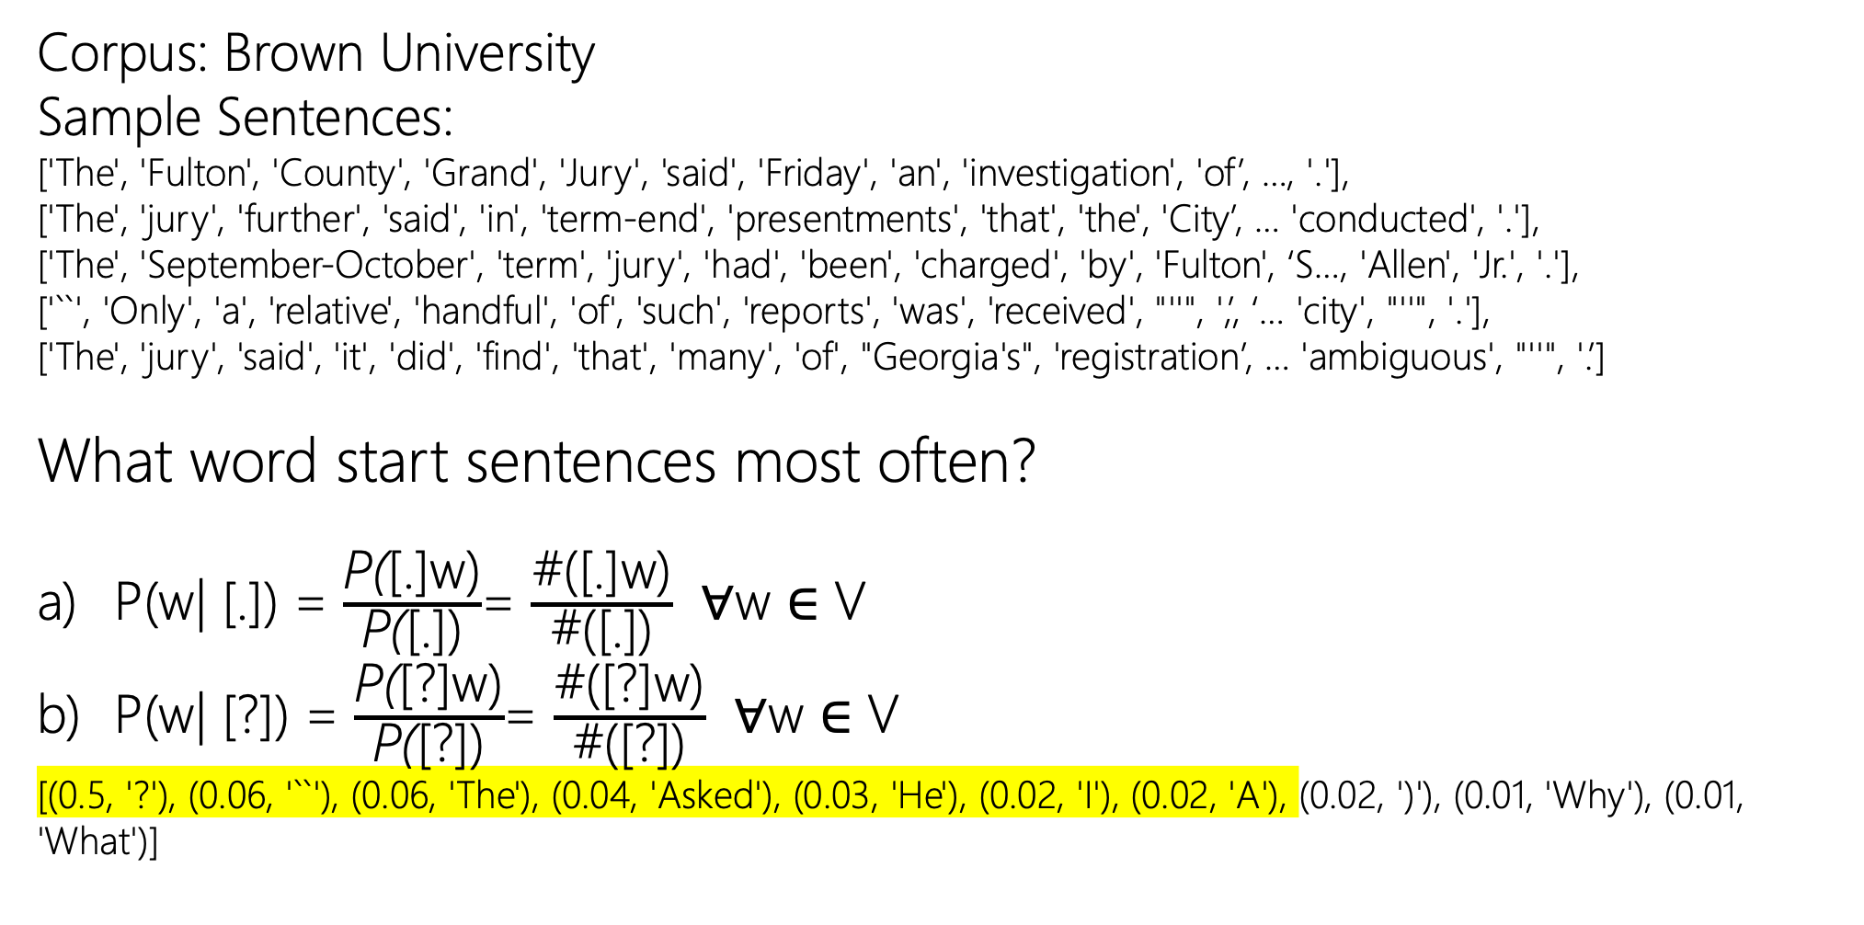
Bigram Language Modeling
Corpus: Brown University
Sample Sentences:
['The', 'Fulton', 'County', 'Grand', 'Jury', 'said', 'Friday', 'an', 'investigation', 'of’, …, '.'],
['The', 'jury', 'further', 'said', 'in', 'term-end', 'presentments', 'that', 'the', 'City’, … 'conducted', '.'],
['The', 'September-October', 'term', 'jury', 'had', 'been', 'charged', 'by', 'Fulton', ‘S…, 'Allen', 'Jr.', '.'],
['``', 'Only', 'a', 'relative', 'handful', 'of', 'such', 'reports', 'was', 'received', "''", ',’, ‘… 'city', "''", '.'],
['The', 'jury', 'said', 'it', 'did', 'find', 'that', 'many', 'of', "Georgia's", 'registration’, … 'ambiguous', "''", '.’]
What word start sentences most often?
P(w| [.]) = $\frac{\text{P}\text{(}\text{[.]}\text{w}\text{)}}{\text{P}\text{(}\text{[.]}\text{)}}$= $\frac{\text{\#}\text{(}\text{[.]}\text{w}\text{)}}{\text{\#}\text{(}\text{[.]}\text{)}}$ ∀w ∈ V
P(w| [?]) = $\frac{\text{P}\text{(}\text{[?]}\text{w}\text{)}}{\text{P}\text{(}\text{[?])}}$= $\frac{\text{\#}\text{([?]}\text{w}\text{)}}{\text{\#}\text{([?])}}$ ∀w ∈ V
[(0.5, '?'), (0.06, '``'), (0.06, 'The'), (0.04, 'Asked'), (0.03, 'He'), (0.02, 'I'), (0.02, 'A'), (0.02, ')'), (0.01, 'Why'), (0.01, 'What')]

Slide 31
Bigram Language Modeling
Corpus: Brown University
Sample Sentences:
['The', 'Fulton', 'County', 'Grand', 'Jury', 'said', 'Friday', 'an', 'investigation', 'of’, …, '.'],
['The', 'jury', 'further', 'said', 'in', 'term-end', 'presentments', 'that', 'the', 'City’, … 'conducted', '.'],
['The', 'September-October', 'term', 'jury', 'had', 'been', 'charged', 'by', 'Fulton', ‘S…, 'Allen', 'Jr.', '.'],
['``', 'Only', 'a', 'relative', 'handful', 'of', 'such', 'reports', 'was', 'received', "''", ',’, ‘… 'city', "''", '.'],
['The', 'jury', 'said', 'it', 'did', 'find', 'that', 'many', 'of', "Georgia's", 'registration’, … 'ambiguous', "''", '.’]
What word start sentences most often?
P(w| [.]) + P(w| [?]) – P(w| [both ‘.’ and ‘?’]) ∀w ∈ V
*From Probability: P(A U B) = P(A) + P(B) – P(AB)

Slide 32
Bigram Language Modeling
Corpus: Brown University
Sample Sentences:
['The', 'Fulton', 'County', 'Grand', 'Jury', 'said', 'Friday', 'an', 'investigation', 'of’, …, '.'],
['The', 'jury', 'further', 'said', 'in', 'term-end', 'presentments', 'that', 'the', 'City’, … 'conducted', '.'],
['The', 'September-October', 'term', 'jury', 'had', 'been', 'charged', 'by', 'Fulton', ‘S…, 'Allen', 'Jr.', '.'],
['``', 'Only', 'a', 'relative', 'handful', 'of', 'such', 'reports', 'was', 'received', "''", ',’, ‘… 'city', "''", '.'],
['The', 'jury', 'said', 'it', 'did', 'find', 'that', 'many', 'of', "Georgia's", 'registration’, … 'ambiguous', "''", '.’]
What word start sentences most often?
P(w| [.]) + P(w| [?]) – 0 ∀w ∈ V
[(0.5, '?'), (0.23, 'The'), (0.12, '``'), (0.07, 'He'), (0.04, 'A'), (0.04, 'Asked'), (0.03, 'In'), (0.02, 'I'), (0.02, ')'), (0.02, 'But')]
*From Probability: P(A U B) = P(A) + P(B) – P(AB)

Slide 33
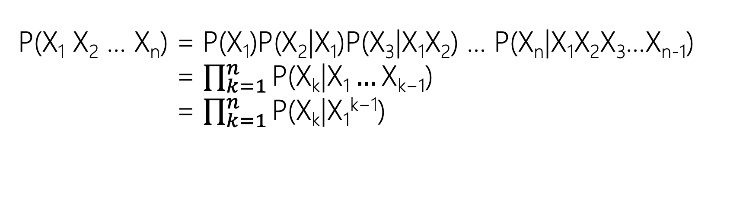
Chain Rule of Probability
P(X₁ X₂ … X_{n}) = P(X₁)P(X₂|X₁)P(X₃|X₁X₂) … P(X_{n}|X₁X₂X₃…X_{n-1})
P(X₁ X₂ … X_{n}) = $\prod_{k=1}^{n}{\text{P}\text{(}\text{Xk}\text{|}\text{X}\text{1}…\text{X}\text{k}\text{−1) }}$
P(X₁ X₂ … X_{n}) = $\prod_{k=1}^{n}{\text{P}\text{(}\text{Xk}\text{|}\text{X}\text{1}\text{k}\text{−1}\text{) }}$

Slide 34
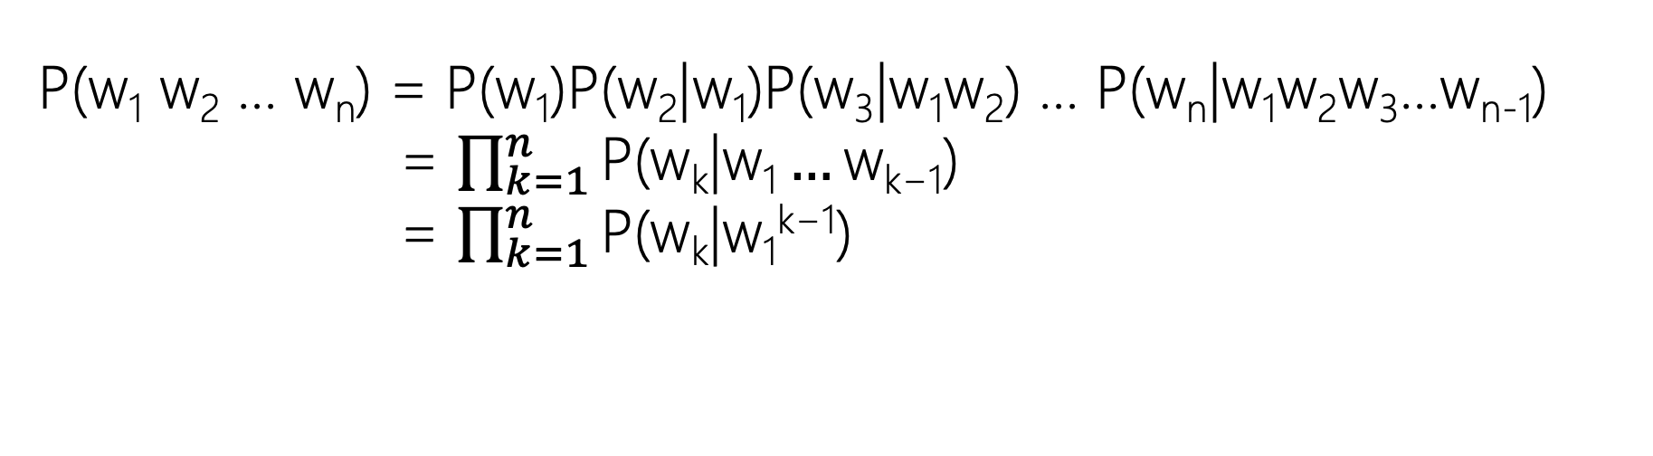
Chain Rule of Probability
P(w₁ w₂ … w_{n}) = P(w₁)P(w₂|w₁)P(w₃|w₁w₂) … P(w_{n}|w₁w₂w₃…w_{n-1})
P(w₁ w₂ … wn) = $\prod_{k=1}^{n}{\text{P}\text{(}\text{w}\text{k}\text{|}\text{w}\text{1}…\text{w}\text{k}\text{−1) }}$
P(w₁ w₂ … wn) = $\prod_{k=1}^{n}{\text{P}\text{(}\text{w}\text{k}\text{|}\text{w}\text{1}\text{k}\text{−1}\text{) }}$

Slide 35
Approximation to Chain Rule
P(w₁ w₂ … w_{n}) = P(w₁)P(w₂|w₁)P(w₃|w₁w₂) … P(w_{n}|w₁w₂w₃…w_{n-1})
- Efficiency: Instead of computing the probability of a word given its entire history, we can approximate the history by just the last few words.

Slide 36
Approximation to Chain Rule
P(w₁ w₂ … w_{n}) = P(w₁)P(w₂|w₁)P(w₃|w₁w₂) … P(w_{n}|w₁w₂w₃…w_{n-1})
- Generalizability: Language is creative and any particular context might have never occurred before! We can’t just estimate by counting the number of
times every word occurs following every long string.

Slide 37
Unigram Approximation
Bag-of-Word (BoW)
P(w₁ w₂ … w_{n}) = P(w₁)P(w₂|w₁)P(w₃|w₁w₂) … P(w_{n}|w₁w₂w₃…w_{n-1})
P(w₁ w₂ … wn) = P(w₁)P(w₂|w₁)P(w₃|w₁w₂) … P(w_{n}|w₁w₂w₃…w_{n-1})
= P(w₁)P(w₂)P(w₃) … P(w_{n}) fff

Slide 38
Bigram Approximation
Markovian
P(w₁ w₂ … w_{n}) = P(w₁)P(w₂|w₁)P(w₃|w₁w₂) … P(w_{n}|w₁w₂w₃…w_{n-1})
P(w₁ w₂ … wn) = P(w₁)P(w₂|w₁)P(w₃|w₁w₂) … P(w_{n}|w₁w₂w₃…w_{n-1})
The assumption that the probability of a variable depends only on the previous variable is called Markov assumption.

Slide 39
Trigram Approximation
P(w₁ w₂ … w_{n}) = P(w₁)P(w₂|w₁)P(w₃|w₁w₂) … P(w_{n}|w₁w₂…w_{n-2}w_{n-1})
P(w₁ w₂ … w_{n}) = P(w₁)P(w₂|w₁)P(w₃|w₁w₂) … P(w_{n}|w₁w₂w_{n-2}…w_{n-1})

Slide 40
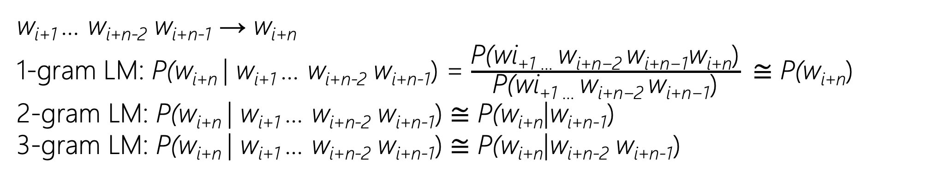
Approx. n-gram Language Modeling
w_{i+1} … w_{i+n-2} w_{i+n-1} → w_{i+n}
1-gram LM: P(w_{i+n} | w_{i+1} … w_{i+n-2} w_{i+n-1}) = $\frac{\text{P}\text{(}\text{wi}\text{+1 … }\text{w}\text{i}\text{+}\text{n}\text{−2 }\text{w}\text{i}\text{+}\text{n}\text{−1}\text{w}\text{i}\text{+}\text{n}\text{)}}{\text{P}\text{(}\text{wi}\text{+1 … }\text{w}\text{i}\text{+}\text{n}\text{−2 }\text{w}\text{i}\text{+}\text{n}\text{−1}\text{)}}$ ≅ P(w_{i+n})
2-gram LM: P(w_{i+n} | w_{i+1} … w_{i+n-2} w_{i+n-1}) ≅ P(w_{i+n}|w_{i+n-1})
3-gram LM: P(w_{i+n} | w_{i+1} … w_{i+n-2} w_{i+n-1}) ≅ P(w_{i+n}|w_{i+n-2} w_{i+n-1})

Slide 41
Approx. n-gram Language Modeling
Corpus: Brown University
Sample Sentences:
['The', 'Fulton', 'County', 'Grand', 'Jury', 'said', 'Friday', 'an', 'investigation', 'of’, …, '.'],
['The', 'jury', 'further', 'said', 'in', 'term-end', 'presentments', 'that', 'the', 'City’, … 'conducted', '.'],
['The', 'September-October', 'term', 'jury', 'had', 'been', 'charged', 'by', 'Fulton', ‘S…, 'Allen', 'Jr.', '.'],
['``', 'Only', 'a', 'relative', 'handful', 'of', 'such', 'reports', 'was', 'received', "''", ',’, ‘… 'city', "''", '.'],
['The', 'jury', 'said', 'it', 'did', 'find', 'that', 'many', 'of', "Georgia's", 'registration’, … 'ambiguous', "''", '.’]
P([Mr.][and][Mrs.]) =0.00045851027827207127
P([Mr.][and][Mrs.]) = P([Mr.])P([and]|[Mr.])P([Mrs.]|[Mr.][and]) Bigram Approx.
P([Mr.][and][Mrs.]) ≅ P([Mr.])P([and]|[Mr.])P([Mrs.]|[and]) P([Mr.][and][Mrs.]) = P([Mr.][and][Mrs.]) ≅ 0.000014208331509791766
P([Mr.][and][Mrs.]) = P([Mr.])P([and]|[Mr.])P([Mrs.]|[Mr.][and]) Unigram Approx.
P([Mr.][and][Mrs.]) ≅ P([Mr.])P([and])P([Mrs.]) P([Mr.][and][Mrs.]) = P([Mr.][and][Mrs.]) ≅ 0.00000009078228423943108
Notes:
Trigrams / Bigrams

Slide 42
Approx. n-gram Language Modeling
Corpus: Brown University
Sample Sentences:
['The', 'Fulton', 'County', 'Grand', 'Jury', 'said', 'Friday', 'an', 'investigation', 'of’, …, '.'],
['The', 'jury', 'further', 'said', 'in', 'term-end', 'presentments', 'that', 'the', 'City’, … 'conducted', '.'],
['The', 'September-October', 'term', 'jury', 'had', 'been', 'charged', 'by', 'Fulton', ‘S…, 'Allen', 'Jr.', '.'],
['``', 'Only', 'a', 'relative', 'handful', 'of', 'such', 'reports', 'was', 'received', "''", ',’, ‘… 'city', "''", '.'],
['The', 'jury', 'said', 'it', 'did', 'find', 'that', 'many', 'of', "Georgia's", 'registration’, … 'ambiguous', "''", '.’]
P([Mr.][and][I]) =0.0
P([Mr.][and][I]) = P([Mr.])P([and]|[Mr.])P([Mrs.]|[Mr.][and]) Bigram Approx.
P([Mr.][and][I]) ≅ P([Mr.])P([and]|[Mr.])P([Mrs.]|[and]) P([Mr.][and][Mrs.]) = P([Mr.][and][I]) ≅ 0.00000175171210394693
P([Mr.][and][I]) = P([Mr.])P([and]|[Mr.])P([Mrs.]|[Mr.][and]) Unigram Approx.
P([Mr.][and][I]) ≅ P([Mr.])P([and])P([Mrs.]) P([Mr.][and][Mrs.]) = P([Mr.][and][Mrs.]) P([Mr.][and][I]) ≅ 0.00000006422936315754214
Notes:
Trigrams / Bigrams

Slide 43
Approx. n-gram Language Modeling
Corpus: Brown University
Sample Sentences:
['The', 'Fulton', 'County', 'Grand', 'Jury', 'said', 'Friday', 'an', 'investigation', 'of’, …, '.'],
['The', 'jury', 'further', 'said', 'in', 'term-end', 'presentments', 'that', 'the', 'City’, … 'conducted', '.'],
['The', 'September-October', 'term', 'jury', 'had', 'been', 'charged', 'by', 'Fulton', ‘S…, 'Allen', 'Jr.', '.'],
['``', 'Only', 'a', 'relative', 'handful', 'of', 'such', 'reports', 'was', 'received', "''", ',’, ‘… 'city', "''", '.'],
['The', 'jury', 'said', 'it', 'did', 'find', 'that', 'many', 'of', "Georgia's", 'registration’, … 'ambiguous', "''", '.’]
P([Mr.][and][Mrs.]) | P([Mr.][and][I])
0.00045851027827207127 | 0.0
1.4208331509791766e-05 | 1.75171210394693e-06
9.078228423943108e-08 | 6.422936315754214e-08
Notes:
Trigrams / Bigrams

Slide 44
Log Probability
P(X₁) × P(X₂) × … × P(X_{n}) = exp(log P(X₁) + log P(X₂) + … + log P(X_{n}))

Slide 45
Log Probability
P(X₁) × P(X₂) × … × P(X_{n}) = exp(log P(X₁) + log P(X₂) + … + log P(X_{n}))
Multiplying multiple numbers in [0, 1] results in very small number!

Slide 46
Log Probability
P(X₁) × P(X₂) × … × P(X_{n}) = exp(log P(X₁) + log P(X₂) + … + log P(X_{n}))
Multiplying multiple numbers in [0, 1] results in very small number!
We don’t care about the actual probability value but the relative order. Our task is often the selection of the most probable item.

Slide 47
Log Probability
P(X₁) × P(X₂) × … × P(X_{n}) = exp(log P(X₁) + log P(X₂) + … + log P(X_{n}))
Multiplying multiple numbers in [0, 1] results in very small number!
We don’t care about the actual probability value but the relative order. Our task is often the selection of the most probable item.
Optimizing the left and right sides have the same effect.

Slide 48
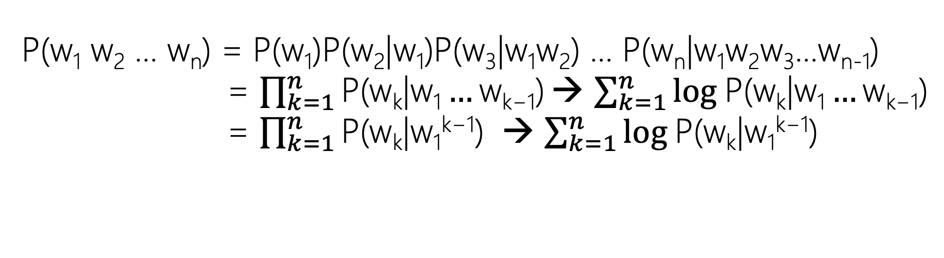
Chain Rule of Probability
P(w₁ w₂ … w_{n}) = P(w₁)P(w₂|w₁)P(w₃|w₁w₂) … P(w_{n}|w₁w₂w₃…w_{n-1})
P(w₁ w₂ … wn) = $\prod_{k=1}^{n}{\text{P}\text{(}\text{w}\text{k}\text{|}\text{w}\text{1}…\text{w}\text{k}\text{−1) }}$→ $\sum_{k=1}^{n}{\text{log} \text{P}\text{(}\text{wk}\text{|}\text{w}\text{1}…\text{w}\text{k}\text{−1)}}$
P(w₁ w₂ … wn) = $\prod_{k=1}^{n}{\text{P}\text{(}\text{w}\text{k}\text{|}\text{w}\text{1}\text{k}\text{−1}\text{) }}$→ $\sum_{k=1}^{n}{\text{log} \text{P}\text{(}\text{wk}\text{|}\text{w}\text{1}\text{k}\text{−1)}}$

Slide 49
