Slide 1
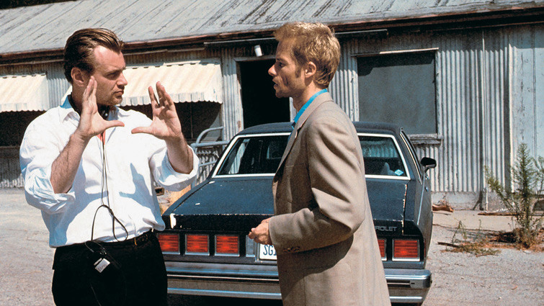

n-gram Language models

Slide 2
Evaluating Language Models
Unigram vs. Bigram vs. Trigram vs. n-gram

Slide 3
Evaluating Language Models
The more n in n-gram, the better language model?
The more history, the better prediction of future?

Slide 4
Evaluating Language Models
Qualitative → Generate
Unigram: stream = []
while (w != '</s>’):
w = unigrams_freq.select()
stream.append(w)

Slide 5
Evaluating Language Models
Qualitative → Generate
Bigram: stream = []
while (w != '</s>’):
w = bigrams_freq[stream[-1]].select()
stream.append(w)

Slide 6
Evaluating Language Models
Qualitative → Generate
Trigram: stream = []
while (w != '</s>’):
w = trigrams_freq[stream[-2:]].select()
stream.append(w)

Slide 7
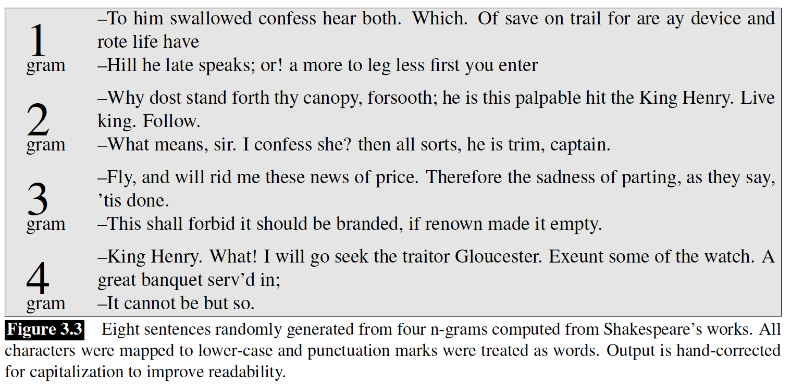

Slide 8
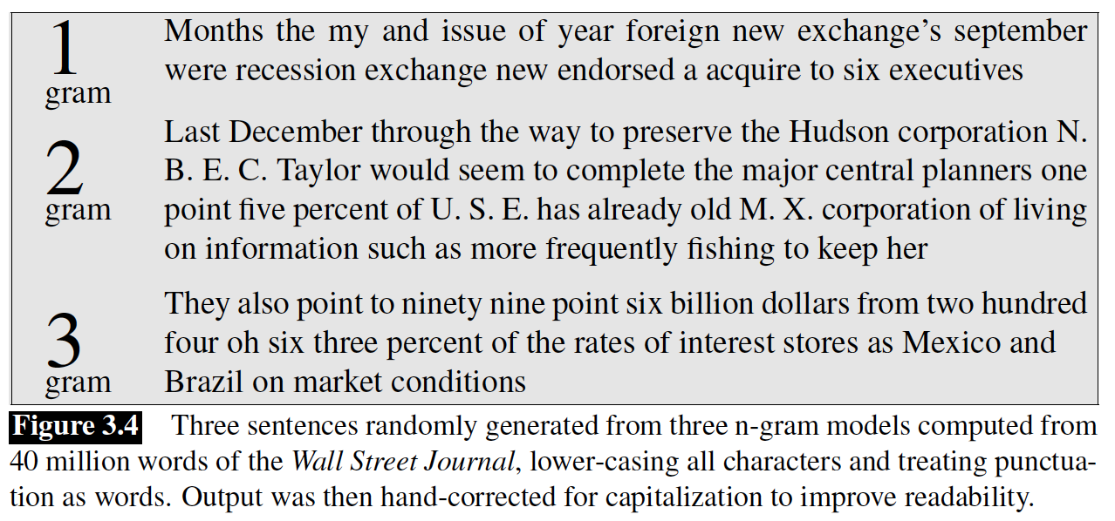

Slide 9
Cross Evaluating Language Models
Qualitative → Generate
Biased toward the corpus! Dialect, Genre, …

Slide 10
Evaluating Language Models
Quantitative → Likelihood

Slide 11
Models
Language
L
M*
P(L | M*) = 1
P(l | M*) = ?
M₂
P(L | M₂) = 0.001
P(l | M₂) = 1
M₁
l
P(L | M₁) = 0
P(l | M₁) = 0

Slide 12
Find M*
Golden Model
The language space is available.
Enumerate the model space to find M*, assuming it exists!

Slide 13
Find M*
Golden Model
The language space is available. → Randomly selected subset
Enumerate the model space to find M*, assuming it exists!

Slide 14
Language
L
l
Model
M*
P(L | M*) = 1
P(l | M*) = 1

Slide 15
Find M* M^
Golden Silver Model
The language space is available. → Randomly selected subset
Enumerate the model space to find M*, assuming it exists!
→ Search subspace, e.g., just linear models!

Slide 16
P(L | M*) = 1
Language
L
Models
M*
l
P(l | M*) = 1
P(l | M₃) = 1
M₂
M₃
P(l | M₄) = 0.9
Linear Model
P(L | M₄) = ?
M₁
M₄
P(l | M₁) = 0
P(L | M₃) = ?
P(L | M₁) = 0

Slide 17
M^ = argmax _{M∈Models} P(l | M)
The language space is available. → Randomly selected subset
Enumerate the model space to find M*, assuming it exists!
→ Search subspace, e.g., just linear models!

Slide 18
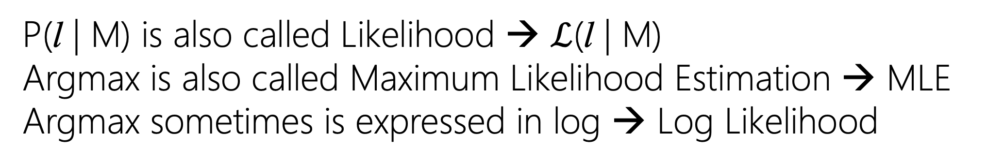
M^ = argmax _{M∈Models} P(l | M)
P(l | M) is also called Likelihood → $ℒ$(l | M)
Argmax is also called Maximum Likelihood Estimation → MLE
Argmax sometimes is expressed in log → Log Likelihood

Slide 19
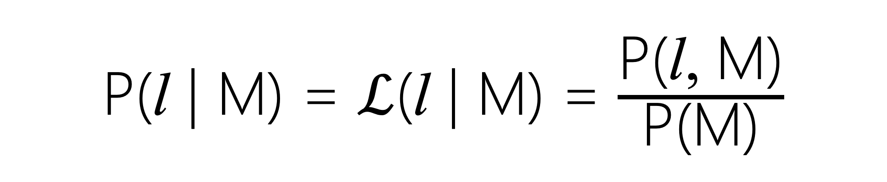
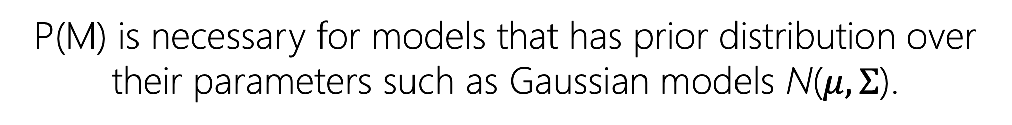
P(l | M) = $ℒ$(l | M) = $\frac{\text{P}\text{(}\text{l}\text{, }\text{M}\text{)}}{\text{P}\text{(}\text{M}\text{)}}$
P(M) is necessary for models that has prior distribution over their parameters such as Gaussian models N($μ, Σ$).

Slide 20
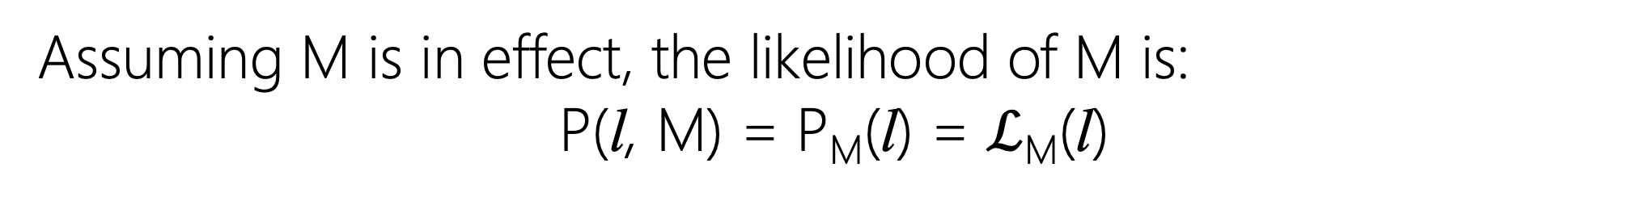
M^ = argmax _{M∈Models} P(l, M)
Assuming M is in effect, the likelihood of M is:
P(l, M) = P_{M}(l) = $ℒ$_{M}(l)

Slide 21
Language
L
l
P(l) = ?
M
P(L) = ?

Slide 22
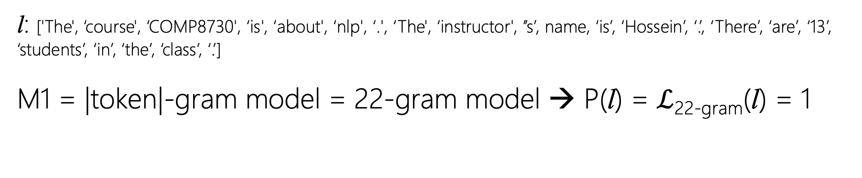
Likelihood of a Language Modeling
l: ['The', ‘course', ‘COMP8730', ‘is', ‘about', ‘nlp', ‘.', ‘The', ‘instructor', ’’s’, name, ‘is’, ‘Hossein’, ‘.’, ‘There’, ‘are’, ‘13’, ‘students’, ‘in’, ‘the’, ‘class’, ‘.’]
M1 = |token|-gram model = 22-gram model → P(l) = $ℒ$_{22-gram}(l) = 1
Notes:
Trigrams / Bigrams

Slide 23
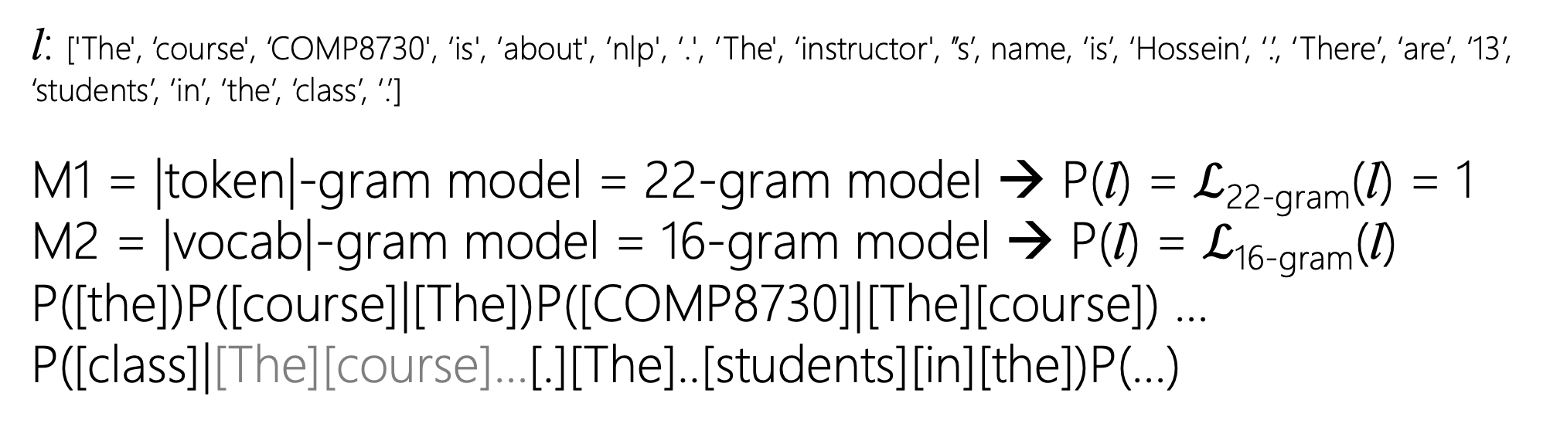
Likelihood of a Language Modeling
l: ['The', ‘course', ‘COMP8730', ‘is', ‘about', ‘nlp', ‘.', ‘The', ‘instructor', ’’s’, name, ‘is’, ‘Hossein’, ‘.’, ‘There’, ‘are’, ‘13’, ‘students’, ‘in’, ‘the’, ‘class’, ‘.’]
M1 = |token|-gram model = 22-gram model → P(l) = $ℒ$_{22-gram}(l) = 1
M2 = |vocab|-gram model = 16-gram model → P(l) = $ℒ$_{16-gram}(l)
P([the])P([course]|[The])P([COMP8730]|[The][course]) …
P([class]|[The][course]…[.][The]..[students][in][the])P(…)
Only the last 15 words
These are not considered in 16-gram model
Notes:
Trigrams / Bigrams

Slide 24
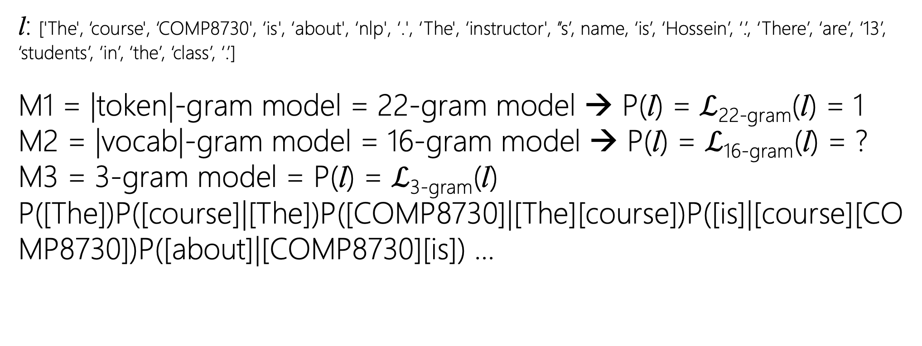
Likelihood of a Language Modeling
l: ['The', ‘course', ‘COMP8730', ‘is', ‘about', ‘nlp', ‘.', ‘The', ‘instructor', ’’s’, name, ‘is’, ‘Hossein’, ‘.’, ‘There’, ‘are’, ‘13’, ‘students’, ‘in’, ‘the’, ‘class’, ‘.’]
M1 = |token|-gram model = 22-gram model → P(l) = $ℒ$_{22-gram}(l) = 1
M2 = |vocab|-gram model = 16-gram model → P(l) = $ℒ$_{16-gram}(l) = ?
M3 = 3-gram model = P(l) = $ℒ$_{3-gram}(l)
P([The])P([course]|[The])P([COMP8730]|[The][course])P([is]|[course][COMP8730])P([about]|[COMP8730][is]) …
Only the last 2 words
Notes:
Trigrams / Bigrams

Slide 25
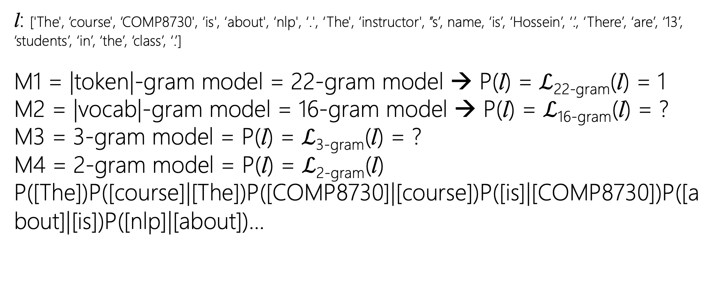
Likelihood of a Language Modeling
l: ['The', ‘course', ‘COMP8730', ‘is', ‘about', ‘nlp', ‘.', ‘The', ‘instructor', ’’s’, name, ‘is’, ‘Hossein’, ‘.’, ‘There’, ‘are’, ‘13’, ‘students’, ‘in’, ‘the’, ‘class’, ‘.’]
M1 = |token|-gram model = 22-gram model → P(l) = $ℒ$_{22-gram}(l) = 1
M2 = |vocab|-gram model = 16-gram model → P(l) = $ℒ$_{16-gram}(l) = ?
M3 = 3-gram model = P(l) = $ℒ$_{3-gram}(l) = ?
M4 = 2-gram model = P(l) = $ℒ$_{2-gram}(l)
P([The])P([course]|[The])P([COMP8730]|[course])P([is]|[COMP8730])P([about]|[is])P([nlp]|[about])…
Only the last word → Markovian
Notes:
Trigrams / Bigrams

Slide 26
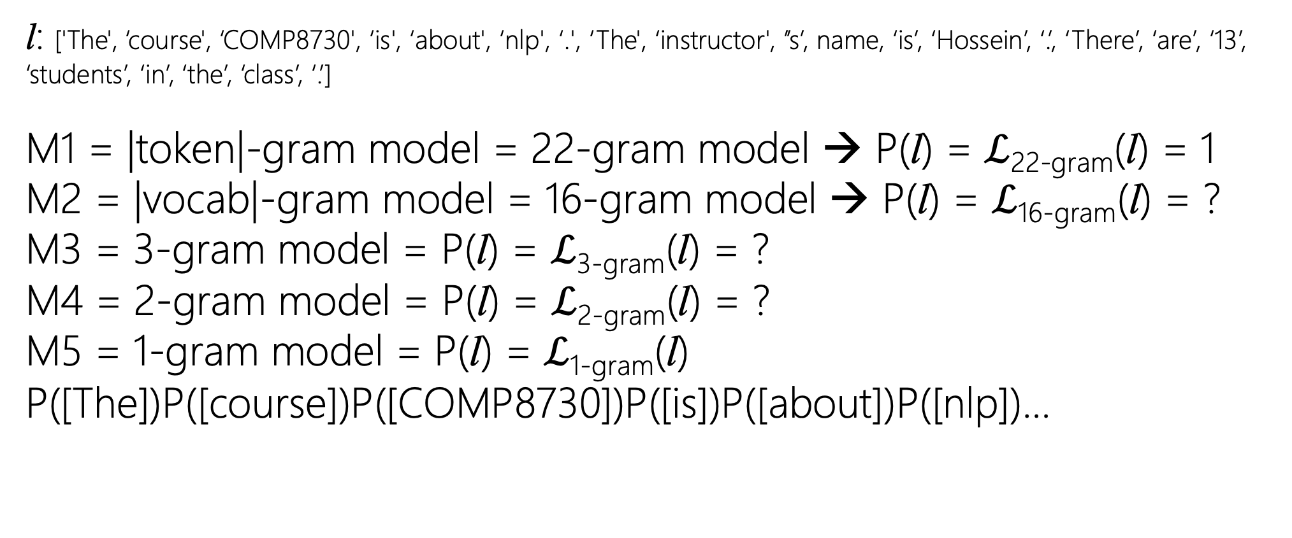
Likelihood of a Language Modeling
l: ['The', ‘course', ‘COMP8730', ‘is', ‘about', ‘nlp', ‘.', ‘The', ‘instructor', ’’s’, name, ‘is’, ‘Hossein’, ‘.’, ‘There’, ‘are’, ‘13’, ‘students’, ‘in’, ‘the’, ‘class’, ‘.’]
M1 = |token|-gram model = 22-gram model → P(l) = $ℒ$_{22-gram}(l) = 1
M2 = |vocab|-gram model = 16-gram model → P(l) = $ℒ$_{16-gram}(l) = ?
M3 = 3-gram model = P(l) = $ℒ$_{3-gram}(l) = ?
M4 = 2-gram model = P(l) = $ℒ$_{2-gram}(l) = ?
M5 = 1-gram model = P(l) = $ℒ$_{1-gram}(l)
P([The])P([course])P([COMP8730])P([is])P([about])P([nlp])…
No history!
Notes:
Trigrams / Bigrams

Slide 27
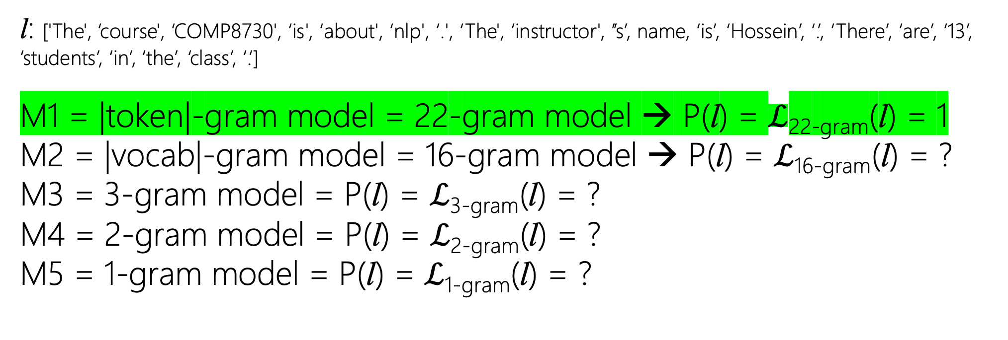
Likelihood of a Language Modeling
l: ['The', ‘course', ‘COMP8730', ‘is', ‘about', ‘nlp', ‘.', ‘The', ‘instructor', ’’s’, name, ‘is’, ‘Hossein’, ‘.’, ‘There’, ‘are’, ‘13’, ‘students’, ‘in’, ‘the’, ‘class’, ‘.’]
M1 = |token|-gram model = 22-gram model → P(l) = $ℒ$_{22-gram}(l) = 1
M2 = |vocab|-gram model = 16-gram model → P(l) = $ℒ$_{16-gram}(l) = ?
M3 = 3-gram model = P(l) = $ℒ$_{3-gram}(l) = ?
M4 = 2-gram model = P(l) = $ℒ$_{2-gram}(l) = ?
M5 = 1-gram model = P(l) = $ℒ$_{1-gram}(l) = ?
Notes:
Trigrams / Bigrams

Slide 28
Language
L
l
22-gram model
P(l) = 1
M
Unseen word, sentence, …
P(L) = ?

Slide 29
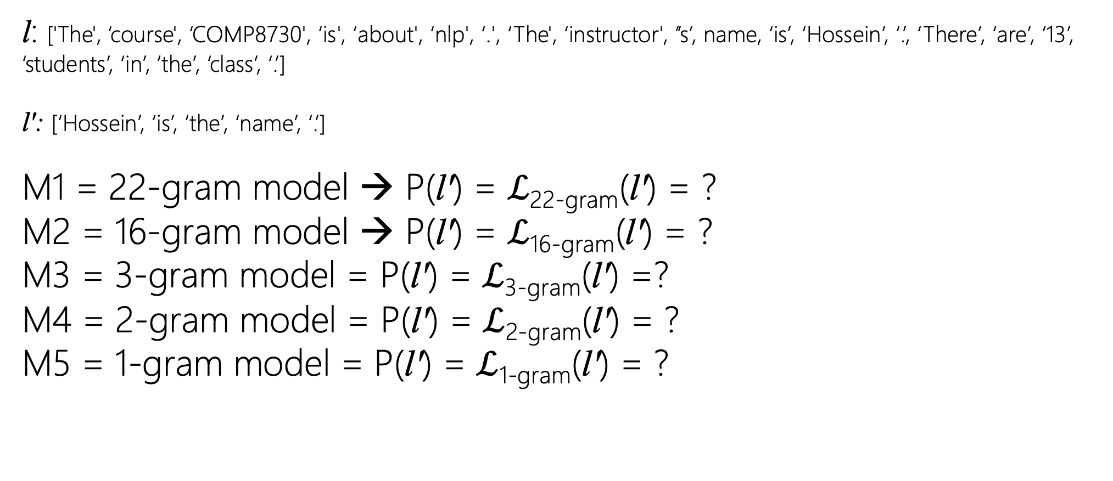
Likelihood of a Language Modeling
l: ['The', ‘course', ‘COMP8730', ‘is', ‘about', ‘nlp', ‘.', ‘The', ‘instructor', ’’s’, name, ‘is’, ‘Hossein’, ‘.’, ‘There’, ‘are’, ‘13’, ‘students’, ‘in’, ‘the’, ‘class’, ‘.’]
l': [‘Hossein’, ‘is’, ‘the’, ‘name’, ‘.’]
M1 = 22-gram model → P(l') = $ℒ$_{22-gram}(l') = ?
M2 = 16-gram model → P(l') = $ℒ$_{16-gram}(l') = ?
M3 = 3-gram model = P(l') = $ℒ$_{3-gram}(l') =?
M4 = 2-gram model = P(l') = $ℒ$_{2-gram}(l') = ?
M5 = 1-gram model = P(l') = $ℒ$_{1-gram}(l') = ?
Notes:
Trigrams / Bigrams

Slide 30
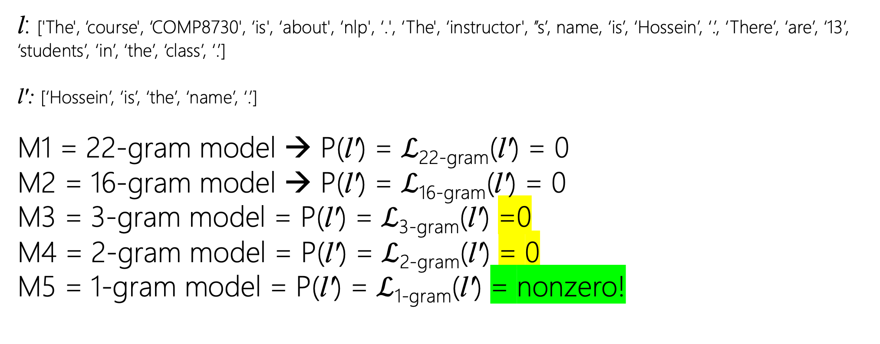
Likelihood of a Language Modeling
l: ['The', ‘course', ‘COMP8730', ‘is', ‘about', ‘nlp', ‘.', ‘The', ‘instructor', ’’s’, name, ‘is’, ‘Hossein’, ‘.’, ‘There’, ‘are’, ‘13’, ‘students’, ‘in’, ‘the’, ‘class’, ‘.’]
l': [‘Hossein’, ‘is’, ‘the’, ‘name’, ‘.’]
M1 = 22-gram model → P(l') = $ℒ$_{22-gram}(l') = 0
M2 = 16-gram model → P(l') = $ℒ$_{16-gram}(l') = 0
M3 = 3-gram model = P(l') = $ℒ$_{3-gram}(l') =0
M4 = 2-gram model = P(l') = $ℒ$_{2-gram}(l') = 0
M5 = 1-gram model = P(l') = $ℒ$_{1-gram}(l') = nonzero!
Notes:
Trigrams / Bigrams

Slide 31
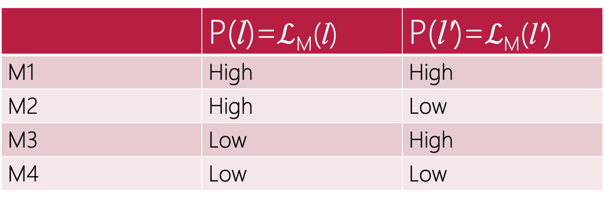
Language
L
l'
l
l
 | P(l)=$ℒ$_{M}(l) | P(l')=$ℒ$_{M}(l')
M1 | High | High
M2 | High | Low
M3 | Low | High
M4 | Low | Low

Slide 32
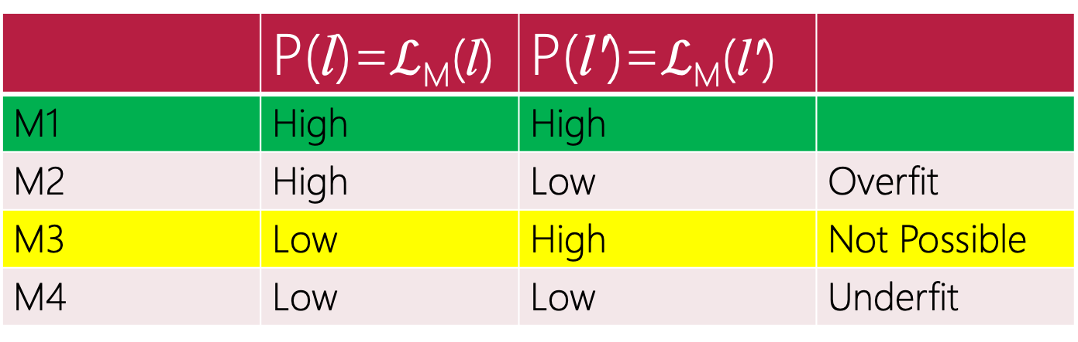
P is trained on $\text{l}$ and does not know anything about $\text{l}′$
Language
L
l'
l
l
 | P(l)=$ℒ$_{M}(l) | P(l')=$ℒ$_{M}(l')
M1 | High | High
M2 | High | Low | Overfit
M3 | Low | High | Not Possible
M4 | Low | Low | Underfit

Slide 33
Evaluating Language Models
Quantitative → Perplexity
How perplexed (confused) a language model is to generate seen or unseen stream of tokens! lower perplexity, the better!

Slide 34
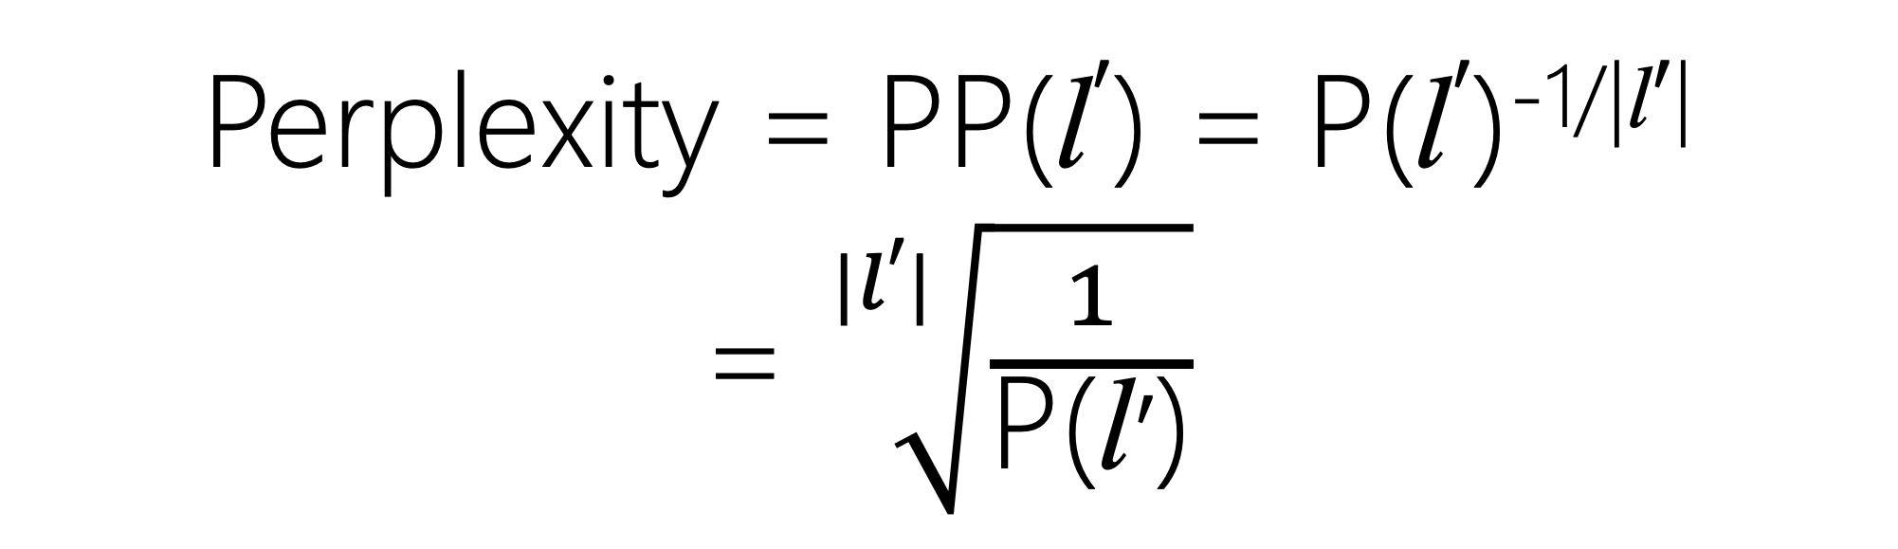
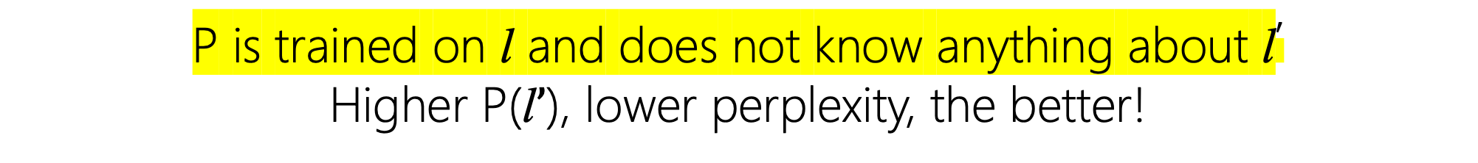
Perplexity = PP(l$′$) = P(l$′$)^{-1/|l}$′$|
= $\sqrt[|l′|]{\frac{1}{\text{P}\text{(}\text{l}′\text{)}}}$
P is trained on $\text{l}$ and does not know anything about $\text{l}′$
Higher $\text{P}\text{(}\text{l}’\text{)}$, lower perplexity, the better!

Slide 35
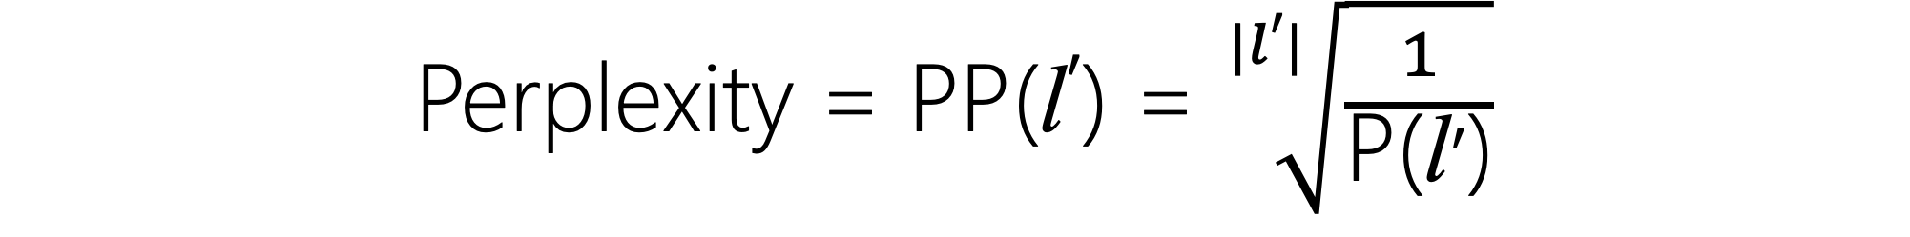
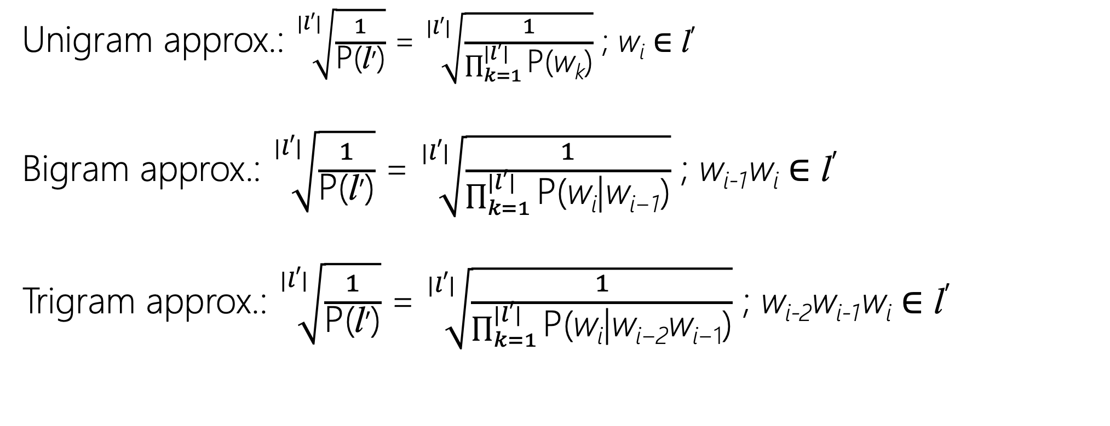
Perplexity = PP(l$′$) = $\sqrt[|l′|]{\frac{1}{\text{P}\text{(}\text{l}′\text{)}}}$
Unigram approx.: $\sqrt[|l′|]{\frac{1}{\text{P}\text{(}\text{l}′\text{)}}}$ = $\sqrt[|l′|]{\frac{1}{\prod_{k=1}^{|l′|}{\text{P}\text{(}\text{w}\text{k}\text{)}}}}$ ; w_{i} ∈ l$′$
Bigram approx.: $\sqrt[|l′|]{\frac{1}{\text{P}\text{(}\text{l}′\text{)}}}$ = $\sqrt[|l′|]{\frac{1}{\prod_{k=1}^{|l′|}{\text{P}\text{(}\text{w}\text{i}\text{|}\text{w}\text{i}\text{−1}\text{)}}}}$ ; w_{i-1}w_{i} ∈ l$′$
Trigram approx.: $\sqrt[|l′|]{\frac{1}{\text{P}\text{(}\text{l}′\text{)}}}$ = $\sqrt[|l′|]{\frac{1}{\prod_{k=1}^{|l′|}{\text{P}\text{(}\text{w}\text{i}\text{|}\text{w}\text{i}\text{−2}\text{w}\text{i}\text{−1}\text{)}}}}$ ; w_{i-2}w_{i-1}w_{i} ∈ l$′$

Slide 36
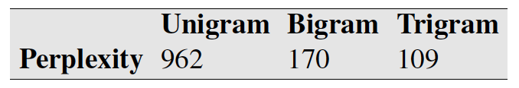
Corpus: Wall Street Journal
Size: 38 million words
Vocab (Types): 19,979
Test Set: 1.5 million words

Slide 37
Zeros!
Unseen

Slide 38
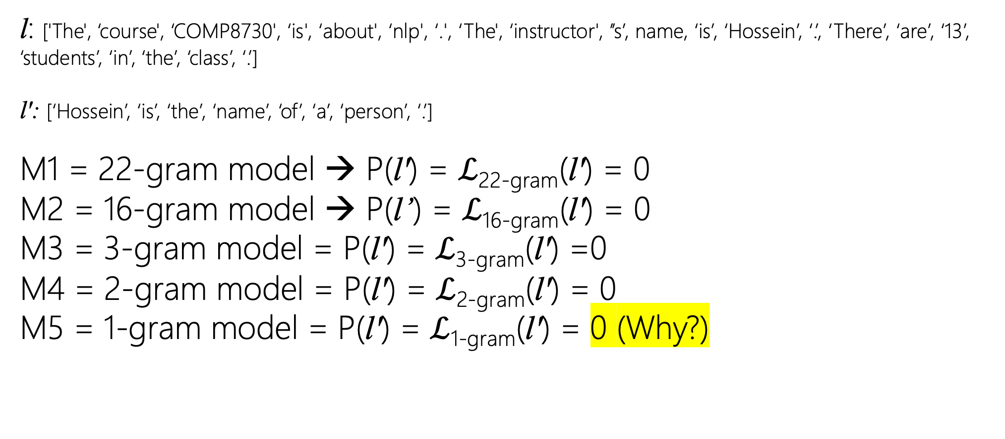
Likelihood of a Language Modeling
l: ['The', ‘course', ‘COMP8730', ‘is', ‘about', ‘nlp', ‘.', ‘The', ‘instructor', ’’s’, name, ‘is’, ‘Hossein’, ‘.’, ‘There’, ‘are’, ‘13’, ‘students’, ‘in’, ‘the’, ‘class’, ‘.’]
l': [‘Hossein’, ‘is’, ‘the’, ‘name’, ‘of’, ‘a’, ‘person’, ‘.’]
M1 = 22-gram model → P(l') = $ℒ$_{22-gram}(l') = 0
M2 = 16-gram model → P(l’) = $ℒ$_{16-gram}(l') = 0
M3 = 3-gram model = P(l') = $ℒ$_{3-gram}(l') =0
M4 = 2-gram model = P(l') = $ℒ$_{2-gram}(l') = 0
M5 = 1-gram model = P(l') = $ℒ$_{1-gram}(l') = 0 (Why?)
Notes:
Trigrams / Bigrams

Slide 39
Zeros!
Unseen
Not all unigrams are available in training set! E.g., [of]
Not all bigrams are available in training set! E.g., [Hossein][is]
Not all trigrams are available in training set! …

Slide 40
Zeros!
Vocabulary + <UNK>
Train Vocabulary + Learn Unseen Tokens (Subwords)
Smoothing

Slide 41
<UNK>
learn the stats of unseen tokens
Pick a dictionary D
From w ∈ l such that w∉D, (OOV) replace it with <UNK>
Train model
At test, from w ∈ l', if w∉l (unseen), replace it with <UNK>
Notes:
The percentage of OOV
open words that appear in the test set is called the OOV rate.

Slide 42
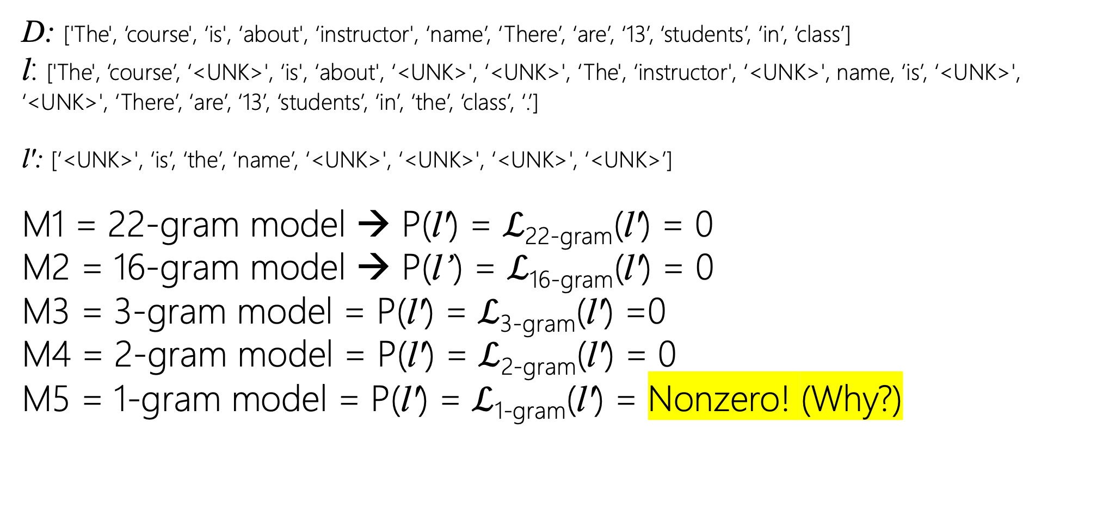
Likelihood of a Language Modeling
D: ['The', ‘course', ‘is', ‘about', ‘instructor', ‘name’, ‘There’, ‘are’, ‘13’, ‘students’, ‘in’, ‘class’]
l: ['The', ‘course’, ‘<UNK>', ‘is', ‘about', ‘<UNK>', ‘<UNK>', ‘The', ‘instructor', ‘<UNK>', name, ‘is’, ‘<UNK>', ‘<UNK>', ‘There’, ‘are’, ‘13’, ‘students’, ‘in’, ‘the’, ‘class’, ‘.’]
l': [‘<UNK>', ‘is’, ‘the’, ‘name’, ‘<UNK>', ‘<UNK>', ‘<UNK>', ‘<UNK>’]
M1 = 22-gram model → P(l') = $ℒ$_{22-gram}(l') = 0
M2 = 16-gram model → P(l’) = $ℒ$_{16-gram}(l') = 0
M3 = 3-gram model = P(l') = $ℒ$_{3-gram}(l') =0
M4 = 2-gram model = P(l') = $ℒ$_{2-gram}(l') = 0
M5 = 1-gram model = P(l') = $ℒ$_{1-gram}(l') = Nonzero! (Why?)
Notes:
Trigrams / Bigrams

Slide 43
<UNK>
learn the stats of unseen tokens
Pick a dictionary D → small
Gives higher probability (lower perplexity) at test
All the model should generate is stream of <UNK>s!
Notes:
The percentage of OOV
open words that appear in the test set is called the OOV rate.

Slide 44

Likelihood of a Language Modeling
D: ['The', ‘is']
l: ['The', ‘<UNK>', ‘<UNK>', ‘is', ‘<UNK>', ‘<UNK>', ‘<UNK>', ‘The', ‘<UNK>', ‘<UNK>', ‘<UNK>', ‘is’, ‘<UNK>', ‘<UNK>', ‘<UNK>', ‘<UNK>', ‘<UNK>', ‘<UNK>', ‘<UNK>', ‘the’, ‘<UNK>', ‘<UNK>']
l': [‘<UNK>', ‘is’, ‘<UNK>’, ‘the’, ‘<UNK>', ‘<UNK>', ‘<UNK>', ‘<UNK>', ‘<UNK>’]
M1 = 22-gram model → P(l') = $ℒ$_{22-gram}(l') = 0
M2 = 16-gram model → P(l’) = $ℒ$_{16-gram}(l') = 0
M3 = 3-gram model = P(l') = $ℒ$_{3-gram}(l') =0
M4 = 2-gram model = P(l') = $ℒ$_{2-gram}(l') = Nonzero!
M5 = 1-gram model = P(l') = $ℒ$_{1-gram}(l') = Nonzero!
Notes:
Trigrams / Bigrams

Slide 45
Subwords
learn the unseen tokens from seen tokens
Please refer to: Text Normalization → Learn to Tokenize

Slide 46
Smoothing
Add-1 (Laplace) or Add-k, → k={1,2,…}
Backoff
Interpolation
…

Slide 47
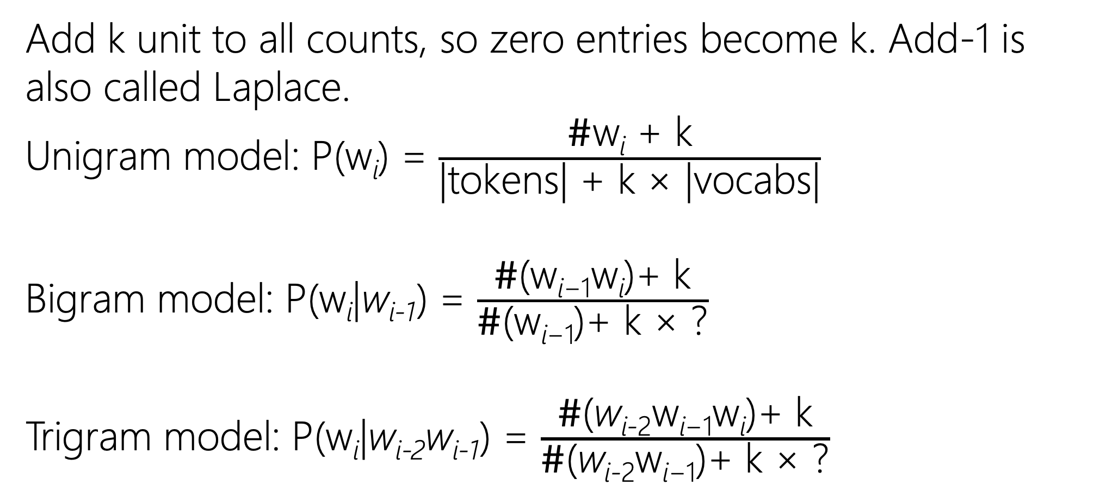
Add-k
Add k unit to all counts, so zero entries become k. Add-1 is also called Laplace.
Unigram model: P(w_{i}) = $\frac{\text{\#}\text{w}\text{i}\text{ + }\text{k}}{\text{|}\text{tokens}\text{| + }\text{k} \text{×}\text{ |}\text{vocabs}\text{|}}$
Bigram model: P(w_{i}|w_{i-1}) = $\frac{\text{\#}\text{(}\text{w}\text{i}\text{−1}\text{w}\text{i}\text{)+ }\text{k}}{\text{\#}\text{(}\text{w}\text{i}\text{−1}\text{)+ }\text{k} \text{×}\text{ ?}}$
Trigram model: P(w_{i}|w_{i-2}w_{i-1}) = $\frac{\text{\#}\text{(}\text{w}\text{i}\text{−}\text{2}\text{w}\text{i}\text{−1}\text{w}\text{i}\text{)+ }\text{k}}{\text{\#}\text{(}\text{w}\text{i}\text{−}\text{2}\text{w}\text{i}\text{−1}\text{)+ }\text{k} \text{×}\text{ ?}}$

Slide 48
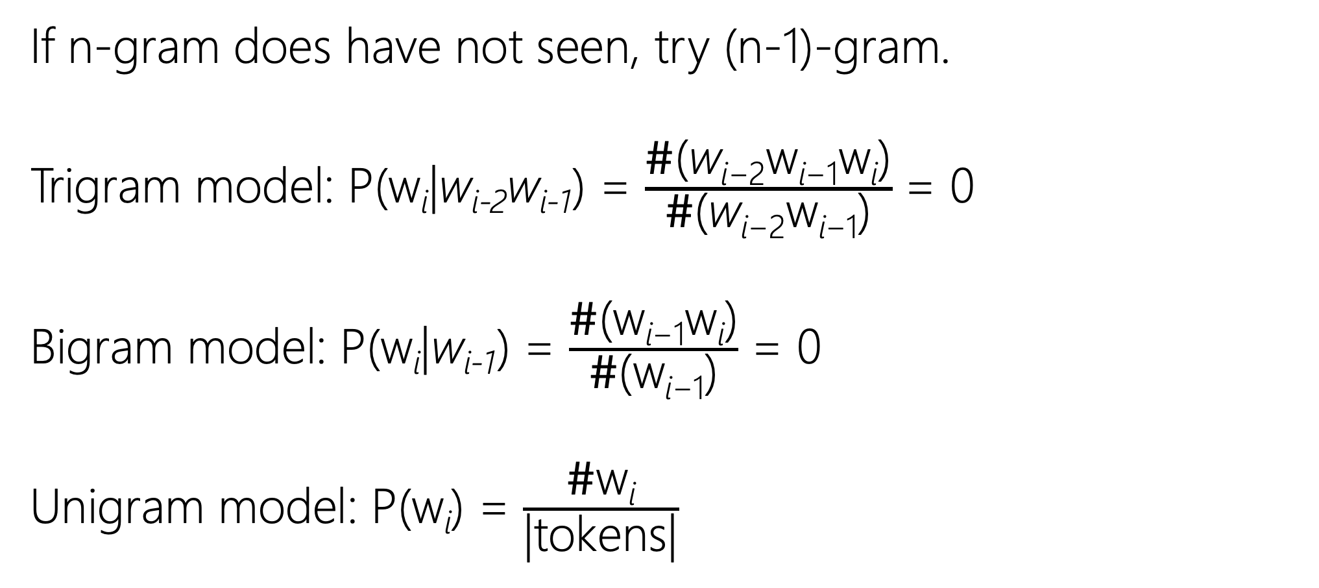
Backoff
If n-gram does have not seen, try (n-1)-gram.
Trigram model: P(w_{i}|w_{i-2}w_{i-1}) = $\frac{\text{\#}\text{(}\text{w}\text{i}\text{−}\text{2}\text{w}\text{i}\text{−1}\text{w}\text{i}\text{)}}{\text{\#}\text{(}\text{w}\text{i}\text{−}\text{2}\text{w}\text{i}\text{−1}\text{)}}$ = 0
Bigram model: P(w_{i}|w_{i-1}) = $\frac{\text{\#}\text{(}\text{w}\text{i}\text{−1}\text{w}\text{i}\text{)}}{\text{\#}\text{(}\text{w}\text{i}\text{−1}\text{)}}$ = 0
Unigram model: P(w_{i}) = $\frac{\text{\#}\text{w}\text{i}}{\text{|}\text{tokens}\text{|}}$

Slide 49
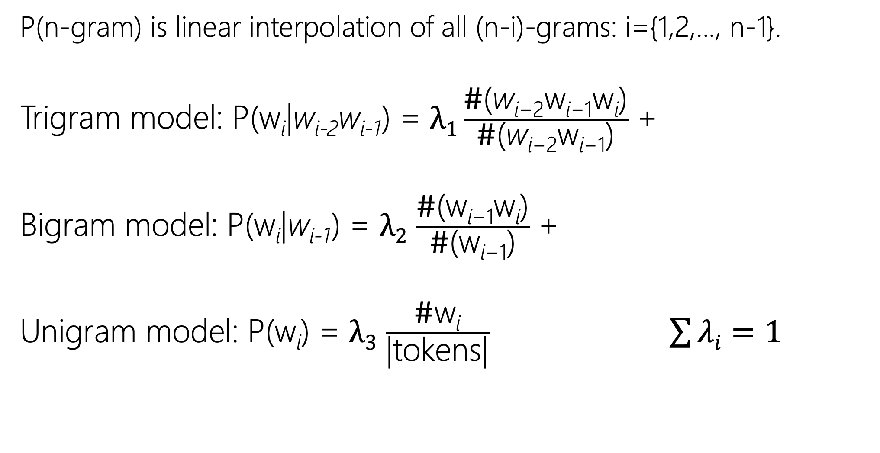
Interpolation
P(n-gram) is linear interpolation of all (n-i)-grams: i={1,2,..., n-1}.
Trigram model: P(w_{i}|w_{i-2}w_{i-1}) = $λ1\frac{\text{\#}\text{(}\text{w}\text{i}\text{−}\text{2}\text{w}\text{i}\text{−1}\text{w}\text{i}\text{)}}{\text{\#}\text{(}\text{w}\text{i}\text{−}\text{2}\text{w}\text{i}\text{−1}\text{)}}$ +
Bigram model: P(w_{i}|w_{i-1}) = $λ2$ $\frac{\text{\#}\text{(}\text{w}\text{i}\text{−1}\text{w}\text{i}\text{)}}{\text{\#}\text{(}\text{w}\text{i}\text{−1}\text{)}}$ +
Unigram model: P(w_{i}) = $λ3$ $\frac{\text{\#}\text{w}\text{i}}{\text{|}\text{tokens}\text{|}}$ $\sum{λi}=1$
Notes:
You have to tune the lamdas based on develop set!

Slide 50
Kneser-Ney Smoothing
Kneser, R. and Ney, H. (1995). Improved backing-off for M-gram language modeling. In ICASSP-95, Vol. 1, 181–184.
Chen, S. F. and Goodman, J. (1999). An empirical study of smoothing techniques for language modeling. Computer Speech and Language, 13, 359–394.

