Slide 1
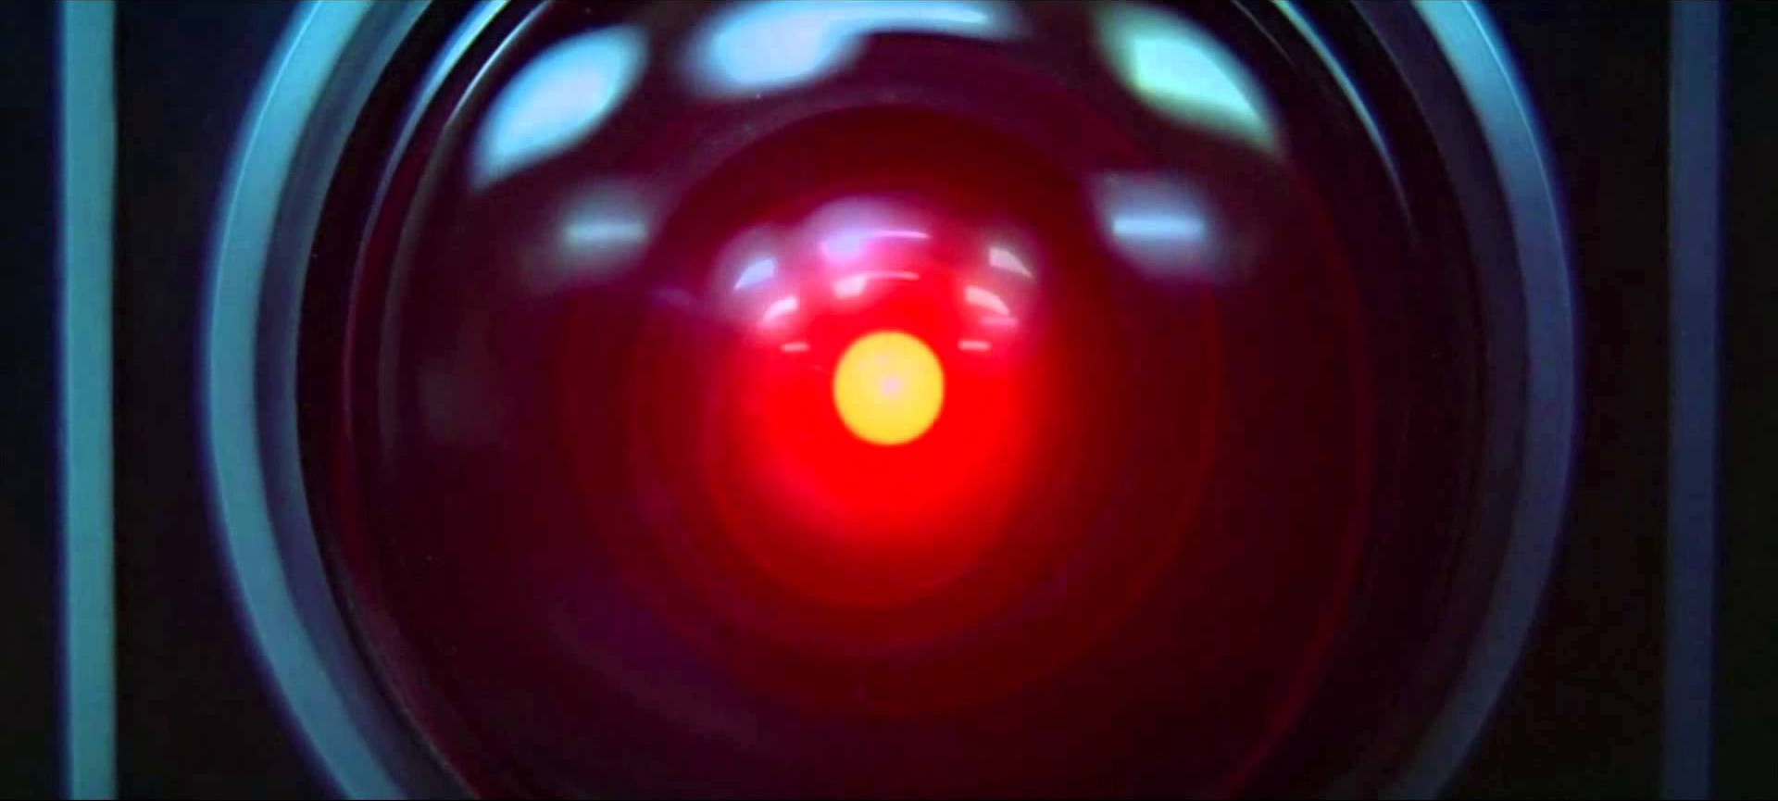
2001: A Space Odyssey (1968), Stanley Kubrick and Arthur C. Clarke
- A Conversation with HAL! https://www.youtube.com/watch?v=r13I-TuDcWI
- HAL Reads Lips! https://www.youtube.com/watch?v=XDO8OYnmkNY
– HAL: I'm Sorry, Dave! https://www.youtube.com/watch?v=Wy4EfdnMZ5g
Notes:
conversational agents or dialogue systems:
Language input (automatic speech recognition and natural language understanding)
Language output (dialogue and response planning and speech synthesis).
Applications:
Machine translation
Web-based question answering → generalization of simple Web search
Definition questions: What does “divergent” mean?
Simple factoid questions like dates and locations: What year was Abraham Lincoln born?
Inference (drawing conclusions based on known facts), or synthesizing and summarizing information from multiple sources or Web pages
Information Extraction (IE)
Word Sense Disambiguation (WSD)

Slide 2
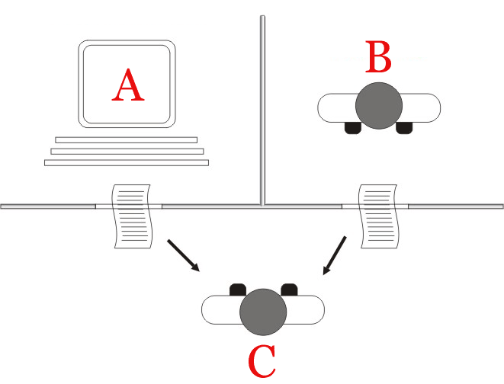
The Turing Test
by Alan Turing in 1950
Player C, the interrogator, is given the task of trying to determine which player – A or B – is a computer and which is a human. The interrogator is limited to using the responses to written questions to make the determination.
Notes:
,^{[2]} is a test of a machine's ability to exhibit intelligent behaviour equivalent to, or indistinguishable from, that of a human.
Turing proposed that a human evaluator would judge natural language conversations between a human and a machine designed to generate human-like responses.

Slide 3
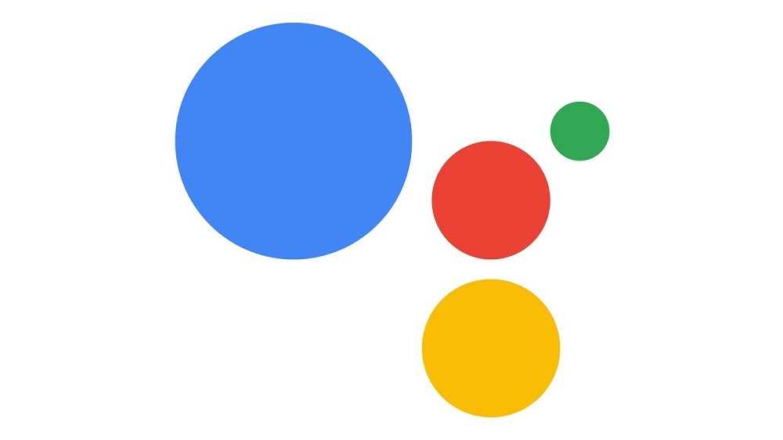
Google Duplex: A.I. Assistant Calls Local Businesses To Make Appointments
https://www.youtube.com/watch?v=D5VN56jQMWM
Notes:
Sundar Pichai
Google’s CEO

Slide 4
Natural Language Understanding
Speech, Text, Emotion, …

Slide 5
Research Priorities for Artificial Intelligence
The capacity for language is one of the central features of human intelligence and is therefore a prerequisite for artificial intelligence.
Despite its many practical applications, language is perhaps number 300 in the priority list for AI research. It would be a great achievement if AI could attain the capabilities of an orangutan, which do not include language!
- Yann LeCun (computer vision researcher)
Russell, Stuart, Daniel Dewey, and Max Tegmark. "Research priorities for robust and beneficial artificial intelligence." Ai Magazine 36.4 (2015): 105-114.

Slide 6
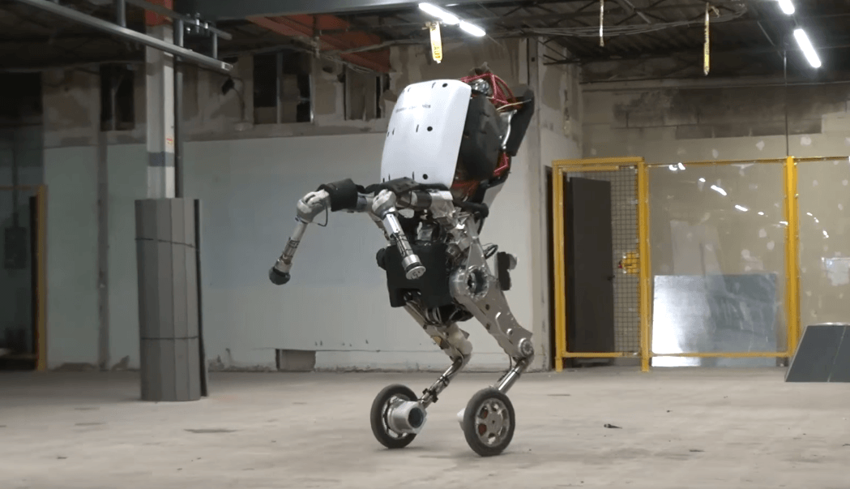
Handle: Boston Dynamics' newest design. Jumps 4 feet in the air and zips around at 9 miles per hour. https://www.youtube.com/watch?v=7h8mX9ZMs7g

Slide 7
NLP is AI-hard (AI-Complete)

Slide 8
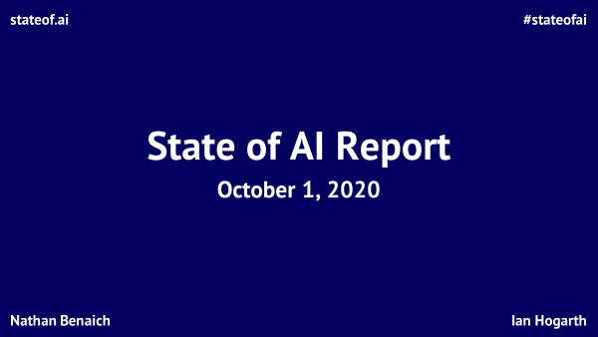

Slide 9
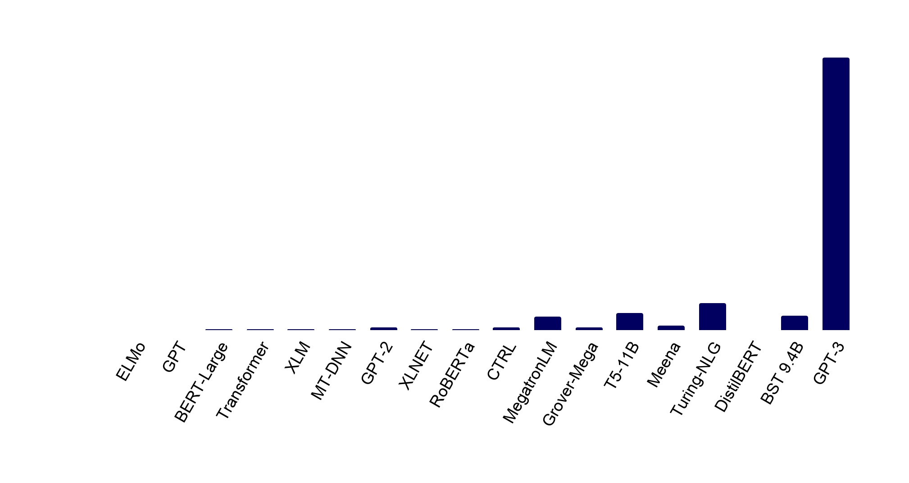
Introduction | Research | Talent | Industry | Politics | Predictions
#stateofai
Language models: Welcome to the Billion Parameter club
Huge models, large companies and massive training costs dominate the hottest area of AI today, NLP.
2018 (left) through 2019 (right)
2020 onwards
175B
8.3B
11B
17B
9.4B
94M
1.5B
1.5B
1.5B
2.6B
110M
340M
465M
665M
330M
340M
355M
66M
stateof.ai 2020
Note: The number of parameters indicates how many different coefficients the algorithm optimizes during the training process.
Notes:
Source: individual papers on said models

Slide 10
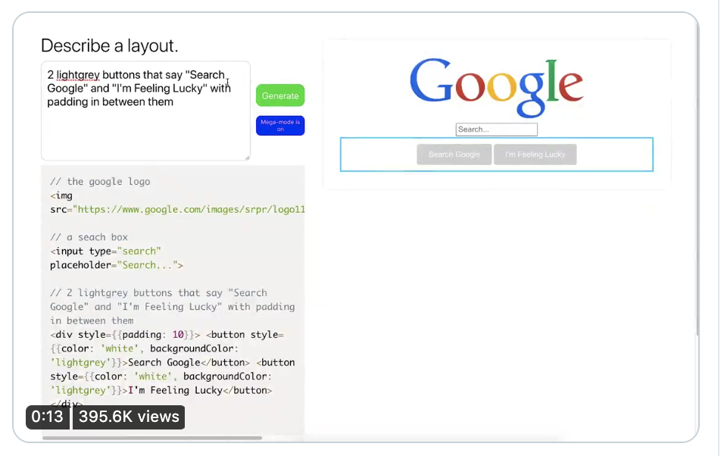
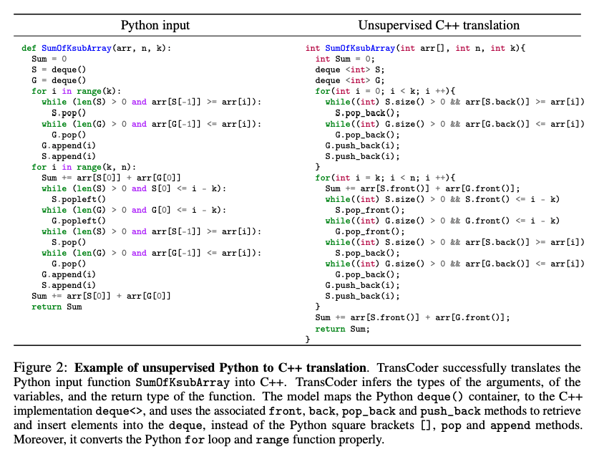
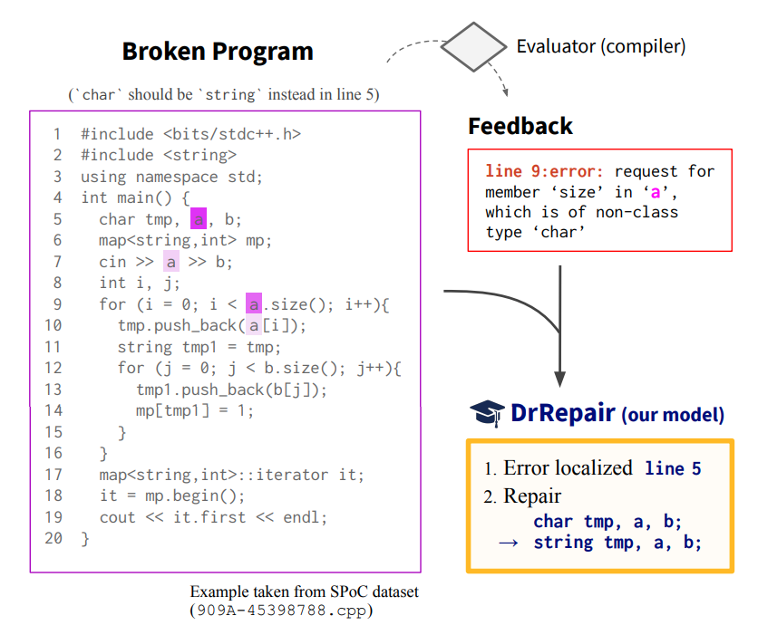
Introduction | Research | Talent | Industry | Politics | Predictions
#stateofai
stateof.ai 2020
Notes:
Source: https://huggingface.co/distilbert-base-cased-distilled-squad?text=Where+do+I+live%3F&context=My+name+is+Sarah+and+I+live+in+London.

Slide 11

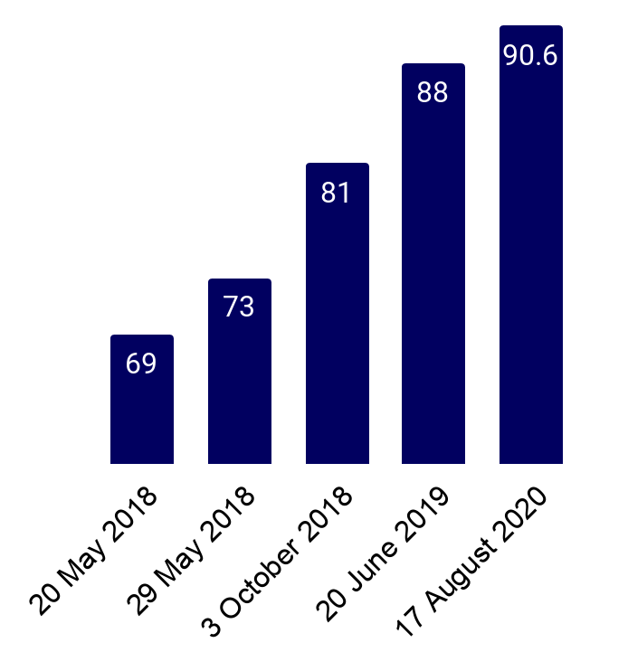

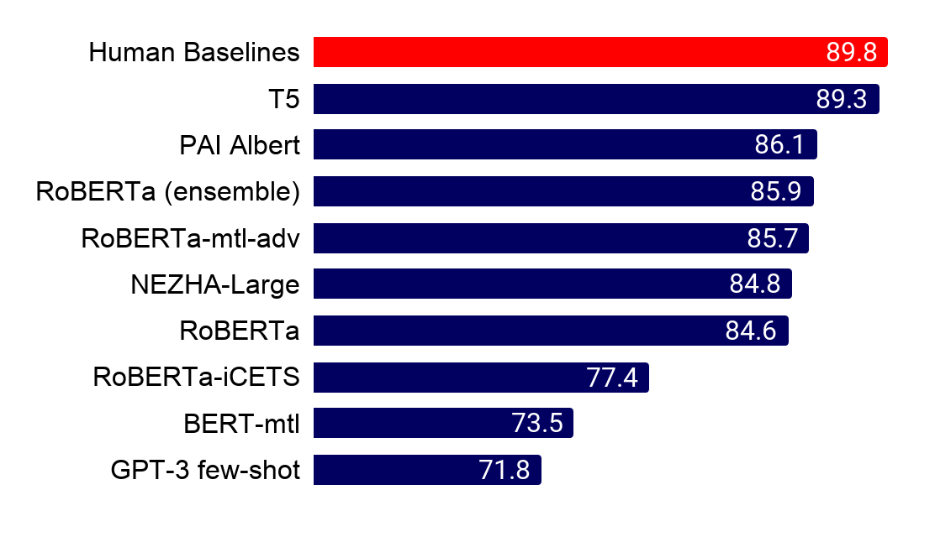
Introduction | Research | Talent | Industry | Politics | Predictions
#stateofai
NLP benchmarks take a beating: Over a dozen teams outrank the human GLUE baseline
It was only 12 months ago that the human GLUE benchmark was beat by 1 point. Now SuperGLUE is in sight.
GLUE and it's more challenging sibling SuperGLUE are benchmarks that evaluate NLP systems at a range of tasks spanning logic, common sense understanding, and lexical semantics. The human benchmark on GLUE is reliably beat today (right) and the SuperGLUE human benchmark is almost surpassed too!
Human baseline = 87
stateof.ai 2020
Notes:
Source: https://gluebenchmark.com/
Source: https://super.gluebenchmark.com/

Slide 12
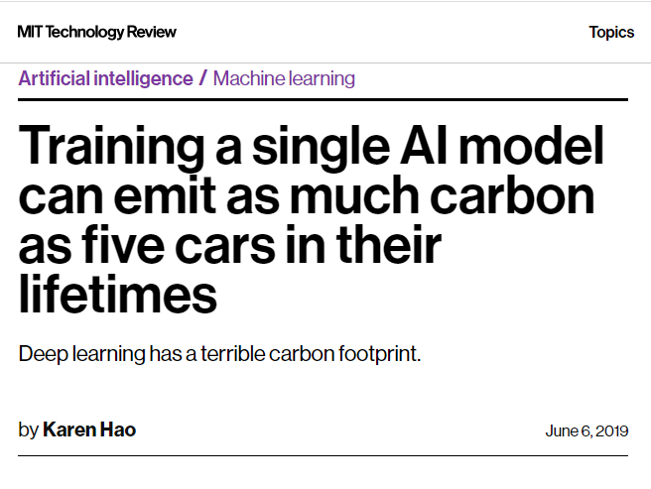
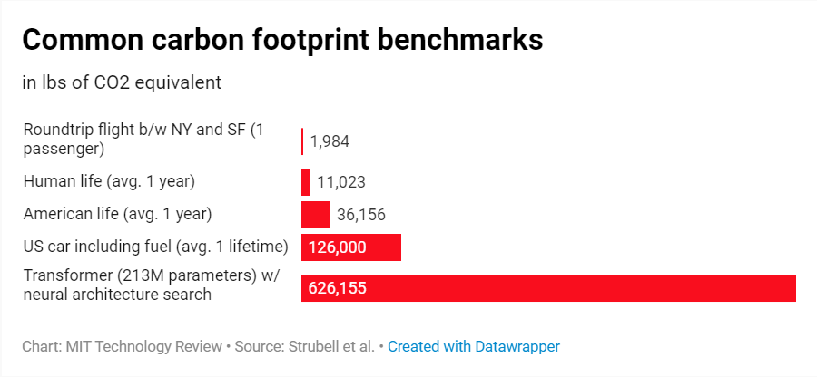
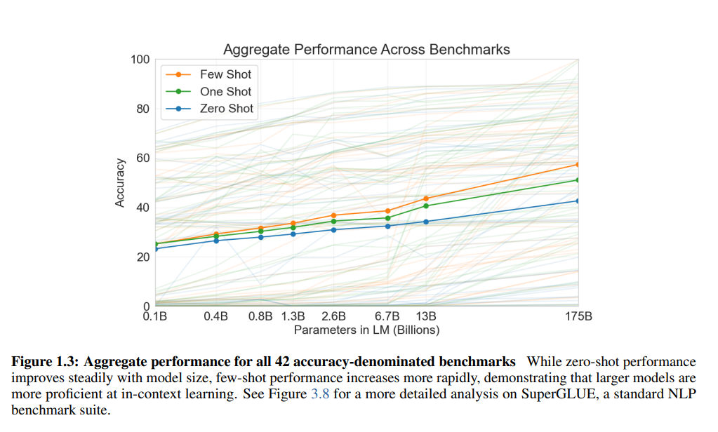

Slide 13
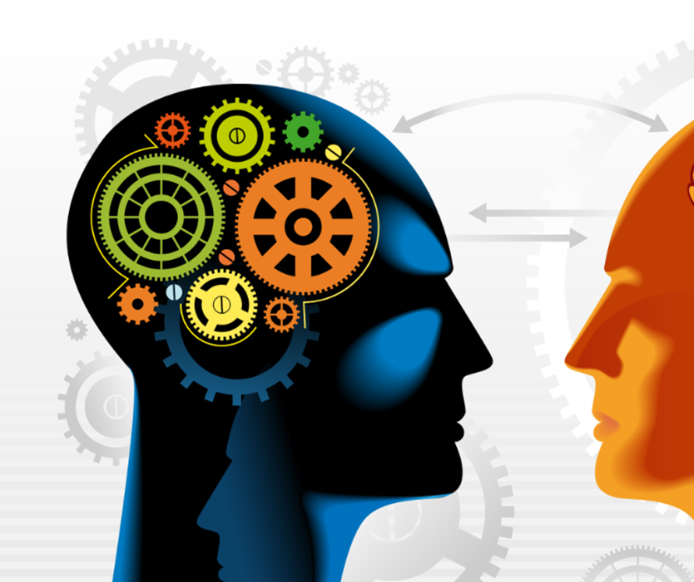
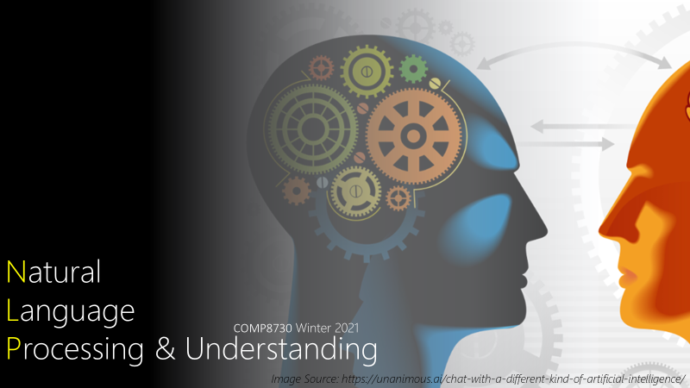
Natural
Language
Processing & Understanding
COMP8730 Winter 2021
Image Source: https://unanimous.ai/chat-with-a-different-kind-of-artificial-intelligence/

Slide 14
Background: the course is targeted at computer scientists!
Assumed to know
Design of Algorithms
Greedy
Dynamic Programming
Divide-Conquer
Recursion
Backtracking
Analysis of Algorithms
Time & Space (memory)
Big O
Complexity Theory
Data Modeling
Data Structure
Computer Science
Mathematic
Linguistics

Slide 15
Background: the course is targeted at computer scientists!
Assumed to know
Multivariate Calculus
Derivatives
Partial Derivatives
Linear Algebra
Vectors
Matrices
Probability & Statistics
Computer Science
Mathematic
Linguistics
Notes:
. A review of basic probability
is found in Appendix A, and a minimal review of numerical optimization is
found in Appendix B. For linear algebra, the online course and textbook from Strang
(2016) provide an excellent review. Deisenroth et al. (2018) are currently preparing
a textbook on Mathematics for Machine Learning, a draft can be found online.1 For
an introduction to probabilistic modeling and estimation, see James et al. (2013); for
1https://mml-book.github.io/
i
ii PREFACE
a more advanced and comprehensive discussion of the same material, the classic
reference is Hastie et al. (2009)

Slide 16
Background: the course is targeted at computer scientists!
Computer Science
Assumed to know
Elementary concepts
Part-of-Speech (Nouns, Verbs, …)
English Grammar
Mathematic
References
- Linguistic Fundamentals for Natural Language Processing:
100 Essentials from Morphology and Syntax, Bender, E. M. (2013).
Linguistics

Slide 17
Natural Language Processing & Text Mining
The goal is to provide new computational capabilities for applications
E.g., predict next form of a word for branding!
extracting information from texts,
translating between languages,
answering questions,
holding a conversation,
taking instructions,
….
Computational Linguistics
Here, language is the object of study.
Computational methods are to support.
Just as in computational biology
E.g, how a word is evolving in time?
Discourse analysis
Parsing
Machine Learning & Data Mining
Methods of learning from data.
Text data needs special care! Why?

Slide 18
Approach: unstructured vs. structured
Statistical
Learning
Structural
Search

Slide 19
Approach: unstructured vs. structured
Statistical
Learning
Structural
Search

Slide 20
Course: Research-oriented, Project-driven
Research
Project
Theory
Assignment

Slide 21
Research Project
vs.
Software Project

Slide 22
Research Project
Problem Definition
Presentation I: Proposal
Experiment
Conference Submission
Literature Review
Proposed Solution
Presentation II: Demo

Slide 23
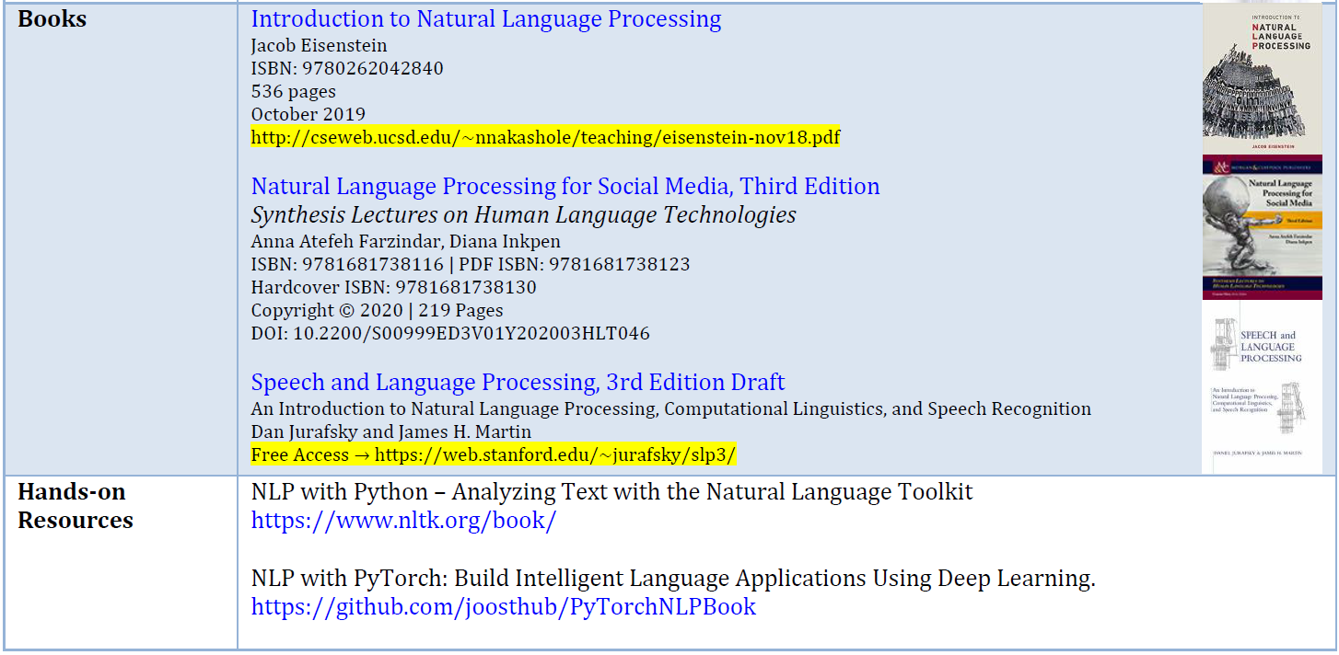

Slide 24
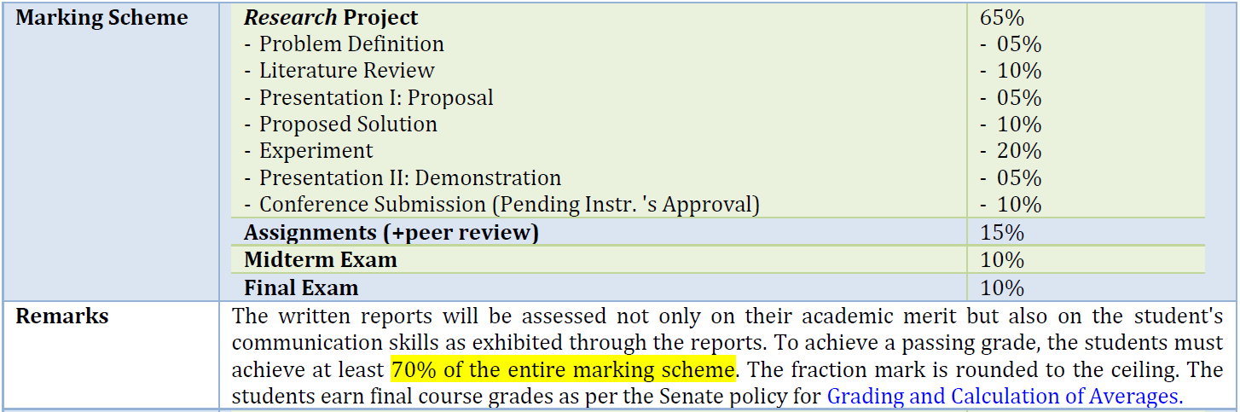

Slide 25
OFFICE
Tuesday-Thursday 5:30 PM-6:30 PM

Slide 26
Natural language

Slide 27
Engaging in Natural Language Behavior
Phonetics and Phonology
knowledge about linguistic sounds
Morphology
knowledge of the meaningful components of words
Syntax
knowledge of the structural relationships between words
Semantics
knowledge of meaning
Pragmatics
knowledge of the relationship of meaning to the goals & intentions of the speaker
Discourse
knowledge about linguistic units larger than a single utterance

Slide 28
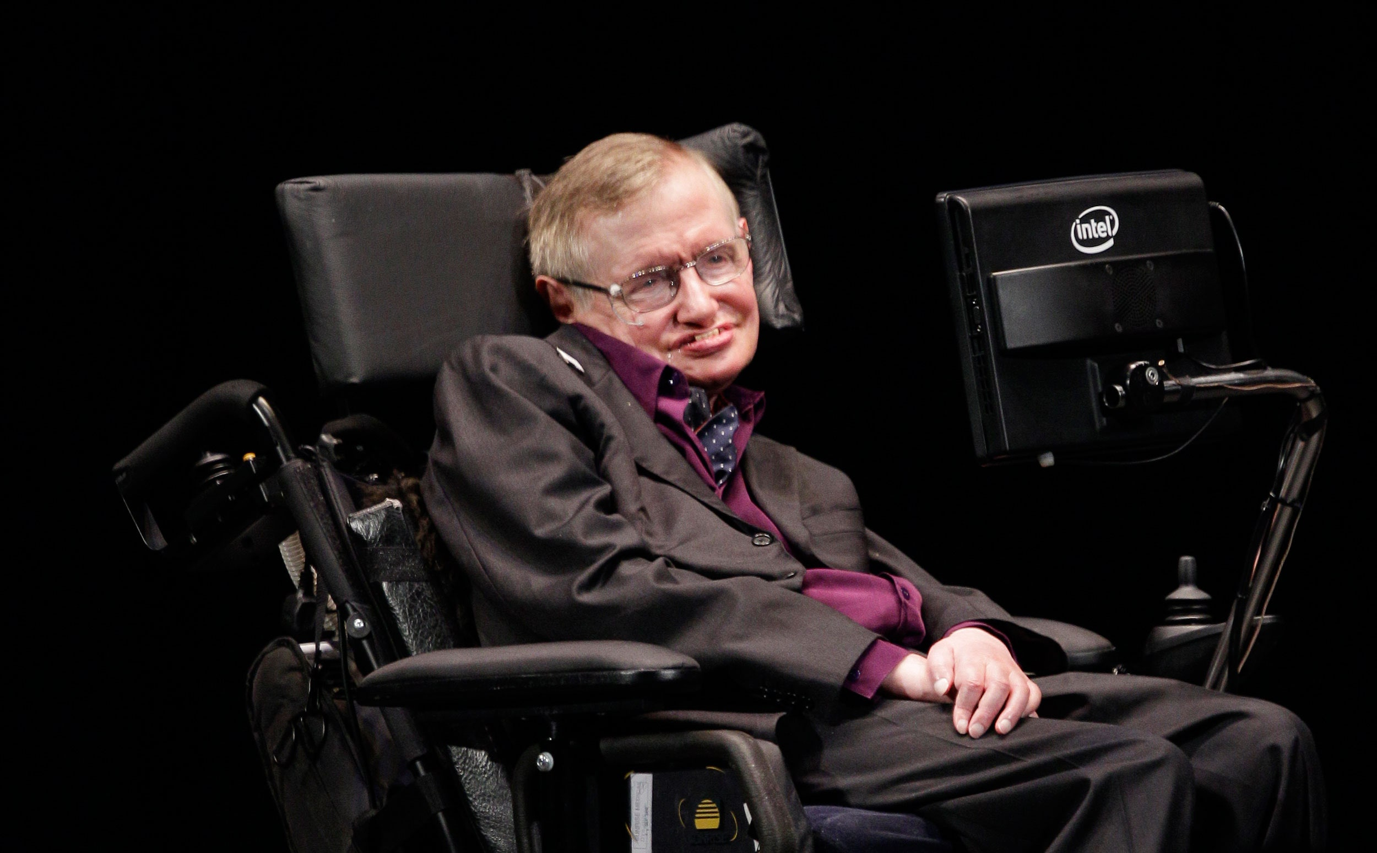
Stephen Hawking talks about technology and ACAT (Assistive Context Aware Tool-kit)
https://www.youtube.com/watch?v=txy8ikfekzs
https://01.org/acat/
image: Ted S. Warren/AP

Slide 29
Engaging in Natural Language Behavior
Phonetics and Phonology
knowledge about linguistic sounds
how words are pronounced in terms of sequences of sounds
how each of these sounds is realized acoustically

Slide 30
Engaging in Natural Language Behavior
Phonetics and Phonology
knowledge about linguistic sounds
how words are pronounced in terms of sequences of sounds
how each of these sounds is realized acoustically
Speech Recognition (SR):
recognize words from an audio signal like in assistants: Alexa, Homepod
Speech Synthesis (Synthesizers):
generate an audio signal from a sequence of words like in Automatic Announcement
Automatic Answering Machine

Slide 31
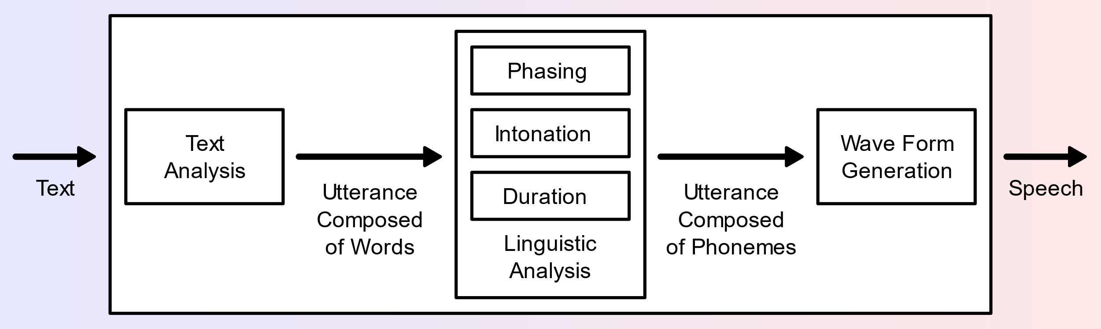
Engaging in Natural Language Behavior
Phonetics and Phonology
knowledge about linguistic sounds
how words are pronounced in terms of sequences of sounds
how each of these sounds is realized acoustically
Text-To-Speech System (TTS)
Phone [fəʊn]→Diphones [fə], [əʊ], [ʊn]→much more natural than combining simple phones

Slide 32
Engaging in Natural Language Behavior
Morphology
knowledge of the meaningful components of words
producing and recognizing variations of individual words
the way words break down into component parts that carry different meanings
study of words, how they are formed, their relationships in the same language

Slide 33
Engaging in Natural Language Behavior
- AKA Lemma or citation form
- Refer to a same entity or concept or …
- Change is called Inflection
- Inflection Rules:
Singular vs. Plural: index → indexes, indices
Contractions: cannot → can’t
Tenses: do → did, done, does
Lexeme
Morphology
Wordforms
- Form new lexemes
- Refer to different entities or concepts or …
- Wordformation Rules:
Compounding: [Dog][catch][er], [Dish][wash][er]
Lemma(Dishwashers) = Dishwashers
Lemma(Dishwashers) ≠ Dishwash ≠ Dish ≠ Wash

Slide 34
Engaging in Natural Language Behavior
Syntax
knowledge of the structural relationships between words
knowledge needed to stream (order) words
moving beyond individual words
HAL:
I’m I do, sorry that afraid Dave I’m can’t.
I’m sorry Dave, I’m afraid can’t.

Slide 35
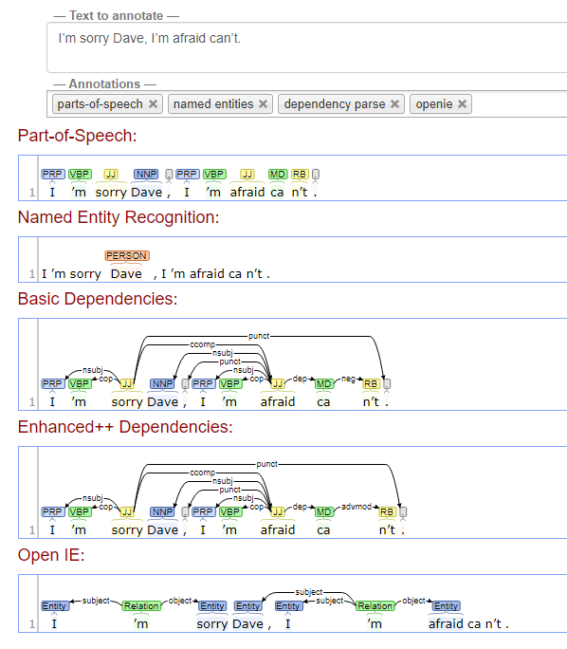
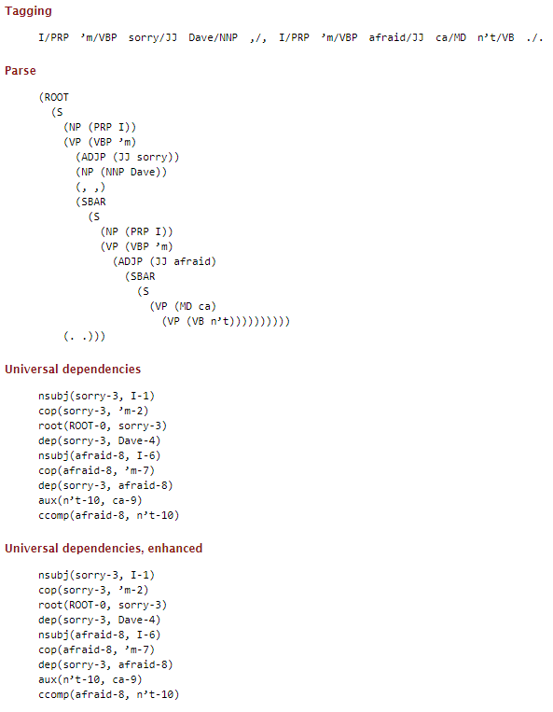
Engaging in Natural Language Behavior
Syntax
Stanford’s CoreNLP
Notes:
https://corenlp.run/

Slide 36
Engaging in Natural Language Behavior
Semantics
knowledge of meaning
Lexical
The meaning of the words
Afraid → Scared
Afraid → Politely apologetic
Semantics
Compositional
The meaning of the sentences
Sorry, I’m afraid I can’t
I’m afraid of being sorry

Slide 37
Engaging in Natural Language Behavior
Pragmatics
knowledge of the relationship of meaning to the goals & intentions of the speaker
REQUEST: HAL, open the pod bay door.
REQUEST: HAL, open the pod bay door, please!
REQUEST: HAL, open the pod bay door, please, please!
STATEMENT: HAL, the pod bay door is open.
QUESTION: HAL, is the pod bay door open?
REFUSE: Dave, I won’t.
REFUSE: Dave, I’m afraid, I can’t.

Slide 38
Engaging in Natural Language Behavior
Discourse
knowledge about linguistic units larger than a single utterance
coreference resolution for what pronouns like it or she refers to
another kind of pragmatic knowledge
REQUEST: HAL, open the pod after.
QUESTION: HAL, is he doing well?
Need to examine the discourse (context)

Slide 39
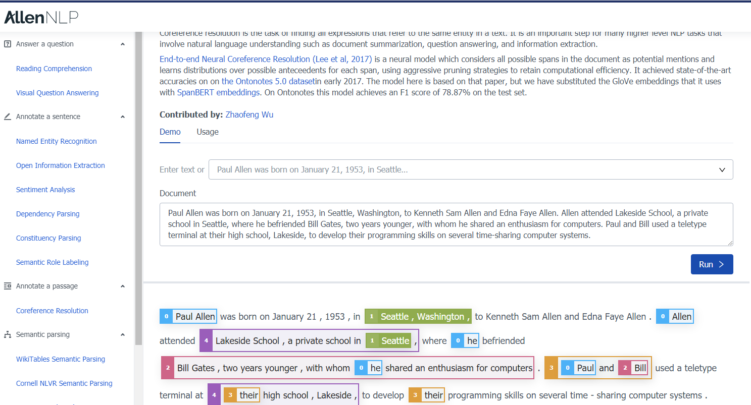
Notes:
https://demo.allennlp.org/coreference-resolution/MjYzNDkxMQ==

Slide 40
ambiguity

Slide 41
I made her duck
I cooked waterfowl for her.
I cooked waterfowl belonging to her.
I created the (plaster?) duck she owns.
I caused her to quickly lower her head or body.
I waved my magic wand and turned her into a waterfowl.
Notes:
Dative vs. Nominative noun/pronoun
The nominative case refers to the case used for a noun or pronoun when it is the subject of a verb. The nominative case uses nouns and pronouns as subjects. The nominative case is also called the subjective case.
The dative case refers to the case used for a noun or pronoun that is an indirect object. The dative case uses noun and pronouns as objects. The dative case is also called one of the objective cases.
https://corenlp.run/

Slide 42
I made her duck
Phonetics and Phonology
[I][made][her duck] vs. [I][made her] [duck]
Morphology
[duck]: ‘NOUN’ vs. ‘VERB’
[her]: ‘PRP’ (object pronoun) vs. ‘PRP$’ (possessive pronoun)
Syntax
[her duck]: direct object
[her][duck]: direct object, indirect object
Semantics
Polysemy: [made]: create vs. cook vs. cause
Pragmatics
[I][made][her duck] vs. [I][made her] [duck]
Discourse
Who is [her]?
Notes:
Dative vs. Nominative noun/pronoun
The nominative case refers to the case used for a noun or pronoun when it is the subject of a verb. The nominative case uses nouns and pronouns as subjects. The nominative case is also called the subjective case.
The dative case refers to the case used for a noun or pronoun that is an indirect object. The dative case uses noun and pronouns as objects. The dative case is also called one of the objective cases.
https://corenlp.run/

Slide 43
disambiguation

Slide 44
I made her duck
Phonetics and Phonology → Speech Act Interpretation
Speech Signal
Morphology → Part-of-Speech Tagging
[duck]: ‘NOUN’ vs. ‘VERB’
[her]: ‘PRP’ (object pronoun ) vs. ‘PRP$’ (possessive pronoun)
Syntax → Syntactic Disambiguation
[her duck]: direct object
[her][duck]: direct object, indirect object
Semantics → Word Sense Disambiguation
[made]: create vs. cook vs. cause
Pragmatics
Discourse → Coreference
Who is [her]?
Notes:
Dative vs. Nominative noun/pronoun
The nominative case refers to the case used for a noun or pronoun when it is the subject of a verb. The nominative case uses nouns and pronouns as subjects. The nominative case is also called the subjective case.
The dative case refers to the case used for a noun or pronoun that is an indirect object. The dative case uses noun and pronouns as objects. The dative case is also called one of the objective cases.
https://corenlp.run/

Slide 45
Language is so situated!

Slide 46
Code Switch
Genre
Corpus
Dialect
Rationale
Time
Author
Place

Slide 47
dost tha or ra- hega ... dont wory ... but dherya rakhe
[he was and will remain a friend ... don’t worry ... but have faith]
Code Switch
Genre
Newspaper, Fiction, non-Fiction, Academic, Social, Conversation → Disfluencies
Corpus
Dialect
Rationale
Time
Standard American English (SAE) vs. African American Vernacular English (AAVE)
iont: I don’t, talmebout: talking about
Language changes over time
Oxford Dictionary has 273,000 headwords; 171,476 of them being in current use, 47,156 being obsolete words
Author
Place
Age, Gender, Race, Socioeconomic

Slide 48
Corpus (plural Copra) Samples
Brown University
English
newspaper, fiction, non-fiction, academic, etc.
1963–64
#Documents = Size = 500
#Tokens = 1 M
#Vocab = Unique Tokens = Types = 38 K
Switchboard
American English
Telephone Conversations between strangers
Early 1990s
#Conversations = Size = 2430
#Tokens = 2.4 M
#Vocab = Unique Tokens = Types = 20 K
Google N-grams
English
Google Books
#Tokens = 1 G
#Vocab = Unique Tokens = Types = 13 M
Notes:
https://docs.google.com/document/d/14PWeoTkrnKk9H8_7CfVbdvuoFZ7jYivNTkBX2Hj7qLw/edit
http://www.nltk.org/nltk_data/

Slide 49
Herdan’s Law or Heaps’ Law
Herdan, G. (1960). Type-token mathematics. The Hague, Mouton.
Heaps, H. S. (1978). Information retrieval. Computational and theoretical aspects. Academic Press.
Notes:
the vocabulary size for a text goes up significantly faster than the square root of its length in words

Slide 50

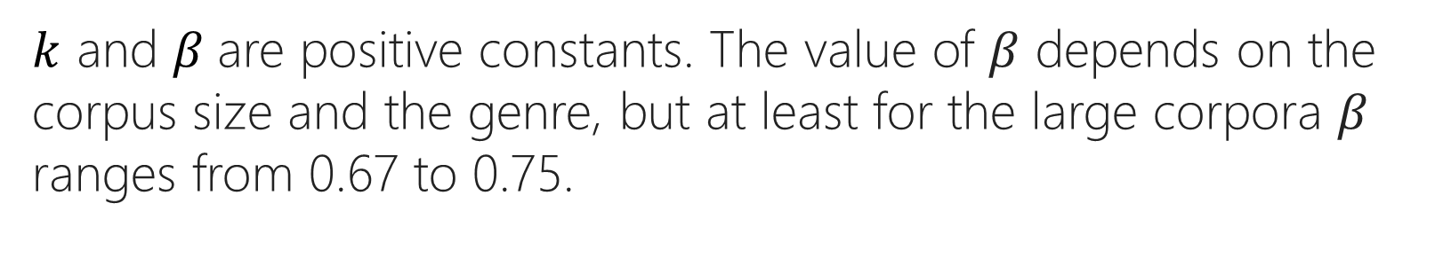
$\left|V\right|=kN^{β}$; 0 < $β$ < 1
$k$ and $β$are positive constants. The value of $β$ depends on the corpus size and the genre, but at least for the large corpora $β$ ranges from 0.67 to 0.75.
Notes:
where k and b are positive constants, and 0 < b < 1.
jVj = kNb (2.1)
The value of b depends on the corpus size and the genre, but at least for the
large corpora in Fig. 2.10, b ranges from .67 to .75.

Slide 51
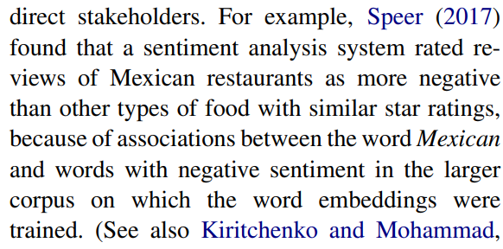
Datasheets (Data Statements) for Datasets
Emily M. Bender, Batya Friedman, ACL (2018)
Gebru, Timnit, et al. (2018)
Notes:
Data Statements for Natural Language Processing: Toward Mitigating System Bias and Enabling Better Science

Slide 52
NLP is AI-hard (AI-Complete)
Let’s do it!

Slide 53
Text segmentation
dividing written text into meaningful units, such as words, sentences, or topics

Slide 54
Word Segmentation: Tokenization
Whitespace (default, natural word delimiter)
Exceptions
New York
rock ’n’ roll
Contractions: I’m
Japanese | Chinese | Thai don’t have spaces between words
Emoticons: :)
Hashtags: #nlproc.
Notes:
Lattice-Based Recurrent Neural Network Encoders for Neural Machine Translation

Slide 55
Word Boundaries: Tokenization: Space
Split()
Regular Expressions (RE): Finite State Automata
Alphabetical: [a-zA-Z]*
Alpha-numerical: [a-zA-Z0-9]*
Punctuations: Ph.D., AT&T, cap’n
Special Chars
Currency $45.55
Dates (01/02/06)
URLs http://www.stanford.edu
Twitter hashtags #nlproc
Email hfani@uwindsor.ca
Notes:
https://en.wikipedia.org/wiki/Speech_disfluency

Slide 56
What should be considered as word?
Disfluencies in utterances
Fragments: broken-off repeated words: miss- misspelled, you- yourself
Fillers: non-lexical: huh, uh, erm, um, well, so, like, hmm
Punctuations , . : ; ? !
part-of-speech tagging
parsing
speech synthesis
Morphemes:
smallest meaning-bearing unit of a language
‘unlikeliest’ : morphemes [un-], [likely], [-est]
Notes:
https://en.wikipedia.org/wiki/Speech_disfluency
https://www.nltk.org/api/nltk.tokenize.html

Slide 57
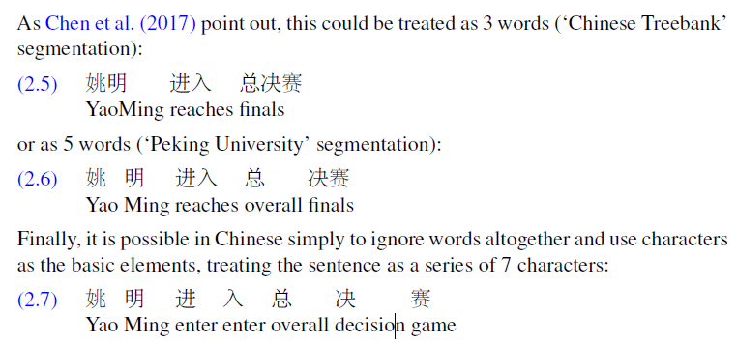
What should be considered as word?
Chinese
Notes:
https://en.wikipedia.org/wiki/Speech_disfluency
https://www.nltk.org/api/nltk.tokenize.html

Slide 58
What should be considered as word?
Chinese
characters are at a reasonable semantic level for most applications
most word standards result in a huge vocabulary with large numbers of very rare words
Take characters as words
Notes:
https://en.wikipedia.org/wiki/Speech_disfluency
https://www.nltk.org/api/nltk.tokenize.html

